Slide 1
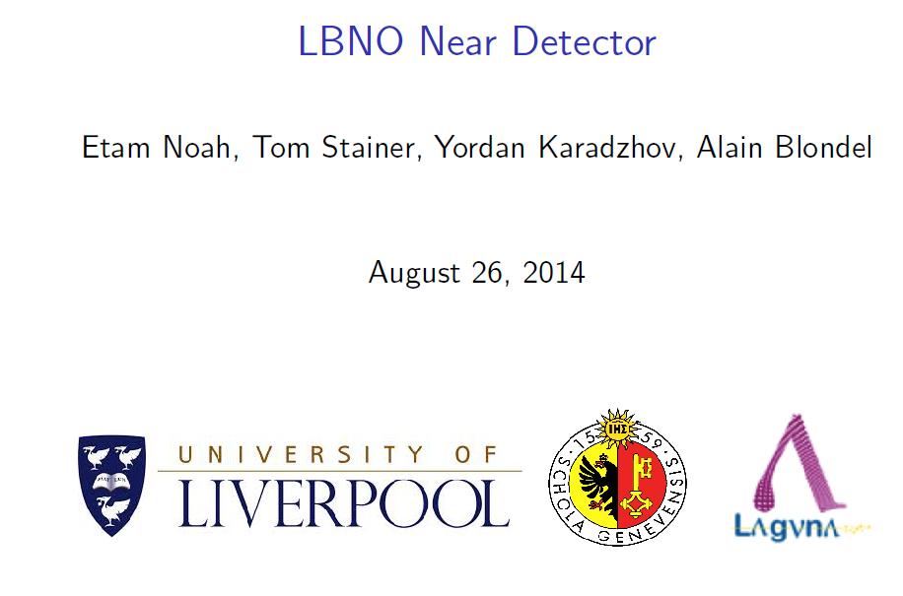
Near detector based on High Pressure TPC

Slide 2
(20 kton + SPS beam x 5 yrs)

Slide 3
What is the near detector supposed to do?
0. assure global normalization of the experiment
from event numbers in ND predict unoscillated event numbers in FD.
We have learned from T2K that low systematics requires
-- same acceptance in ND as FD
-- same nucleus
Measure cross-sections for signals
ν_{μ} ‾ν_{μ} , (CC and NC)
ν_{e} and ‾ν_{e}
normalization channels
as function of neutrino energy.
2. Magnetic detector necessary especially for anti-neutrino exposure
3. Energy resolution should be as good as in far detector
➔good containment of evts: 50/70tons of scintillator/Larg
4. Also need hadro-production experiment,
description of NA61/SHINE acceptance for LBNO beam given in EOI
In the case of T2K/T2K2/T2HK require improvements in the NA61 long target set-up (empty target measts, bring target closer to detector, some near-target tracking)
NB: original slide from July 2012
Add-ups for T2K/T2K2/T2HK in blue

Slide 4
Global set up and some numbers
Underground (100m), located at 500m from target
Event rates are very large.
At 500m location estimate ~0.6 events per pulse per ton for 750kW,
2 pulses every 6s. This needs to be verified
1kton magnetized iron (MINOS ND) ➔ 600 events per pulse of 10μs 1 evt / 16ns. pile-up
Even with 100ton scintillator this is not trivial and probably precludes liquid Argon TPC
Liquid Argon also ruled out because of neeed to measure sign of 5 GeV electrons.
(Original slide with typos for LBNO ND, Feb. 2013:
liquid argon ruled out because of pile-up and need to measure sign of 5 GeV electrons. ➔ proposed HPTPC in magnetic field )
verified rates OK (0.1 evt per spill for 200kg of gas)

Slide 5
INITIAL IDEA

Slide 7
(SC) coil
ν Beam
Tracking
volume
1.m
1.m
1.m

Slide 8
(SC) coil
Scintillator-based calorimeter
with neutron-absorbing and
photon-pointing capabilities
B
Tracking
volume
2x2x4=16m³
2m
MIND
4m
1m

Slide 10
CONCEPT

Slide 11
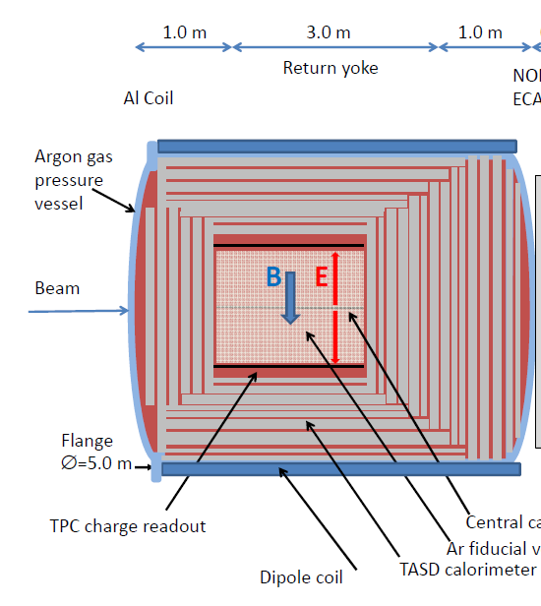
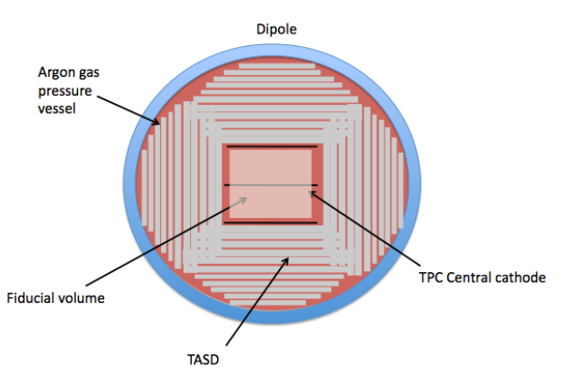
∅=5000
Choice of pessure vessel around the scintillator based calorimeter motivated by
Integration without large amount of material between TPC and calorimeter
TPC inside its own vessel but now low pressure differential (easier, thin)
Magnetic field required is not very high
4. Difficulty and cost likely to be in the large 5 m diam. flange

Slide 12
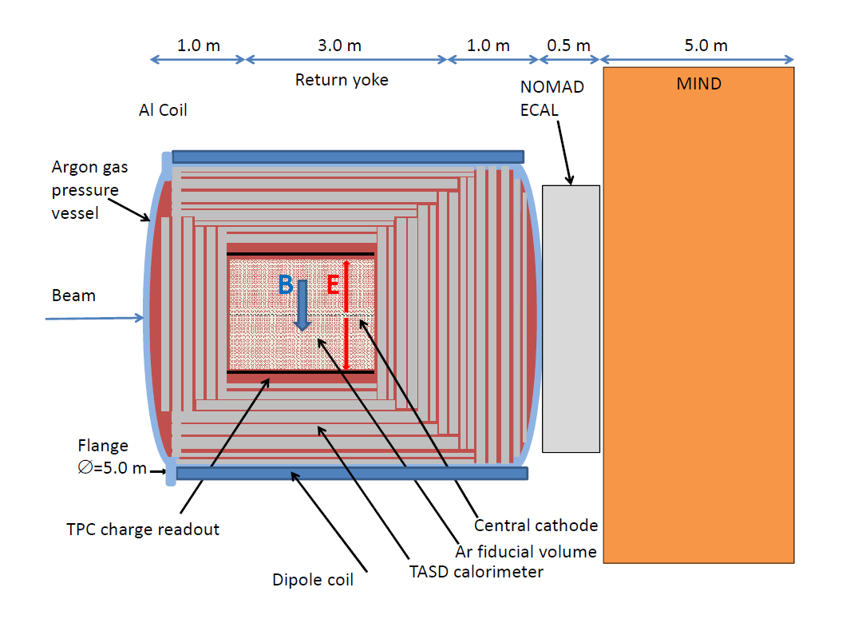

Slide 13
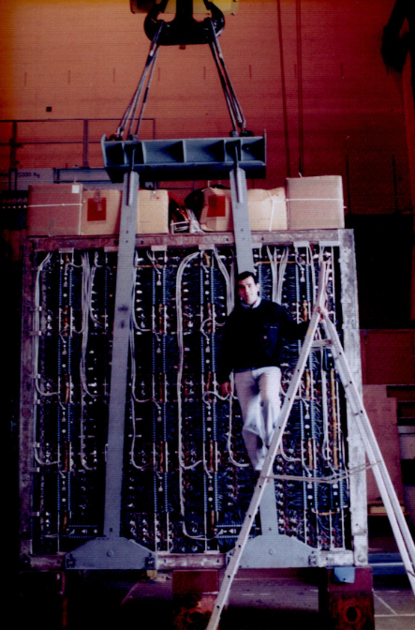
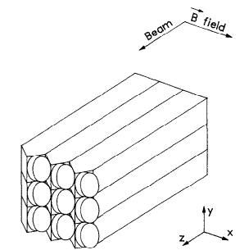
The NOMAD ECAL
D.Autiero et al. NIM A 373 (1996) 358
Wall of 875 Lead glass blocks TF1-000
Operating in B field 0.4 T
Read out by Hamamatsu tetrodes R2186-01 (at 45° wrt B)
Cell size: 79x112 mm² cross section, 19 Xo (52cm)
Resolution: 3.2%/sqrt(E) + 1%
25 columns 2.8 m
Detector with its original supporting frame and its electronics stored in the ISR tunnel
Possibility to recover a 3 MCHF detector in a « plug&play » configuration
35 rows 2.8 m

Slide 14
In the LBNO design study report

Slide 23
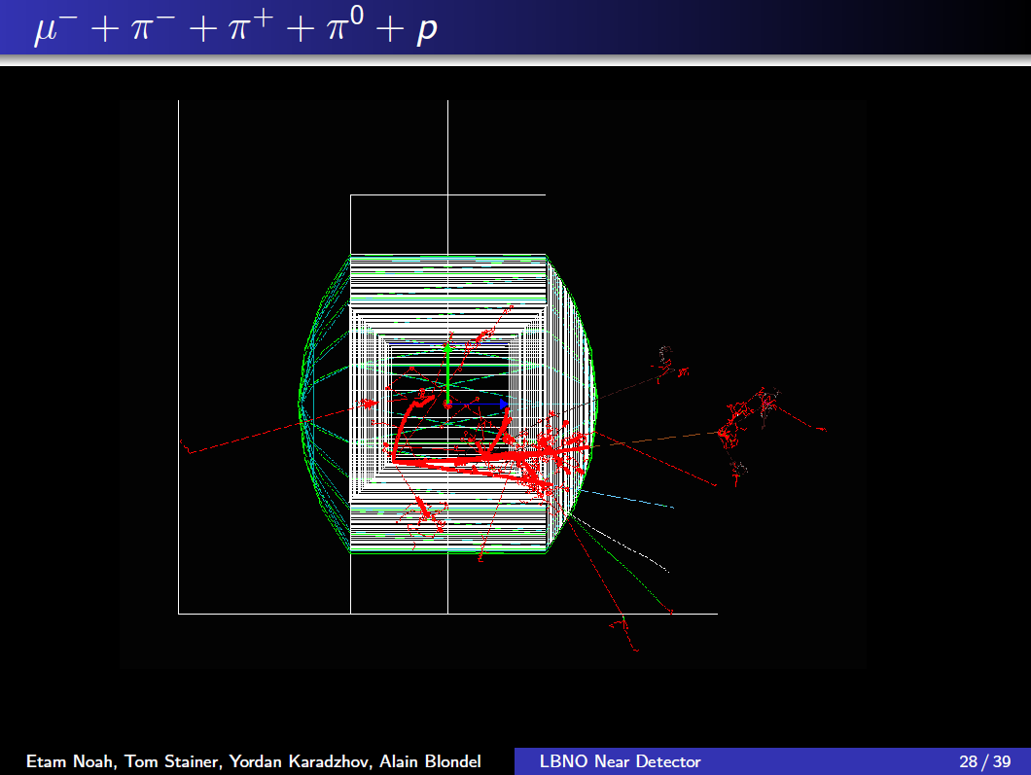
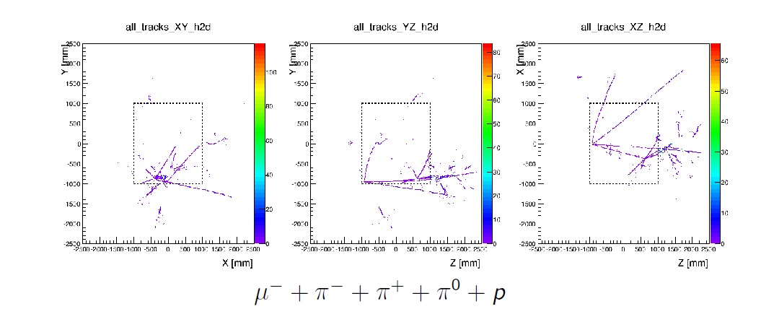

Slide 24
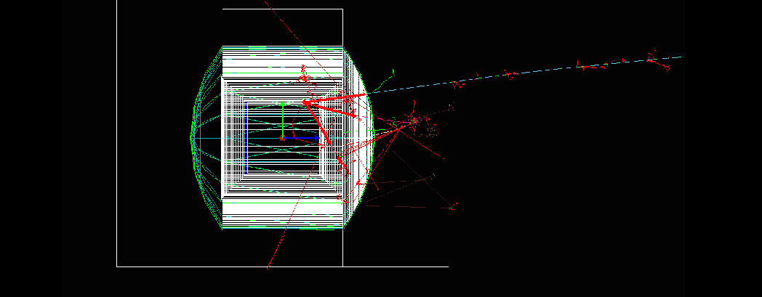
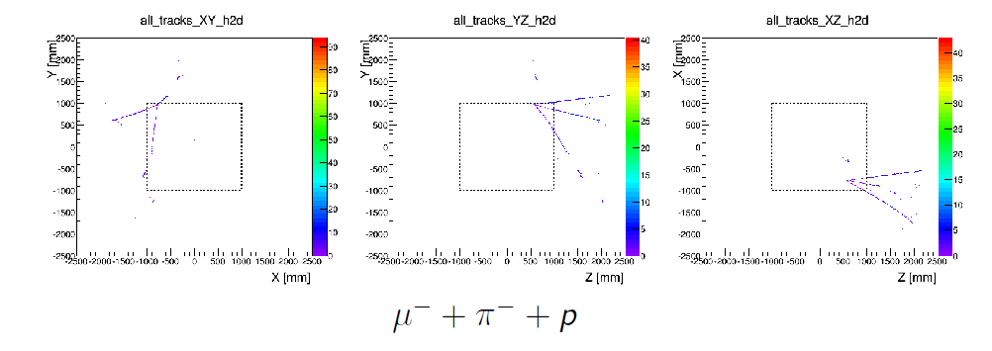

Slide 25
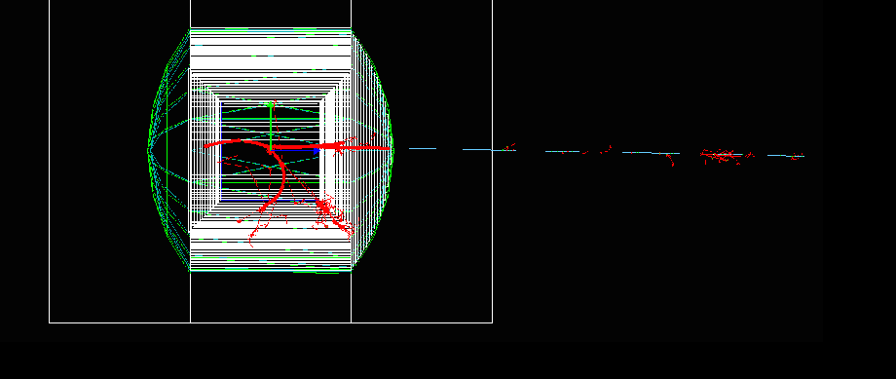
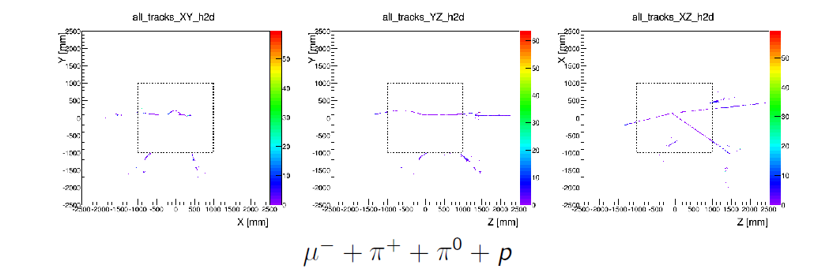

Slide 26
Conclusion and (pre/post) judices.
1. We had introduced the concept of High pressure TPC for the ND of LBNO in 2012
and worked out a conceptual design.
20bar vessel of 20 mm Al is only possible with integration in the (thicker) magnet mandrel
normally its about 5mm Al per bar. (10 cm)
2. It is a good proposal for a LBL experiment with LArg as far detector
BUT there is no way to get a 20 bar TPC with significant partial pressure of e.g. CO2 or H2O
➔ a priori not a good idea for an experiment in water.
3. It allows magnetic measurement of muons an electrons with reasonable magnet.
important condition for measuring anti-electron-neutrino cross-sections in Argon.
4. Must think of the integration of a good ECAL/neutron detector
(a large amount of Gd loaded scintillator ?)
our proposed solution: TASD within the pressure vessel and magnet.
a solution that reduces X0 without losing pointing quality and energy resolution ?
5. time measurement of TPC events (not addressed here) is important if drift time is longer
than neutrino spill gate (this is the case). Backgrounds from beam and rock are large.
6. As a by-product one can see lots of scattered or evaporated fragments
but I have no idea how one would do something useful with this.

Slide 27
Epilog
LBNE (DUNE) has no HPTPC in its plans...

Slide 28
-- High pressure TPC
very nice vision of vertex
(but what do we learn from that?)
good solution for near detector in case far detector is LArg TPC
(this is why we proposed it for the ND of LBNO!)
photon and neutron detection remains to be addressed in detail
need pressure vessel around photon detector (→ LBNO prototype)
In principle could reconstruct H2O cross-section by combination of gases
e.g. 0.5 CO₂ + 13/6*CH₄ - 2/3 C₄H₁₀ = H₂O
However high P CO₂ captures electrons heavily (capture ↑ more than P)
(Rob Veenhof)

Slide 29
For a far detector with water (T2K/T2K2/T2HK) same requirements lead to something like this:
$$\vec{B}$$
active water target
MIND
Gas tracking volume(TPCs)
pointing and timing calorimeter for photons and neutrons
But .... this looks a lot like ND280 with a different configuration! see next talk.

