Slide 1
Plans for this week
Preparation of Master course ...
Push Thorlabs and order in worst case what is already available
Work on DNA setup
MWPC: Stretch 4 wires on new PCB for testing or electronics tests
DAQ discussion with Joan (already started)
3D MPGD project: FET Open proposal, phone meeting to discuss status and plans

Slide 2
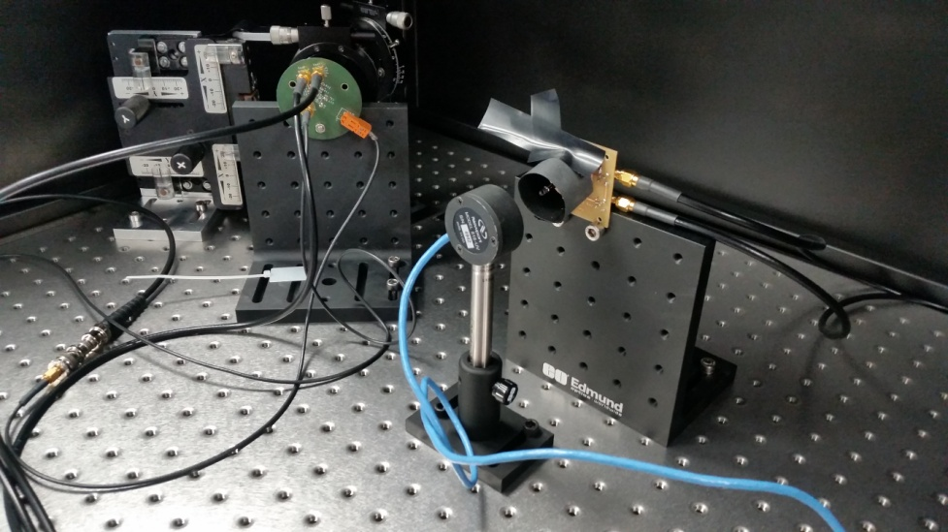
Kaputschinsky LED Driver Tests
LED driver allows to produce light pulses of <= 10 ns width
What is the power we can detect with photodiode 6 cm away from LED
Pulsed with 1 kHz (readout speed of photodiode 10-20 Hz)
LED
Photo diode

Slide 3
Kaputschinsky LED Tests

Slide 4
Laser + Diffusor Tests
Photodiode
Continous laser operation
Diffusor
Laser

Slide 5
Solar Cell Tests
testing response of solar cell to laser light
photodiode in parallel to be sure that we see light
laser pulsed

Slide 6
Response
pulsing down to 1 Hz possible
but difficult to control power output
minimum width of 200 us
even at higher frequencies not linear in power

Slide 7
Plans for this week
Continuing of preparation of Master course ...
First Thorlabs pieces will arrive today => start playing with them
Work on DNA setup
MWPC: Stretch 4 wires on new PCB for testing, fixing current PCB, analysing data from this week
3D MPGD project: Minutes of this week meeting and preparing meeting of next week

