Slide 1
Plans from last meeting
Continuing of preparation of Master course ...
First Thorlabs pieces will arrive today => start playing with them
Work on DNA setup
MWPC: Stretch 4 wires on new PCB for testing, fixing current PCB, analysing data from this week
3D MPGD project: Minutes of this week meeting and preparing meeting of next week

Slide 2
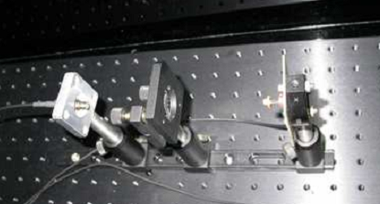
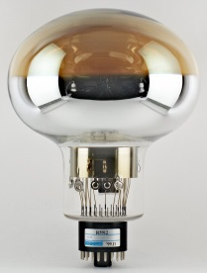
WA105: Light Monitor System
Light Monitor System
Air
X2
X2
Cryostat
black box with light source outside of cryostat
2 fibers going to cryostat
each splitting into 20 micro fibers (~100 μm thick)
either directly on top of cryostat or at bottom of cryostat

Slide 3
Light Monitor System
Temperature sensors
Reference Sensor
To SMA 1
Laser/LED
Filter wheel/ attenuator
To SMA 2

Slide 4
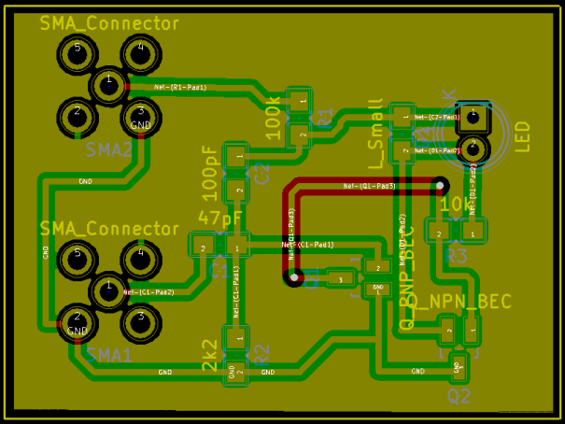
Light Monitor System
commercial enclosure from Thorlabs
includes small bread board e.g 30x45 cm²
only need to add feedthroughs
Light source:
Laser (408 or 450 nm) => 30-40 ns pulses
LED with Kaputschinsky driver => <=10 ns pulses

Slide 5
Characterization of Light Sources
Light sources available at IFAE for tests
Characterization of light sources ongoing at IFAE
LED tested already in pulsed mode
Laser in constant current too
Laser pulses of 30 ns width measured with PMT
Detailed analysis of laser data in pulsed mode ongoing

Slide 6
Light Monitor System
commercial enclosure from Thorlabs
includes small bread board e.g 30x45 cm²
only need to add feedthroughs
Light source:
Laser (408 or 450 nm) => 30-40 ns pulses
LED with Kaputschinsky driver => <=10 ns pulses
Perhaps worth to think about an alternative

Slide 7
Alternative Idea
About 10 cm
Put LED with Kaputschinsky driver directly in front of SMA feedthrough to shine on fibers inside the cryostat

Slide 8
First Tests
Kaputschinsky with blue LED
Measured power released with Kaputschinsky
Result: 11.5 nW
Amazing result: E(465 nm)=430*10**-21 J => 11.5 nW correspond to 27 billion photons
1 kHz pulsing => each pulse 27 million photons which will directly go to fiber bundle
next step measure no of photons at end of 30 m fiber
Advantages of this approach:
much cheaper than laser approach
no safety issues at CERN
Question: Do we really need a reference sensor?
2 mm
SMA feedthrough
Black coat
45 mm
Powermeter

Slide 9
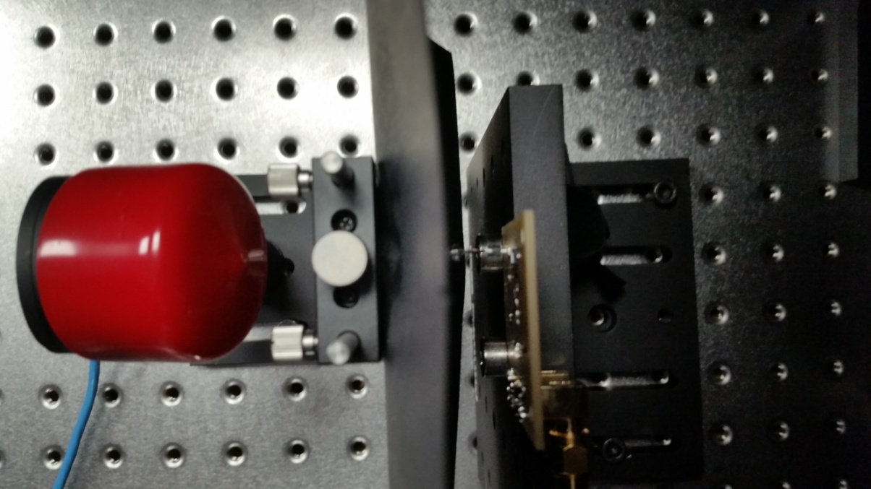
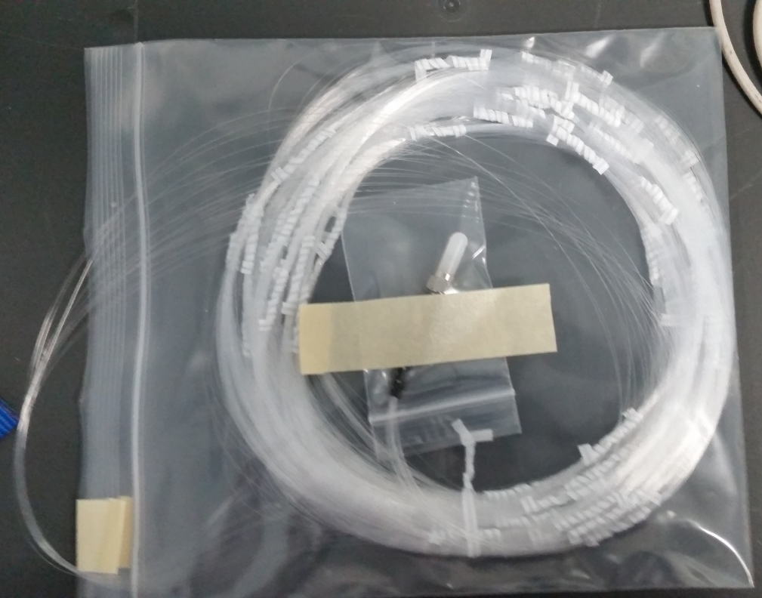

Slide 10
Other WA105 Stuff
Last week collaboration meeting
No objections to do direct TPB coating
Can use Qeff setup at CERN for QC in Oct/Nov for free
Installation of PMTs shifted to March 2018 instead Nov 2017
Further delays are possible/likely
Discussion ongoing to postpone 666 construction until results from 311 => would mean no testbeam data before 2021
Hot meeting expected on Friday

Slide 11
DNA Setup
Kaputschinsky with blue LED
project with Mokhtar
aim to improve cancer detection system
excite DNA+scintillator with blue light
look for green light
visit from another institute on Tuesday with DNA samples
Took a lot of data but interpretation not clear
more detailed data analysis needed
several ideas what could have went wrong
Polarisor
Polarisor
DNA+ Scintillator
SiPM
500 nm filter
PMT

Slide 13
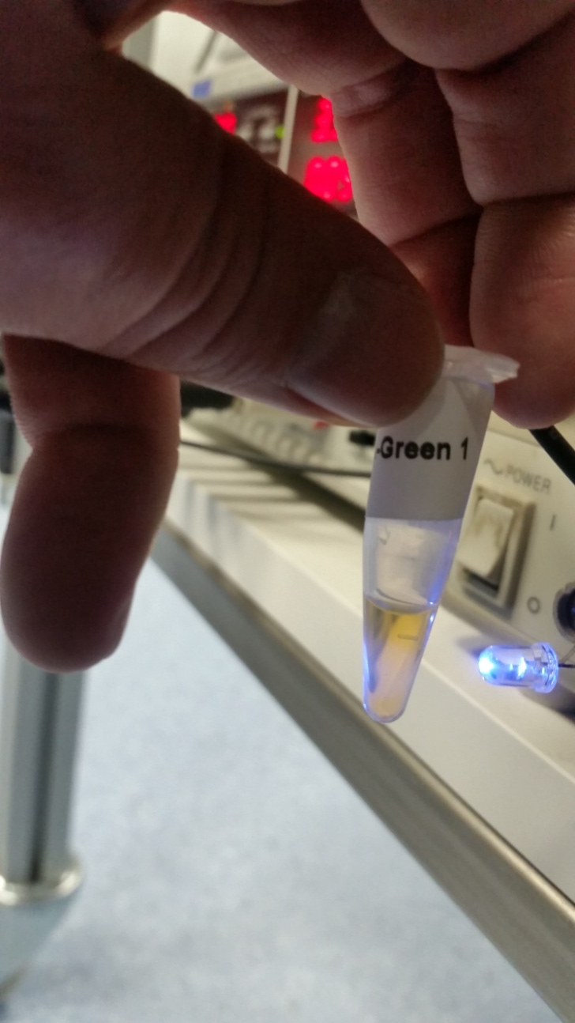

Slide 14
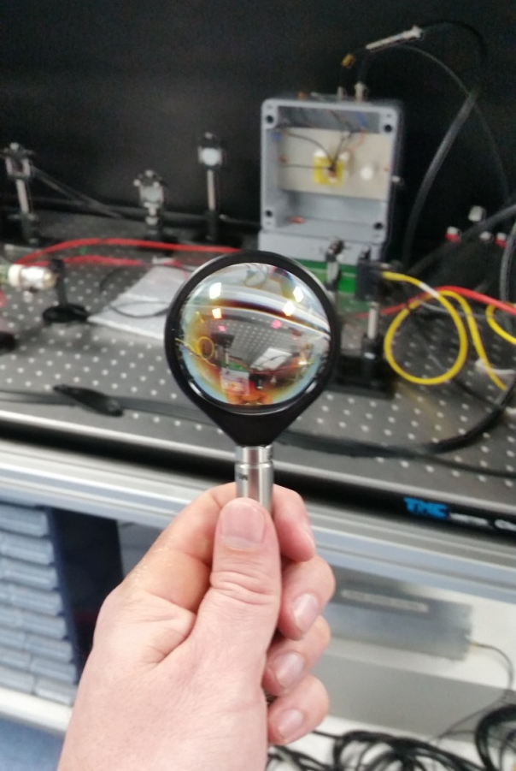
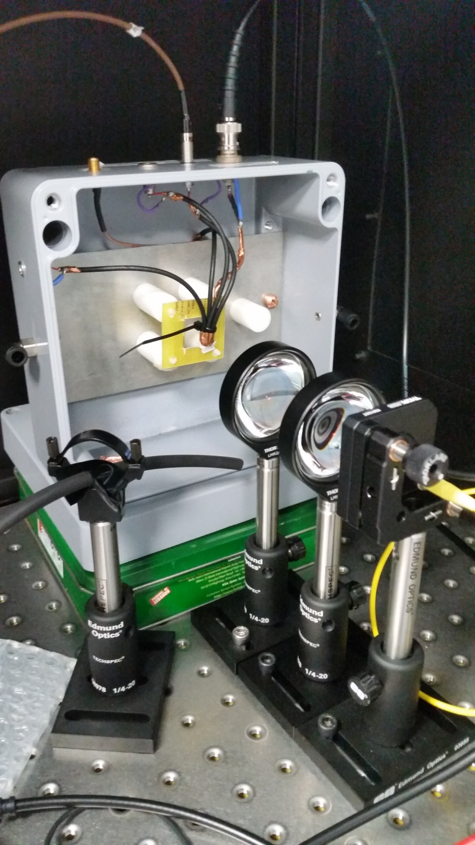
Other Stuff Ongoing

Slide 15
Plans for next week
MWPC: wire stretching today
Analysis of DNA setup data
Measurement of light at end of 30 m fiber
Look into charge readout options of gas detectors (AGET/DREAM chips)
Clarify if workshop available to contribute to ND T2K upgrade
Finish Master course on Monday

