Slide 1

Flavor Physics
Cibrán Santamarina
Universidade de Santiago de Compostela

Slide 2
Bibliography
For me the best reference (these slides reproduce a lot of them) are the notes:
P. Kooijman & N. Tuning. Lectures on CP violation (or: The Physics of Anti-matter).
  Available online: https://www.nikhef.nl/~h71/Lectures/2015/ppII-cpviolation-29012015.pdf
  You can also find the slides by N. Tuning.
Slides from three courses were also used:
  M. Merk. CP Violation and the Standard Model. https://www.nikhef.nl/~i93/Presentations.html
  O. Steinkamp. Flavour Physics. Chipp PhD Winter School 2013. http://www.physik.uzh.ch/~olafs/presentations/130121_CHIPP.pdf
  F. Teubert. Indirect Searches of NP from Flavour Physics. TAE 2014.
There are now several books that discuss CP violation with some detail. Two of them, that were also employed in the preparation of this material are:
  M. Thomson. Modern Particle Physics. Cambridge University Press 2013.
  A. Bettini. Introduction to Elementary Particle Physics. Cambridge University Press 2013.
Finally, there is material on the latest Flavor Physics results. I have taken a lot of material from two recent presentations:
  S. Blusk. New experimental results and prospects in flavor physics. DPF 2017, Fermilab.
  J.J Saborido. CP Violation at LHCb. REFIS Benasque 2017.

Slide 3
Roadmap
First an introduction on discrete symmetries.
  The weak interaction and flavor changes.
  P violation.
  CP violation and its relevance.
Second a discussion of CPV in the Standard Model.
  The Cabbibbo mechanism.
  The CKM matrix and the SM.
  Neutral mesons oscillation.
  CPV classification.
Third a discussion of relevant flavor physics results.
  Experiments.
  Measurements.

Slide 4
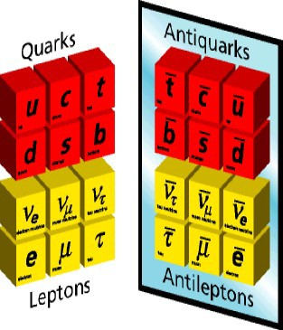
Flavour Physics
In the Standard Model (SM) flavour physics is intimately related to the weak interaction.
  It is the only SM interaction allowing transitions between different flavour families of either quarks and leptons.
  Flavour is conserved in strong and electromagnetic interactions.
Weak interaction is responsible for:
  Beta decay
  Muon decay
  Kaon decays
  Neutrino emission in nuclear reactions (solar neutrinos)
There are three very important sectors in which flavour physics is involved:
  Quarks: measure mixing parameters, test SM predictions.
  Charged leptons: test lepton number conservation.
  Neutrinos: measure neutrino masses and mixing parameters and determine their Majorana or Dirac nature.

Slide 5
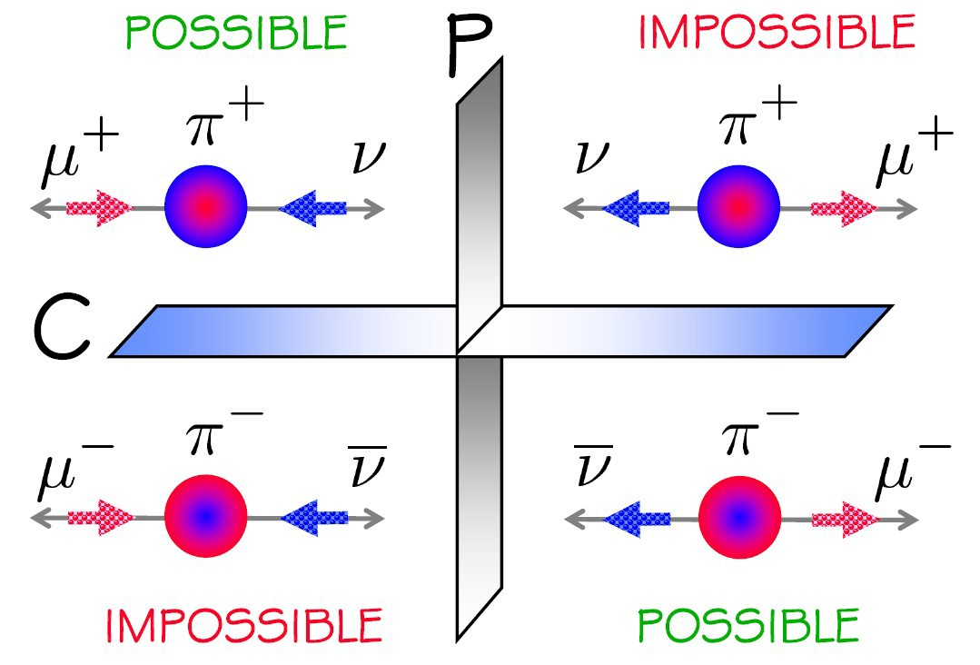
Weak Interaction and beyond
Understanding the weak interaction implies
  Analyzing the break-up of discrete simmetries, Parity (P), Charge Parity (CP) and Time Reversal (T)
Study the properties of the fermion families and their interactions.
  Masses, lifetimes, couplings, amplitudes, phases,…
There is flavour physics in one of the evident examples of physics beyond the SM (BSM)
  Neutrino masses, evident in oscillations
And flavour physics could be involved into:
  CP violating interactions BSM
  Lepton and baryon number violation
  Dark matter

Slide 6
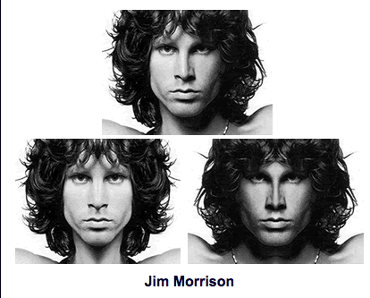


Parity
Parity: creates the mirror of a physical system.
Until 1956, assumed that physical laws obey mirror symmetry:
Parity is a unitary operator with eigenvalues either 1 or -1:
Eigenfunctions have (-1)^{l} parity.
A nucleon (n or p) is an eigenstate of P.
  No other object exists with the same charge, mass, etc.
  The relative parity between states with different quantum numbers Q and B is arbitrary.
  Due to conservation of baryon number and charge the eigenparity of electron, proton, and neutron can be fixed at +1.

Slide 7
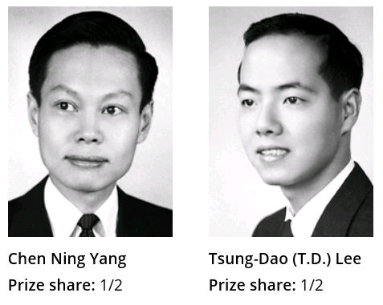
Parity Violation
Parity violation
  Maximally violated in weak interactions.
  Only left-handed components of particles participate in weak interactions.
  Right-handed of antiparticles.
Predicted by Lee and Yang (Nobel 1957), found by Wu in 1956 (Nobel 1978).

Slide 8
The Wu experiment
Analyze the decays:
  ⁶⁰Co is spin-5 and ⁶⁰Ni is spin-4, both e⁻ and are spin-½
γ-rays release from the ⁶⁰Ni in EM process.
  EM respects P-conservation: distribution of γ-rays controls the polarization of emitted electrons and uniformity of ⁶⁰Co atoms.
  The experiment compared the distribution of γ and e- emissions with the nuclear spins in opposite orientations.
    If e⁻ were always emitted in the same direction and proportion as the γ rays: P-conservation would be true.
    If the distribution of e⁻ did not follow the distribution of γ rays: P-violation would be established.

Slide 9
Spin and parity helicity
Helicity = the projection of the spin on the direction of flight of a particle
H=+1 (“right-handed”)
H=-1 (“left-handed”)

Slide 10
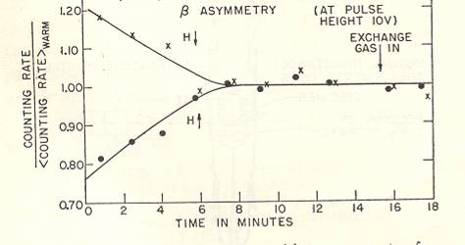
The Wu experiment
Experimental challenge: obtain the highest polarization of ⁶⁰Co nuclei.
  Due to the very small magnetic moments of nuclei high magnetic fields were required at extremely low temperatures.
  Cryogenics in 1956 was not at the same stage as it is today.
Radioactive cobalt was deposited on a crystal of cerium-magnesium nitrate and magnetized.
A vertical solenoid was introduced to align the cobalt nuclei either upwards or downwards.
The production of γ-rays was monitored using equatorial and polar counters as a measure of the polarization.
  γ-ray polarization was continuously monitored over the next quarter-hour as the crystal warmed up and anisotropy was lost.
  Likewise, beta-ray emissions were continuously monitored during this warming period.

Slide 11
The Wu experiment
Electrons are preferentially emitted in direction opposite of ⁶⁰Co spin.
  Angular distribution of electrons: only pairs of left-handed (H=-1) electrons/right-handed anti-neutrinos are emitted.
  Right-handed electrons are known to exist (H is not Lorentz-invariant) this means no left-handed anti-neutrinos are produced in weak decay.
Parity is 100% violated in weak processes.
How can you see that ⁶⁰Co violates parity symmetry?
  If there is parity symmetry there should exist no measurement that can distinguish our universe from a parity-flipped universe, but we can!
e⁻
Parity
transformation
θ
θ
→
→
J
J
Magnetic
field
⁶⁰Co
⁶⁰Co
e⁻

Slide 12
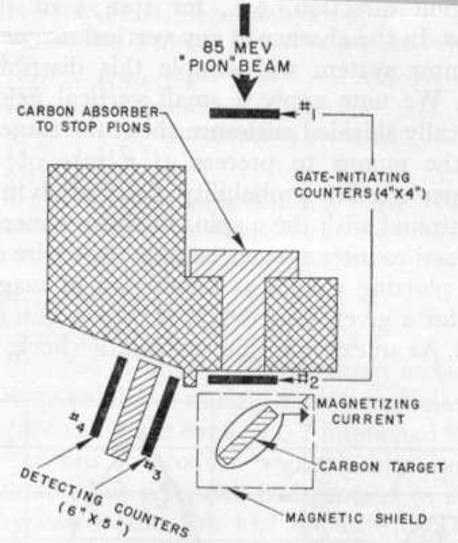
The Lederman experiment
Charged pions of 85 MeV created in pp collisions and separated magnetically according to their charge.
Subsequently decay
Muons stopped in carbon target with magnetic field perpendicular to their line of flight.
Muons precess in magnetic field and decay.
  Precession frequency
  aa
  g~2 (gyromagnetic ratio of the muon).

Slide 13
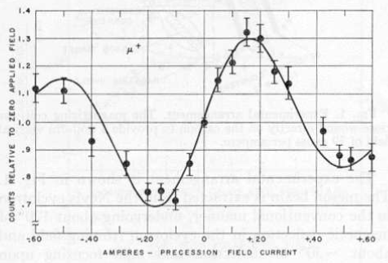
The Lederman experiment
A counter placed at fixed angle is gated with a fixed delay after the entry of the muon into the target.
  Detects e⁺ from decays emitted with 1-1/3cosθ distribution.
The experiment is repeated for several different settings of the magnetic field and precession frequency.
  A clear oscillation is seen:
    Muons are produced with non-zero polarization
    Therefore, pion decay parity is not conserved.
The hypothesis of a single helicity for the neutrino can explain the result.
The wavelength of the oscillation allowed the first measurement of the gyromagnetic moment of the muon confirming its spin 1/2 nature.

Slide 14
The Lederman experiment
What Lederman experiment shows is that all neutrinos are left handed and all anti-neutrinos are right handed:
Charge conjugation is the operation that exchanges particles into anti-particles.
C symmetry is broken just like P:
μ⁺
π⁺
ν_{μ}
OK
OK
μ⁺
π⁺
ν_{μ}(LH)
OK
C
μ⁻
π⁻
ν_{μ}(LH)
OK

Slide 15
The Lederman experiment
An allowed reaction can be obtained if C and P transformations are combined:
ν_{μ}
μ⁺
μ⁻
Intrinsic
spin
π⁺
P
π⁺
C
π⁻
CP was thought to
be conserved
in the weak
interaction
μ⁺
ν_{μ}
ν_{μ}
CP

Slide 16
The θ-τ puzzle
60 years ago physicists knew of two mesons, θ and τ, with the same mass and spin.
  These names are now used for other particles.
However, θ decayed into two pions, and τ decayed into three pions.
Since the intrinsic parity of a pion is P = −1 the two final states have P = +1 and P = −1.
The puzzle was resolved by the discovery of parity violation in weak interactions.
Since the mesons decay through weak interactions parity is not conserved and both modes are decays of the same particle, the K⁺.
K⁺ is not a CP eigenstate.

Slide 17
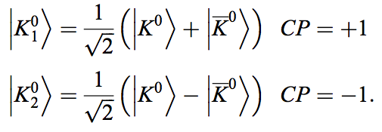
Neutral kaon mixing
Strong interactions produce two different neutral K mesons of strangeness +1 ( ) and -1 ( ).
These two mesons are related by
And to the CP eigenstates:

Slide 18

Neutral kaon mixing
Therefore
K₁ and K₂ are not physical states.
  They do not have definite mass and lifetime.
CP not conserved in the weak interaction!!
The physical states are K_{S} and K_{L}.
  With lifetimes and widths
  And average and mass difference
Notes:
A discussion here on the P eigenvalue of three pions can be issued.

Slide 19
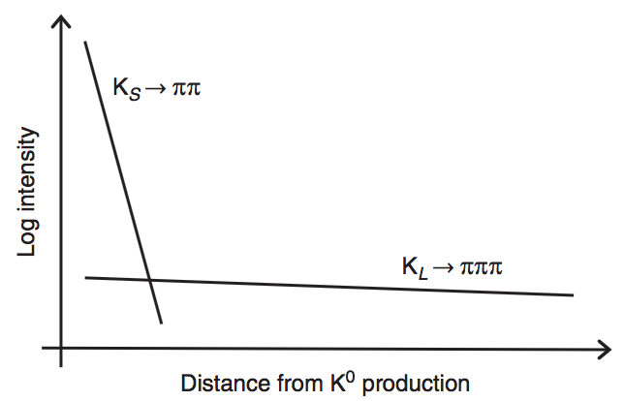
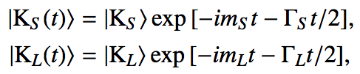
What if CP was conserved in kaon mixing?
In that case K_{S} = K₁ and K_{L} = K₂.
Imagine we have an initial beam of K⁰.
The time evolution (we shall see this in more detail) is given by:
Since the lifetime of K_{S} is much smaller at a distance of ~15m we expect a pure beam of K_{L}.
No decays into two pions are expected at this distance!!

Slide 20
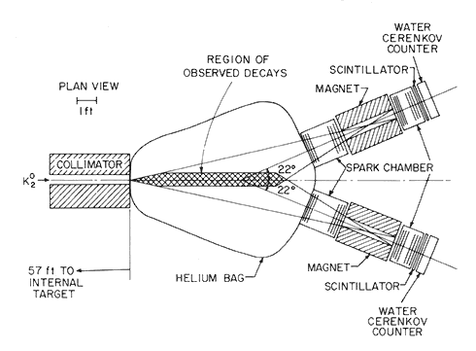
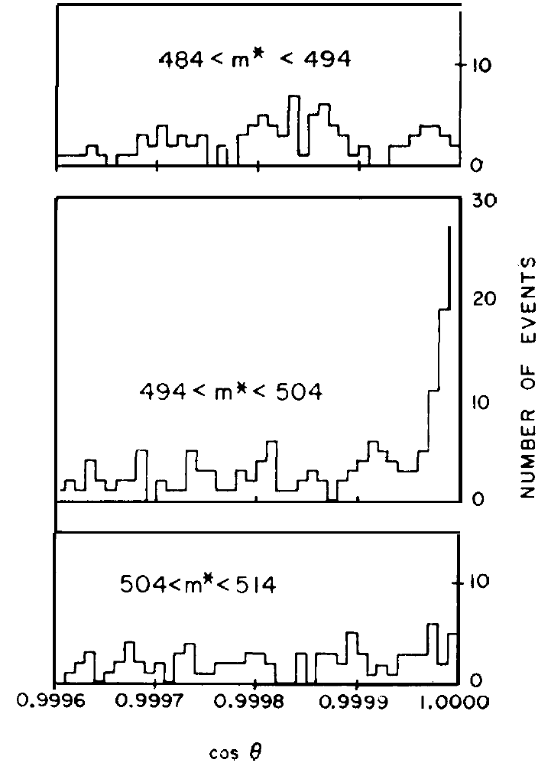
Discovery of CP violation
K_{s}: Short-lived CP even:
K₁⁰ → π⁺ π⁻
K_{L}: Long-lived CP odd:
K₂⁰ →π⁺ π⁻ π⁰
Create a pure K_{L} (CP=-1) beam: (Cronin & Fitch BNL in 1964).
Wait until the K_{s} component has decayed.
If CP conserved, should not observe the decay K_{L}→ 2 pions.
K₂→π⁺π⁻
Effect is tiny:
about 2/1000
θ
Main background: K_{L}→π⁺π⁻π⁰
Notes:
Kl-> pi+pi-pi0

Slide 21
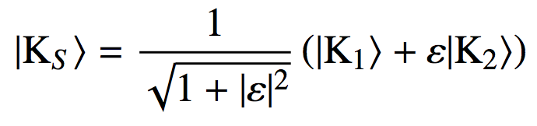
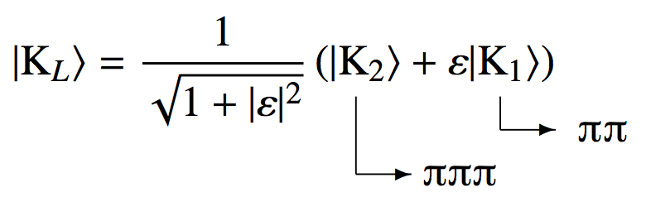
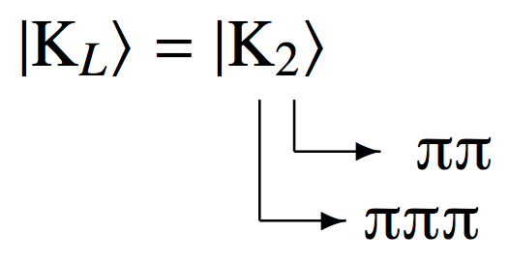
CP Violation in neutral kaons
There are two main ways of introducing CP violation into the neutral kaon system.
CP violated in the K⁰ ↔ K⁰ mixing process.
  K_{S} and K_{L} do not correspond to the CP eigenstates, K₁ and K₂.
  K_{S} and K_{L} can be related to CP eigenstates by the small (complex) parameter ε.
Second possibility: CP violated directly in the decay of a CP eigenstate.
  Relative strength of direct CPV parameterised by
  It is known that CP is violated in both mixing and directly in the decay.
  NA48 (CERN) and KTeV (Fermilab) demonstrate direct CPV is relatively small.
  CPV in mixing is dominant in neutral kaon system.
This explains long distance two pion decays

Slide 22
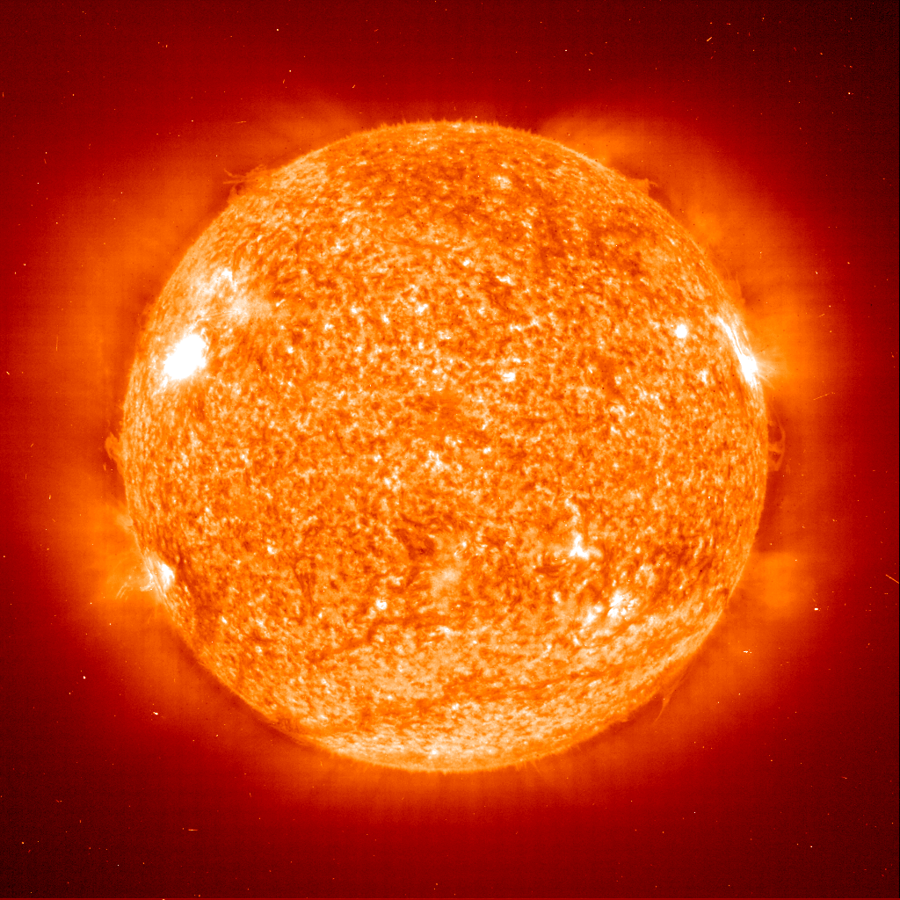
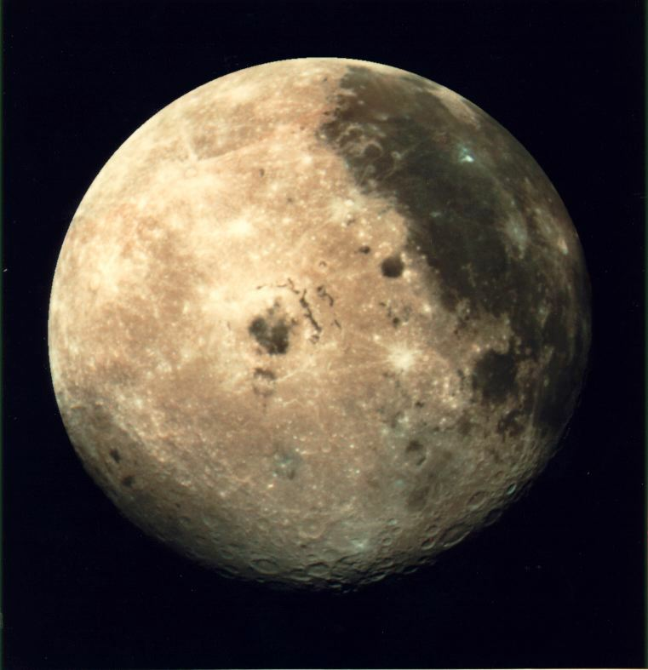
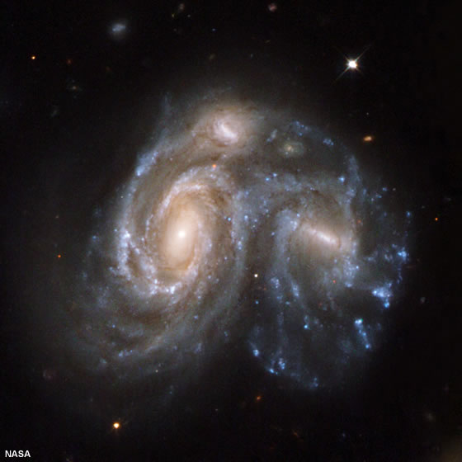
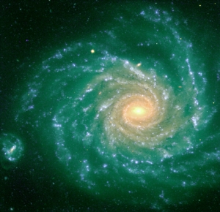
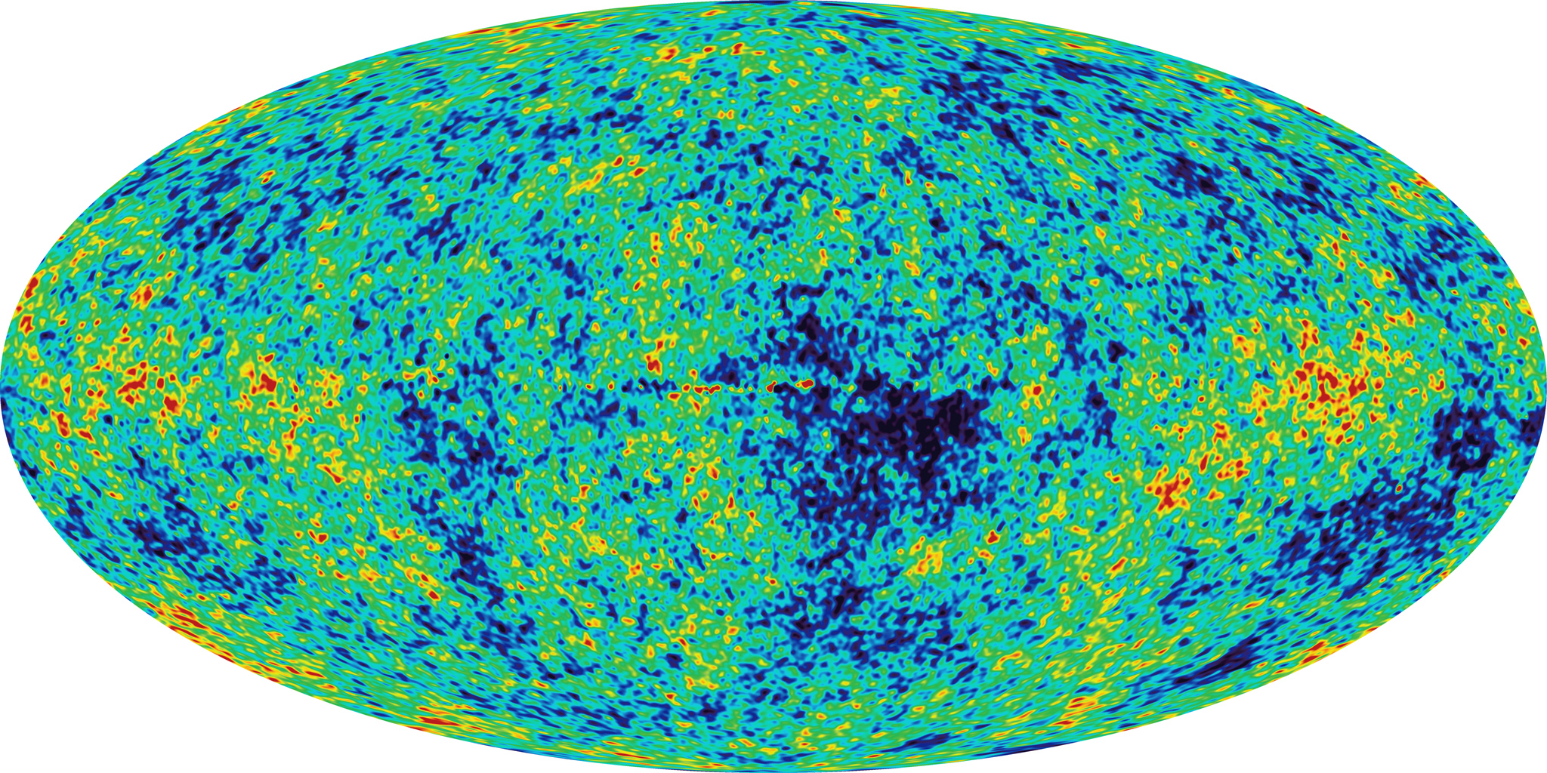
Why CP violation matters?
Visible Universe: matter rather than antimatter.
Moon: lunar probes and astronauts would have vanished in a fireball.
Sun and Milky Way: solar wind and cosmic rays do not destroy us.
Local cluster of galaxies: radiation from annihilations at the boundaries.
Microwave background: no disturbance by annihilation radiation. No large regions of antimatter within 10 billion light years (the whole visible universe?).
Big Bang: equal amounts of matter and antimatter.
Why so much of one and so little of the other? CP violation.

Slide 23
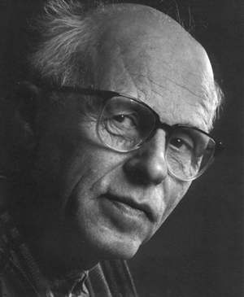
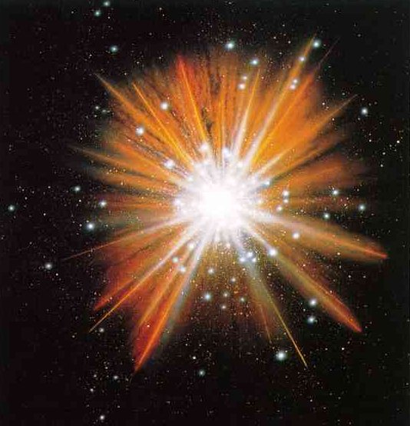
CP violation and matter-antimatter balance
A. Sakharov’s conditions (1967):
  Unstable Proton: no baryon conservation.
  Interactions violating C conjugation and CP symmetry: initial matter­antimatter balance upset.
  Universe: phase of extremely rapid expansion. Prevents restoration of balance due to CPT symmetry.
Standard Model. Two ways to break CP:
  QCD: unobserved.
  Weak force: verified. Accounts for a small portion. Net mass ~ only a single galaxy ☹.
Physics beyond SM?

Slide 24
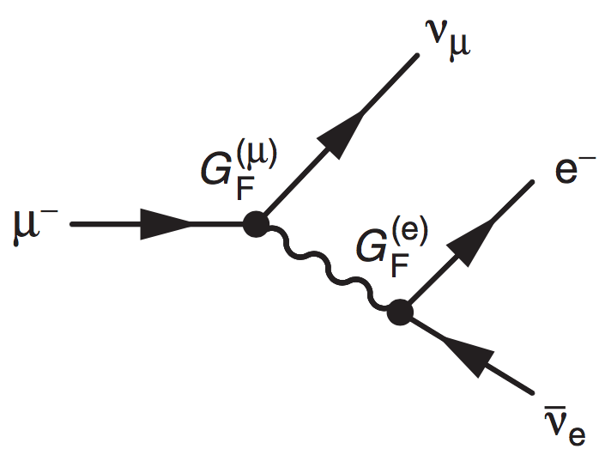
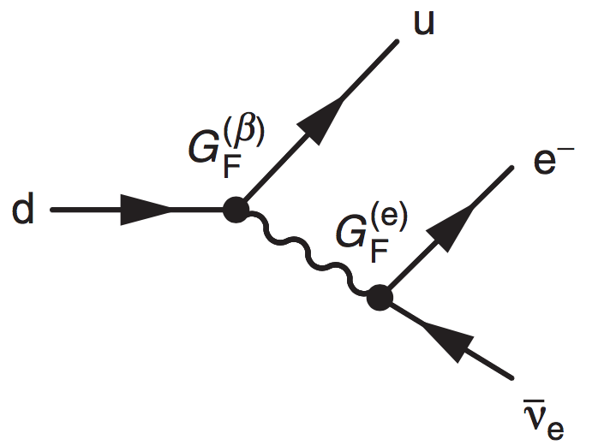
The Cabibbo mechanism
In the SM the weak interaction to charged leptons and the corresponding neutrino is universal (G^{(e)} = G^{(μ)} = G^{(τ)})
The strength of the weak interaction for quarks can be determined from the study of nuclear β-decay.
  The matrix element |M|² ∝ G^{(e)}G^{(β)}
  G^{(β)} gives the coupling at the weak interaction vertex of the quarks.

Slide 25
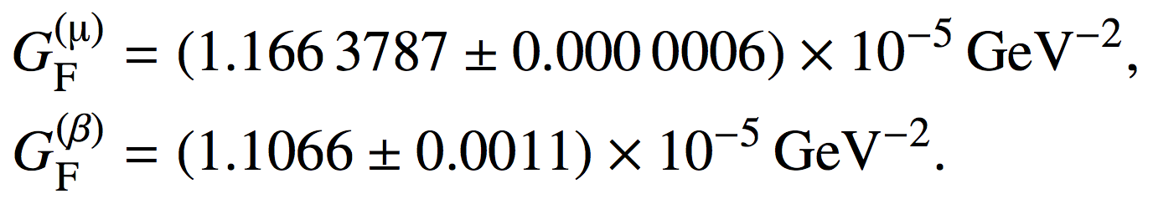
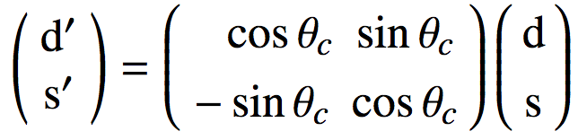
The Cabibbo mechanism
From β-decay rates for superallowed nuclear transitions the strength of the coupling at ud vertex is found 5% smaller than that at μν_{μ} vertex.
Different coupling strengths are found for the ud and us weak charged- current vertices.
These observations explained by the Cabibbo hypothesis.
  Weak interactions of quarks have the same strength as the leptons.
  Weak eigenstates of quarks (d′ and s′) differ from mass eigenstates (d and s).
  They are related by the unitary matrix:
θc is the Cabibbo angle

Slide 26
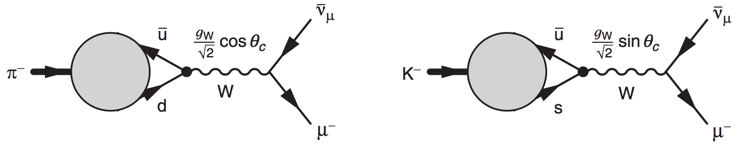
The Cabibbo mechanism
Nuclear β-decay involves the weak coupling between u and d quarks.
  With the Cabibbo hypothesis: β-decay matrix elements proportional to g_{W} cosθ_{c} and decay rates to G_{F} cos² θ_{c}.
  Matrix elements for K⁻ → μ⁻ν_{μ} and π⁻ → μ⁻ ν_{μ} include factors of cosθ_{c} and sinθ_{c} and the K⁻ decay rate is suppressed by tan² θ_{c} relative to the π⁻ one.
  Observed β-decay rates and measured ratio of Γ(K⁻ → μ⁻ν_{μ})/Γ(π⁻ → μ⁻ ν_{μ}) can be explained if θ_{c}≃13◦.

Slide 27
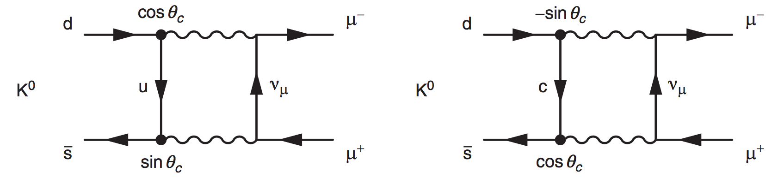
The Cabibbo mechanism
When the Cabibbo mechanism was proposed the charm quark had not been discovered.
Since it allows for ud and us couplings, the flavour changing neutral current (FCNC) decay K_{L} → μ⁺μ⁻ can occur via the exchange of a virtual up-quark.
Measured BR (6.84±0.11)×10⁻⁹ much smaller than expected from this diagram alone.
Explained by the Glashow, Iliopoulos and Maiani (GIM) mechanism (1970).
  A postulated fourth (charm) quark coupled to the s′ weak eigenstate.
  The two diagrams of the figure interfere with matrix elements:
  Cancellation is not exact because of the different masses of the up and charm quarks.
Notes:
A similar diagram can explain the oscillation of neutral mesons.

Slide 28
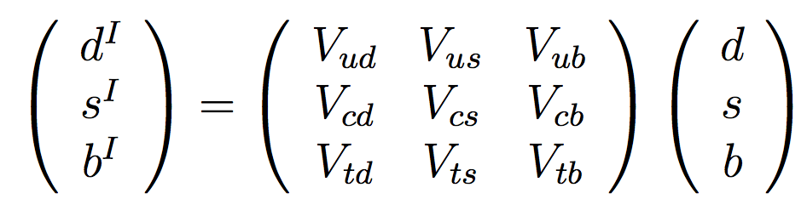
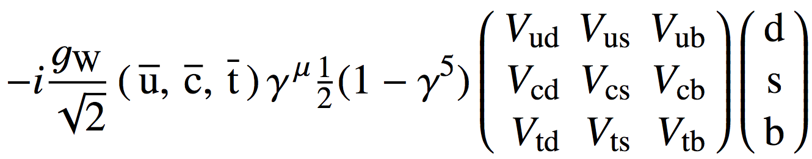
CP violation in the SM
The Cabibbo mixing matrix can be reduced to be real.
  No CP violation involved.
The extension to the three quark generations of the SM is described by the unitary Cabibbo–Kobayashi–Maskawa (CKM) matrix.
The weak interaction eigenstates are related to the mass eigenstates by:
And the weak charged vertices are given by:

Slide 29

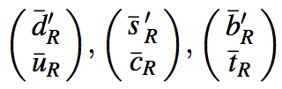

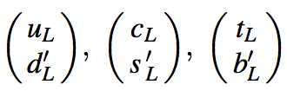




SYMMETRIES OF THE EW INTERACTION
Symmetry: a powerful idea.
Nature remains unaltered mixing-exchanging two particles.
Eg.: strong sector, combine quarks (not loosing unitarity). SU(3). Isospin.
  This includes permutations.
In the electroweak sector: combining left-handed fermions.
Electroweak isospin.
There are not left-handed neutrinos.
Additionally there is a U(1) symmetry. Hypercharge:
The EW sector (before symmetry break-up) is SU(2)_{L}xU(1)_{Y} symmetric.
  Physicists discovered all these with experimental input(~1968)

Slide 30
CP Violation in the Weak Sector of the SM
Standard Model: unifies Strong and Electro-Weak interactions.
EW symmetry break-up: might describes mass generation.
Fermions: Yukawa couplings to the Higgs Boson (sandwich terms).
h(x): Higgs field ν: vacuum expectation.
M’s: complex mass matrixes depending on the Yukawa coefficients.
Simultaneously diagonalized define physical quarks:
Mass part becomes:

Slide 31
CP Violation in the Weak Sector of the SM (2)
How does this transformation change the rest of the Lagrangian?
Invariant except for one term:
Charged currents only term containing u-type and d-type quarks product:
Only term allowing flavor changes and breaking CP symmetry.
The product of the two U matrixes can be re-written as:
Cabibbo-Kobayashi-Maskawa matrix.

Slide 32
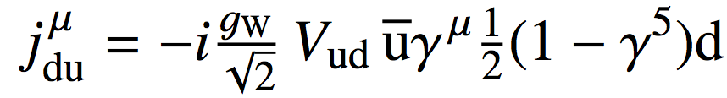
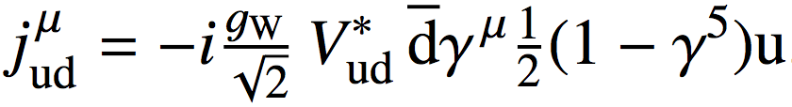
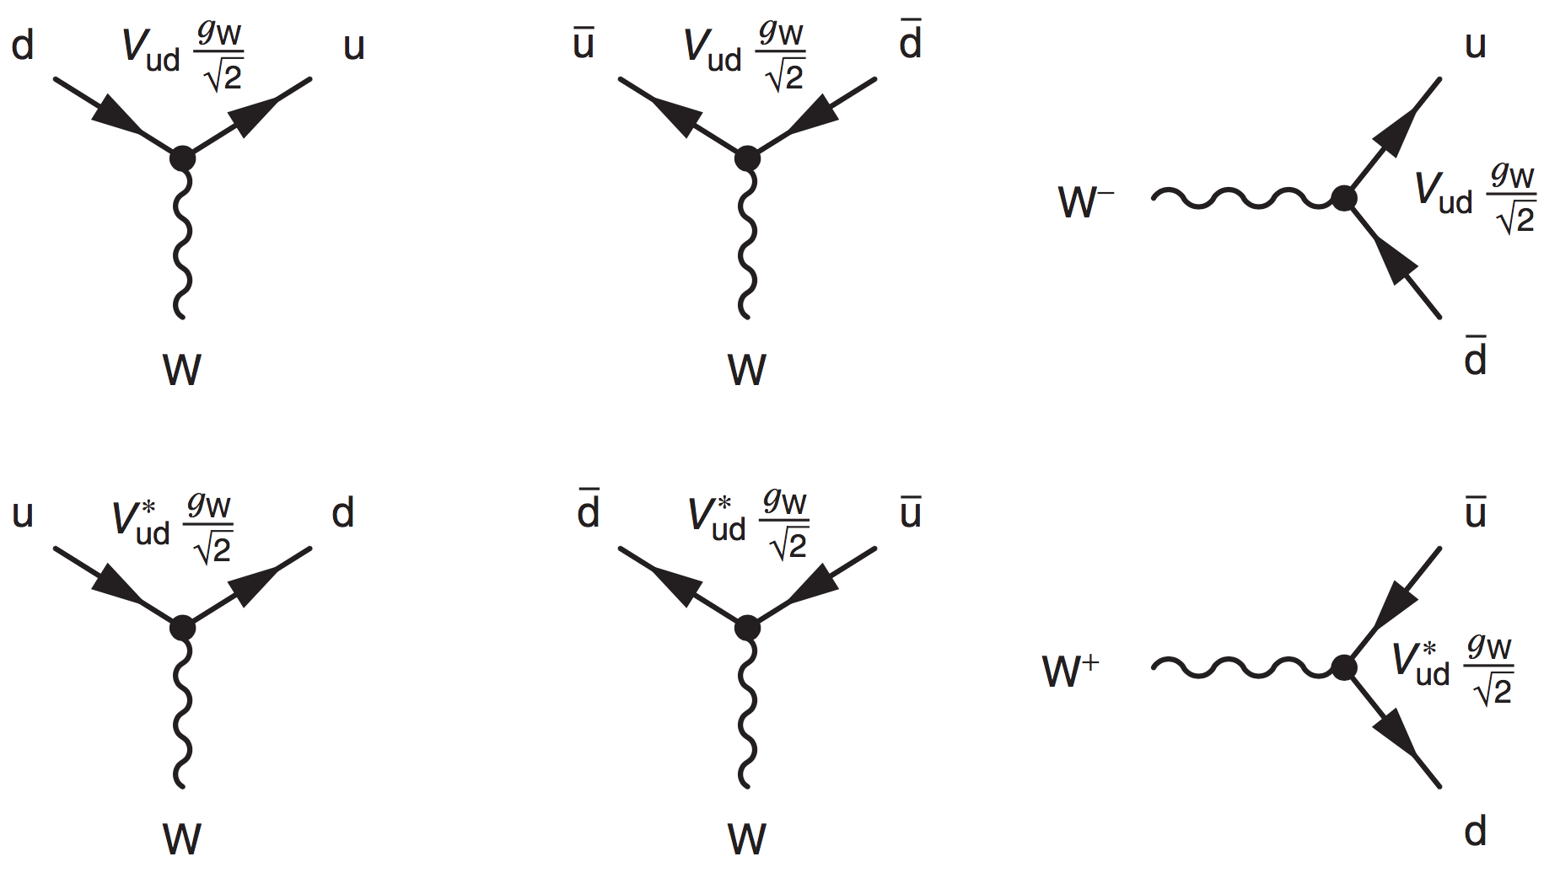
CP violation in the SM
The vertex factor for calculating Feynman diagrams involving flavour ud change in the weak interaction is
Whereas for du transitions we have
In general

Slide 33
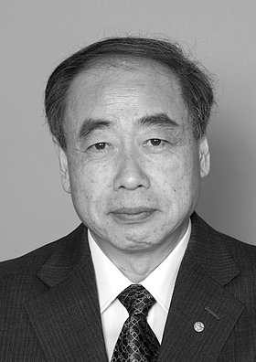
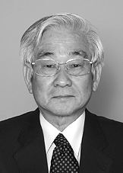
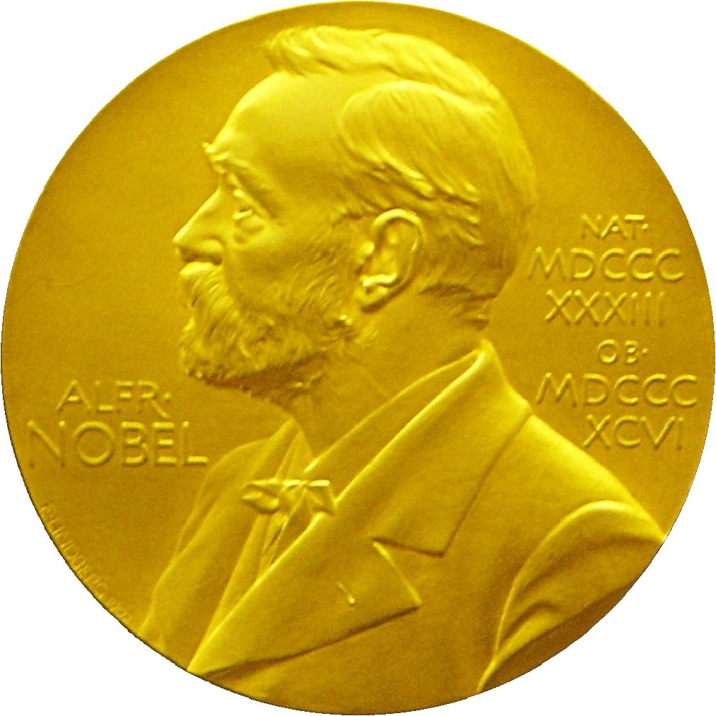
CKM
CKM matrix: unitary.
Minimum dimension to include a complex phase (CP violation): 3.
3x3 complex unitary matrix: three mixing angles and one phase.
1973 Makoto Kobayashi & Toshihide Maskawa: 3 quark families.
Extended Cabbibo 1963 idea of a unitary matrix of 2 quark families to explain weak interaction mixing.
2008 Nobel Prize of Physics.
KM predicted a 3rd family of quarks in 1973 to accommodate CP violation. At the time only 3 quarks were know (u,d,s).

Slide 34
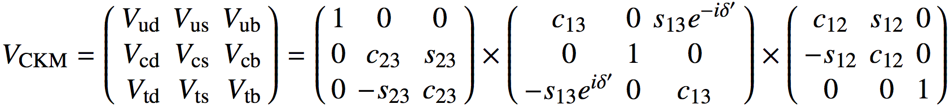
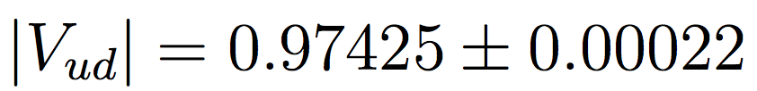
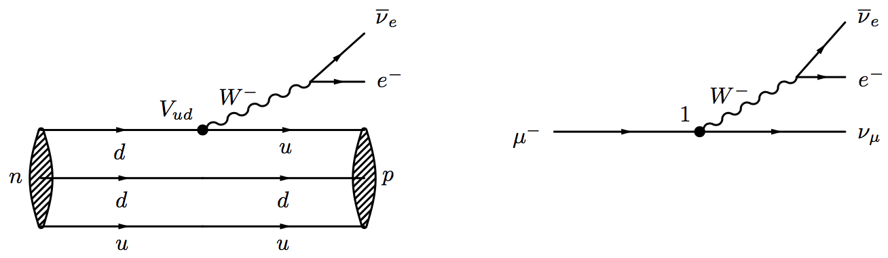
CP violation in the SM
A general nxn orthogonal matrix depends on n(n-1)/2 angles, describing the rotations among the n dimension and (n-1)(n-2) phases.
The CKM matrix is 3x3 and can be described by three rotation angles and a complex phase (s_{ij} = sin φ_{ij} and c_{ij} = cosφ_{ij}):
The elements of the CKM matrix are measured from the flavour initial or final state eigenstates (mesons or baryons containing the corresponding quark).
|V_{ud}| is determined from superallowed nuclear β-decays.
Notes:
Superallowed beta decay: conserves spin and parity

Slide 35
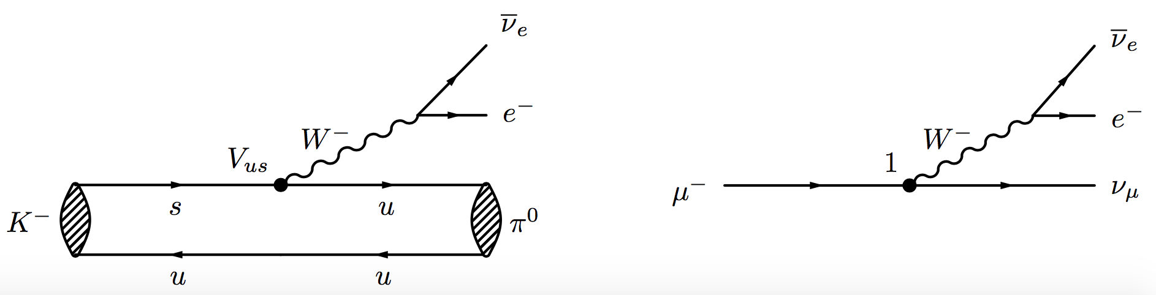

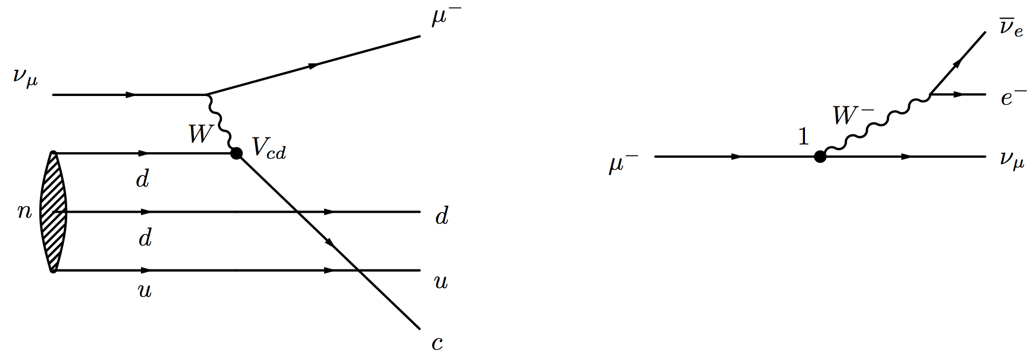

CP violation in the SM
|V_{us}|: is obtained analyzing semi-leptonic K-decays.
|V_{cd}|: Is obtained by the analysis of neutrino and anti-neutrino induced charm-particle production of the valence d-quark in a neutron (or proton) and on semileptonic charm decays.
Notes:
Vcd BaBar [25] and BESIII [26] as well as CLEO-c [27] and Belle [28] other CHORUS.

Slide 36

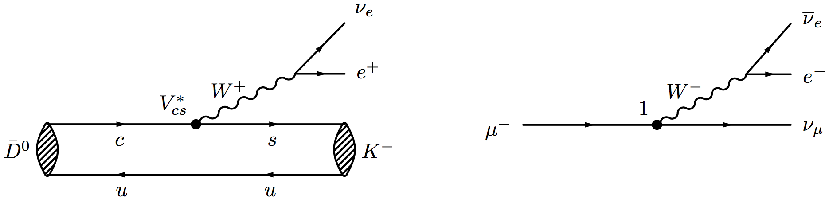

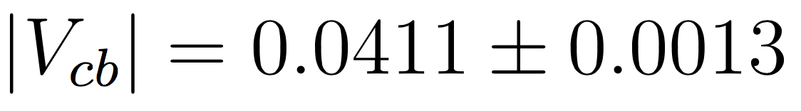
CP violation in the SM
|V_{cs}|: Main matrix element relevant for decay modes of the charm quark. Obtained analyzing semi-leptonic D-decays The major uncertainty is due to the form-factor of the D-meson.
|V_{cb}|: Determined from the B⁰ →D^{∗-}l⁺ν_{l} decay. A large amount of data is available on these decays from LEP and lower energy e⁺e⁻ accelerators.
Notes:
In particle physics the semileptonic decay of a hadron is a decay caused by the weak force in which one lepton (and the corresponding neutrino) is produced in addition to one or more hadrons. Again Vcs: BaBar, BESIII, CLEO-c, Belle

Slide 37
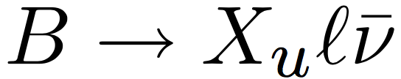

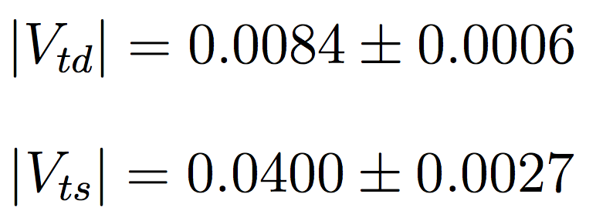
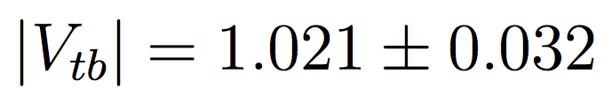
CP violation in the SM
|V_{ub}| from inclusive analises:
|V_{td}| and |V_{ts}|:
  Top quark matrix elements cannot be measured from tree-level top-quark decays.
  These elements are probed through loop diagrams
  The reason for the previous matrix elements to remain not accessible is that top decays into something different than Wb remains unobserved.
CDF, D0, ATLAS and CMS measured the ratio of branching ratios Br(t→W b)/Br(t→Wq) finding the 95% CL:
Notes:
Using lattice calculations to take long-distance effects into account, and assuming |Vtb| = 1, yields:

Slide 38
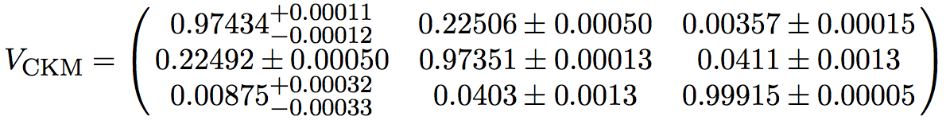
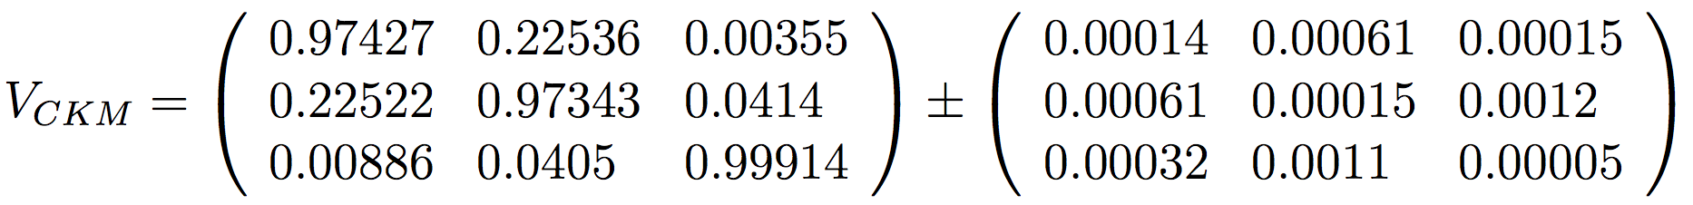

CP violation in the SM
In summary, our knowledge of the CKM matrix magnitudes is summarized in
Remember the expression for the CKM matrix as a function of the Euler angles (I did not give the multiplication result):
Comparing the two expressions we see that s_{ij} are small and s₁₂≫s₂₃≫s₁₃. This motivated a parameterization of the CKM matrix proposed by Wolfenstein.

Slide 39


Wolfstein parametrization of the CKM matrix
Defining
Being A, ρ and η of order unity.
With this parametrization
Which is accurate up to order of λ³.

Slide 40


The unitarity of the CKM matrix
The unitarity condition for the CKM matrix imposes constraints on its elements.
Three of them express the weak universality.
  The squared sum of the coupling strengths of the u-quark to the d, s and b-quarks is equal to the overall charged coupling of the c and t-quarks.
Furthermore, the sums add up to 1, eliminating the possibility to couple to a 4th down-type quark.
  This relation deserves continuous experimental scrutiny.

Slide 41


The unitarity of the CKM matrix
There are three other independent relations
From the previous new relations, also obtained from , can be derived:
Each of the above can be interpreted as the sum of three complex numbers (2d vectors) forming a triangle.

Slide 42



The unitarity of the CKM matrix
The Wolfstein parametrization reveals that all unitarity triangles contain terms of different order in λ except two.
This means that all the triangles except these two are very squeezed and less sensitive to CP violation.
The first relation can be rewritten, in terms of the Wolfstein parameters, as:
Where

Slide 43


The unitarity of the CKM matrix
This is the celebrated unitarity triangle
That motivates the angle definitions

Slide 44





The unitarity of the CKM matrix
The other triangle is at the origin of the β_{s} angle
The Wolfstein parametrization adopts a phase convention such that
Since CP violation requires that turns out that the surface of the unitary triangle is different from zero.
In fact all triangles have the same, surface which is half the Jarlskog invariant
That in our known parametrizations can be expressed as

Slide 45

Neutral meson oscillations
All neutral weak decaying mesons (K⁰, D⁰, B⁰ and B_{s}⁰) can oscillate into each other antiparticle.
  We take a B⁰ meson as an example.
  The formalism is valid for any of the previously mentioned mesons.
Consider |B⁰⟩ and |B⁰⟩, strong and EM eigenstates with mass m and opposite flavor.
An arbitrary superposition with time-dependent coefficients a(t) and b(t):
Notes:
Recall what a neutral meson is!!

Slide 46


Neutral meson oscillations
The time evolution is governed by
Where
  CPT invariance: M = M₁₁ = M₂₂, M₂₁ = M₁₂∗ and Γ₁₁ = Γ₂₂, Γ₂₁ = Γ₁₂*
The first matrix provides a mass term.
Due to −i, Γ provides an exponential decay.
  Because of this term H is not hermitian. The probability to observe either P⁰ or P⁰ goes down with time:

Slide 47


Neutral meson oscillations
There can be a relative phase between Γ₁₂ (absorptive transition) and M₁₂ (dispersive transition)
This leads to
If T were conserved Γ₁₂∗ /Γ₁₂ = M₁₂∗ /M₁₂ and adding a free phase Γ₁₂ and M₁₂ can be set real.
Solving the time dependent matrix means finding the eigenstates and eigenvalues of H.
  This will describe the masses and decay widths and the P⁰, P⁰ combinations that correspond to the physical particles.

Slide 48




Neutral meson oscillations
The eigenvalue equation is
If we consider the resulting eigenvalues are .
Where the mass and width of the two physical states are identified.
Two standard definitions are:

Slide 49




Neutral meson oscillations
Let us find the eigenstates.
Solving
If P_{H} is the heavier state we have
q/p can be related to the mixing phase as
This will be the size of a possible CP asymmetry for flavor-specific final states, a_{fs}.

Slide 50



Neutral meson oscillations
The time evolution of the eigenstates is given by
Since the physical states are related to the eigenstates by
The time evolution of a physical state is

Slide 51





Neutral meson oscillations
The functions g₊ and g₋ are defined as
The corresponding antiparticle evolution being
For an initial pure sample of P⁰ the probability of finding a P⁰ at time t is
Physical meaning of Γ as a decay length.

Slide 52


Classification of CPV effects
Let us consider a meson, its CP conjugated, a final state and its CP conjugated. This results in four decay amplitudes:
If we define the parameters
And consider the time evolution
We can see that the time dependent decay rates, defined as

Slide 53


Classification of CPV effects
Are given by:
Where
In the decay rates the terms proportional |A|² are associated with decays without oscillation, the terms proportional to |A|²(q/p)² or |A|²(p/q)² are associated with decays following a net oscillation. The terms proportional to Re(g∗g) are associated to the interference between the two cases.

Slide 54


Classification of CPV effects
The previous expressions can be combined to give the so-called master equations:
Where the sinh and sin terms are associated to the interference between the decays with and without oscillation.
The master equations are often expressed as
After defining
For a given final state f we only have to find λ_{f} to fully describe the decay of the oscillating mesons.

Slide 55


CPV in decay
When the decay rate of a B to a final state f differs from the decay rate of an anti-B to the CP-conjugated final state.
This happens if
The canonical example of such a case are the and decays.
A CP asymmetry is observed for such decays of
Since charged mesons do not oscillate this is the only type of asymmetry they present.

Slide 56

CPV in decay in a nutshel
Decays with Tree and Penguin contributions: interfere ⇒ CPV
- φ_{1,2} weak phases. - θ_{1,2} strong phases.

Slide 57



CPV in mixing
This occurs if the oscillation from meson to anti-meson is different from the oscillation from anti-meson to meson:
There us CPV if |q/p| ≠ 1.
A final flavor specific decay, in which f is only accessible to B⁰, and its CP conjugate are considered:
To measure that decay rates in which the -quark in the B⁰-meson decays weakly to a positively charged lepton are compared to rates of the b-quark in the meson into a negatively lepton.
  An event with two leptons with equal charge in the final state means that one of the two B-mesons oscillated.
  The asymmetry in the number of two positive and two negative leptons allows to compare the oscillation rates.
  Examples are modes

Slide 58




CPV in interference between a decay with and without mixing
Also referred to as CPV involving oscillations.
It is measured in decays to a final state that is common for the B0 and B ̄ meson.
CP is violated if
In particular CP-eigenstates verify that two amplitudes contribute to the transition.
If there is not CPV in mixing, , the time dependent CP asymmetry is given by

Slide 59



CPV in interference between a decay with and without mixing
The canonical example is the decay.
If we had considered the mode we would have a different state for B0 and B0, since .
For the meson and anti-meson to have a common final state the mass eigenstates are considered:
The considered diagrams are b+c and a+b+c and the corresponding CP conjugated.
In this case the CP asymmetry simplifies because of the common final state and
For this decay λ has three parts

Slide 60




CPV in interference between a decay with and without mixing
Let us analyze these three parts
Therefore
And
In summary, a time-dependent analysis of this channel provides a measurement of the beta angle

Slide 61
How is this done?
We have seen so far the formalism to access relevant magnitudes involving B meson decays.
Which are the key experiments to perform such measurements and their characteristics are the topic of the following slides.
We will cover also relevant measurements that have not been treated in the canonical examples.
And will cover how to search for physics BSM.

Slide 62

CLEO
A wise way of producing B-mesons is in e⁺e⁻ colliders.
The CMS energy is tuned to the Υ(4s) resonance (the 4-th lowest mass bb meson) that almost exclusively decays into B⁰-B⁰ and B⁺-B⁻ (50% each) pairs.
This resonance was discovered at CLEO and CUSB experiments at Cornell
CLEO was the main experiment in this lab dedicated to the study of B-mesons.
The e⁺e⁻ beams were symmetric.

Slide 63

ARGUS
The European competitor of CLEO was ARGUS.
The ARGUS A Russian-German-United States-Swedish Collaboration) experiment performed such measurements using the electron-positon pairs of DORIS II at DESY.
  Construction started in 1979
  Operation 1982-1992
The problem with symmetric e⁺e⁻ beams is
m_{Υ(4s)} = 10.58 GeV → p_{B}= 340 MeV → βγ = 0.064
Therefore the mean B decay length cτβγ ~ 30 μm.
  This is too close to be resolved by tracking detectors.

Slide 64

Coherent B-B pairs
The advantage of producing meson-antimeson pairs in colliders is that the pair is produced in a coherent quantum state.
Both mesons oscillate in phase until one decays.
Simply counting the asymmetry in charged leptons CPV in mixing can be detected.
However, to observe the oscillation pattern the difference of decay times needs to be measured.
How can this be achieved?

Slide 65
B-factories
With the use of asymmetric e⁺e⁻ beams.
The Υ(4s) will not be produced at rest in the laboratory.
  The two B mesons will have significant momentum with respect each other to produce measurable distances.
  For example, the PEP-II collider at SLAC collides beams of 9 GeV e⁻ with beams of 3.1 GeV e⁺.
    With that βγ ~ 0,56 and cτβγ ~ 260 μm.
  KEKB collided 7GeV e⁻ with 2.6 e⁺.
    βγ Calculate and cτβγ ~ Calculate μm.

Slide 66

B-factories
The B factories strategy for mixing analysis consisted of:
Reconstruct B_{rec} fully → B_{rec} decay vertex, momentum and flavor at decay assign remaining final-state particles to B_{tag} decay (not necessarily full reconstruction).
Reconstruct B_{tag} decay vertex → fixes t=0 for oscillation measurement infer flavor of B_{tag} at its decay → fixes flavor of B_{rec} at t=0.
B_{rec} oscillated (not oscillated) if opposite (same) flavor at t=0 and decay.
Calculate oscillation time from B_{rec} momentum and Δz of decay vertices.

Slide 67

The BaBar spectrometer
[NIM A479 (2002) 1]
Electromagnetic Calorimeter 6580 CsI crystals
e± ID, π⁰ and γ reconstruction
Instrumented Flux Return 12-18 layers of RPC/LST
μ ID
Cherenkov Detector 144 quartz bars K, π, p separation
e⁺ [3.1 GeV]
Drift Chamber 40 wire layers tracking, dE/dx
e⁻ [9 GeV]
Silicon Vertex Tracker
5 layers double-sided sensors vertexing, tracking (+ dE/dx)
1.5T Magnet

Slide 68

The Belle spectrometer
[NIM A479 (2002) 117]

Slide 69

Belle II
An upgraded version of both the KEKB and Belle spectrometers is ongoing.
BaBar stopped taking data in 2008.
Aims at a luminosity of 8x10³⁵ cm⁻²s⁻¹ thus 10¹⁰ BB pairs per year.
First physics runs in fall 2018.

Slide 70


Hadron colliders
The other way of producing b hadrons is in hadron colliders.
Hadron collider advantages:
  All species of b hadrons produced: B±, B⁰_{s}, B⁰, B⁺_{c} , Λ_{b}.
  σ_{bb} much higher than at B factories.
Hadron collider disadvantages:
  σ_{bb}/σ_{tot} much smaller than at B factories.
  Large number of additional particles from underlying hadronic interaction.
The way to overcome these difficulties is to rely in the high transverse momentum originated in the heavy mass of the b-particles and the large impact parameter originated in the long lifetime of b-particles in the lab system.
Facility | √s | σ_{bb} [nb] | ^{σ}bb ^{/σ}tot
e⁺e⁻ @ Υ(4s) (4s) | 10.58 GeV | 1 | 0.25
HERA-B pA | 42 GeV | ~ 30 | ₁₀-6
Tevatron pp | 1.96 TeV | 5 x 10³ | ₁₀-3
LHC pp | 7 TeV | 3 x 10⁵ | ₁₀-2
LHC pp | 14 TeV | 6 x 10⁵ | ₁₀-2
event in BaBar
event in CDF

Slide 71

Production of bb in hadron colliders
The bb pair is not created in a coherent quantum state
  The oscillation measurement is made with respect to the primary vertex.
    B flavor needs to be known at production.
  Primary vertex reconstruction: excellent precision due to large number of charged tracks from underlying event.
The flavor tagging is performed in messier environment. Tagging power of ∼ 5%.
  “Opposite side tagging” as in B factories (lepton, kaon, vertex charge).
  “Same side tagging”: charge of a lepton or a kaon from b decay.

Slide 72


The Tevatron GDPs
At the p-pbar collider in Fermilab two General Purpose Detectors were installed: CDF and D0.
Their main target was to discover the top quark and eventually the Higgs boson.
However they also had an ambitious B-physics program.
  Their main challenge was the trigger and the π/K identification.
  The achieved very good results for example in the analysis of the xxxxxxxxxx decay (B⁰_{s} was not usually produced in the B factories although Belle had dedicated runs)

Slide 73


The LHC GDPs
As for the Tevatron the LHC GDPs, ATLAS and CMS also have a B-physics program.
  It has produced excellent results.
The challenge is to trigger and select b-hadron decays in the midst of the pile up environment.

Slide 74



LHCb
b$\overline{b}$ acceptance
JINST 3 (2008) S08005
Muon system
μ identification ε(μ→μ) ~ 97 %,
mis-ID ε(π→μ) ~ 1-3 %
RICH detectors
K/π/p separation
ε(K→K) ~ 95 %,
mis-ID ε(π→K) ~ 5 %
10-250mrad
~12m
~20m
10-300mrad
+ Herschel
energy measurement
e/γ identification
ΔE/E = 1 % ⨁10 %/√E (GeV)
Vertex Detector
reconstruct vertices
decay time resolution: 45 fs
IP resolution: 20 μm
Dipole Magnet
bending power: 4 Tm
Tracking system: IT, TT and OT
momentum resolution
Δp/p = 0.4%–0.8%
(5 GeV/c – 100 GeV/c)
Calorimeters (ECAL, HCAL)
energy measurement
e/γ identification
ΔE/E = 1 % ⨁10 %/√E (GeV)

Slide 75


LHCb Velo
One of the mains characteristics of LHCb is its capability of resolving secondary vertices.
This is possible thanks to the Vertex Locator detector.
21 modules per half + 2 Pile Up sensors
Per module, one R and one Φ sensor
  Silicon strip sensors
  2048 channels
  300 μm thick

Slide 76

LHCb Velo
One of the mains characteristics of LHCb is its capability of resolving secondary vertices.
Detector divided in two halves
Sensors placed in vacuum, separated from LHC by an RF foil
Entire half can be moved
  Beam position unknown
  Beam halo during injection
21 modules per half + 2 Pile Up sensors
Per module, one R and one Φ sensor
  Silicon strip sensors
  2048 channels
  300 μm thick

Slide 77



LHCb Velo
Slide from Ivan Mous
Proton beams collide inside VELO
B mesons and other particles produced in p-p interaction
B mesons decay, produce new particles
Decay products pass through sensors
Primary and secondary Vertex can be reconstructed
Vertices displaced (≈1cm)
  Identify B mesons
  Determine B meson lifetime
proton
Primary vertex
Secondary vertex
proton
B meson

Slide 78




LHCb RICH
Particle ID: p~2-100 GeV provided by two RICH detectors.
Cherenkov light produced in a radiator gas is focused with mirrors, to produce ring images in a fly eye array of PMs.
The ring pattern permits identification of hadron species.
RICH1
RICH2

Slide 79


LHCb new trigger
Slide from F. Alessio
New trigger system
New
New
New
~50k logical cores
Same online and offline reconstruction and PID!
prompt alignment and calibration
completely automatic and in real-time
Physics out of the trigger with Turbo Stream
Raw info discarded, candidates direclty available 24h after being recorded
~5PB disk space

Slide 80
Flavor Physics highlights

Slide 81



Direct CPV
Slide from J Saborido
Not only the already shown canonical and .
Also charmless three body decays.
These modes can show huge assymetries in regions of the Dalitz-plot.
$$A_{CP}\left(B^{±}→π^{±}K^{+}K^{−}\right)=−0.123±0.022$$
$$B^{−}→π^{−}K^{+}K^{−}$$
$$B^{+}→π^{+}K^{+}K^{−}$$
PRD 90, 112004 (2014)

Slide 82

Dalitz plot
A Dalitz plot is a useful technique for the analysis of three body decays.
Two invariant relativistic variables are constructed in a decay:
The third combination, m_{bc} depends on these two (the choice is arbitrary).
  It can be shown (exercise) that:

Slide 83





sin(2β)
Slide from J Saborido
Effective tagging efficiency: (3.02 ± 0.05) %
Typical time resolution: 45 fs
LHCb has become competitive with B-factory measurements.

Slide 84











Time-dependent CPV in $B^{0}→D^{+}D^{−}$ decays
Slide from J Saborido
PRL 117, 261801 (2016)
$$\frac{dГ(t,d)}{dt}=∝e^{−t/τ}\left[1−d S\sin\left(∆mt\right)+d C\cos\left(∆mt\right)\right]$$
( $d$ is the $B^{0}$ flavour at production time)
$$\frac{S}{\sqrt{1−C^{2}}}=−\sin\left(φ_{d}+∆φ\right)$$
$$φ_{d}=2β$$
$${S=−0.54}_{−0.16}^{+0.17}±0.05$$
$${C=+0.26}_{−0.17}^{+0.18}±0.05$$
Observed CPV at a level of $4.0 σ$
$${∆φ=−0.16}_{−0.21}^{+0.19}$$
Notes:
D+ → K−π+π+ and D+ → K−K+π+

Slide 85


sin(2β)
Slide from J Saborido
World average $\sin{2β=0.69±0.02}$

Slide 86


Probing CKM: Unitarity triangle
Slide from S Blusk
Unitarity of V → Triangles in complex plane (5 others, incl. one for B_{s} decays)
α
γ
β
Worldwide amalgamation of many results in B decays (and kaons, for e_{K})
  |V_{ub}/V_{cb}| & γ (tree level) ---- β, α, V_{td} , V_{ts} (loop level) could contain NP in B_{(s)} mixing.
  If SM CKM is correct, all measurements must agree on the apex of this triangle.
Notes:
Blue = CPV measurements, Black = “rates”

Slide 87



QCD in the Decays
Things are not as easy as one wishes.
While studying the weak interaction we can not switch of the strong interaction.
Describe b→Dqq, b → Dg, b → Dγ transitions by an effective Hamiltonian.
Long distance effects are absorbed in the definition of the operators O_{i}, while the short distance interactions are condensed in the Wilson coefficients C_{i}.

Slide 88


Clean SM measurements -- |V_{ub}/V_{cb}|
Slide from S Blusk
Exclusive decays
Longstanding tension in V_{ub} and V_{cb}.
Global fit “prefers” |V_{cb}|_{incl} and |V_{ub}|_{excl.}
V_{qb}
u , c
see also Gambino et al, 1703.06124
Need FF(q² = 0)
from LQCD
Grinstein et al, suggest alternate Form Factor fit (BGL) to recent Belle B→D*lν data instead of the common CLN choice
New BaBar analysis of |V_{ub}|_{incl}
with different Heavy Quark Effective Theory extrapolation
schemes (closer to |V_{ub}|_{excl} )
Inclusive & exclusive measurements
converging? More data needed!
Grinstein et al,
arXiv:1703.08170
Inclusive decays: b→Xlν
Inclusive properties e.g., p_{l}
Theory input to extrapolate to
full phase space, esp for X_{u}.
PRD95, 2017
BaBar
Notes:
Exclusive implies that you have measured the energy and momenta of all the products (well, with an exception I'll discuss below). Inclusive means that you may have left some of the products unmeasured.
This applies to scattering processes as well as decays.
Some things to note:
Exclusive measurements allow you to nail down one, well defined physics process, while inclusive measurements may tell you about a collection of processes
It is generally difficult to measure neutral particles
If there are more than a couple of products it begins to require a lot of instrumentation to reliably collect them all and (crucially) to know how well you have done so
In the process you are asking about the neutrino is necessarily unobserved rendering the measurement inclusive, further an XX in the final state is often used to indicate unmeasured and unspecified stuff (i.e. it means the measurement is inclusive by design). Here unspecified includes case in high acceptance instruments where you consider all events with the specified products: those for which we know XX is empty those for which XX is non-empty and well characterized, and those for which XX is ill-characterized.

Slide 89










The CKM unitarity angle γ
Colour suppressed
Favored
coherence factor
(example of decay rate, 6 are considered
While 5 observables)
weak phase
CP conserving phases
Three main methods depending on the D final state:
GLW, $D→$ CP-eigenstate ($ππ, KK$)
ADS, $D→$ quasi-flavour-specific state ($Kπ, Kπππ$)
GGSZ, $D→$ self-conjugated multibody final state ($K_{S}ππ,K_{S}KK$)
Notes:
Gronau-London-Wyler (GLW) and the Atwood-Dunietz-Soni (ADS) Anjan Giri, Yuval Grossman, Abner Soffer, Jure Zupan (GGSD)
In the first method the information of the CP even eigenstates, where a D ̃ decays to π+π− or K+K− is used. Note that re- construction of the CP odd eigenstates, which include neutral particles, is rather challenging in LHCb and is not considered in this analysis. The ADS method ex- ploits the interference between the favoured and dou- ble Cabibbo suppressed decay modes of the neutral D mesons to state such as Kπ or Kπππ.
5 unknowns (γ, rB, δB, δD and NKπ) and 6 observables.

Slide 90

CKM: Clean SM measurements -- γ
Slide from S Blusk
Arises from interference between b→c and b→u transitions.
when using final states, f, accessible to both D⁰ and D⁰.
LHCb-CONF-2017-004
f
Many “variants”
B→D*K, DK*, DKππ
B_{s}→D_{s}K, ..
Λ_{b}→DpK⁻
f

Slide 91





CKM - |V_{td} / V_{ts}|: could contain NP contributions
Slide from S Blusk
Currently, best precision from B_{(s)} mixing
NP?
SU(3) flavour-symmetry breaking factor ξ = 1.206 ± 0.018 ± 0.006, obtained from lattice QCD calculations
NP in box diagram could
modify mixing rate (Δm)
B⁰→D*μν
EPJC 76 (2016)
B_{s}→D_{s}π
NJP 15 053021 (2013)
HFlav, arXiv:1612.07233 (if no NP)
A(t)
Exp
Theory
t [ps]

Slide 92



sin(2β): could contain NP contributions
Phase associated with B⁰ mixing (V_{td})
Interference between direct decay & mixing+decay.
Slide from S Blusk
HFlav, arXiv:1612.07233
Stat. error > syst. err
PRL108, 171802 (2012)
Belle
PRD79, 072009 (2009)
BaBar
PRL115, 031601 (2015)
LHCb
B⁰→(ψ,ψ′,χ_{c1})K_{S}
B⁰→(ψ,ψ′,χ_{c1,}η_{c})K_{S}
B⁰→J/ψK_{S}

Slide 93
2β_{s}
Slide from S Blusk
Phase of B_{s} mixing [ V_{ts} ] (analog of sin(2β) for B⁰)
Small & precisely known in SM (-37.6 ± 0.08 mrad)
  NP in “box” diagram could introduce new phases.
Currently consistent w/ SM.
  LHCb Upgrade(s) needed to push uncertainty below 0.01 rad.
2017
2016
2016

Slide 94


Constraints on NP in B decays
Slide from S Blusk
Does (ρ,η)_{tree} = (ρ,η)_{loop}?
Model Independent constraints on NP in B_{(s)} mixing
NP in B⁰ mixing
NP in B_{s} mixing
SM
No smoking gun yet … but O(20%) NP contributions not excluded.
Greater precision needed -- LHCb upgrade(s) and Belle II necessary.
Reduced theory errors on many inputs important & anticipated (LQCD)

Slide 95



b→s penguins
Slide from Frederic Teubert
If we focus into b → s transitions the relevant operators are
These appear in the so know rare decays with small SM contributions that could compete with comparable BSM.
  Impact BRs, angular distributions
  C_{NP} could be complex → new CPV phases
  Could affect each generation differently, e.g. Lepton Universality

Slide 96
Angular analysis of B⁰→K*l⁺l⁻
Decay described by 3 angles
Ω=(θ_{l}, θ_{K*}, φ) and q².
Slide from S Blusk
Non-factorizable corrections
(charm loops, broad cc reson)
B→K* form factors
(LQCD)
96

Slide 97
Angular analysis of B⁰→K*l⁺l⁻
Slide from S Blusk
LHCb ATLAS, Belle show tension
in P₅’ with SM predictions.
New analysis by Belle,
separately for e and μ!
2.6σ deviation for K*μμ
1.1σ deviation for K*ee
Belle, PRL, 118, 111801 (2017)

Slide 98



B_{(s)}→μ⁺μ⁻
Slide from S Blusk
Highly suppressed in the SM.
[Bobeth et. al, PRL112, 101801 (2014)]:
Sensitive to NP in C₁₀ & C_{S,P} .
Ratio of BFs stringent test for NP.

Slide 99
B_{(s)}→μ⁺μ⁻
Slide from S Blusk
Recent updates
ATLAS
LHCb
Highly suppressed in the SM.
[Bobeth et. al, PRL112, 101801 (2014)]:
Sensitive to NP in C₁₀ & C_{S,P} .
ATLAS
LHCb
Ratio of BFs stringent test for NP.
Signal in B_{s} clearly established, no anomalously large BF.
Observing & measuring B⁰→μ⁺μ⁻ high priority & steadily
improve precision on B_{s}→ μ⁺μ⁻.
Expect update from CMS soon..

Slide 100
B_{(s)}→μ⁺μ⁻ lifetime
Slide from S Blusk
Complementary probe of NP to BF
  ➔ SM: τ_{μμ}= τ_{H} = 1.61 ± 0.012 ps
(SM)
A way to go here for a precision test
Will require LHCb upgrade statistics
Notes:
Big degeneracy. Only the high state decays.

Slide 101

What is this all telling us?
Slide from S Blusk
Several global analyses performed to rare b decay data, assuming NP in one or more of the C_{i}’s.
  Tension in SM fits if no NP allowed.
Fits favor NP contribution
to C_{9 ,} possibly C₁₀
Capdevila et al
arXiv:1704.05340
Altmannshofer et al
arXiv:1703.09189
Possibly NP in the vector couplings?
Larger samples should help illuminate the situation.
SM
SM
Z′, Leptoquarks, composite models, ..
C₉^{(‘)} & C₁₀^{(‘)} are Wilson coeff for EW penguins
Many more details at Instant Workshop on B meson
anomalies, https://indico.cern.ch/event/633880/
Vector
Axial vector

Slide 102
Anomalies in the SM
Slide from S Blusk
In the SM, coupling of W±, Z⁰ to e⁻, μ⁻, τ⁻ same → Lepton universality.
  Confirmed with high precision in Z⁰→l⁺l⁻
  Some “tension” here …
  A hint? Or a fluctuation?
  (g−2)_{μ} ~ 3σ from SM ?
(Semi)leptonic decays
  SM: Universal coupling of W± to leptons
  NP: Could violate lepton universality
    Charged Higgs
    New, heavy W (W′)
    Leptoquarks
    …
PDG, see also
J. Park, hep-ph/0607280
(Example)

Slide 103

B→D^{(*)}τ⁻ν / B→D^{(*)}μ⁻ν
Slide from S Blusk
In 2012, BaBar reported ratios:
BaBar, PRL 109,101802 (2012)
Deviates from
SM by 3.4σ!
Since that time, several new measurements from Belle & LHCb
Including additional measurements, discrepancy of 4.1σ.
Several BSM scenarios possible (H⁺, W′, LQs), but must evade other expt constraints → challenging.
Better precision & additional modes to come! e.g. R(Λ_{c})

Slide 104


R_{K}
Slide from S Blusk
Theoretically clean
Stringent test of LFU
LHCb

Slide 105

R_{K*}
Slide from S Blusk
Similar to R_{K}
Double-ratio, wrt B⁰→J/ψ K*⁰
Measured in two q² intervals
  q² is the μ⁺μ⁻ or e⁺e⁻ invariant mass squared, q²

Slide 106

Summary of anomalies
Slide from S Blusk
Cartoon
adapted from
A. Crivellin
Several tensions
  Other “tensions”: B(W→τν)/Β(W◊μν), ε’/ε (kaons)
But, many constraints as well
  No direct signatures from CMS or ATLAS
  B(B_{s}→μ⁺μ⁻)
  B_{(s)} mixing.
  B(b→sγ)
  B_{c} lifetime (see Alonso at al, arXiv:1611.06676)
  B(τ→(μ,e)νν), rare/forbidden τ decays, ..
  + many others
A number of possibilities for NP to explain one or more of these deviations
  Scalar or vector leptoquarks, H⁺, Z’, W’
  Analysis of Wilson coefficients can help identify the form of the interaction.
  Or, is it SM with theory and/or experimental errors underestimated ?
  Extensive presentations at the Instant Workshop on B anomalies (May 17, 2017)
Improved precision (expt + theory) should provide some illumination here..

Slide 107
FIN

Slide 108



Tetra and pentaquarks
14 July 2015: LHCb reported the observation of two particles P_{c}⁺(4450) and P_{c}⁺(4380) analyzing 26 000 Λ_{b}⁰ → J/ψpK⁻ decays.
More than 9 sigma significance.
The Argand plot analysis favours the interpretation of these resonances as pentaquarks.
28 June 2016: LHCb reported the observation of three new "exotic" particles X(4274), X(4500) and X(4700) and the confirmation of the existence of X(4140) (already seen by CDF) in the analysis of final J/ψφ states.
These particles seem to be formed by two quarks and two antiquarks (tetraquark).
  An alternative interpretation: strange charm charged meson pairs D_{s} D_{s}* bouncing off each other and rearranging their quark content to emerge as a J/ψφ system.

Slide 109


Discovery of Ξ_{cc}⁺⁺
6th July 2017. The Ξ_{cc}⁺⁺baryon is identified by LHCb in its decay Ξ_{cc}⁺⁺ → Λ_{c}⁺K⁻π⁺π⁺
Obtained in the analysis of 1.7 fb⁻¹ 2016 LHCb data.
M_{Ξcc++} =3621.40± 0.78 MeV
The discovery opens a new field
  Entire family of doubly charmed baryons related to Ξ_{cc}⁺⁺ predicted and will be searched for.

