Slide 1
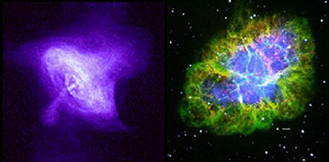
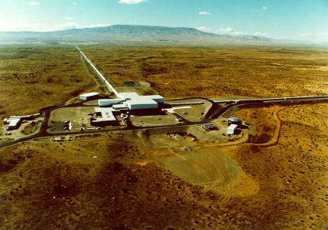
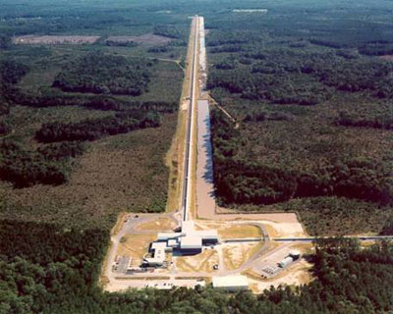
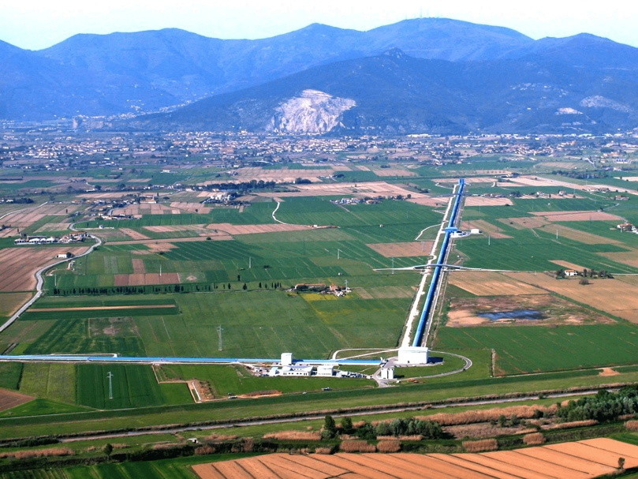
Gravitational Wave Data Analysis:
1. Introduction to data analysis techniques
2. Search for continuous waves
Alicia M Sintes
Dept. Física & IAC3 - Universitat de les Illes Balears &
Institut d'Estudis Espacials de Catalunya (IEEC).
For the LIGO Scientific Collaboration and Virgo Collaboration

Slide 2
Outline
1. Introduction
  The Dawn of a New Era in Astronomy
  The problem of data analysis in GW
2. Search for continuous gravitational waves:
  Neutron stars as sources of gravitational waves
  Search strategies in the LVC
2

Slide 3
Challenges & Payoffs
Many major challenges in the new era of gravitational wave astronomy
Building and installing
advanced detector hardware
Commissioning detectors; achieving desired sensitivity
Understanding the detectors and the data they produce
Searching the data for gravitational wave signals
Using GW observations in astronomy, cosmology, relativity
3

Slide 4
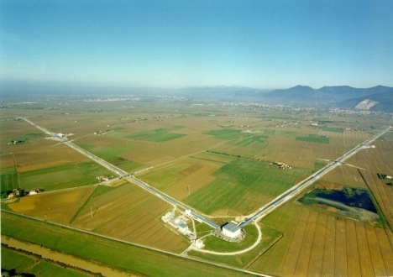
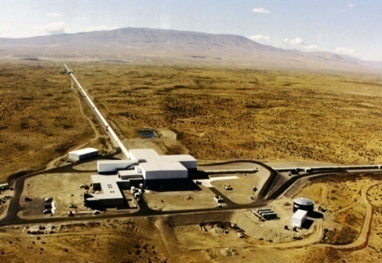

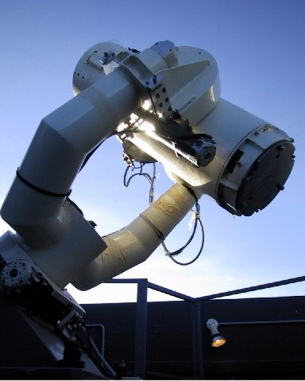
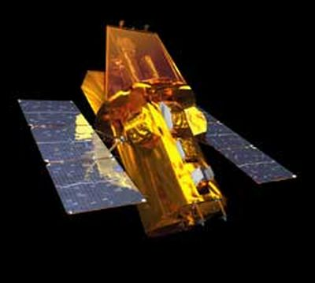
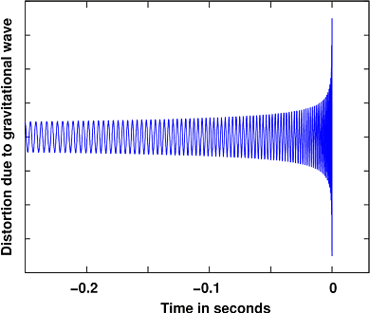

Initial detectors upper limits legacy
GW Detectors
Sensitivity / Duty cycle / Glitchiness
Calibration / h(t) reconstruction / Data quality
Computing
Sources
Connecting with other messengers
Data Analysis
Waveform
predictions
Astrophysics
Fundamental Physics
4

Slide 5
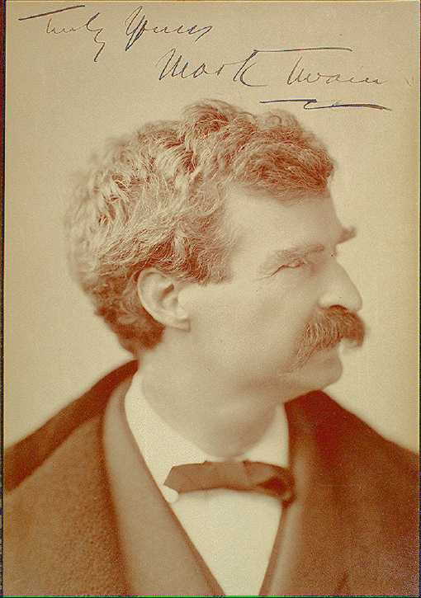
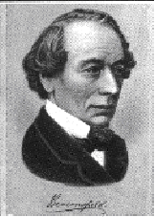
Why statistical astronomy?
Generally, statistics has got a bad reputation
“There are three types of lies:
lies, damned lies and statistics”
Mark Twain
Benjamin Disraeli
Often for good reason:
Jun 3rd 2004
… two researchers at the University of Girona in Spain, have found that 38% of a sample of papers in Nature contained one or more statistical errors…
The Economist
5

Slide 6


Why statistical astronomy?
Data analysis methods are often regarded as simple recipes…
Data
Analysis
Meat
Dishes
Soups
http://www.numerical-recipes.com/
6

Slide 7

Why statistical astronomy?
Data analysis methods are often regarded as simple recipes…
…but in analysis as in life, sometimes the recipes don’t work as you expect.
Low number counts
Distant sources
Correlated ‘residuals’
Incorrect assumptions
Systematic errors and/or
misleading results
7

Slide 8
The Astrophysicist’s Shopping List
We want tools capable of:
dealing with very faint sources
handling very large data sets
correcting for selection effects
diagnosing systematic errors
avoiding unnecessary assumptions
estimating parameters and testing models
8

Slide 9
what is “probability”?
There are three popular interpretations of the word, each with an interesting history:
  Probability as a measure of our degree of belief in a statement
  Probability as a measure of limiting relative frequency of outcome of a set of identical experiments
  Probability as the fraction of favourable (equally likely) possibilities
We will call these the Bayesian, Frequentist and Combinatorial interpretations.
Note there are signs of trouble here:
  How do you quantify “degree of belief”?
  How do you define “relative frequency” without using ideas of probability?
  What does “equally likely” mean?
Thankfully, at some level, all three interpretations agree on the algebra of probability, which we will present in Bayesian terms:
9

Slide 10
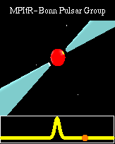
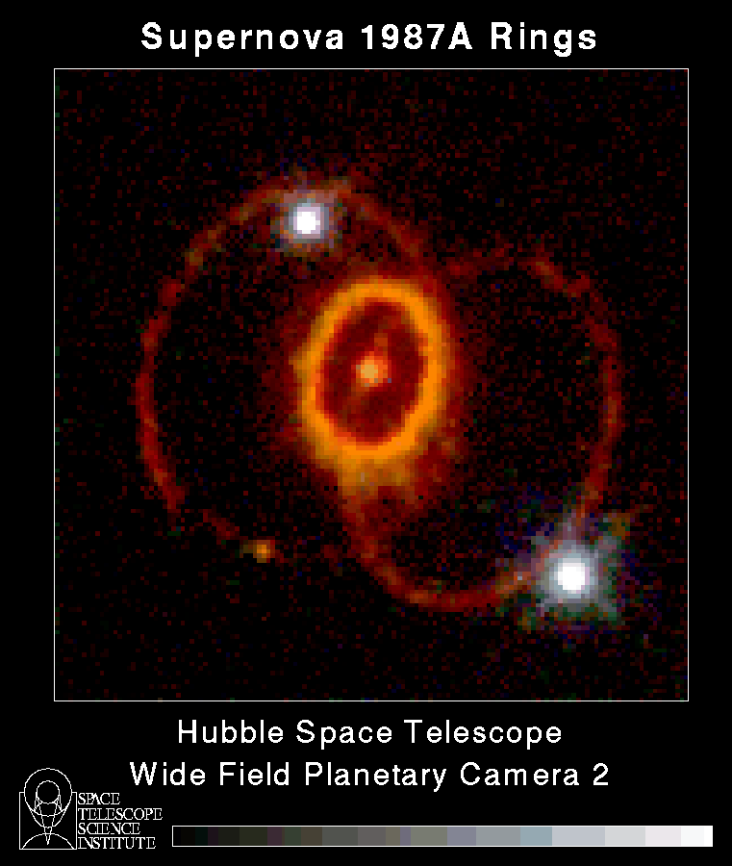
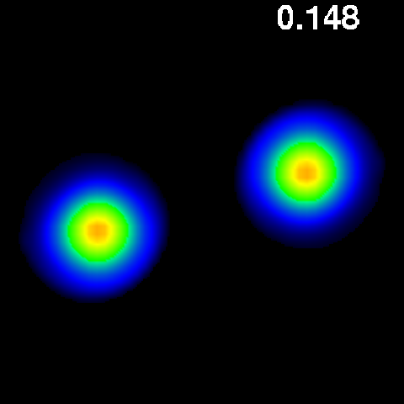
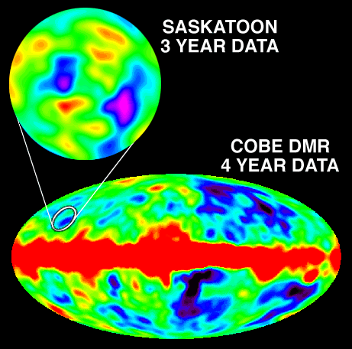
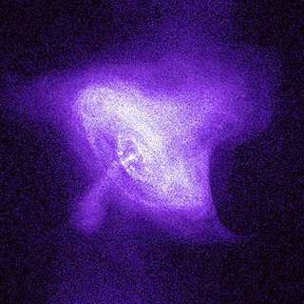
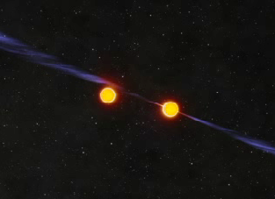
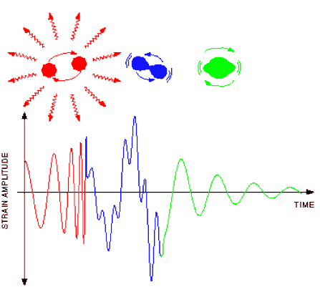
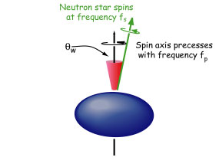
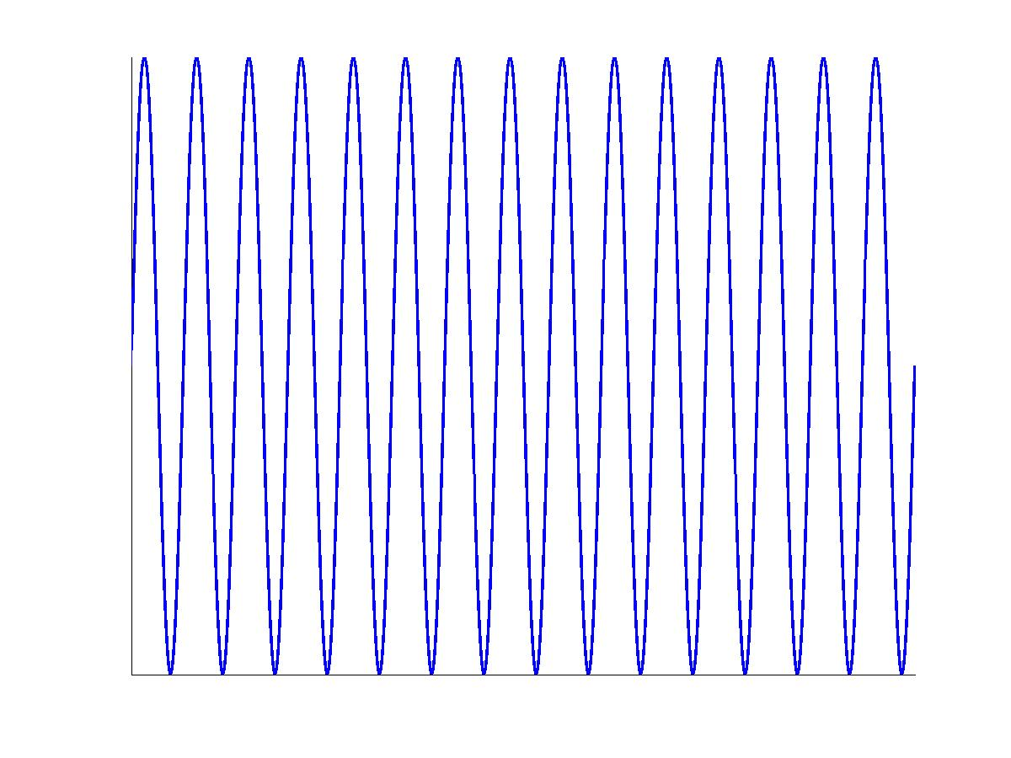
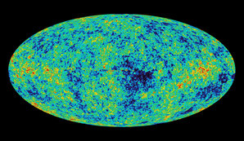
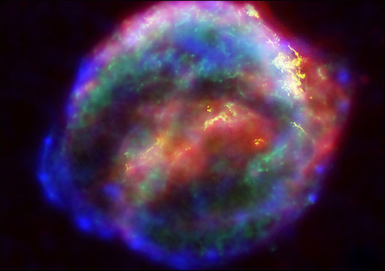
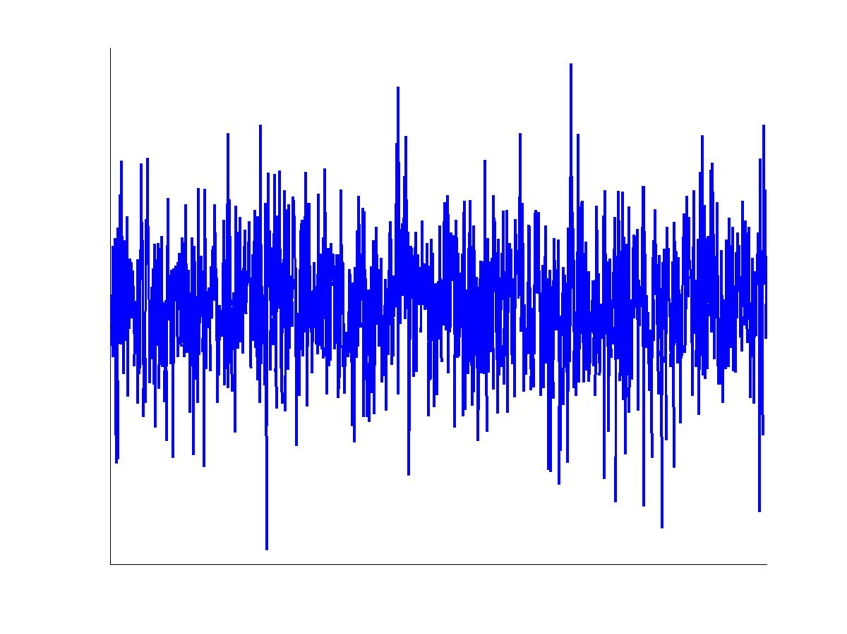
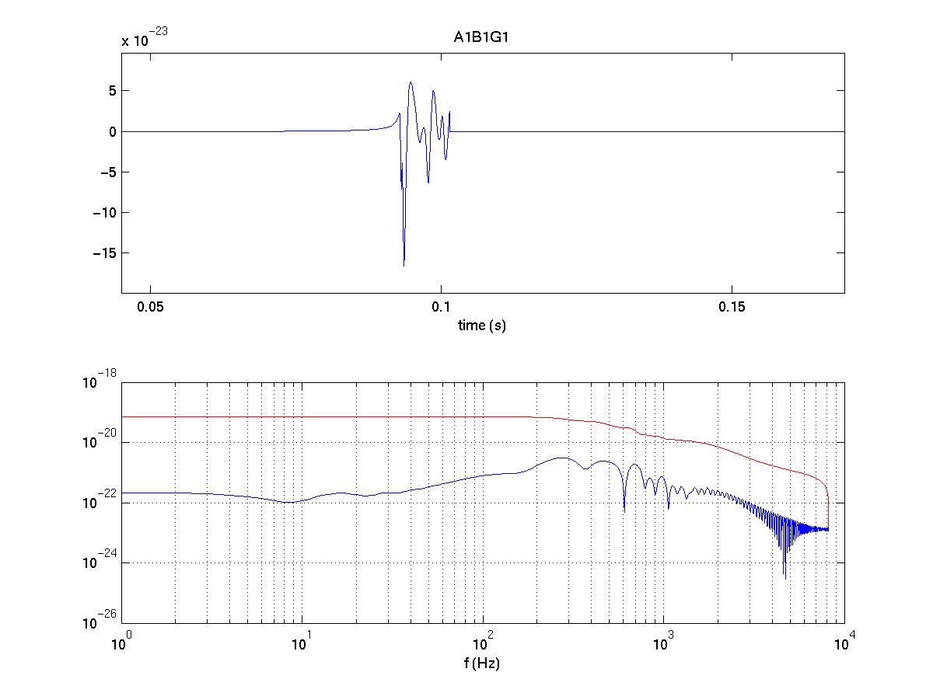
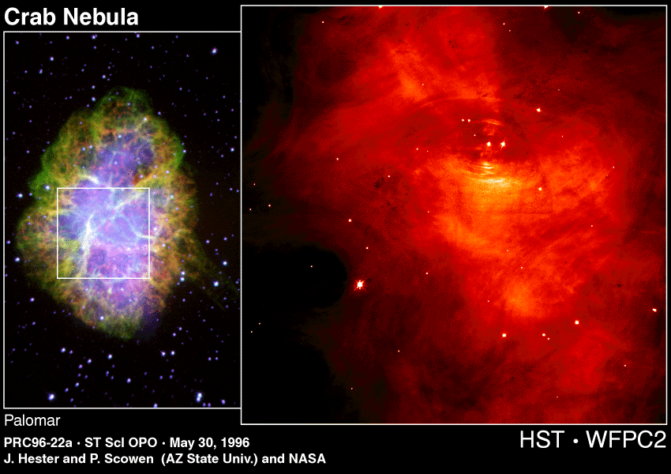
GW sources and methods
Supernovae, BH/NS formation
BH and NS Binaries
Stochastic background
Long duration
Short duration
Matched filter
CW
Spinning NS
in X-ray binaries
CBC
Template-less methods
Wobbling NS
10

Slide 11
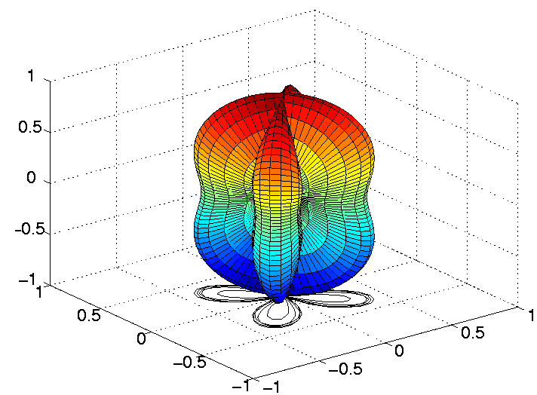
Why GW data analysis is challenging?
All sky sensitivity
  Quadrupolar antenna pattern
  multiple detectors to determine
  direction to source
Wide frequency band sensitivity
Large data rates
  Hundreds of instrumental and environmental channels
  up to 10 MB per second from each detector
Low event rates
Large number of parameters and templates to search over
11

Slide 12
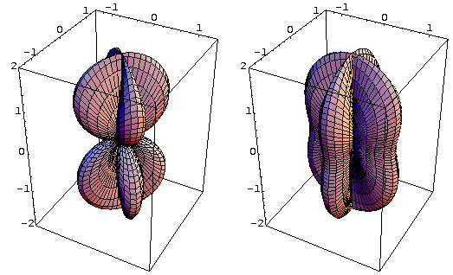
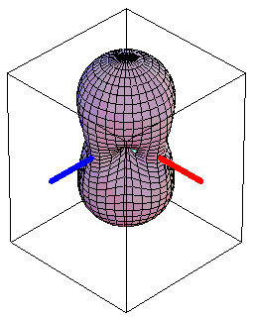
Antenna Pattern of a Laser Interferometer
The strain x(t) measured by a detector is mainly dominated by noise n(t), such that even in the presence of a signal h(t) we have
x(t)=n(t)+h(t)
F₊ and F× are the strain antenna patterns. They depend on the orientation of the detector and source and on the polarization of the waves.
“×” polarization
“+” polarization
RMS sensitivity
A broad antenna pattern
⇒ More like a microphone than a telescope
12

Slide 13
Using the GW Detector Network
A signal arriving at Earth is generally seen by all GW detectors operating at the time (assuming comparable sensitivities)
  Antenna responses and relative times of arrival depend on sky position
  Can in principle operate 24/7 monitoring whole sky; in practice, 60-90% up
  All raw data is archived – enables many after-the-fact searches
Analyzing the data together allows us to:
  Be more confident in events seen by multiple detectors
  Infer the sky position
  Separate the + and × polarization components
->GW detection is a cooperative endeavor
  LIGO + GEO 600 + users = LIGO Scientific Collaboration (LSC)
  LSC and Virgo Collaboration share all data, analyze and publish together
13

Slide 14
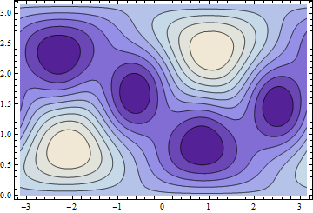
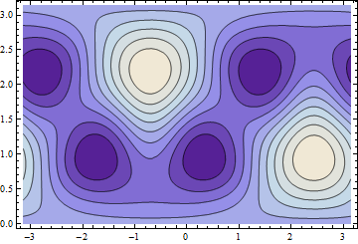
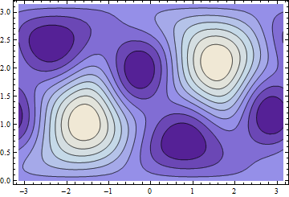
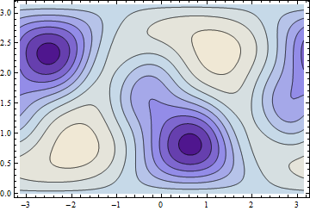
Benefits of a global network
Improved sky coverage
LIGO Hanford
Virgo
LIGO Livingston
Nulls of the antenna pattern
vary between observatories
LIGO/Virgo
Average response to signals with random linear polarization in Earth fixed coordinates
Less likely that event occurs in
a null of the detector network
14

Slide 15
Benefits of a global network
Improved duty cycle
  Less likely that event occurs when no detectors are looking
Increased signal to noise ratio
  Coherently sum signals from multiple detectors
Improved detection confidence
  Multi-detector coincidence greatly reduces false rate
  Coherent consistency tests can differentiate between gravitational-wave signals and instrumental anomalies
Permits improved directional searches
  Gamma ray burst progenitors
  Supernovae
Improved source reconstruction
  “Inverse problem” requires 3 non-aligned detectors
  Provides sky position and both polarizations of waveform
  Permits comparison with theory
Shared best practices
  Learn from each other’s approaches
15

Slide 16
Gravitational-Wave Data
Data = Instantaneous estimate of strain for each moment in time
i.e. demodulated channel sensitive to arm length difference
That’s not the whole story – there is the calibration issue
Digitized discrete time series recorded in computer files
( t_{j} , x_{j} )
LIGO and GEO sampling rate: 16384 Hz ≡ fs
VIRGO sampling rate: 20000 Hz
Synchronized with GPS time signal
Common “frame” file format (*.gwf)
Many auxiliary channels recorded too
Total data volume: a few megabytes per second per interferometer
16

Slide 17
Relevance of the Sampling Rate
Is 16384 Hz a high enough sampling rate ?
The Sampling Theorem:
  Discretely sampled data with sampling rate f_{s} can completely represent a continuous signal which only has frequency content below the Nyquist frequency, f_{s} / 2
GW signals of interest to ground-based detectors typically stay below a few kHz
  e.g. binary neutron star inspiral reaches ISCO at ~1 to 1.5 kHz
  Neutron star f-modes: ~3 kHz
  Black hole quasinormal modes: ~1 kHz for 10 M
  Some core collapse supernova signals could go up to several kHz
What if the signal extends above Nyquist frequency?
  Higher frequencies are “aliased” down to lower frequencies
17

Slide 18
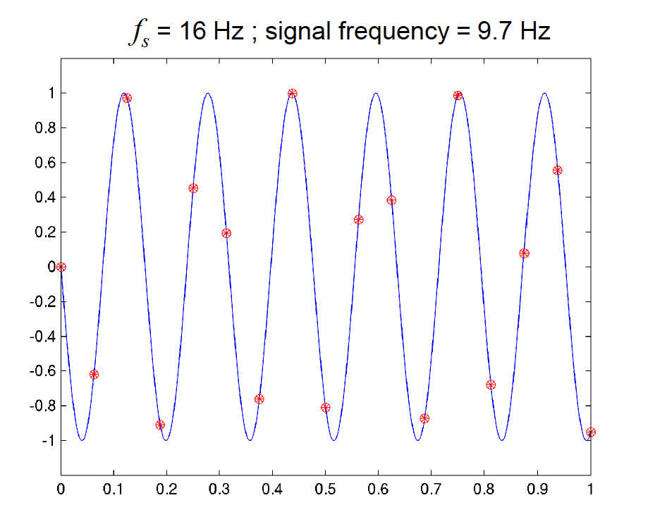
Aliasing
18

Slide 19
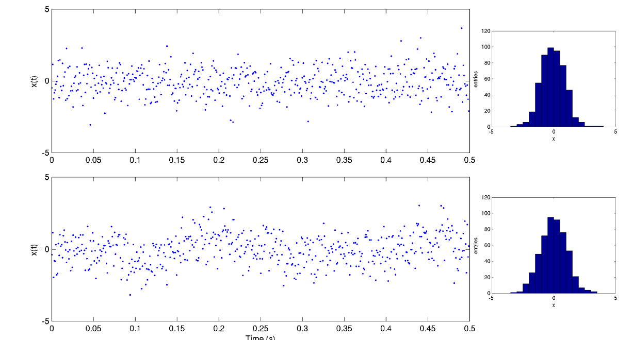
Characterizing Noise
Noise is random, but its properties can be characterized
19

Slide 20
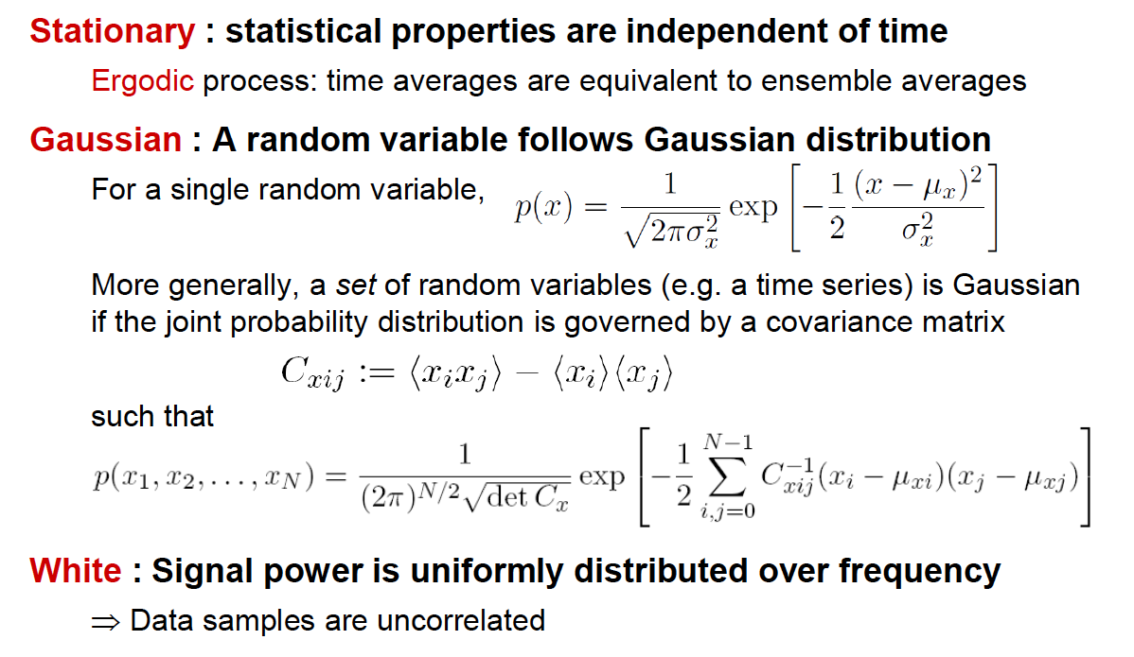
Possible Properties of Noise
Color : Signal does not have equal power in any band of a given bandwidth.
20

Slide 21
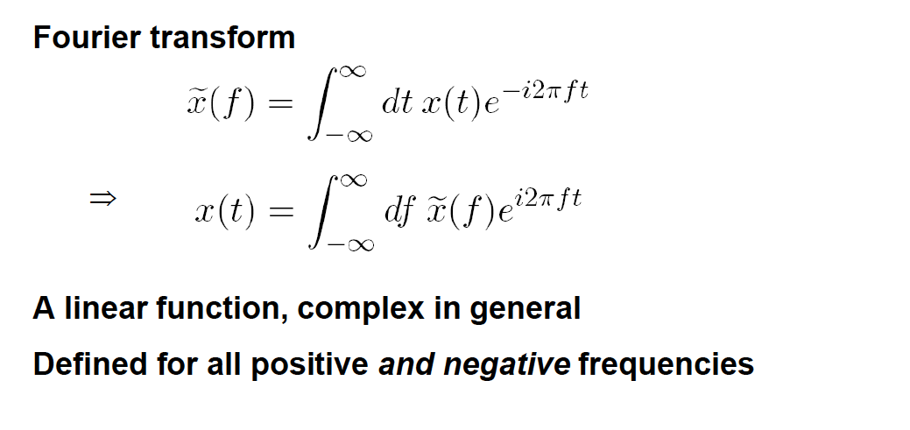
Frequency-domain representation of a Time-Series
21

Slide 22
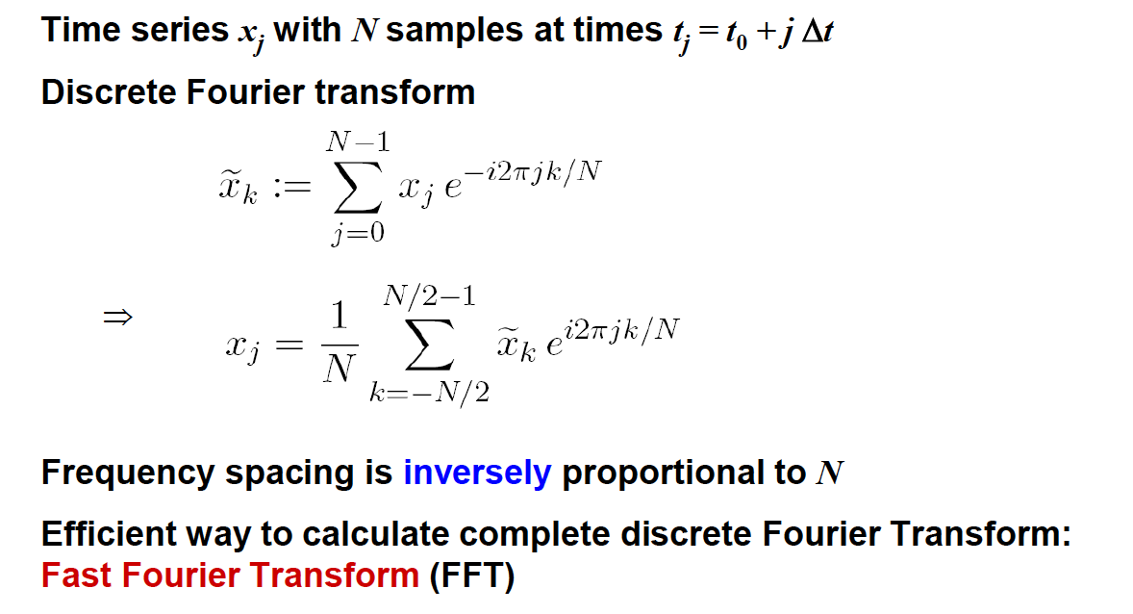

Frequency-Domain Representation of a Discrete, Finite Time Series
22

Slide 23
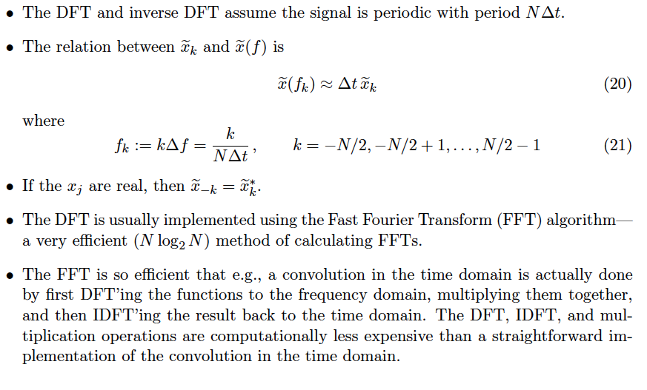
23

Slide 24
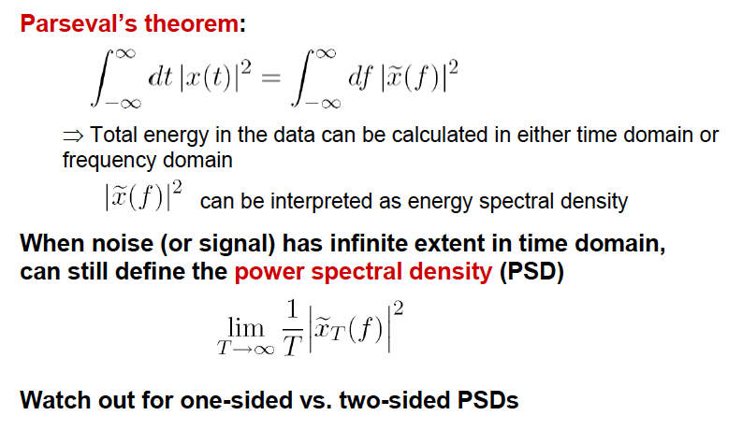
Power Spectral Density
24

Slide 25
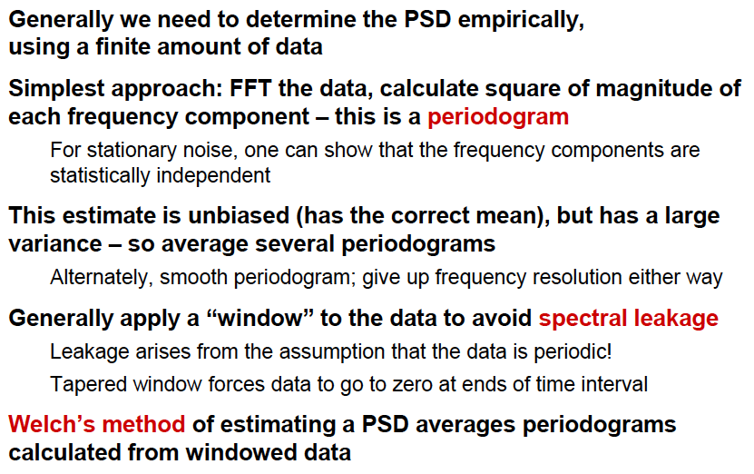
Estimating the PSD
25

Slide 26
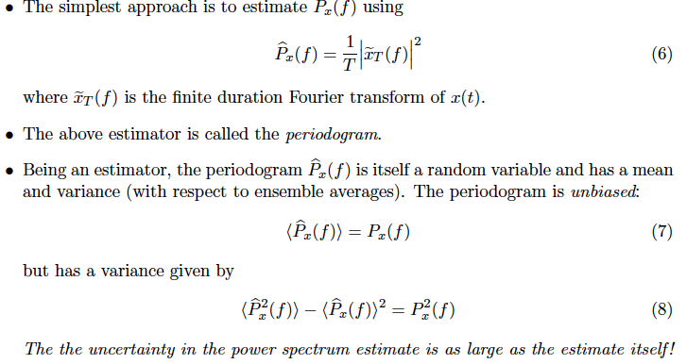
Estimating the PSD
26

Slide 27
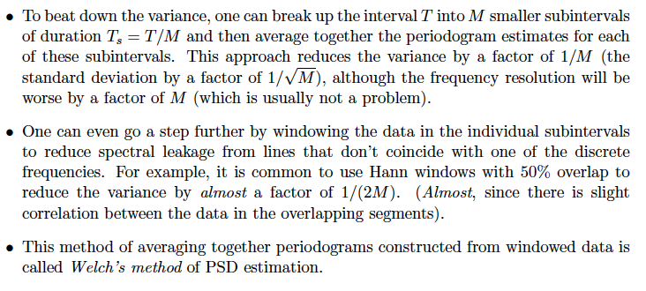
Estimating the PSD (cont.)
27

Slide 28
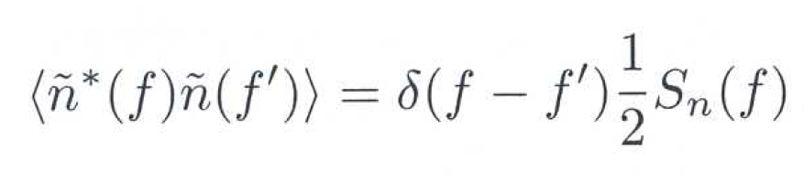
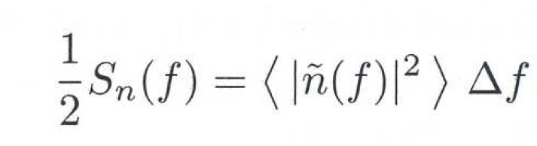
Finding the signal: the noise spectral density
We need first to represent the behaviour of the input noise n(t) which is summed to the GW strain h(t) to give what we call the detector output x(t) = n(t) + h(t).
We suppose that the noise is stationary; then, the different Fourier components are uncorrelated and therefore:
S_{n}(f) (Hz⁻¹) is the single-sided noise spectral density or power spectrum (PSD).
If we restrict the time interval to [-T/2; T/2], and write Δf = 1 / T, we get:
It is often used the square root called spectral amplitude (ASD) and has the dimension of Hz^{-1/2}
Credits: M. Maggiore- Gravitational Waves
28

Slide 29

Matched filtering I
Normally we are in a situation where the signal is much weaker than the noise: we must be able to filter the signal in such a way we can dig into the noise
If we know the signal we are looking for, we can think to multiply the detector output x(t) for the signal h(t) (a filter) and integrate over an observation time T:
  y=1/T Int(0,T) dt x(t)K(t) y=1/T Int(0,T) dt x(t)h(t)
  As the signal and the noise are uncorrelated, this should «amplify» the first with respect to the second.
  We want to find the optimum filter, i.e. the filter function K(t) that maximizes the signal-to-noise ratio SNR:
    S/N= expected value of the filtered output y when the signal is present / rms value of y when the signal is absent.
Credits: M. Maggiore- Gravitational Waves
29

Slide 30
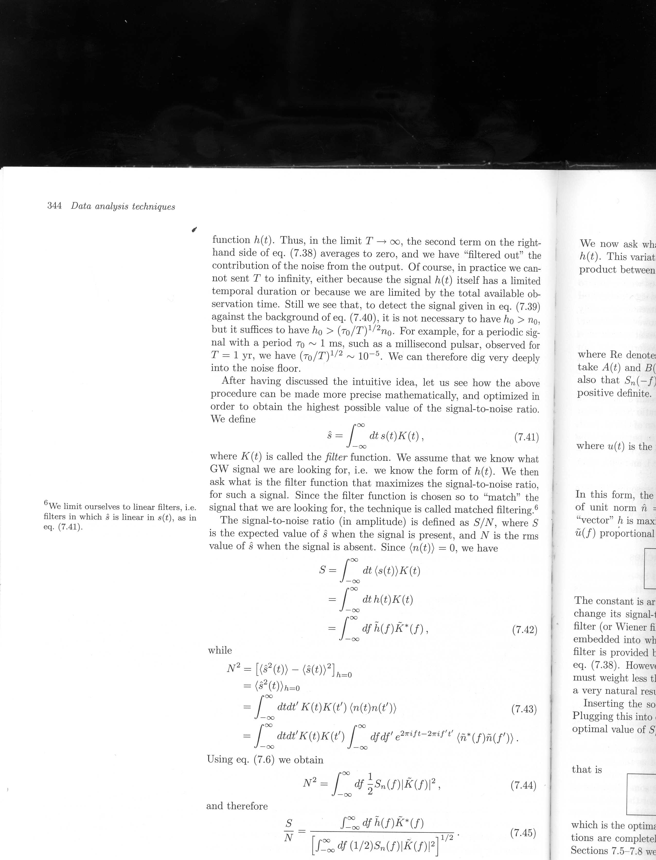
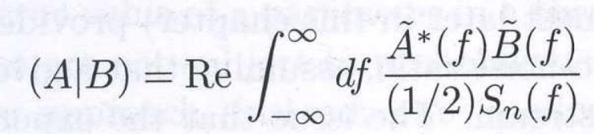
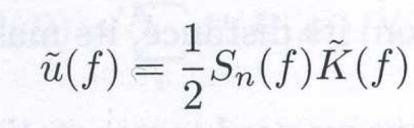
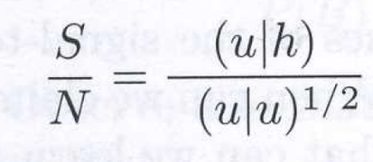
Matched filtering II
Taking <n(t)> = 0 and making use of the noise spectral density definition, we can express SNR as:
Defining the scalar product between real functions: we can re-write the signal-to-noise ratio as:
with
Credits: M. Maggiore- Gravitational Waves
30

Slide 31
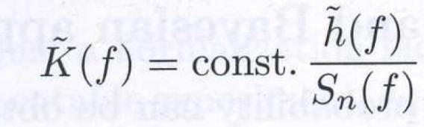
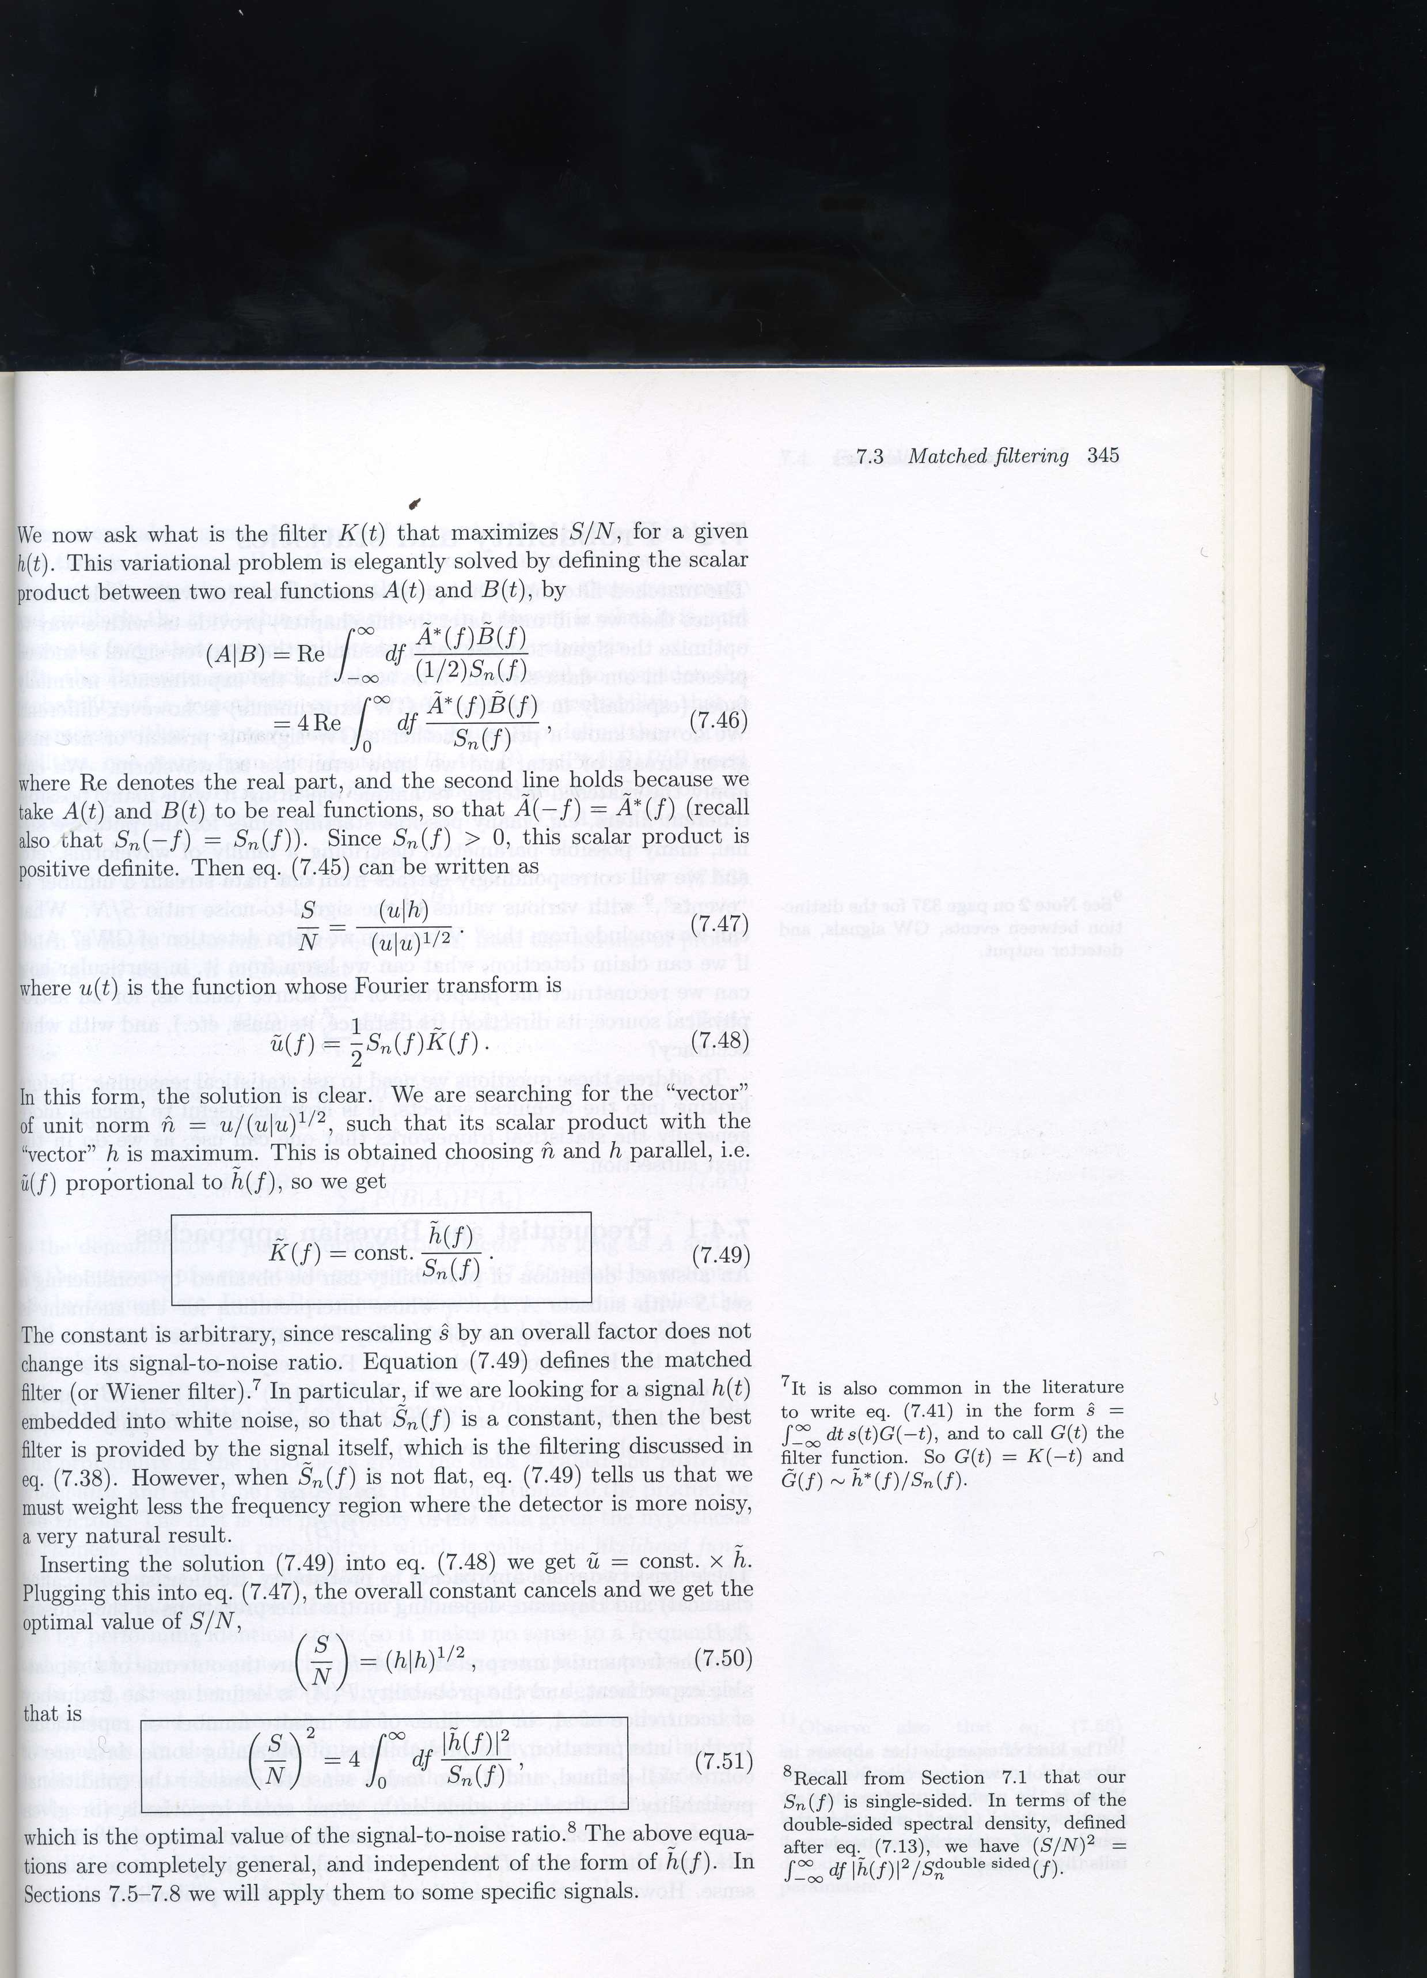

Matched filtering III
The unit vector u/(u|u)^{1/2} which maximize the scalar product is then parallel to h, i.e. we need to choose:
Thus we have that the optimal value of the SNR is:
and the statistic we use:
where s is here the normalized h signal wrt n.
ρ=
Wiener filter is the optimal detection statistic if noise is Gaussian
Credits: M. Maggiore- Gravitational Waves
31

Slide 32



Maximum Likelihood estimator
To claim that an event coming out of the matched filtering is a detection we need to understand the statistical properties of ρ.
We compute the likelihood function Λ, i.e., in general, the probability of the data given the hypothesis: supposing that the noise is stationary and Gaussian, we can express the probability of a given noise realization n₀ as:
Then the likelihood function for the observed output s(t), given the hypothesis that there is a GW signal with parameters θ_{t} is obtained using: n₀ = s – h(θ_{t}):
p
Credits: M. Maggiore- Gravitational Waves
32

Slide 33


Matched filtering statistics
To discriminate between events which are produced by noise and events which are produced by a real GW we need to know the probability distribution of the matched filtering statistics.
Instead of using the statistics of ρ, we refer to the probability distribution P(R|R) of R = ρ², where R is the value in presence of a GW signal:
P
R=0
R=10
R
Credits: M. Maggiore- Gravitational Waves
33

Slide 34
Matched filtering statistics: p_{FA} and p_{FD}
We can set a threshold R_{t} which helps to discriminate in Gaussian noise between noise and GW events.
We can then define a False Alarm probability and a False Dismissal Probability:
P
P
R=0
R=0
R=10
R=10
R_{t}
R
R_{t}
R
34

Slide 35
Frequentist hypothesis testing
Type II error
Type I error
false alarm probability
False dismissal probability
Λ
We should strive to minimise both false alarm and false dismissal probabilities.
According to the Neyman-Pearson lemma, this optimal test is the so-called likelihood ratio:
For Gaussian noise, one finds
which is the well-known expression for the matched-filtering amplitude.
If some of the parameters of the signal h(t;A,λ) are unknown, one has to find the maximum of lnΛ as a function of the unknown parameters
35

Slide 36

Amplitude maximization
We have to recall that we should search the maximum of Λ varying the signal parameters: in particular, we can analytically maximize over the amplitude A and the initial phase φ.
36

Slide 37

Finding a weak signal in noise
“Matched filtering” lets us find a weak signal submerged in noise.
For calculated signal waveforms, multiply the waveform by the data
Find signal from cumulative signal/noise
PHYS. REV. X 6,041015 (2016)

Slide 38
Spanning the signal parameter space: we need a bank of templates!
To cover in an efficient way the physical parameter space (i.e. masses and spins, frequencies) of the signals with our modelled waveforms h, also called templates T, we construct a set of waveforms which assures that a signal can be found with a maximum loss in SNR of a fixed choosen value (i.e. 0.03)
A mismatch bewteen template waveforms T is defined as:
where maximization is done over time and ϕ.
The Fitting Factor is then defined as:
38

Slide 39
Template placement
We can define a distance and construct a metric from the mismatch:
The metric tensor can be found after maximization over t_{C} and ϕ.
39

Slide 40

Dealing with Non-Stationary Noise
40

Slide 41
How do we know whether a signal in the data is a real GW?
Available tools:
  Consistency of the signal with a source model (if there is a model)
  Coincidence / consistency of signals in multiple GW detectors
  Absence of instrumental problems at the time of the signal
  Validation of instrument response and data analysis software
  Association with a known astrophysical object / event
Consistency with Source Model?
  Inspiral: (Matched filter already supposes a source model)
    Chi-squared test
    Sanity of filter output and/or chi-squared time series
  Cont.-wave:
    Does it show the expected Doppler modulation?
    Is it present all the time?
  Stochastic:
    Does the signal have the expected spectrum?
    Is it on all the time?
  Burst: Is it isolated in time?
41

Slide 42
Is it a real GW signal?
Coincidence / Consistency Tests:
Having multiple detectors is extremely valuable
Signals should arrive at consistent times
  LIGO Hanford vs. Livingston: within ±10 ms
  LIGO vs. Virgo: within ±27 ms
  Also get sky position information from having multiple detectors
Signals should have consistent properties
  Same or similar templates, if a matched-filter search
  Consistent frequencies, durations
  Consistent amplitudes (allowing for different orientations)
42

Slide 43


Signal Consistency Tests
Crucial since a GW burst in a single detector
may look just like an instrumental glitch !
Coincidence
  Require signals in different detectors to have compatible times, frequencies, amplitudes and/or other waveform properties
Cross-correlation
  Look for same signal buried in two data streams
  Checks for consistent shape, regardless of relative amplitude
  Best to integrate over a time interval comparable to the target signal
Time
Time
H1
L1
43

Slide 44

Coherent Burst Analysis
44

Slide 45


Geometric View of Coherent Analysis
Coherent sum:
Find linear combination of detector data that maximizes signal to noise ratio
Null sum
N-2 dimensional
null space
detector
data
Coherent sum
Null sum:
Linear combination of detector data that has no GW signal—provides consistency test
2 dimensional
signal space
Treat this as a maximum likelihood problem
  Consider all possible sky positions (arrival directions)
  Find most likely h₊(t) & h×(t) , maximizing over arrival directions
  Regulator penalizes physically unlikely signal hypotheses
45

Slide 46

Waveform Consistency Tests
46

Slide 47
Background Estimation
Background = expected “detection” rate of false events
Depends on criteria for a “trigger”
  e.g. threshold on some measure of signal strength
  Any analysis involves a trade-off between sensitivity and background
How can we determine the background?
  Simple method: product of average trigger rates in each detector and
  coincidence time window
  More reliable: Analysis of time-shifted data
  Choose time shifts longer than maximum light travel time, so any real GW in the data is no longer coincident
  Incorporates the consistency tests used in the actual analysis
  Follows time variability better
Can only get an estimate of the background
  Using many different time shifts, get high statistics
47

Slide 48


Data Quality
We attempt to catalog various environmental and instrumental conditions, then study relevance using time-shifted coincident triggers
Example from LIGO S4 all-sky burst search:
Minimal data quality cuts Additional data quality cuts
Require locked interferometers Avoid high seismic noise, wind, jet
Omit hardware injections Avoid calibration line drop-outs
Avoid times of ADC overflows Avoid times of “dips” in stored light
Omit last 30 sec of each lock
Net loss of observation time: 5.6%
48

Slide 49


Non-Stationary Noise / Glitches
For inspirals: chi-squared test
and other consistency tests
Auxiliary-channel vetoes
Frequency
Time
GW
channel
Beam
splitter
pick-off
49

Slide 50
Vetoes
If there is a significant glitch in a selected auxiliary channel, then veto any trigger found at the same time in the GW channel
Goals:
  Reduce background level
  Prevent triggers from rare, large environmental effects
  Study additional auxiliary channels for following up a detection candidate
Only want to do this for relevant auxiliary channels
  Ideally, with known physical coupling mechanism to GW channel
  Or, established statistically with single-detector triggers or
  time-shifted coincidence triggers from GW channel
Measures of relevance
  Veto efficiency : what fraction of GW triggers are vetoed
  Use percentage : what fraction of times identified for vetoing actually do veto a GW trigger
  Deadtime : how much observation time is vetoed
50

Slide 51

Validating the Detector:
Hardware Signal Injections
51

Slide 52

Significance: claiming a discovery
If we measure a signal yield s sufficiently inconsistent with zero, we can claim a discovery
Statistical significance = probability p to observe s or larger signal in the case of pure background fluctuation
Often preferred to quote “nσ” significance, where:
Usually, in literature:
  If the significance is > 3 (“3σ”) one claims “evidence of”
  If the significance is > 5 (“5σ”) one claims “observation”
  (discovery!)
    probability of background fluctuation = 2.87×10⁻⁷
52

Slide 53
When using upper limits
Not always experiments lead to discoveries ☹
What conclusion can be drawn if no evidence of signal is observed?
One possible definition of upper limit:
  “largest value of the signal s for which the probability of a signal under-fluctuation smaller or equal to what has been observed is less than a given level α (usually 10% or 5%)”
  Upper limit @ x Confidence Level = s such that α(s) = 1 − x
  Similar to confidence interval with a central value, but the interval is fully asymmetric now
Other approaches are possible:
  Bayesian limits: extreme of an interval over which the poster probability of [0, s] is 1−α
    It’s a different definition!
  Unified Feldman-Cousins frequentist limits
53

Slide 54
Search for continuous gravitational waves:
Neutron stars as sources of gravitational waves
Search strategies in the LVC
54

Slide 55



Spinning Neutron Stars
Relic of past collapse of a moderately massive star
  Remnant spin from progenitor, or from having been spun up by accretion
  Generally magnetized, sometimes very strongly
  A small fraction of neutron stars are seen as pulsars
If not axisymmetric, will emit gravitational waves
Example: ellipsoid with distinct transverse axes
NASA
(NASA/CXC/SAO)
55

Slide 56
No continuous gravitational waves (CW) detected… yet!
Most searches begin after an observing run has ended, and all the data is in
Still analysing LIGO O1 data
Strict emission limits have already been set from initial detector era data on signals from known and unknown neutron star sources.
56

Slide 57

Neutron Stars and Pulsars
57

Slide 58

Pulsar population
Should be ~160 000 isolated and ~40 000 binary pulsars in the Galaxy
Should be a total of ~10⁸+ neutron stars in the Galaxy
– where are they all?
The P-Pdot Diagram is useful for following the lives of pulsars, playing a role similar to the Hertzsprung-Russell diagram for ordinary stars.
It encodes a tremendous amount of information about the pulsar population and its properties, as determined and estimated from two of the primary observables, P and Pdot.
Using those parameters, one can estimate the pulsar age, magnetic field strength B, and spin-down power dE/dt.
58

Slide 59

Neutron Stars Sources
Great interest in detecting radiation: physics of such stars is poorly understood.
  After many years we still don’t know what makes pulsars pulse.
  Interior properties not understood: equation of state, superfluidity, superconductivity, solid core, source of magnetic field.
  May not even be neutron stars: could be made of strange matter!
59

Slide 60

Neutron star structure
60

Slide 61
Regions of NS Interior
Main Components:
(1) Crystalline solid crust
(2) Neutron liquid interior
Boundary at ρ = 2 10¹⁷ kg/m³ – density of nuclear matter
Outer Crust:
  Solid; matter similar to that found in white dwarfs
  Heavy nuclei (mostly Fe) forming a Coulomb lattice embedded in a relativistic degenerate gas of electrons.
  Lattice is minimum energy configuration for heavy nuclei.
Inner Crust (1):
  -Lattice of neutron-rich nuclei (electrons penetrate nuclei to combine with protons and form neutrons) with free degenerate neutrons and degenerate relativistic electron gas.
  For ρ > 4.3 10¹⁴ kg/m³ – the neutron drip point, massive nuclei are unstable and release neutrons.
  Neutron fluid pressure increases with ρ
61

Slide 62
Regions of NS Interior (cont)
Neutron Fluid Interior (2):
  For 1 km < r < 9 km, ‘neutron fluid’ – superfluid of neutrons and Superconducting protons and electrons.
  Enables B field maintenance.
  Density is 2 10¹⁷ < ρ <1 10¹⁸ kg/m³.
  Near inner crust, some neutron fluid can penetrate into inner part of lattice and rotate at a different rate – glitches?
Core:
  Extends out to ~ 1 km and has a density of 1 10¹⁸ kg/m³.
  Its substance is not well known.
  Could be a neutron solid, quark matter or neutrons squeezed to form a pion concentrate.
62

Slide 63

Simple view of a neutron star
Non-axisymmetric distortions do not exist in perfect fluid stars, but in realistic neutron stars such deformations can be supported either by elastic stresses or by magnetic fields.
63

Slide 64

Simple view of a neutron star
I_{jj} are the three principal moments of inertia.
64

Slide 65

Rigid crust epsilon?
65

Slide 66
R-modes and other exotics
In addition to GWs from elastic crustal distortions, we can also expect them from:
  • unstable oscillation in the fluid part of the neutron star -- Chandrasekhar-Friedman-Schutz (CFS) instabilities
  e.g. through r-modes
  • free precession
  • magnetic stresses
  • accretion induced deformation
  • …
66

Slide 67




Emission mechanisms for continuous GW from spinning NS in the LIGO-VIRGO frequency band
  Non-axisymmetric distortions
  Unstable oscillation modes in the fluid part of the star
  Free precession
Bumpy Neutron Star
Low Mass X-Ray Binaries
R-modes in accreting stars
Magnetic mountains
Wobbling Neutron Star
67
Notes:
The pulsar literature contains several mechanisms which may lead to deformations of the star, or to the precession of its rotation axis, and hence to gravitational wave emission:
Mountains on solid crust, trapped magnetic fields, (2xf)
Unstable fluid modes
Compositional/thermal inhomogeneities

Slide 68

Gravitational Waves from Spinning Neutron Stars
Review article: Reinhard Prix for the LIGO Scientific Collaboration, “The Search for Gravitational Waves from Spinning Neutron Stars”, Springer Lecture Notes Series.
GW energy emission rate from a spinning neutron star
Schwarzschild radius
Rotational velocity at the surface
10⁵²W
compact objects (i.e. with R_{s} ~ R) in rapid rotation (V ~ c), such as spinning neutron stars, can emit enormous GW luminosities even for small ε.
However, spacetime is a very “stiff” medium: large amounts of energy are carried by GWs of small amplitude.
68
Notes:
The fiducial values for eccentricity, Izz, frequency and distance correspond to a neutron star with typical moment of inertia, a relatively strong deviation from axisymmetry, at a distance of the order of the closest known neutron star, and spinning in the millisecond regime.
Even for this optimistic case, the amplitude is about two orders of magnitude below the noise-level of LIGO-I

Slide 69

Continuous GWs from Spinning Compact Objects
69

Slide 70

Continuous GWs from Spinning Compact Objects
70

Slide 71
Continuous GWs from Spinning Compact Objects
Various physical mechanisms could operate in a neutron star to produce interesting levels of GW emission
As the signal-strength is generally expected to be weak, long integrations times (several days to years) are required in order for the signal to be detectable in the noise.
Therefore this GW emission has to last for a long time, which characterizes the class of ‘continuous-wave’ signals.
Large uncertainties!
Prior range: ε~ [10⁻¹²; 10⁻⁴] for I_{zz} = 10³⁸kgm²
quadrupole moments Q ~ I_{zz}ε~ [10²⁶; 10³⁴] kgm²
Neutron stars might also be interesting sources of burst-like GW emission,
  f-mode or p-mode oscillations excited by a glitch
  crustal torsion modes
71

Slide 72
1) Non-axisymmetric distortions
A non-axisymmetric neutron star at distance a d, rotating with frequency ν around the I_{zz} axis emits monochromatic GWs of frequency f = 2ν with an amplitude
Bumpy Neutron Star
The strain amplitude h₀ refers to a GW from an optimally oriented source with respect to the detector
The equatorial ellipticity is highly uncertain, ε~10⁻⁷. In the most speculative model can reach up to 10⁻⁴.
Accreating neutron stars in binary systems can also have large crust deformations
Strong internal magnetic fields could produce deformations of up to ε~10⁻⁶. These deformations would result in GW emission at f = ν and f = 2ν.
Magnetic mountains
72

Slide 73
2) Non-axisymmetric instabilities
At birth or during accretion, rapidly rotating NS can be subject to various non-axisymmetric instabilities, which would lead to GW emission,
The r-mode instability (toroidal modes with a Coriolis restoring force) has been proposed as a source of GWs (with frequency f = 4ν/3) from newborn NS and from rapidly accreting NS.
R-modes in accreting stars
3) Free precession
Similar emission would occur if the core and crust had non-aligned spins. This results in emission at (approximately) the rotation rate ν and twice the rotation rate, i.e. f =ν+ν_{prec} and f = 2ν.
Wobbling Neutron Star
73

Slide 74

Spindown upper-limits for known pulsars.
74

Slide 75

Spindown upper-limits for known pulsars.
75

Slide 76

Theoretical maximum sustainable ellipticities provide upper limit, but whether these are realised in nature is unknown/unlikely.
Methods of producing/sustaining ellipticities are also highly uncertain:
  ∙ mountains locked-in to crust following formation
  ∙ strong internal magnetic fields
We have no idea how many signal detections to expect in first years of aLIGO/AdV.
Advocate for better modeling of neutron star deformation to enhance science case?
76

Slide 77

aLIGO sensitivity
77

Slide 78
What would we learn from a CW signal?
if accompanied by EM observation either from a known pulsar search or through follow-up of unknown sources
f_{GW} = 2f_{rot} star is probably a triaxial ellipsoid
f_{GW} ≈ 2f_{rot} shows components producing EM and GW emission are not completely coupled (information on crust and core coupling of star?)
f_{GW} ≈ f_{rot} precession play important role in emission
f_{GW} ≈ (4/3) f_{rot} emission from r-modes is favoured
(information on interior fluid motion of star)
78

Slide 79
What would we learn from a CW signal?
if ellipticities are at the very high range we could potentially narrow down neutron star EOS
multiple sources could yield information on ellipticity distributions to help constrain models of formation of deformations
  are there different distributions for “normal” and millisecond pulsars?
  But, we actually measure h ∝ Izz ε /d, where I_{zz} is the moment of inertia and d is the distance, so measuring ε requires this additional information
Compare GW phase to EM pulse timing -- phase locking/drift?
Test General Relativity with a long-lived source.
79

Slide 80
Theoretical implications
Interpretation of upper limits
  • Constraints to the energy budget
  • Can’t constrain equations of state (stars could just be axially symmetric)
  unless we know there are mountains
  • Can constrain internal magnetic strength/configuration
Interpretation of detections
  • High ellipticity means some exotic equation of state (quarks)
  • Somewhat high  means EOS or high internal B field: which?
  • Frequency ratio reveals emission mechanism ( or r-mode); also rough guide to star’s compactness if r-mode
  • Steady r-mode signal means strange particles in core
80

Slide 81


The signal from a NS
The ‘periodic’ GW signal from a neutron
star:
Nearly-monochromatic continuous signal
  spin precession at ~f_{rot}
  excited oscillatory modes such as the r-mode at 4/3* f_{rot}
  non-axisymmetric distortion of crystalline structure, at 2f_{rot}
(Signal-to-noise)² ~
81
Notes:
It is an almost monochromatic signal
assuming emission due to deviation from axisymmetry: moment of inertia tensor E=gravitational ellipticity of pulsar
SNR grows as sqrt(T) for monochromatic signals.These signals are expected to be weak, thus coherent integrations for extended periods of time(months to years) is necessary in order to accumulate snr sufficient for detection,

Slide 82
Expected Signal on Earth (1)
Spin-down ⇒ phase evolution
the phase of the received signal depends on the initial phase, the frequency evolution of the signal and on the instantaneous relative velocity between source and detector.
T(t) is the time of arrival of a signal at the Solar System Barycentre (SSB)
t is the time at the detector
82

Slide 83
Expected Signal on Earth (2)
Relative motion detector/source ⇒ frequency modulation
Doppler shift:
Antenna sensitivity of the detector ⇒ amplitude modulation
strain antenna patterns of the detector to plus and cross polarization, bounded between -1 and 1.
They depend on the orientation of detector and source and on the waves polarization.
83

Slide 84

Expected Signal on Earth (3)
For an isolated tri-axial non-precessing neutron star
emitting at twice its rotational frequency:
Signal parameters:
  ψ = polarization angle
  ι = inclination angle of source with
  respect to line of sight
  Φ(t)= φ(t) + φ₀
  φ₀ = initial phase of pulsar
  h₀ = amplitude of the GW signal
equatorial ellipticity
84

Slide 85


The Signal
At the source
At the detector
  Annual variation: up to ~10^{–4}
  Daily variation: up to ~10^{–6}
… more complications for GW signals from pulsars in binary systems
  Additional Doppler shift due to orbital motion of neutron star
  Varying gravitational red-shift if orbit is elliptical
  Shapiro time delay if GW passes near companion
85

Slide 86



Amplitude and phase modulation, due to the detector sidereal response
Signal persistent nature allows to significantly increase the detection significance, and to pin down the NS parameters to extremely high accuracy even with a single detector
In practice, the detector makes a very large baseline network with itself
d~3E8 km
86

Slide 87
Type of searches
We will see GWs from any neutron star that is
  sufficiently lumpy
  sufficiently close
  spinning at a rate that will appear in our band
A two-part attack:
  target neutron stars we can see electromagnetically,
     reduced parameter space, so good sensitivity
    detections would usually need ‘new’ physics (quark stars etc…)
  perform a general search for EM-dark neutron stars,
     large population
     our range (reach) is computationally-bound, even with E@H! We need several different search methods optimised for specific search tasks.
87

Slide 88
Continuous Waves Searches (1)
These searches have several parameters:
May be known, used in the search:
Not explicitely searched for:
initial phase
inclination angle
polarization
amplitude
position
frequency,
frequency derivatives
orbital parameters
Different algorithms have been developed, depending on what we know about the source: source parameters knowledge, waveform knowledge, isolated or binary system sources etc.
88
Notes:
Four Neutron Star Populations
1) Known pulsars
Position & frequency evolution known (derivatives, timing noise, glitches, orbit)
2) Unknown neutron stars
Nothing known, search over position, frequency & its derivatives
3) Accreting neutron stars in low-mass x-ray binaries
Position known, sometimes orbit & frequency
4) Known, isolated, non-pulsing neutron stars
Position known, search over frequency & derivatives

Slide 89
Neutron star populations
Known radio, X-ray and γ−ray pulsars
    Position & frequency evolution known (including derivatives, timing noise, glitches, orbit)
Unknown neutron stars
    Nothing known, search over position, frequency & its derivatives
Accreting neutron stars in low-mass x-ray binaries
    Position known, sometimes orbit & frequency
Known, isolated, non-pulsing neutron stars
    Position known, search over frequency & derivatives
89
Notes:
Types determined by searches, in turn by computational cost ie what you can tell us

Slide 90
Neutron star searches
As a consequence, searches are roughly divided in a few categories:
Targeted searches for signals from known pulsars
Blind searches of previously unknown objects
Directed searches (i.e. searches for targets with unknown rotation rate but with some knowledge of source, generally sky position,) :
  supernova remnants (e.g. Cas A),
  galactic center,
  LMXBs (e.g. Sco X–1)
The cornerstones of CW searches are:
  sensitivity
  robustness with respect to signal uncertainties and instrumental noise
  computational load
Methods:
  Coherent methods (require accurate prediction of the phase evolution of the signal)
  Semi-coherent methods (require prediction of the frequency evolution of the signal)
What drives the choice The computational expense of the search
90
Notes:
Types determined by searches, in turn by computational cost ie what you can tell us

Slide 91
Based on matched filter.
E.g. pulsars for which accurate ephemeris are available
Allows for a small mismatch between the GW and the EM signal
Targeted search
Narrow-band search
Hierarchical methods. Follow-up of the most interesting candidates. Computationally bound
Sensitivity
Based on semi-coherent methods.
E.g. SNR remnants
Wide-band (‘directed’) search
Blind search
Binary systems (e.g. Sco X-1)
Binary system orbital parameters must be taken into account.
Computationally bound
S_{n}(f): detector noise power spectrum
T_{coh}: search coherence time
Computational load
91
Notes:
NS position and rotational parameters assumed to be known with high accuracy (e.g. from EM observations) → matched filtering
Allow for a small mismatch between the GW frequency and that inferred from EM observations (O(10 mHz)).
Matched filter still applicable but look-elsewhere effect reduces sensitivity.
Explore a large volume of the parameter space. Hierarchical methods. Compute on grid/cloud/Einstein@Home.
Very complicate problem. Some partial knowledge of the main parameters is crucial.
Position fairly known, but rotational parameters largely unknown (e.g. CCOs, globular clusters, r-modes…). Semi-coherent methods typically used.

Slide 92
If you know what you’re looking for, it’s easier to find it
Coherent integration gains signal-to-noise as T^{1/2}
Easy if you know sky position, frequency, derivatives, …
If you don’t know these, integrate for each possible parameter value
Cost may scale as up to T⁷, so T is computationally limited
Incoherent combination of N coherent stretches gains as N^{1/4}
Scaling and overall factor depend on parameter space searched - smaller is better!
92

Slide 93

Gridding the parameter space
93

Slide 94

Sensitivity for semi-coherent
CW searches scales as :
  where T_{coh} is the coherent time, N is the number of coherent data stretches,
  S_{n}(f) is the power spectral density and C is a search dependent pre-factor.
  C is proportional to the number of templates used – longer coherent times and larger parameter spaces require more templates to ensure phase coherence. Also, computational cost (for all-sky searches) scales as T_{coh}³- T_{coh}⁶
  Best way to improve search sensitivity is to improve S_{n}(f)
For all-sky and directed searches any candidate detections can be followed up using fully coherent methods to regain T^{1/2} sensitivity increase
  provide better parameter estimation to constrain ellipticity
  for year long (or potentially less) integrations provides source sky position to arcsec precision, which greatly aids EM follow-up
94

Slide 95
References to recent observational papers
ApJ 785, 119, 2014
PRD 91, 022004. 2015
ApJ 839, 12, 2017
Targeted search
Narrow-band search
CQG 31, 085014, 2014
CQG 31, 165014, 2014
PRD 93, 042007, 2016
PRD 94, 042002, 2016
PRD 94, 122006, 2016
Wide-band (‘directed’) search
ApJ 813, 39, 2015 (9 SN remnants)
PRD 95, 082005, 2017 (NGC 6544)
Blind search
Binary systems (e.g. Sco X-1)
Arxiv: 1706.03119
PRD 95, 122003, 2017
PRL 118, 121102, 2017
95
Notes:
NS position and rotational parameters assumed to be known with high accuracy (e.g. from EM observations) → matched filtering
Allow for a small mismatch between the GW frequency and that inferred from EM observations (O(10 mHz)).
Matched filter still applicable but look-elsewhere effect reduces sensitivity.
Explore a large volume of the parameter space. Hierarchical methods. Compute on grid/cloud/Einstein@Home.
Very complicate problem. Some partial knowledge of the main parameters is crucial.
Position fairly known, but rotational parameters largely unknown (e.g. CCOs, globular clusters, r-modes…). Semi-coherent methods typically used.

Slide 96



EM observations
Sensitivity can be improved by narrowing the parameter space (fewer templates), so input from EM observations are vital:
  targeted searches rely on EM information to provide phase evolution templates, so need to make sure we have access to latest radio, X-ray, γ-ray (new surveys, LOFAR, SKA, Fermi, ASTROSAT)
  encourage deeper searches (Einstein@home) in existing data to find more sources.
  LMXB searches require huge template banks due to many source uncertainties, so narrowing these uncertainties (e.g. finding the rotation period of Sco X–1) would greatly increase sensitivity
  Directed searches could also be improved with more information, e.g. finding rotation periods of isolated X-ray sources, or neutron stars in supernova remnants
Advocate for pulsar surveys and X-ray timing with future radio and high energy observatories
Jodrell Bank
Green Bank
Parkes Telescope
96

Slide 97
EM follow-up
For all-sky searches EM follow-up of detections enables greater physics return
  observations of pulsations gives rotational frequency and immediately narrows down the emission mechanism
But, pulsations may not be observed. We could require deeper imaging to look for faint X-ray source, or supernova remnant/pulsar wind nebula. How much telescope time would be required/could be obtained for these?
Follow-up of LMXBs may be most useful if it is coincident with
further GW observations - can observe how GW and EM signals
change over the same periods. This would require long term monitoring.
Jodrell Bank
Green Bank
Parkes Telescope
97

Slide 98

O1 targeted search for known pulsars
ApJ 839, 12, 2017
About 430 known pulsars in Advanced LIGO band (∼20-2000 Hz)
200 known pulsars analyzed,
11 high-value targets using 3 pipelines: TD Bayesian, TD F/G-Stat and FD 5-vector method, rest with the TD Bayesian method.
ULs improved by a factor 2.5 w.r.t the Initial LIGO/Virgo results,
spindown limit beaten for 8 pulsars, including Crab & Vela:
  Crab: less than 2 x 10⁻³ Ė_{rot} in GW, ∼10 cm deformation
  Vela: less than 10⁻² Ė_{rot} . elipticity-> ∼50 cm
PSR J1918-0642: smallest UL
h₀ = 1.6 x 10⁻²⁶.
98

Slide 99

ApJ 839, 12, 2017
The ellipticity can roughly be converted to a "mountain" size using 25×(ε/10⁻⁴) cm
The diagonal lines show the ellipticities that would be required if a star had a particular characteristic age and was losing energy purely through gravitational radiation.
99

Slide 100
Coherent detection methods
There are essentially two types of coherent searches that are performed
Frequency domain
Conceived as a module in a hierarchical search
Matched filtering techniques. Aimed at computing a detection statistic.
These methods have been implemented in the frequency domain (although this is not necessary) and are very computationally efficient.
Best suited for large parameter space searches
(when signal characteristics are uncertain)
Frequentist approach used to cast upper limits.
Time domain
process signal to remove frequency variations due to Earth’s motion around Sun and spindown
Standard Bayesian analysis,
as fast numerically but provides natural parameter estimation
Best suited to target known objects, even if phase evolution is complicated
Efficiently handless missing data
Upper limits interpretation: Bayesian approach
100

Slide 101
F-statistics
We can express h(t) in terms of amplitude A {A₊, A×, ψ, φ₀} and Doppler parameters λ
101

Slide 102
F-Statistics
Analytically maximize the likelihood over A
102

Slide 103
Frequency domain method
The outcome of a target search is a number F* that represents the optimal detection statistic for this search.
2F* is a random variable: For Gaussian stationary noise, follows a χ² distribution with 4 degrees of freedom with a non-centrality parameter λ∝(h|h). Fixing ι, ψ and φ₀ , for every h₀, we can obtain a pdf curve: p(2F|h₀)
The frequentist approach says the data will contain a signal with amplitude ≥ h₀ , with confidence C, if in repeated experiments, some fraction of trials C would yield a value of the detection statistics ≥ F*
Use signal injection Monte Carlos to measure Probability Distribution Function (PDF) of F
103

Slide 104

Measured PDFs for the F statistic with fake injected worst-case signals at nearby frequencies
h₀ = 1.9E-21
h₀ = 2.7E-22
S1 Example
Note: hundreds of thousands of injections were needed to get such nice clean statistics!
95%
95%
2F* = 1.5: Chance probability 83%
2F*
2F*
2F* = 3.6: Chance probability 46%
h₀ = 5.4E-22
h₀ = 4.0E-22
95%
95%
2F*
2F*
2F* = 6.0: chance probability 20%
2F* = 3.4: chance probability 49%
104
Notes:
This slide shows preliminary results obtained with S1 data.

Slide 105
Time Domain Search for GWs from Known Pulsars
Sky position and spin frequency known accurately
Method: heterodyne time-domain data using the known spin phase of the pulsar
  Requires precise timing data from radio or X-ray observations
  Include binary systems in search when orbits known accurately
  Exclude pulsars with significant timing uncertainties
  Special treatment for the Crab and other pulsars with glitches, timing noise
Known phase evolution of the signal: account for both spin-down rate and Doppler shift.
Heterodyne, i.e. multiply by:
so that the expected demodulated signal is then:
The only remaining time dependence is that of the antenna pattern
Here, a = a(h₀, ψ, ι, φ₀), a vector of the signal parameters.
105
Notes:
The time domain search technique involves multiplying (heterodyning) the quasisinusoidal signal from the pulsar with a unit-amplitude complex function that has a phase evolution equal but of opposite sign to that of the signal.
By carefully modeling this expected phase F(t), we can take account of both the intrinsic frequency and spindown rate of the neutron star and its Doppler shift. In this way the time dependence of the signal is reduced to that of the strain antenna pattern, and we are left with a relatively simple model-fitting problem to infer the unknown pulsar parameters h0 , i, c, and f0

Slide 106

Search for Gravitational Waves from Known Pulsars
Heterodyne IFO data at the instantaneous GW frequency (2*radio rotation frequency)
  Coarse stage (fixed frequency) 16384 ⇒ 4 samples/sec
  Fine stage (Doppler & spin-down correction) ⇒ 1 samples/min ⇒ B_{k}
  Low-pass filter the data at each step. E.g., at 0.5Hz
  Down-sample from 16384Hz to 1/60Hz, or 1/minute ⇒ B_{k}
    The data is down-sampled via averaging, yielding one value B_{k} of the complex time series, every 60s
Noise level is estimated from the variance of the data over each minute to account for non-stationarity ⇒ σ_{k}
Additional parameters a = a(h₀, φ_{0 ,} ψ, ι), are inferred from their Bayesian posterior probability distribution, assuming Gaussian noise
106
Notes:
The time domain search algorithm comprises stages of heterodyning, noise estimation, and parameter estimation.
The data are first heterodyned at a constant frequency close to the expected frequency of the signal, low-pass filtered to suppress contamination from strong signals elsewhere in the detector band, and rebinned to reduce the sampling frequency from 16384 to 4 Hz.
A second, finer heterodyne is applied to the data to account for the time varying Doppler shift and spin down of the pulsar and any final instrumental calibration, and the data are rebinned to one sample per minute. We take the data as stationary during this period and make an estimate of the noise variance in each 1-min bin from the variance and covariance of the data contributing to that bin. This variance is used in the likelihood function

Slide 107

Time domain target search
Standard Bayesian parameter fitting problem, using time-domain model for signal -- a function of the unknown source parameters h₀ ,ι, ψ and φ₀
Additional parameters a = a(h₀, φ_{0 ,} ψ, ι), are inferred from their Bayesian posterior probability distribution, assuming Gaussian noise
  The data are broken up into M time segments over which the noise can be assumed stationary. Marginalize over noise floor.
Number of data points in the j-th segment
(5-30min to maximize analyzed data)
107

Slide 108
Time domain: Bayesian approach
We take a Bayesian approach, and determine the joint posterior distribution of the probability of our unknown parameters, using uniform priors on h₀ ,cos ι, ψ and φ₀ over their accessible values, i.e.
The likelihood ∝ exp(-χ² /2), where
To get the posterior PDF for h₀, marginalizing with respect to the nuisance parameters cos ι, ψ and φ₀ given the data B_{k}
posterior prior likelihood
108

Slide 109

The Bayesian Approach
Bayesian statistics: quantifying the degree of certainty (or “degree of belief”) of a statement being true
posterior
likelihood
prior
  Assume uniform priors on all parameters
  Combine posterior pdfs from different detectors
  Marginalize the posterior over nuisance parameters (φ_{0 ,} ψ, ι)
  (i.e. integrate over possible values)
  Set 95% upper limits on GW amplitude emitted by each pulsar solving:
109

Slide 110

Posterior PDFs for CW time domain analyses
Simulated injection
at 2.2 x10⁻²¹
p
S1 Example
shaded area = 95% of total area
p
110
Notes:
This slide shows preliminary results obtained with S1 data.

Slide 111

Pulsar glitches
Rotating neutron stars are, in general, very stable rotators but can be affected by two kinds of irregularity, especially in the case of young objects: glitches and timing noise.
A glitch may produce a ‘jump’ in the phase of the GW signal: coherent analysis across the glitch time may not be possible.
Maybe due to a star-quake or to the interaction between the star crust and inner superfluid.
EM alerts on glitch occurrence for the most interesting targets are extremely important for CW analysis.
111

Slide 112
Blind searches and coherent detection methods
Coherent methods are the most sensitive methods (amplitude SNR increases with sqrt of observation time) but they are the most computationally expensive,
why
  Our templates are constructed based on different values of the signal parameters (e.g. position, frequency and spindown)
  The parameter resolution increases with longer observations
  Sensitivity also increases with longer observations
  As one increases the sensitivity of the search, one also increases the number of templates one needs to use.
112

Slide 113
Coherent wide-parameter searches
The second effect of the large number of templates N_{p} is to reduce the sensitivity compared to a targeted search with the same observation time and false-alarm probability: increasing the number of templates increases the number of expected false-alarm candidates at fixed detection threshold. Therefore the detection-threshold needs to be raised to maintain the same false-alarm rate, thereby decreasing the sensitivity.
Note that increasing the number of equal-sensitivity detectors N improves the SNR in the same way as increasing the integration time T_{obs}. However, increasing the number of detectors N does — contrary to the observation time T_{obs} — not increase the required number of templates N_{p}, which makes this the computationally cheapest way to improve the SNR of coherent wide-parameter searches.
113

Slide 114
Semi-coherent power-sum methods
The idea is to perform a search over the total observation time using an incoherent (sub-optimal) method.
Three methods have been developed to search for cumulative excess power from a hypothetical periodic gravitational wave signal by examining successive spectral estimates:
  Stack-slide (Radon transform)
  Hough transform
  Power-flux method
They are all based on breaking up the data into segments, FFT each, producing Short (30 min) Fourier Transforms (SFTs) from h(t), as a coherent step (although other coherent integrations can be used if one increasing the length of the segments), and then track the frequency drifts due to Doppler modulations and df/dt as the incoherent step.
Frequency
Time
114
Notes:
The method we propose is to perform, at some stage, a search over the total observation time using an incoherent sub-optimal method able to do a search efficiently over a large parameter space.
In particular we would search for evidence…
The method used here is a particular implementation of the Hough transform. The basic idea is the following:The input is a set of points in a time-frequency plane.The output: histogram in the parameter space (f0, f1) and sky location.
What we do, is for each point in the t-f plane we search all those pixels in parameter space that are consistent, and we enhance their number count by unity. After having transformed all the data points if a signal is present we would find a significant clustering in the pixel corresponding to the source parameters

Slide 115
Differences among the semi-coherent methods
What is exactly summed
StackSlide – Normalized power (power divided by estimated noise)
→ Averaging gives expectation of 1.0 in absence of signal
Hough – Weighted binary counts (0/1 = normalized power below/above SNR), with weighting based on antenna pattern and detector noise
PowerFlux – Average strain power with weighting based on antenna pattern and detector noise
→ Signal estimator is direct excess strain noise
(circular polarization and 4 linear polarization projections)
115

Slide 116
The Hough Transform
Robust pattern detection technique.
We use the Hough Transform to find the pattern produced by the Doppler modulation (due to the relative motion of the detector with respect to the source) and spin-down of a GW signal in the time – frequency plane of our data:
Detector RF
SSB
For isolated NS the expected pattern depends on the parameters:
116

Slide 117
The Hough Transform
Procedure:
1
Break up data (x(t) vs t) into segments
Take the FT of each segment and calculate the corresponding normalized power in each case (ρ_{k} )
2
Select just those that are over a certain threshold ρ_{th.}
3
ρ
f
ρ_{th}
f
Frequency
t
t
117

Slide 118
The Hough Transform
Procedure:
f
n
n₀
t
δ
α
To improve the sensitivity of the Hough search, the number count can be incremented not just by a factor +1, but rather by a weight ω_{i} that depends on the response function of the detector and the noise floor estimate → greater contribution at the more sensitive sky locations and from SFTs which have low noise.
f
The thresholds n₀ and ρ_{th} are chosen based on the Neyman – Pearson criterion of minimizing the false dismissal (i.e. maximize the detection probability) for a given value of false alarm.
t
118

Slide 119
Hough Transform Statistics
The probability for any pixel on the time - frequency plane of being selected is:
Signal absent
Signal present
SNR for a single SFT
After performing the Hough Transform N SFTs, the probability that the pixel
has a number count n is given by
Without Weights
With Weights
Number Count
Number Count
Signal absent
Signal present
Signal absent
Signal present
Mean
Mean
Variance
Variance
119

Slide 120

Frequentist upper limit
Perform the Hough transform for a set of points in parameter space λ={α,δ,f₀,f_{i}}∈ S , given the data:
        HT: S → N
        λ → n(λ)
Determine the maximum number count n*
        n* = max (n(λ)): λ ∈ S
Determine the probability distribution p(n|h₀) for a range of h₀
The 95% frequentist upper limit h₀^{95%} is the value such that for repeated trials with a signal h₀≥ h₀^{95%}, we would obtain n ≥ n* more than 95% of the time
Compute p(n|h₀) via Monte Carlo signal injection, using λ ∈ S , and φ₀ ∈[0,2π], ψ ∈[-π/4,π/4], cos ι∈[-1,1].
120

Slide 121

Number count distribution for signal injections
p(n|h₀) ideally binomial for a target search (no weights), but:
  Amplitude modulation of the signal for different SFTs
  Different sensitivity for different sky locations
  Random mismatch between signal & templates
‘smear’ out the binomial distributions
0.1%
30.5%
87.0%
1
121

Slide 122
All-sky CW search in LIGO O1 [10, 475] Hz
A selection of methods:
  PowerFlux (PRD 94, 042002, 2016)
  FrequencyHough (PRD 90, 042002,2014)
  SkyHough (CQG 31, 085014, 2014)
  Time domain F-statistic (CQG 31,165014, 2014
  Einstein@Home followup method of interesting outliers (PRD 94,122006, 2016)
At 475 Hz we are sensitive to NSs with equatorial ellipticity ε ≃ 8 x 10⁻⁷ and as far away as 1 kpc,
Sensitivity several times better than LIGO S6
122

Slide 123

Highlights on O1 all-sky searches
Frequency range: 20 - 475 Hz
Spin-down range: -10⁻⁸ → +10⁻⁹ Hz/s
arXiv:1707.02667 and arXiv:1707.02669
No candidate survived the follow-up
Significant improvement in the ULs with respect to past analyses (> 3x)
We can exclude the existence of neutron stars with ε>10⁻⁵, spinning at a frequency larger than ~200 Hz, within 1 kpc from the Earth
123

Slide 124

124

Slide 125

125

Slide 126



Several types of disturbances affect real data. We try to identify and remove their source. Or, alternatively, they must be vetoed at the analysis level.
126

Slide 127

Highlights on O1 directed Scorpius X-1 searches
95% Upper limits improvements of a factor 7 over initial-LIGO
Arxiv: 1706.03119
No evidence for standard CW signal in the range 25 Hz-2kHz
About a factor of 2 above
the “torque-balance limit”
The torque balance line is an optimistic expected signal strength inferred from the X-ray flux from Sco X-1
127

Slide 128
Conclusions
Still no CW detection so far, but several astrophysically interesting upper limits
More results of CW searches on advanced detector data will be out in the next months.
In the meanwhile we are developing more sensitive, more robust and faster analysis pipelines.
A lot of physics and astrophysics can be done with CW.
Detection of CW could be the next surprise of GW astronomy!
128

Slide 129




Agradecimientos
El grupo de Relatividad y Gravitación es miembro del Instituto de Aplicaciones Computacionales de Código Comunitario (IAC3) de la UIB y del Instituto de Estudios Espaciales de Cataluña (IEEC).
Tiene el apoyo del Ministerio de Economía y Competitividad (FPA2016-76821-P, FPA2013-41042-P), la Conselleria d’Educació, Cultura i Universitats del Govern de les Illes Balears, el Fondo Social Europeo, el Fondo Europeo de Desarrollo Regional, la Red Española de Supercomputación y PRACE. Además participa en el proyecto Consolider Ingenio Multidark (CSD2009-00064) y forma parte la red consolider: Centro Nacional de Física de Partículas, Astropartículas y Nuclear (CPAN – FPA2015-69037-REDC) y de las redes de excelencia: red nacional de astropartículas (RENATA- FPA2015-68783-REDT) y red temática de ondas gravitacionales (REDONGRA – FPA2015-69815-REDT).
129

Slide 130

Maximizing Λ wrt the amplitude
We can express the generic waveform h = A h_{a}, where A is the amplitude. Maximizing Λ with respect to A we get the expression:
Where ξ are the remaining parameters, for example the arrival time and the initial phase.
It can be seen that maximizing this last expression of Λ is equivalent to maximize the SNR according to matched filtering!
Credits: M. Maggiore- Gravitational Waves
130

Slide 131




Maximizing wrt the initial phase φ₀
We can express the GW signal in the form (beware that here s is the signal and x is the detector output and <..|..> is the scalar product):
Then Λ has the form:
and the maximization with respect φ₀ gives:
If we use, instead of s₀ and s₁, two other function s_{p} and s_{q} that are obtained through a rotation and are such that <s_{p}|s_{q}> = 0, we simplify the above expression to:
Credits: A. Viceré
131

Slide 132

Windowing
Multiplication of a signal x(t) by a top-hat function is an example of windowing. Windowing restricts the duration of a signal to a finite range.
The top-hat function is also called a rectangular window because of its obvious rectangular shape.
Tapered windows, which go smoothly to zero at both the beginning and end of the window, are useful because they help suppress leakage of power into neighboring frequency bins.
This leakage is basically due to the sinc-function shape of the Fourier transform of the rectangular window, which has non-negligible support at high frequencies because of the rapid turn-on and turn-off of the rectangular window in the time domain. If the frequency of a periodic signal does not lie at the one of the discrete frequencies f_{k}, convolution with the sinc function in the frequency domain will spread the power to neighboring frequency bins.
132

Slide 133

Wiener filtering
is :
Wiener filter is the optimal detection statistic if noise is Gaussian

Slide 134

134

