Slide 1

T2K Near Detector Upgrade
Thorsten Lux

Slide 2
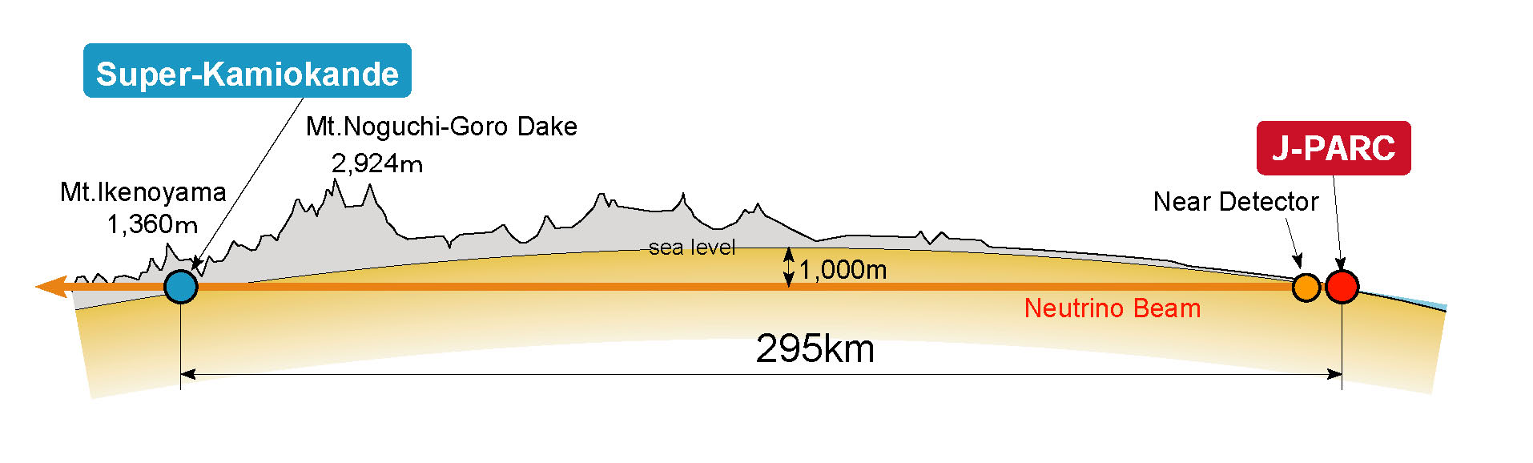
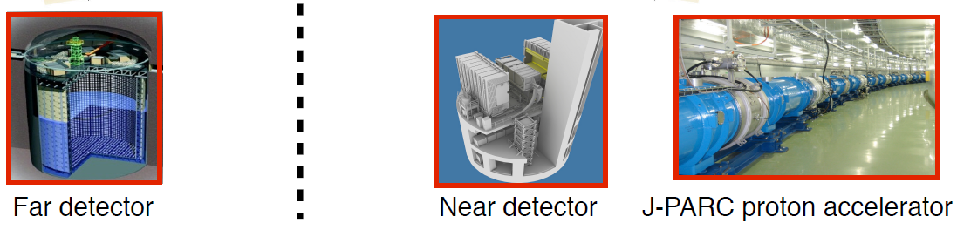
T2K
Long baseline neutrino oscillation experiment
2 detectors:
  Near Detector: measure before oscillation
  Far Detector: measure after oscillation

Slide 3
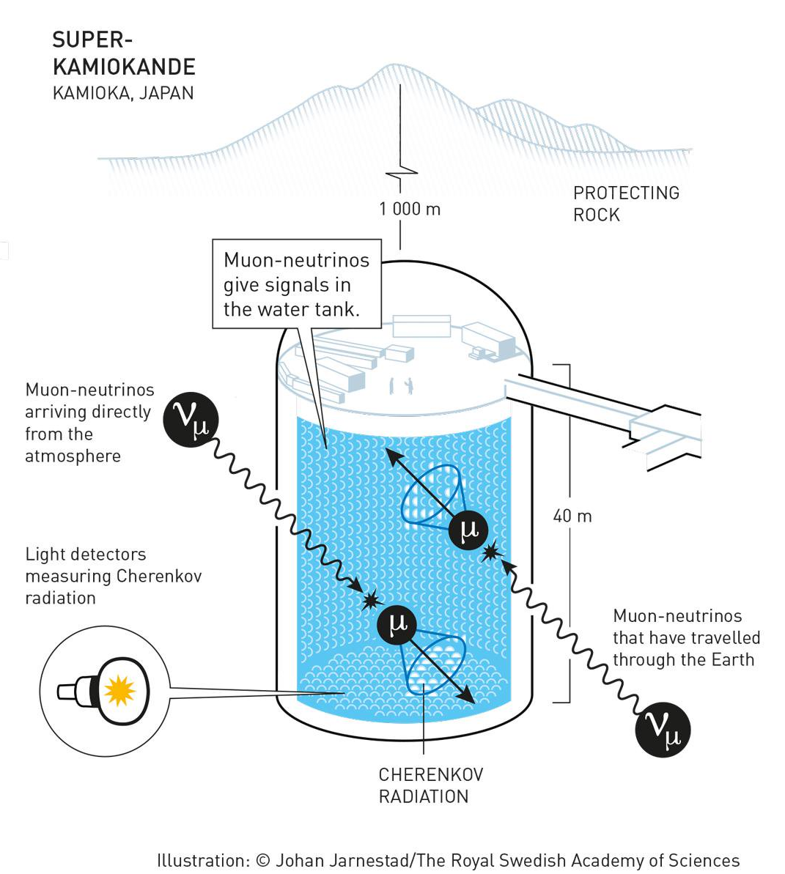
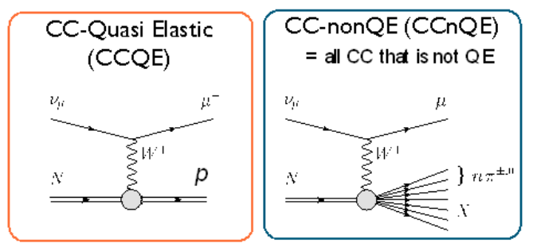
Far Detector: SuperKamiokande
Water Cherenkov detector
4π sensitivity
CC events
Relatively high threshold for particle detection => mainly detection of charged lepton

Slide 4
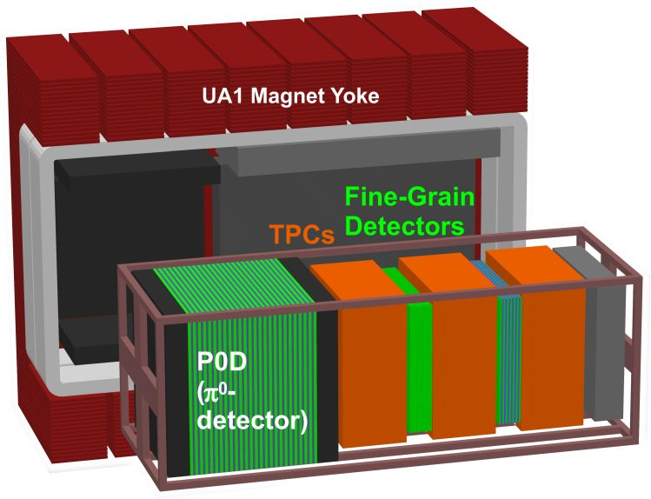

Current Near Detector: ND280

Slide 5
Current Near Detector: ND280
target and detector
NC events
background in SK

Slide 6
Current Near Detector: ND280
FGD: target, TPC: tracker
CC events
signal in SK

Slide 7
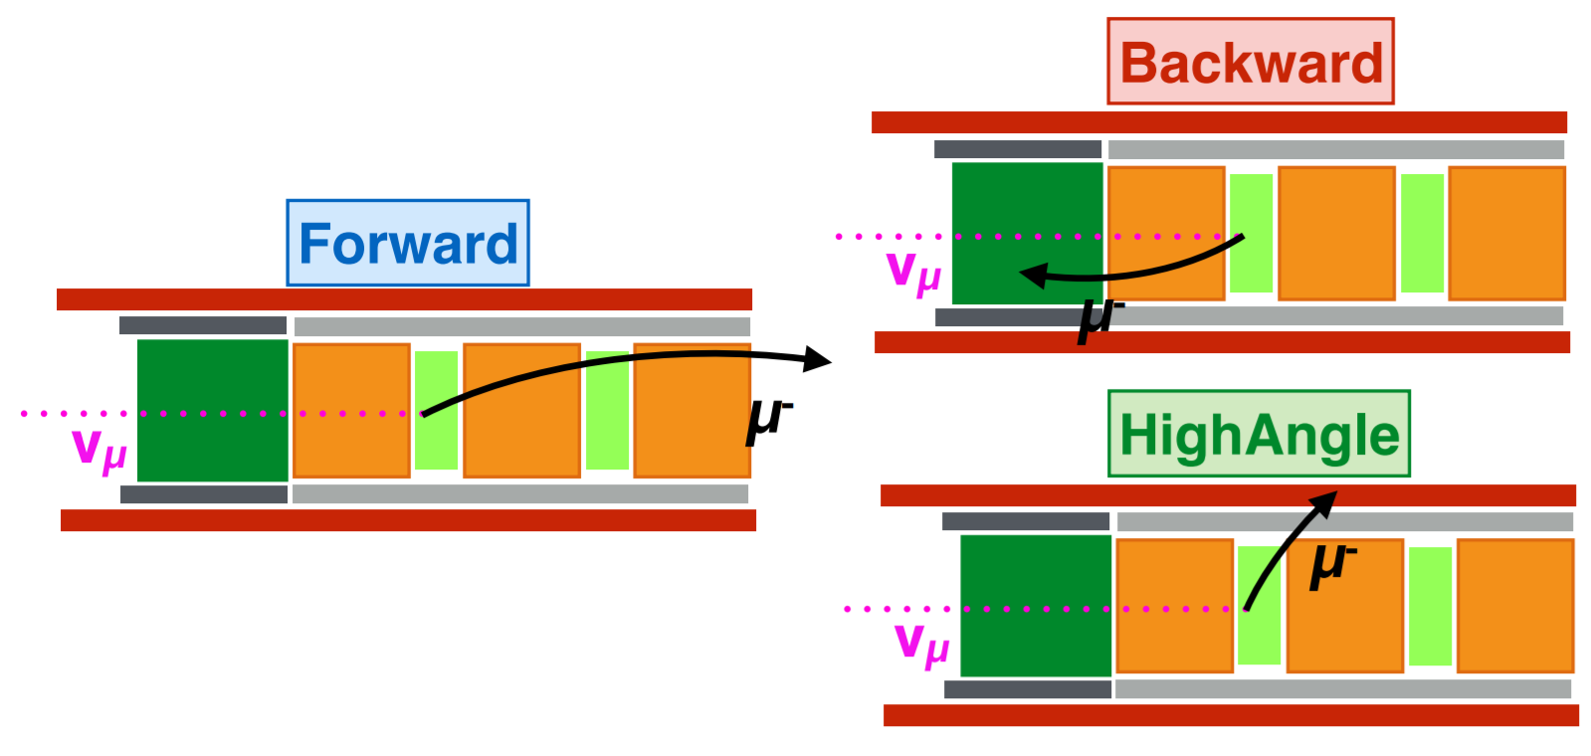
Current Near Detector: ND280
backward: without time information difficult to identify correctly backward going lepton
not 4π detector
optimized for forward direction
high angle has problems:
  FGD dense material
  short track in TPC => bad for p and dE/dx measurement => bad for PID

Slide 8
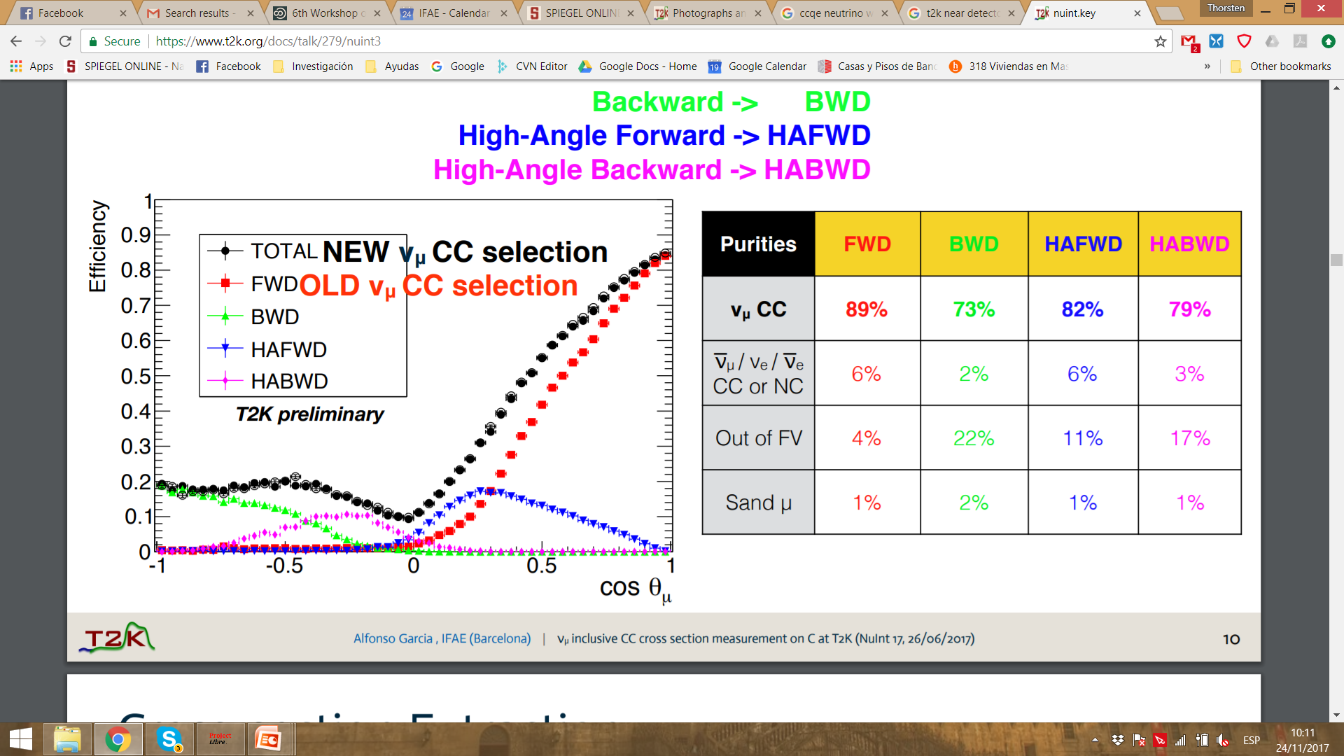
Current Near Detector: ND280
selection efficiency high in forward direction
originally only forward direction
for current detector already achieved some efficiency for high angle and backward
Alfonso Garcia (IFAE) thesis
still very low efficiency for high angle and backward direction
=> Significant systematic error for SK results

Slide 9
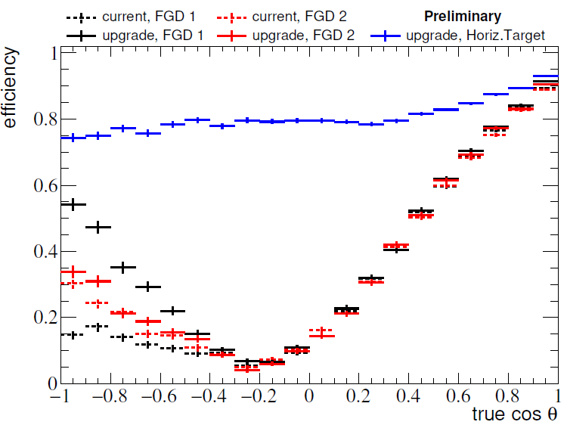
What we want

Slide 10
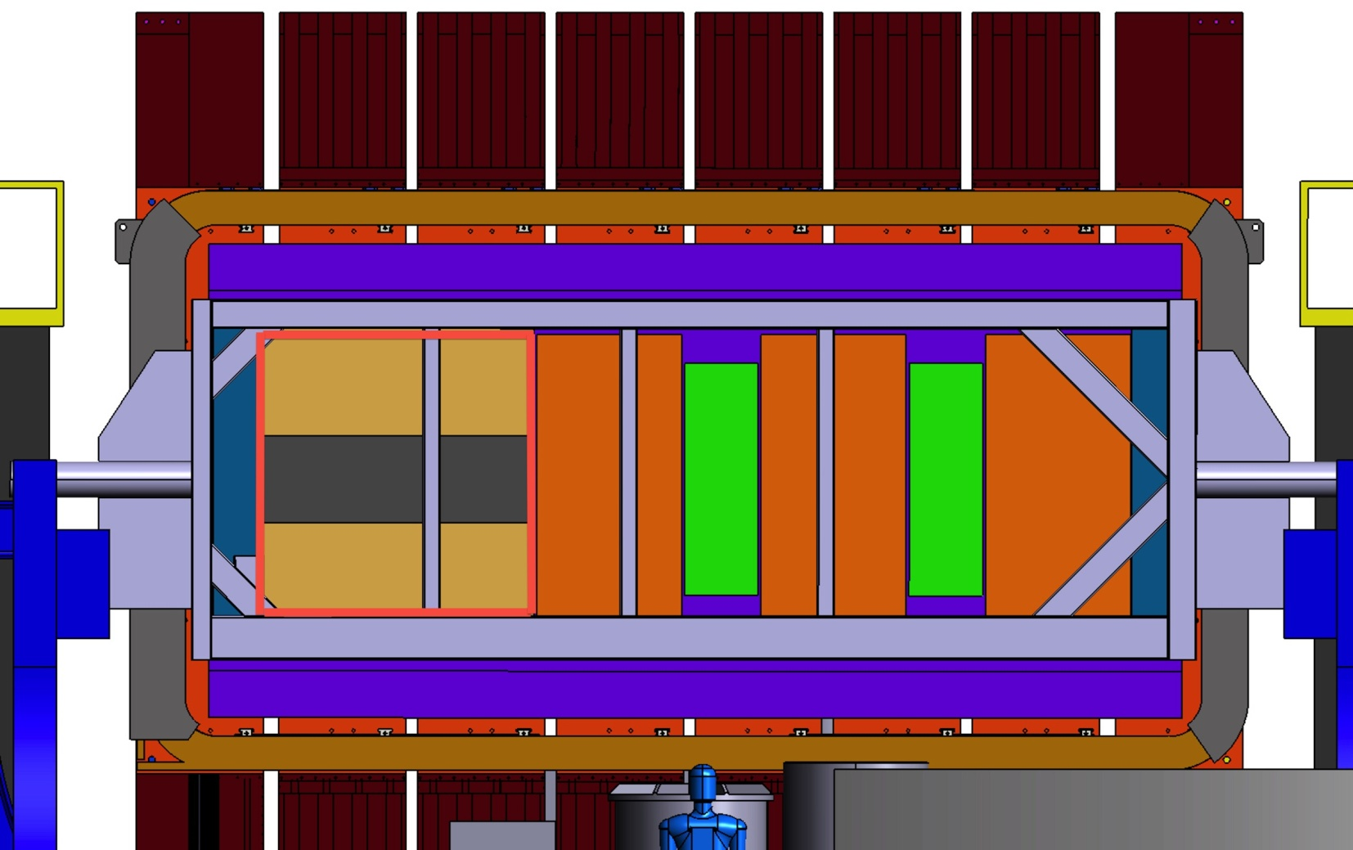
How to achieve this?
Get rid of P0D and replace it by something more useful!
  Scintillator tracker as target
  2 vertical TPCs as tracker
  TOF panels surrounding all other detectors
μ
TPC
ν beam
STD
TPC

Slide 11
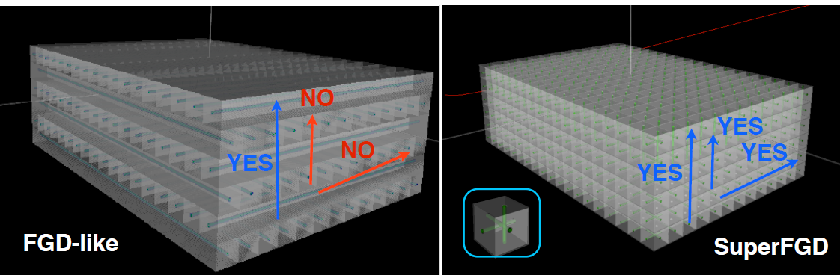
Scintillator Tracker
Scintillator with WLS fiber read out by MPPC/SiPM
2 variations under consideration: 2D and 3D (SuperFGD)
2D FGD well known technology
3D would provide 4π sensitivity
3D needs factor 2-3 more readout channels
Target mass: ~2 ton

Slide 12
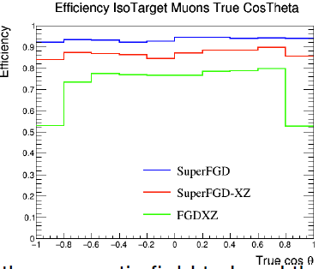
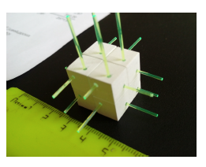
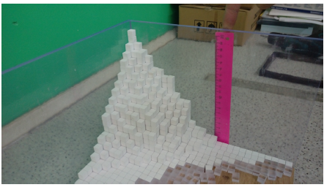
Scintillator Tracker
Current baseline choice: SuperFGD
  1 cm³ cubes, optically isolated, each with 3 WLS fibers
  Fibers read out by ~60.000 MPPCs
  Total detector: 2.000.000 cubes
Simulations indicate that SuperFGD in 2D performs better than classical 2D FGD

Slide 13
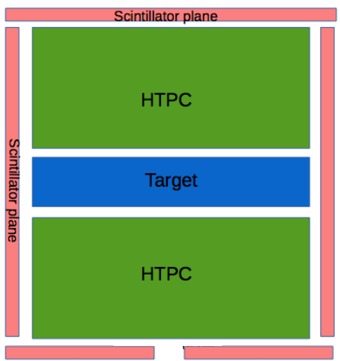

Time of Flight
Magnet
TOF will provide:
  PID with p from track curvature
  Identify direction of particle
Crucial time resolution: scintillator, electronics, ...
μ- from target to magnet or π+ from magnet to target?
Magnet

Slide 14
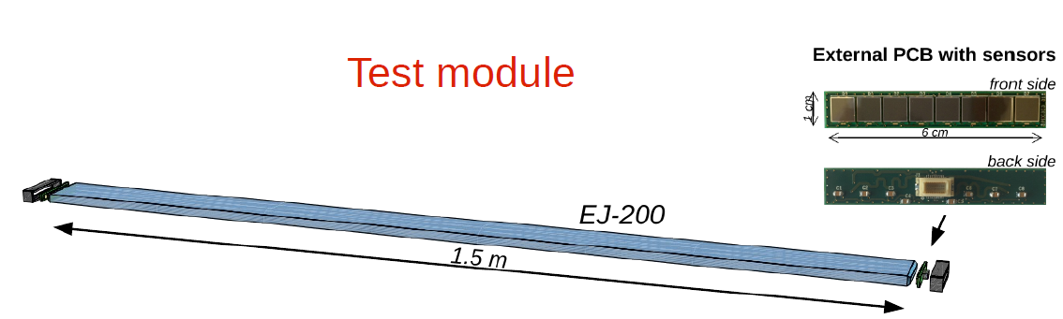
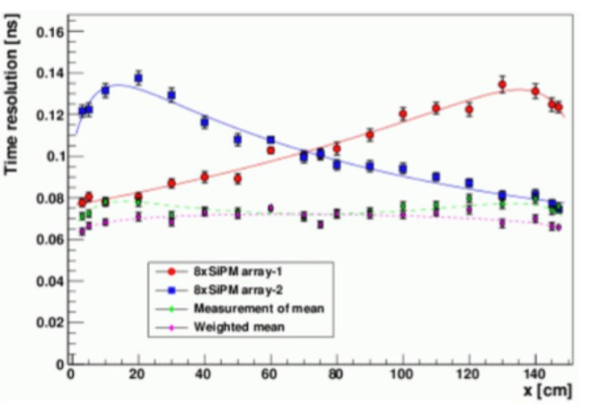
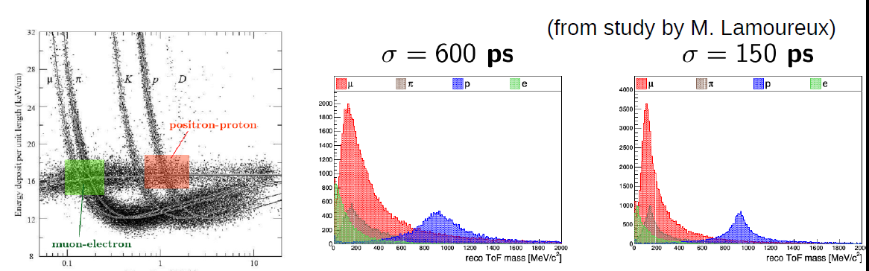
Time of Flight
Baseline choice:
Cast plastic scintillator: EJ-200
6 or 12 SiPM (6x6 mm2) directly coupled to scintillator
readout from both sides
tested already in CERN testbeam
~70 ps time resolution for 1.5 m bars achieved
electronics could increase this to 150 to 600 ps

Slide 15
TPC Principle
Field cage: inside HV on copper strips, outside ground plane
Anode: segmented in pads
Anode
Noble gas + quencher gas at ambient pressure + up to 10 mbar
Cathode:
-20 - 100 kV
E, B field
Ampflification stage
up to 2.5 m

Slide 16
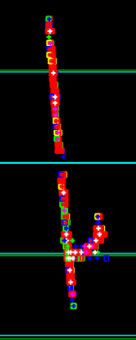
TPC Principle
e-

Slide 17
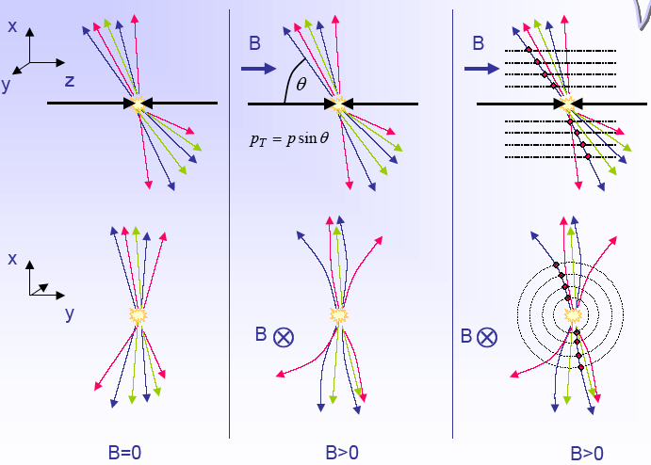
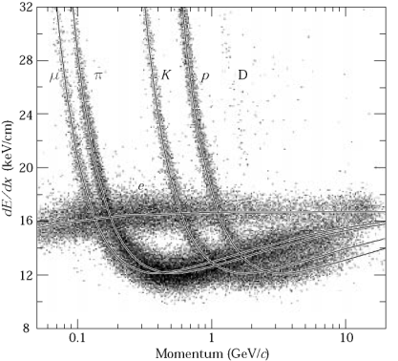
TPC Principle
momentum from track reconstruction
dE/dx from deposited charge along track
=> Particle identification (PID)

Slide 18
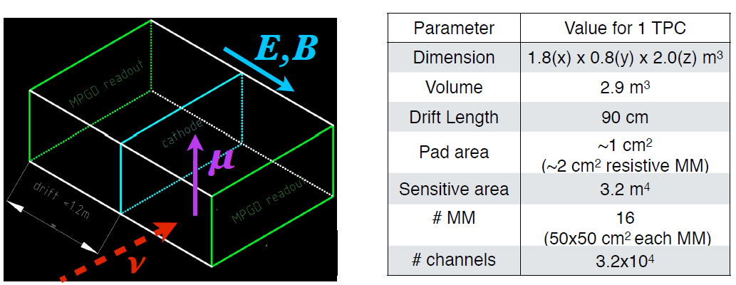
New vertical TPCs
Walls have to ensure:
  Gas tightness
  Passing of low momentum particles => light materials
  Electric insulation of tens of kV for years
  Minimal deformations due to overpressure and gravity
Already done for ALEPH/DELPHI/... but these were cylindrical TPCs
while we have rectangular TPCs!

Slide 19
New vertical TPCs
Challenging requirements/tolerances:
Flatness of the cathode 100 μm
Flatness of anode 200 μm
Anode and cathode parallel within 200 μm
Electric field homogeneity <= 10⁻⁴ (199.98 < E <200.02 V/cm)
Sensitive volume starts 1.5 cm from wall surface
Withstand at least 30 kV
Oxygen levels <= 10 ppm (21% ⇒ 0.001%)
...
And all this with a tight time schedule of course!
=> Many design choices to be taken soon!

Slide 20
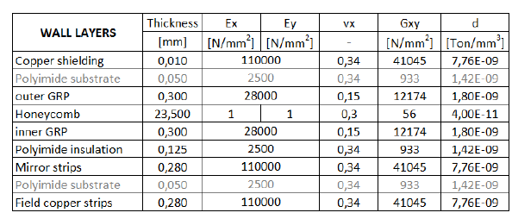
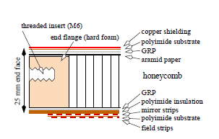
Field Cage Wall Material
Flat surface suffering gravity and overpressure
What is the right choice for the wall material?
Composite materials but which?
First iteration based on choice of other experiments
(for cylindrical TPCs):

Slide 21

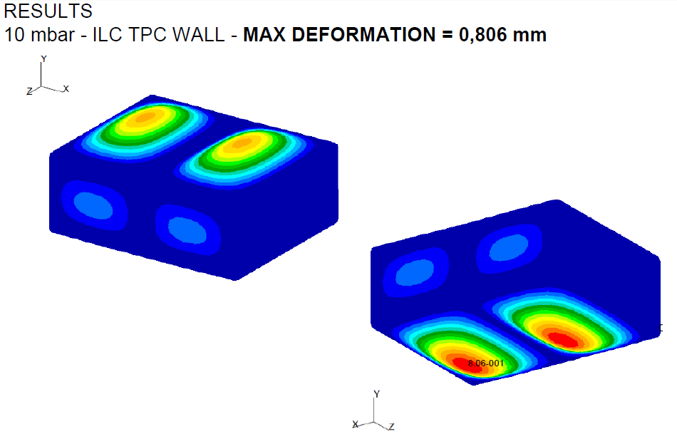
Field Cage Wall Material
Rad. Length: 1.6%
That is a lot!
Structural simulations done by Juli

Slide 22
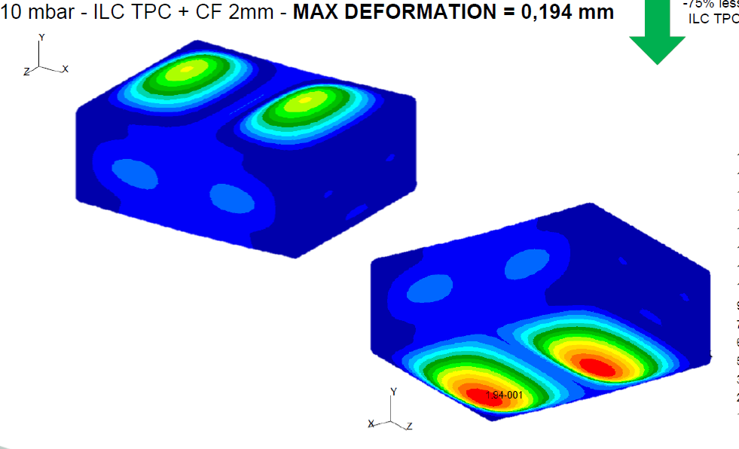
Field Cage Wall Material
Rad. Length: 2.4%
Adding 2 mm of carbon fiber helps a lot!
More options under study and iterations required.
Also thermal expansion will be studied.

Slide 23
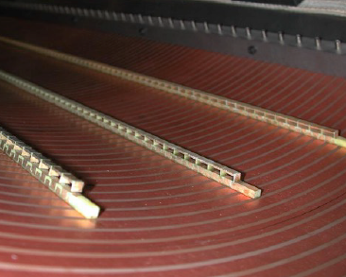
Field Forming Structure
Aim: continuous degradation of potential between anode and cathode
Practice: Do it in small steps! Parallel copper strips on the walls connected by resistors.
Sounds simple but many options how to realize it:
Double sided copper strips on Kapton: more expensive
Mirror strips inside the gas: cheaper but more space lost

Slide 24

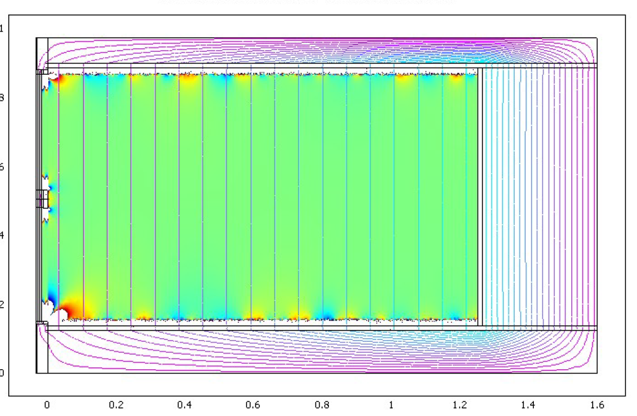
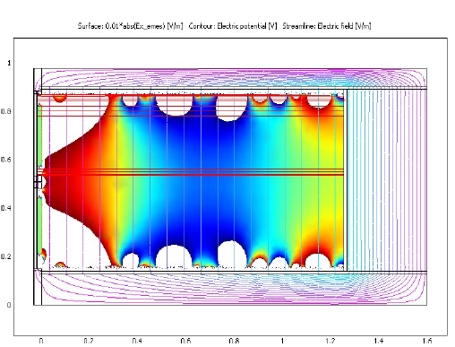
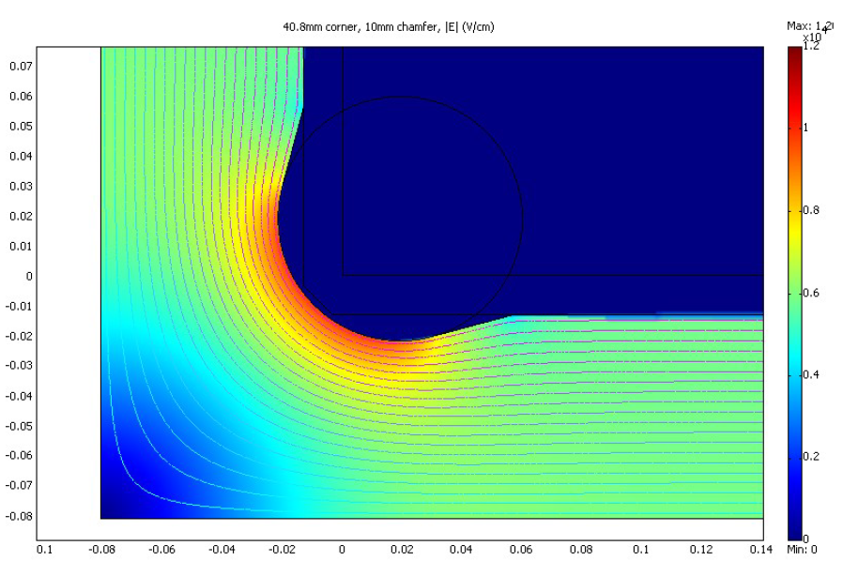
Electric Field Simulations
Many electric field simulations needed for detector optimization:
realistic resitors have tolerances e.g. 0.1%
Corners of the TPC
Readout plane integration
Cathode integration
...
For original T2K TPCs

Slide 25

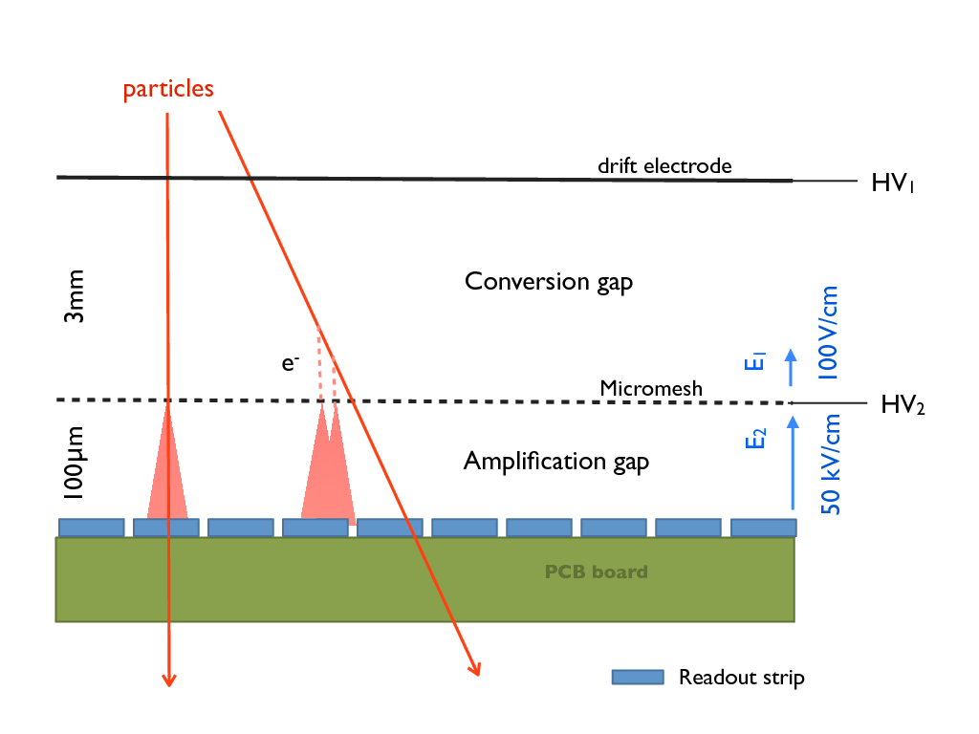
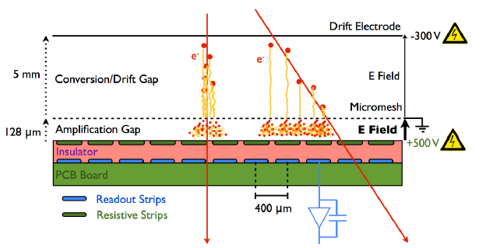
Micromegas Readout
T2K was first full size TPCs with MPGD readout
Good performance for T2K but further development ongoing
Aim: use resistive foil in readout to spread charge over several pads
T2K will have first TPCs with resistive MM readout
Resistive foil

Slide 26
Time Schedule
2 phases:
TPC Prototype (funds available):
  Currently design phase
  Production of pieces in spring/early summer
  Assemblying of field cage: June/July 2018 at INFN Padua
  Full integration: July/August 2018 at CERN
  Testbeam: September 2018
  Test resistive foil MMs and production process of TPC construction
1 MM
~55 cm
~55 cm
100 cm

Slide 27
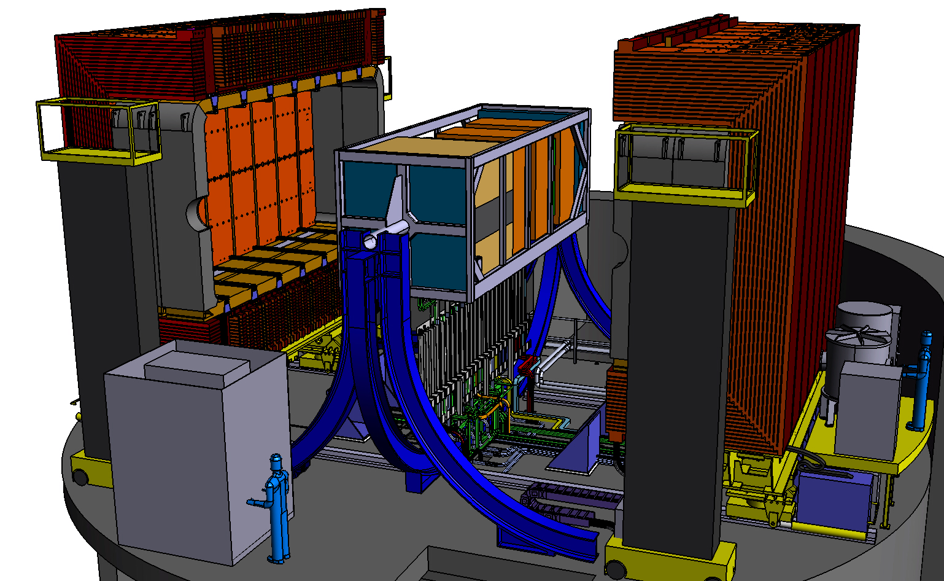
Time Schedule
Final TPCs:
  Optimize design
  Production 2019/20
  Commissioning with cosmics
  2021 installation at JPARC

Slide 28






T2K TPC Collaboration
Bari and Padova
Krakow

Slide 29
IFAE Contribution to Upgrade
F. Sanchez:
  Testbeam working group convener
T. Lux:
  Overall integration working group convener
  TPC field cage design
J. Mundet:
  TPC field cage design
J. Boix:
  Optimization of electronics readout
PhD student (candidate there but funding to be ensured):
  Geant 4 simulations related to TPC
  TPC prototype construction, commissioning, testbeam and data analysis

Slide 30
Conclusions
IFAE Neutrino group: Back to the roots!
Participating in the upgrade of T2K ND
Focussing on TPC where our expertise lays
Number of important positions in management organization
Challenging year with design, production and testing of TPC prototype lays ahead
Final TPCs have to be delivered in 2021 to Japan

Slide 31
Current horizontal TPCs
0.9 m
dual gas volume design
outer volume filled with CO2
inner/sensitive volume with Ar:iC4H10:CF4 gas
Pros:
  electric insulation by CO2 gas => undestrutable
  practivally no pressure difference between inner and outer volume => no deformation of inner walls
  additional layer of gas purity protection
Cons:
  2 volumes to be produced
  large dead volume between subdetectors: ~10 cm
2 m
2 m

Slide 32
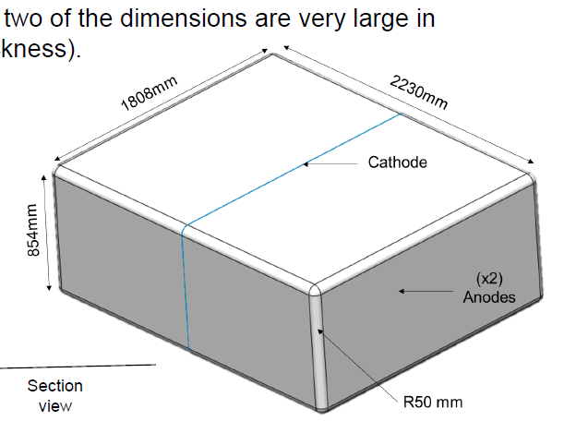
New TPC Geometry

