Slide 1
Light Calibration System: Preliminary Characterization
Thorsten Lux

Slide 2
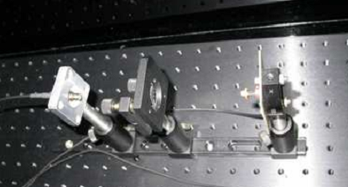
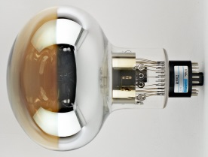
WA105: SETUP-SUMMARY
Light box
X2
Air
← CIEAMT | IFAE →
X2
Ar

Slide 3
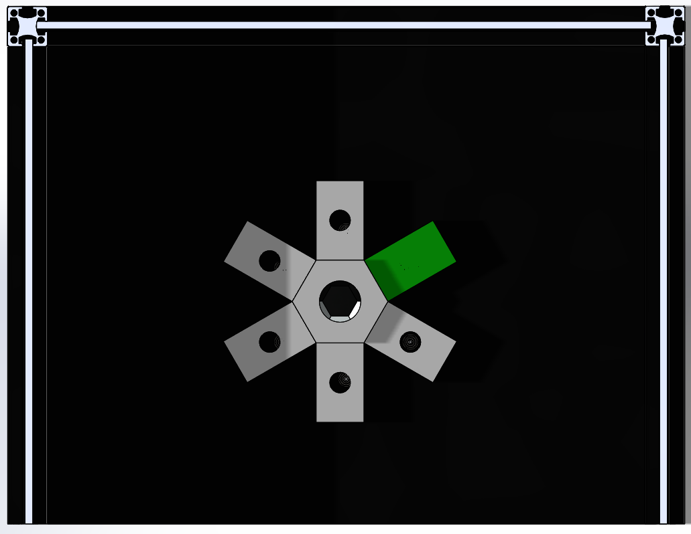
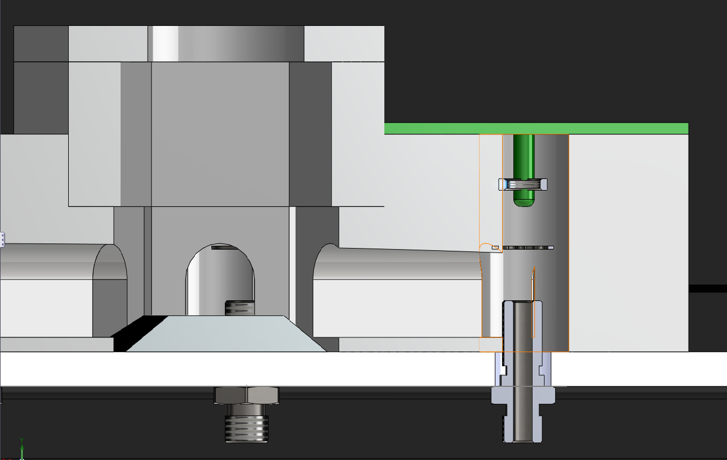
Implementation (Conceptual)
central reference sensor
6 Kaputschinsky PCBs around
each Kaputschinsky with light cavity to guide light to reference sensor
material: either 3D printed plastic or aluminium
Kaputschinsky PCB
Reference Sensor
Reference sensor
Position of LED adjustable
Stray light
LED
Feedthrough
Fiber

Slide 4
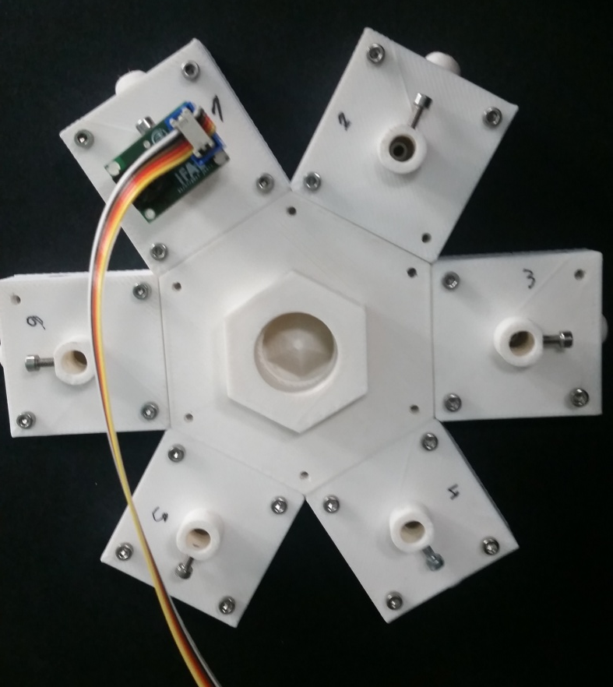

Slide 5
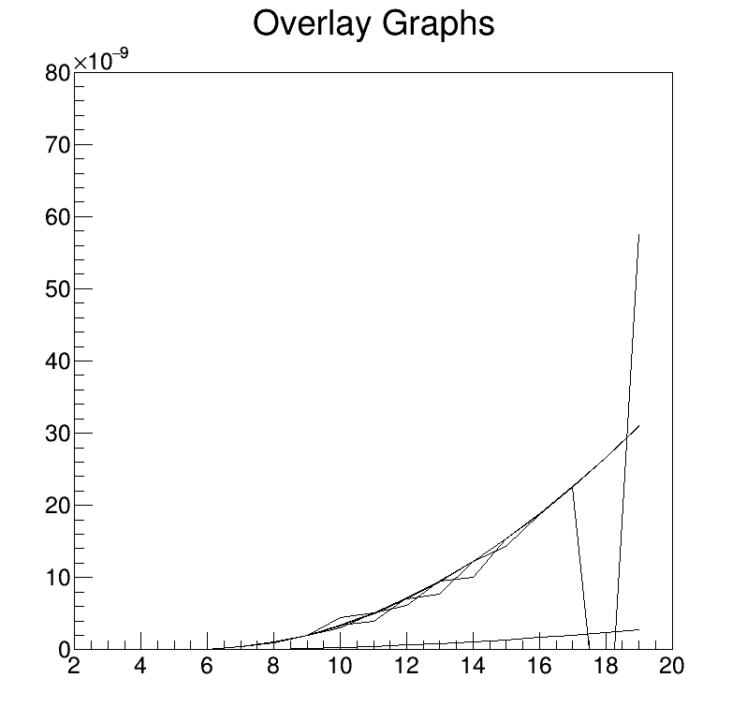
First PCB Test
7 PCBs assembled
tested directly in front of photodiode
2 of 5 showed strange behaviour (e.g. too much light)
5 additional will be assembled
+/- 30% power output between PCBs
Photodiode
LED
PCB | 1 | 2 | 3 | 4 | 5 | 6 | 7
Max. Pulse Energy [pJ] @ 19 V | 30.3 | X | 20.2 | X | 23.9 | 19.5 | 31.3
Max. Power@ 100 Hz [nW] @ 19 V | 3 |  | 2 |  | 2.4 | 2 | 3.1

Slide 6
Test Setup
Optical fiber
Blackbox Wall
Photodiode
Structure
Kaput
Controller
Beaglebone
all pieces as in final setup
using 1 m fiber, 1 mm diameter reduces power to 1/3
~ 1 nW @ 100 Hz

Slide 7
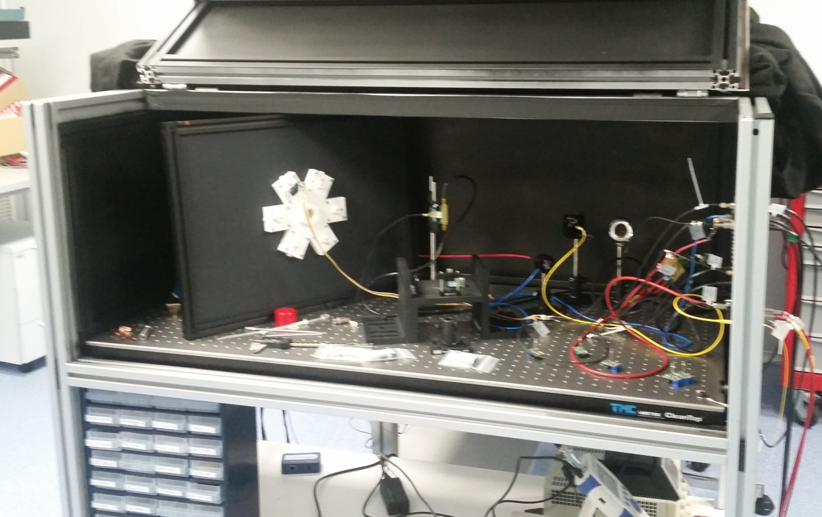
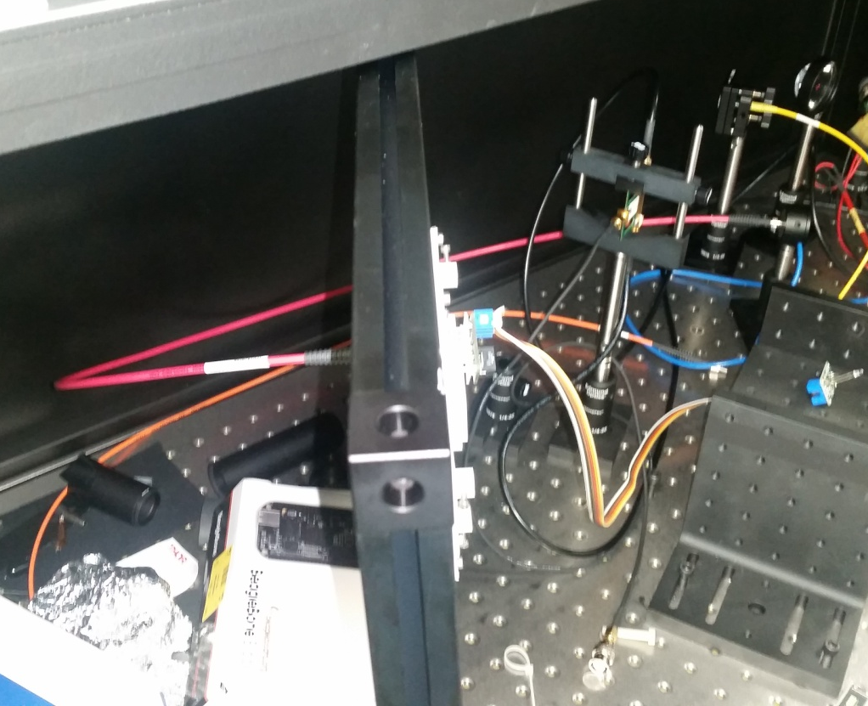

Slide 8
Fiber Diameter Dependence
smaller diameter => less power
follows well cross section area
using 50 um instead of 1000 um gives reduction factor of about 400

Slide 9
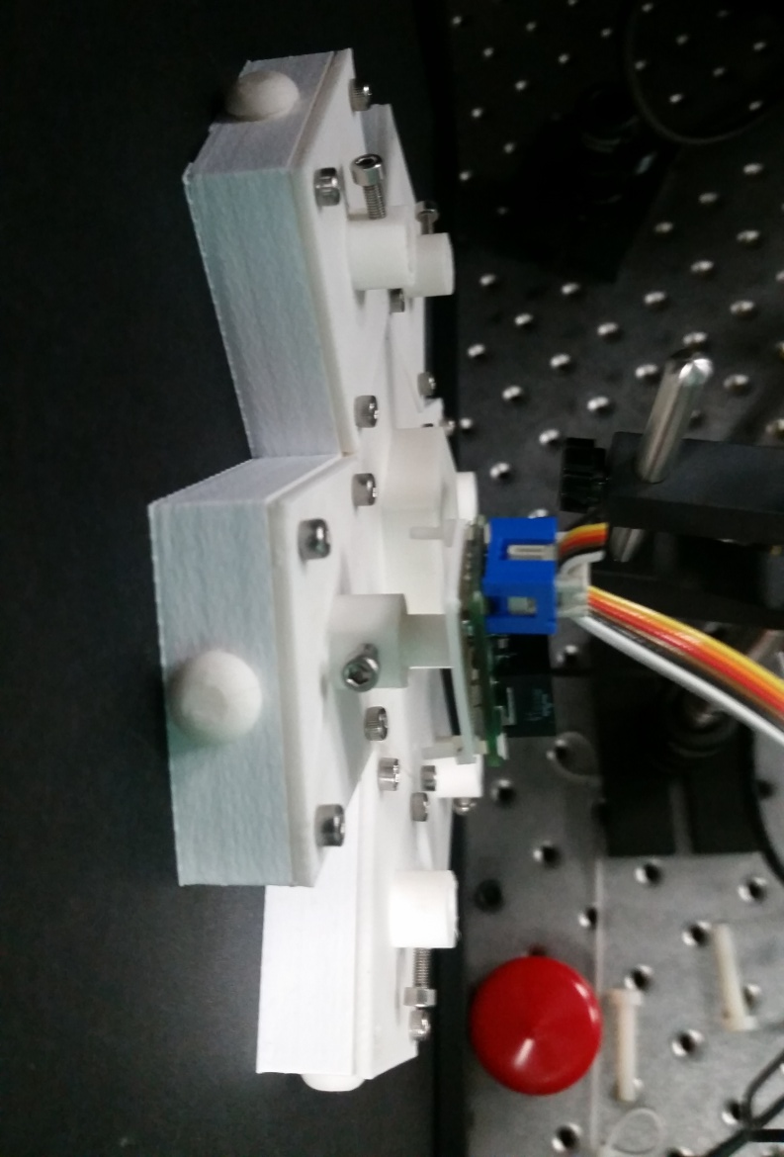
Positioning Effects
2
3
1
6

Slide 10
same PCB and fiber used at all 6 positions
difference between positions less than +/- 10%

Slide 11
same PCB, position and fiber used at all 5 rotation positions
difference between positions less than +/- 10%

Slide 12
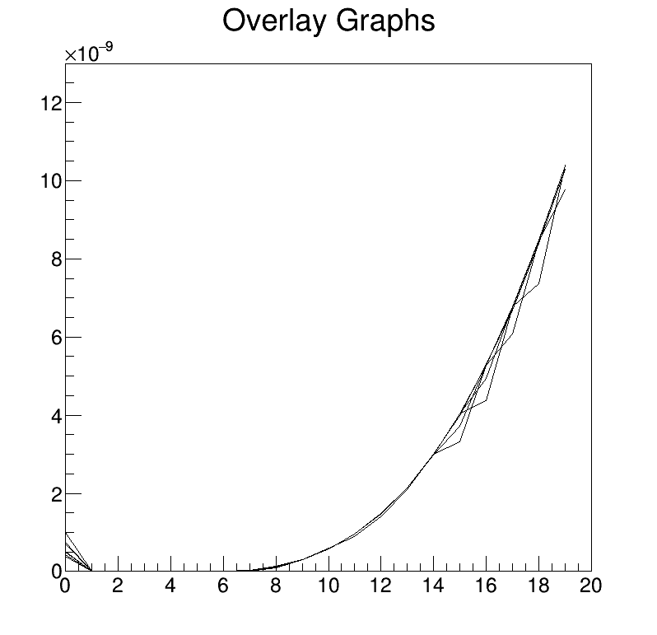
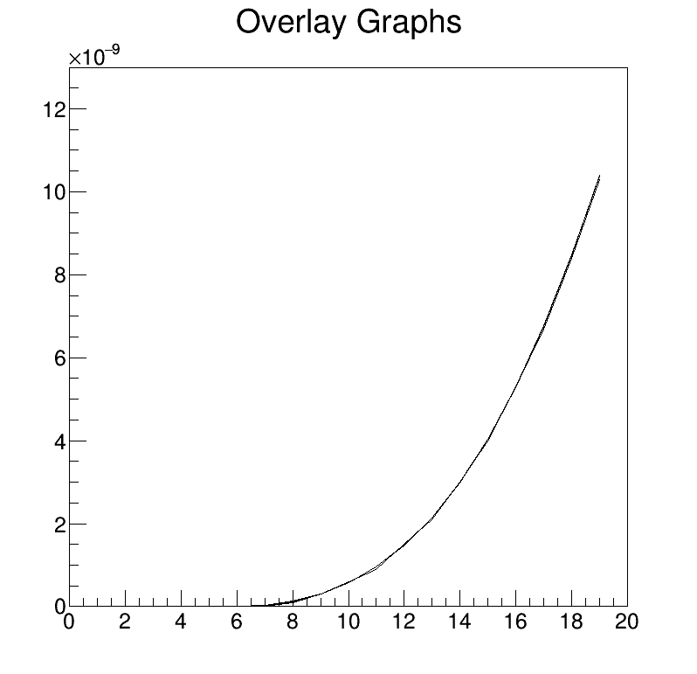
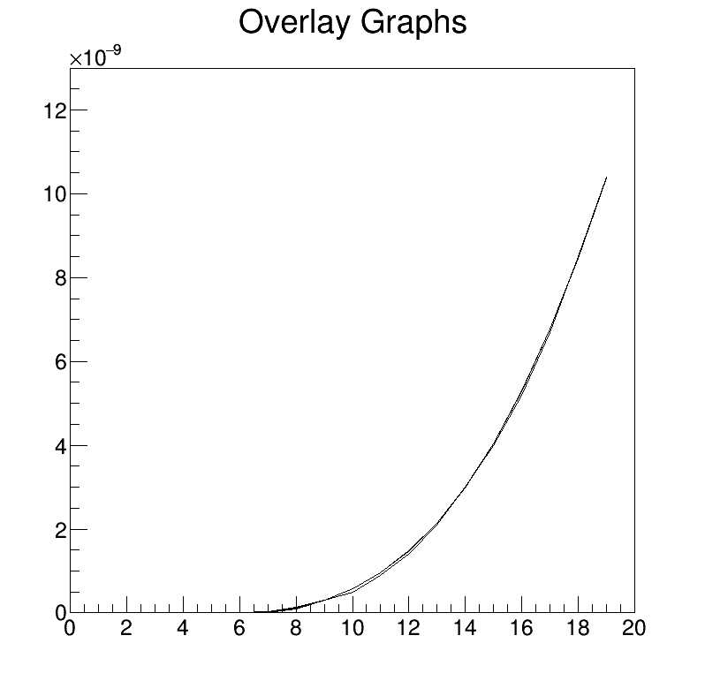
Frequency Sweep
LED voltage increased from 0 to 19 V
Output power at end of fiber measured with powermeter
pulse rate varied between 100 and 10100 Hz
for plot all power values normalized to 1 kHz
some fluctuations at the beginning due to too short time between setting voltage and start reading => might contribute to previous variations
all curves lay perfectly over the other => system can be operated between 100 Hz and 10 kHz
1 s
Output power norm to 1 kHz
V
2.5 s
5 s

Slide 13
same PCB, position and fiber used at different gaps
Reduction factor from 0 to 7.5 mm gap about 3-4

Slide 14
Optical Attenuators
1000 um fiber
400 um fiber
Mating sleeves with gap
Blackbox Wall
Photodiode
Structure
Kaput
Controller
Beaglebone
“1000-standard sleeve-400” 70% of only 400 um fiber
sleeves with different gaps available

Slide 15
using 2 fibers (1000 and 400 um) with gap mating sleeve gives another reduction factor of 4-5
using a standard SMA + gap + 400 um fiber gives a reduction factor of 20-25 => increasing hole in SMA does not seem to change this much

Slide 16
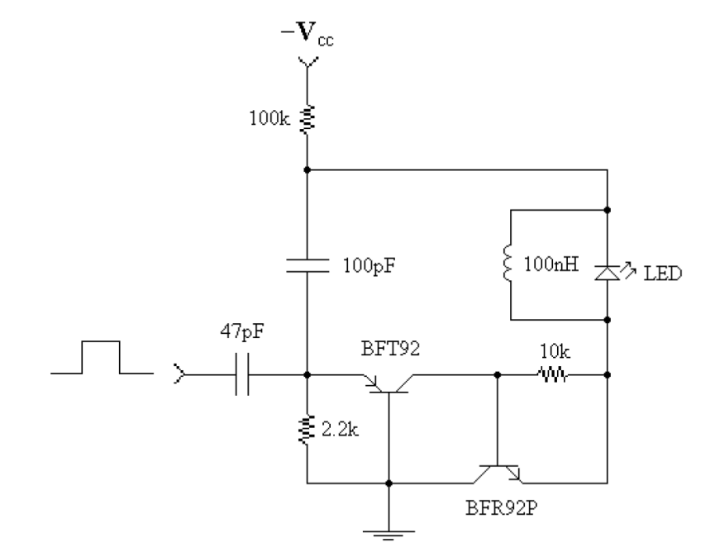
Alternative Reduction Idea
replace 100 pF by smaller value

Slide 17
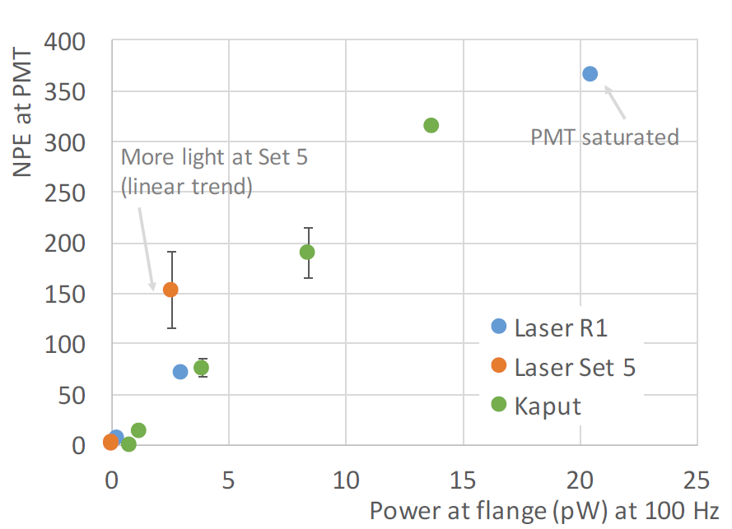
Requiered Power/ Pulse Energy
up to ~ 1 nW@100Hz@19V with 1 mm diameter fiber => 10 pJ per light pulse
up to 20 pW@100Hz requested => 0.2 pJ per light pulse
large variety of options to match PCB output to required power at flange input
simplest would be to use 400 um fiber instead of 1000 um fiber => 2 pJ per light pulse which could be reduced to 2/3 by positioning of PCB and finally limiting the LED voltage to up to 13 V instead of 19 V
Open question for us still: makes 100 Hz limitation sense in detector with ~10 kHz of cosmics and ~200 kHz of Ar39?
From Clara’s talk in September:

Slide 18
Status
20 PCBs were ordered, 7 assembled, 5 working and 5 additional are currently assembled
PCBs were tested and the whole system characterized preliminary
Differences between PCBs much larger than positioning issues
Various reduction methods tested to match the output power to the one needed to get single photons
Most of pieces at IFAE => final fibers to be ordered
From this side on track for tests end of February
Reference sensor/DAQ/... => Joan’s talk

