Slide 1
COVID-19 meeting 1/2/2021
Martine Bosman

Slide 2
Ongoing code work
Collect mobility data for both waves
Ola 1 (done), Ola 2 ongoing
Implement and study residences
Implementation (done), study starting
Implementation of lambda_work_TP (transporte público)
Implementation (ongoing)
Implementation of lambda_play_TP (transporte público)
Not yet started
Implementation of mobility intensity as proxy for confinement
Not yet started
Information saving from simulation, analysis framework
Ongoing

Slide 3
Which information to write to file?
For all individuals in population:
If exposed, level of infectiousness, diagnosed, date when exposed
File 5.5 M with 9 variables = 280 MB
One can correlate that information for any variable of the population file:
HomeID', 'Age', 'Gender', 'HomeRegion', 'HomeOccupancy', 'WorkRegion', 'companyID’, 'SchoolRegion', 'schoolID’
As a function of time:
for “Old”, “Adult”, “Child”, “Residence” aggregated per municipies: 300 tics * 4 * 7 * 85
statusPeopleOld[tic,:] = [np.sum((statusID==statSusceptible)&(age>=65)), \
np.sum((statusID==statExposed)&(age>=65)), \
np.sum((statusID==statInfectious)&(age>=65)), \
np.sum((statusID==statRecovered)&(age>=65)), \
np.sum((statusID==statDiagnosed)&(age>=65)), \
np.sum((statusIDold==statSusceptible)&(statusID==statExposed)&(age>=65)), \
np.sum((statusIDold==statInfectious)&(statusID==statDiagnosed)&(age>=65))]

Slide 4
“Analysis” projects
Mobility
How to normalize the # of contacts in the public transport: Enzo will review the literature
Study of impact of London subway on propagation of influenza
https://ehjournal.biomedcentral.com/articles/10.1186/s12940-018-0427-5
General population
Propagation per age category, correlation with census, relative importance of different lambdas
Residences
Comparative study of speed of propagation residence, normal home, pattern
Pattern of infectiousness vs age, probability to be diagnosed
Current implementation is as known at the beginning of the pandemics, needs to be reviewed for Ola2

Slide 5
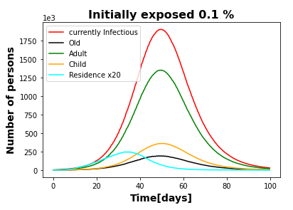
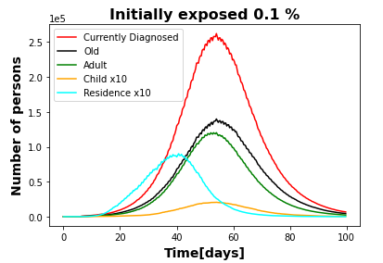
Residencias
All people = 5527233 People with >= 65 years = 961372
People with >= 16 & <65 years = 3656081
People with < 16 years = 909780
People in residences = 39373
Sum newly infectious = 4976687.0 (90%)
Sum newly diagnosed = 1081463.0 (20%)
People in residency get infected much faster than the “old” segment of population

Slide 6
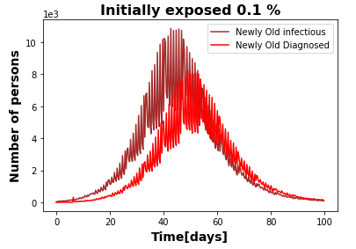
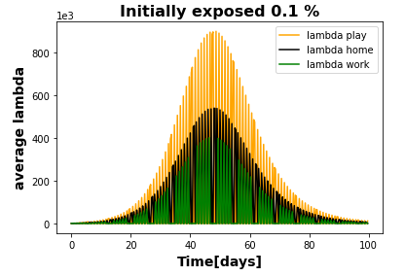
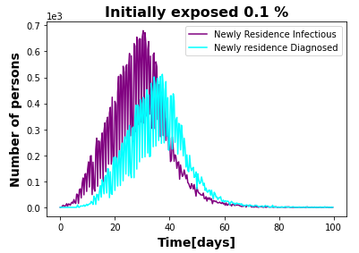
Residencias
In order to keep statistics of infected and diagnosed, here we show the number of people newly infected every 8 hours, as well as the ones diagnosed.
In that case fluctuations from ”tic-to-tic” can be seen, following the fluctuations of the different contributions to lambda .
Currently in the code people get diagnosed 6 days after becoming infected
People in residence gets to the maximum level of infection more than 2 weeks before “old” people in normal homes

