Slide 1
Analysis code 5/2/2021
Martine Bosman

Slide 2
Software and files to analyse the results of simulation
The analysis code reads files and fill data structure with the description of the full population and the result of the propagation of Covid. The results can be easily correlated to the characteristics of every individual
Python code to read files and plot:
SimulationAnalysisFramework.ipynb
Available in github https://github.com/covidifae/basicproject
Excel file with output of simulation:
SummaryInfo4Feb21.csv
Available in https://drive.google.com/drive/folders/19alFSi790b84VXRvXCzBTcXV07h_MFcL
Excel file with description of population:
NewWorld.csv
Available in https://drive.google.com/drive/folders/19alFSi790b84VXRvXCzBTcXV07h_MFcL

Slide 3
Files and variables
File SummaryInfo4Feb21.csv containing 5527233 number of entries read
Shape: (5527233, 8)
Columns: Index(['Unnamed: 0', 'exposed', 'lambda_home', 'lambda_work', 'lambda_play', 'diagnosed', 'exposedTic', 'diagnosedTic'], dtype='object’)
File NewWorld.csv containing 5527233 people read
Shape: (5527233, 9)
Columns: Index(['HomeID', 'Age', 'Gender', 'HomeRegion', 'HomeOccupancy', 'WorkRegion', 'companyID', 'SchoolRegion', 'schoolID'], dtype='object')

Slide 4
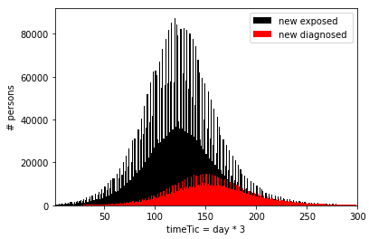
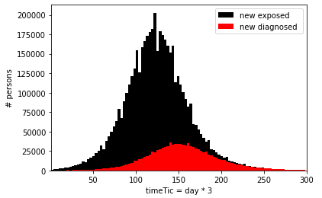
Time when a person got infected
1 bin = 1 Tic (8h)
1 bin = 3 Tics (1 day)
Peak structure due to the different level of lambda_home, lambda_work and lambda_play
The structure is smoothen when integrated per day

Slide 5
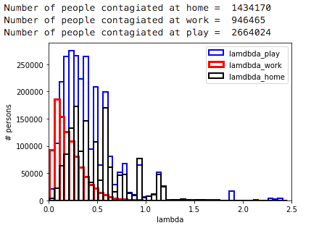
Value of the 3 lambda components at the time of contagion

Slide 6
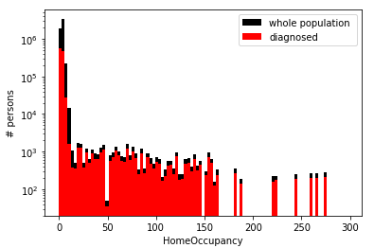
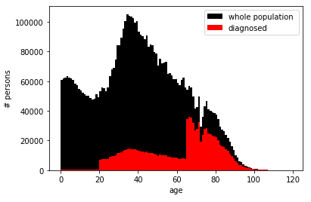
Some characteristics of the population (including people in residencies)

Slide 7
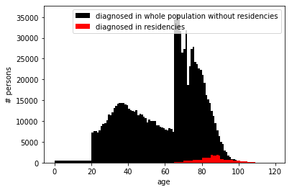
Some characteristics of the population (including people in residencies)
The structure observed is the result of the current implementation of the probability to be diagnosed. It follows the data of the first wave and is assigned in 3 coarse age bins. It could be made smoother and the data for the second wave are different (more younger people are diagnosed as a result of PCR test to contacts.

