Slide 1
Implementing mobility information to reproduce confinement measure
M.Bosman

Slide 2
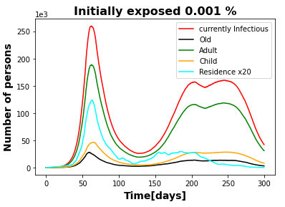
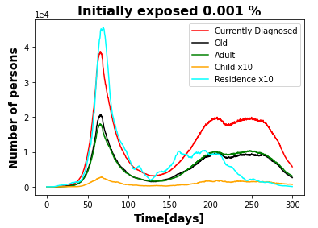
Confinement starts after 6 weeks

Slide 3
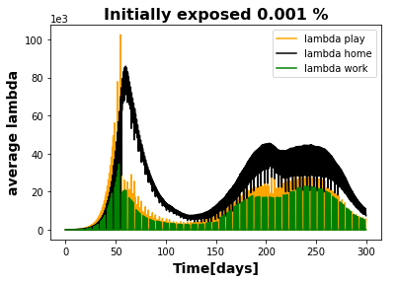
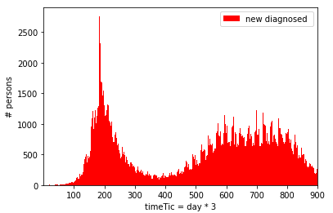
Confinement starts after 6 weeks
1 Febrero
1 July
1 December
15 March

Slide 4
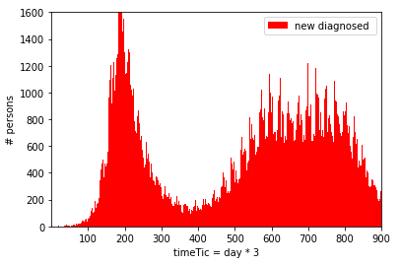
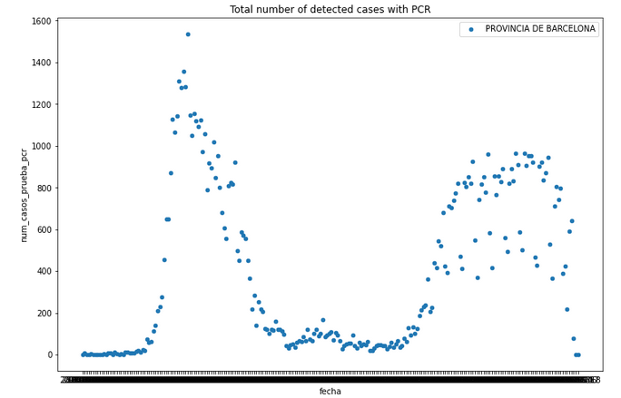
Comparing to data
Vertical scales are the same
Horizontal scales adjusted to roughly correspond (data start 20 February extend until mid-December)
The main features of the data are reproduced

