Slide 1
Contacts in transport
M.Bosman

Slide 2
Different types of contracts
 | People affected | Total # contacts | Average / affected | # of 8H tics
Home | 5.5 M | 15.5 M | 2.7 | 8 (or 13)
Work | 2.5 M | 86.5 | 38.4 | 5 (or 0)
Play | 5.5 M | 26.4 | 4.8 | 8
Work transport | 867k |  | 0 / 1 / 10 | 5 (or 0)
Play transport | 552k |  | 0 / 1 / 10 | 8
In case of transport:
calculate the average infectiousness of people travelling
Multiply by # of contacts
For home, work, play:
Sum the infectiousness of individual contacts
Caveat: the relevant quantity for contagion is the # of contact multiplied by time interval. Units are tics of 8 hours.
One spends less time in the public transport, in average 1 hour compared to time spent at home 8 hours

Slide 3
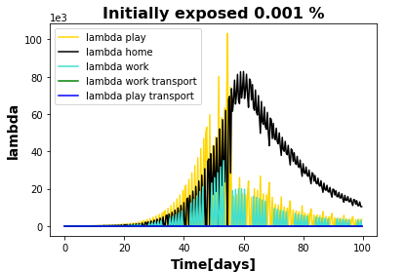
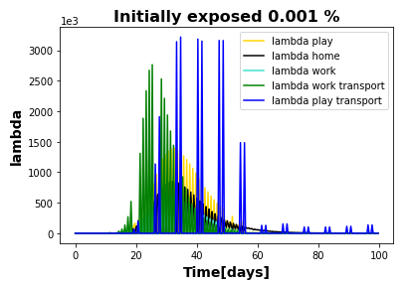
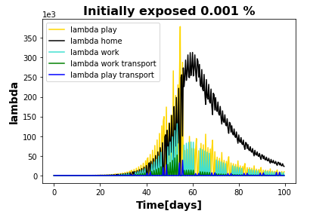
Effect of transport
No transport
transport
1 contact in average
transport
10 contacts in average

Slide 4
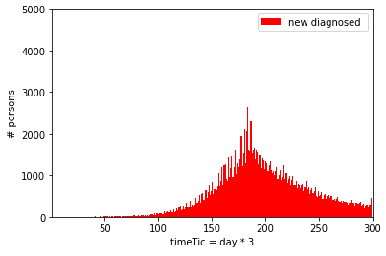
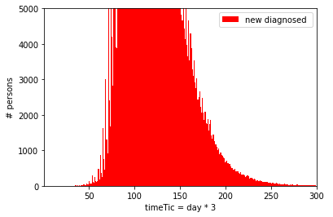
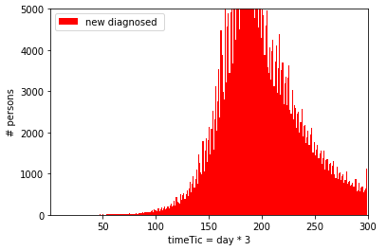
Effect of transport
No transport
~correct number of diagnosed in Ola1
transport
1 contact in average
transport
10 contacts in average

Slide 5
Effect of transport
Impact on number of infected people in different places
 | 0 | 1 | 10
Home | 316922 | 1026924 | 1230874
Work | 120973 | 407574 | 984059
Play | 275291 | 862449 | 2224595
Work transport | 0 | 148181 | 736398
Play transport | 0 | 59408 | 390010

