Slide 1
BSC Infrastructure and Services
Oriol Pineda
Infrastructure Access Policy
8 October 2021
Einstein Telescope Spain meeting

Slide 2
Barcelona Supercomputing Center – Centro Nacional de Supercomputación
Supercomputing services
to Spanish and
EU researchers
R&D in Computer,
Life, Earth and
Engineering Sciences
PhD programme,
technology transfer,
public engagement
Spanish Government 60%
Catalan Government 30%
Univ. Politècnica de Catalunya (UPC) 10%
BSC-CNS is
a consortium
that includes

Slide 3
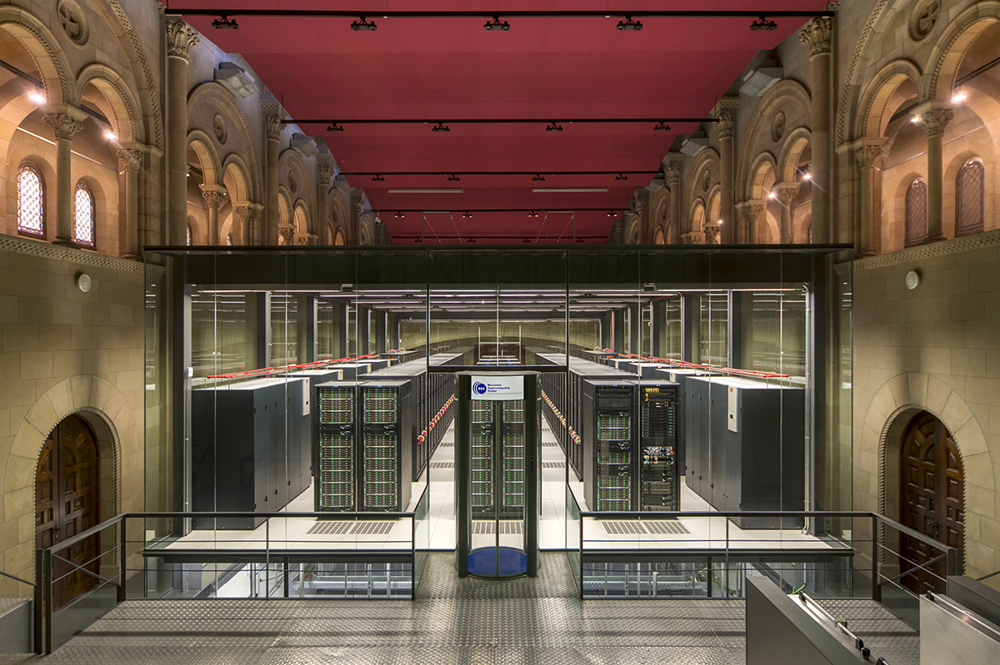
MareNostrum4
Total peak performance: 13,7 Pflops/s
Includes
Large, general-purpose Intel partition - 11,5PB
AMD-based high-memory (1TB) cluster
Power9+Nvidia V100 cluster
ARM-based Fujitsu cluster

Slide 4
Other infrastructures
Agora
HSM storage (disc/tape)
135 PB
Heavy-duty VMs
Openstack cluster
Flexible nodes to deploy VMs and cloud environments

Slide 5
Competitive Access to BSC infrastructures
Red Española de Supercomputación (up to 50%)
Competitive calls for HPC and Data Management services, peer reviewed
Up to 30M core hours per year
From 200TB per year
PRACE (50%)
Competitive calls for large-scale HPC projects, peer reviewed
From 30M core hours per year
Strategic projects
Dedicated allocations, after scientific assessment
Up to 10% of total annual capacity

Slide 6
Spanish Strategic Projects
Requirements:
Medium- to long-term needs of large-scale access to HPC and Data Management services
Endorsement by BSC Board of Trustees
Positive scientific assessment
Capacities:
Up to 10% of the total competitive resources
Currently 96Mh CPU per year and 1PB of HSM storage
Current projects
GAIA
LHC
EGA
…

Slide 7
Thank you
oriol.pineda@bsc.es

