Slide 1
Preparation of INFRA-DEV Horizon Proposal for ET
M. Martínez
ET INFRA-DEV Meeting, 18th October 2022

Slide 2
Goals of this (1h) meeting
Provide some details of the INFRA-DEV Call.
Present the WP proposal & Discuss it.
Start collecting EoI for the different WPs.
Make a plan for the rest of the week.
Make a master plan for the rest of the time.

Slide 3
Goals of the INFRA-DEV Initiative
LINK
In this respect, proposals should address all following aspects:
the development of legal and financial frameworks/plans relating to the setting-up, construction and/or integration of national resources, operation and decommissioning of the research infrastructure as well as its Governance structure; the complementarities between national and EU instruments (such as the European Structural and Investment Funds or the European Investment Bank) and/or innovative financing solutions (e.g.: pre-commercial procurement; public-private partnerships);
the preparation of legal and financial agreements, including site, governance, internal rules, financing of the new research infrastructures. These are deliverables that should be finalised before the end of the project (e.g.: through a Memorandum of Understanding; a 'signature-ready' document for the setting-up and the actual implementation of the research infrastructure);
the establishment of plans for logistics and human resources management, in relation to the construction/integration and future operation, including RI service provision as well as for an efficient data curation and preservation and for the provision of access to data collected or produced by the future infrastructure, in line with the FAIR principles;
the technical challenges concerning the joint development, transfer of knowledge and implementation of key RI technologies and the completion of the final technical design of the infrastructure;
the development of plans for the provision of RI services to identified scientific user communities;
the relevance of the RI for science and society, including its socio-economic impacts at local/regional level and links with the smart specialisation strategies at regional level.
Environmental (including climate-related) impacts as well as the optimisation of resource and energy use should be integrated in the Preparatory phase of new research infrastructures.
Proposals should explain any synergies and complementarities with previous or current EU grants.

Slide 4
ESFRI recommendations
See document attached to the INDICO agenda on ESFRI recommendations.
I encourage everyone to read it before we go into deep discussions on how to present the different WPs objectives, deliverables.. etc
This link

Slide 5
Notes on INFRA-DEV Call
Deadline 20-01-2022 (94 days from deadline)
Part A (web online)
Requires some information from participants
Will try to conclude in 2 weeks time
Part B (template in the INDICO) Technical Description
Limits of 30 pages in total
WPs Objectives, Deliverables, Milestones, FTEs
Costs, Subcontractors, in-kind contributions
Risk of the WP

Slide 6
Some notes on Part A

Slide 7
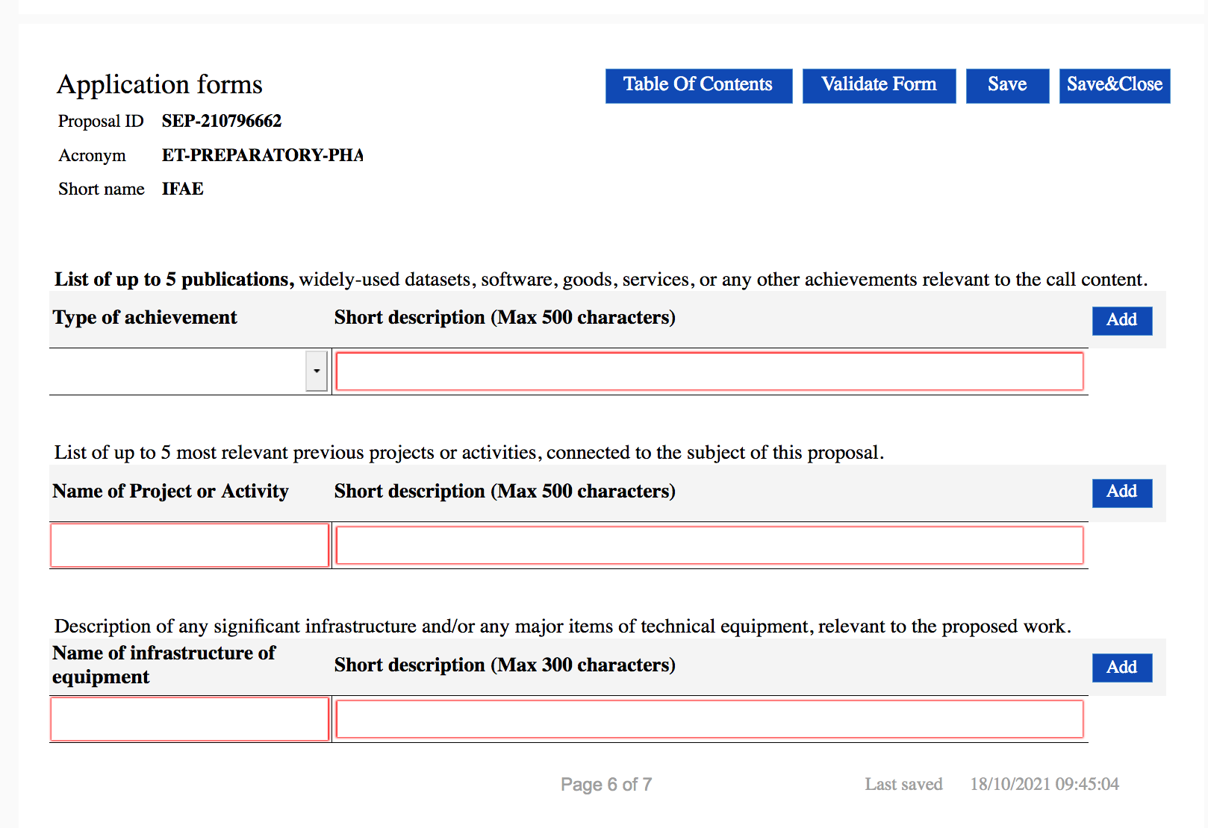
Participants information

Slide 8
Some notes on Part A (cont.)
We are still in the process of adding partners
→ Will rely on the information from Part B on financial details

Slide 9
Notes on Part B
Most urgent item is to converge on the WPs
During the last week in coordination with PD (Jo, Nando) we have converged into a refined proposal (see excel in the INDICO)
It includes 12 WPs taking into account the original proposal presented to the ET-SC in July and resonating on the ESFRI recommendations and the main missions of the INFRA-DEV call
Lets dedicate 20 minutes today to revisit them and collect comments.

Slide 10
WPs headers
WP1 Coordination and Management
WP2 Governance and Legal Aspects
WP3 Financial Architecture
WP4 Site Selection
WP5 Project Office
WP6 Technical Design
WP7 Risk Management
WP8 Transfer of Technology
WP9 Computing and Data Access
WP10 Climate and Environmental aspects
WP11 Outreach and Relation with Society
WP12 Ethics

Slide 11
WP details

Slide 12
WP details

Slide 13
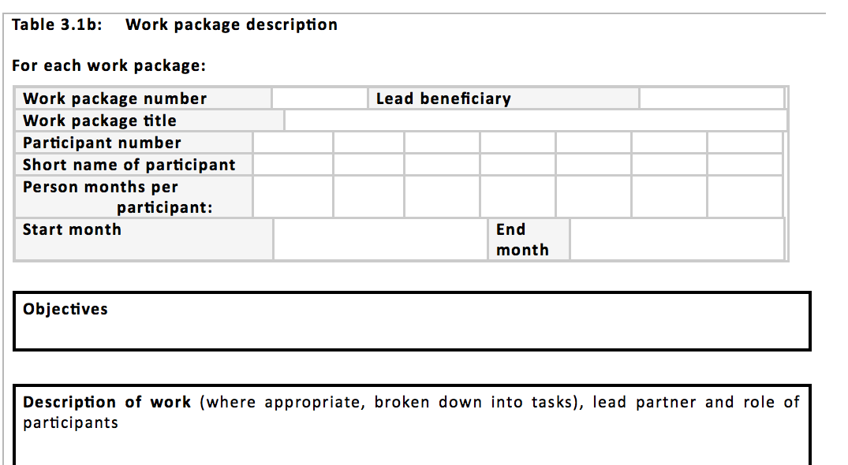
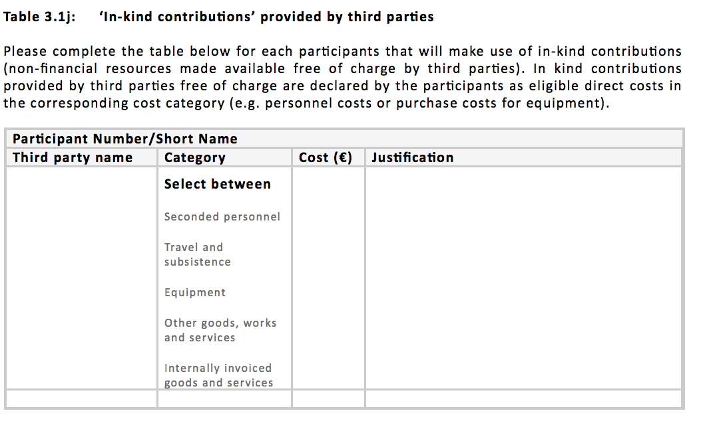
WP details
Lots of information in N tables to be
produced by each of the work packages

Slide 14
Next Steps on Part B → this week !
Reach agreement on the WP definitions
Collect EoI of Institutions/Countries
I will facilitate the process with a poll system
Define a Matrix of WPs, institutions, Countries
Converge into a satisfactory distribution
Identify TWO coordinators for each WPs

Slide 15
Plan for the Proposal
All done by 11th January 2022 (10 days margin)
Part A concluded by mid November
Complete list of institutions
Information from Participants
Budget (v1.0) (to be declared final by end November)
Part B
version 0.0 by mid November
version 1.0 by end of November
Version 2.0 by mid December
Final version by 20th December

