Slide 1
ET WP-coordinators INFRA-DEV meeting
WP3 – Financial Architecture
Executive report
^{17th} December 2021
Thomas Berghöfer – Chiara Arina - Attilio Sequi

Slide 2
Status of process for collecting objectives/deliverables
Funds come to the project timely and in due amount so to match the project’s needs
identify risks (price, time, technological, legal, etc.);
set a strong financial model and a common tool for all financial data.
To prepare the financial items of a signature-ready contract to commonly fund and build ET
Handbooks for design and construction phase and for operating phase
define guidelines with a fair sharing of costs and scientific, industrial and socio-economic returns among all participating parties in the ET collaboration;
Financial plan and Scenario analysis
investigate all aspects of the funding architecture required to ensure the construction, operation, and eventual decommissioning of the ET even with different alternatives in construction and legal settings;

Slide 3
Status of process for collecting objectives/deliverables
Deliverable (Number) | Deliverable name | Work package number | Short name of lead participant | Type | Dissemination level | Delivery date (in months)
1 | Handbook for design and construction phase | 3 |  | R | PU | 36
2 | Handbook for operating phase | 3 |  | R | PU | 42
3 | Financial plan and Scenario analysis | 3 |  | R, OTHER | PU | 48

Slide 4
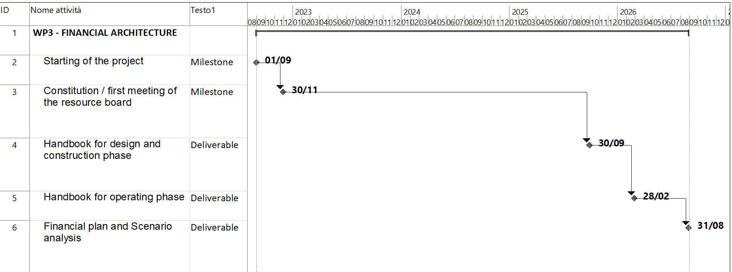
Deliverables and Milestones
Handbook for design and construction phase
Handbook for operating phase
Financial plan and Scenario analysis
D1 – Month 36
D2 – Month 42
D3 – Month 48
Constitution / first meeting of the resource board
M1 – Month 3

Slide 5
Interaction with the ET boards
WP 3
Financial architecture
EB
Executive Board
ISC
Instrument Science Board
SPB
Site Preparation Board
EIB
e-Infrastructures Board
IFB
Internal Financial Board
The IFB will have the mandate to evaluate the financial needs of the ET project, collecting and harmonizing the inputs received from the other technical boards. The IFB will, also, suggest the funding tools needed to the EB to elaborate a financial strategy to be proposed to the Council.

Slide 6
WP subdivisions inside each WP: WP 3
Current
Proposed
Cost evaluation
Cost sharing
In-kind contributions
Industrial returns
RI layout, Strategic issues and international networking
Cost evaluation
Cost sharing
In-kind contributions
Industrial returns
We think that “RI LAYOUT, STRATEGIC ISSUES AND INTERNATIONAL NETWORKING” in WP6 and WP2.

Slide 7
Person-months and how you will be collecting participants !!!(TBD)!!!
 | Months | Y1 | Y2 | Y3 | Y4 | TOT
 | DESY
 | INFN
 | UC LOUVAIN
 | WIGNER

Slide 8
Personnel needs from the INFRA-DEV funds
Financial manager / officer 60€k*3 years →180€K

Slide 9
WP-WP bilateral coordination – WP 3
WP 3
Financial architecture
WP1
Coordination and Management
WP2
Organization, Governance and Legal Aspects
WP4
Site Selection
Legal/Financial aspects of the RI implementation
WP5
Project Office
Strategic decisions making process
Planning
Risk management
Legal framework
Enlargement of the ET Consortium

