Slide 1
ET-PP INFRA-DEV Kick-off Meeting Report bis on ongoing discussions
Barcelona July 20th, 2022
R.Flaminio
A.Freise
R.Saban

Slide 2
WP6 H.Lueck, M.Punturo, R.Saban, A.Variola
Work has started for the implementation of an operative structure for the project management environment fitting the constraints of the present collaboration and organization.

Slide 3
WP6 H.Lueck, M.Punturo, R.Saban, A.Variola
The Project Schedule
3
2
4
1

Slide 4
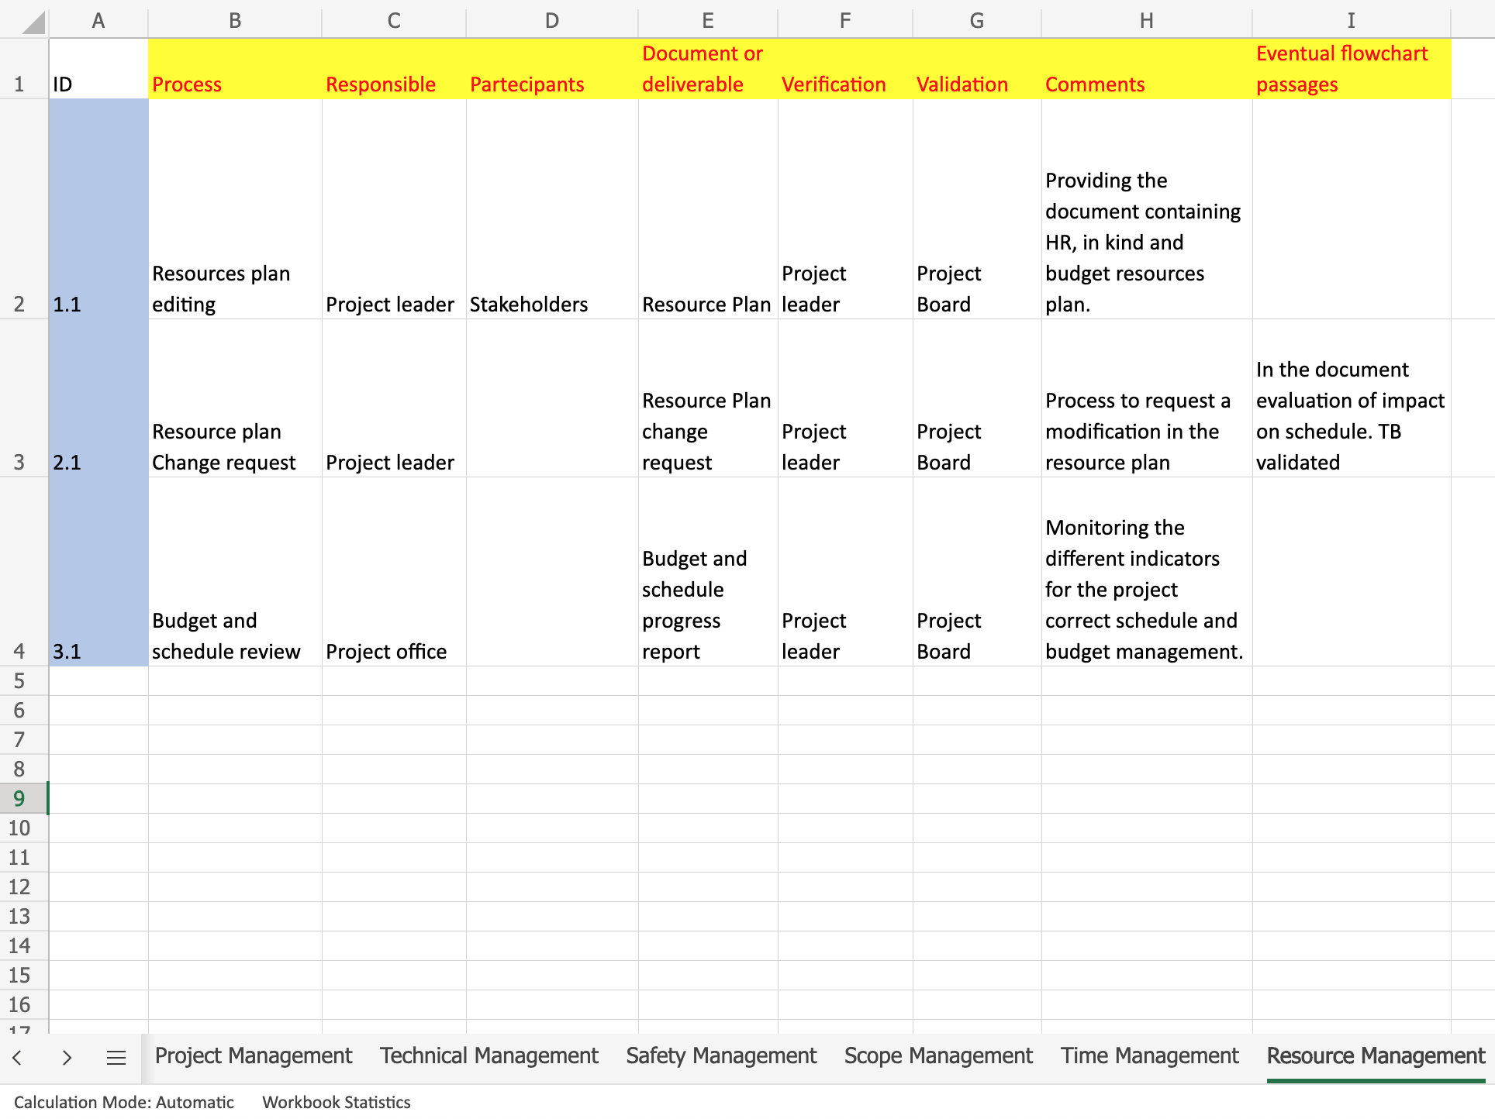
WP6 H.Lueck, M.Punturo, R.Saban, A.Variola
The global project management was divided in the different specific parts (project management, technical management, schedule management etc. ).
Each type of management was decomposed in its characteristic processes, and for each process the different milestones and the regulating documents and processes were identified

Slide 5
WP6 Systems Engineering
A systems approach to the Engineering of the Research Infrastructure which relates all the systems to each other and the detector itself as a single entity.
This will bring in the associated tools

Slide 6
WP 3 Ch.Arina, Th.Berghoefer, L.Kamlade, R.Saban, A.Sequi, A.Variola
There was a first discussion between the WP5 and WP3 where the necessity to work with standard tools for the main management processes were pointed out.
The main proposal is to work in MS environment with MS PRO and Teams as tools for document sharing and editing.
The necessity to decompose in processes for the two WP to identify the different roles was identified. It was also agreed that, in principle, WP3 should assure the budget and finance management.

Slide 7
WP2 / WP3 / WP8 Administrative Computing
Document storage and lifecycle Management
Resource management
Workflow of administrative processes
Budget
Contract follow-up
…
The administrative computing environment needs to be defined together with the main users Finance, Procurement and Human Resources but also with the Project Office, the Engineering Department and the Collaboration

Slide 8
WP4 Civil Engineering
With the creation of the Engineering Department with the competences for
the technical systems linked to the gravitational wave detector
infrastructure systems
proceed with the integration of the Civil Engineering activity into the Engineering Department

Slide 9
WP7 Partnership, sustainability and Innovation
Mostly targeted to the technical and the infrastructure systems of the Engineering Department
Sustainable and innovative solutions must be adopted and partnerships have to be built in order to attract industry

