Slide 1
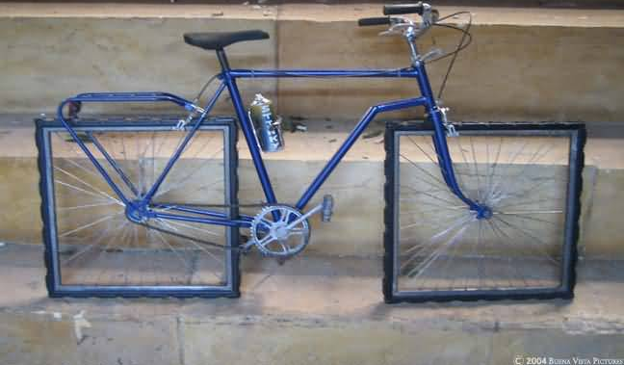
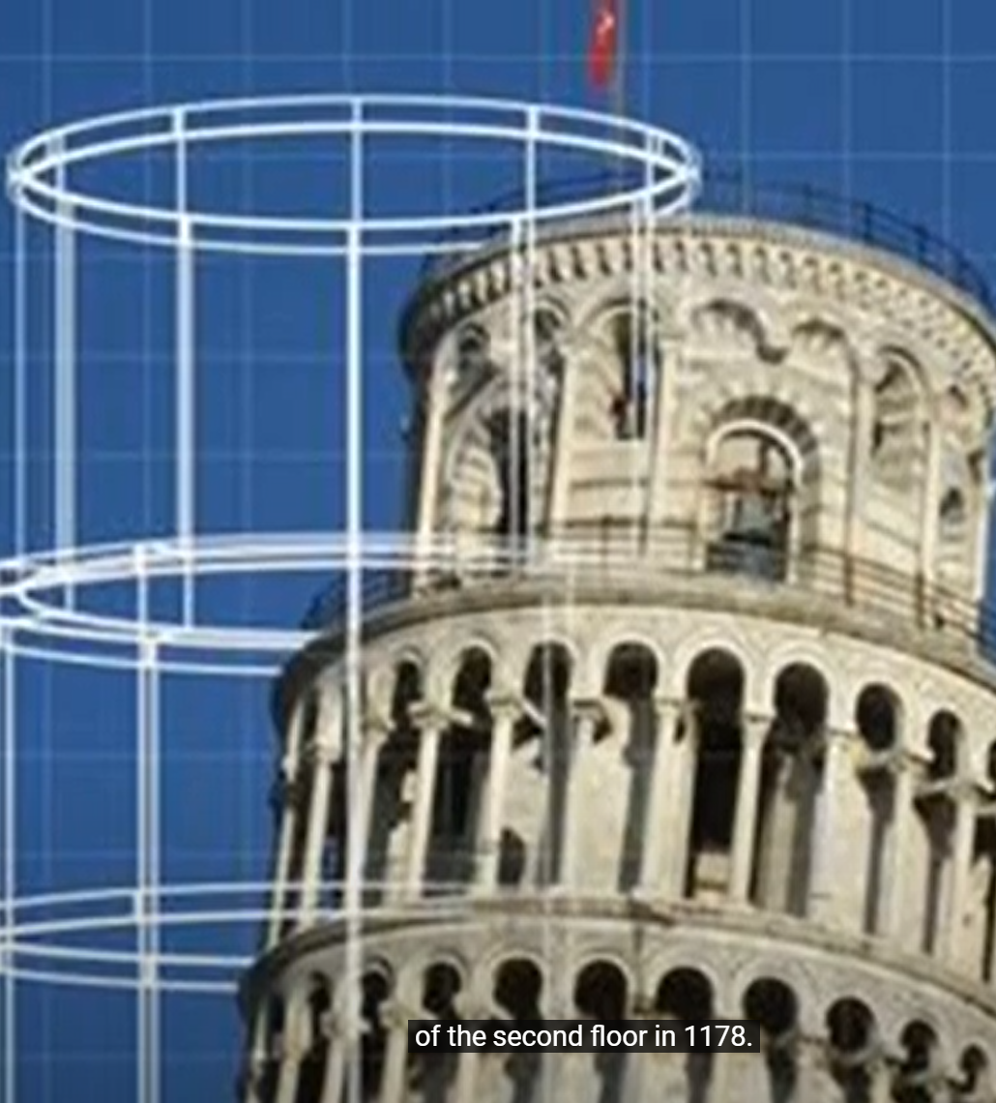
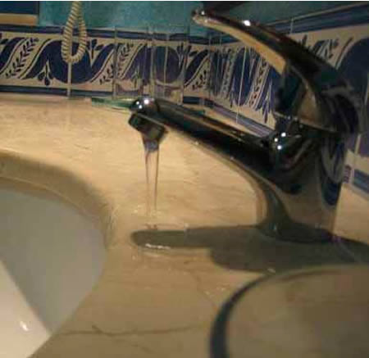
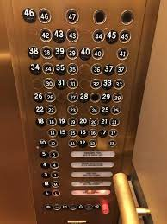

WP6-Technical design(s)
Michele Punturo, INFN-PG
Harald Lück, LHZ and AEI
Paolo Chiggiato
ET-0173A-22

Slide 2
Design of ET
2011
ESFRI
https://apps.et-gw.eu/tds/ql/?c=7954
https://apps.et-gw.eu/tds/ql/?c=15418
Updated CDR driven by the ESFRI needs in terms of releasing time and contents

Slide 3
Design of ET
https://apps.et-gw.eu/tds/ql/?c=15418
2011
https://apps.et-gw.eu/tds/ql/?c=7954
ESFRI
A subteam of the ET Steering Committee, in few months, assembled the study during the preparation of the ESFRI proposal
3 years work, of a large team of scientists, with an EU support of 3M€
Updated CDR driven by the ESFRI needs in terms of releasing time and contents

Slide 4
ET technical design report(s)
The production of the ET TDRs must follow the original ET approach; it needs
  Competences
  Human resources
  Financial support
  Study
  Time
The output(s) must have
  Feasibility
    We need to be at the forefront of the next future technology, not beyond!
  Roboustness
    Backup solutions, risk evaluation, contingency, …
  Internal coherence
    Interfaces, interfaces, interfaces, interfaces, interfaces, interfaces, ….
  External constraints compatibility
    Time, funds, performances

Slide 5
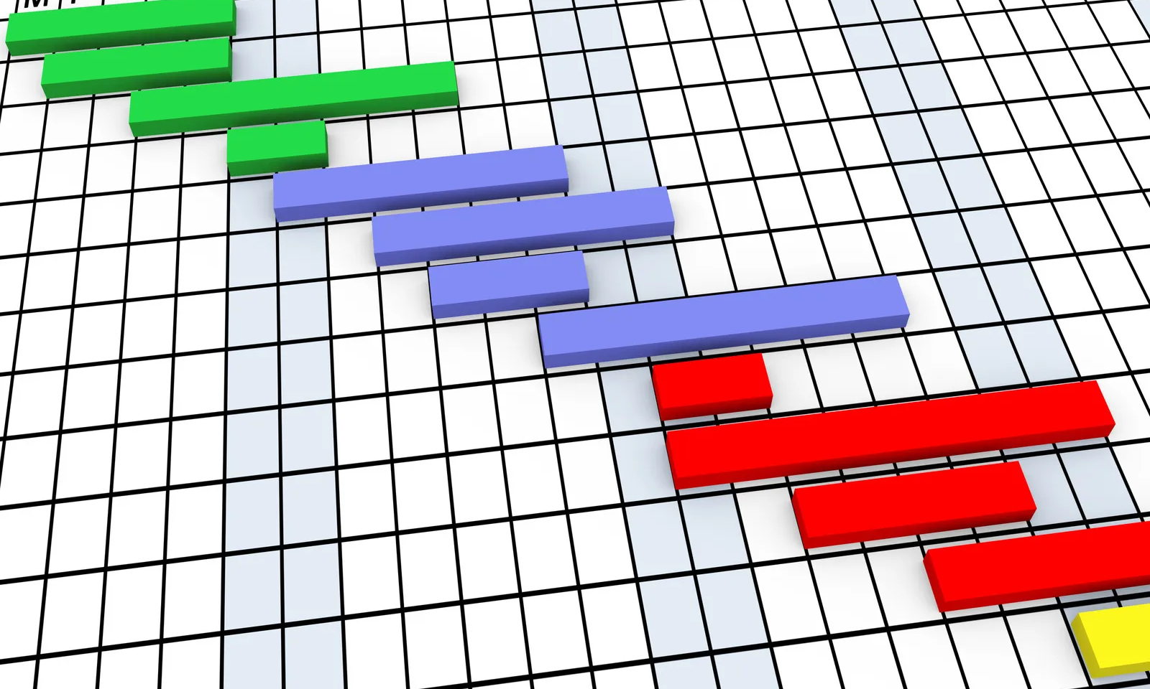
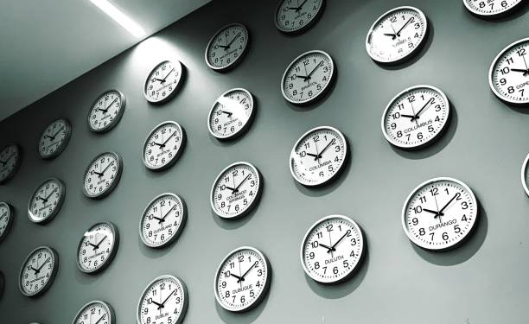
Jeopardized situation
We have timing & planning statements in
  ESFRI proposal
  INFRA-DEV
  CERN MOU on vacuum
  SPB/SCB
  National activities?
Are they consistent and, moreover,
are they realistic?

Slide 6
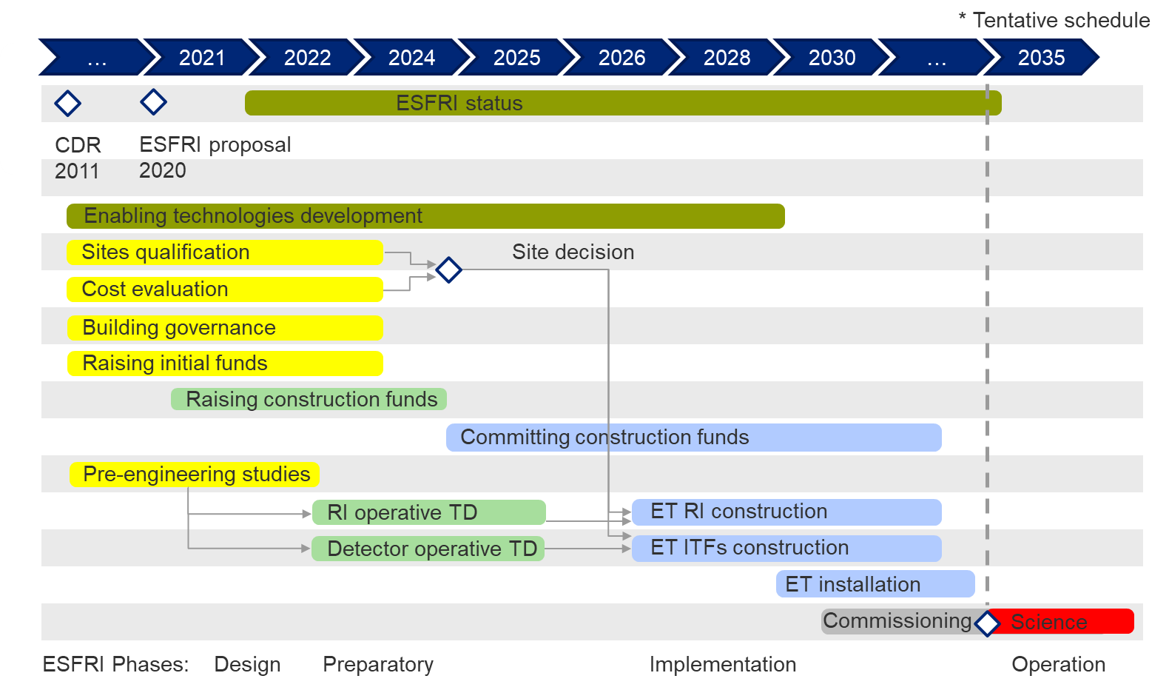
ESFRI Proposal
Site selection Q3 2024
  Bid Books early 2024
    Pre-engineering study needed to give common inputs to the national host teams: end 2022
    Cost evaluation standards:
      End 2022
RI operative TD: end 2025
Detector operative TD: end 2025

Slide 7

INFRA DEV Grant Agreement Annex 1
Let us consider M₀= Sept 2022
  TDRs M24 →Sept 2024
  But WP4:
    D4.4 Report on 3D geology, hydrology, etc. model with localisation of the ET infrastructure (M30); → Mar 2025
    D4.5 Updated cost and schedule estimates of the excavations. Including, if necessary: instrumentation for Newtonian Noise cancellation; costs of debris removal; costs of land acquisition, permitting, etc. (M42). → Mar 2026

Slide 8
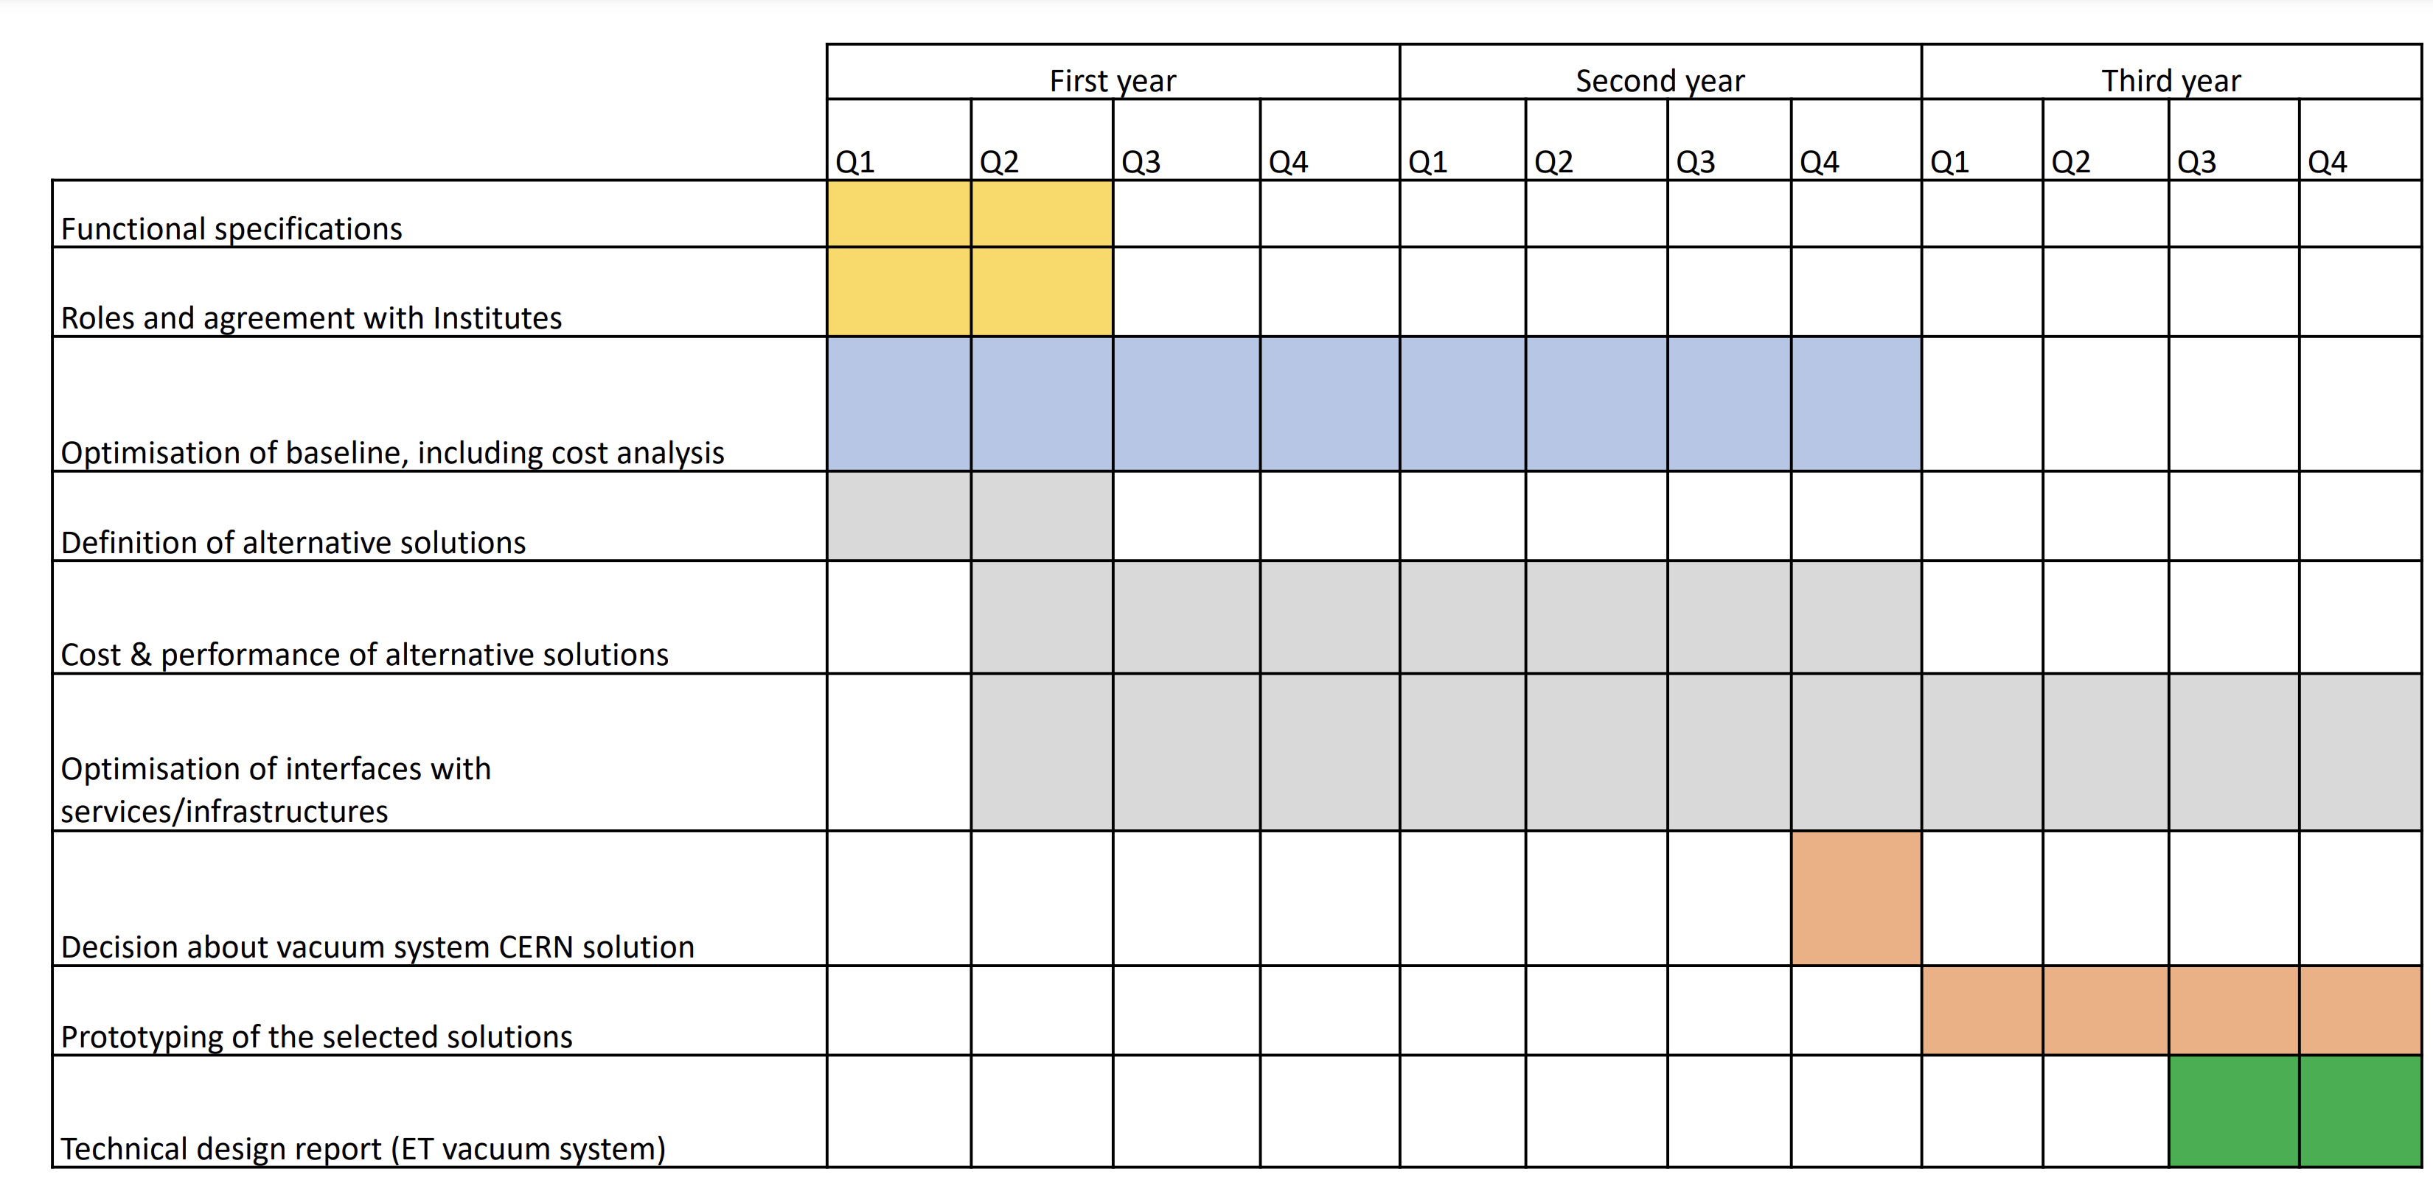

CERN Vacuum pipe time-plan
T₀=Sept 2022
  Optimisation of the baseline M24 (Sept 2024)
  TDR M36 (Sept 2025)

Slide 9
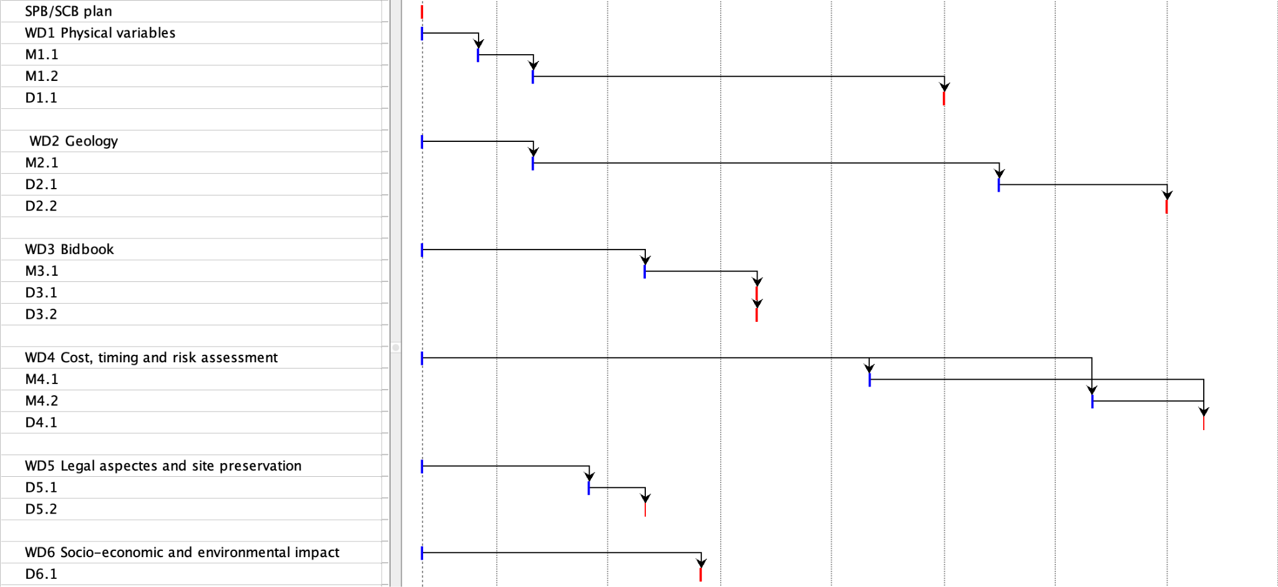
SPB/SCB Timing
2023
2024
2025
2026
ET-PP/M4.1
ET-PP/D4.3
ET-PP/D4.4
ET-PP/D4.5
ET-PP/D4.1
ET-PP/D4.2

Slide 10

Proto-council
Advisory Bodies
Scientific and Technical Advisory Committee
Program Advisory Board
ESFRI Coordinators
Stan Bentvelsen, Antonio Zoccoli
BGR (Board Governm. Represent.)
Policy & monitoring
BSR (Board Scient. Represent.)
Project Directorate
Jo v.d. Brand, F. Ferroni
ET Collaboration
CERN
MOA CERN-INFN-Nikhef
P. Chiggiato
TDR ET Vacuum Pipe
monitoring
Providing services
Policy proposals+
monitoring
CB
Collaboration Board
EB
Executive Board
  Deliverables:
  Beam pipe vacuum
  Site Preparation
  Civil Infrastructure
monitoring
Informing
reporting
delivering
managing
managing
reporting
INFRA-DEV
M. Martinez
WP1 Coordination and Management
WP2 Organization , Governance, Legal
WP3 Financial Architecture
WP4 Site Preparation
WP5 Project Office/Engineering Dept.
WP6Technical Design
WP7Transfer of Technology
WP8 Computing and Data Access
WP9 Sustainable Development Strategy
WP10 Education, Outreach, Citizen Engagement
SSB
Services and Standards Board
SF
Science Forum
reporting
Requirements
& competences
managing
Providing services
participating
supervisioning
Communication Office
Strategy
ISB
Instrument Science Board
EIB
Electronics/Computational Infrastructure Board
OSB
Observational Science Board
SCB
Site Characterisation Board
Project Office
setting
Engineering Department
ET Observatory
Specific Boards

Slide 11
ET Interfaces (over-simplified)
SPB
Geophysical qualification
ISB
Geometry,sizes (when)
Geotechnical qualification
Specifications, geometry
Requirements
Geometry,sizes (when)
ED
VAC
Specifications, Geometry

Slide 12
Logical correspondence
EB
ISB
SPB
EIB
OSB
Div1
Div2
Div3
…
WP1
WP2
…
ET design
MacroSystem1
MacroSystem2
Macrosystem3
…
System1
System2
System3
…
Subsystem1
Subsystem2
…
Element1
Element2

Slide 13
Mapping example
Level
Object
Macrosystem
  System
    Subsystem
      Element
Macrosystem
  System
    Subsystem
      Element
ET-LF interferometer
  Suspension
    Payload
      Marionnette
Underground Infrastructures
  Tunnel
    Dewatering subsystem
      Water pump

Slide 14
Inventory and Mapping: possible steps
The EB creates a list of Macro-systems mapping them to the specific boards (the interaction with the PO/ED is fundamental)
The Specific Board chairs (mainly ISB+SPB) create an initial list of systems
The Divisions complete the list of systems and subdivide them into subsystems
WPs elaborates the subsystems into a collection of elements
  Are we able to map the needed systems/subsystems/elements to the current divisions/WPs?
  Do we need new WPs or do we need to optimize their definition/distribution?
Are we creating a TDR for Macrosystems? Or for each system? Or a hybrid solution?

Slide 15
Itemization
Each item (no matter at which level, system, subsystem or element) is defined by parameters:
  Input parameters:
    Requirements (including time, if needed)
    …
  Output parameters:
    specifications (including timing, if needed)
    …
  Relational parameters
    Affected by (element, subsystem, system)
    Affecting (element, subsystem, system)

Slide 16
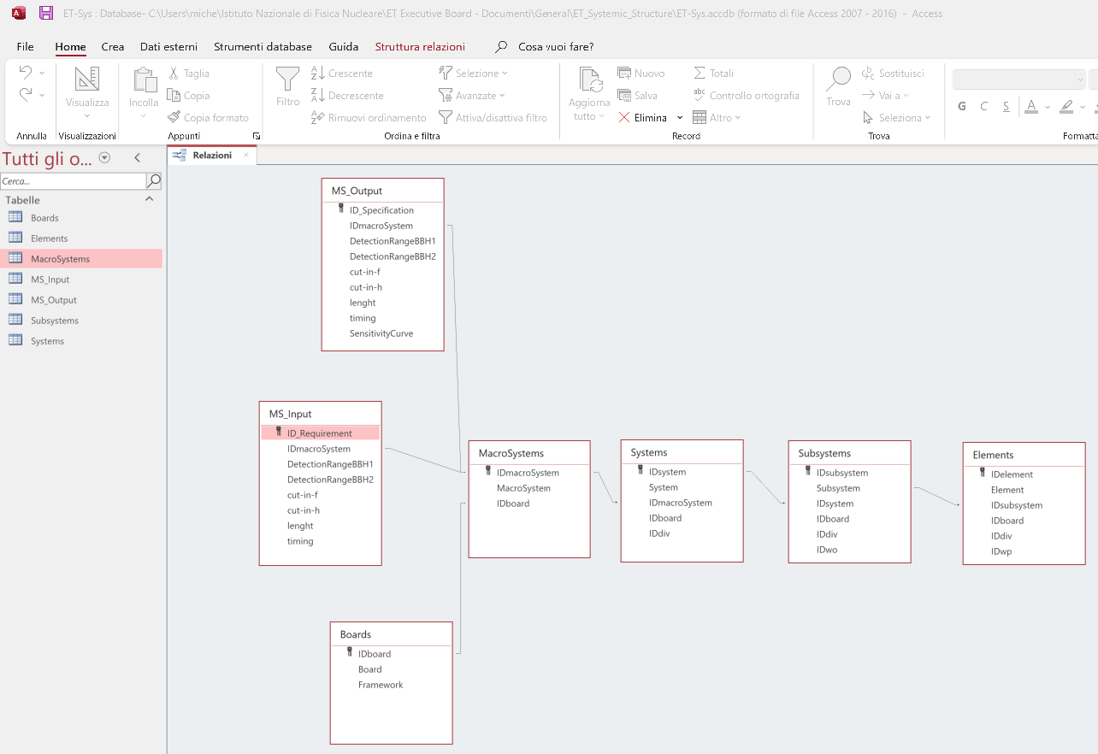
Example of a relational DB using MS Access

Slide 17
Looking around
The EB invited Didier Contardo (IN2P3) who had the responsability of the CMS upgrade
  Very interesting presentation
It doesn’t work for ET!
Interfaces, interfaces, interfaces, ….

Slide 18
CMS lessons
Credits: Didier Contardo

Slide 19
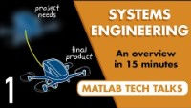
Systems Engineering
Ok we need systems engineering
The EB and in particular the ISB (but not only the ISB) have to elaborate
macro-system / system / … subdivisions
Confronting with other large experiments, we need to elaborate our software solutions
TDR(s) and timing will finally be defined, based on WBS, tasks, interfaces, requirement definition …
Thread is started in the EB

Slide 20

Project Management (PM)
OK, through Systems Engineering we understand how to structure the information and the outputs
Through the PM we define how to proceed
  In the Collaboration the top PM body is the Executive Board
    The EB is optimally interfaced with the ET Observatory organisation inviting the Project Office head and the Engineering Department head as permanent observers in the EB
  The spokesperson (SP) and the deputy have regular meetings with the PO head

Slide 21
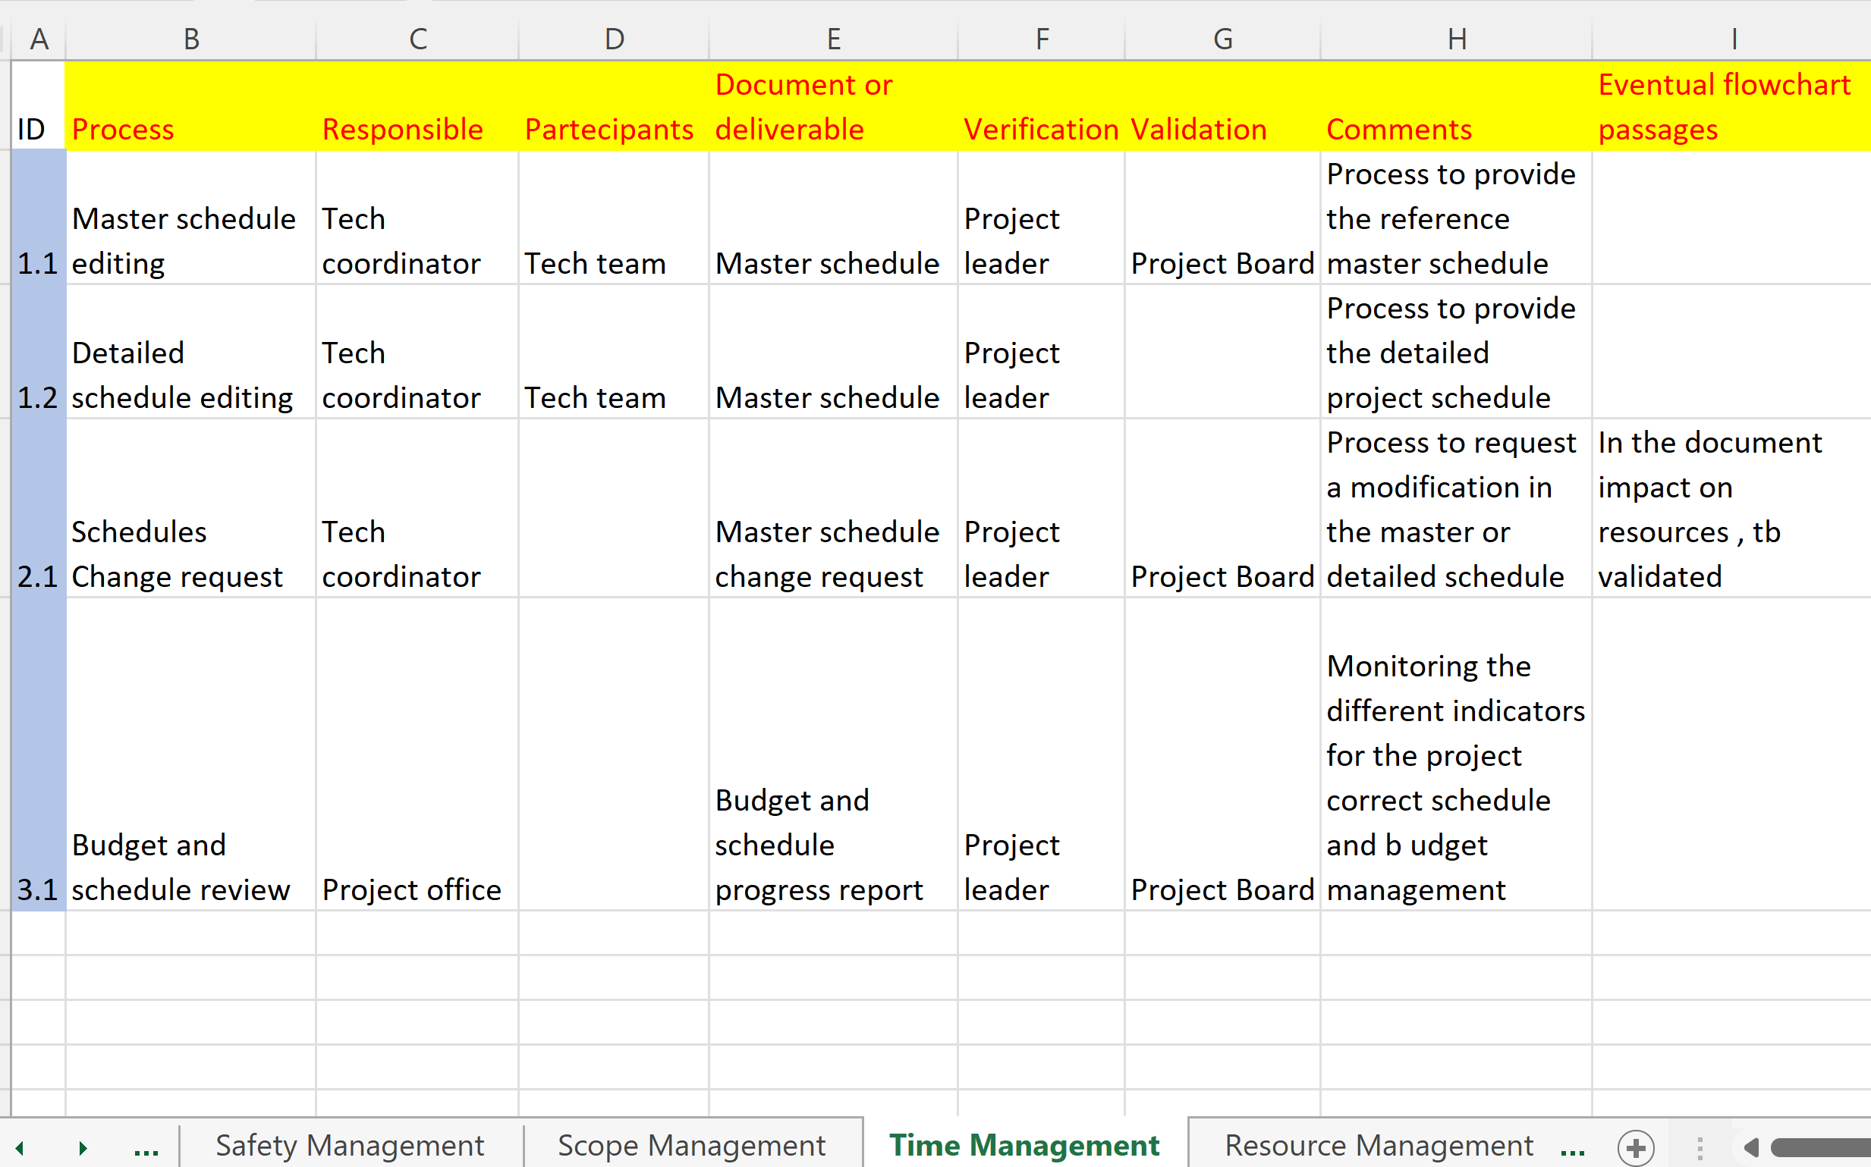
PM: Processes definition

Slide 22
Conclusions
TDR and timing definition is a complex process that cannot be realised on an occasional basis and independent evaluations
They need professional and custom tools for the correct evaluation of the time and costs
We need to approach them in an iterative way, going deeply into the WBS structure and the the details of each item
Interfaces, interfaces, interfaces, …

