Slide 1
WP9
ET Sustainable Development Strategy
N. Arnaud, R.Galler, E. Hauzinger, S.Katsanevas, M.Marsella, A.Paoli
Objectives
Minimize the global carbon footprint of the Einstein Telescope (ET)
Evaluate landscape, environmental and societal impact and implement valorization and mitigation actions
Contribute to Sustainable goals
Links to site selection (WP4), technology WPs (WP6,7,8) and communication (WP10)

Slide 2
Topics to be discussed
Carbon Footprint types
Current efforts,
HEP/Astrophysics Infrastructures
EGO/Virgo
LVK
Future cases an exemple: computing in ET
Contributions to climate monitoring
Planning and Deliverables

Slide 3
Task 9.1 ET Carbon footprint assessment and mitigation (CNRS, EGO, INFN)
Sub-task 9.1.1 ET carbon budget. The first sub-task is an accurate evaluation of the ET carbon footprint during both its construction and initial operation stages.
All power consumptions of the infrastructure will be considered (instruments, service plants, computing facilities) as well as those linked to the transportations (commuting, supplies, travels) by analysing all the scientific scenarios envisioned.
The study will be based on simulations and projections using literature standards, plus some critical revision of the existing studies for the current ground-based gravitational-wave detectors: the two LIGO instruments (USA), Virgo at EGO (Italy) and KAGRA (Japan, underground).
Surveys made by large research infrastructures like CERN , other large Astroparticle and Astrophysics Infrastructrues will be used as well, both for their methodology and as inspiration for our actions for ET.

Slide 5
Snowmass 2021

Slide 7
https://labos1point5.org/

Slide 9
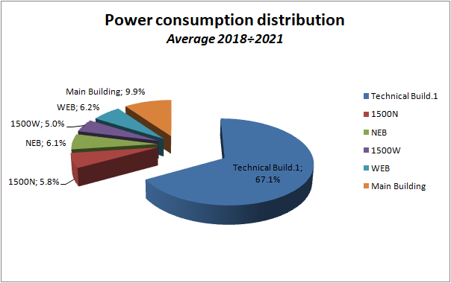
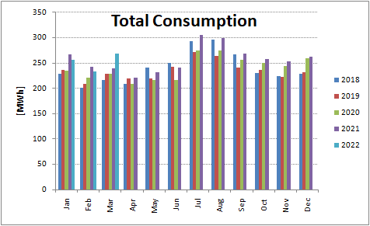
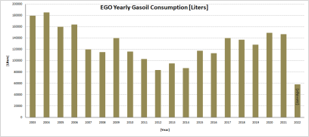
EGO operation and Virgo collaboration activities provide an excellent field for projections
EGO Operation Budget: 10 M€
Included above: travel (INFN/CNRS), Computing, Electricity/liquids
Virgo

Slide 10
Task 9.1 ET Carbon footprint assessment and mitigation (CNRS, EGO, INFN)
Sub-task 9.1.2 ET Energy consumption optimization. The goals of this sub-task are twofold.
First, to enforce a responsible energy consumption policy by
increasing the efficiency of all devices;
reducing the ET global need for energy thanks to an optimized design of the most energy-consuming areas;
recovering as much emitted energy as possible (e.g. heat from cooling systems) to reuse it.
Second, to ensure a responsible production for the consumed energy, whether it be produced on site (e.g., by arrays of solar panels) or provided by external suppliers.
Such optimization will be done separately for the three main elements of the on-site infrastructure – underground constructions, surface buildings and the local computing center – that all have different requirements to fulfil and challenges to meet. Joint work with other work packages (WP6, WP7, WP8) will be necessary to complete this sub-task.

Slide 11
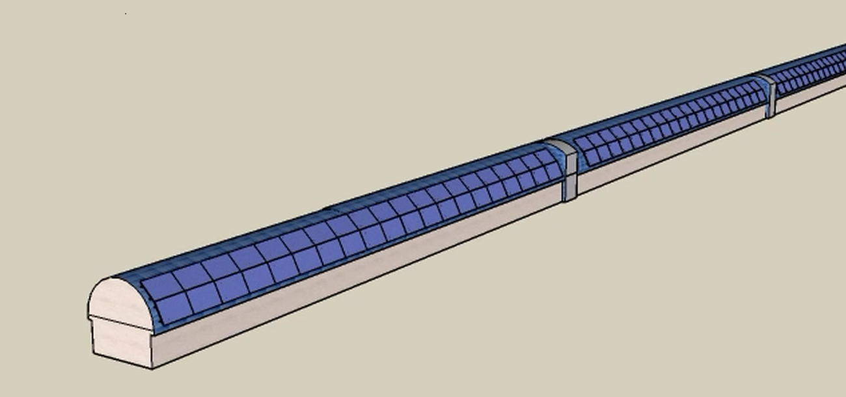
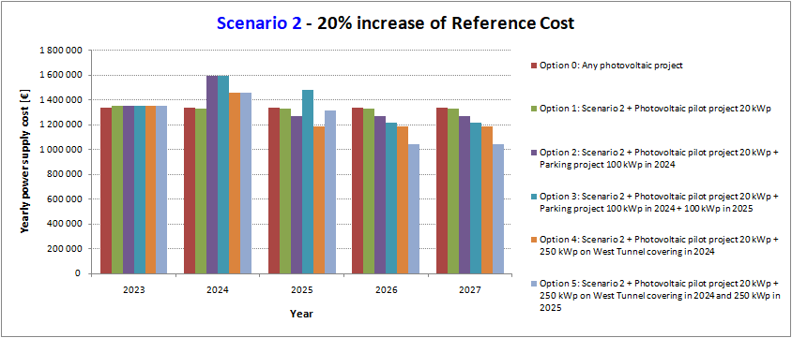
Accepted by EGO council, tests for interferences with sensitivity
Annual power consumption: 3 GWh
Daily average power 350 kW
A. Paoli
Option 3, scenario 2,
10% of energy in photovoltaics
100 k€/year savings

Slide 12
LVK Sustainability commitee
Gijs Nelemans
David Shoemaker
Szabi Marka
Stefan Hil
Mario Martinez
Luca Baiotti
Stefan Hild
Irene Fiori
Quynh Lan Nguyen
Steven Penn
Common LVK management agreement, intensify its work, support of EGO initiatives

Slide 13
LVK Carbon footprint I
LVK existing document (3 years old)
Power.
Total power usage: LLO reports that they use on average 800 kW. This leads to a rough yearly number of kWh of 800*24*365 of 5,088,000 kWh -- 5GWh.
For LHO: we average 700,000kWh per month. A good estimate for the year is 8,4 GWh. A very nice fact: the power for LHO is mostly renewables.
Virgo:average power consumption of the EGO site is 320 kW annual energy consumption of the EGO site is between 2.4 to 3.2 GWh/year. In 2019 it has been 2.7 GWh.
KAGRA: Power (kWh) consumption at KAGRA site.2,2 MWh.
LHO is >50% higher power usage than LLO. Surprising? ➔ Weather
Summary power usage: LHO: 8.4 GWh (100% renewables!), LLO: 5 GWh, Virgo: 2.7 GWh, KAGRA: 2.2 GWh Total is 18.3 GWh. subtracting LHO (green!), end up with 10 GWh.
Using 1 kg CO2/kWH, get total power carbon footprint: 1e7 kg of CO2. ~1000 tons of CO2

Slide 14
LVK Carbon footprint II
Computing. LIGO: O3 computing cycles, 500 million CPU core hours, over roughly 18–24 months Baseline computing estimate: 250 million CPU core hours per year. Power/computing comes from ~10 different sources. Caltech. Milwaukee. XSEDE. etc. Assume average carbon footprint for US power. Virgo (not known yet). Kagra: The total computing cycles of KAGRA’s dedicated clusters, assuming a duty cycle of 80% for each system. The total number is approximately 550k computing cycles/day (≈ 16M computing cycles/month). Combined computing is ~700M CPU core hours per year Supposing that 10 CPU core hours requires 0.52 kWh. So 700M CPU core hours requires 364 MWh each year.
Using 1 kg CO2/kWH, get total power carbon footprint ~400 tons of CO2

Slide 15
LVK Carbon footprint III
Travel: Start with 2 main meetings? Start with LVK specific ones. ask LVK labs business office to give data on trips. At some point need to do poll. Also contact previous two LVK meetings. 3 Virgo weeks per year. Start google doc/sheet to collect information. Some scientific meetings are almost completely “our” community. Start with actual LVK collaboration activities (because we can influence). Exemples: Sonoma meeting: Asia (Japan, australia): 300, US: 200 Europe: 112, S. America (mostly Brazil): 12. .Using this calculator, it’s 1.3 tons of CO2 from CDG to SFO. Sonoma meeting generated roughly: 200 tons of CO2. Glasgow meeting: Using the participant country breakdown for the Glasgow LVC meeting in 2016: one calculates ~120 tons CO2
Kagra:They have lists of participants of KAGRA members to LVK related conferences and in principle could estimate the total number of km traveled, maybe separating planes and other means of transport. But we better have a common way of doing this. How do we want to estimate the impact of travel? 24th KAGRA face-to-face meeting (University of Tokyo., December 2019) Participants: 110 ~ 54 tons CO2, 5th The KAGRA International Workshop (KIW), Perugia - Italy, 2019 ~123 tons CO2; ù
Two annual international LVK conferences, plus assorted workshops: ~400 tons CO2

Slide 16
LVK Carbon footprint
Bottom Line
Power at sites: 1000 tons CO2 per year,
Travel: 400 tons CO2 per year
Computing: 400 tons CO2 per year
Total 1800 tons CO2 per year (TBC)
The group will study the use of photovoltaic and geothermal energy.
Photovoltaic, sea deployments
Reuse dissipated energy from computing center
Reuse dissipated energy from vacuum and cryogenic installations ?
Efficient internet / wifi distribution?
Organize passive house buildings, green car shuttle,
Videoconferences instead of travels? how much we gain , find the numbers. Reduce travels, taking into account needs of new scientists.

Slide 17
LVK task: Organize 3 workshops internal to the community and the last evening open to the public in the context of the UN International Year of Basic Sciences for Sustainable Development 2022
LVK I Europe , November ? EGO or Paris (UN headquarters)
LVK II , US (March 2023 , Northwestern)
LVK III Asia, (September 2023, Toyama)
Tentative Agenda
Estimate Carbon footprint of
LIGO, Virgo, KAGRA, Projections of ET, Projections of CE
Reports, discussions with
Astronomical Research infrastructures J. Knodleseder et al. (Arxiv 2201.06748),
Particle Physics Community
Expand: energy for operation, communication and travelling needs, computing
Keynote speakers on green technologies for energy production and climate monitoring, Part I
GW low frequency sensor networks as monitors of the environment and natural catastrophes
LIGO, Virgo, KAGRA, ET, CE
Synergies with underground labs
Keynote speakers on green technologies for energy production and climate monitoring, Part II
Closing: Global coordination (IGWIN ?, Multimessenger ? ) on BSSD

Slide 18
A case for projection
Computing

Slide 20
Optimistic

Slide 25
WP7-WP9 (Mauro Morandin Rob van der Meer)
WP7 will perform:
Risk analysis on maturity of technologies and industry capabilities needed in the C&O phase;
Mapping of engagement initiatives already in place in partner countries, both for ET and other RIs;
Address gaps from Risk analysis and extend activities into an engagement plan for national and international activities;
Execute this plan and report on activities at the end of the project;
WP7 does not have an active sustainability component in our plans, but we might consider sustainability as one of our gaps and integrate it in our engagement plan. On general technologies we suggested to WP6 to exchange information on the items below. We could use this list as starting point for our discussion on information exchange.
list of maturity of technologies; * list of industry standards and capabilities; * Gap analysis on maturity and capabilities; * industry Engagement plan for national and international activities; * updates on industry engagement activities;
We foresee to request/receive from WP9 to WP7 * WP7.2: List of (necessary) technologies for risk analysis on maturity and industry capabilities. o Q: At what moment can we learn from the technical design what your requests to industry are? * List of industry contacts found by WP6 activities. * Requests for industry contacts, necessary for WP6 activities. * WP7.1 Innovation plan: We could use you input on possible innovation activities * WP7.3 IP: We could use your input on possible IP sensitive developments.

Slide 26
Task 9.2 Landscape, environmental and societal impact
(Austria, INFN, EGO, CNRS)
Sub-task 9.2.1: Assessing and minimizing the ET impact on its environment. This sub-task will study
the impact of different scenarios for the design of the underground structures (tunnels, shafts and caverns) to minimize interference with external surface infrastructure networks, urban and natural areas;
the development of layout concepts for the foreseen surface infrastructures taking into account technical requirements, environmental constraints and connection with existing infrastructure and service plants;
how to optimize the surface transportation network and design an underground transportation system for personnel and materials, by identifying the paths, the types of users, the vehicles needed, and also by considering the highest safety standards;
the planning and management issues related to the definition of critical areas (safety and environmental) and to the necessary investigations to obtain the associated risk assessments;
the development of integrated processes for environmental assessment evaluation in agreement with local regulations;
the study of the impact on biodiversity and on the hydrologic cycle;
finally, a global approach for non-hazardous and hazardous waste management and recycling both during the construction and operation phases.

Slide 27
Sub-task 9.2.2 Environmental management approach.
This subtask, inspired by relevant CERN actions, will study the organization to manage environmental issues.
As part of its Environmental Protection Strategy, ET may launch
an ET Environmental Protection Steering Board to identify and prioritize environmental areas to be addressed and to propose programs of action, and
an ET Energy Management Panel to monitor the ET energy consumption and identify measures to improve efficiency and promote energy re-use.
These actions will be developed in the framework of the environmental protection regulations of the ET hosting and member states.
Interfaces with Governance WPs

Slide 28
Task 9.3 Contribution to sustainable goals (EGO, INFN, CNRS) ET will extend its sensibility down to the Hz range. It will be necessary to deploy surface and underground distributed or mobile monitoring networks to measure
low frequency seismic activity and other vibrations (e.g., sea waves),
electromagnetic noise and atmospheric pressure variations that may have an impact on GW measurements.
Through these monitoring systems developed for the ET noise mitigation strategy other studies in geosciences and atmospheric sciences can be supported also developing specific machine and deep learning techniques for data analysis. Consequently, ET can become an interdisciplinary and technological hub open to a variety of collaborations with geoscientists, electromagnetic and data science expert and contribute to the studies on natural hazards and climate changes.

Slide 29
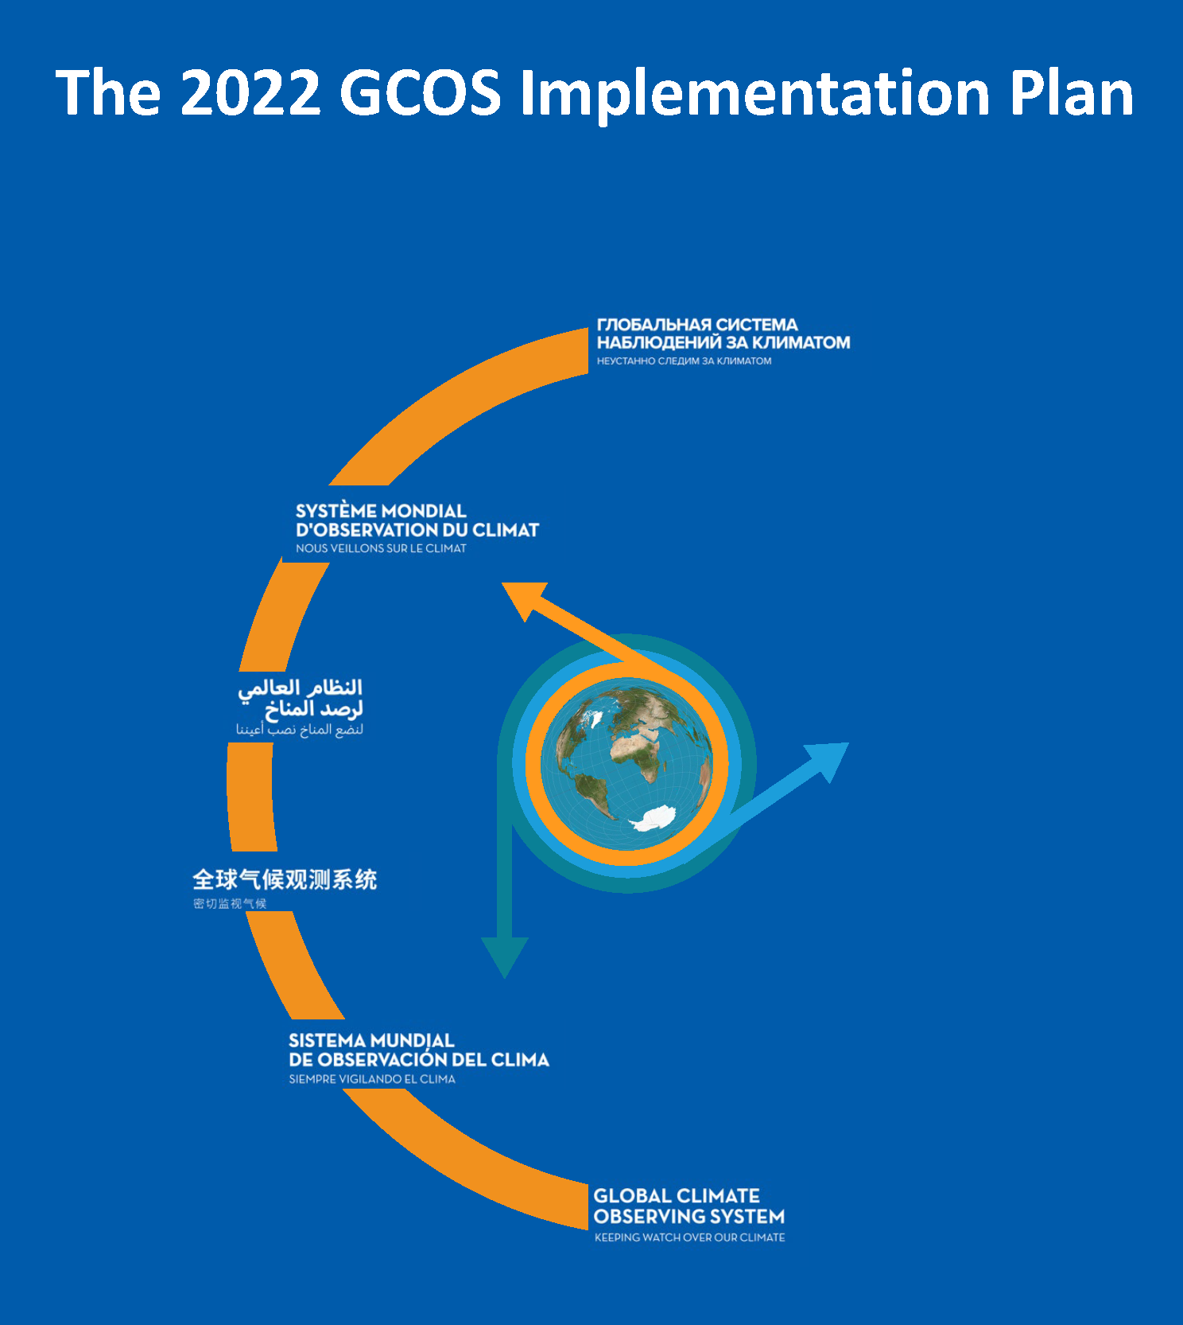
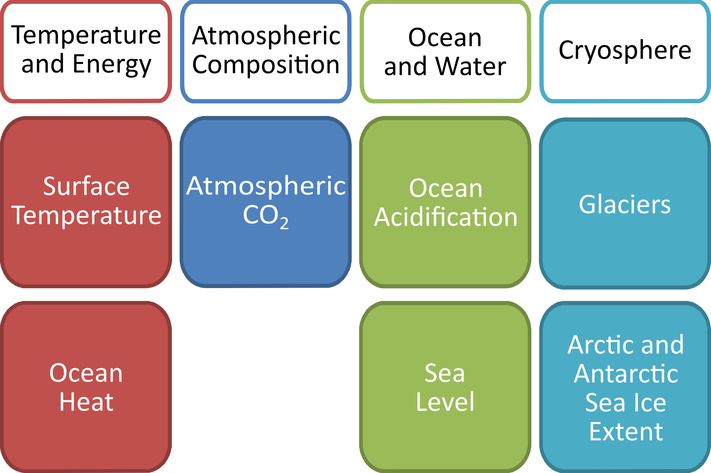
Participate with our sensor networks to climate monitoring but also natural catastrophe warning networks

Slide 34
Planning
Year 1: bibliography + survey of existing practice and plans in the scientific community at large; collecting data from existing GW facilities; discussion with other WPs and the relevant divisions of the ET collaboration to get a better idea on what is planned.
Year 2: first draft of the plan (including rules and long-term goals); discussion with ET; discussion with existing GW facilities to see what could be tested/implemented.
Year 3: iterations of the plan
Year 4: completion.

Slide 35
Internal Deliverables
An assessment of the CO2 footprint linked to construction/operation stage of the infrastructure, computing facilities and transportation and supplies for personnel. A report on the strategy for minimization of the CO2 emission.
A report on the environmental impact of ET RI on the landscape and on the effect of surrounding urban areas. A roadmap for establishing the organization and the mandate for an ET management boards on sustainability and environmental protection
A report on the contribution of the ET measurements on climate change studies, low latency alert and on the technologies to develop to enforce this activity .
Deliverable (number) | Deliverable name | Work package number | Short name of lead participant | Type | Dissemination level | Delivery date (in months)
9.1. | ET Sustainable Development Implementation Strategy | WP9 | CNRS | Report | PU | 18
9.2. | ET Environmental impact assessment and mitigation strategy | WP9 | INFN | Report | PU | 24
9.3 | ET CO2 footprint ET assessment and mitigation strategy | WP9 | EGO | Report | PU | 36
WP Deliverables

