Slide 1
ET-PP INFRA-DEV
Kick-off Meeting
Barcelona July 19th, 2022
R.Flaminio
A.Freise
R.Saban

Slide 2
Outline
WP5 in short
  The Project Office
  The Engineering Department
  The timeline
  The resources
A brief incursion into the topics suggested by Mario, namely a short report on the discussions which we started and are ongoing with other WP of INFRA-DEV and Boards of the Collaboration

Slide 3




The context
1
We are in the process of creating a research infrastructure complete with a governance, a collaboration of scientists, the procurement service, the resource management, the technical and the engineering departments, etc.
Which in turn has the project of designing, procuring, installing, building, commissioning and operating a gravitational wave detector with all the associated technical and infrastructure systems
2

Slide 4
The Project Office : the goal
Guarantee, that the as built research infrastructure, comprising
  the gravitational wave detector
  the technical systems
  the infrastructure systems
fully complies with
  the requirements
  the parameters
  the layout
detailed in the Technical Design Reports
without having undergone changes which were not endorsed by the stakeholders
within the schedule and the budget

Slide 5
The Project Office: the actors
Boards in the Collaboration
Executive
The Engineering Dep
Safety
Instrument Science
Quality Assurance
Observation Science
Procurement
Project Office
other …
Project Management Environment

Slide 6
The Project Management Environment
the technical design
the engineering
the technical specifications
the risks
the budget
the schedule
consultative and executive bodies
to monitor
to control
to coordinate
to report
These activities are project-wide and make use of methodologies and tools which are the same across the whole of the Einstein Telescope construction project.

Slide 7
The Project Office: a service/a discipline
The Project Office proposes/imposes to the actors of the project
  a methodology
  procedures
  tools
  support
Which aims at guaranteeing quality, coherence, transparence
but which imply a discipline

Slide 8
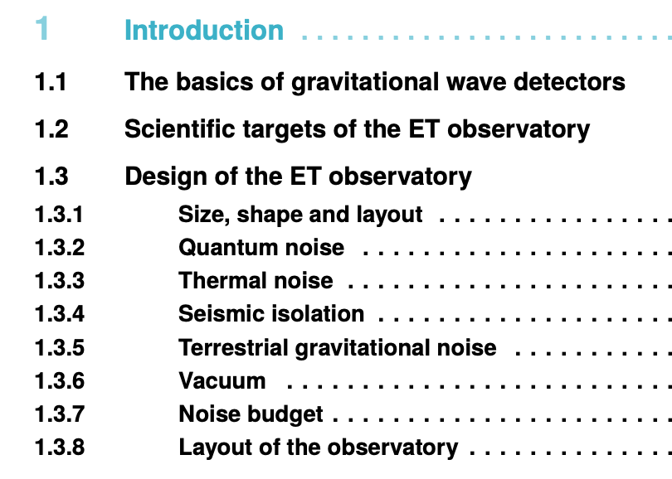


The Project Office: Parameters and Layout
A committee, largely composed of members of the collaboration chaired by a senior member of the Project Office
  elaborates,
  controls and
  follows-up
the requirements, the parameters and the layout that define the project baseline of the Einstein Telescope.
+ the requirements parts of

Slide 9
The Project Office: Technical Coordination and Planning
A committee, largely composed of members of the ISB and of the Engineering Department chaired by a senior member of the Project Office
builds, owns and maintains the Project Breakdown Structure (PBS) and Work Breakdown Structure (WBS) and the associated documents
runs the change management process
prepares and follows-up the strategic and a detailed planning of the project
periodically reviews the design and the interfaces of the infrastructure systems and the sub-systems of the interferometer

Slide 10
The Project Office: the Environment and the Tools
A unit within the Project Office which will set up a computer assisted environment to store engineering, procurement, change management, manufacturing and test results documentation and the associated workflows

Slide 11
The Engineering Department : the mission
The Engineering Department will design, procure, install, commission, operate, maintain and, eventually, dismantle
the special systems (e.g. vacuum, cryo, survey) associated with the gravitational wave detector and
the technical infrastructure systems needed to operate the interferometer (e.g. civil engineering, cooling, ventilation, electricity distribution)

Slide 12
The Engineering Department : the fields of competence
1 of 5
Type of System | Activity | System
Engineering of the special systems associated to the gravitational wave detector and the infrastructures systems | design procurement installation commissioning operation and maintenance dismantling | Access Control Cooling Cryogenics Electricity Distribution Site Monitoring Vacuum Ventilation

Slide 13
The Engineering Department : the fields of competence
2 of 5
 | Activity | Works
Civil Engineering | study design procurement construction monitoring and maintenance | surface roads office buildings infrastructure buildings access shafts underground caverns tunnels

Slide 14
The Engineering Department : the fields of competence
3 of 5
 | Activity | System
Mechanical Engineering | study design integration studies procurement manufacturing assembling installation | Parts of the gravitational wave detector Parts of the infrastructures systems and of the special systems associated to the gravitational wave detector
at least …

Slide 15
The Engineering Department : the fields of competence
4 of 5
 | Function | Scope
Technical Coordination in the Field … in close collaboration with the PLC and the TCC in the Project Office | scheduling of activities follow up of the planning coordination of integration coordination of safety site supervision | mid- and long-term schedule weekly meetings to monitor progress in the field, resolve issues, correct non-conformities layout & change management

Slide 16
The Engineering Department : the fields of competence
5 of 5
 | Function | Scope
Transport and handling Engineering | safety transport installation special handling devices | surface shafts underground mobile and building cranes

Slide 17
The deliverables and a few milestones
WP5-D1 | A document which defines the structure and the mandate of the Project Office.
WP5-D2 | A document describing the functionalities required from the tools in support of the project management activity used across all the project units
WP5-D3 | A document containing the structure and the mandate of the Engineering Department.
WP5-M1 | The recruitment of the Project Office team (both junior and senior) and the key figures of the Engineering Department is completed | 31 Dec 2023
WP5-M2 | All three documents (WP5-D1, D2 and D3) are published in their final version | 1 Oct 2024
WP5-M3 | The Engineering Department as a functional unit complete with key figures operational, mission statement and budget is created | 31 Dec 2024
WP5-M4 | The Project Office as a functional unit complete with manpower, mission and budget is operational | 31 Dec 2024

Slide 18
Internal Milestones
The Project Office
WP5-IM1 | All three documents (WP5-D1, D2 and D3) are published in a first draft version | 1 Sep 2022
PO-IM2 | The Head of the Project Office and the in-kind positions made available by the national institutes for the Project Office are appointed. | 1 Sep 2022
PO-IM3 | The two-day review of the Proposal for the Project Office detailed in deliverables WP5-D1 and D2 is held. The conclusions are published within 1 Dec 2022. | 1 Nov 2022
PO-IM4 | The process for the recruitment of the INFRA-DEV funded positions for the Project Office team is launched. | 1 Dec 2022
PO-IM5 | The Project Office, manned with the new recruits, starts operation of the Project Office with reduced but gradually increasing functionalities in collaboration with a few project units | 1 Jun 2023
PO-IM6 | Review of the Project Office is held and the conclusions are published within 1 Oct 2024. | 1 Sep 2024

Slide 19
Internal Milestones
The Engineering Department
WP5-IM1 | All three documents (WP5-D1, D2 and D3) are published in a first draft version | 1 Sep 2022
ED-IM2 | The Head of the Engineering Department and the in-kind positions made available by the national institutes for the Engineering Department are appointed. | 1 Dec 2022
ED-IM3 | The two-day review of the Proposal for the Engineering Department detailed in deliverable WP5-D3 is held. The conclusions are published within 1March 2023. | 1 Feb 2023
ED-IM4 | The process for the recruitment of the INFRA-DEV funded positions for the Engineering Department is launched | 1 Apr 2023
ED-IM5 | The Head of the Engineering Department presents an organigram of his/her department drafting the mandate of each unit, a resource plan, a schedule and a budget. | 1 May 2023
ED-IM6 | The Engineering Department manned with the new recruits, starts interactions with the collaboration contributing to the preparation of the TDR. | 1 Sep 2023
ED-IM7 | Review of the Engineering Department is held and the conclusions are published within 1 Nov 2024. | 1 Oct 2024

Slide 20
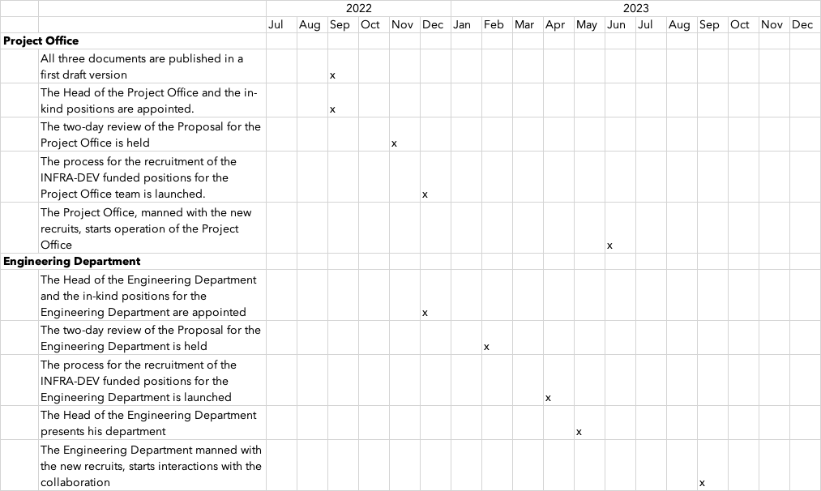
The timeline

Slide 21
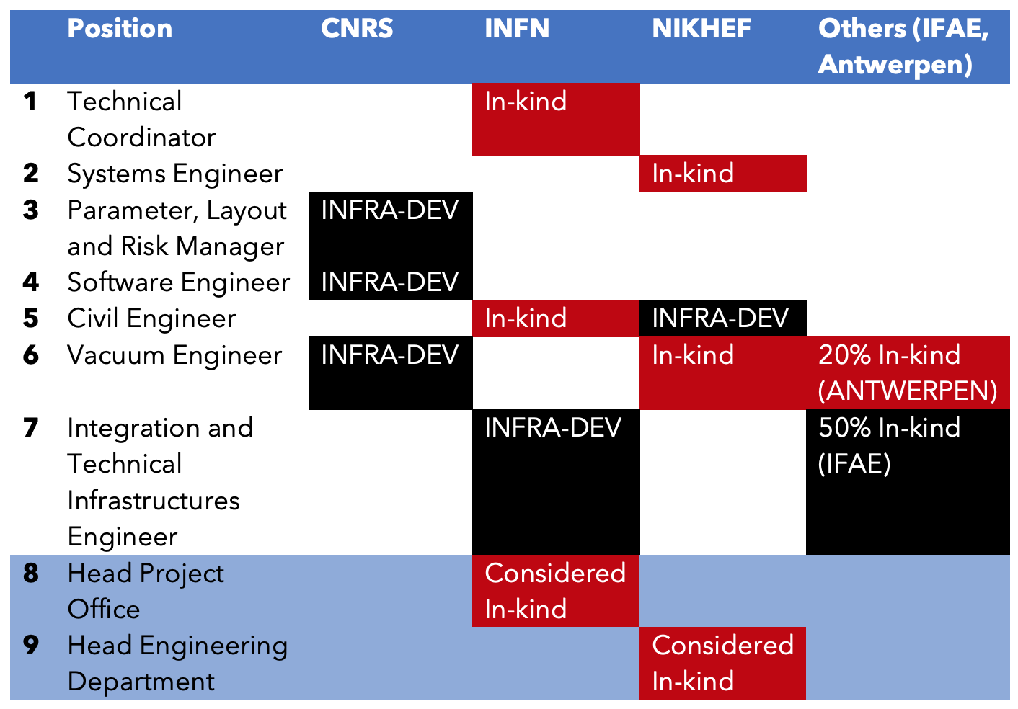
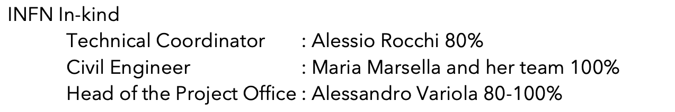
INFRA-DEV the resources
The preparatory phase
CNRS In-kind
Parameter, Layout, Risk : Christian Olivetto, Joseph Martino
Software environment : Remi Barbier, Patrice Verdier
NIKHEF In-kind
Head of the Engineering Department : Patrick Werneke

Slide 22
WP5 - WP6
WP2-Harmonize Project schedule
Relation of PO/ED with ET Collaboration and ET Boards
WP4-Relation with Site Characterization
WP2-Vacuum pipe Design & Requirements
WP2-Civil Infrastructure & Requirements
WP4-Qualification of aspects affecting ET performance

Slide 23
Program of Work
Obtain the endorsement of the Collaboration
Resources
  Complete the team with in-kind contributions from the participating national institutes
  Start the recruitment process of the INFRA-DEV resources
Committees
  Finalize the Mandates for the P&L Committee and for the Technical Coordination & Planning Committee
  Populate these committees
Deliverables & milestones

