Slide 2
ET-PP INFRA-DEV Kick-off Meeting Beampipe Vacuum

Slide 3
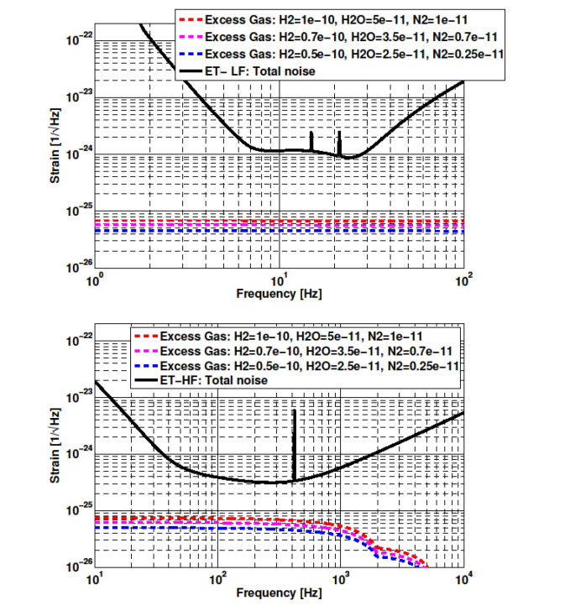
The ET beampipe: the main input from physics
Main specifications
1 m diameter
P_{H2}≈10⁻¹⁰ mbar
P_{H2O}<5*10⁻¹¹ mbar
P_{CxHy}<10⁻¹⁴ mbar (M>100 amu)
No surface roughness and reflectivity constraints.
ET design report update 2020, p. 137
amplitude noise spectral densities
CDR:
‘For the maximum acceptable residual gas pressure, a safety factor of 10 was applied with regard to the pressure at which
the detector sensitivity would be limited by phase ﬂuctuations of the residual gas at the frequency of highest sensitivity’
Main input to beampipe vacuum system: Noise level below 10⁻²⁵ Hz^{−1/2}
ET-HF is the most critical

Slide 4
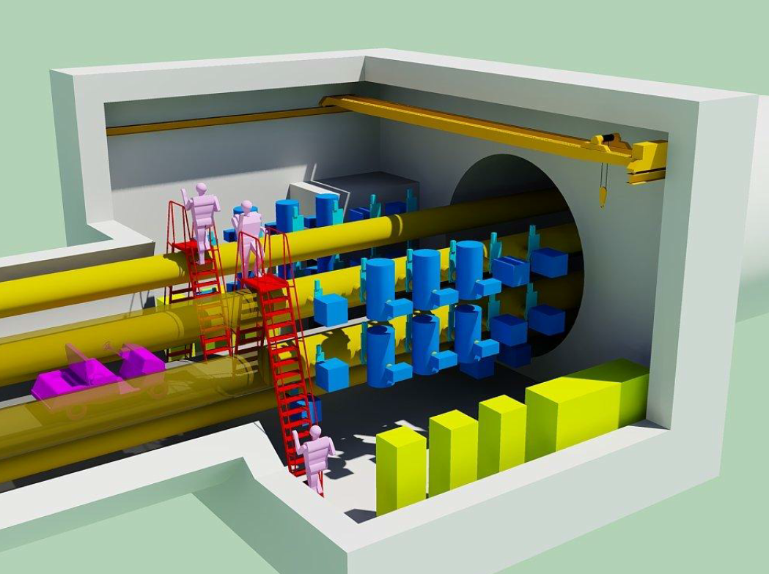
The ET beampipe baseline (design report update 2020)
Material and manufacturing
AISI 304L austenitic stainless steel.
3 to 4 mm thick walls reinforced by stiﬀening rings every 1 to 2 meters.
20 m long pipe elements (produced at surface in the site of installation???)
Thermal expansion compensated by bellow at the pipe element extremities
Post-production treatments
Detergent based cleaning
Air firing at 450°C for a week
Installation
Detailed sequence well described in the CDR.
Welding is performed in enlarged rooms (12-m wide, 10-m long) every 500 m in the tunnel, where vacuum pumps and controls are finally located.
In-situ treatment
Bakeout at 150°C for 10 days: joule effect in the beampipe walls, 2 MW for a single 10-km arm, without ventilation ΔT≈13° in the tunnel walls.
Important input for beampipe design:
The requested maximum straightness error for the arms is of the order of 10 mm.

Slide 5
The ET beampipe baseline: cost estimation
It includes the vacuum of the towers in the corner stations.
Slide copied from: Andreas Freise, The current status of the Einstein Telescope 10.05.2020

Slide 6
CERN participation in vacuum studies for Gravitational Wave Detectors
2019: NSF workshop on vacuum in GWT
2019: CERN-INFN-Nikhef agreement
2020: CERN-NSF L.o.I.

Slide 7
The Nikhef-INFN-CERN collaboration
Nikhef, INFN and CERN have signed an addendum to the ET general collaboration agreement.
The purposes of the agreement focus on the ET beampipes; the main objectives are:
coordinate the efforts of the institutes that work for the ET beampipes;
ensure the link with the vacuum community of the CE.
propose less expensive technical solutions that fulfil the requirements
leading to a pilot sector and a TDR by end of 2025.
The activity is divided in 8 work packages.

Slide 8
Main technical objectives of the addendum to the agreement
Re-evaluate the baseline solution (Virgo/LIGO and CDR) with minor modifications imposed by the new requirements.
Design and test technical solutions that fulfil the ET requirements and are less expensive than the baseline. The required technical infrastructure will be evaluated and optimized as well.
Manufacture, assembly and test a pilot sector.
Write the technical design report, including cost estimations.
Main coordination objectives of the addendum to the agreement
Coordinate the effort of ET collaborators interested in the same technical objectives.
Coordinate the contact and sharing of information with Cosmic Explorer in the field of vacuum technology.

Slide 9
Boundaries of the addendum to the agreement
This collaboration:
does not include the vacuum of the experimental towers; interaction with the designer of the cryogenic traps at the pipe extremities will be important;
needs important inputs from the other services, including civil engineering, alignment, cooling-ventilation, electrical infrastructure, transport and handling, logistics, premises and planning;
needs essential input from the physics teams to froze the functional specification.
First step
The first step of this collaboration, which is ongoing, is the definition and editing of the functional specifications, which comprise beam pipe requirements, and constraints with respect to infrastructures and services.

Slide 10
Contacts with Cosmic Explorer
CERN will ensure the link with the CE vacuum technology community.
Experimental data, results, and progress will be openly shared in regular meetings.
Such contacts will have the positive effect of cross-fertilisation and peer review between the two communities.

Slide 11
WP1: engineering
WP2:
production
WP3:
treatments
WP4:
transport
WP5:
installation
WP6:
vacuum
Design and engineering of the vacuum chamber
Choice of materials and manufacturing technology
Choice of post-manufacturing treatments
Handling and logistics
Installation procedure and interface with other systems
Choice of vacuum pumps and valves
WP7:
prototyping
WP8:
coordination
Installation and test of a pilot sector
Coordination of the different work packages and contribution of collaborators
Work-Breakdown Structure
I am expecting work package chairs to be installed by end of September or, at the latest, first half of October 2022.

Slide 12
Potential contributions of ET collaborators to WPs
All WPs are open to ET collaborators that are or intend to be involved in the study of the beam pipe of the ET’s arms.
The collaboration of other institutes in the frame of the Nikhef-INFN-CERN agreement :
would create a common platform for the proposal of the ET beampipes, that would ensure cohesion, coherence and a critical size;
could be direct, when responsibilities in WP deliverables are ascribed, or indirect, participating in the regular meetings and sharing data and progress reports;
might increase the chance of receiving funding from national agencies;
would benefit of the coordination of CERN leading to the TDR under the guidance of the ET directorate;
would be site independent.

Slide 13
Work-Breakdown Structure: WP1
Deliverables
WP1: engineering
1.1 Mechanical design and stability analysis of the pipe (pipeline and corrugated).
1.2 Provide a detailed design of the supports for the two versions.
1.3 Design of the pumping modules and their interface with the main pipes.
1.4 Assessment of the thermal characteristics during bakeout and choice of thermal insulation.
1.5 Design of the optical baffle and their integration in the pipes.
1.6 Provide cost analysis of pipes, supports, baffle and pumping modules.
Design and engineering of the vacuum chamber

Slide 14
2.1 Choice and acceptance tests of steel grade and processing for corrugated and pipeline-like vacuum chambers
2.2 Choice of raw material treatments before manufacturing
2.3 Choice and tests of manufacturing for corrugated walls and pipeline-like vacuum chambers
2.4 Methods for hydrogen degassing of materials, including precleaning if necessary.
2.5 Choice of manufacturing for the pumping module
2.6 Choice of manufacturing for the supports.
2.7 Qualification of the weld procedures for ex-situ welding.
2.8 Quality control including leak test procedure during production.
2.9 Mechanical finishing and preparation for in-situ welding.
2.10 Cost assessment of manufacturing
Work-Breakdown Structure: WP2
Deliverables
WP2:
production
Choice of materials and manufacturing technology

Slide 15
Work-Breakdown Structure: WP3
Deliverables
3.1 Choice of the final surface treatment for the corrugated walls.
3.2 Choice of the final surface treatments for the pipeline-like vacuum chamber.
3.3 Procedure to validate surface cleanliness.
3.4 Choice of contamination barriers and packaging after cleaning.
3.5 Measurement of the thermal insulation efficiency (for bakeout) .
3.6 Feasibility study of coatings for the reduction of water vapour outgassing.
3.7 Cost assessment of post-manufacturing treatments.
WP3:
treatments
Choice of post-manufacturing treatments

Slide 16
Work-Breakdown Structure: WP4
Deliverables
4.1 Maximum length and weight for transport and handling.
4.2 Transport and handling procedures for pipes on road, on surface and in underground tunnels.
4.3 Storage strategy at the production unit, surface cleaning plant, and at surface buildings.
4.4 Procedure for installation and bakeout sequence (access point to tunnels).
4.5 Define logistics and quantity of thermal insulation and bakeout materials.
4.6 Estimation of costs for transport, logistic and storage.
WP4:
transport
Handling and logistics

Slide 17
Work-Breakdown Structure: WP5
5.1 Design of tooling for assembly in the tunnel.
5.2 Procedure for alignment.
5.3 Procedure for in-situ welding.
5.4 Procedure for final leak test.
5.5 Procedure for the repairing/replacement in case of leaks or non-conformities in the phase of assembly.
5.6 In-situ bakeout methods, equipment and procedure.
5.7 Constraints from and impact on the other systems in the phase of installation.
WP5:
installation
Installation procedure and interface with other systems

Slide 18
Work-Breakdown Structure: WP6
WP6:
vacuum
6.1 Complete the vacuum layout: sectorisation, pumps and gauge positions.
6.2 Choice of sector valves.
6.3 Choice of the vacuum system.
6.4 Choice of pressure measurement, control system and monitoring.
6.5 Design the vacuum system at the interconnection (boundaries) with the experimental areas.
6.6 Outgassing measurement of proposed materials and treatments.
6.7 Cost estimation for vacuum system.
Choice of vacuum pumps and valves

Slide 19
Work-Breakdown Structure: WP7
7.1 Purchasing of vacuum chambers, vacuum module, supports, pumping system, control system and instrumentation.
7.2 Purchasing of equipment for bakeout
7.3 Preparation of the area of installation at CERN.
7.4 Installation of supports and pilot sector.
7.5 Vacuum commissioning and tests.
7.6 Measurement of dust size distribution.
WP7:
prototyping
Installation and test of a pilot sector

Slide 20
Work-Breakdown Structure: WP8
8.1 Coordinating the work packages of the Nikhef-INFN-CERN collaboration, including the tracking of the collaboration costs, planning, deliverables, and reporting. Share the sets of information via a webpage and CERN-EDMS data bases.
8.2 Coordinate the contributions of the ET collaborators in the frame of the Nikhef-INFN-CERN agreement.
8.3 Organize the coordination meetings on average every two months and an annual meeting to address progress and challenges.
8.4 Ensure the contact and sharing of information with Cosmic Explorer in the field of vacuum technology.
8.5 Provide a detailed cost analysis of the vacuum system of the ET’s arms.
8.6 Prepare a global QA plan
8.7 Write the TDR integrating all contributions.
WP8:
coordination
Coordination of the different work packages and of contributions of collaborators

Slide 21
Formal approval
Kick-off meeting
Start up phase 1 by July
Availability of INFRA-DEV personnel
Functional specifications
Start-up phase 2
by September
Availability of CERN FELLs
Definition of the contributions from ET collaborators
Contact with the Industry
Review of the baseline costs
Alternative materials, processing and design for pipelines
Technical work
Contact with the Industry
Procurement of pilot sector
Tests with pilot sector
TDR
Pilot sector at CERN
A Gantt chart will be proposed by September with dates of inputs from the other systems.

Slide 22
The ET beampipe: interaction with other INFRA-DEV WPs
Tunnel integration, transport & logistic & storage, installation procedure and pace, available services.
Examples:
Manufacturing: is the pipe final manufacturing and/or cleaning made at the ET site? If not, how many pipes are stored at the ET site? Length more than 16 m: exceptional transport in Europe. Choice of contamination barriers and packaging after cleaning.
Installation in the tunnel: are the enlarged rooms necessary? What is the impact on assembly and integration of the vacuum system if tunnel recesses are removed?
Integration of beampipes, pumps, valves and supports.
Transport in the tunnel.
Bakeout: availability of electrical power in the tunnel.
Bakeout: maximum temperature of the tunnel walls.
Bakeout: logistics and quantity of thermal insulation and bakeout materials.
Corrosion: expected moisture level in the tunnel.
…
Tight cooperation with the other engineering teams is essential; several iterations will be required.

Slide 23
Planned or to-be-planned meetings
Contacts with and visits to European institutes:
CNRS-LAPP Annecy: visited on June 10th , strong potential in design and manufacturing
Universitat Autonoma de Barcelona (IFAE): visit planned on July 19th , design and integration of optical baffles.
Nikhef – Etpathfinder, Maastricht: visit planned on week 38 or 39, participation of Tata-Steels and VDL, materials and manufacturing.
INFN, Frascati, and EGO-Virgo, Cascina: visit to be planned in September
KIT-Karlsruhe: visit to be planned, outgassing measurements and cryopumps at beampipe extremities.
Forschungszentrum Jülich / Aachen University/ GEO600 Hanover: visit to be planned
Belgian institutes (U. Antwerpen, U. Gent, Werkhuizen Hengelhoe, SIM Flanders): visit to be planned.

