Slide 1
ET-PP INFRA-DEV kick-off meeting
M. Martínez
Closing remarks
20th July 2022

Slide 2
Random (personal) notes (I)
A good starting points but a lot of work ahead us in the following 4 years
We had a real WP-WP f2f discussion that will help
Need for a strongly recognized leadership role of ET Project
Define and consolidate the Project Office and Engineering Department
Distributed model ? Location ?
Need for dedicated services & support decoupled from collaboration ones [who will provide it ?]
Need for dedicated budget / common funds
Involve more funding agency actors in the conversations
Keep the hard work on W2, WP3, WP7

Slide 3
Random notes II
Need for a f2f dedicated discussions on sustainability and how this will translate into concrete aspects of the ET designs
Maybe gentle visits from ET Management needed to trigger third party interests showing industrial potential, etc…

Slide 4
Random Notes
Need to work towards a clear timeline over time.. Meanwhile ET-PP is the reference
INFRA-DEV timeline of deliverables and milestones was set generously to guarantee success in the EU project… we need to give common message from INFRA-DEV and ET Collaboration …
Following closely the Triangle vs 2L saga and how this will be affecting ET-PP execution and WP4

Slide 5
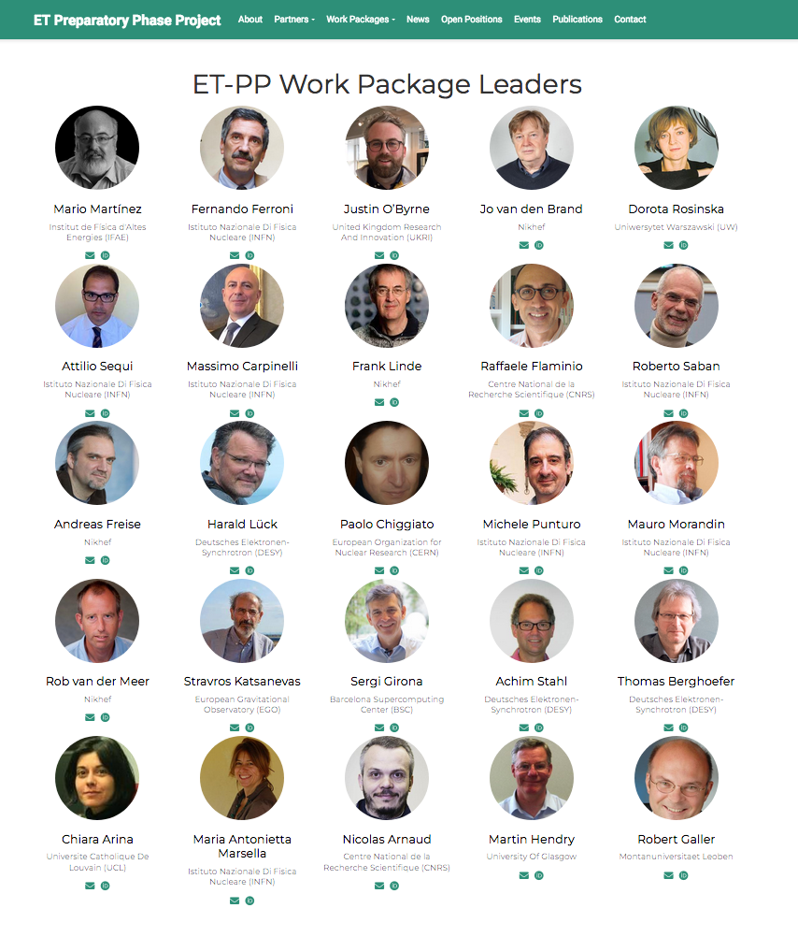
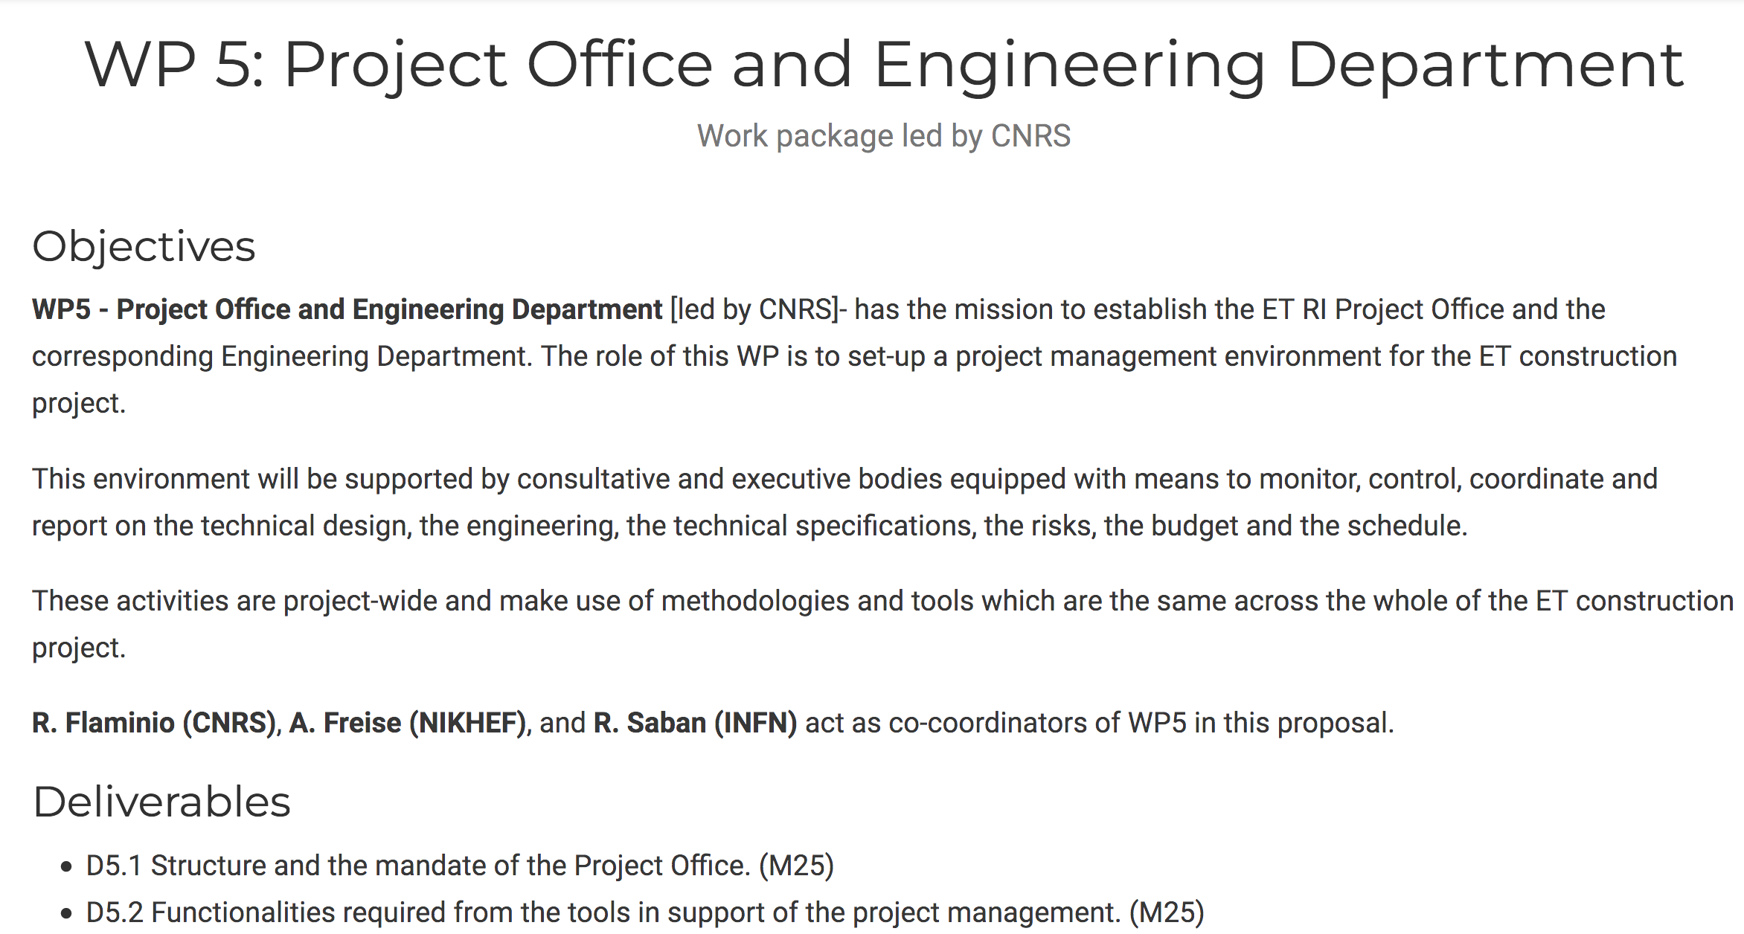
ET-PP web online etpp.ifae.es
Will be portal for all the ET-PP
information

Slide 6
Next Steps
Biweekly meeting stating in September 5th
Decide the funding profiles for the different WPs
Focus on particular items instead of WPs round reports
Suggest to start on WP5+WP6
Conclude the Collaborative Agreement

Slide 7
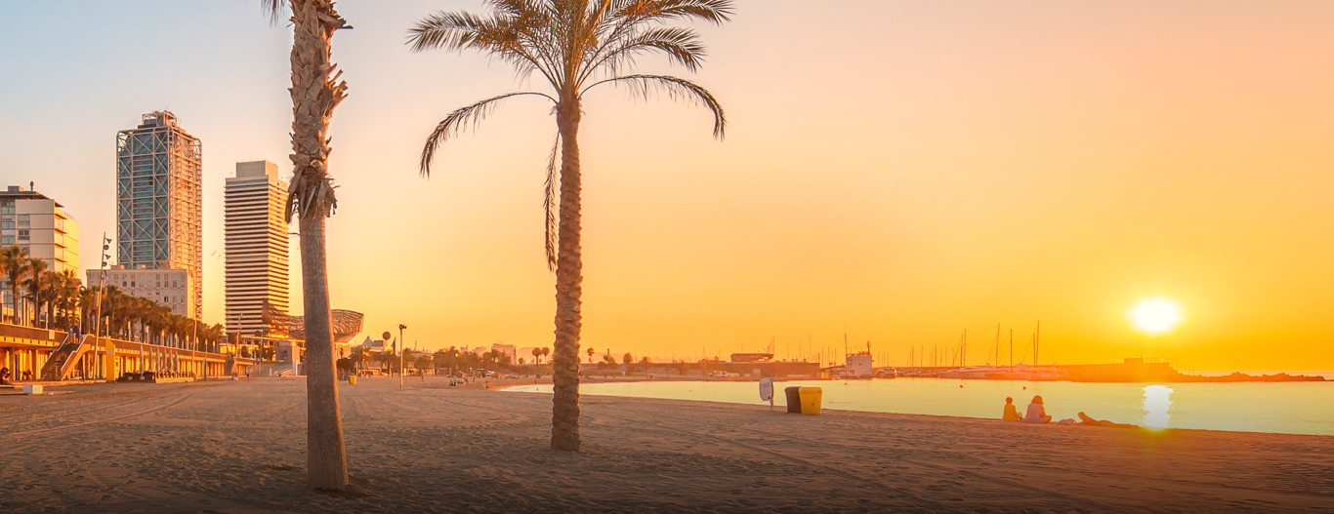
ET-PP @ BCN closing
55 persons registered
30 in person
Have a safe trip back!

