Slide 1
Sergio Bottai – Barcellona 2015
CHARGED COSMIC RAYS PHYSICS
HE ASTROPHYSICS
COSMIC RAY PHENOMENOLOGY
DETECTION OF RARE ANTIMATTER COMPONENTS
LOW ENERGY PARTICLES (<GeV)
HE ELECTRONS
HE PROTONS AND NUCLEI (>>GeV)
‘NEW PHYSICS’
DARK MATTER
ANTIUNIVERSE
Solar flare
Earth magnetic field, trapped
particles...
LOCAL HE ASTROPHYSICS, ...hint of ‘new physics’...
HE ASTROPHYSICS
COSMIC RAY PHENOMENOLOGY !
Far to be ‘solved’ !!
PHYISCS GOAL FOR LARGE ACCEPTANCE CALORIMETER IN G400

Slide 2
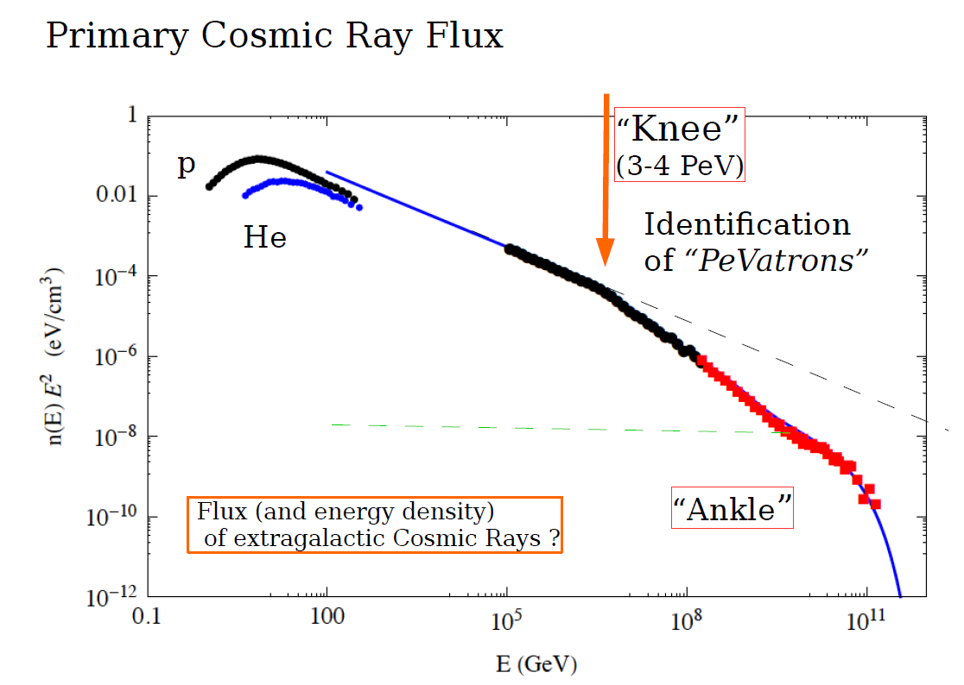
~E^{-2.7}
POWER LAW SPECTRUM
OVER MANY ORDER OF MAGNITUDE
EXTRAGALACTIC ?

Slide 3
The standard CR/SNR Paradigm
Energy balance work !
SNR are the principal sources of CR
Provide perfect enviroment
for Diffusive-Shock Fermi first order
acceleration (Power law spectrum)
Emits high energy (TeV) gammas !
Some of them have ‘hadronic’ signature
in e.m. spectrum
Basic predictions and ingredients
Fermi-Shock SNRs: power-law source spectra (α~ 2.0 – 2.2)
Propagation-diffusion irregular B , Galaxy escape probability
Expected CR spectra at Earth (E>>GeV/n)
γ ; δ ARE BASICS PARAMETER FOR ACCELERATION-PROPAGATION MODELS
Primary CR data: γ+δ = 2.7
Gamma-ray data: γ < 2.3 → δ > 0.4 ?
Secondary/Pri ratios: δ = 0.2 - 0.6
Anisotropy data: δ < 0.3 → γ > 2.4?

Slide 4
The standard CR/SNR Paradigm
Energy balance work !
SNR are the principal sources of CR
Provide perfect enviroment
for Diffusive-Shock Fermi first order
acceleration (Power law spectrum)
Emits high energy (TeV) gammas !
Some of them have ‘hadronic’ signature
in e.m. spectrum
PROBLEM :
MAXIMUM ACCELERATION ENERGY SNR CAN REACH :
E < 10¹⁴ × Z
2 ORDER OF MAGNITUDE BELOW KNEE FOR PROTONS!!
ONLY UNDER SPECIFIC HYPOTHESIS ABOUT SNR REALIZATION WE CAN OBTAIN :
E < 10¹⁶ × Z
Which is still a problem for existence or galactic CR well above the knee!!
P. Blasi , Nuclear Physics B Proceedings Supplement 00 (2014) 1–12
“It is worth stressing that pushing the parameters to somewhat extreme values (ξCR = 0,2, higher mass loss rate,dM/dt = 10^-4 Ms yr-1 and Vs = 30000 km/s) one can possibly push the maximum energy up to EM < 2 10^7 GeV, although such types of supernovae, if they exist at all, are bound to be much more rare than standard type II supernova events.”

Slide 5
DEVIATION FROM ‘simple’ POWER LAW SPECTRUM
PRESENT ‘HOT’ PROBLEMS IN HE GALACTIC CR PHYISCS
PHENOMENOLOGY AND EXPLANATION OF THE KNEE
BREAK IN THE CR SPECTRUM AT RIGIDITY ~240 GV
DIFFERENT SLOPE IN THE SPECTRUM OF PROTONS AND NUCLEI

Slide 6
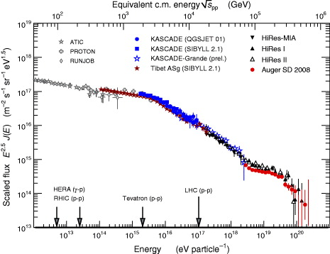
THE KNEE OF COSMIC RAY SPECTRUM
(measured indirectly only by AIR shower detectors)
WHAT WE KNOW :
there is a change of spectral index in ‘ALL PARTICLES’ inclusive spectrum around 3-4 PeV
~E^{-2,7}
~E⁻³
knee

Slide 7
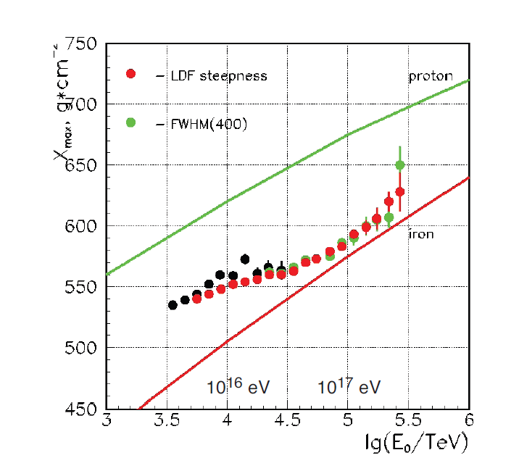
THE KNEE OF COSMIC RAY SPECTRUM
(measured indirectly only by AIR shower detectors)
WHAT WE KNOW :
there is a change of spectral index in ‘ALL PARTICLES’ inclusive spectrum around 3-4 PeV
Around the KNEE the CR composition (IN AVERAGE) gradually become heavier
Cherenkov (Xmax)
Muon/electron content
proton
iron
iron
proton

Slide 8
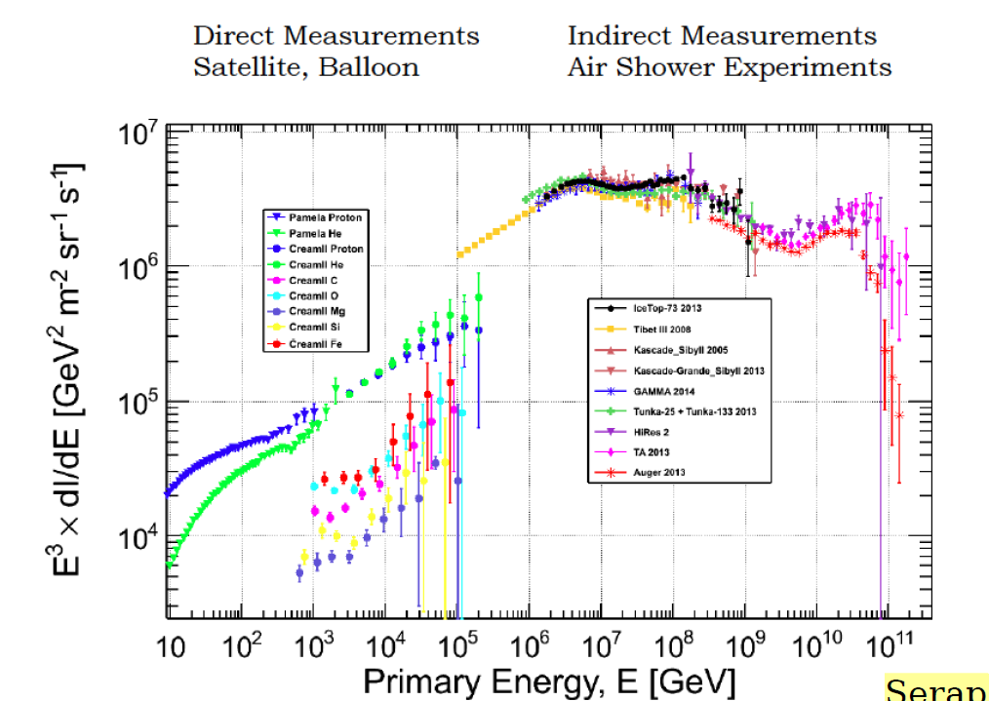
THE KNEE OF COSMIC RAY SPECTRUM
(measured indirectly only by AIR shower detectors)
WHAT WE DO NOT KNOW :
DETAILED COMPOSITION AT THE KNEE
NO SIGNIFICATIVE DIRECT MEASUEREMENT ABOVE 100TeV
PAY ATTENTION : Helium become dominant already at 10 TeV (CREAM) !!

Slide 9
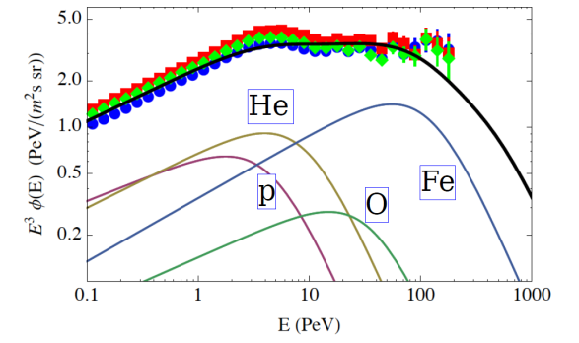
THE KNEE OF COSMIC RAY SPECTRUM
(measured indirectly only by AIR shower detectors)
WHAT WE DO NOT KNOW :
DETAILED COMPOSITION AT THE KNEE
UNIVOCAL PHYSICAL MODEL FOR THE KNEE
...........................................................
Superposition of different kind, ‘age’, location of sources ?
Not standard hadronic interactions at UHE
Effect of progressive magnetic galaxy deconfinement at high energy
Effect of cutoff in the acceleration mechanism (Emax in SNR)
In these 3 models the ‘knee’ for each NUCLEI appear at different energy
Ecutoff = k * A
Ecutofi = k * Z
They can explain the observed weighting at the knee
NOT STANDARD hadronic interactions at UHE is now RULED OUT at LHC

Slide 10
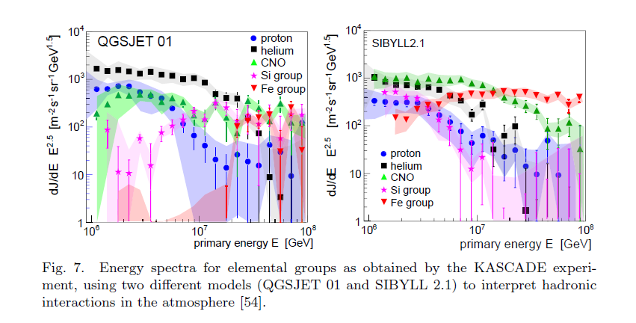
THE KNEE OF COSMIC RAY SPECTRUM
(measured indirectly only by AIR shower detectors)
INDICATION OF INDIVIDUAL NUCLEI SPECTRA BY AIRSHOWERS:
KASKADE ( HIGH DENSITY DETECTOR scint. ARRAY + HADRONICH CALORIMETER)
THRESHOLD AT PEV
DIFFERENT SCENARIO ACCORDING TO INTERACTION MODELS !
PROTON CUTOFF AT 2-3 PEV - HELIUM CUTOFF AT 4-10 PEV !
Problem for Emax in SNR
In this scenario is possible but not easy to detect proton-helium cutoff with G400

Slide 11
ARGO YBJ (+ LHAASO-CT): high altitude , ultra segmented RPC + cherenkov telescope (Xmax) LESS SENSITIVE TO INTERACTION MODELS
THE KNEE OF COSMIC RAY SPECTRUM
(measured indirectly only by AIR shower detectors)
INDICATION OF INDIVIDUAL NUCLEI SPECTRA BY AIRSHOWERS:
Superposition
with direct
CREAM measurement
(P + HE) SPECTRUM
NEW KASKADE ANALYSYS
WITH QGSJET-II02
Relaxed scenario
for Emax in SNR
proton
Ecutoff (p+HE) = 700 TeV
But according to CREAM HE dominate
Eknee=700/2 TeV ?

Slide 12
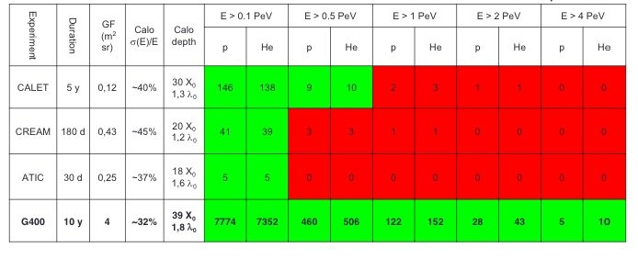
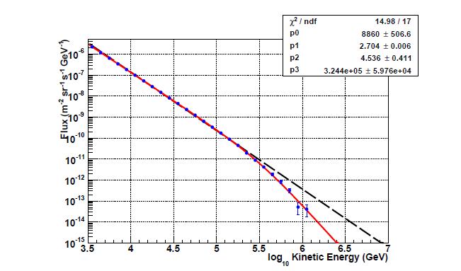
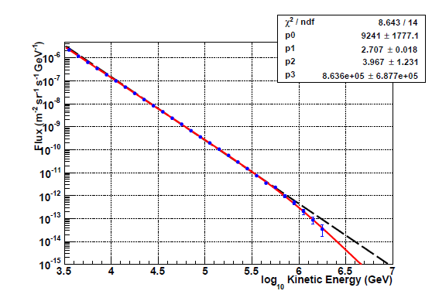
GAMMA 400 expected statistics according to polygonato model
(20)
Pre knee
structure
All particle knee ?
Proton cutoff ?
He cutoff ?
300 TeV cutoff – 6 years
1 PeV cutoff – 6 years

Slide 13
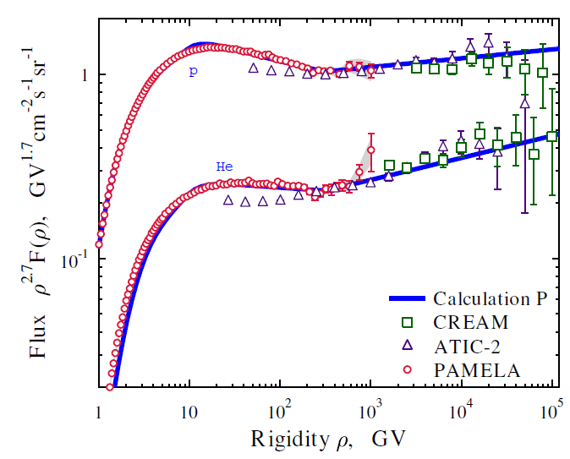
PAMELA HAS REVEALED A BREAK IN PROTON AND HE SPECTRUM
NO STANDARD EXPLANATION !
R=240 GV

Slide 14
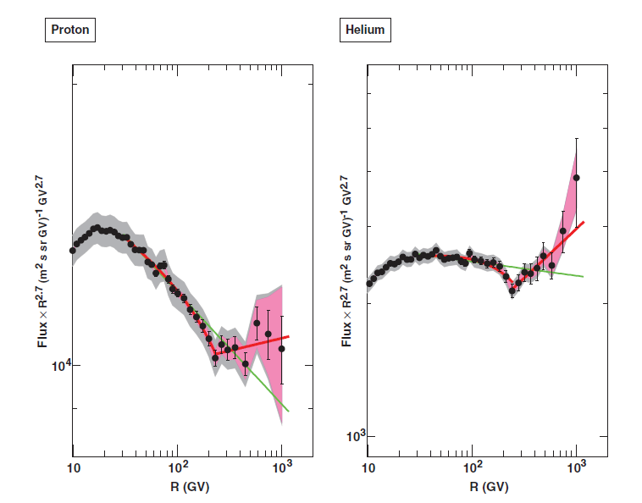
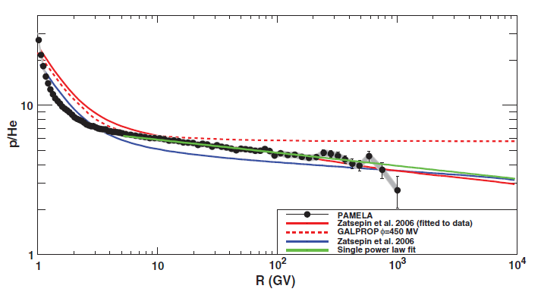
PAMELA MEASUREMENT OF DIFFERENT SLOPE OF PROTON AND HELIUM
P/He fluxes not constant
NO STANDARD EXPLANATION !

Slide 15
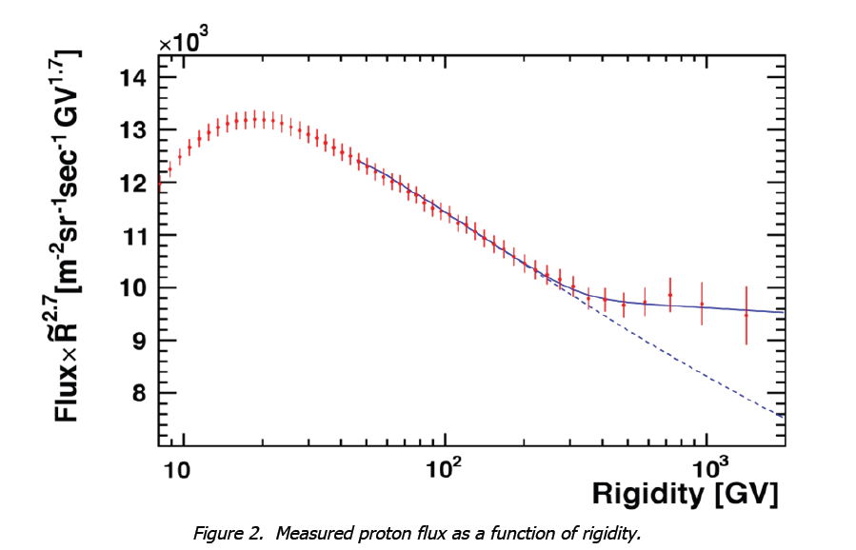
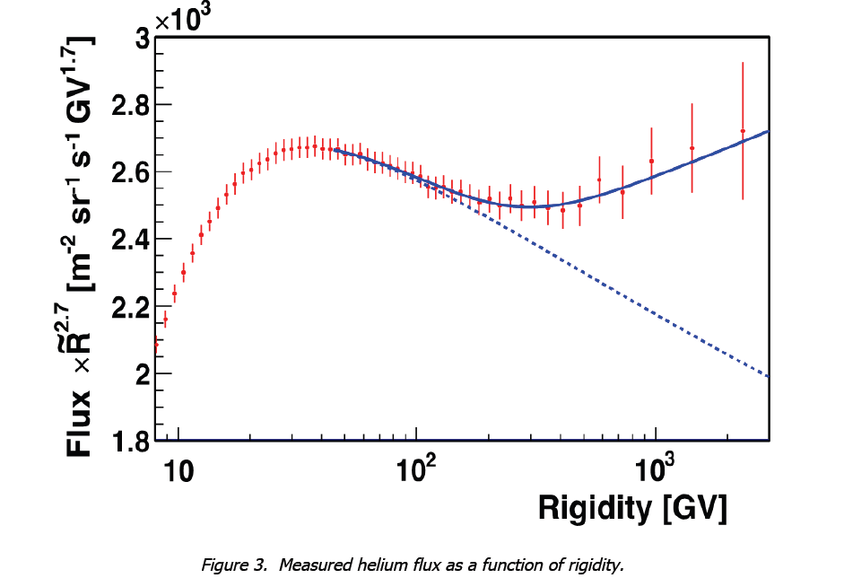
NOW CONFIRMED BY AMS-02 (YET TO BE PUBLISHED)

Slide 16
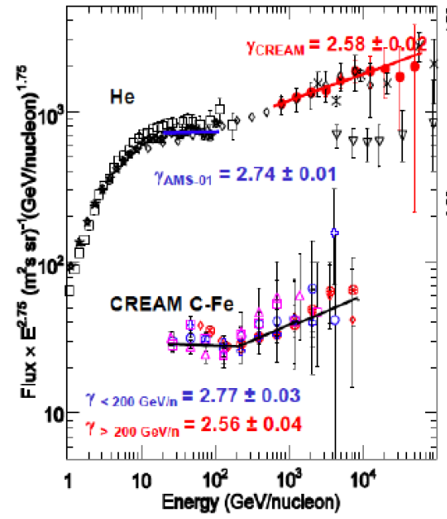
The break also
appear in the
spectrum of NUCLEI
measured by CREAM
The HE slope of
NUCLEI is similar
to He, hence different
from protons
TO BE CONFIRMED
AND POSSIBLY EXTENDED
TO HIGHER ENERGY
G400 !!!

Slide 17
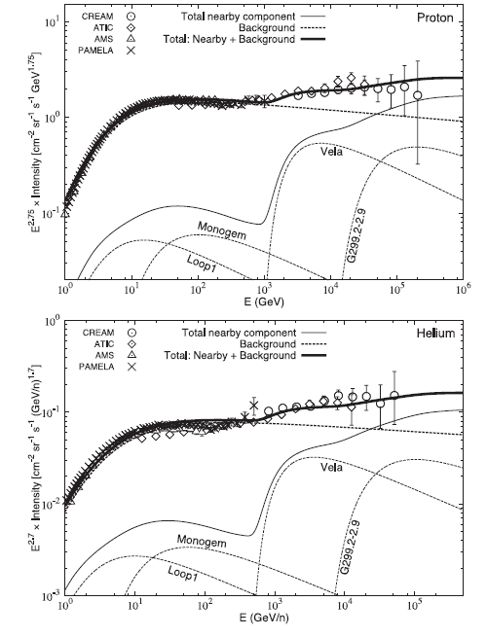
HARDENING AT 240 GV EXPLAINED WITH ‘LOCAL’ SOURCES

Slide 18
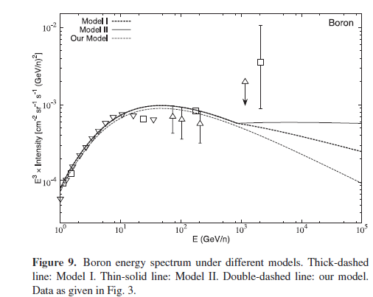

Slide 19
HARDENING EXPLAINED WITH Two-Halo Model of CR Diffusion
NT ApJ 715 L13 [astro-ph/1204.4492]
[ 08 / 14 ]
ECRS 2012 - Moscow

Slide 20
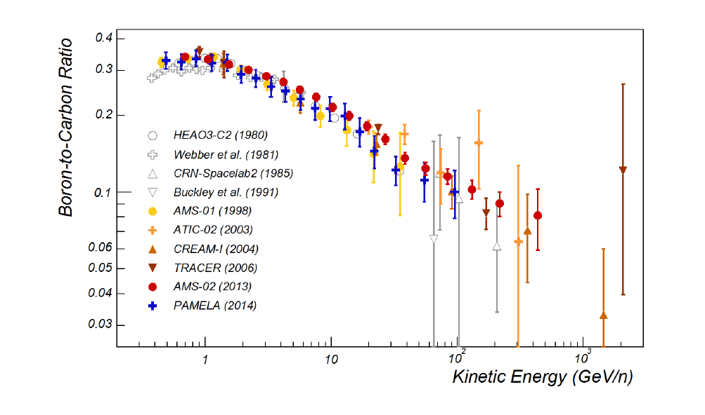
SECONDARY(SPALLATION)/PRIMARY helps the understanding of CR propagation
δ=0.3
δ=0.4
The difference in the predictions is enhanced at high energy
G400

Slide 21
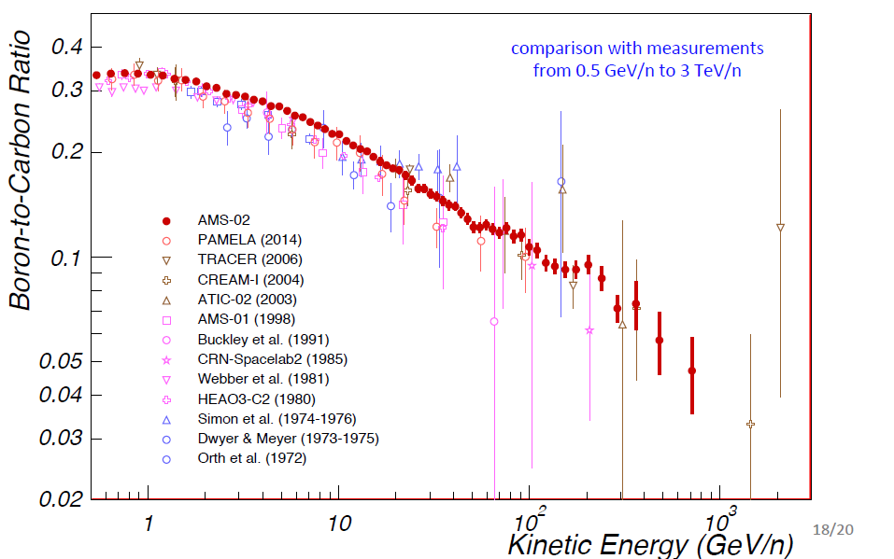
AMS02 NEW DATA (LOWER AT HIG ENERGY)
δ=0.3
δ=0.4

Slide 22
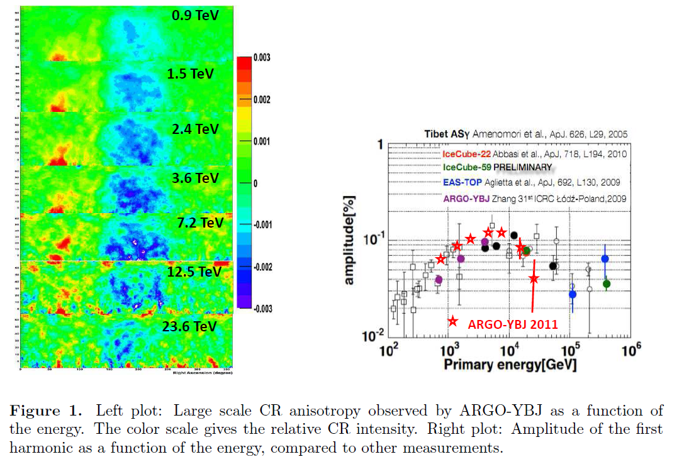
LARGE SCALE ANISOTROPY !!!
Measured by several airshower experiment
in 10 TeV region
To be explained!

Slide 23
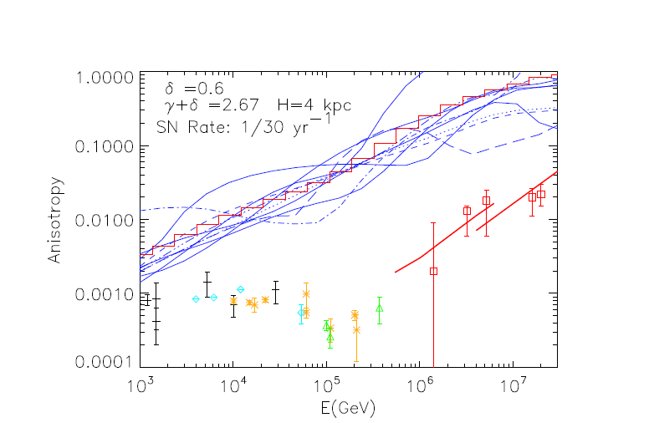
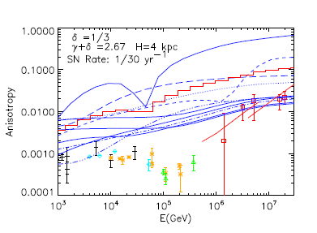
The study of CR anisotropies and their evolution with energy is a powerful tool to study propagation properties and sources.
“Standard” parameters Random source distributions
Calculation with 10 different implementations of random sources
δ=0.6
δ=0.3
G400 could give , by direct measurement for first time, LSA for individual NUCLEI !
THIS NEEDS VERY LARGE ACCEPTANCE INSTRUMENTS ! – G400 CAPABILITY TO BE STUDIED

Slide 24
CONCLUSION
MAIN PROBLEMS IN CR PHYSICS :
THE KNEE OF PROTON AND HELIUM
THE SPECTRAL HARDENING OF NUCLEI E>TeV
THE FINE STRUCTURE OF NEUCLEI SPECTRUM JUST BELOW THE KNEE
CAN BE ADDRESSED BY G400 WITH UNPRECENDENTED RESOLVING POWER
ADDITIONALLY :
CR PROPAGATION IN THE GALAXY CAN RECEIVE IMPORTANT CONTRIBUTION !
ASTROPHYSICAL OUTCOME
Study the acceleration mechanism (or mechanisms)
Study the limit of the acceleration phenomena of the sources
Understand the kind of sources in the Galaxy
Answer the question: is there the same mechanism (or source) for different nuclei?
Study the distribution of the sources
Study the propagation process in the Galaxy

Slide 25
