Slide 1
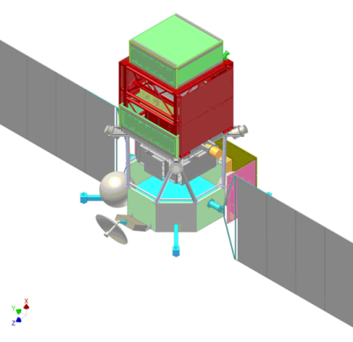

Status of the GAMMA-400 project at INFN
Valter Bonvicini
INFN – Trieste, Italy
on behalf of the Italian Gamma-400 Collaboration:
Trieste
Firenze
Pavia
Pisa/Siena
Roma 2
GAMMA-400 Workshop in Barcelona, June 15-19 settembre 2013

Slide 2
Contents
INFN: mission and structure
INFN: space heritage
Recent history and current status of the GAMMA-400 project in Italy
Some recent R&D on the Converter/Tracker
Conclusions and perspectives

Slide 3
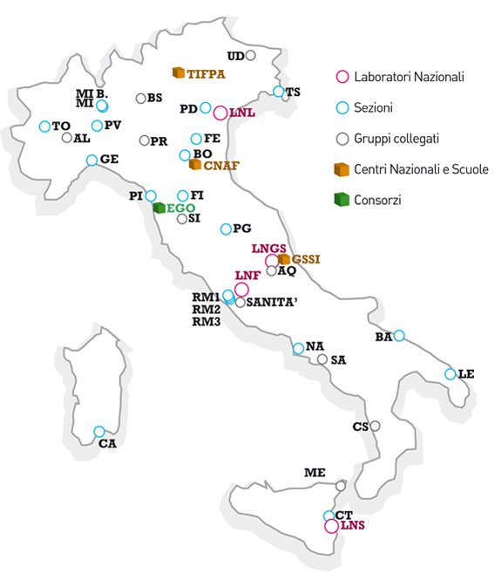
INFN mission and structure
INFN is an organization dedicated to the study of
the fundamental constituents of matter, and
conducts theoretical and experimental
research in the fields of subnuclear, nuclear,
and astroparticle physics.
20 Divisions
4 National Labs
3 National Centres/Schools
Several Consortia
Scientific policy ⇒ National Scientific Committees
CSN1: Subnuclear and Particle Physics
CSN2: Astroparticle Physics
CSN3: Nuclear Physics
CSN4: Theoretical Physics
CSN5: Technological and Applied Research

Slide 4
INFN space heritage I
INFN has a world-recognized experience in the design, construction and operation of advanced particle detectors for space experiments;
INFN, in particular, is world leader in the technology of silicon detectors and associated low-noise front-end electronics for space applications, and has pioneered the use of advanced silicon detectors manufactured with planar technology in space;
INFN has a long and fruitful tradition of collaboration with Russian Institutes in some of the most scientifically successful space missions of the last decades

Slide 5
INFN space heritage II
List of realized space projects in which INFN has designed, constructed, tested and operated instruments similar to the GAMMA-400 converter-tracker and imaging calorimeter:
  NINA (1998, first INFN satellite mission)
  Sil-Eye1, Sil-Eye2, Sil-Eye3 (2000 – 2003)
  PAMELA (launched in 2006, still operating)
  ALTEA (2008)
  AGILE (launched 2007, still operating)
  AMS-01 (1998) and AMS-02 (2011, operating)
  Fermi-GLAST (launched 2008, still operating)
  DAMPE (under construction, launch by 2016)

Slide 6
GAMMA-400 in Italy
First contacts between Russian and Italian physicists: 2009
R&D on the program financed by INFN CSN 2 (GAMMA-400-RD, 2012-2014)
  Task: preparation of a joint proposal for the apparatus and the science, agreed with the Russian part;
INFN funding :
  CSN 2: 187 k€ (from 2012 to 2014) for the R&D phase
  CSN 5: an R&D program (“CaloCube”) to study the development of 3-D, homogeneous and isotropic calorimeters for space experiments has been approved by INFN CSN 5 (2014-2016, ∼ 900 k€)

Slide 7
Important steps in 2013
Letter from INFN President, Prof. F. Ferroni, to Academician G. Mesyats and Prof. A. Galper (July 17th, 2013): “… INFN is ready to provide the Converter/Tracker for GAMMA-400 instrument if this work were supported by the Russian side…”
Presentation of a progress report to INFN CSN 2 (23-27 September, 2013):
  Very positive evaluation of the referees
  Approval of continuation of work in view of the definition of a collaboration agreement (Memorandum of Understanding)
INFN Proposal for the design and construction of converter-tracker and strip part of imaging calorimeter for gamma-ray telescope GAMMA-400 (October 21st, 2013)

Slide 8
Important steps in 2014
  Letter from INFN President (Prof. F. Ferroni) to ASI President, asking ASI to inform Roscosmos about INFN intention to participate to GAMMA-400 and to take the necessary steps for the definition of a MoU (January 29, 2014)
Letter from ASI to Roscosmos in which:
  The involvement of INFN in the GAMMA 400 mission is promoted and supported;
  INFN will provide the system of silicon tungsten tracker and the silicon strip part of the imaging calorimeter of GAMMA 400
  The details of the collaboration have to be spelled out in a separate document (MoU) between INFN and LPI RAS

Slide 9

Meeting ASI-Roscosmos (and INFN-LPI)
23 July, 2014 in Rome
  Pre-meeting between INFN and LPI on July 22 focused on the operative MoU
Results:
  Decision about an ASI-Roscosmos general LoI
    Draft discussed at both agencies
    Involvement of MAE and Italian Ambassy in Moscow
    Text of the LoI finalized and approved (to be signed in these days)
  FIAN-INFN Draft MoU
    Draft already under discussion at INFN and FIAN International Relationship Departments

Slide 10

Improvements in the GAMMA-400 design and performance
During the last years, the collaboration between Italian and Russian groups has resulted in a new version of the apparatus. Guideline:
  to develop a jointly defined dual instrument that, taking into account the currently available financial resources, optimizes the scientific performance and improves them with respect to the original version: this new version has been agreed upon by both (Russian and Italian) sides during a collaboration meeting held in Moscow in February 2013.

Slide 11
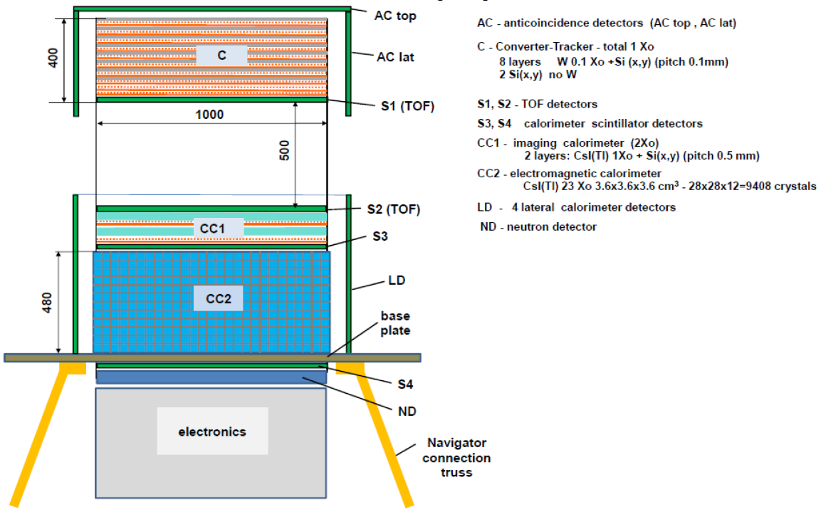
The GAMMA-400 apparatus
B2 over B1 improvements:
Introduction of a highly segmented homogeneous calorimeter with CsI cubes ⇒ improved energy resolution, extended GF with lateral particle impingement, nuclei capability
Increase of the planar dimensions of
the calorimeter (from 80 cm x 80 cm
to 100 cm x 100 cm) ⇒ larger A_{eff}
Si strip detector pitch of the 2 CC1
layers decreased from 0.5 mm to 0.08 mm
(pitch 0.1 mm)
GAMMA-400 characteristics:
a dual instrument for photons
(100 MeV ÷ 1 TeV) and cosmic
rays (electrons ∼ 10 TeV and high
energy cosmic-ray nuclei, p and He
spectra at the “knee” (10¹⁴ – 10¹⁵ eV);
State of the art Si-W converter/tracker
with analogue read-out;
3-D, deep, homogeneous calorimeter
with excellent resolution and large
acceptance.

Slide 12
Recent activities- I
Converter/Tracker
  Simulations: the whole converter/tracker structure has been simulated in a GEANT4 framework. Key parameters of the detector, like angular resolution and effective area have been calculated through Monte Carlo simulations. Trigger simulations and evaluation of the efficiency selection of events are on going. Also, different configurations of the C/T (number of planes, silicon-only planes…) were investigated
  Pre-prototype: INFN has produced two pre-prototypes of GAMMA-400 silicon strip detectors, which were tested and recognised as fully compliant with prototype technical requirements. The pre-prototypes, complete with full electronics, were handed off to Russian side on April 4th, 2014, for usage in the Russian phase B2 activity.
  INFN has produced (at FBK, Trento, Italy) several prototype silicon microstrip detectors with the same design and technology foreseen for GAMMA-400, with very fine segmentation (implant pitch down to 80 µm). The purpose of this production is to test the technology and the design .
  TB at CERN PS (T9 beam), p=10 GeV/c negative particles (mostly π), equipped with DAMPE FE ASICs, September 2014

Slide 13
Converter/Tracker
10 x-y layers (20 views):
  8 layers W 0.08X₀ + 8 planes Si (x,y)
  2 layers of Si (x,y), no W

Slide 14
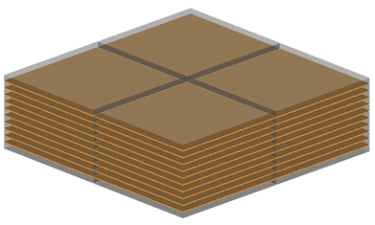
Converter/Tracker
Homogeneous Si-W Tracker
4 towers (∼ 50 cm x 50 cm each);
8 W/Si-x/Si-y planes + 2 Si-x/Si-y planes (no W)
Thickness of each plane 0.1 X₀
Each sensor ∼ 9.7 cm x 9.7 cm from 6” wafers;
Sensors arranged in ladders (5 detectors/ladder), 1 ladder ∼ 50 cm;
Implant pitch 80 µm (fine segmentation)
Read-out pitch 240 µm (capacitive charge division, one strip every 3 is read-out), 384 read-out strips/ladder;
2000 silicon detectors;
153600 readout channels, 2400 front-end ASICs (64 channels/ASIC)
Power consumption (FE only): ∼ 80 W

Slide 15
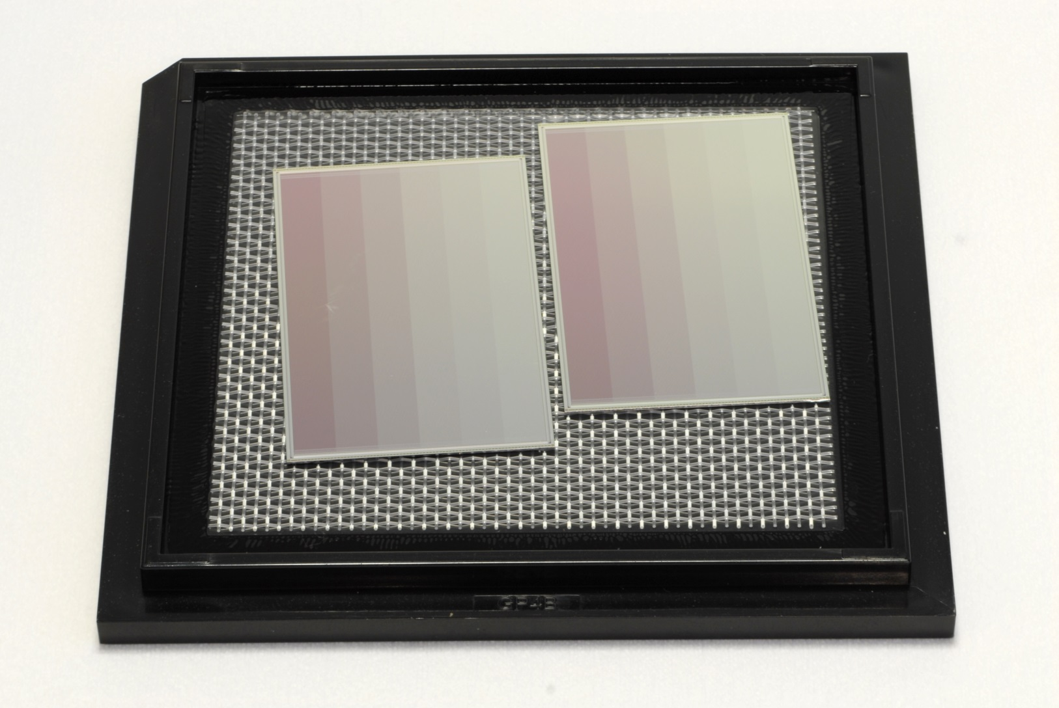
“Baby” µ-strip detectors by FBK Trento, Italy)

Slide 16
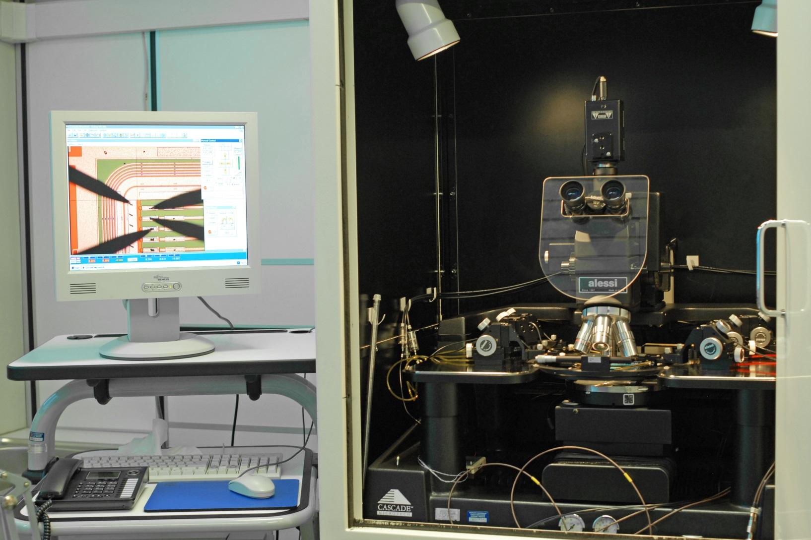
Detectors under test in Trieste

Slide 17
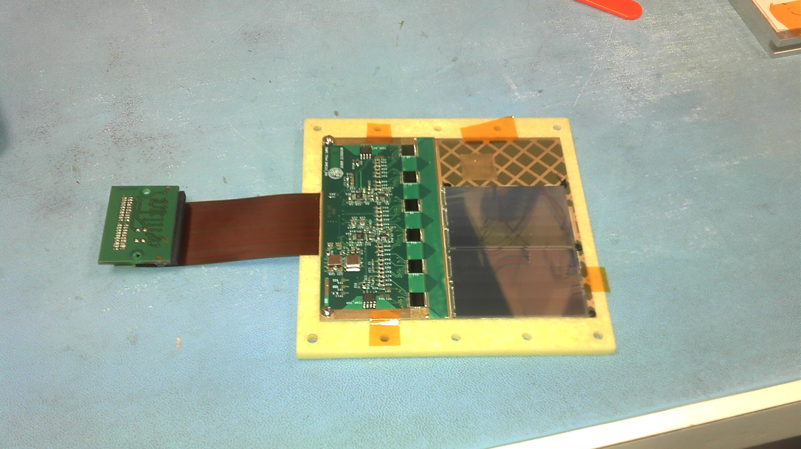
FBK strip prototypes bonded in Perugia to VA140 Front-end ASICs

Slide 18
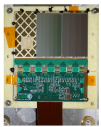
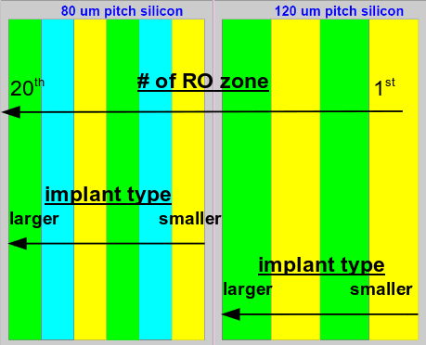
Test beam in September 2014
Test performed in September 2014 at CERN – PS T9 beamline with 10 GeV/c
negative particles

Slide 19
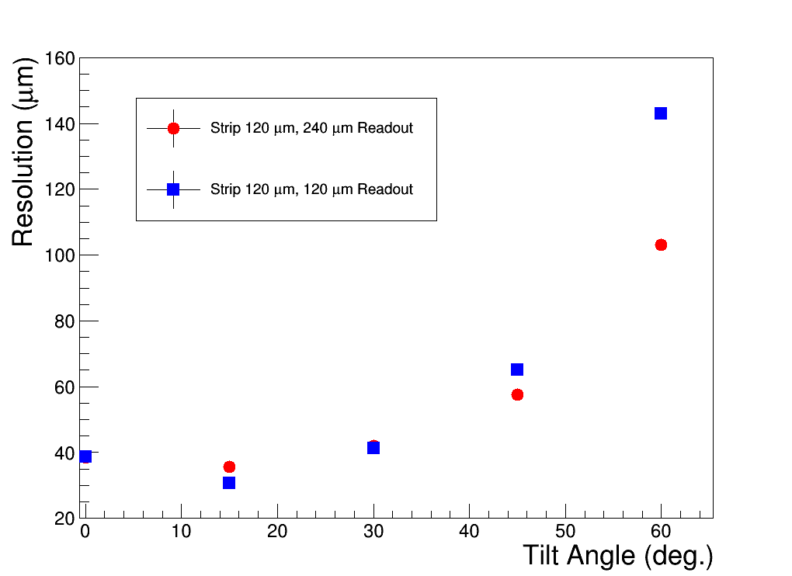
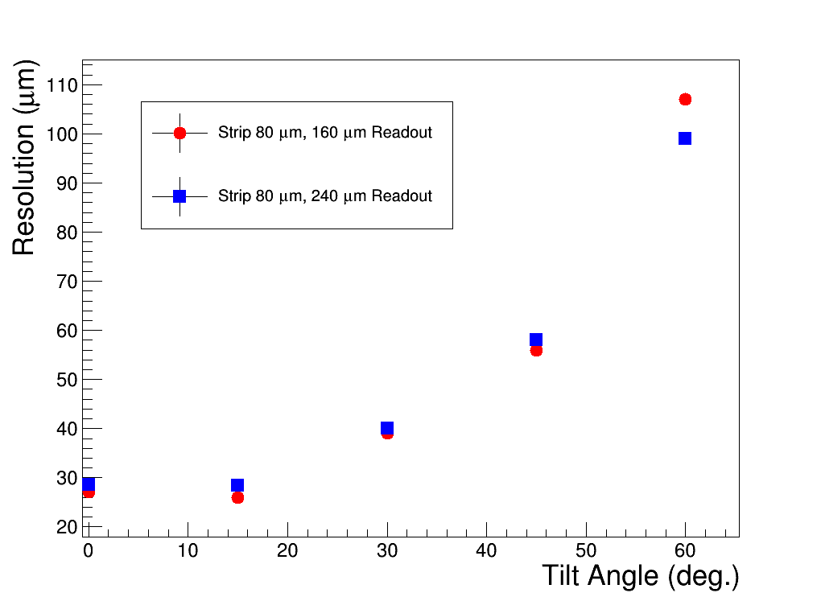
Test beam preliminary results

Slide 20
Activities 2014 - II
Calorimeter:
  An R&D program (“CaloCube”) to study the development of 3-D, homogeneous and isotropic calorimeters for space experiments has been approved by INFN CSN 5.
  Simulation of the performance of the 28x28x12 cubes calorimeter for GAMMA-400
  Construction, test and calibration of a 126 crystal prototype
  Study of heavy nuclei detection with GAMMA-400
  INFN has prepared a pre-prototype of cubic calorimeter intended to be used in the GAMMA-400 prototype. The pre-prototype, fully equipped with electronics, has been delivered on June 16th to the Russian collaborators for usage in the Russian phase B2 activity.
  INFN has produced a new version of the front-end ASIC for the calorimeter. This new prototype includes the ADC inside the front-end chip and has been designed on purpose for the flight model of CC2.
  TB in Frascati (BTF) with low-energy e- end of July 2014

Slide 21
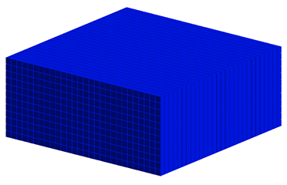
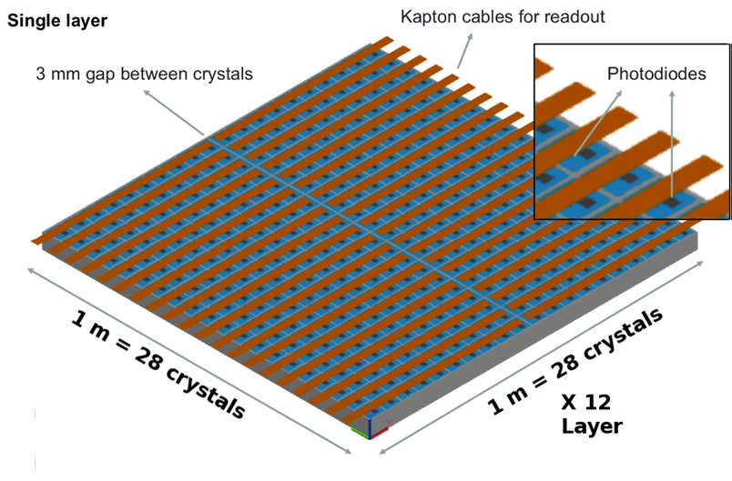
CC2 Calorimeter
28 x 28 x 12 CsI(Tl) cubes
L_{cubes} = 3.6 cm
CC2 dimensions: 1 x 1 x 0.47 m³
X₀: 54.6 x 54.6 x 23.4
λ_{I}: 2.5 x 2.5 x 1.1
Mass = 1980 kg
Planar GF: 9.5 m²sr
GF_{eff, el.} ^{0.1-1 TeV}∼ 3.4 m²sr
GF_{eff, prot.} ^{1 TeV}∼ 3.9 m²sr

Slide 22
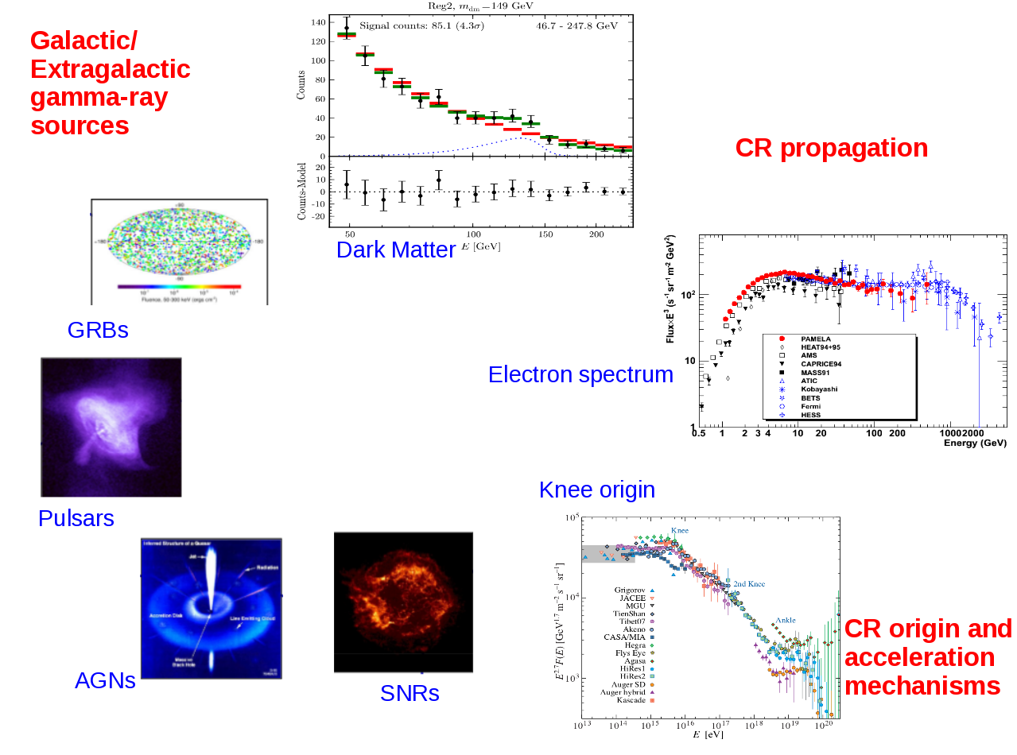
Physics with GAMMA-400

Slide 23
Physics with GAMMA-400
GAMMA-400 is focused on the detection of the three main component of cosmic radiation:
  γ-rays from 100 MeV up to TeV energies, to be studied with substantial improvements concerning the angular resolution at high energies and the continuous exposure to sources without Earth occultation
  electrons/positrons up to ∼ 10 TeV, to be measured with much improved sensitivity compared with current space, balloon-borne, and ground measurements
  cosmic-ray nuclei up to the "knee", whose spectrum and composition is to be studied with unprecedented detail up to ∼ few PeV/nucleon

Slide 24

orbit evolution and Observation modes
Observation modes:
continuous long-duration (∼ 100 days) observation of specific regions of celestial sphere, including point and extended gamma-ray sources, without Earth occultation;
monitoring of the celestial sphere.
Initial orbit parameters:
- apogee: 300,000 km:
- perigee: 500 km;
- inclination: 51.8°
After ∼ 5 months the orbit will become more circular with a radius of ∼200,000 km.

Slide 25
Photons
Detection of possible Dark Matter signal
  Gamma-ray lines
  Satellites
  Dwarf Spheroidal Galaxies
  Galactic Center
Measurement of the high-energy γ-ray spectrum
  SNR
  Pulsars and PWN
  Massive star clusters
  AGN
  GRB

Slide 26
Increasing the energy resolution
background
10% (Fermi/LAT)
5% (Fermi/LAT)
1–2% (GAMMA‑400)
The γ-ray differential energy results for a 135 GeV right-handed neutrino dark matter candidate.
L. Bergström, Phys. Rev. D 86 (2012) 103514, arXiv:1208.6082

Slide 27
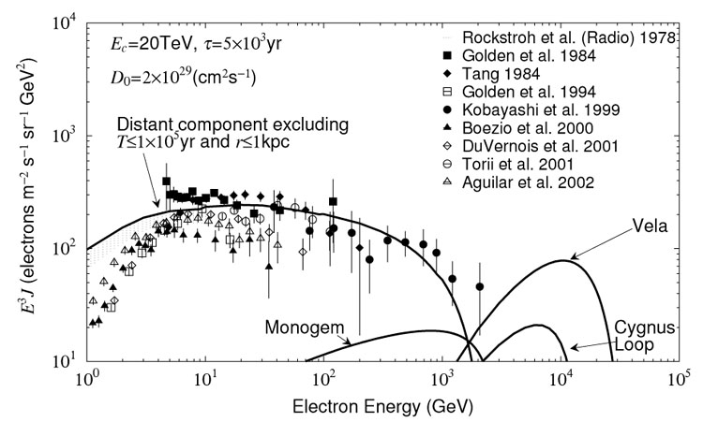
Electrons can tell us about local GCR sources
High energy electrons have a high energy loss rate ∝ E²
  Lifetime of ∼10⁵ years for > 1 TeV electrons
Transport of GCR through interstellar space is a diffusive process
  Implies that source of high energy electrons are < 1 kpc away
Only a handful of SNR meet the lifetime & distance criteria
Kobayashi et al., ApJ 601 (2004) 340-351: calculations show structure in electron spectrum at high energy
J. P. Wefel, TevPA 2011, Stockholm (2011)

Slide 28
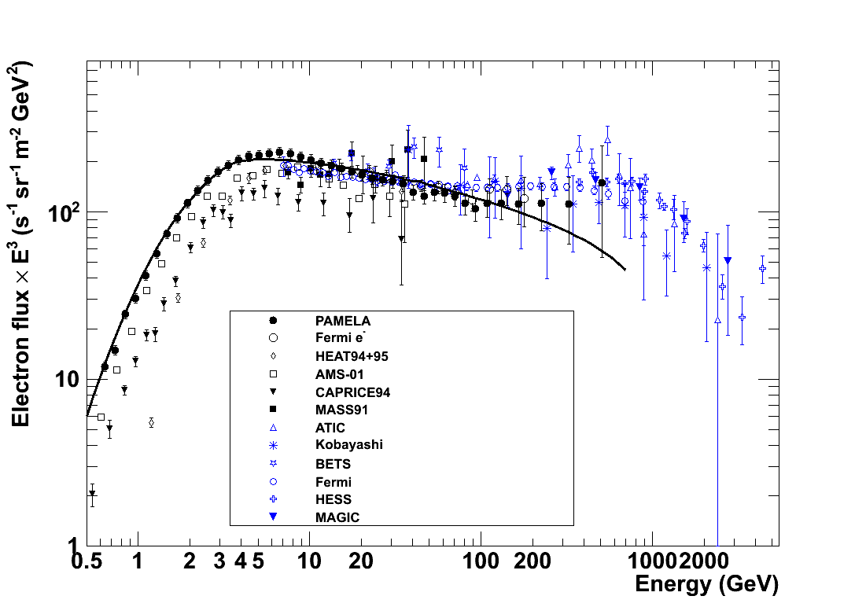
Electron Spectrum
GALPROP
?
e⁻
e⁺ + e⁻

Slide 29
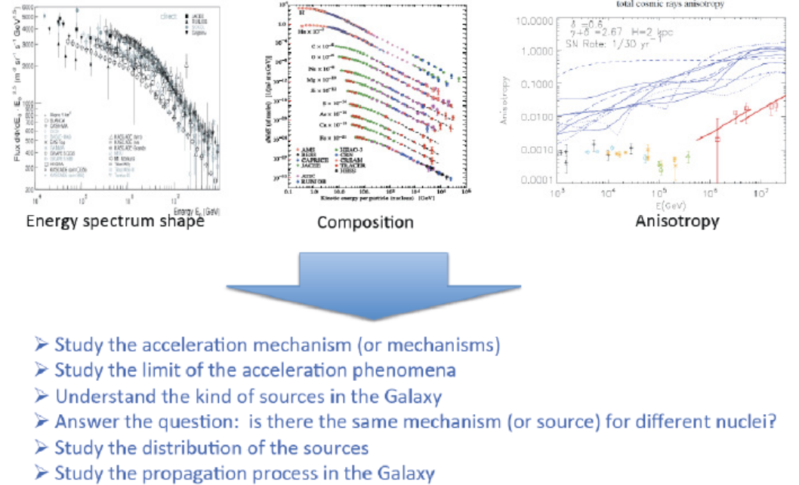
Nuclei

Slide 30
Conclusions
The GAMMA-400 mission represents a unique opportunity to perform simultaneous measurements of photons, electrons and nuclei with unprecedented accuracy.
GAMMA-400 will provide in-depth investigations on some of the most challenging physics items, such as:
  DM search in γ and high-energy electron spectra
  CR origin, production and acceleration to the highest energies
  Flux and elemental composition of nuclei at the knee
Synergy with ground-based Cerenkov arrays (CTA) and other wavelength instruments.
A Spanish collaboration in GAMMA-400 would provide an outstanding “plus” to the project: there are many areas (electronics, DAQ, calibration, space qualification, …) in which important contributions by Spanish groups would be very important (and very much welcome!)

Slide 31
Spare slides

Slide 32
The GAMMA-400 project
Mission is approved by ROSCOSMOS (launch currently scheduled in the first 20ies)
GAMMA-400:
  Scientific payload mass: 4100 kg
  Power budget: 2000 W
  Telemetry downlink capability: 100 GB/day
  Lifetime: > 7 years
  Orbit (initial parameters): apogee 300000 km, perigee 500 km, orb. period 7 days, inclination 51.8 °
  GAMMA-400 will be installed onboard the platform “Navigator” manufactured by Lavochkin

Slide 33
GAMMA-400
Original Russian design focused on:
  High Energy Gamma-rays (∼ 10 GeV – 3 TeV)
  High energy electrons (e⁺ and e⁻) up to TeV
Scientific objectives (from Russian proposal):
  “To study the nature and features of weakly interacting massive particles, from which the Dark Matter consists”
  “To study the nature and features of variable gamma-ray activity of astrophysical objects, from stars to galactic clusters”
  “To study the mechanisms of generation, acceleration, propagation and interaction of cosmic rays in galactic and intergalactic spaces”

Slide 34
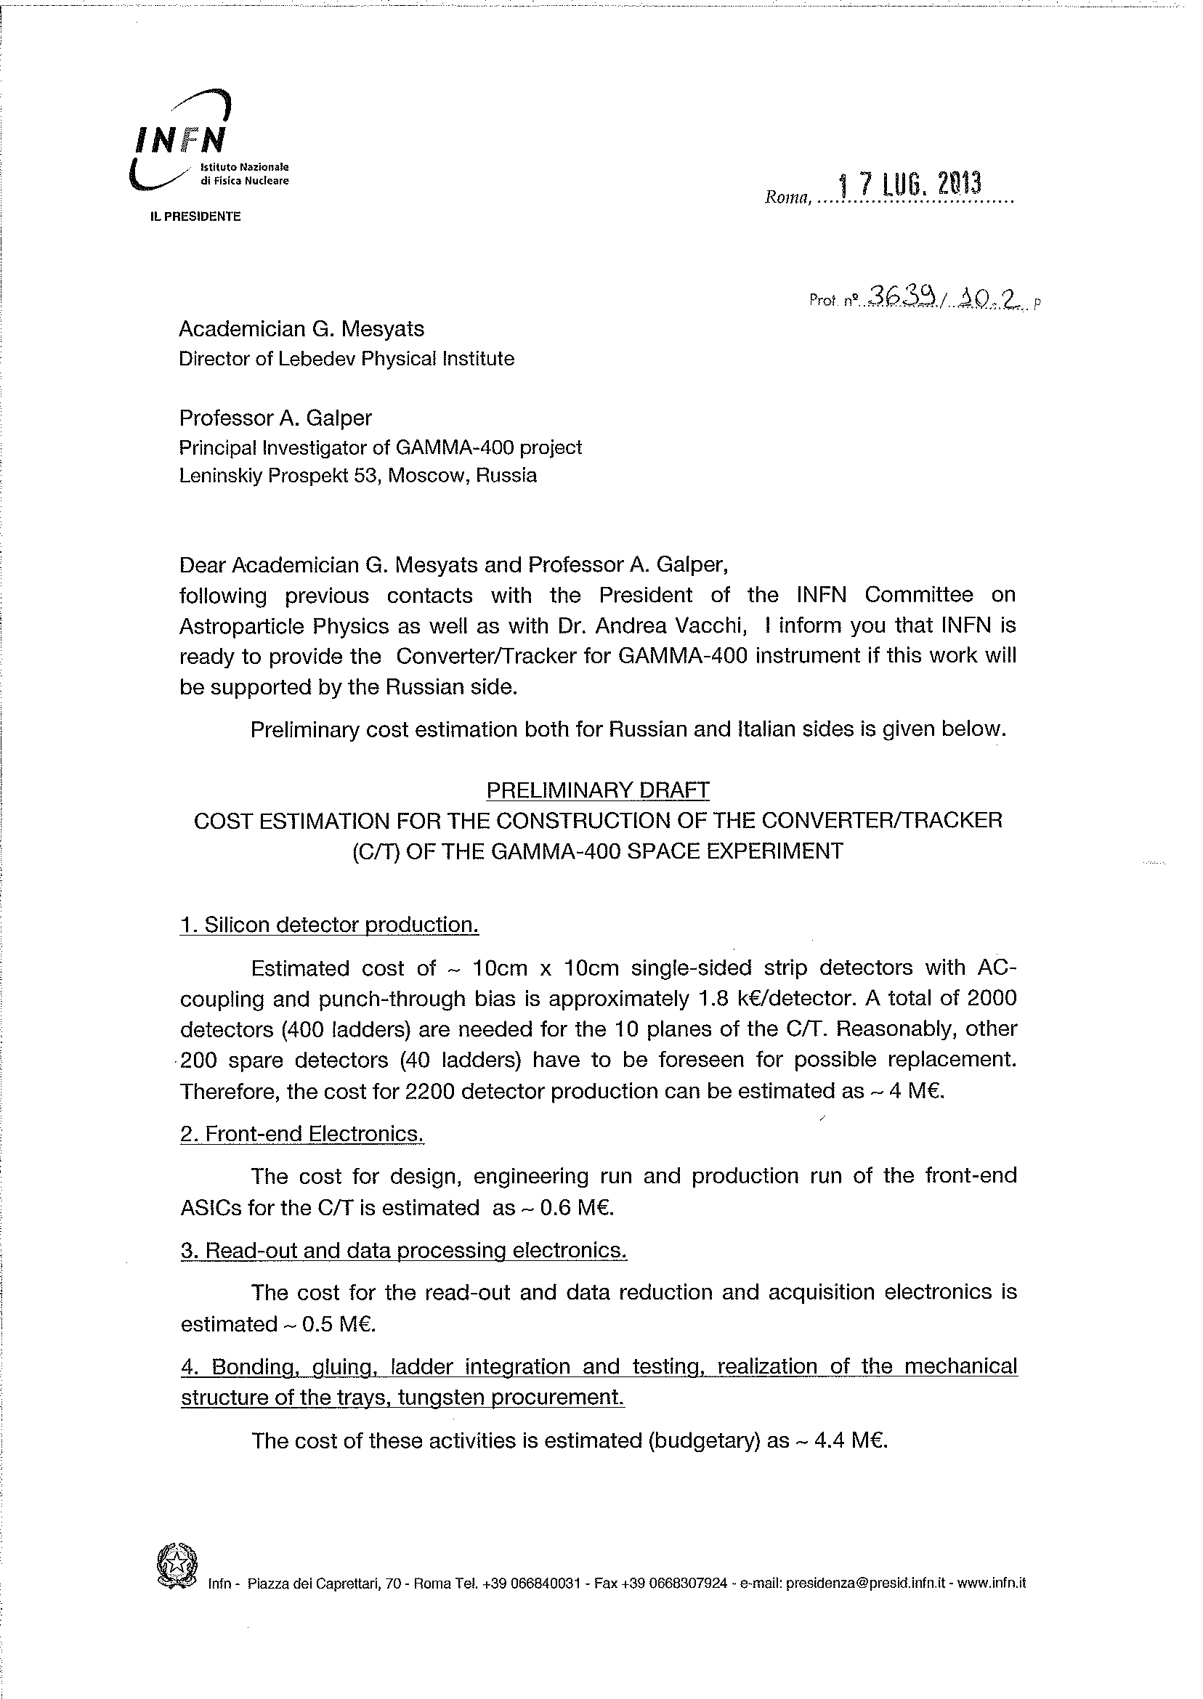
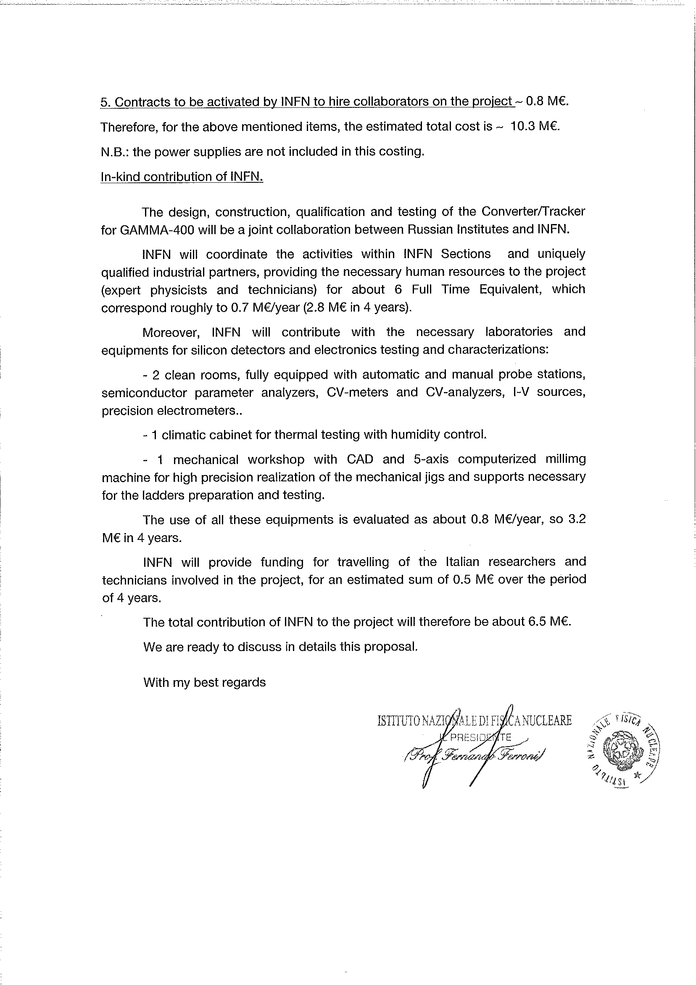

Slide 35
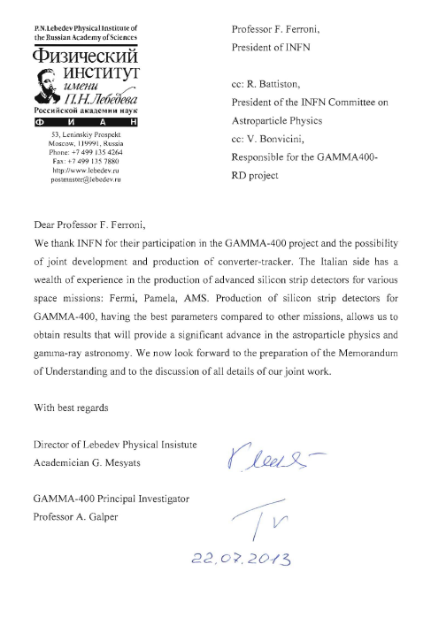

Slide 36
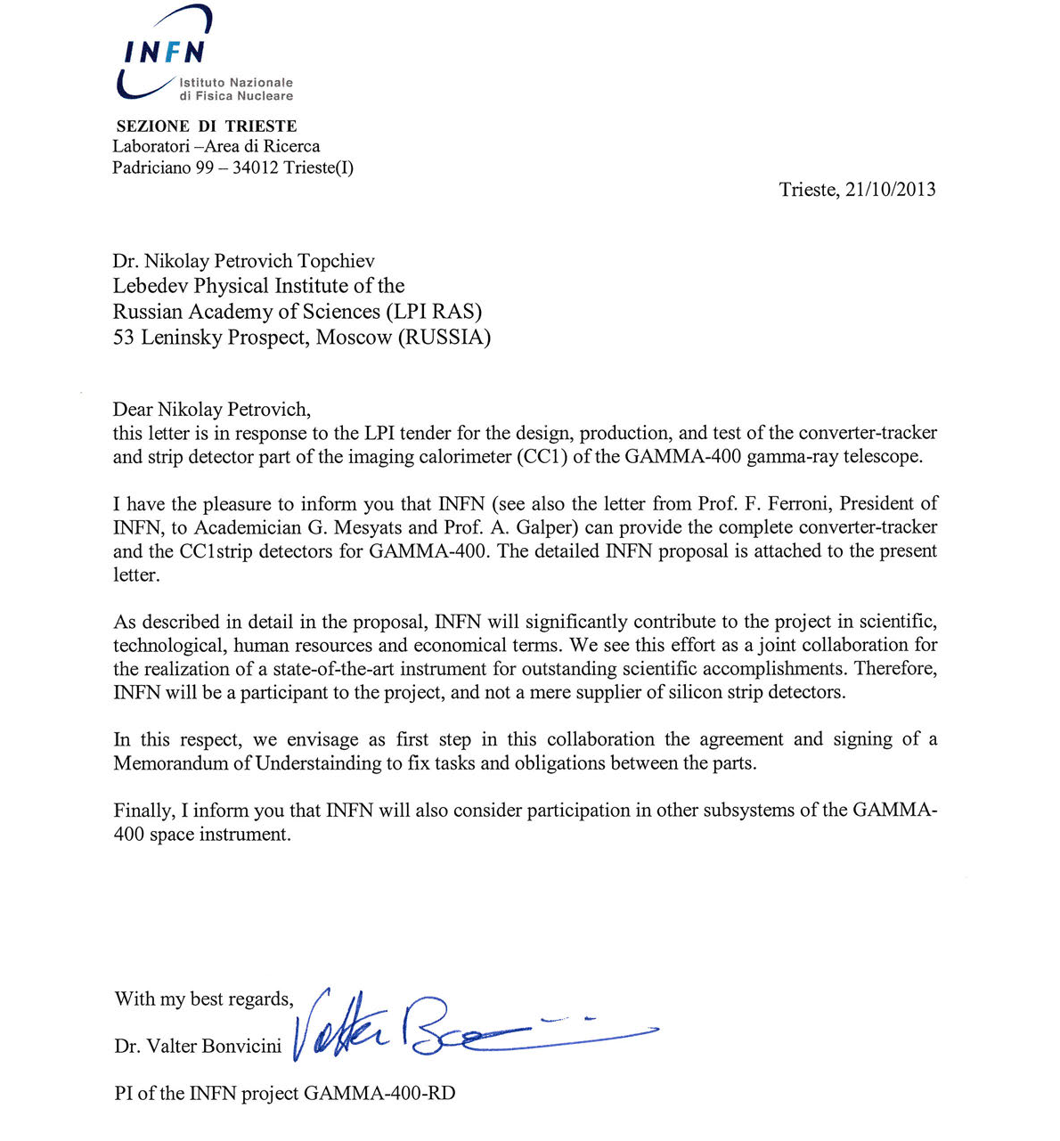

Slide 37
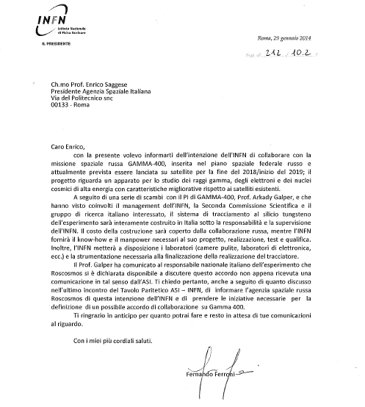

Slide 38
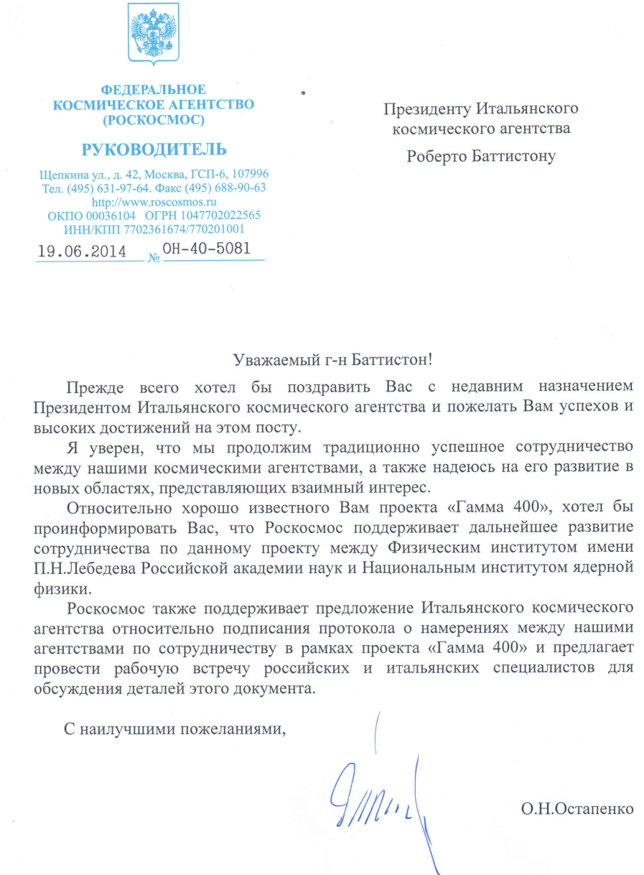
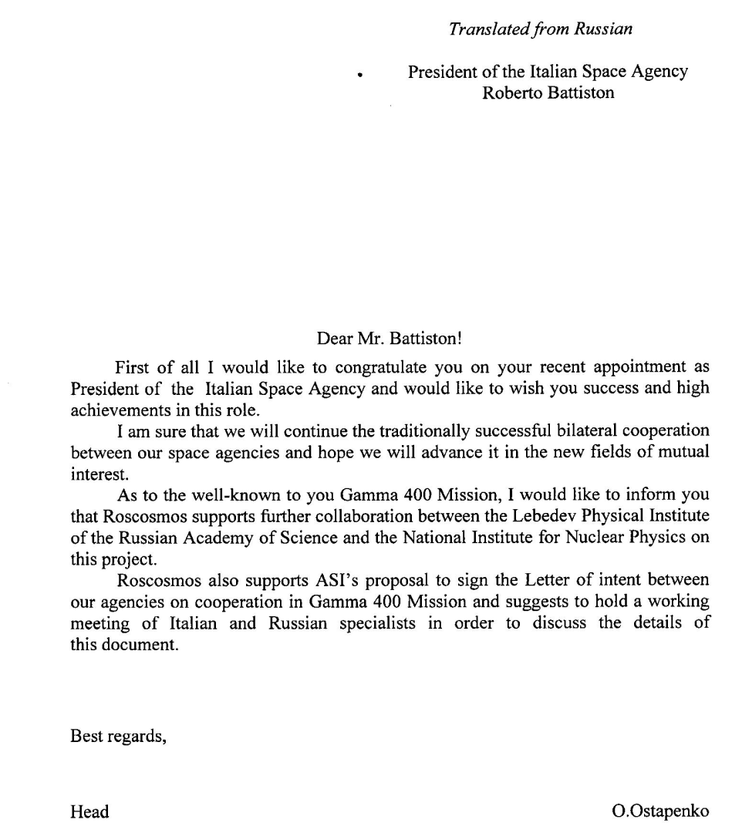

Slide 44
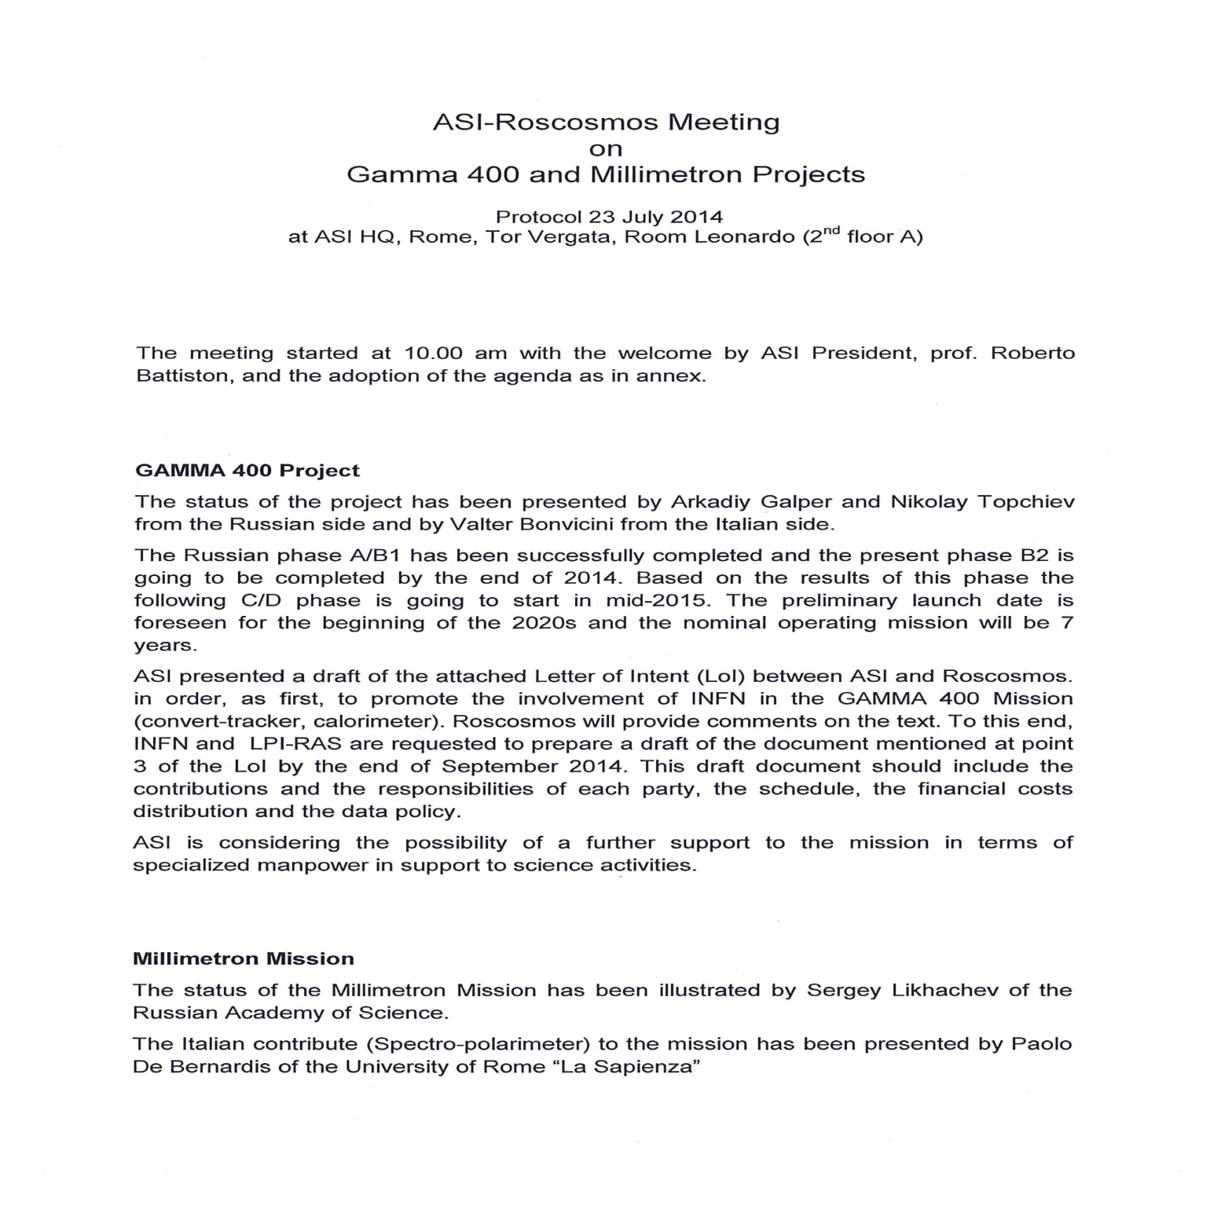

Slide 45
Preliminary results

Slide 46
Preliminary results

Slide 47
Preliminary results

Slide 48
AC-coupling scan

Slide 49
Test @ BTF (Frascati) Lug 2014
Setup:
  versione ridotta del prototipo: 3×3×5=45 cristalli + PD(large) + CASIS
Particelle:
  pacchetti di elettroni
  energie: 1,8,12,22 elettroni × 491 MeV e 50,100,200,400 elettroni × 295 MeV
  incidenza normale su cristallo centrale
Obiettivi:
  studio della risposta a sciami elettromagnetici di varie energie
  studio del regime di transizione di CASIS tra alto e basso guadagno e della dipendenza della risposta dalla tempistica del segnale
Analisi in corso…

Slide 50

GAMMA-400 scientific complex on the Navigator service module
GAMMA-400 gamma-ray telescope
Star sensors (2) with accuracy of ≈5"
(Space Research Institute)
Gamma-ray burst monitor “Konus-FG” (6)
(Ioffe Physical Technical Institute, St. Petersburg)
4 direction detectors on telescopic booms
2 spectrometric detectors
Magnetometer (2)
(Ukraine, Lviv)
on telescopic boom
Navigator service module

Slide 51
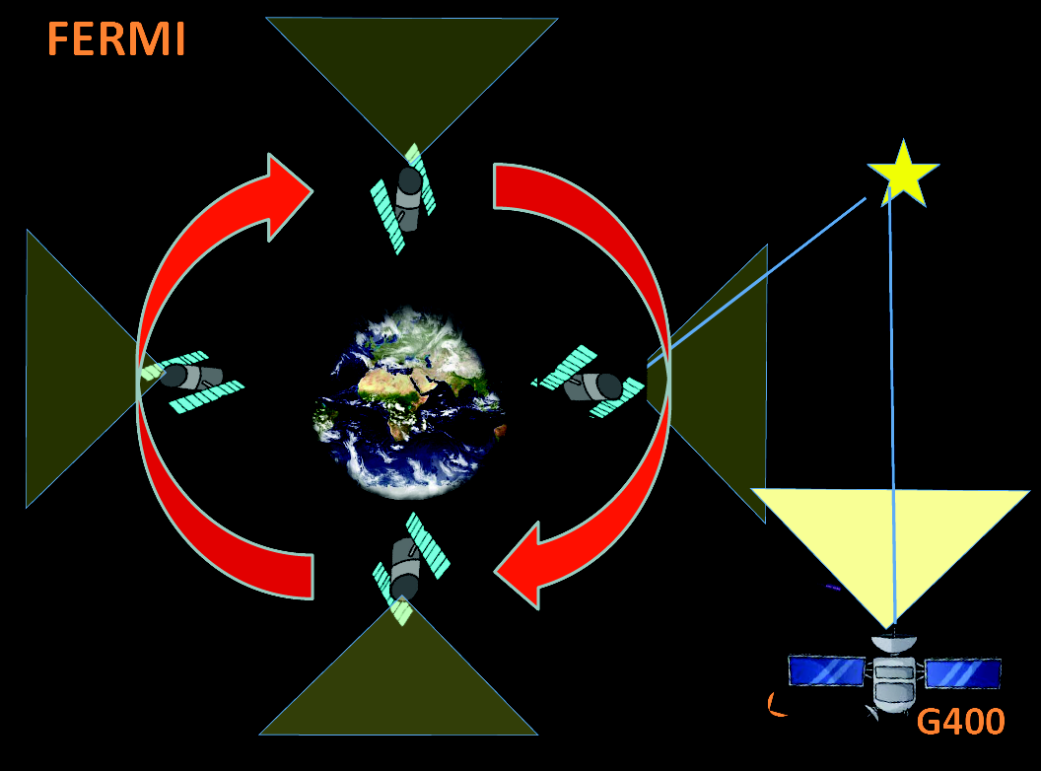

Slide 52
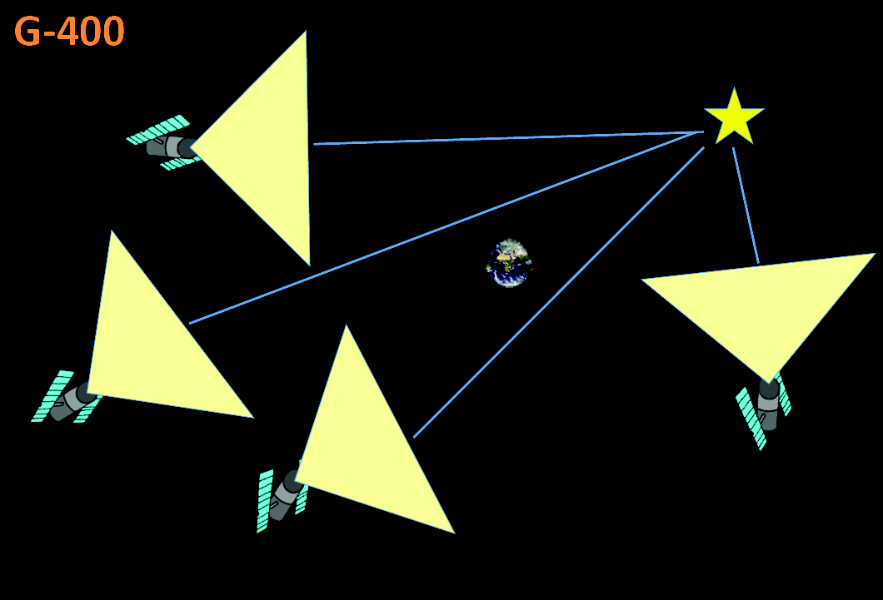

Slide 53
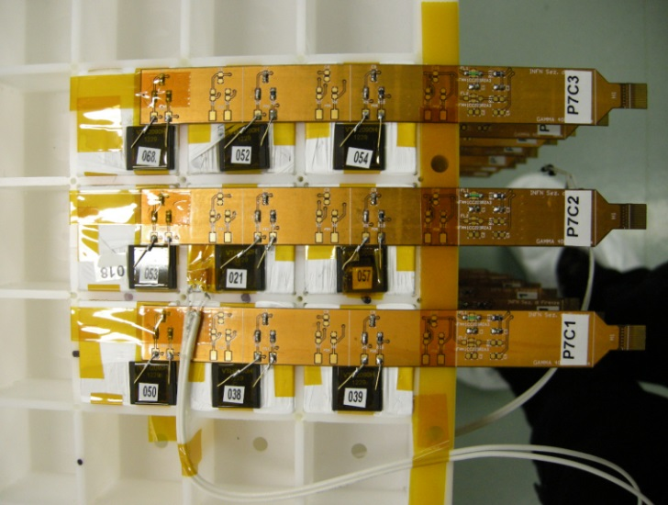
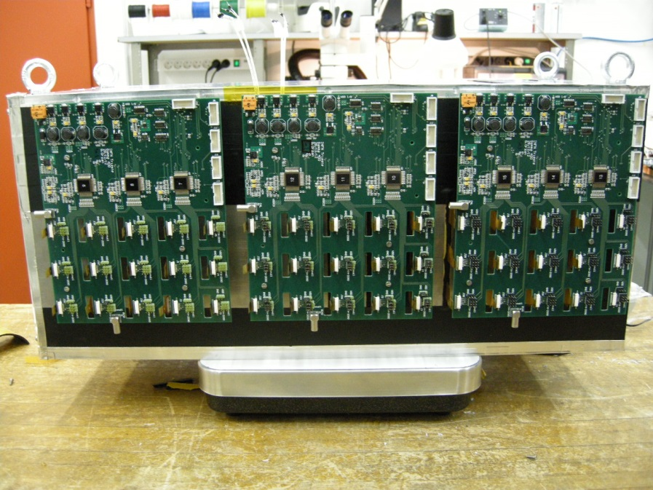
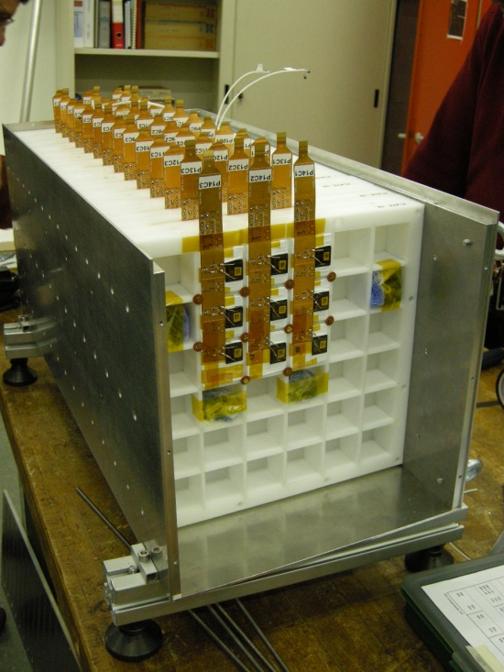
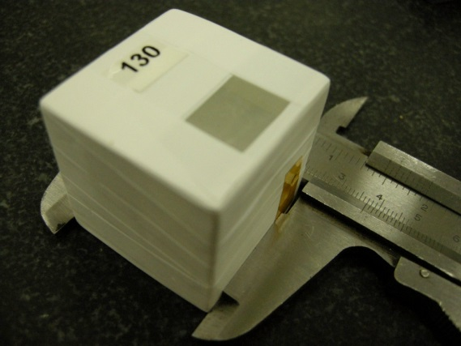
Calorimeter prototype
14 Layers
9 crystals in each layer
(crystals 3.6 x 3.6 x 3.6 cm³)
126 Crystals in total
126 Photodiodes
50.4 cm of CsI(Tl)
27 X_{0,} 1.44 λ_{I}
Photodiodes read-
out by 9 CASIS1.2A
16-channel ASICs)
Mechanics:
INFN Pisa
Front-end electronics:
INFN Trieste
Crystals, photodiodes,
DAQ, assembly:
INFN Florence

Slide 54
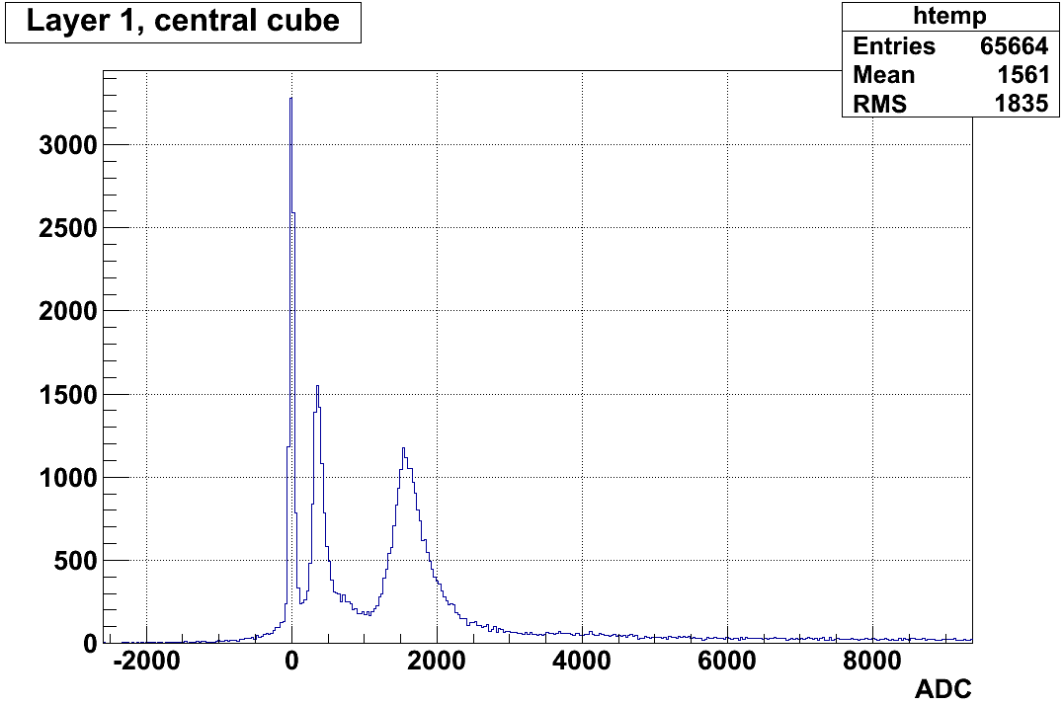
Prototype test beam results - 1
CERN SPS H8 Ion Beam: Z/A = 1/2, 12.8 GV/c and 30 GV/c (February 2013)
Notice: charge information from a precise silicon Z-measuring system located in front of the prototype
For deuterium:
S/N ~ 14
²H
⁴He

Slide 55
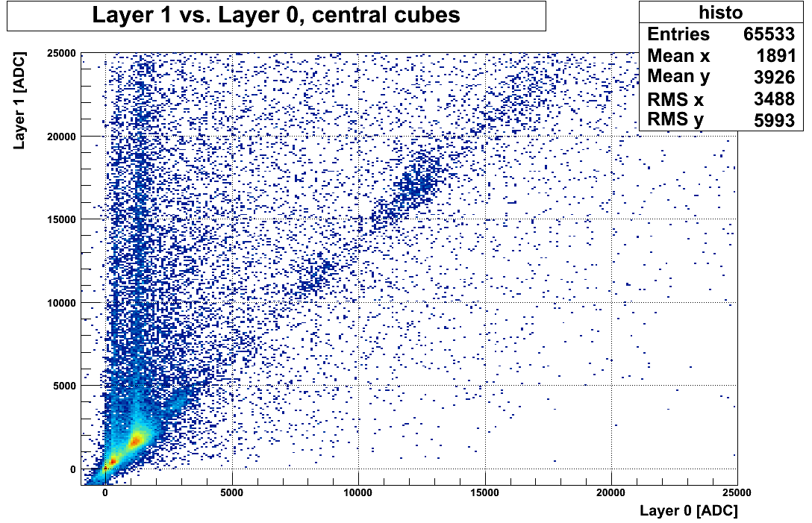
Prototype test beam results - 2
N
C
B
H: Z=1 <ADC>=330
He: Z=2 <ADC>=1300
Li: Z=3 <ADC>=3000
Be: Z=4 <ADC>=5300
B: Z=5 <ADC>=8250
C: Z=6 <ADC>=12000
N Z=7 <ADC>=16000
Be
Li
He

Slide 56
Prototype test beam results - 3
Charge is selected with the placed-in-front tracking system
Good linearity even with the large area PD!
Preliminary!
Total particle energy

Slide 57
General considerations
In the current configuration of silicon-based converter/trackers for Gamma-rays (AGILE, Fermi-LAT, GAMMA-400), the parameters that mainly affect the angular resolution are:
The converter thickness X per plane;
The distance between the planes;
The strip pitch;
The read-out system (binary or analog) and the attainable S/N ratio;
Event filtering, event topology, trigger

Slide 58


Silicon detector technology
Silicon µstrip detectors with AC-coupling and integrated DC-bias (either punch-through or polysilicon): well known and reliable technologies.
  PT bias:
    Less expensive, simpler process
    Very high R_{b} IF I_{leak} is small (low noise)
    R_{b} ÷ (I_{leak})⁻¹
    More sensitive to TID
  Polysilicon bias:
    “Fixed” R_{b} value (physical resistor)
    More expensive (additional step in the process)
    Larger dead area at the detector’s edge (to get large R_{b})
Test run (free of charge) with FBK on 6” wafers at the end of 2013, dimensions 5.3 x 3.28 cm², two designs with PT bias implemented:
  120 µm pitch, 256 strips with different widths (30, 40, 50, 60 µm);
  80 µm pitch, 384 strips with different widths (20, 30, 40, 50, 55, 60 µm);
4 detectors received in Trieste and currently being tested

Slide 59
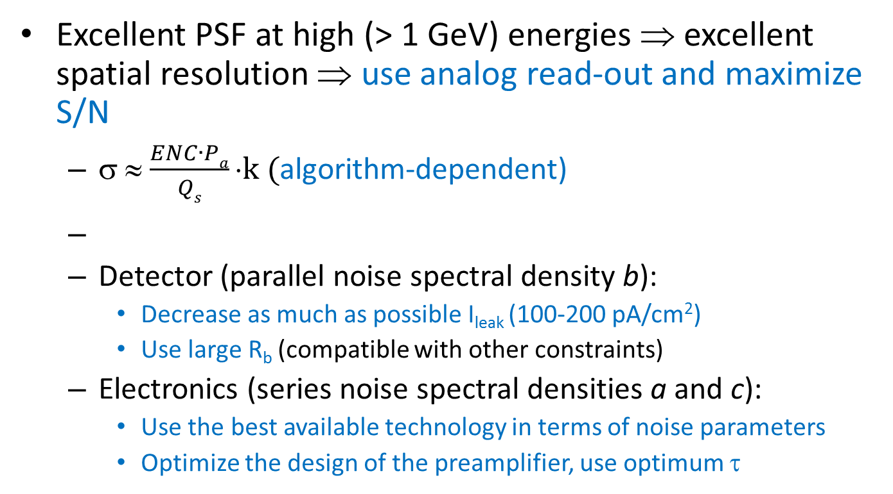
Optimization of the spatial resolution
Excellent PSF at high (> 1 GeV) energies ⇒ excellent spatial resolution ⇒ use analog read-out and maximize S/N
  σ ≈ $\frac{ENC∙Pa}{Qs}⋅k ($algorithm-dependent)
  Detector (parallel noise spectral density b):
    Decrease as much as possible I_{leak} (100-200 pA/cm²)
    Use large R_{b} (compatible with other constraints)
  Electronics (series noise spectral densities a and c):
    Use the best available technology in terms of noise parameters
    Optimize the design of the preamplifier, use optimum τ

Slide 60
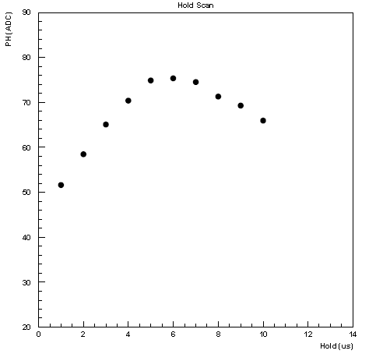
Test beam results: hold scan

Slide 61
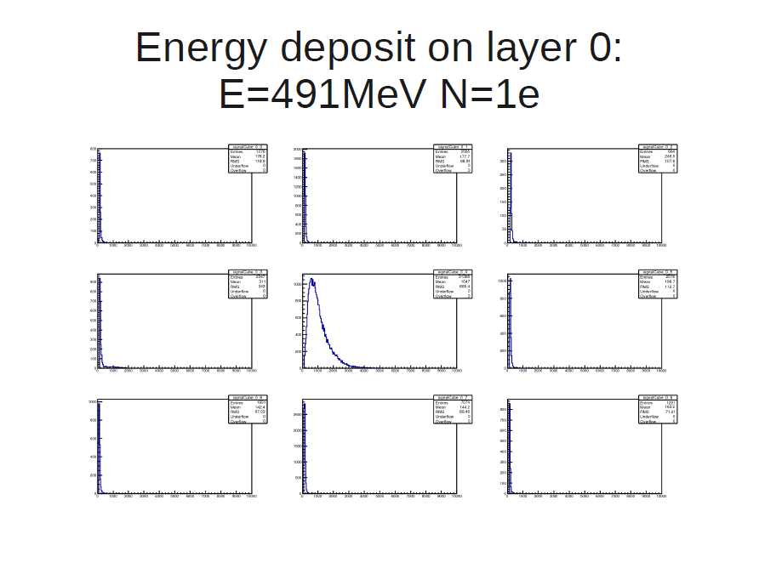

Slide 62
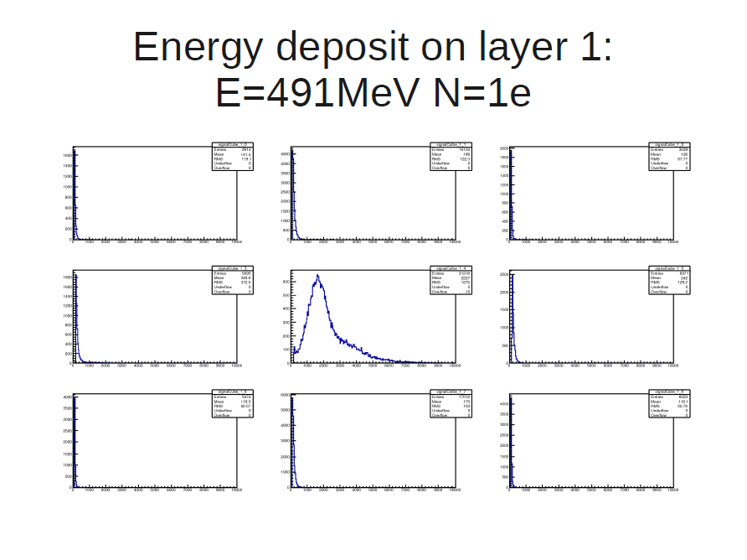

Slide 63
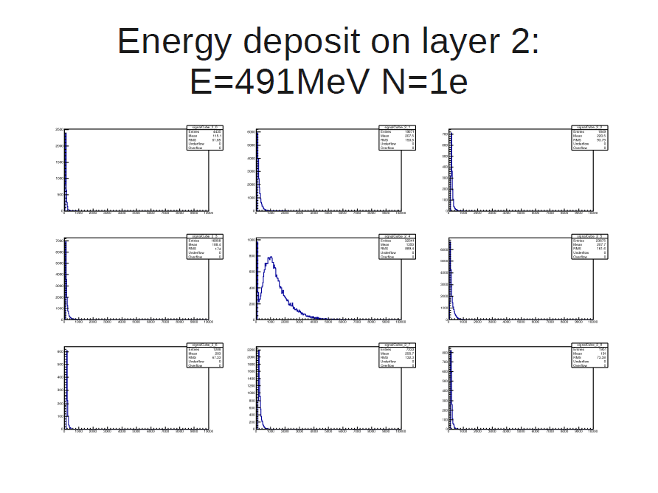

Slide 64
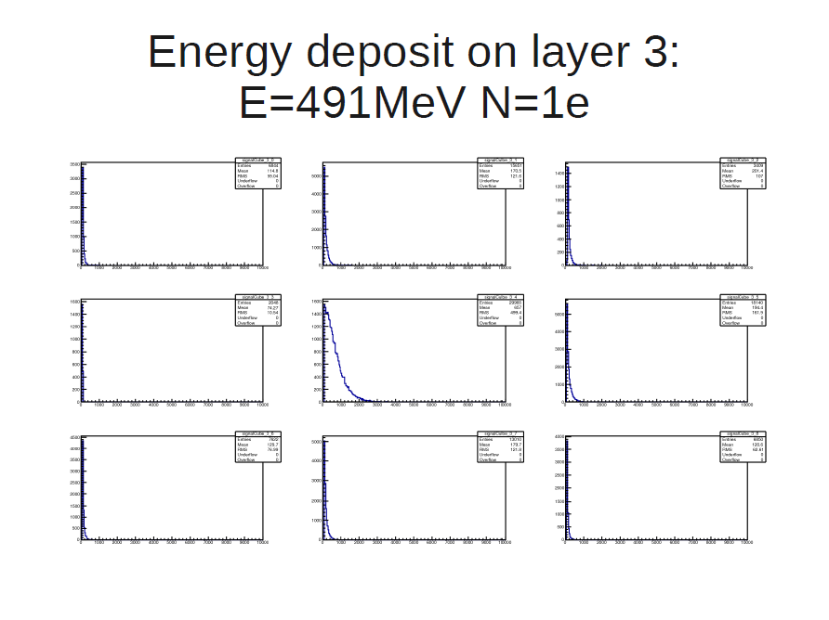

Slide 65
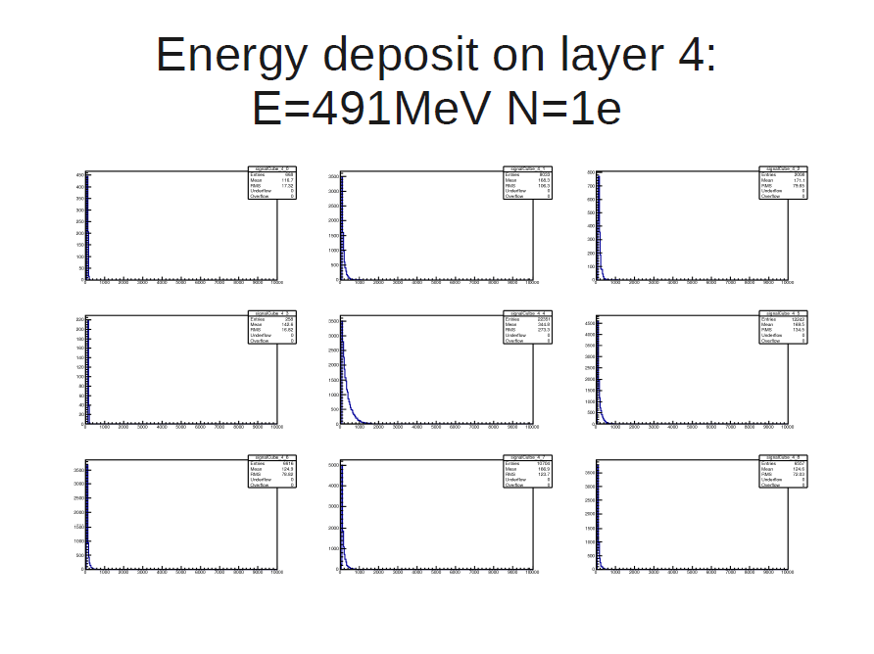

Slide 66
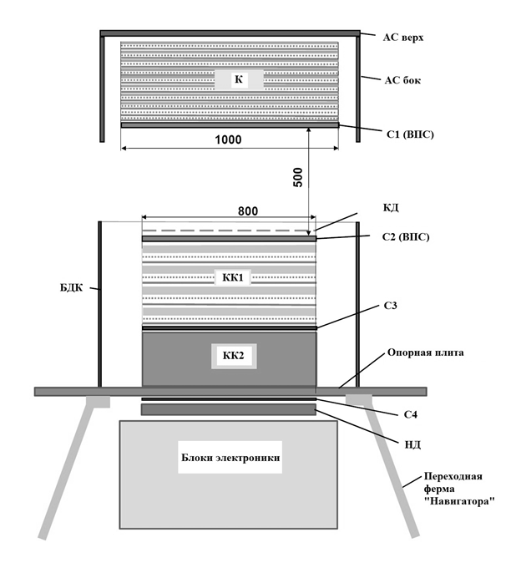
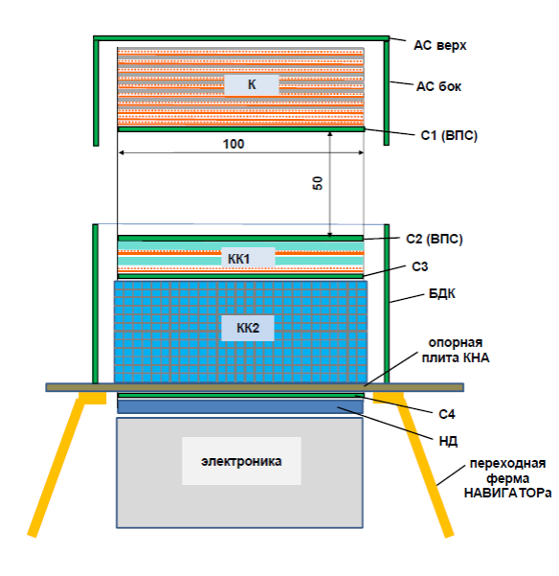
GAMMA-400 evolution
C
C
C/T
CC1
CC1
CC1
CC2
CC2
CC2
Electronics
Electronics
Electronics
Original Russian proposal (2011)
Jointly agreed Russian-Italian proposal (2013)

Slide 67
INFN in general
Istituto Nazionale di Fisica Nucleare (INFN) is the Italian research agency dedicated to the study of the fundamental constituents of matter and the laws that govern them;
INFN conducts theoretical and experimental research in the fields of subnuclear, nuclear and astroparticle physics. All of the INFN’s research activities are undertaken within a framework of international competition, in close collaboration with Italian universities on the basis of solid academic partnerships spanning decades;
Fundamental research in these areas requires the use of cutting-edge technology and instruments, developed by the INFN at its own laboratories and in collaboration with industries

Slide 68
Attivita’ 2015 - I
Finalizzazione dettagliata dell’attività di realizzazione del tracciatore
Completamento delle misure sui “baby detectors” di prova prodotti nel test run su 6” da FBK (fine 2014-inizio 2015).
Realizzazione e test su fascio di particelle di un mini-telescopio con detectors “baby” per verifica delle performance (prima parte 2015).
Definizione delle specifiche complete e degli acceptance criteria per i rivelatori al silicio, definizione del design finale e delle maschere (giugno/luglio 2015).
Produzione di un primo lotto di test (20 fette) di rivelatori 9.7x9.7 cm², disegno finale, su 6” (a valle 1° tranche russa), autunno 2015 .
Design dell'ASIC di front-end del tracker presso IDE.AS e produzione di un primo lotto di test di 100 chip per la verifica di tutte le specifiche (a valle 1° tranche russa), autunno 2015 .

Slide 69
Attivita’ 2015 - II
Prova su fascio del prototipo di calorimetro, aggiornato rispetto alla versione precedente con: (a) l'integrazione di ulteriori cristalli (fino a un totale di 400 elementi), e (b) l'istallazione di un secondo fotodiodo per la rivelazione di alti depositi energetici. Il prototipo aggiornato sarà testato su fasci di particelle di alta energia presso l'SPS del CERN durante la prima parte del 2015.
Progettazione di un sistema di calibrazione per il calorimetro a cubi, basato sulla distribuzione in fibra di un segnale luminoso generato da un laser, che consenta di monitorare la raccolta di luce ed equalizzare la risposta di ogni singolo elemento del calorimetro.
Attività di simulazione: affinamento delle simulazioni del calorimetro e del tracciatore tramite i risultati dei test su fascio (seconda parte del 2015).
Sviluppo di un dimostratore per misure TOF/Anti equipaggiato con SiPM, attività di test del dimostratore (prima parte del 2015).

Slide 70
Recent history
R&D on the program financed by INFN CSN 2 (GAMMA-400-RD, 2011-2014)
Task: preparation of a joint proposal, agreed with the Russian part
Evolution of the project in 2013:
  Letter from INFN President, Prof. F. Ferroni, to Academician G. Mesyats and Prof. A. Galper (July 17th, 2013): “… INFN is ready to provide the Converter/Tracker for GAMMA-400 instrument if this work was supported by the Russian side…”
  Presentation of a progress report to INFN CSN 2 (23-27 September, 2013):
    Positive evaluation from the referees
    Approval of continuation of work in view of the definition of a collaboration agreement (Memorandum of Understanding)
  INFN Proposal for the design and construction of converter-tracker and strip part of imaging calorimeter for gamma-ray telescope GAMMA-400 (October 21st, 2013)

Slide 71
Totale GAMMA-400
Totale ricercatori + tecnologi: 33 heads, 14.6 FTE
Totale richieste 2015: 160 k€ (84 miss, 47 cons, 20 altri cons, 4 trasp, 5 inv)

Slide 72
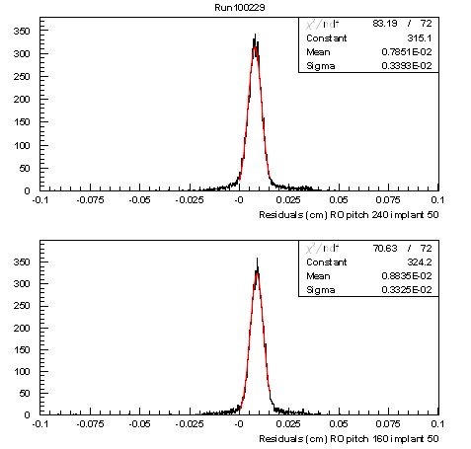
Test beam results: spatial resolution

Slide 73
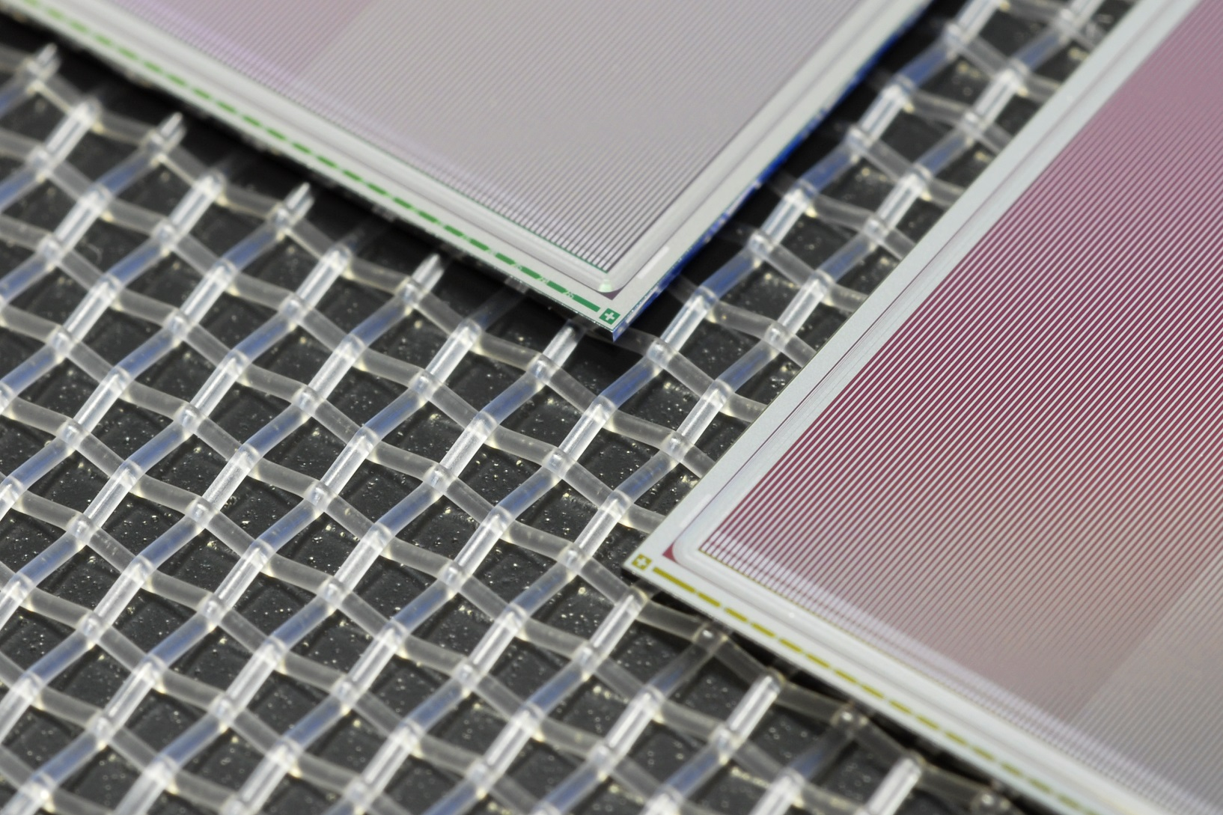
Detectors under test in Trieste

Slide 74
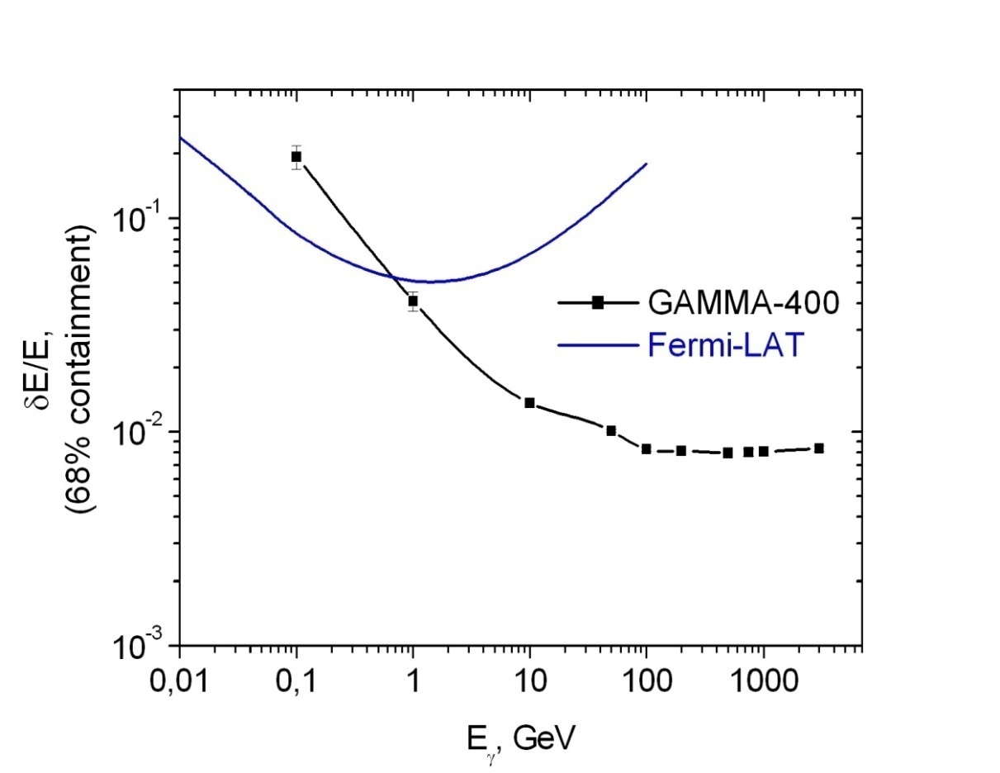
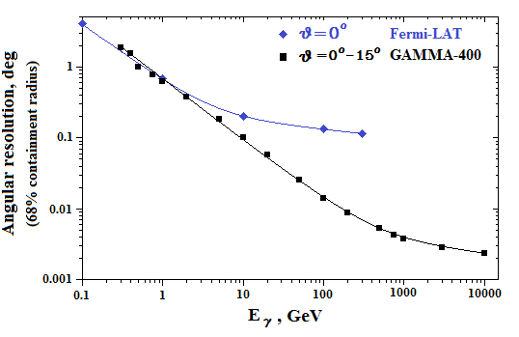
Energy resolution vs. energy for normal incidence for Fermi-LAT P7 V6 and GAMMA-400
Angular resolution vs. energy for Fermi-LAT P7 V6 (for normal incidence) and GAMMA-400
(for θ=0°-15°)
A. Galper, Workshop on the Future of Dark Matter Astroparticle Physics 2013, Trieste, Italy

Slide 75
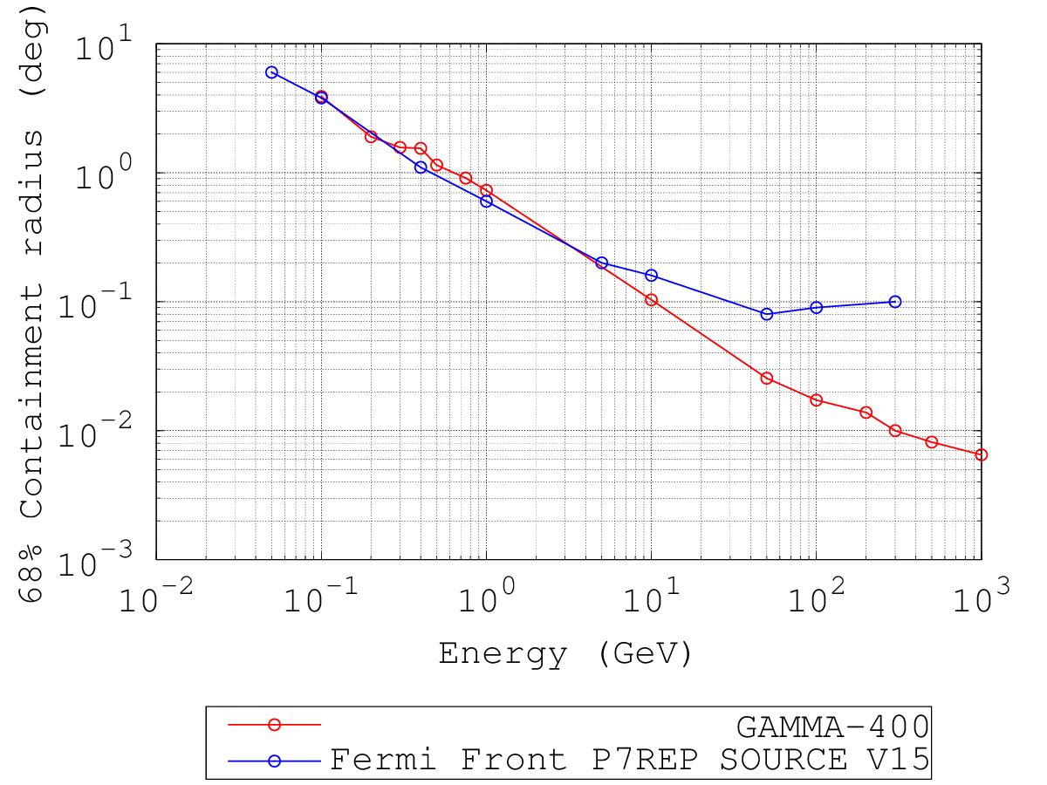
Angular resolution

Slide 76
Energy resolution for γ

Slide 77
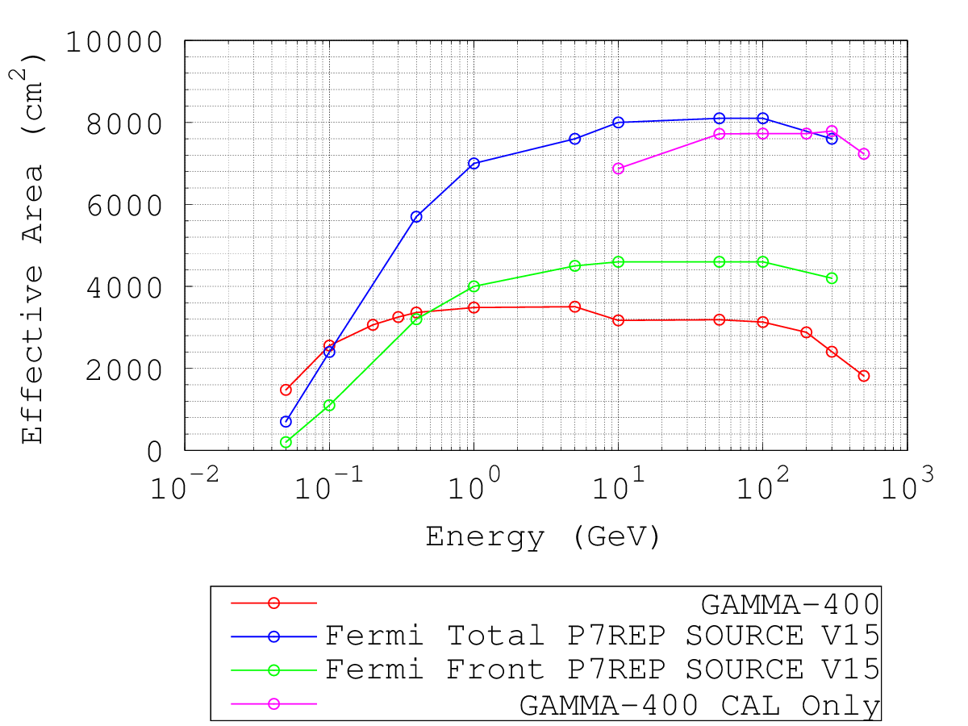

Slide 78
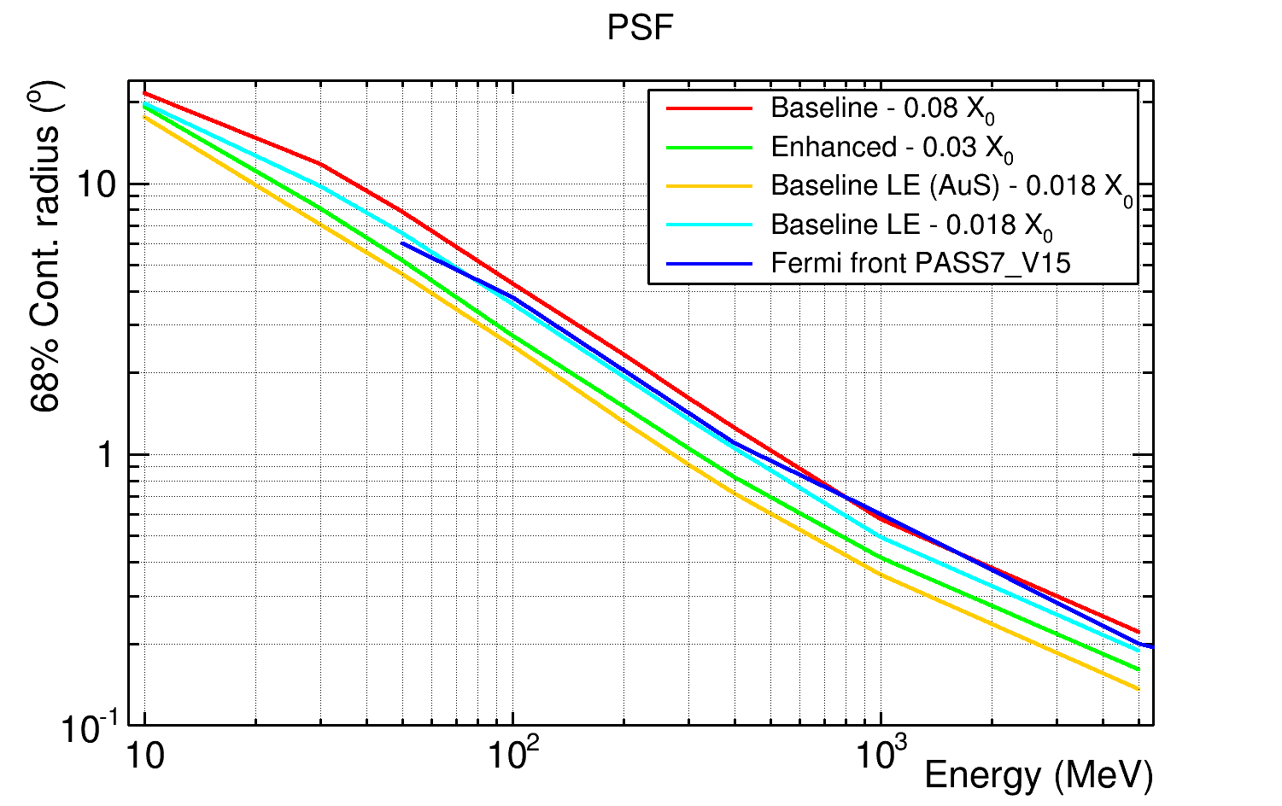

Slide 79
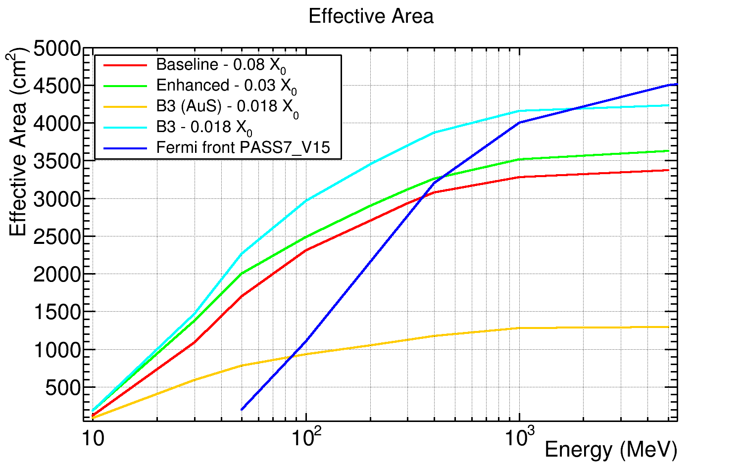

Slide 80


