Slide 1
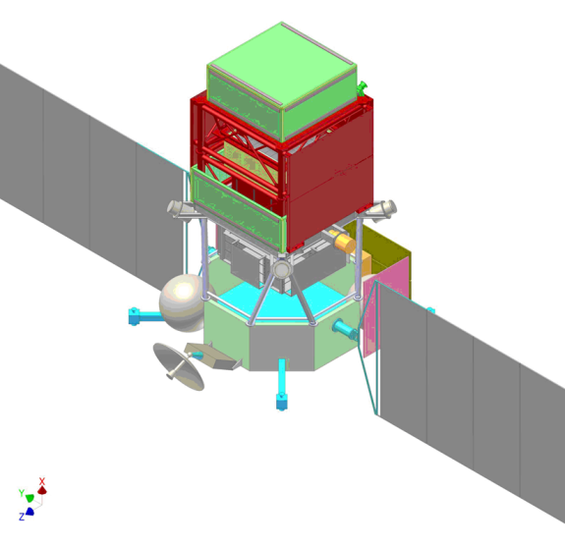
Overview of the CaloCube project
Oscar Adriani
University of Florence and INFN Firenze
Barcelona, June 26th,2015

Slide 2
Historical preamble
We started to think to a ‘Cubic’ calorimeter when the Gamma-400 project was under discussion and modification to enlarge the Gamma-400 scientific capabilities
The basic idea of the cubic calorimeter has been accepted by the Gamma-400 collaboration in 2013 to optimize the high energy CR detection
The overall geometry has subsequently been revised to cope with the new mass & dimensions of Gamma-400
  Cube has become a parallelepiped! (28x28x12 crystals)
In Italy we are continuing an R&D project (approved in 2014 by INFN for ~1 M€) to learn as much as possible from a finely segmented almost cubic calorimeter
This talk will give a review on both the Gamma-400 calorimeter and the CaloCube R&D project
  Many aspects of the R&D project will not be used in Gamma-400

Slide 3
Basic ideas for a Cosmic Ray calorimeter
An homogeneus, deep, isotropic calorimeter
  can accept events from all sides (mechanical support on bottom side) → ~GF * 5
  segmentation in every direction gives e/p rejection power by means of topological shower analysis
  small size (~Molière radius) scintillating crystals for homogeneity
  gaps between crystals increase GF and can be used for signal readout
    small degradation of energy resolution
  must fulfill mass&power budget of a space experiment
  modularity allows for easy resizing of the detector design depending on the available mass&power
  dual/multiple readout
    Improve the hadronic energy resolution
    Improve the p/e rejection
A weight of few tons is feasible
Assumption for the next few slides: 2000 kg of active material

Slide 4
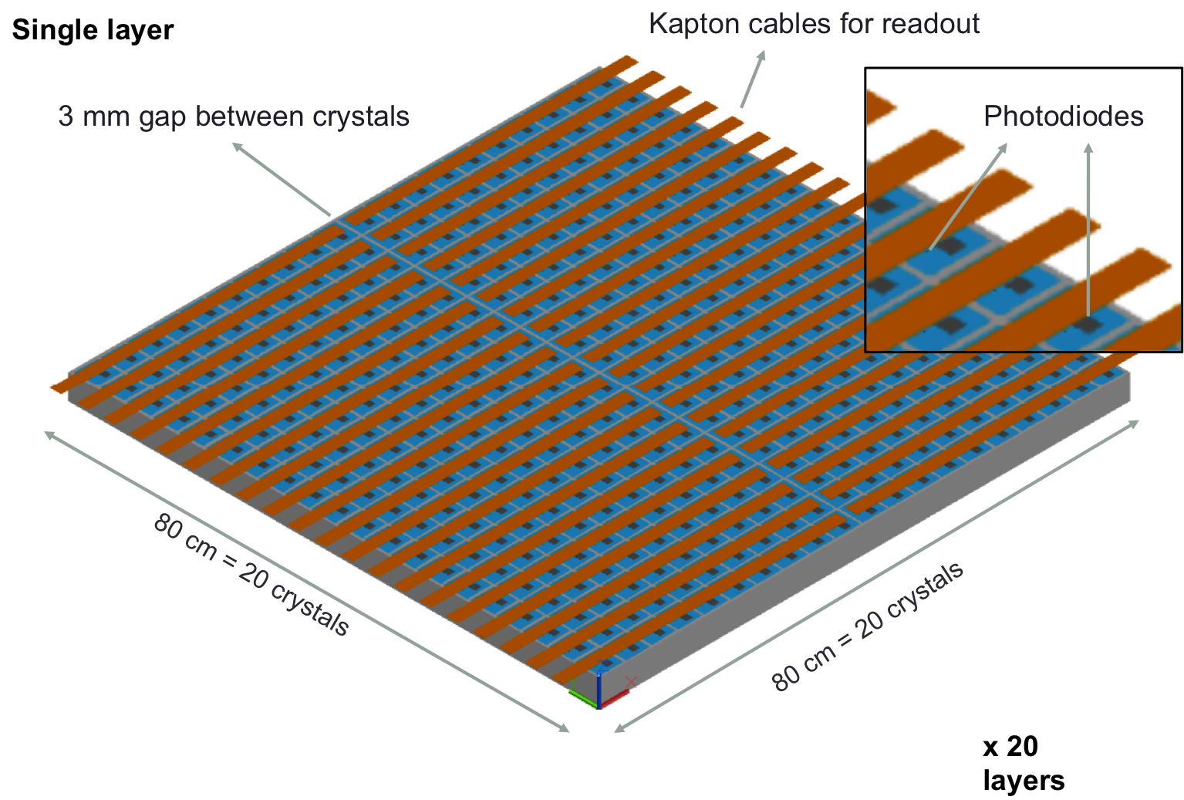
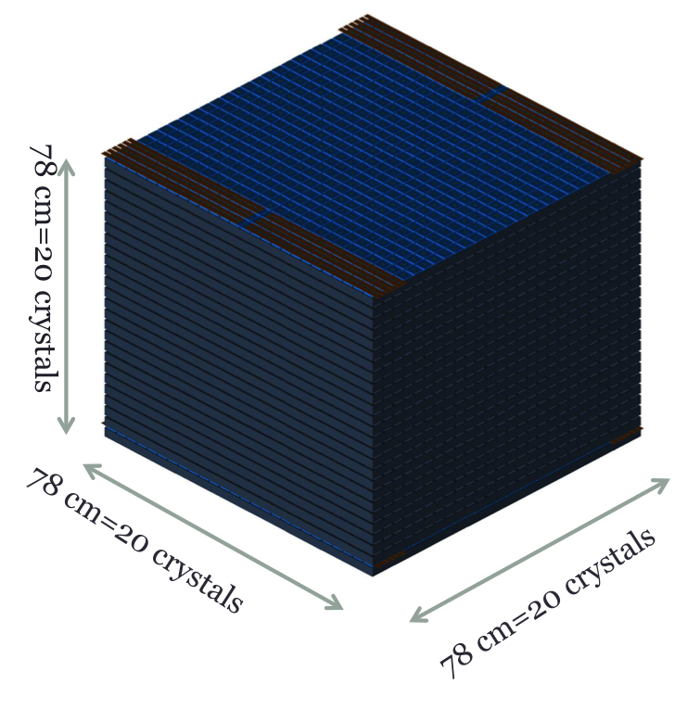
The simplest solution: a large cube made by small scintillating cubes

Slide 5
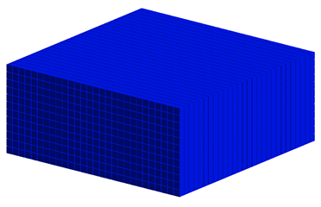
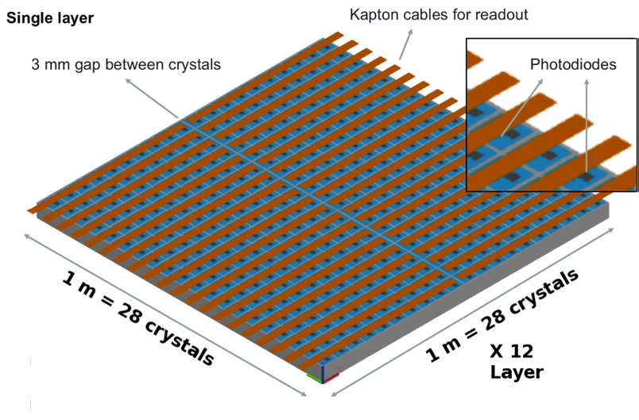
CC2 Calorimeter currently inserted in Gamma-400
28 x 28 x 12 CsI(Tl) cubes
L_{cubes} = 3.6 cm
CC2 dimensions: 1 x 1 x 0.47 m³
X₀: 54.6 x 54.6 x 23.4
λ_{I}: 2.5 x 2.5 x 1.1
Mass = 1980 kg
Planar GF: 9.5 m²sr
GF_{eff, el.} ^{0.1-1 TeV}∼ 3.4 m²sr
GF_{eff, prot.} ^{1 TeV}∼ 3.9 m²sr
Slightly staggered planes to avoid dead regions

Slide 6
Geometry and materials

Slide 7
Notes:
Legenda:

Slide 8
Other materials vs CsI
  CaF2
    Low density→ larger geometrical acceptance
    Better hadronic containment, but not e.m.
  BaF2
    Density ∼ CsI → same geometrical acceptance
    Better containment hadronic and e.m.
    UV Transparent → optimal properties for the Dual readout
  YAP
    Lightest material with maximum hadronic containment
    Smaller em containment
  BGO, BSO and LYSO
    Optimal containment both for Hadronic and e.m. showers
    Good optical properties for the Dual Readout
    High Density → smaller geometrical acceptance
      Can we increase the acceptance by increasing the gaps?

Slide 9
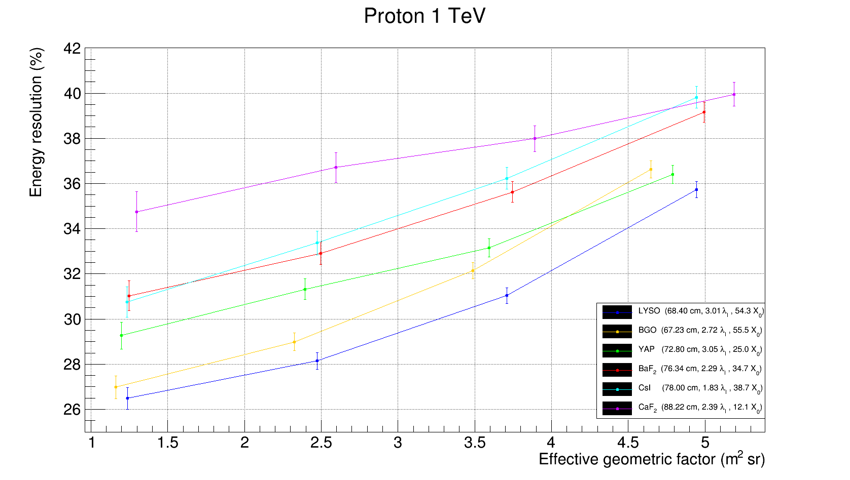
Effective hadronic geometrical factor for a 2 tons calorimeter of different materials
Gap btw crystals =0.1 of the crystal size
Crystal size = 1 Moliere radius
We can obtain different GF by applying different selection criteria

Slide 10
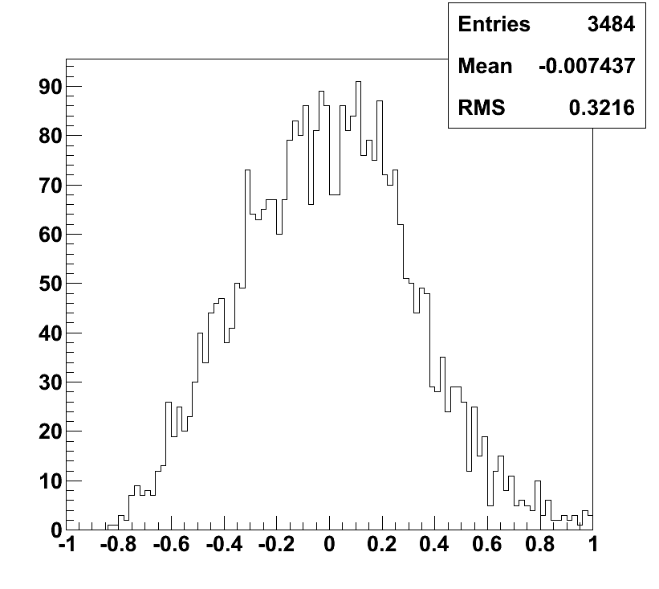
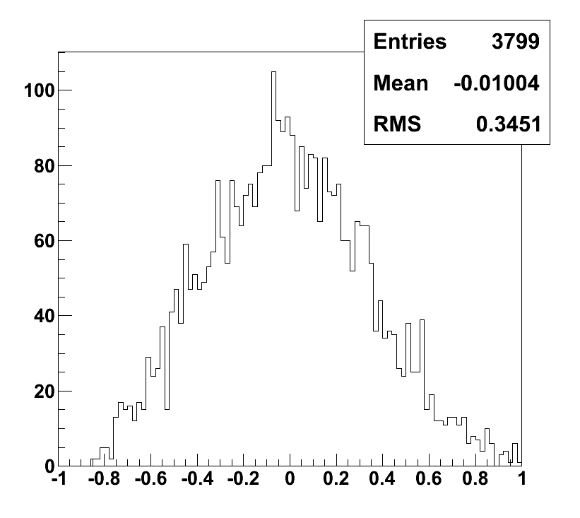
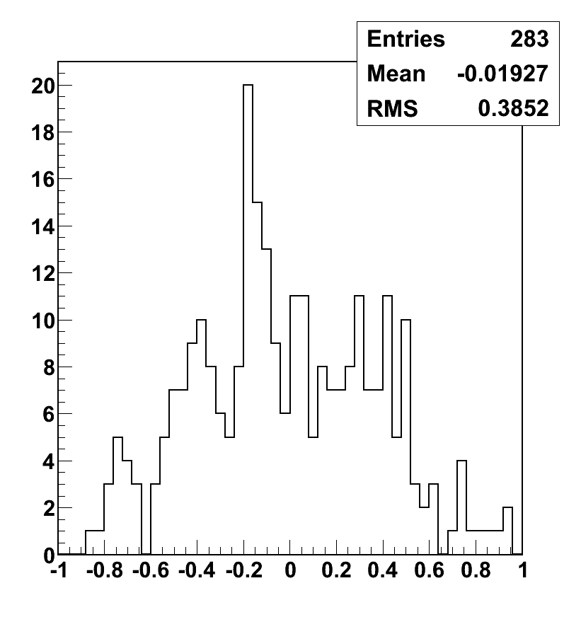
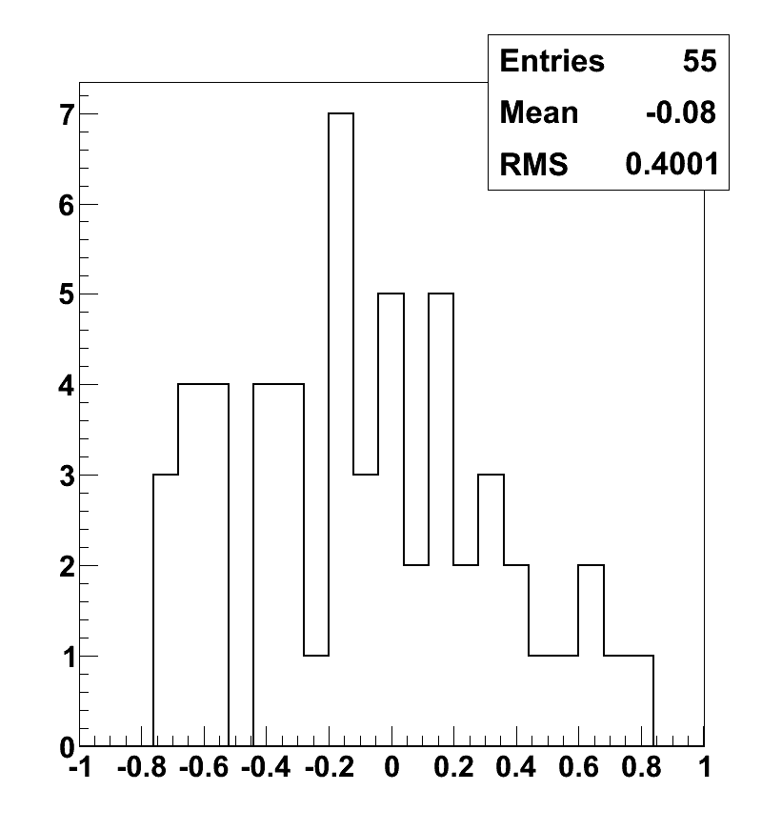
Protons
Details in the S. Bottai talk
Energy resolution (correction for leakage by looking at the shower starting point)
100 – 1000 GeV
1 TeV
Selection efficiencies:
ε^{0.1-1TeV} ~ 35%
ε^{1TeV} ~ 41%
ε^{10TeV} ~ 47%
GF_{eff}^{0.1-1TeV} ~ 3.3 m²sr
Gf_{eff} ^{1TeV} ~ 3.9 m²sr
Gf_{eff} ^{10TeV} ~ 4.5 m²sr
32%
35%
(Measured Energy – Real Energy) / Real Energy
(Measured Energy – Real Energy) / Real Energy
10 TeV
100 TeV
Proton rejection factor with simple topological cuts:
2.10⁵-5.10⁵ up to 10 TeV
39%
40%
(Measured Energy – Real Energy) / Real Energy
(Measured Energy – Real Energy) / Real Energy

Slide 11
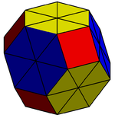
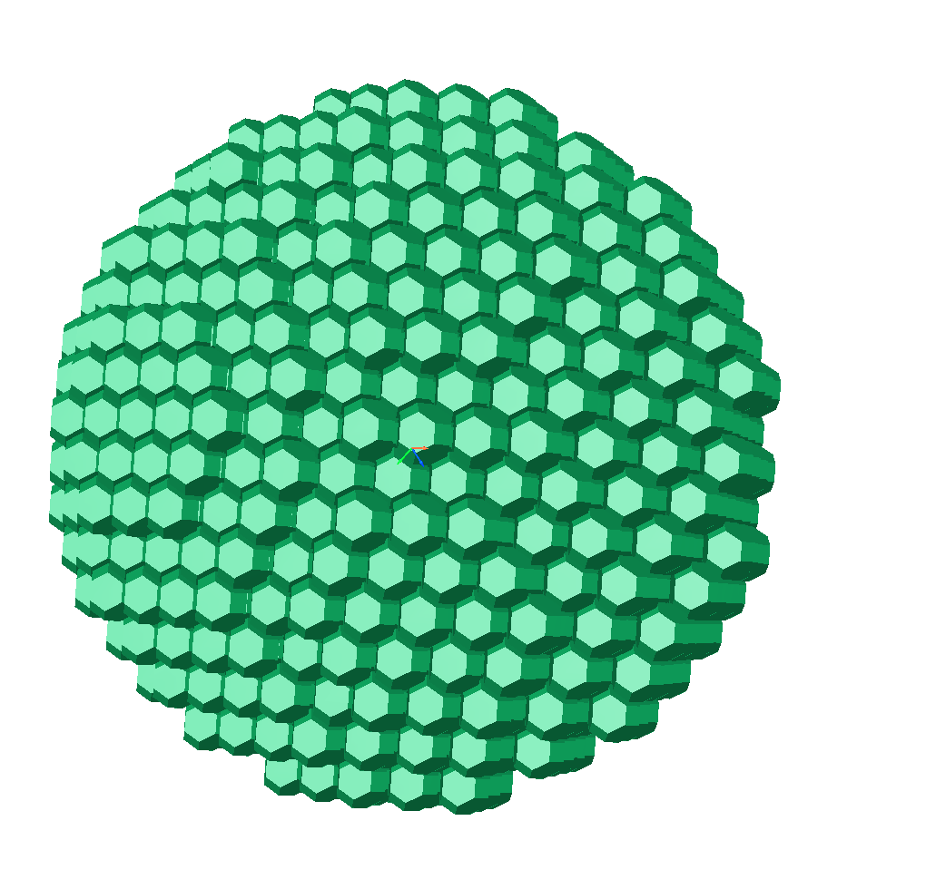
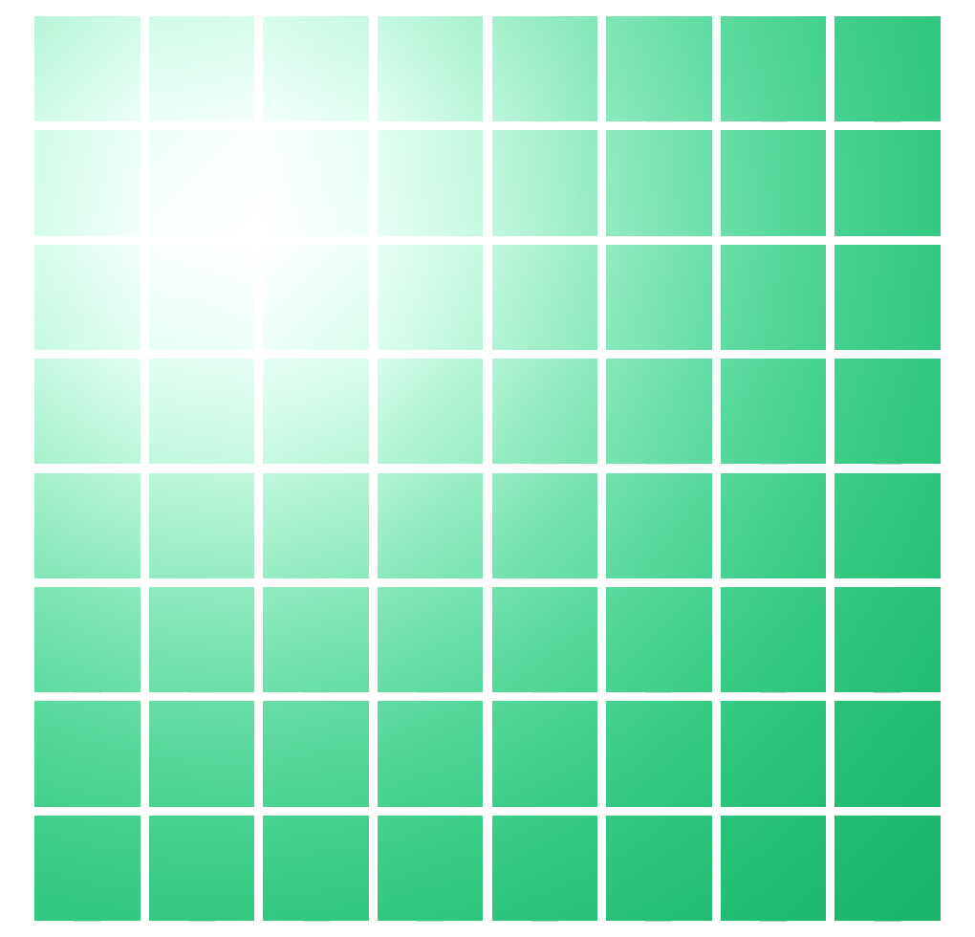
A more exotic solution
Cubic configuration with small size cubic crystal
Simpler from the mechanical point of view
Spherical configuration with small crystals with
truncated octahedron shape
More complex from the mechanical point of view
Basic ideas:
Reduce as much as possible the leakages by avoiding possible escape planes
Spherical geometry to increase the acceptance (maximize the surface, and hence the GF, once the weight is fixed)
Optimization criteria:
Crystals dimensions
Gap btw crystals to increase the acceptance
•

Slide 12
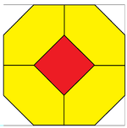
a
gap
l
Size of the red square a = 1.2 cm
Size of the yellow cubic envelope l = √2 × 2 × a = 3.4 cm
Gap gap = 0.8 cm
Volume V = 8 × √2 × a³ = 19.55 cm³
Weight W = 139.4 g
Single crystal
Number of crystals along the diameter 25
Total number of crystals 14361
External Diameter 103.6 cm
Total weight 2002 kg
Depth on the diameter 3.75 λ_{I}
Geometrical factor 10.6 m² sr
Spherical calorimetric

Slide 13
The Spherical Calorimeter
Cubes

Slide 14
Expected number of high energy charged cosmic rays events with a GF_{eff}=10 m² sr
Some assumptions:
10 years exposure
e/p rejection factor ~ 10⁵
Protons and Helium (Polygonato model)
Effective GF (m² sr) | σ(E)/E | E>0.1 PeV |  | E>0.5 PeV |  | E>1 PeV |  | E>2 PeV |  | E>4 PeV
 |  | p | He | p | He | p | He | p | He | p | He
~10.0 | 35% | 20.10³ | 19.10³ | 1.1.10³ | 1.3.10³ | 3.0.10² | 3.7.10² | 70 | 110 | 12 | 25
Electrons (no nearby sources)
Effective GF (m² sr) | σ(E)/ E | E>0.5 TeV | E>1 TeV | E>2 TeV | E>4 TeV
10 | ~1% | 550.10³ | 105.10³ | 15.10³ | 18.10²

Slide 15
The dual readout

Slide 16
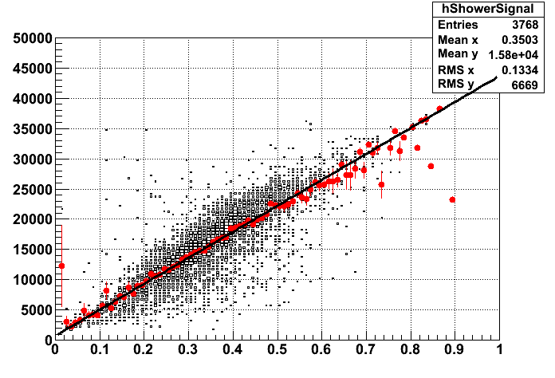
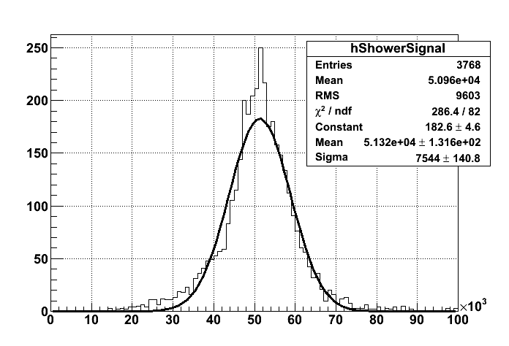

MC simulations for the improvement of hadronic energy resolution using Cherenkov signal
The idea :
IF THE ELECTROMAGNETIC FRACTION (fem=E_{em}/E) IS GIVEN FOR EACH SHOWER IT CAN BE USED TO IMPROVE THE RESOLUTION
for 1 TeV vertical proton the resolution scale from 35% to 15%
PERFECT fem CORRECTION
Slices
has lower
RMS

Slide 17
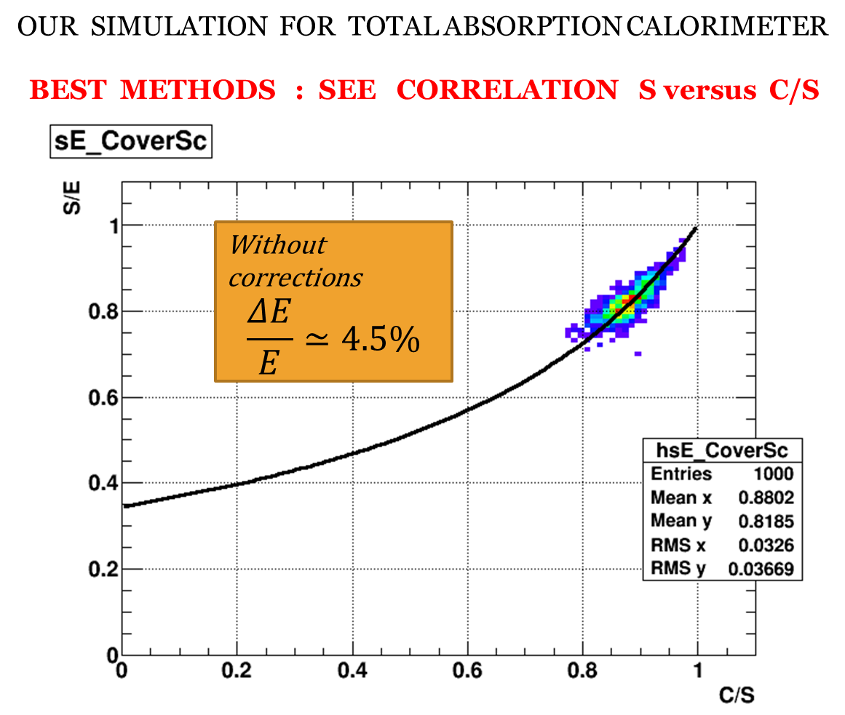
The DREAM concept : USE CHERENKOV LIGHT [ Q ]
FIRST TEST :

Slide 18
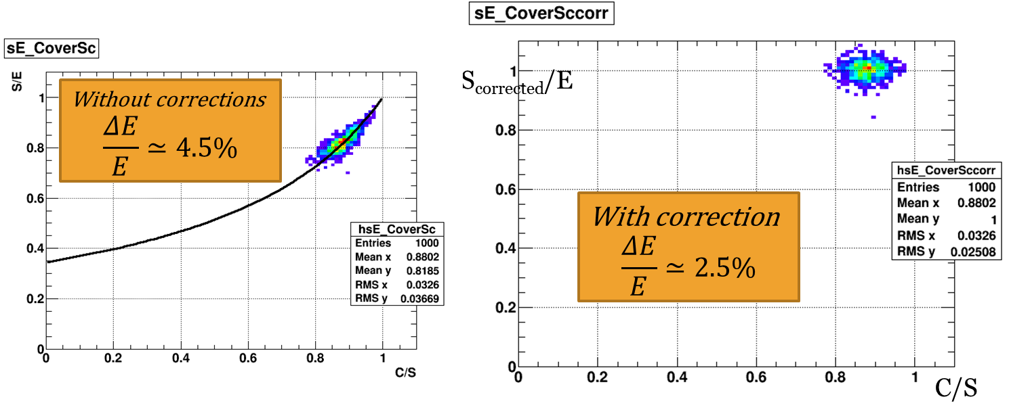
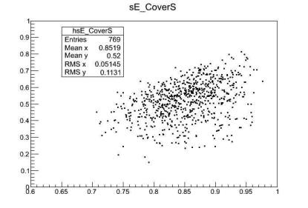
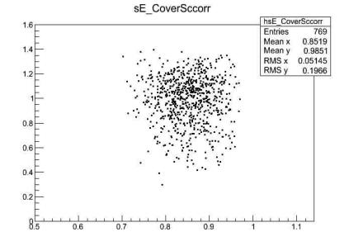
TOTAL ABSORPTION CALORIMETER
40% IMPROVEMENT IN RESOLUTION , GOOD AGREEMENT WITH EXISTING LITTERATURE
CALOCUBE with CsI (1.6 λ_{I})
Vertical protons E=100 GeV, interacting in the first layer
S/E
S_{corrected}/E
RMS=22%
RMS=20%
C/S
C/S
RESOLUTION IMPROVEMENT ONLY ~ 10%

Slide 19
How to improve the hadronic energy resolution
The leakage fluctuations at fixed Hadron Energy are the limiting effect
They can be significantly improved by increasing the calorimeter’s depth for hadronic showers
Optimal choice of the material.
  For the 2 ton scheme:
  CsI: 1.6 λ_{I} 41 X₀
  BGO: 2.9 λ_{I} 58 X₀
  LYSO: 3.1 λ_{I} 59 X₀
  YAP: 3.3 λ_{I} 26 X₀
Optical properties are essential to allow a good UV light collection

Slide 20
Notes:
Legenda:

Slide 21
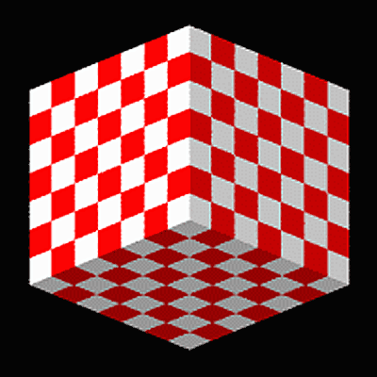
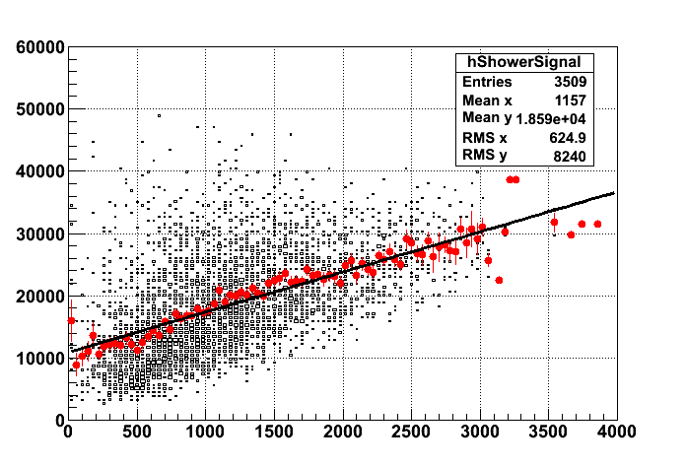
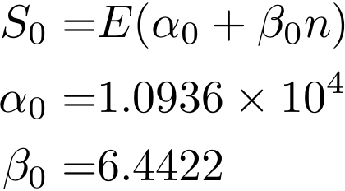
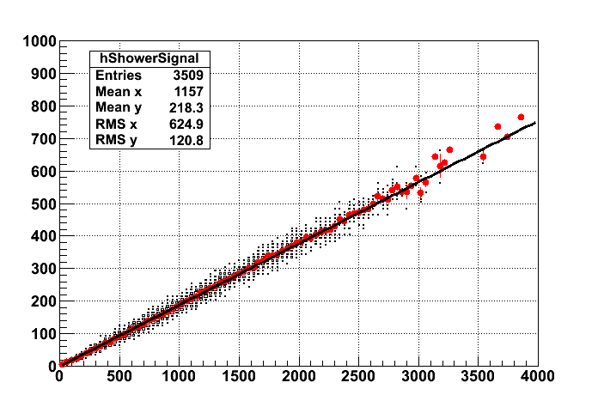
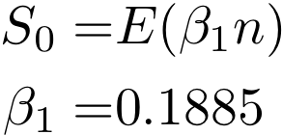
Another Dual Readout option
The number of neutrons N_{n} is correlated to the energy release
And delayed signal in plastic scintillator is a good tool to estimate N_{n}!

Slide 22
How to readout the Cherenkov light?
The tiny quantity of Cherenkov light should be separated from the scintillation light
  Use of filters to block the scintillator light
  Use of sensors blind to the scintillation light
  Use of gold nanoparticles material on the surfaces to wavelenght shift the UV light
    Tunability of absorption/emission bands by using Silver doping or by incorporating the gold nanoparticles in organic compunds

Slide 23
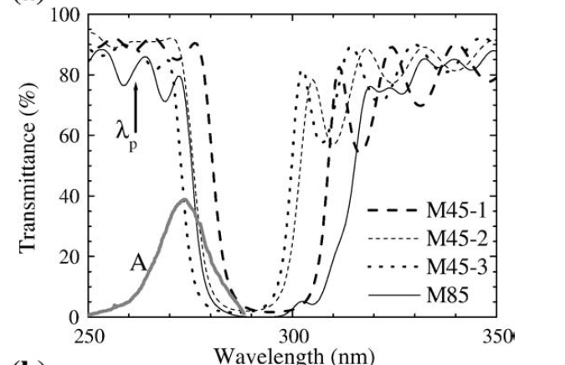
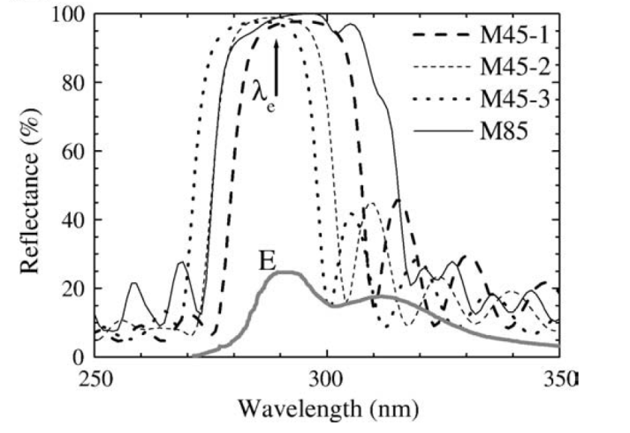

INVESTIGATION ON MATERIALS
Thin films synthesis
Optimization of post-deposition treatments
Choice of proper materials
Dichroic filters
1
a)
b)
c)
Al₂O₃ / SiO₂ multilayer is optimum for UV band
Transmittance and reflectance spectra of Al2O3/SiO2 multilayers
~
~
~
~
Al₂O₃
SiO₂
Transparent
quartz
Grilli et al., Thin Sol. Films 517, 1731 (2009)

Slide 24
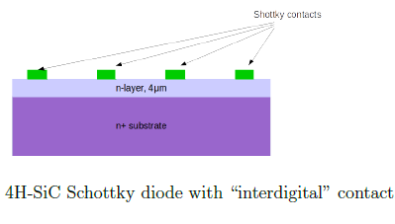

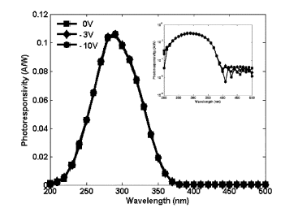
Silicon Carbide Photo Diodes
Antonella Sciuto - MATIS

Slide 25
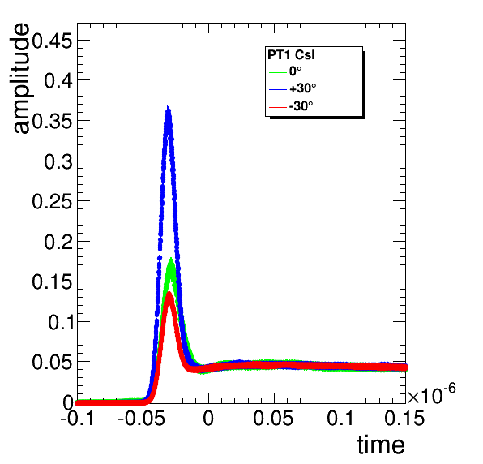
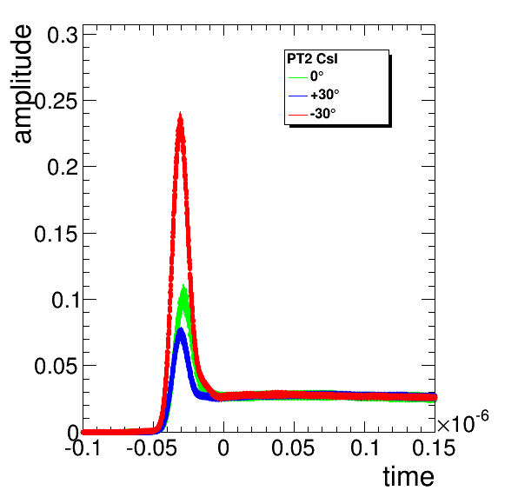
BTF Test beam of the prototype with 500 MeV electrons
CsI cube wrapped in black, 2 phototubes, both with UV filters (DREAM-like)
Signal time profile averaged over many events
Beam
PT1
PT2
+30°
PT2
Cherenkov
Light!?!
Angular dependence is an hint for Cherenkov detection
Great Thanks to DREAM groups!!!!
PT1
Scintillation light
-30°
PT1
PT2
It seems that we could disentangle Ch from scintillator in CsI(Tl)!

Slide 26
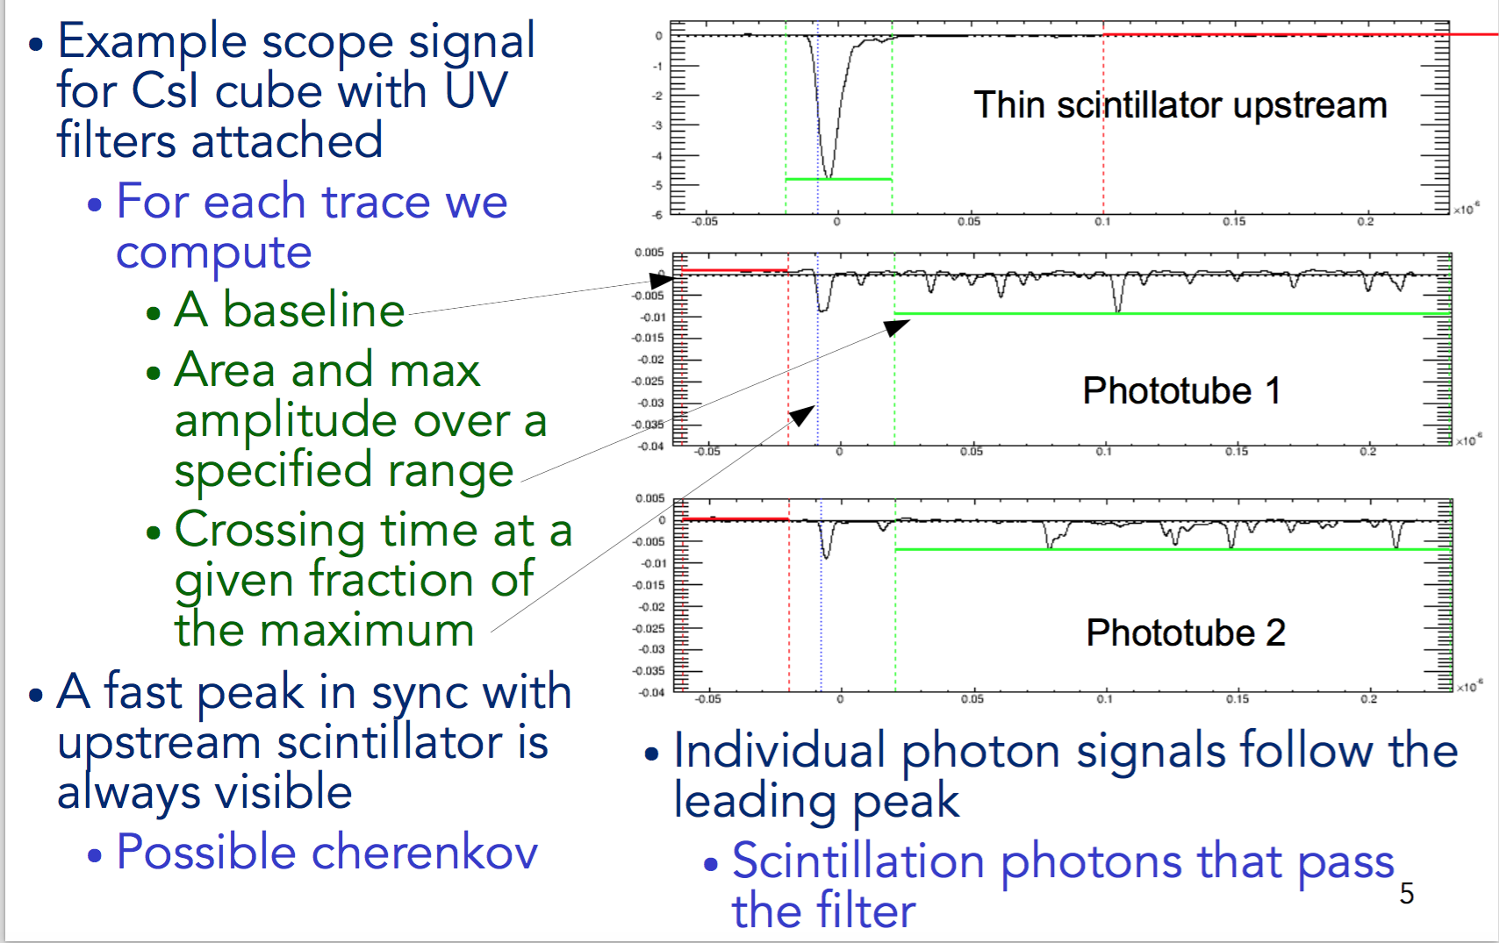
A finer analysis of the BTF data

Slide 27
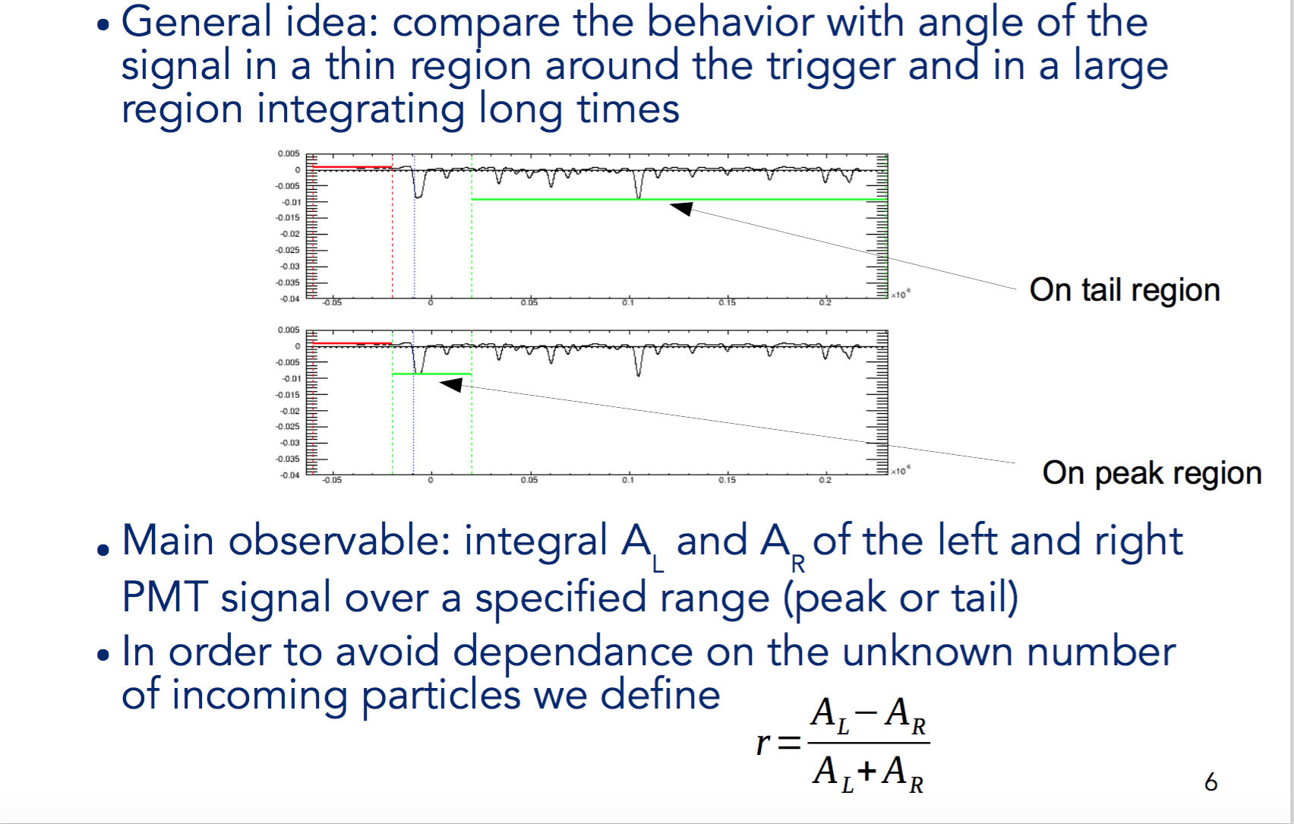
BTF Analysis

Slide 28
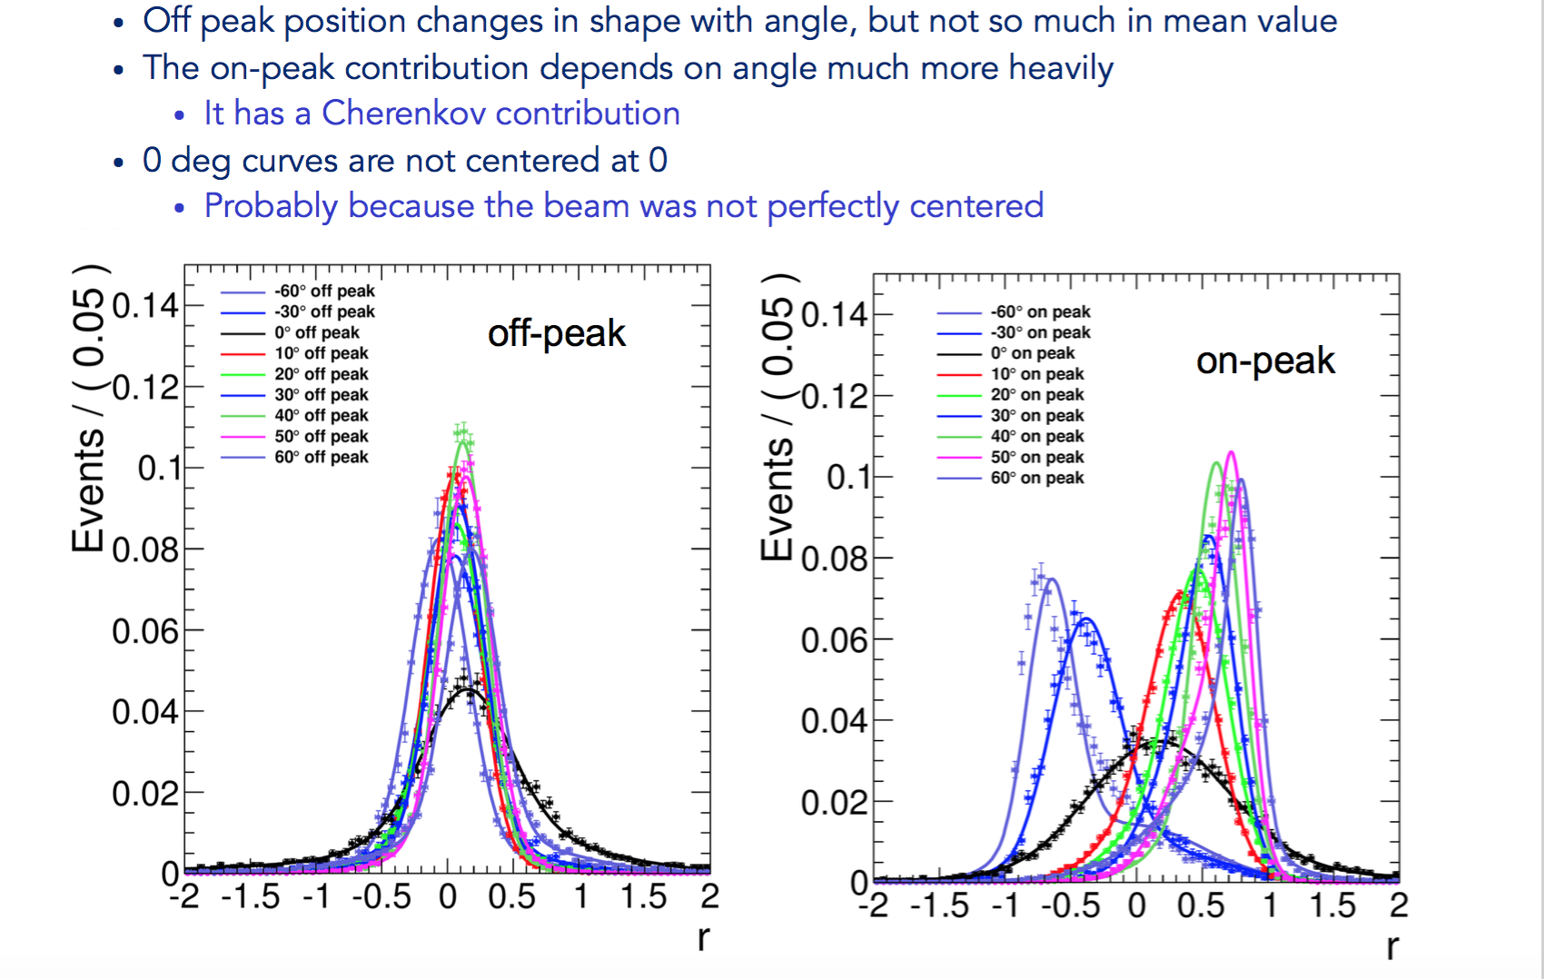
CsI Results

Slide 29
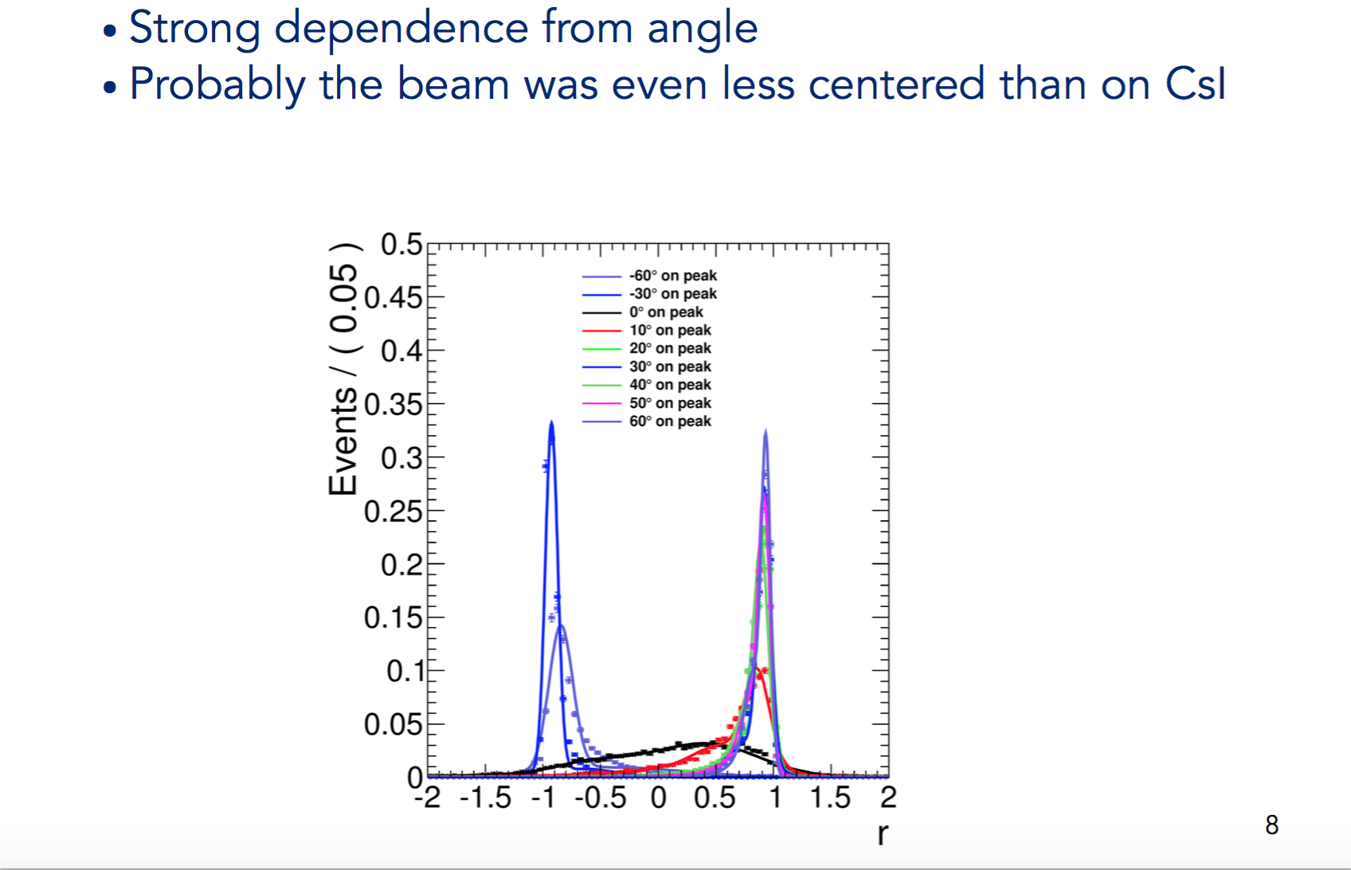
Quartz

Slide 30
The readout

Slide 31
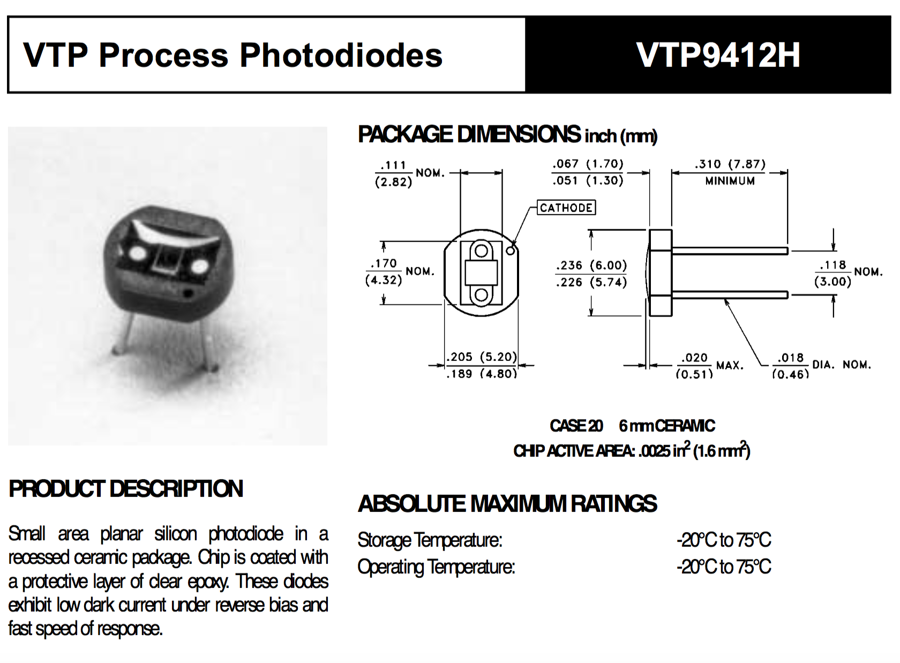
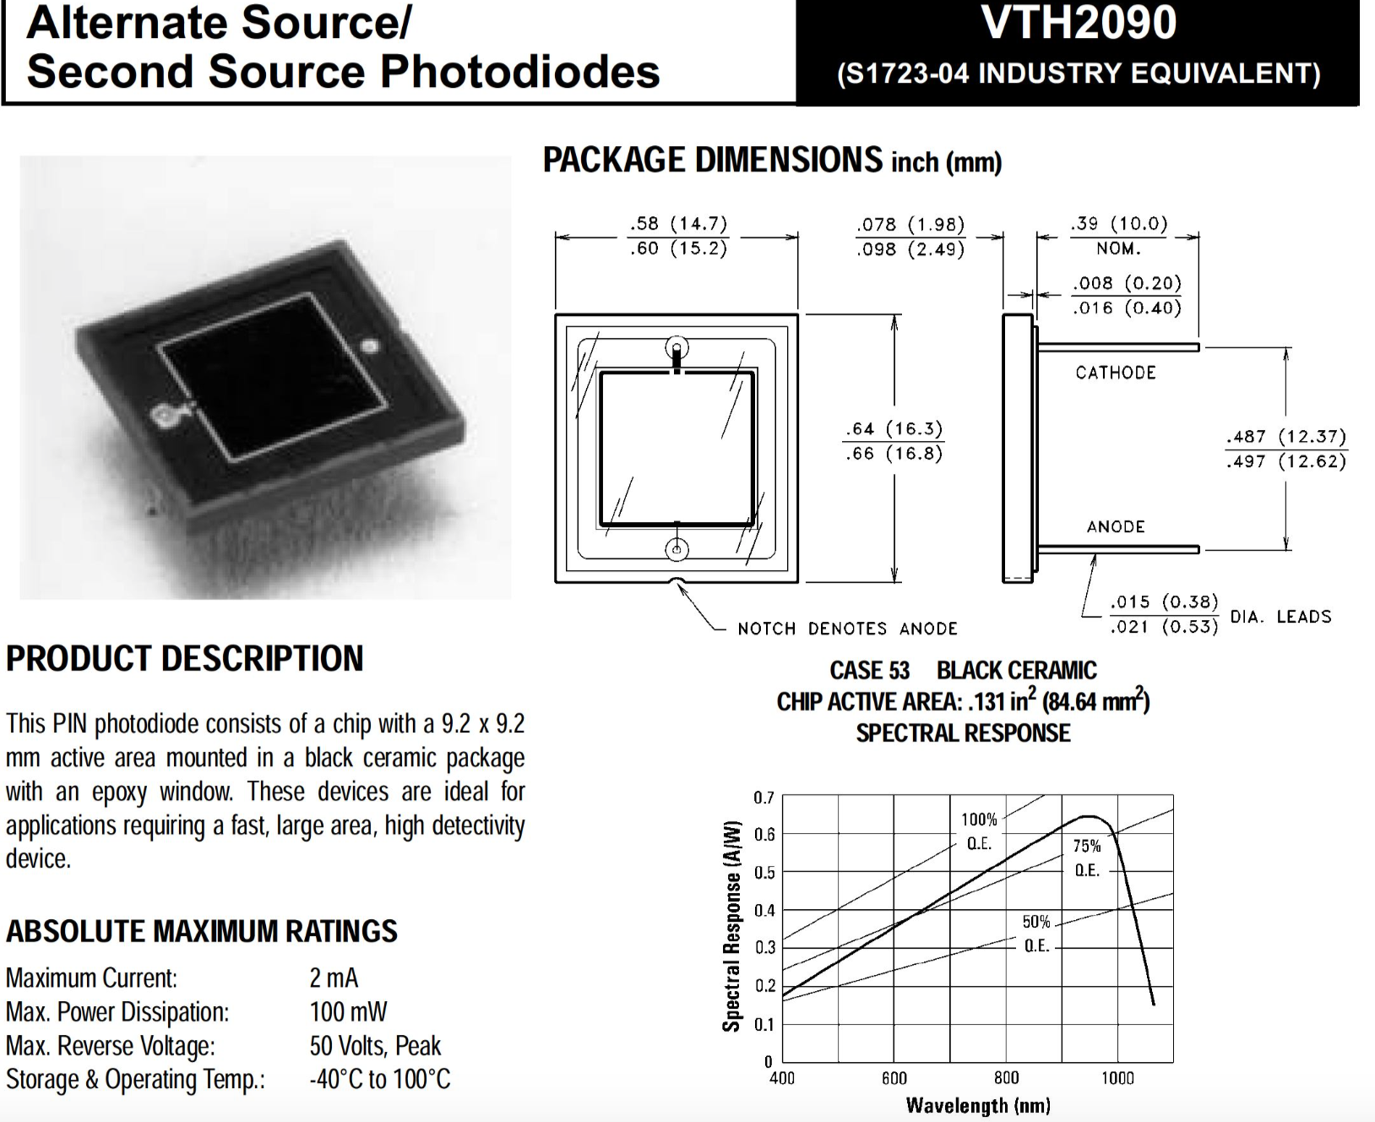
Readout sensors
At least 2 Photo Diodes are necessary on each crystal to cover the whole huge dynamic range from 1 MIP to 10⁷ MIP (in a single crystal E_{max} ~ 0.1 E_{tot}):
  large-area PD 9.2 x 9.2 mm² for small signals (Excelitas VTH2090)
  small-area PD 0.5 x 0.5 mm² for large signals (Excelitas VTP9412)

Slide 32
The front-end chip
Front-End electronics: a big challenge
The CASIS chip, developed in Italy by INFN-Trieste, is very well suited for this purpose
  IEEE TRANSACTIONS ON NUCLEAR SCIENCE, VOL. 57, NO. 5, OCTOBER 2010
16 channels, Charge Sensitive Amplifier + Correlated Double Sampling filter and shaper
Automatic real-time switching between low- and high-gain mode
  2.8 mW/channel
  3.10³ e⁻ noise for 100 pF input capacitance
  53 pC maximum input charge
A new version of the chip with 28 channels (HIDRA) has been produced by INFN-Trieste and is under test now
The digital self-trigger output will be available in one of the next versions

Slide 33
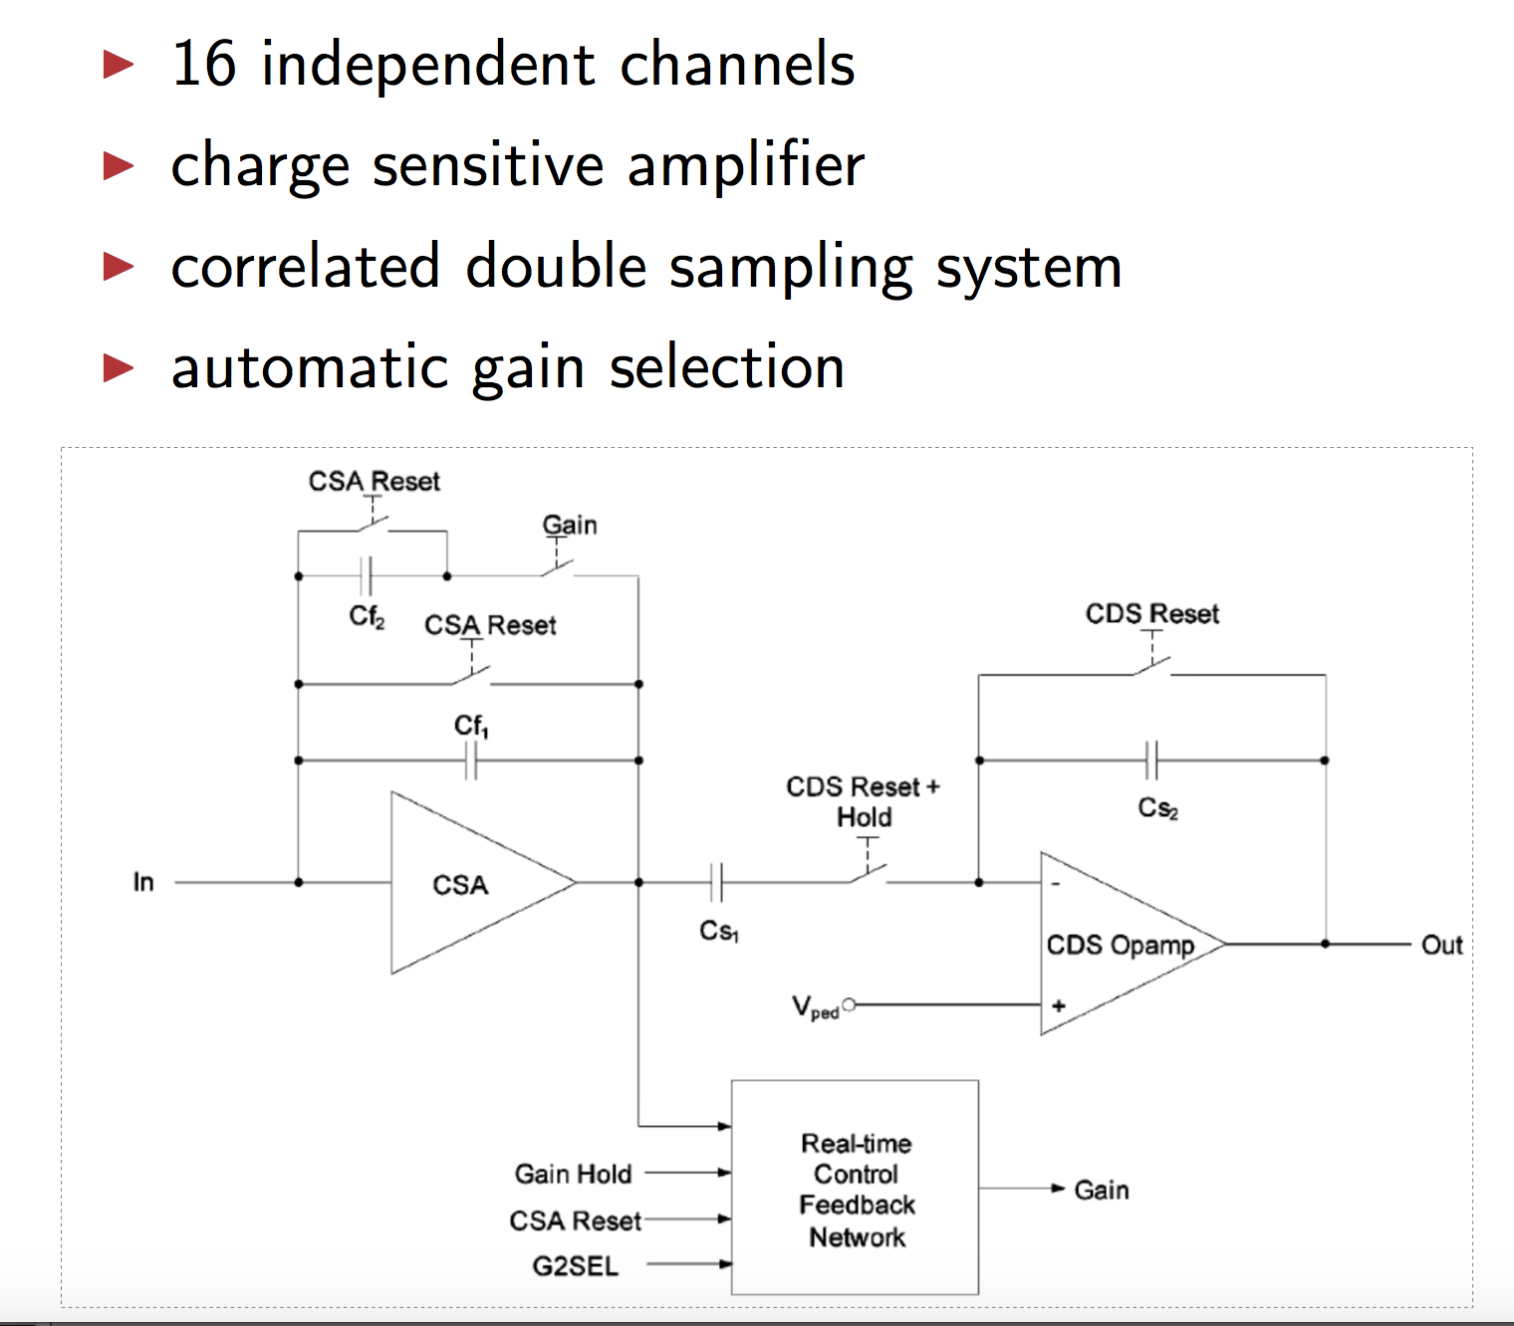
The Casis chip
One possible problem:
Dead Time ~20% due to the intrinsic operation method
We are investigating possible alternative operation method to avoid dead time
New chip scheme in the future versions?

Slide 34
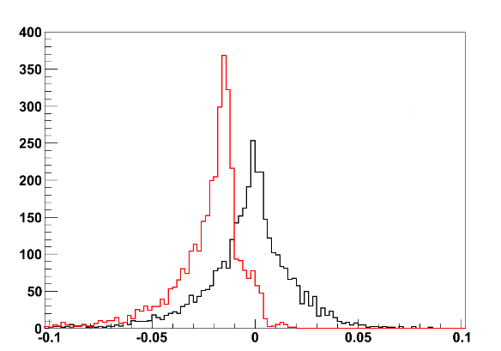
ELECTRONS: PD DIRECT IONIZATION
Electrons 100 – 1000 GeV
Ionization effect on PD: 1.7%
RMS~2%
Crystals only
Crystals + photodiodes
(Measured Energy – Real Energy) / Real Energy

Slide 35
Response as function of impact point
ADC counts
we can clearly see the PD
Y (cm)
X (cm)
He ions on the central cube of the first layer, using BT tracking
PD direct ionization is compatible with MC expectations

Slide 36
Signals for different impact points
Particles on the PD
PD contribution is compatible with the expectations!
PD Signal

Slide 37
The mechanics

Slide 38
The challenges of the mechanics
The mechanical structure is challenging in many aspects
  2 tons overall weight
  Very large planar surface (>1 m²)
  No stiff supporting structure in the middle (the tower structure used for FERMI will greatly reduce the Geometrical Factor)
We are studying a carbon fiber based structure
  Single planes hosting 28x28 crystals
  Different horizontal shifts of every plane to avoid passive gaps (see S. Bottai talk)
  40x40x40 mm³ grid (4 mm gaps, 36 mm crystals size)
We will have a prototype plane in our hands in few months from now

Slide 39
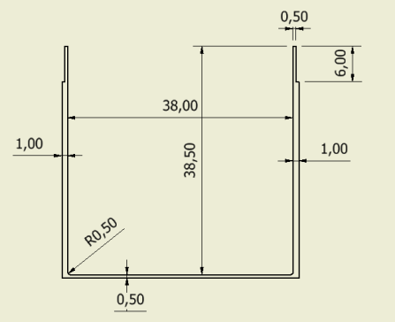
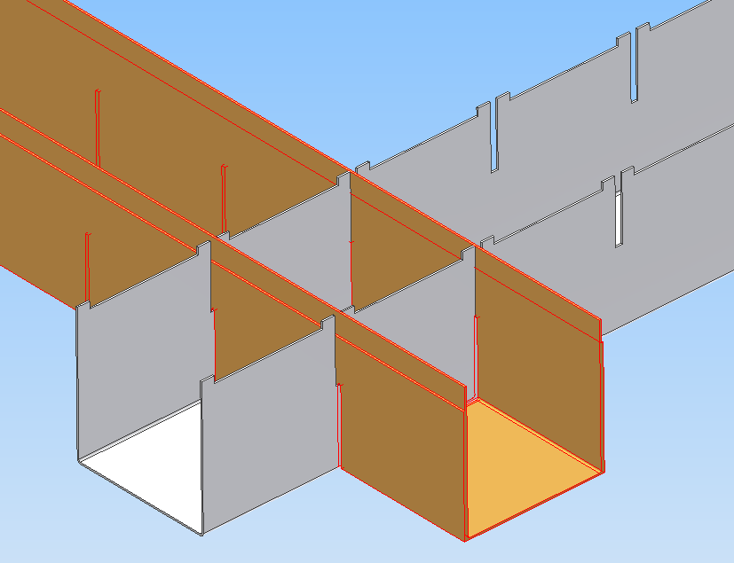
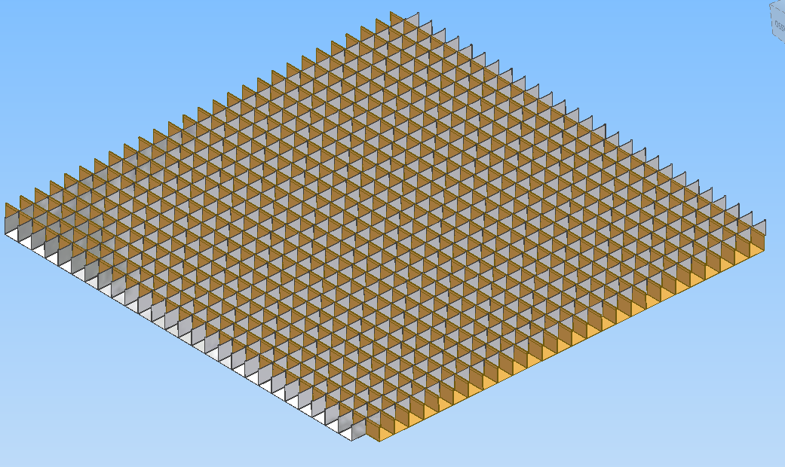
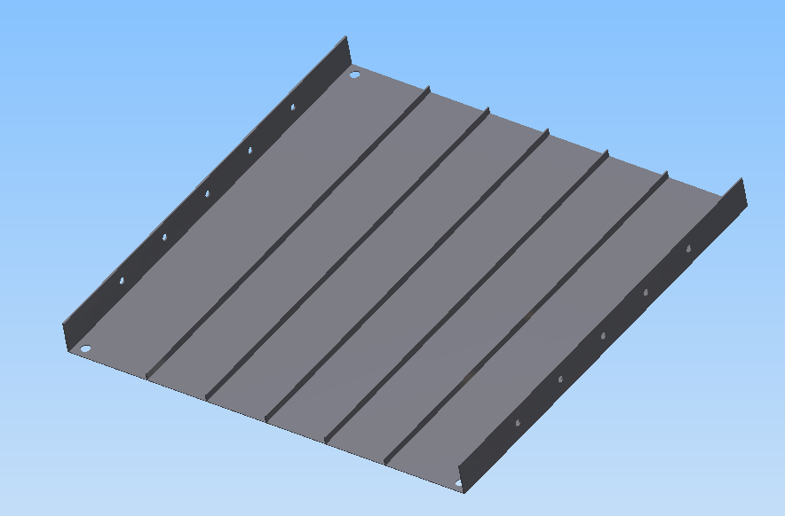
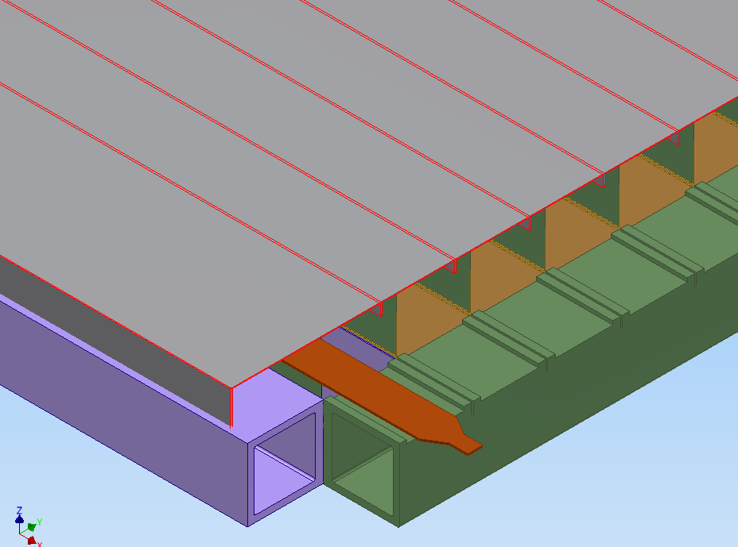

Slide 40
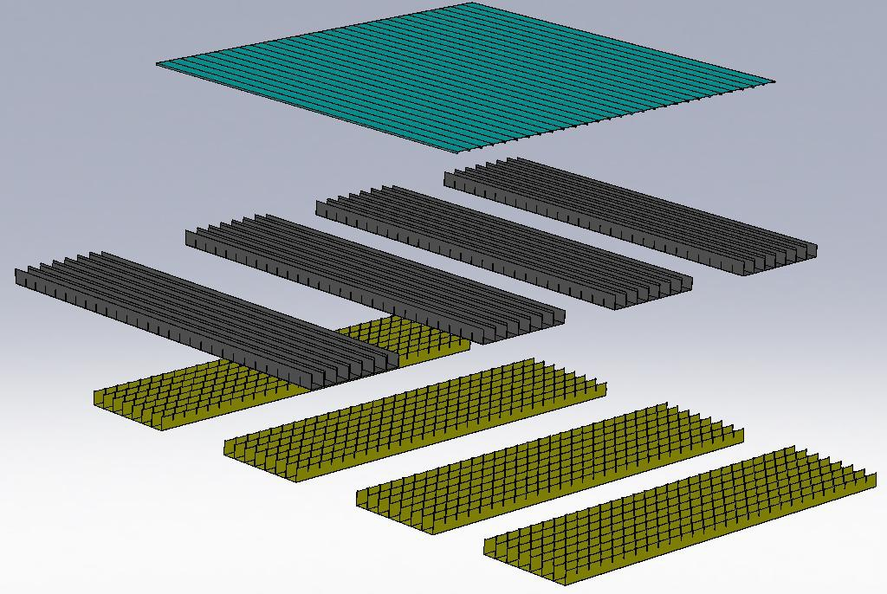
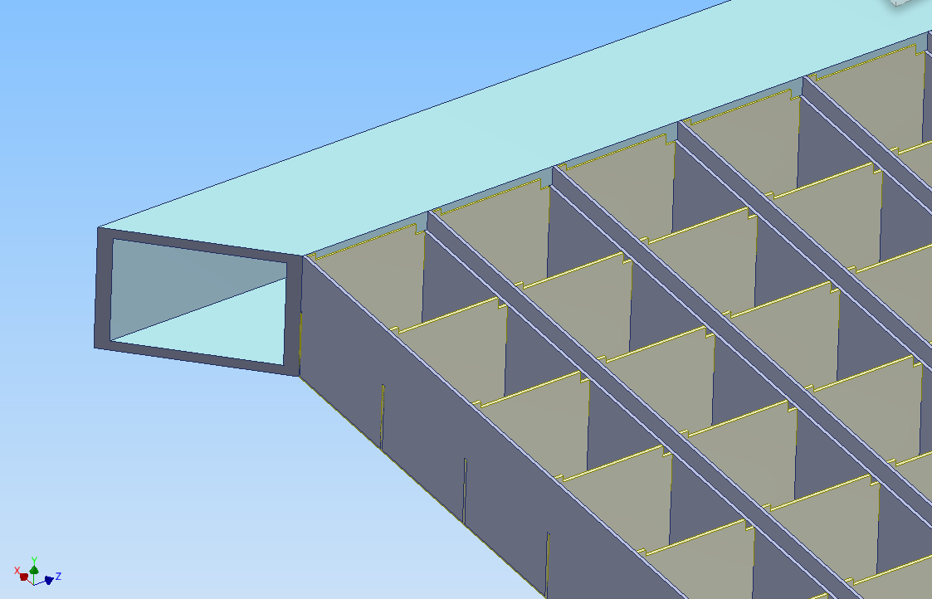
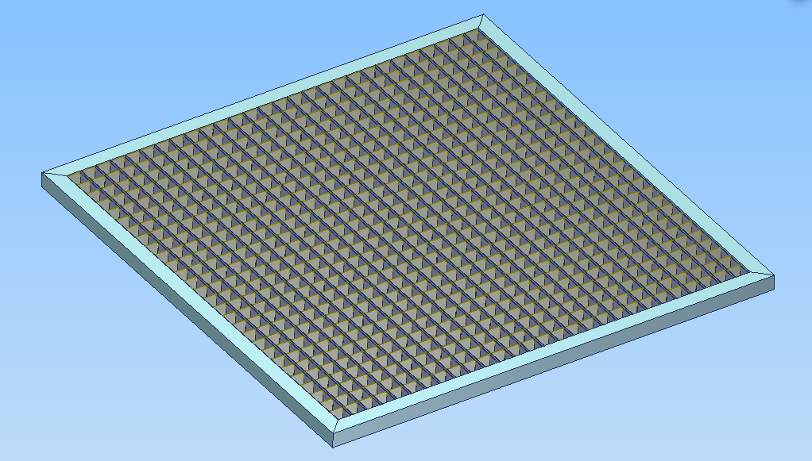

Slide 41
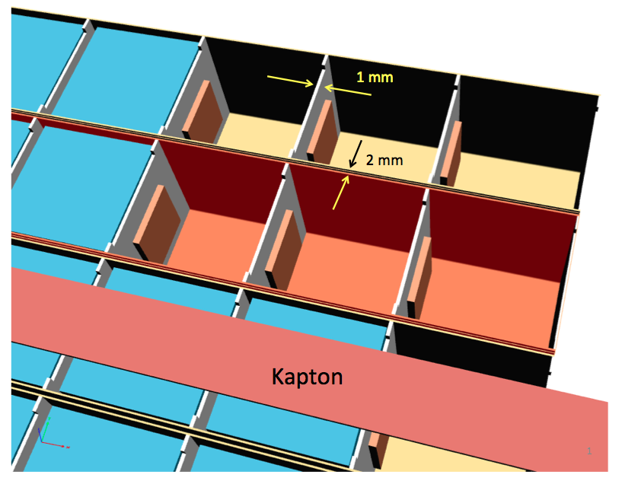
4 mm gap btw crystals in every direction

Slide 42
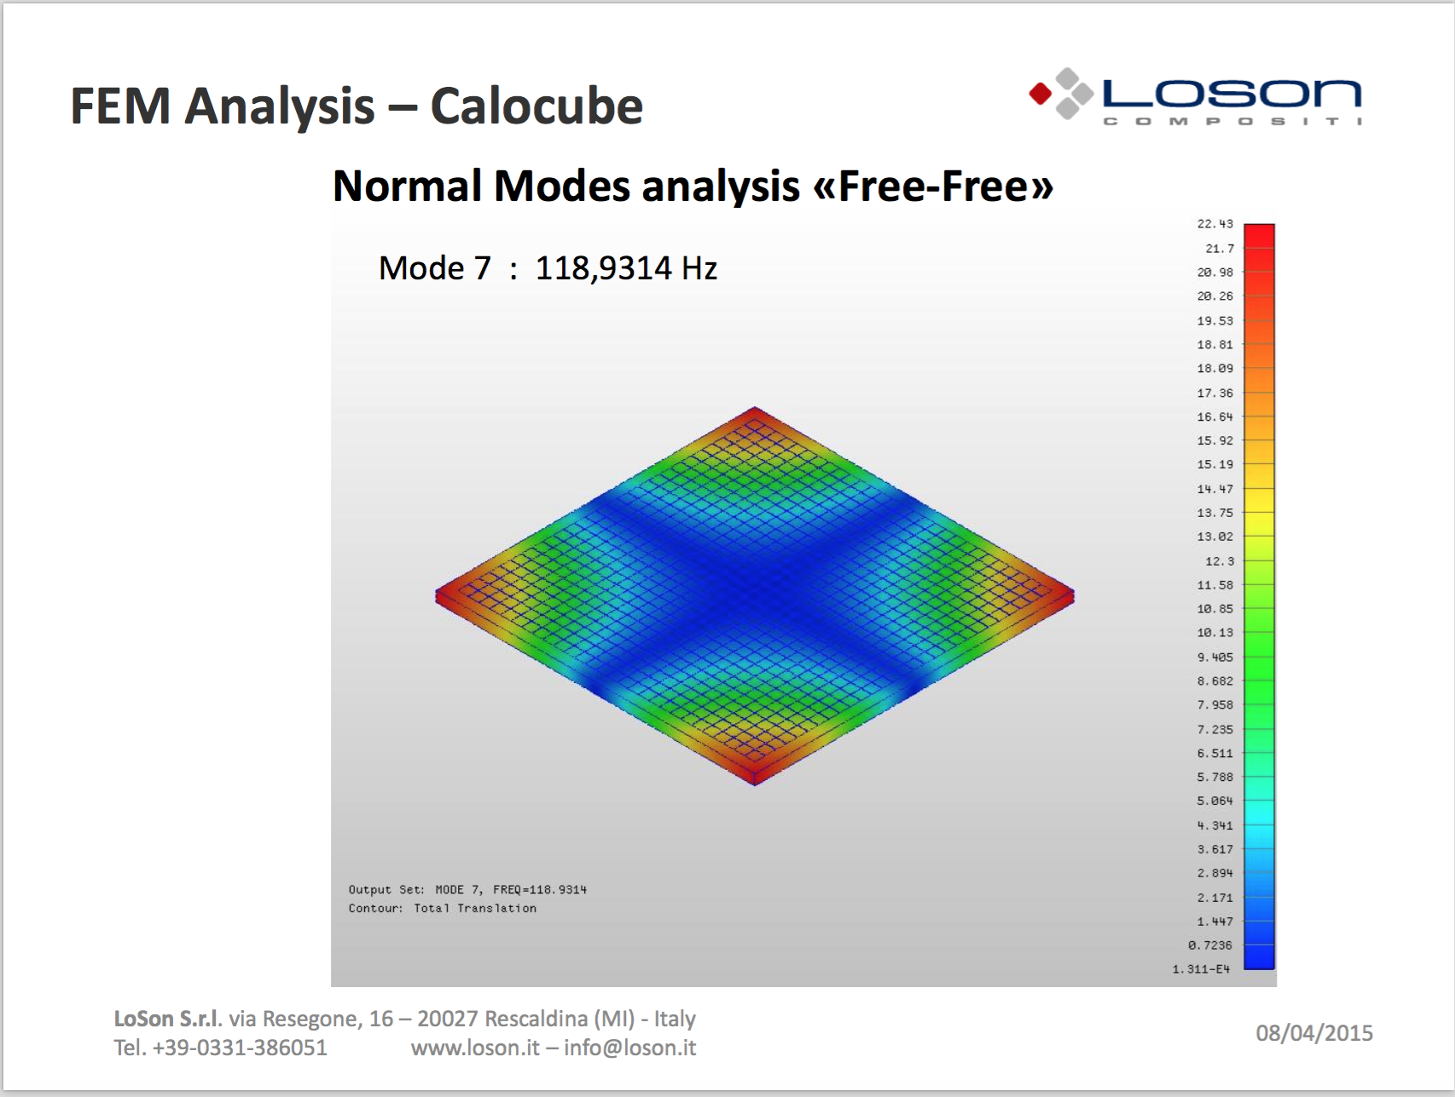

Slide 43
The prototype

Slide 44
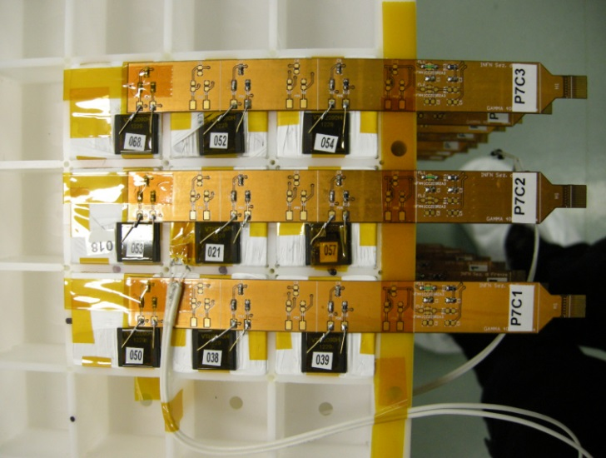



Calorimeter prototype
14 Layers
9 crystals in each layer
(crystals 3.6 x 3.6 x 3.6 cm³)
126 Crystals in total
126 Photodiodes
50.4 cm of CsI(Tl)
27 X_{0,} 1.44 λ_{I}
Photodiodes read-
out by 9 CASIS1.2A
16-channel ASICs)
Mechanics:
INFN Pisa
Front-end electronics:
INFN Trieste
Crystals, photodiodes,
DAQ, assembly:
INFN Florence
See E. Vannuccini talk

Slide 45
What is missing for Gamma-400?

Slide 46
Open points for the Gamma-400 calorimeter
Calibration
  Nobody has really studied the calibration procedure
  See next slide for some comments
Trigger
  Russian colleagues are developing the overall Gamma-400 trigger system
  They need input for the subdetectors
  The calorimeter should provide a configurable trigger system to:
    Trigger on high energy particles coming from the whole acceptance
    Trigger on MIPs for calibration
    Trigger on lateral photons?
Readout
  The readout system has not been studied
  Fast data compression is essential to reduce the data size
  Could be common to every subdetector?
Lateral Charge Identifier system
  To measure laterally impinging nuclei we need a precise measurement of Z
  Fine segmentation is mandatory to avoid contamination from back splash
  Array of Silicon Pins? Bars of plastic scintillators?
  We are also studying the possibility to use the first layers of the calorimeter but….

Slide 47
Calibration (from my mail to John)
1) calibration with nuclei MIP
2) calibration with laser/led
3) calibration of the electronics with charge injection
Point 1): we are starting some study with Fluka to see if it is feasible to use nuclei not interacting to calibrate all the crystals. We are simulating the orbit and the particle fluxes, to see weather it is possible to calibrate all the crystals, but we do not have results to be shown now.
With this method we calibrate all:
(A) light production in the crystals,
(B) light collection efficiency (for example to monitor the radiation damage that change the attenuation length of the light in the crystal) and
(C) the front end chips
Point 2): there is a group in Italy that started to work on this point, but no results up to now. They plan to use few light sources and a distribution system with optical fibres to bring light to every crystal. In this way we test B and C since it is impossible to excite scintillation light even with UV pulses
Point 3): standard charge injection in every channel of the front end chips, to monitor the from end gain (C)
Clearly we should also monitor temperature in precise way since light yield depend on T..

Slide 48
Future plans
Before the end of 2015 we plan to build a larger scale prototype, optimized for the Gamma-400 experiment (for this application the CsI(Tl) is certainly the best material)
  > 500 CsI(Tl) crystals
  6x6x14 planes
  2 sensors/crystal
  Few channels instrumented with filters and readout for Cherenkov light
  New version of HIDRA chip
    More channels
We should start to work on the missing items
Meanwhile we will continue to investigate other options for future experiments

Slide 49
Spare slides

Slide 50

Prototype test beam results
CERN SPS H8 Ion Beam: Z/A = 1/2, 12.8 GV/c and 30 GV/c (February 2013)
Notice: charge information from a precise silicon Z-measuring system located in front of the prototype
For deuterium:
S/N ~ 14
²H
⁴He

Slide 51

Non interacting ions: charge linearity
12.8 GeV/amu
30.0 GeV/amu
LAYER 1
D,He,Li,Be,B,C,N,O

Slide 52

Interacting ions: charge linearity
D,He,B,C,O,Mg,Si,S,Ti,Fe
Total particle energy (GeV)
Charge is selected by Beam Tracker in front of the calorimeter
Good linearity even with just the large-area photodiode

Slide 53
Some additional ideas about the CaloCube project
Parameters that can be tuned:
Choice of material
Dimension of crystals
Dimensions of the gaps btw crystals
Dual readout
More exotical shapes

Slide 54
MOVING FORWARD FROM HERE…
Improving the existing CALOCUBE concept:
(3-year R&D activity financed by INFN, ~0.8 Meuro)
Optimize the overall calorimeter performances, in particular the hadronic energy resolution
  Calorimeter compensation:
    Cherenkov light
    Neutron induced signals
Optimize the charge measurement
  Make use of the excellent results from the SPS test
  e.g. smaller size cubes on the lateral faces
Build up a fully space-qualified prototype
  Mechanics
  Thermal aspects

Slide 55

Calorimeter structure
Large dynamic range required by a single crystal: 1 - 10⁷ MIPs
Two double-gain photodiodes coupled to each crystal (4 channels/crystal):
  large area photodiode (∼9.2 x 9.2 mm²) for small signals
  small area photodiode (∼0.5 x 0.5 mm²) for large signals
CASIS 1.2 ASIC (INFN Gr. 5 experiments CASIS and CASIS-2), automatic real-time switching between low- and high- gain modes

Slide 56
CC2 Calorimeter
28 x 28 x 12 CsI(Tl) cubes
L_{cubes} = 3.6 cm
CC2 dimensions: 1 x 1 x 0.47 m³
X₀: 54.6 x 54.6 x 23.4
λ_{I}: 2.5 x 2.5 x 1.1
Mass = 1980 kg
Planar GF: 9.5 m²sr
GF_{eff, el.} ^{0.1-1 TeV}∼ 3.4 m²sr
GF_{eff, prot.} ^{1 TeV}∼ 3.9 m²sr
Slightly staggered planes to avoid dead regions

Slide 57




Protons: energy resolution
10 TeV
100 TeV
Analysis criteria can be changed to optimize:
Acceptance
Energy resolution
Different analysis criteria can be used for different portions of the spectrum
RMS=38%
ε = 0.43
GF_{eff}=4,5 m² sr
RMS=41%
ε = 0.44
GF_{eff}=4,6 m² sr
(E-E_{true})/E_{true}
(E-E_{true})/E_{true}
10 TeV
100 TeV
RMS=29%
ε=0.21
GF_{eff}=2,2 m² sr
RMS=32%
ε=0.21
GF_{eff}=2,3 m² sr
(E-E_{true})/E_{true}
(E-E_{true})/E_{true}

Slide 58


Protons: energy resolution
10 TeV
100 TeV
With differents cuts
With differents cuts
RMS ( % )
RMS ( % )
GF_{eff}(m² sr)
GF_{eff}(m² sr)

Slide 59

Electrons: ENERGY RESOLUTION
Selection efficiency:
ε ~ 36%
length of the shower
at least 40 cm (~22 X₀)
GF_{eff} ~ 3.4 m²sr
Electrons 100 – 1000 GeV
RMS ~ 2%
Non-gaussian tails due to leakage and to energy losses in passive material (carbon fiber structure)
(Measured Energy – Real Energy) / Real Energy
Effect of direct ionization on PD: ~1.7% on the average value, negligible on the RMS

Slide 60
OPTIMIZATION FOR VERTICAL GAMMAS

Slide 61



VERTICAL GAMMA RAYS
Detector optimized for vertical gammas: 27 X 27 X 14 CRYSTALS;
1 mm vertical gaps; horizontal planes shifted in x-y to avoid alignment
Gamma rays total signal distribution for energies: 10 GeV, 100 GeV and 1 TeV. The incident position is uniform on the top of the calorimeter.
Gamma rays energy | Selection efficiency | Energy resolution
10 GeV | 95% | 0.86%
100 GeV | 90% | 0.83%
1 TeV | 80% | 0.73%

Slide 62


LEAKAGE fluctuations at fixed E_{h} prevent effective Cherenkov correction !
Even if we suppose to have perfect access to the scintillation signal produced by
e.m. particles Sem and separately to the scintillation signal produced by hadrons S_{had}…
100-300GeV protons
interacting first layer
100-300GeV protons
interacting first layer
S_{em}(GeV)
Shad(GeV)
RMS ~ 40% !
Ee (GeV)
E_{h}(GeV)
Sem, Shad = Energia depositata effettivamente per ionizzazione (em , had)
E=E_{e}+E_{h}=S_{em}+S_{had}*<1/η>
EE
Eh
S_{em} ~Ee
<1/η>=<1/η_{t}>*<1/η_{leak}>
<η_{t}>~ 0.85
<η_{leak}>~ 0.25
S_{had}
Nuclei Excitation,
neutrons
Pions leakage
RMS ~ 40% !
ΔE/E ~ 20%
π+/-

Slide 63
MC simulations for the improvement of hadronic energy resolution using Cherenkov signal
Next steps :
STUDY HOW THE IMPROVEMENT IN ENERGY RESOLUTION DEPENDS ON :
CALORIMETER DEPTH
CALORIMETER LATERAL CONTAINMENT
ENERGY OF THE PRIMARY
TYPE OF PRIMARY (PROTON , CARBON ......)

Slide 64
Electrons
Electrons 100 – 1000 GeV
RMS~2%
Selection efficiency:
ε ~ 36%
GF_{eff} ~ 3.4 m²sr
Crystals only
Crystals + photodiodes
Non-gaussian tails due to leakages and to energy losses in carbon fiber material
(Measured Energy – Real Energy) / Real Energy
Ionization effect on PD: 1.7%

Slide 65
MC simulations
Fluka-based MC simulation
  Scintillating crystals
  Photodiodes
    Energy deposits in the photodiodes due to ionization are taken into account
  Carbon fiber support structure (filling the 3mm gap)
Isotropic generation on the top surface
  Results are valid also for other sides
Simulated particles:
  Electrons: 100 GeV → 1 TeV
  Protons: 100 GeV → 100 TeV
  about 10² – 10⁵ events per energy value
Geometry factor, light collection and quantum efficiency of PD are taken into account
Requirements on shower containment (fiducial volume, length of reconstructed track, minimum energy deposit)
  Nominal GF: (0.78*0.78*π)*5*ε m²sr= 9.55*ε m²sr

