Slide 1
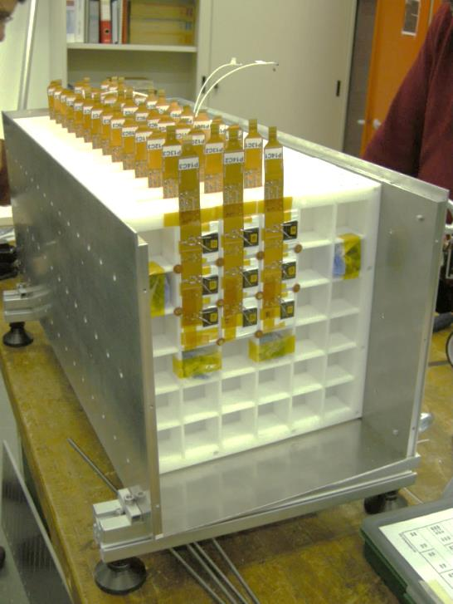
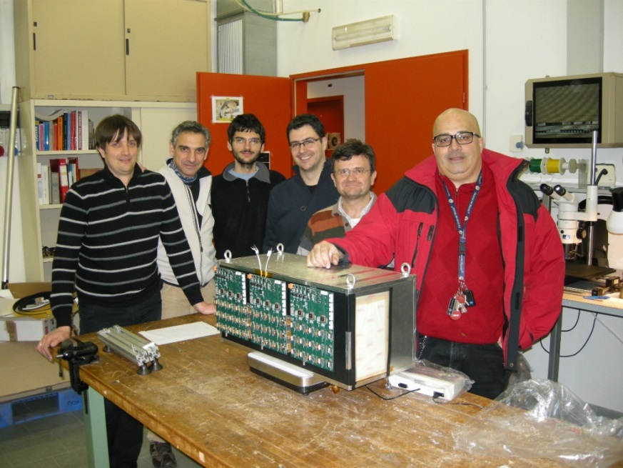
Performance of the GAMMA400 Calorimeter Prototype
Vannuccini Elena
On behalf of the GAMMA400 Florence group

Slide 2
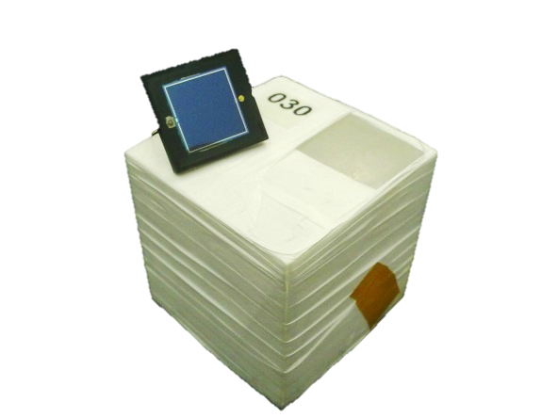
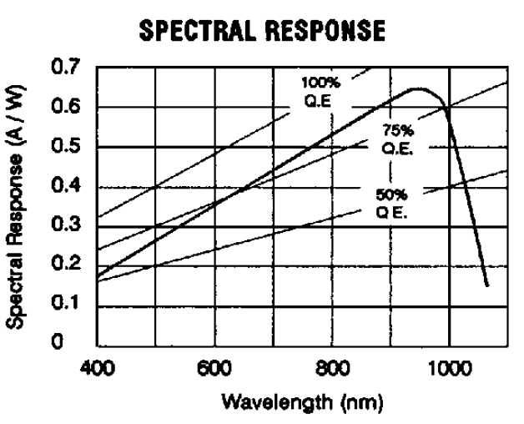
Active material & sensor
CsI(Tl) scintillating crystals
3.6 cm side ( ∼ 1 Molière radius )
Diffusive wrapping (∼100 μm Teflon tape)
Excelitas VTH2090 photodiodes
Large area (9.2×9.2mm²)
Density | 4.51 g/cm³
Wavelength @max | 550 nm
Light output | 45 % of NaI(Tl)
Primary decay time | 1 ms

Slide 3
Crystal wrapping
Studied by comparing signal induced by 5,5 MeV α from Am source
Tested materials:
Teflon (diffusive)
Tyvec (diffusive)
Vikuiti (reflective)
Applied to prototype
Feb.2013 → Teflon
Feb.2015 → Teflon+Tedlar
Aug.2015 → Vikuiti (planned!)
Teflon
Tyvec
Teflon + Vikuiti
Vikuiti

Slide 4
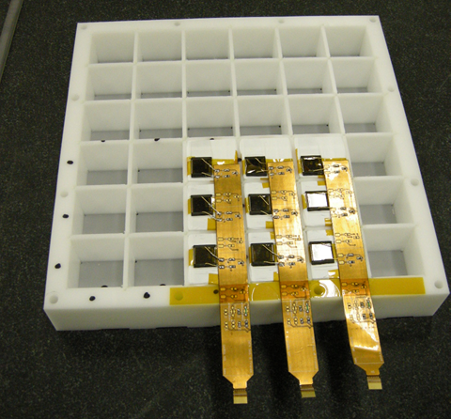
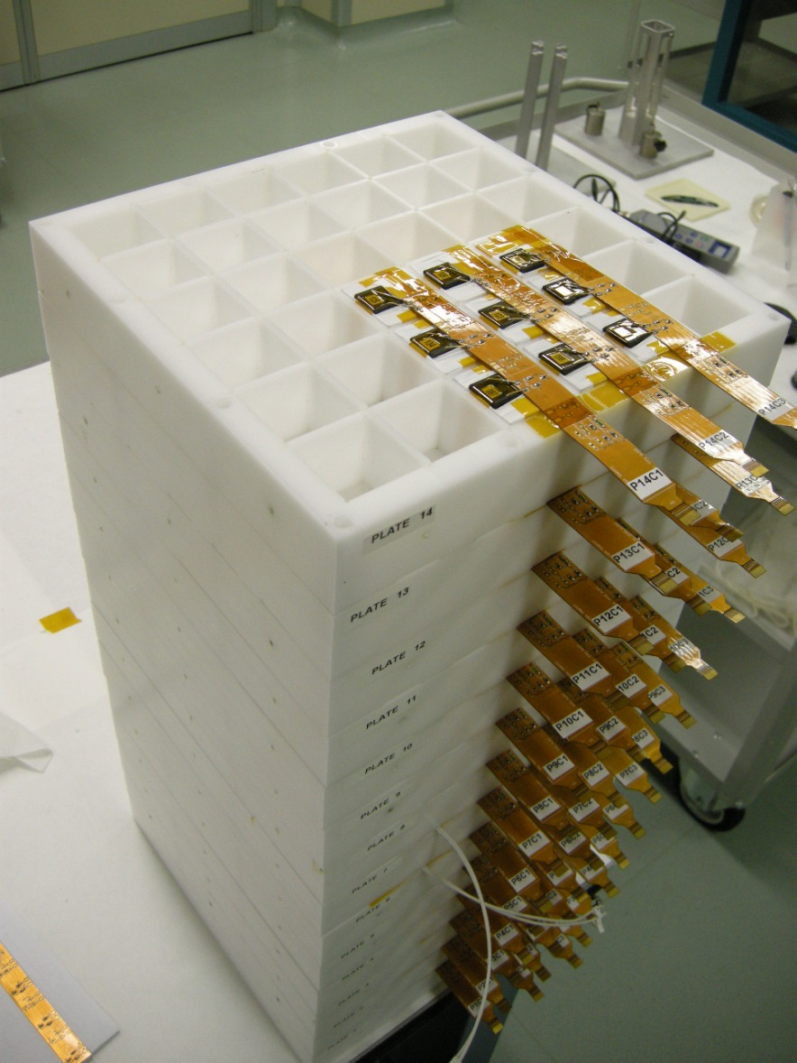
The calorimeter assembly
4mm gap between active elements
3×3 elements for each plane
∼ 1.5 R_{M} shower containment
14 layers
active depth 27 X₀ → 1.44 λ_{I}
126 total elements

Slide 5
Front-end electronics
CASIS chip (developed by INFN-Trieste)
Very large dynamic range (0÷10000 MIP)
Automatic switching btw low and high (×20) gain mode
16 channels (CSA+CDS shaper)

Slide 6
Beam tests
Ion beams extracted from CERN SPS H8 line
Feb 2013 → A/Z=2 ions (12.8 and 30.0 GeV/u) from Pb primary beam on Be target
Feb 2015 → primary Ar and A/Z=2 ions (19.0 and 30.0 GeV/u) from Ar beam on Polyethylene target
ION
BEAM
BEAM TRACKER (BT)
4 Si-pixel matrixes + 8 Si-strip layers
Z tagging
particle tracking (<200μm resolution)
CALORIMETER PROTOTYPE
3×3×14 CsI(Tl) crystals

Slide 7
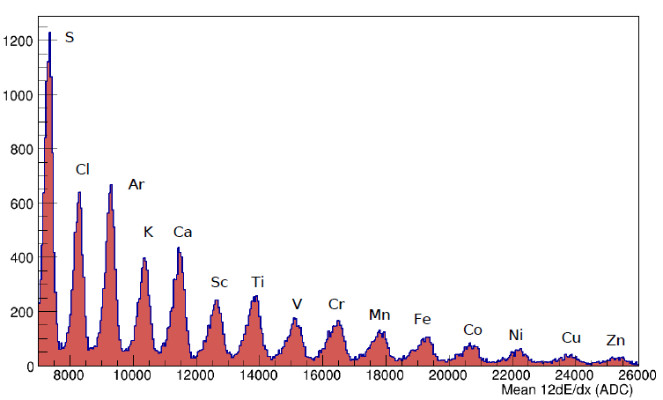
Beam Tracker (BT) ⇒ Z-tagging
8 dE/dx meas. from Si-strips
4 dE/dx meas. from Si-pixels
Courtesy of Siena group

Slide 8
Beam Tracker (BT) ⇒ precise beam position
Central cube first layer
He ions traversing the photodiode
Equalized ADC counts
Y (cm)
1MIP(Si)/1MIP(CsI) ~ 30÷40%
X (cm)
Courtesy of Pisa/Siena group

Slide 9
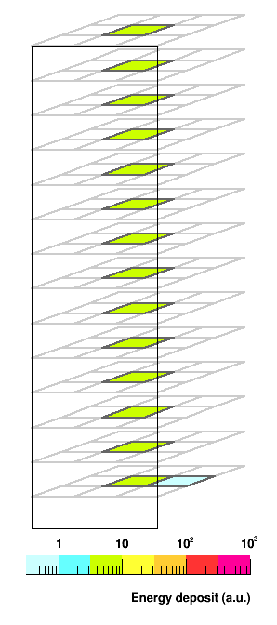
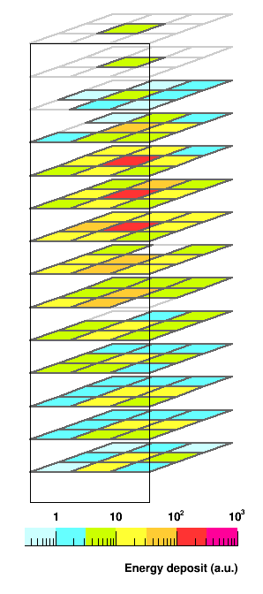
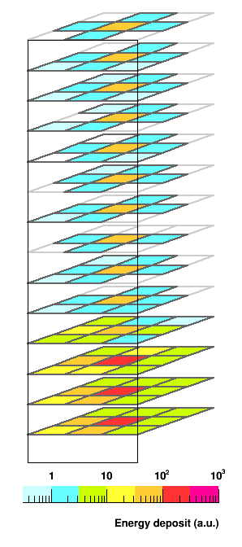
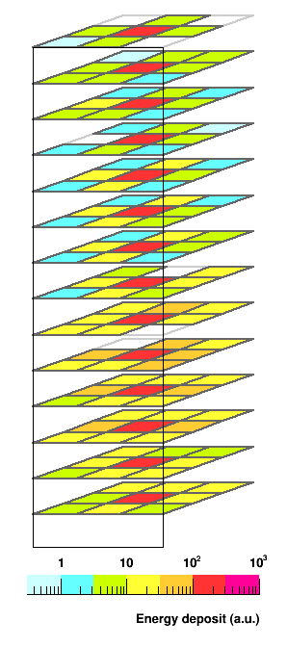
He @12.8 GeV/u
He @30.0 GeV/u
C @12.8 GeV/u
Na @12.8 GeV/u
0
1
2
3
4
5
6
7
8
9
10
11
12
13
14

Slide 10
Single crystal performance

Slide 11
Channel Noise
CASIS
0
CASIS
1
CASIS
2
CASIS
3
CASIS
4
CASIS
5
CASIS
6
CASIS
7
CASIS
8
RMS( PED )
RMS( PED-CN)
ADC counts
Channel pedestals (PED) evaluated by acquiring off-spill events
Random noise (RN) ⊕ common noise (CN) ∼ 30÷40 ADC counts

Slide 12
Single crystal signal
Signal of the first crystal along the beam direction
All events
Not-interacting 4He
hig gain ←|→ low gain
Test 2013
Pb+Be
30 GeV/u
Hit ≡ 5×RN cut
4He
2H
log(ADC counts)

Slide 13
Single crystal signal
Signal of the first crystal along the beam direction
All events
Not-interacting 4He
hig gain ←|→ low gain
Test 2015
Ar+Polyethylene
30GeV/u
4He
Hit ≡ 5×RN cut
2H
log(ADC counts)

Slide 14
Gain dispersion
RMS ∼ 14%
Crystal responses equalized by normalizing to 4MIP the ionization energy deposit of 4He (@peak)
2013 → ${\left\langle S/N\right\rangle }_{1MIP} \sim 11$
ADC counts
∼1500

Slide 15
Gain dispersion
RMS ∼ 21%
Crystal responses equalized by normalizing to 4MIP the ionization energy deposit of 4He (@peak)
2015 → ${\left\langle S/N\right\rangle }_{1MIP} \sim 8$
Lower signal and larger dispersion due to absorber wrapping
(preliminary)
(Spare plane with test crystals)
CsI(Tl) with diffusive+reflective wrapping (Teflon+Vikuiti)
ADC counts
∼1510
∼1050

Slide 16
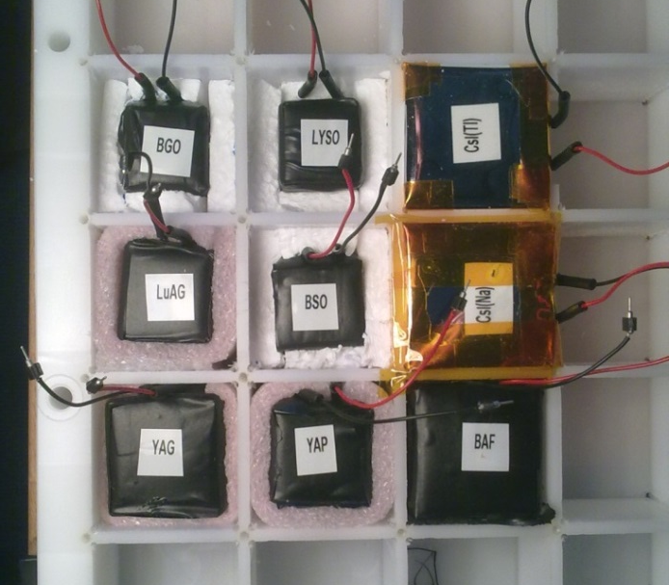
Test of scintillating materials
Test of 9 scintillating materials
CsI:Na, CsI:Tl, YAG:Ce, BaF2, YAP:Ce, LuAG:Ce, BSO, BGO, LYSO:Ce
Teflon+Vikuiti+Tedlar wrapping
Z-tagging from BT+CAL
Study of the ionization signal –vs– Z²
ION
BEAM
BEAM TRACKER (BT)
4 Si-pixel matrixes + 8 Si-strip layers
SPARE PLANE
3×3 test crystals
CALORIMETER
3×3×14 CsI:Tl crystals

Slide 17
Test of scintillating materials
 | Expected |  | Measured
 | Z=1 (a.u.) | Z=2 (a.u.) | Z=2 (ADC counts) | Norm. @CsI:Tl (a.u.) | Measured/Expected
CsI:Na | 43 | 172 | 1336 | 229 | 1,3
CsI:Tl | 100 | 399 | 2330 | 399 | 1,0
YAG:Ce | 19 | 78 | 642 | 110 | 1,4
BaF2 | 10 | 40 | -- | -- | --
YAP:Ce | 16 | 65 | 316 | 54 | 0,8
LuAG:Ce | 11 | 44 | 674 | 115 | 2,6
BSO | 3 | 12 | -- | -- | --
BGO | 11 | 46 | 312 | 53 | 1,2
LYSO:Ce | 38 | 151 | 759 | 130 | 0,9
(preliminary)

Slide 18
Z resolution
Not-interacting ions
12.8 GeV/u
test 2013
Good Z separation up to Oxygen
Courtesy of Pisa/Siena group

Slide 19
Ionization signal –vs– Z²
Non-linear behaviour for higher Z
Ionization signal
Not-interacting ions
30.0GeV/u
(2013 test)
Equilized ADC counts
|
Cl
Na
|
Ne
|
F
|
O
|
↑ low
↓ high gain
Linear fit from He to O
Linear fit from Na to Cl
Courtesy of Pisa/Siena group

Slide 20
Optical cross-talk
Feb.2013 prototype:
Teflon wrapping + Delrin mechanical structuers
⇒ scintillation light propagates to adjacent crystals
Optical cross-talk verified in lab with green and red led light
Feb.2015 prototype:
Absorber film (Tedlar) added to Teflon wrapping
LED light
Layer 0
0.5% | 3.4% | 0.7%
3.4% | 100% | 4.0%
0.6% | 3.3% | 0.8%
Layer 1
0.1% | 0.5% | 0.1%
0.4% | 2.1% | 0.4%
0.1% | 0.5% | 0.2%

Slide 21
Ionization signal –vs– Z²
Non-linear behaviour for higher Z → not instrumental but physical effect
Ionization signal
Cross-talk signal
Equilized ADC counts
Equilized ADC counts
|
Cl
Na
|
F
|
Ne
|
Ne
|
O
|
|
Na
F
|
O
|
Non-linearity in scintillator response to high-Z ions
Linear fit from He to O
Linear fit from Na to Cl
Courtesy of Pisa/Siena group

Slide 22
Ionization signal vs Z²
Not-interacting ions
30.0GeV/u
(2013 test)
$$S∝Z^{2}$$
MC tuning:
14% optical cross talk → to match cube/layer signal ratio for C
4.5% additional gaussian spread to single-crystal signal → to match ionization-signal spread
17%
discrepancy
 Central crystal (gaussian fit)
 Total over layer

Slide 23
MC model of the prototype
Fluka package
Materials:
CsI crystals
Si sensors (150 μm tichness)
Kapton cables
Delrin plates
Beam
Gaussian, on central cube
Monoenergetic ions (²H, ⁴He, ¹²C )
MC normalization:
MeV → #p.e. conversion from nominal CsI and Si parameters
#p.e. → ADC channels conversion at measured MIP signal
Gaussian random noise from measured map ⊕ common noise extract event-by-event from data

Slide 24
MC tuning
14% optical cross talk → to match cube/layer signal ratio for C
4.5% additional gaussian spread to single-crystal signal → to match ionization-signal wight
²H @ 30.0GeV/u
C ions @ 30.0GeV/u
Average ion.signal distribution
Cube-to-layer signal distribution

Slide 25
Shower study

Slide 26
Calorimeter linearity
Equilized ADC counts
Shower initiating within ~5° layer
A/Z=2 fragments from Pb+Be collisions
12.8 GeV/u
30.0 GeV/u
Courtesy of Pisa/Siena group

Slide 27
Shower classification
max ∝ A⋅E
ion ∝ Z²
Ion-beam data
30.0GeV/u
2013 test
start
$$\frac{Maximum shower signal}{Ionization signal}$$
At least one hit with
signal > 7.5⋅Z
At least two hits with
signal > ⟨ion⟩+3σ
Shower classified on the basis of the starting point

Slide 28
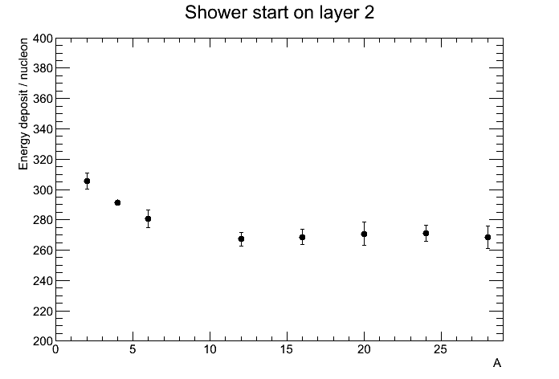
Shower profile
Li
He
D
C
He
Ions @ 30.0GeV/u
2013 test

Slide 29
Energy resolution –vs– shower containment
Ion-beam data
He @ 30.0GeV/u
2013 beam-test
Energy deposit (a.u.)
Energy resolution
Gaussian fit
Histogram statistics

Slide 31
Beam-test –vs– MC data
MC (Fluka)
Ion-beam data
He @ 30.0GeV/u
2013 setup
Energy deposit (a.u.)
Energy resolution
Gaussian fit
Histogram statistics
Better than 5% agreement
Up to 15% disagreement

Slide 32
Beam-test –vs– MC data
+4%
-10%
● Beam-test
○ MC
30.0 GeV/n
12.8 GeV/n
Beam test
MC
+6%
-14%

Slide 33
Beam-test –vs– MC data
+1%
-5%
Beam test
MC
+5%
-3%

Slide 34
Energy resolution –vs– A
$${\left(\frac{σ_{E}}{E}\right)}_{A}=\frac{1}{\sqrt{A}}{\left(\frac{σ_{E}}{E}\right)}_{p}$$
● Beam test 2013
○ MC
$$\left(\frac{σ_{E}}{E}\right)\sim \frac{RMS}{MEAN}$$
30 GeV/n
12.8 GeV/n
Showers starting on layer 1

Slide 35
Energy resolution –vs– A
$${\left(\frac{σ_{E}}{E}\right)}_{A}=\frac{1}{\sqrt{A}}{\left(\frac{σ_{E}}{E}\right)}_{p}$$
● Beam test 2013
○ MC
$$\left(\frac{σ_{E}}{E}\right)\sim \frac{RMS}{MEAN}$$
30 GeV/n
12.8 GeV/n
Showers starting on layer 2

Slide 36
Energy resolution –vs– A
$${\left(\frac{σ_{E}}{E}\right)}_{A}=\frac{1}{\sqrt{A}}{\left(\frac{σ_{E}}{E}\right)}_{p}$$
● Beam test 2013
○ MC
$$\left(\frac{σ_{E}}{E}\right)\sim \frac{RMS}{MEAN}$$
30 GeV/n
12.8 GeV/n
Showers starting on layer 3

Slide 37
beam‘-test 2013
MC
33.8%
28.3%
Showers starting on layer 1
He @ 30.0 GeV/n
Energy deposit +4%
Resolution -16%

Slide 38
2013 –vs– 2015 prototype
beam-test 2013
beam-test 2015
33.8%
33.5%
Showers starting on layer 2
He @ 30.0 GeV/n
preliminary
(Z-tagging from first calorimeter layer )

Slide 39
Summary & conclusions
Beam tests
Feb.2013 → first test of 3×3×14 prototype with ions @SPS
Feb.2015 → second test with ions @SPS
Upgrade: optical cross talk removed by shielding the crystal with Tedlar layer
Study of detector response to ionization energy deposits
Non-linear Z² dependency found
Precise characterization with 2015 data under progress
Study of shower classification and energy resolution
MC tuned on 2013 data → agreement MC/data within 15%
MC tuning with 2015 under progress → better MC-to-data match expected
Planned beam-test
Aug.2015 → test of the 3×3×14 prototype with high-energy p and e @SPS
Upgrade: Vikuiti wrapping & (if possible) small-area PDs

Slide 40
SPARE SLIDES

Slide 41
Channel Noise
CASIS
0
CASIS
1
CASIS
2
CASIS
3
CASIS
4
CASIS
5
CASIS
6
CASIS
7
CASIS
8
Without common-noise subtraction
With commom- noise subtraction
ADC counts

Slide 42
MIP signal
CN subtracted → S/N~13.5
No CN subracted →S/N~7.2
D
He

Slide 43
Ionization signal relative width
A×30GeV
Additional gaussian fluctuations (4.5%) tuned to match carbon resolution
NB distributions are not gaussian

Slide 44
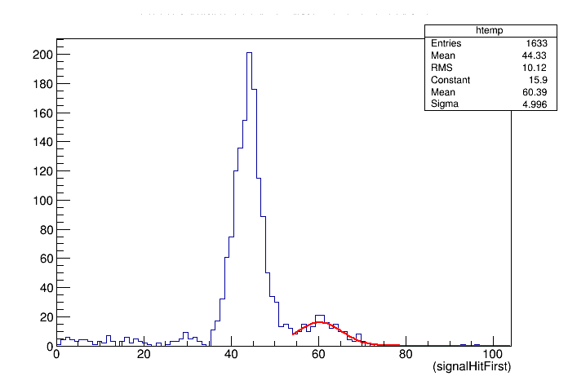
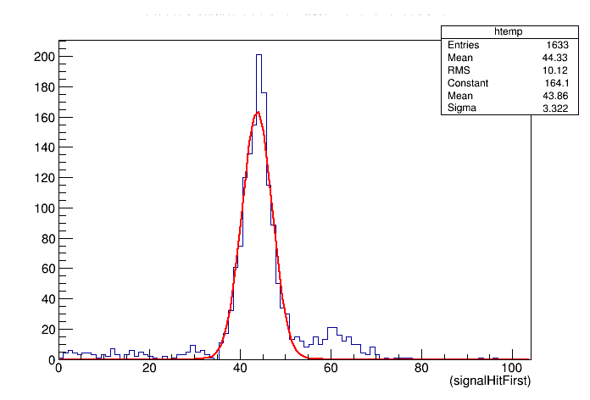
Direct energy deposit on photodiode
Central cube first layer
Carbon 12.8 GeV/amu
Crystal ~ 44 MIP
Crystal+sensor ~ 60 MIP
C ions traversing the photodiode
MIP

Slide 45
Switching from high to low gain
High gain | low gain
Saturation
He
F
Na

Slide 46
Saturation
30.0 GeV/n

Slide 47
Saturation
12.8 GeV/n

Slide 54
Shower starting-point distribution
4He @ 12.8 GeV/u
$$N_{int}\left(i\right)∝e^{−i∙s}$$
$$s=Δx∙σ_{int}$$

Slide 55
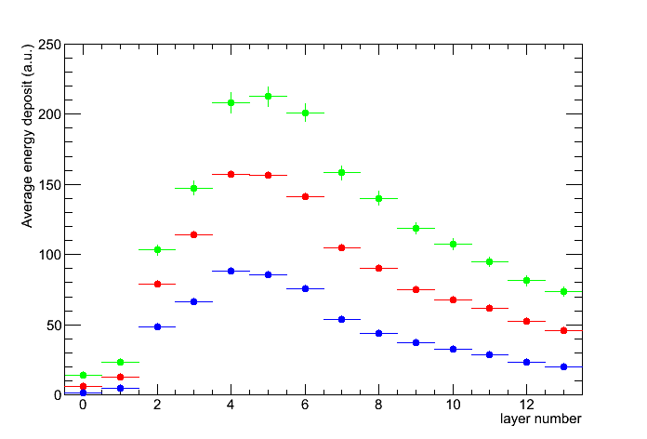
Missing lateral
element
Missing corner
element
Ion-beam data
30.0GeV/u
2013 setup
Li
He
D

Slide 56
Missing lateral
element
Missing corner
element
Missing central
And lateral element
Ion-beam data
30.0GeV/u
2015 setup

Slide 57
Shower profile
Showers starting on layer 2
Ion-beam data
2013 setup
C @ 30 GeV/u
C @ 12.8 GeV/u

Slide 58
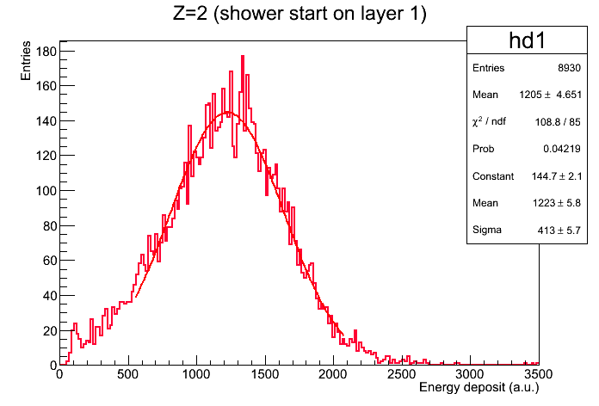
Energy resolution –vs– A

Slide 59
Discrepancy
+1%
-5%
Discrepancy
+5%
-3%

Slide 60
NB!
Discrepancy
-3%
-7%
*
*

Slide 61
NB!
Discrepancy
-2%
-8%
+1%
-5%
Discrepancy
-2%
-9%
+5%
-3%

Slide 62
NB!
Discrepancy
0%
-11%
+2%
-5%
21.6%
21.5%
21.3%
Discrepancy
-2%
0%
+5%
+6%
21.6%
21.5%
21.3%

Slide 63
Teflon tape 50 um
Number of layers varies from 2 (prototype config) to 16
Peak α 5,5 MeV

Slide 66
Cube-to-layer signal fraction
Data:
Carbon beam
12×30.0GeV/c
MC: noise included
Selection:
Events with maximum signal on first-layer central cube
Second layer
Simulation vs data

Slide 67
Cube-to-layer signal fraction
Data:
Carbon beam
12×30.0GeV/c
MC: noise & OCT (20%)
Selection:
Events with maximum signal on first-layer central cube
Expected
cube-to-layer signal fraction ∼83%
Second layer
Simulation vs data

Slide 68
Cube-to-layer signal fraction
Cube-to-layer signal fraction forced to ∼88%, by modifying $ε_{OCT}→\sim 86\%$
Data:
Carbon beam
12×30.0GeV/c
MC: noise & OCT (14%)
Selection:
Events with maximum signal
on first-layer central cube
Second layer
Simulation vs data

Slide 69
Total number of hits
Data:
Helium beam
4×30.0GeV/c
MC: noise included
Selection:
Events with maximum signal on first-layer central cube
Simulation vs data

Slide 70
Total number of hits
Data:
Helium beam
4×30.0GeV/c
MC: noise & OCT (14%)
Selection:
Events with maximum signal on first-layer central cube
Simulation vs data

Slide 71
Ionization signal (average)
Data:
Deuterium beam
2×30.0GeV/c
MC:
noise
OCT (14%)
Gaussian spread (4.5%)
Non interacting ions selected
Single-cube signals (sensor excluded)
Cumulative distribution of all (internal) layers
p.e.-to-ADC normalization tuned to match deuterium ionization peak

Slide 72
Ionization signal (average)
Data:
Helium beam
4×30.0GeV/c
MC:
noise
OCT (14%)
Gaussian spread (4.5%)
Non interacting ions selected
Single-cube signals (sensor excluded)
Cumulative distribution of all (internal) layers

Slide 73
Ionization signal (average)
Data:
Carbon beam
12×30.0GeV/c
MC:
noise
OCT (14%)
Gaussian spread (4.5%)
Non interacting ions selected
Single-cube signals (sensor excluded)
Cumulative distribution of all (internal) layers
Additional gaussian fluctuations added to match the Carbon relative width

