Slide 1
CIEMAT - Technical/Scientific Capabilities
Gamma-400 Workshop
J. Berdugo
CIEMAT, Madrid
June 29, 2015, Barcelona

Slide 2
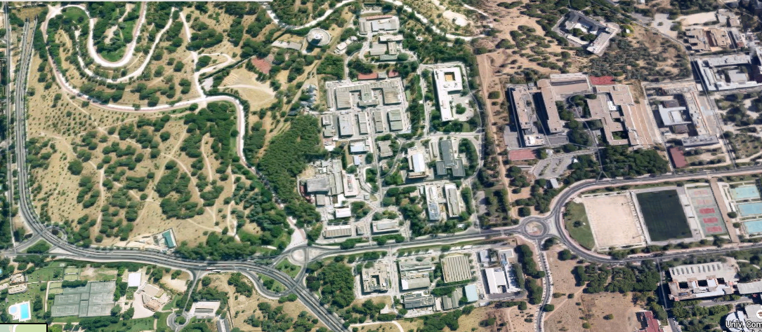
CIEMAT
The CIEMAT (Centro de Investigaciones Energéticas, Medioambientales y Tecnológicas) is a public research institute assigned to the Ministry of Economy and Competitiveness under the Secretariat of State for Research
The CIEMAT is structured in five technical departments (1200 people including administration)
Energy
National Fusion Laboratory
Environment
Technology
Basic Research
Particle and Astroparticle Physics
Molecular and Cellular biology

Slide 3
CIEMAT: Basic Research on Physics
Physics program
High Energy Physics
Collisions in accelerators (CMS Experiment)
Neutrino Physics (Double Chooz)
Direct search of Dark Matter (ArDM Experiment)
R&D on Particle Physics Detectors
CALICE Collaboration
Liquid Argon Detectors
Astroparticle Physics
Cosmic Rays (AMS Experiment)
Observational Cosmology (DES and PAU Experiments)
High Energy Gamma Rays (CTA Experiment)
Physics projects are carried out in close collaboration with the Department of Technology
Electronics Laboratory
Mechanical Workshops

Slide 4
CIEMAT: Electronics Laboratory
Hardware: PCB development. Low noise high bandwidth Analog and Digital systems. Cadence and Altium development environments.
Microelectronics: Design, simulation and characterization of mixed signal Analog-Digital ASICs. Cadence Virtuoso development tool. Access to Multi-Wafer runs via Europractice membership.
Firmware: development and simulation of reconfigurable logic (FPGAs). Hardware debugging with both commercial platforms and in-house prototypes. Xilinx, Altera and Actel development tools.
Software: instrumentation control programming for automatized characterization and quality control test-benches. LabView development environment. Programming of embedded systems, microcontrollers and DSPs.
Facilities:
about 300m2 of electronic workshops.
High bandwidth scopes and differential probes; Spectrum, network and logic analyzers; High speed waveform and pattern generators. BGA soldering and de-soldering stations; semi-automatic bonding machine; Thermal chambers.
Irradiation facility (Nayade): Co-60 sources. Suitable for Total Ionizing Dose qualification.

Slide 5
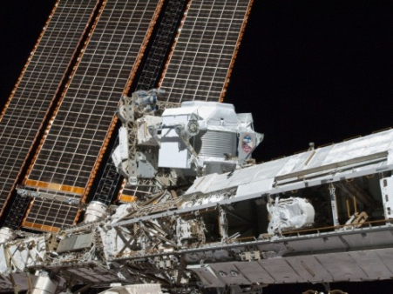
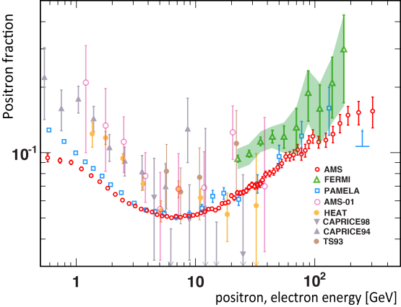
Participation in AMS
CIEMAT joined AMS Collaboration in 1997
Participation in AMS02 (2000-2015) (CIEMAT, IAC)
Detector construction
Cherenkov Radiation Detector (RICH)
Magnet System
Operation and maintenance of the RICH
Software development and data analysis
Collaboration with external space specialized companies:
Spanish: CRISA EADS-Astrium (electronics), CEDEX (magnet), Iberspacio (thermal),
INTA (qualification),
Non-Spanish: Carlo Gavazzi (thermal, mechanics), CAEN (electronics)
Funding: National Spanish Space Program (CDTI, CICYT) and CIEMAT

Slide 6
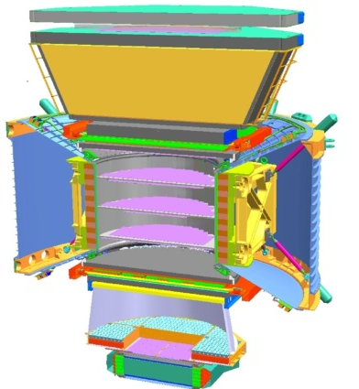
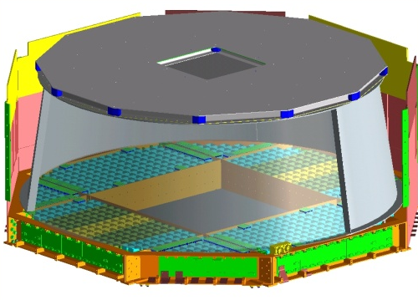
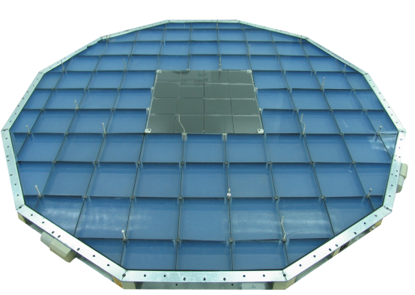
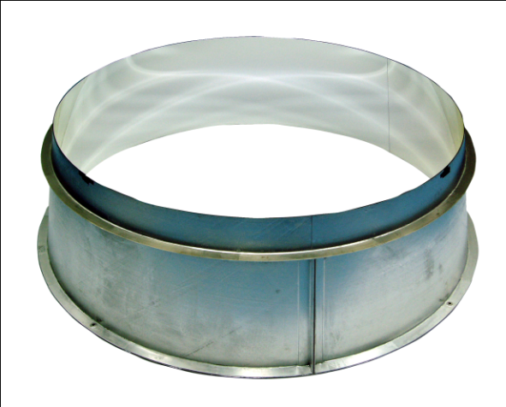
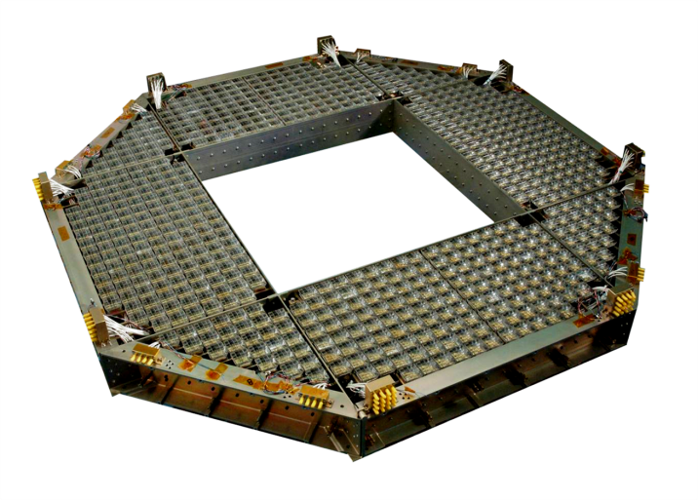
AMS Ring Imaging CHerenkov (RICH)
AMS-RICH Collaboration:
CIEMAT (Madrid), IAC (Tenerife), INFN (Bolonia), LIP (Lisboa), LPSC (Grenoble), UMD (Maryland), UNAM (México)
Precise measurement of the velocity of charged particles
Measurement of the charge of the particles
Particle
Charge Z
Velocity β
Velocity
Radiador
Cherenkov
β
Reflector
Cónico
Charge
Foto- detectores
Z
Cherenkov Radiator
Reflector
100 nm of Aluminum- Nickel Plated with 300 nm SiO₂ coating
Photon´s detection
10880 pixels (680 PMT´s 4x4)
Hamamatsu PMT-7600-00-M16
Gain~ 10⁶ @ 800 V
QE ≈ 20 % in the range of 250-600 nm
92 silica aerogel tiles and
16 NaF crystals
NaF
Aerogel
 | Aerogel | NaF
Threshold velocity (v/c ) | 0.952 | 0.752

Slide 7
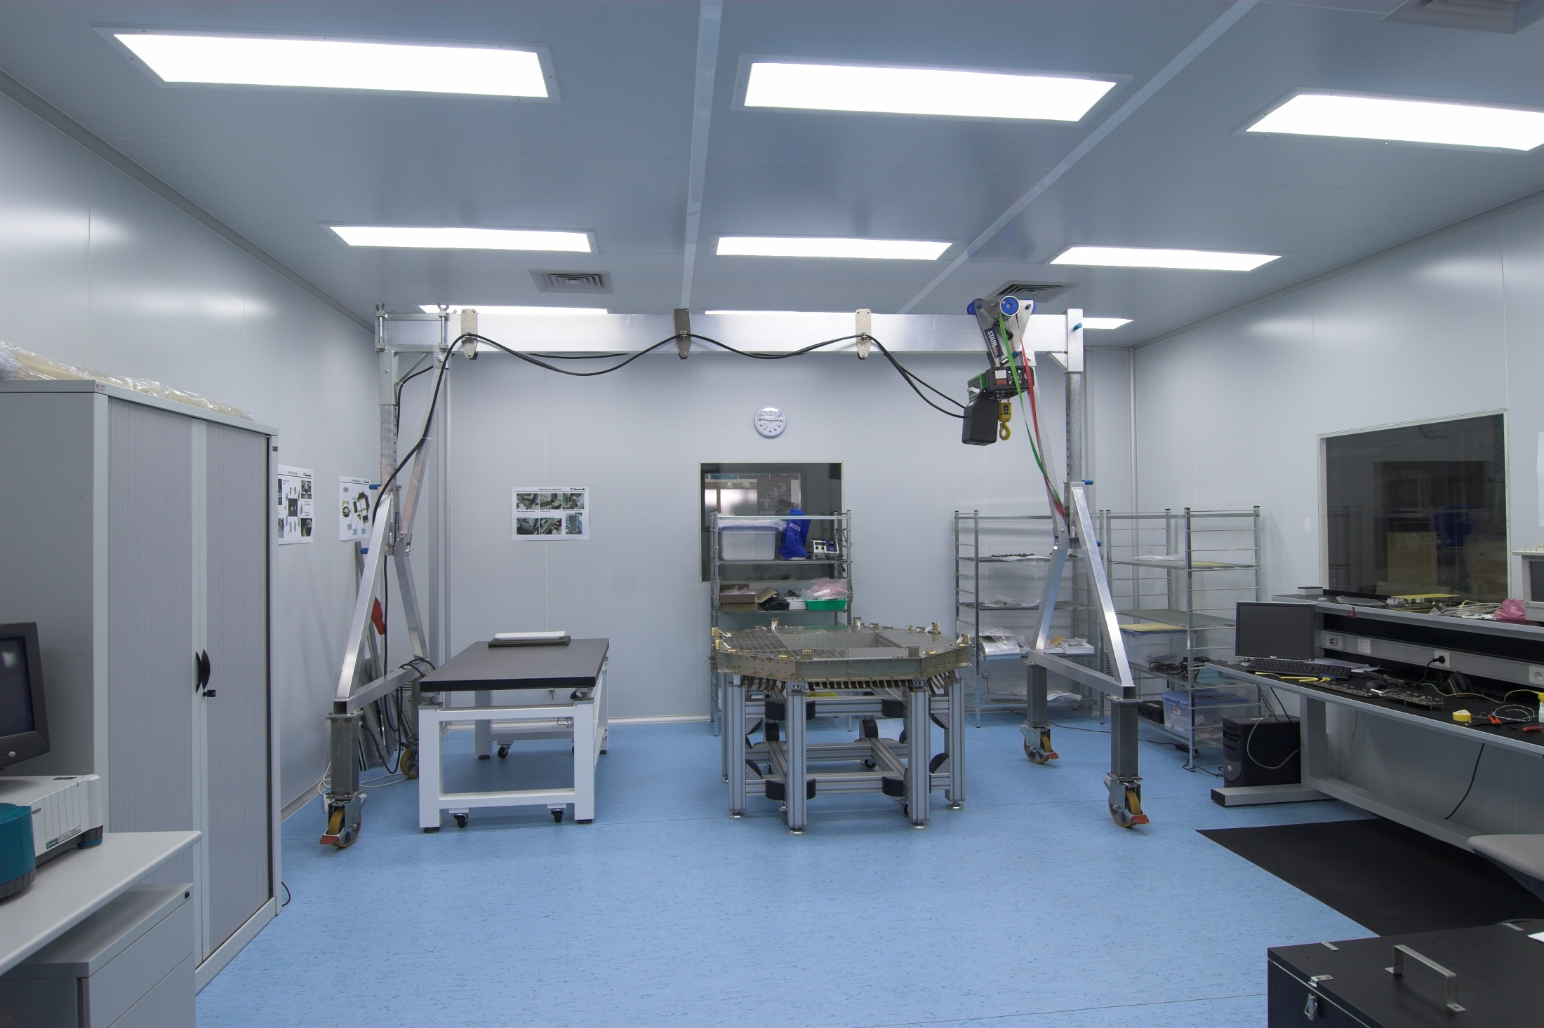
RICH Assembly and Tests
Clean Room Class 100000
Surface 44,5 m²
Hight 2,35 m
CIEMAT Assembly Clean Room

Slide 8
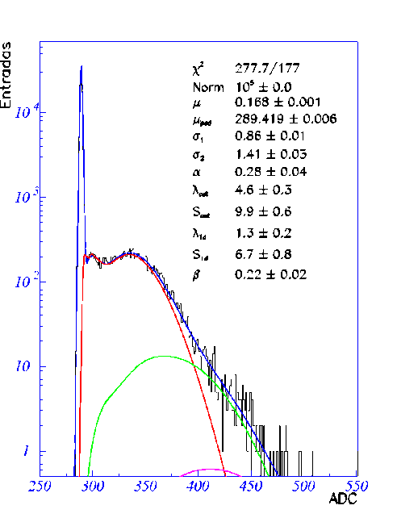
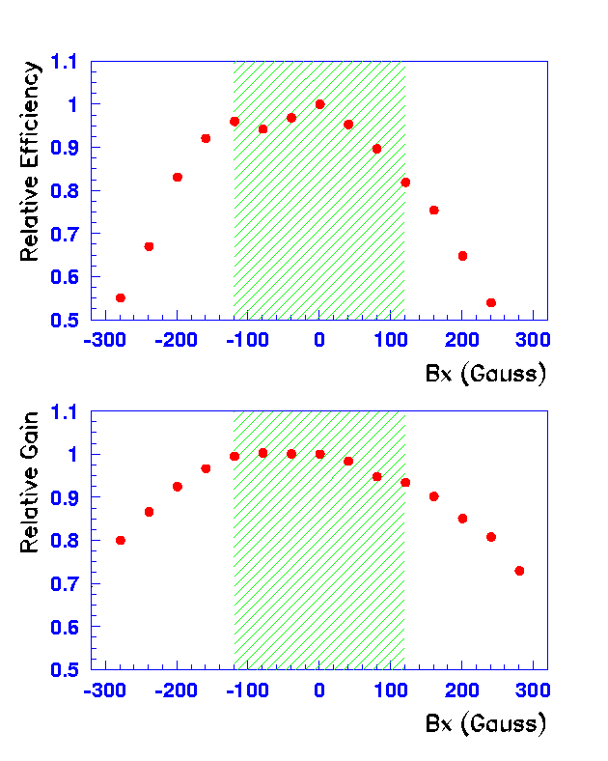
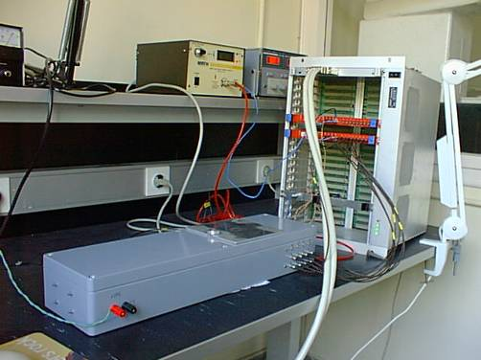
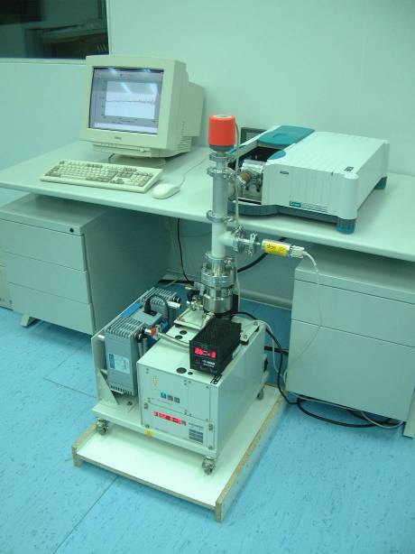
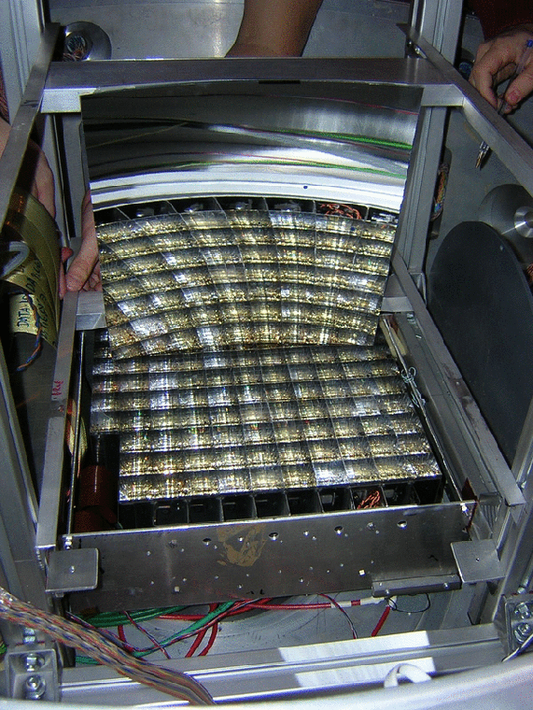
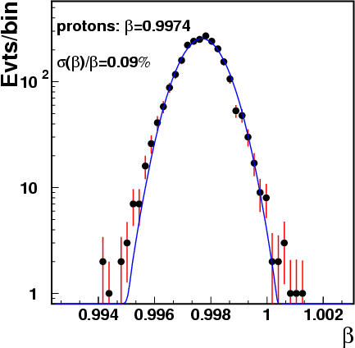
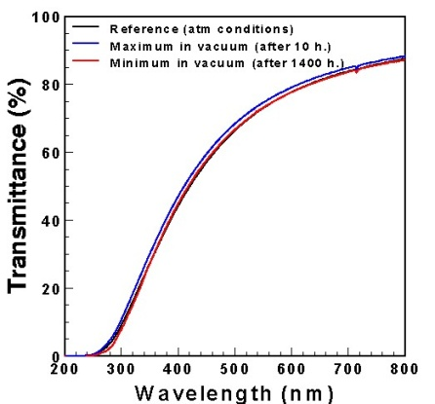
Definition and characterization of RICH components and prototypes
PMT characterization: “single photon” response
PMT characterization: Magnetic field effects
Aerogel characterization
TB1: 20 GeV/n (Pb beam in Berilium)
TB2: 158 GeV/n (In beam in Lead)
Thermal cycling
UV radiation
Aging
Storing conditions
In vacuum
Prototype mechanics and read-out
Data analysis

Slide 9
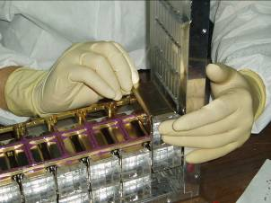
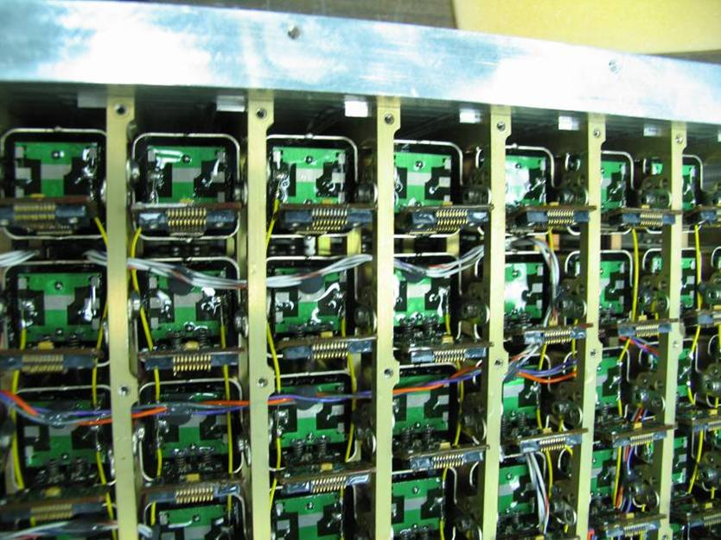
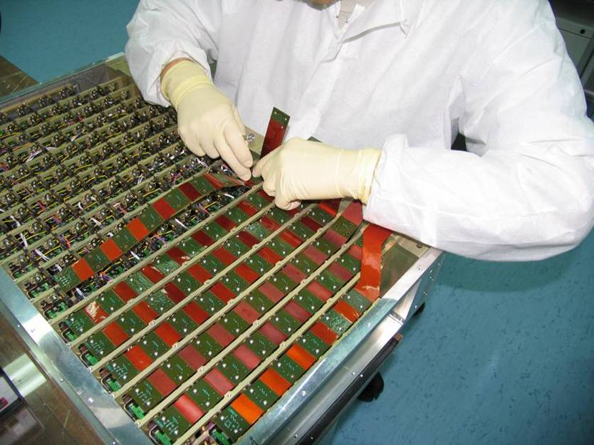
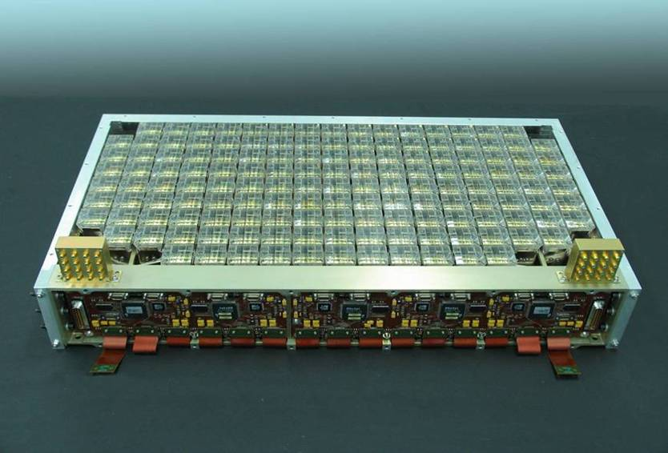
RICH detection Plane
Mechanical assembly and internal cabling

Slide 10
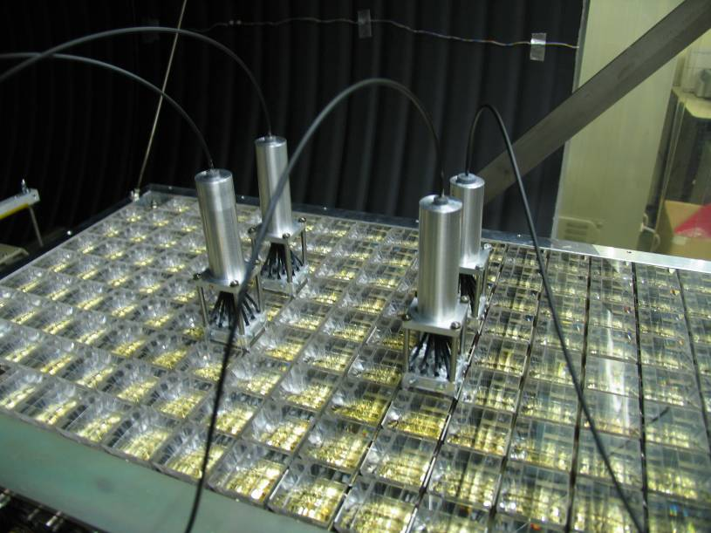
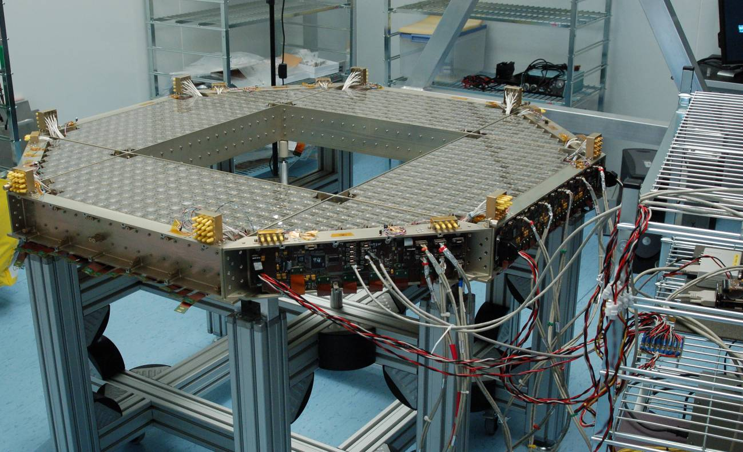
RICH detection Plane: Functional Tests
Online/SlowCtrl Software Validation:
Read-out Communication Protocol
HV Power Supply Control
Software for Calibration and Data taking
Temperature Sensors Read-out
Characterization Data per channel
Dark Current
Gains
Efficiencies

Slide 11
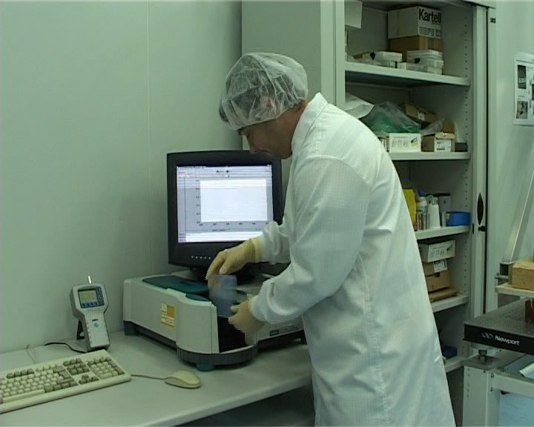
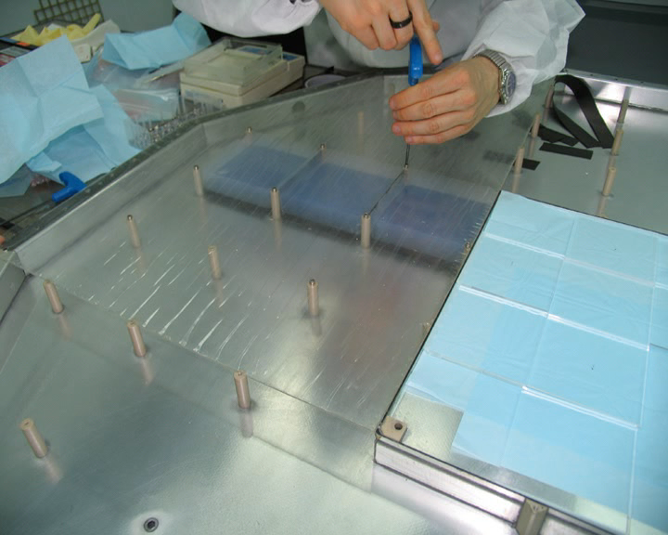
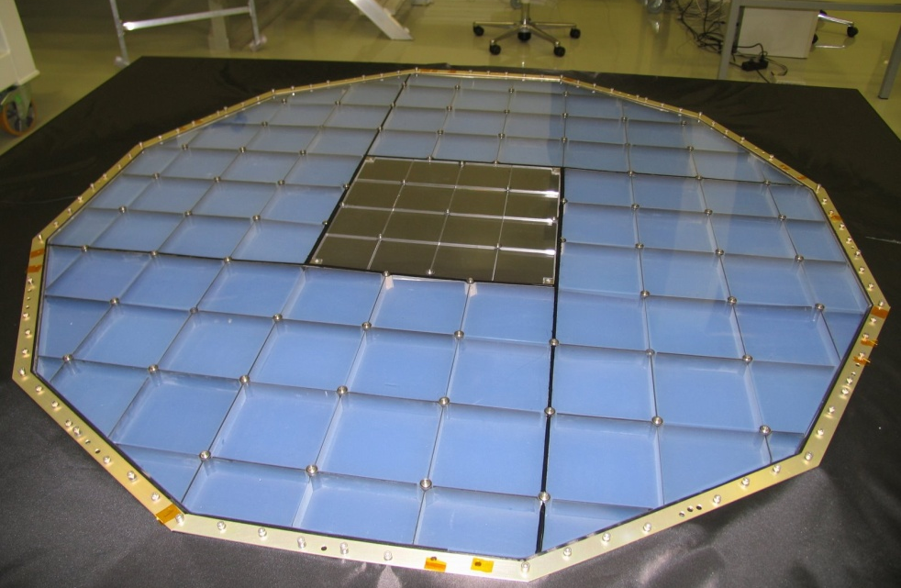
RICH Radiator Container: assembly and test
NaF
Aerogel
Aerogel Data base
Radiator container assembly

Slide 12
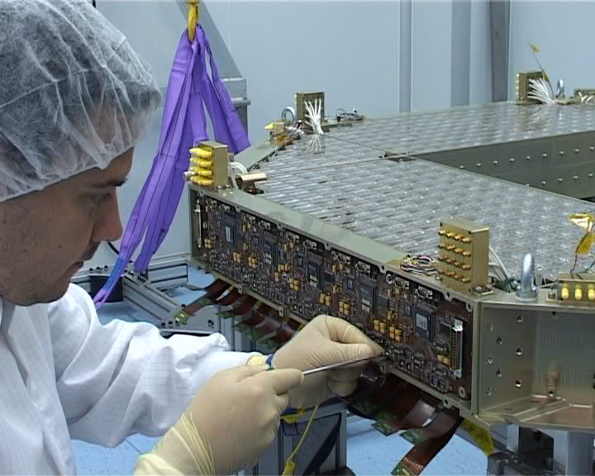
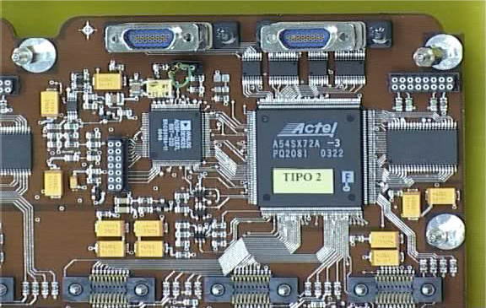
RICH DAQ system
Design and fabrication of the RICH DAQ system
Design , fabrication and test of EM boards at CIEMAT
QM and FM Fabrication at CRISA EADS
Functional and qualification tests (Thermal stress, Thermal cycling, vibration) (+INTA)
Assembly and cabling
Development and implementation of the online onboard software
Initialization and configuration parameters
Generation of control signals to drive the front-end electronics
Processing of the signal and monitoring
Online calibration
Data reduction
Housekeeping data
Read Out Board Unit
Read Out Assembly at CIEMAT

Slide 13
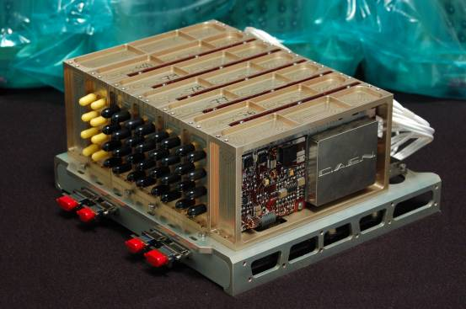
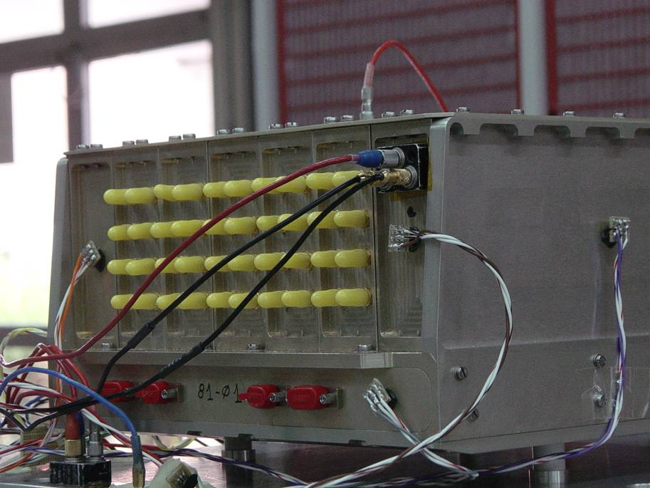
HV Power supply system
HV Elevators and regulators modules (CAEN)
Functional test
Qualification test
HV Bricks:
Mechanics (+IAC)
Asssembly and cabling
Functional tests

Slide 14
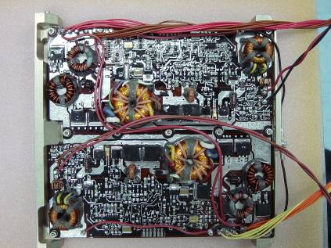
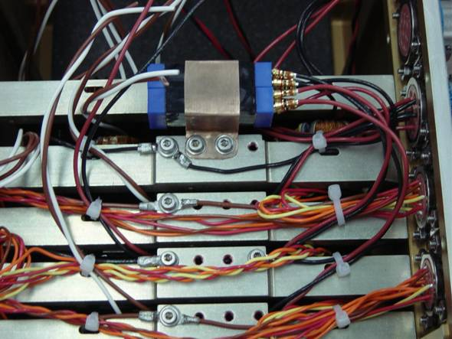
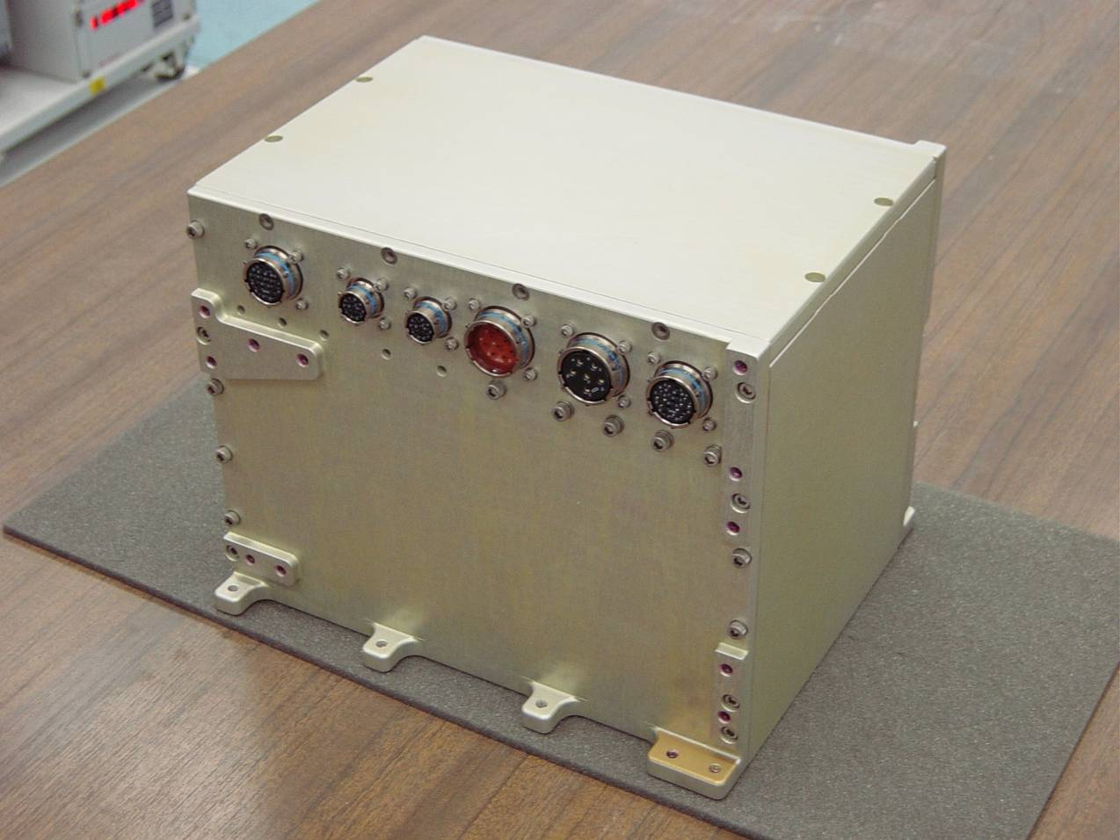
LV Power Supply
LV DC/DC (CSIST, Taiwan)
Functional test
Qualification test
Power distribution Box:
Mechanics (+IAC)
Assembly and cabling
Functional tests

Slide 15
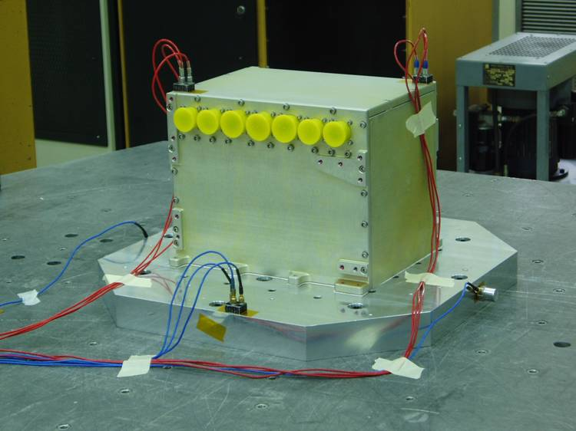
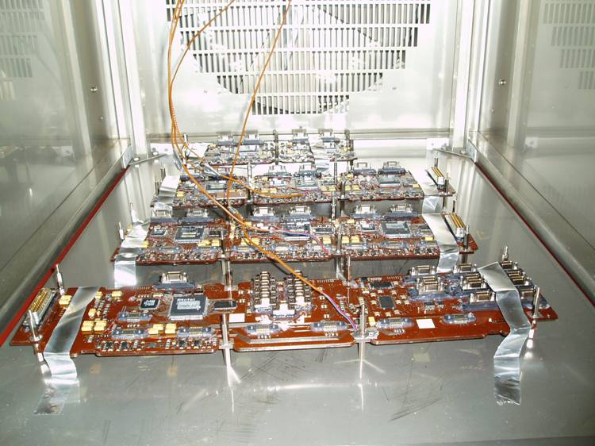
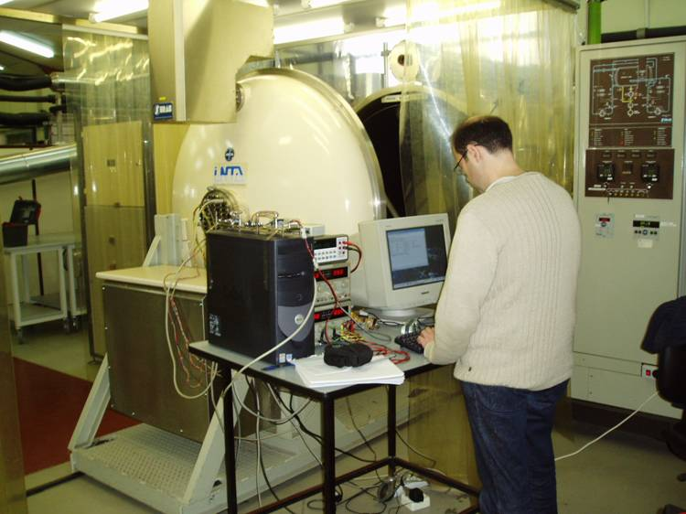
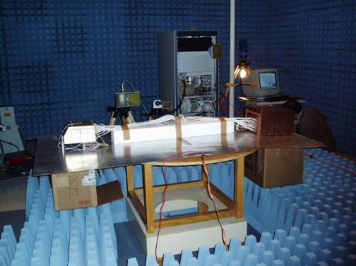
Space Qualification Tests of RICH electronics
Instituto Nacional de Técnicas Aeroespaciales (INTA)
LV System Vibration Test
Read-Out Boards Thermal Cycling
HV Thermal cycling in Vacuum
HV EMI Test

Slide 16
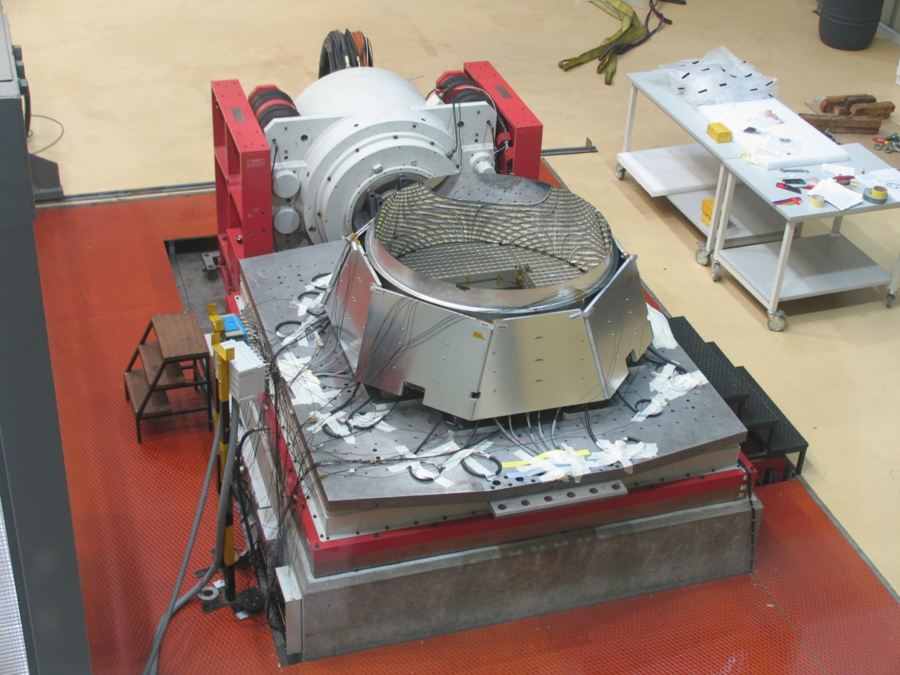
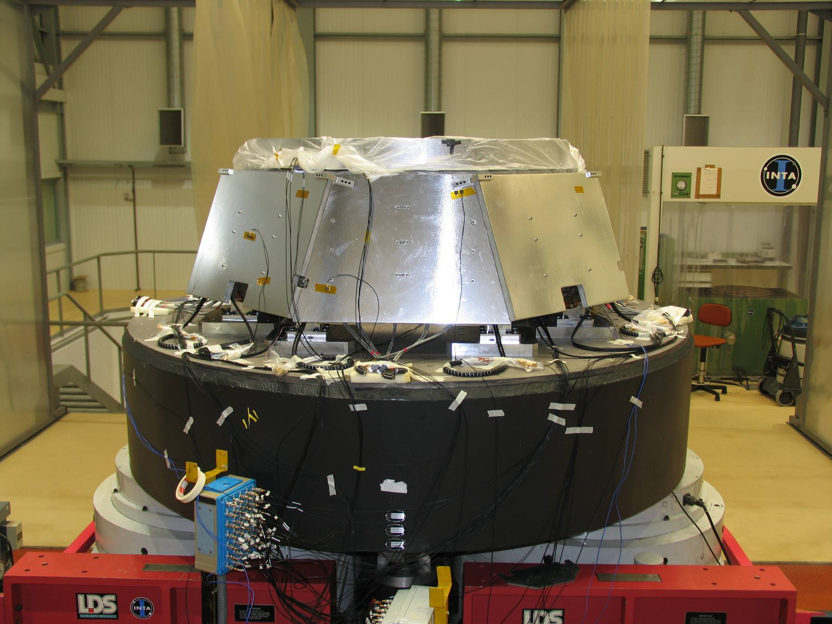
Vibration Tests of RICH Detector
Instituto Nacional de Técnicas Aeroespaciales (INTA)

Slide 17
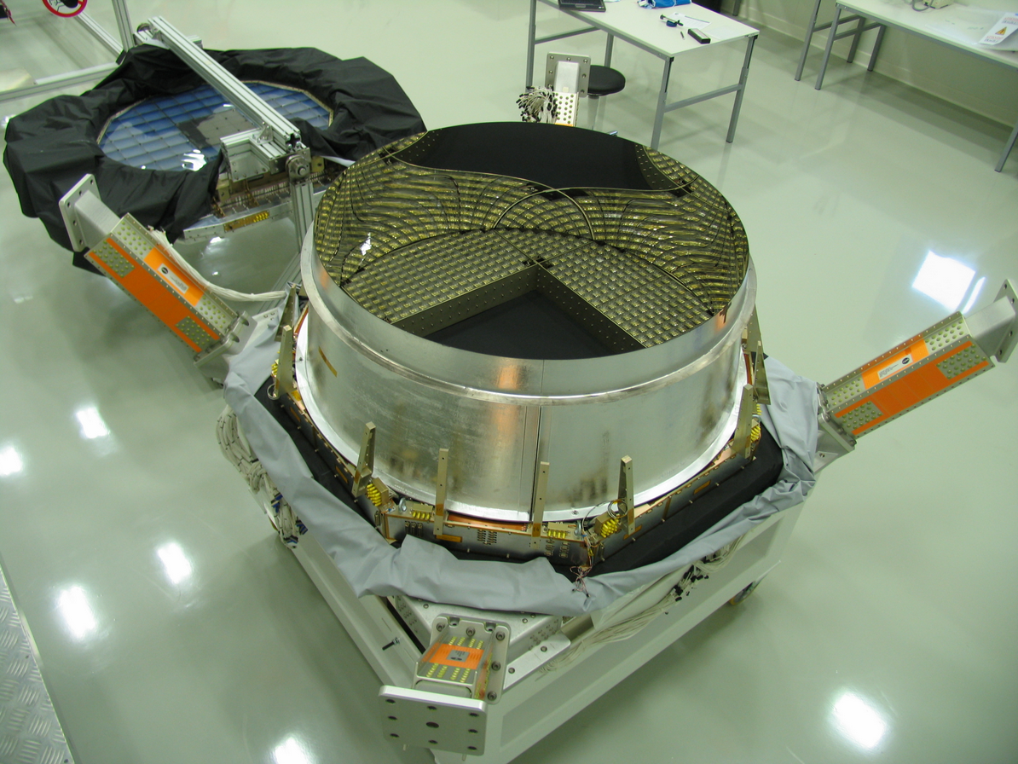
RICH Integration at CERN (2009)

Slide 18
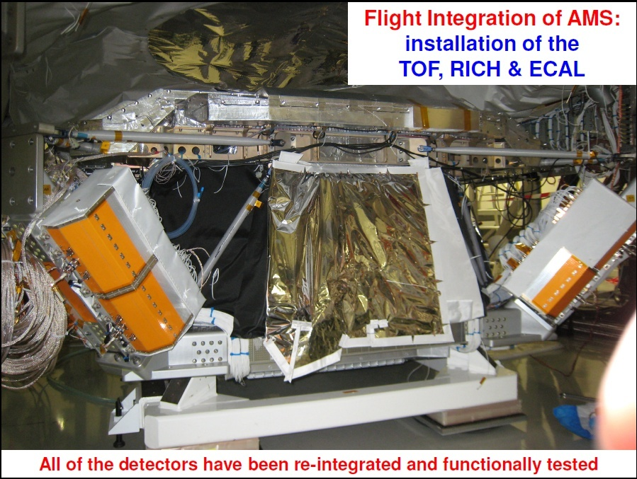

Slide 19
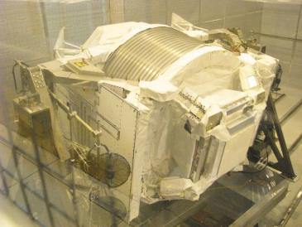
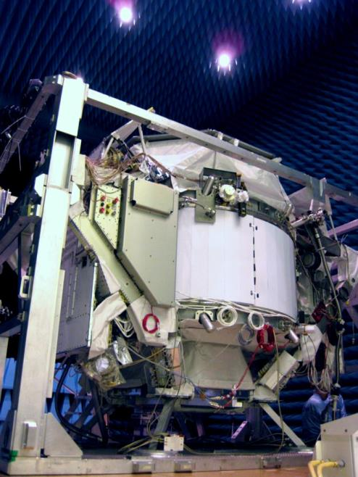
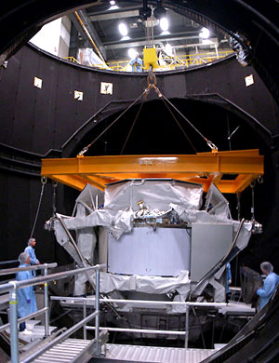
RICH OPERATION AND MONITORING
For the RICH, CIEMAT group has been responsible for the maintenance and operation of the detector during
the assembly at CIEMAT
validation periods at CERN and ESTEC
during the commissioning process at KSC.
AMS Test Beam @CERN
AMS Test @ESTEC

Slide 20
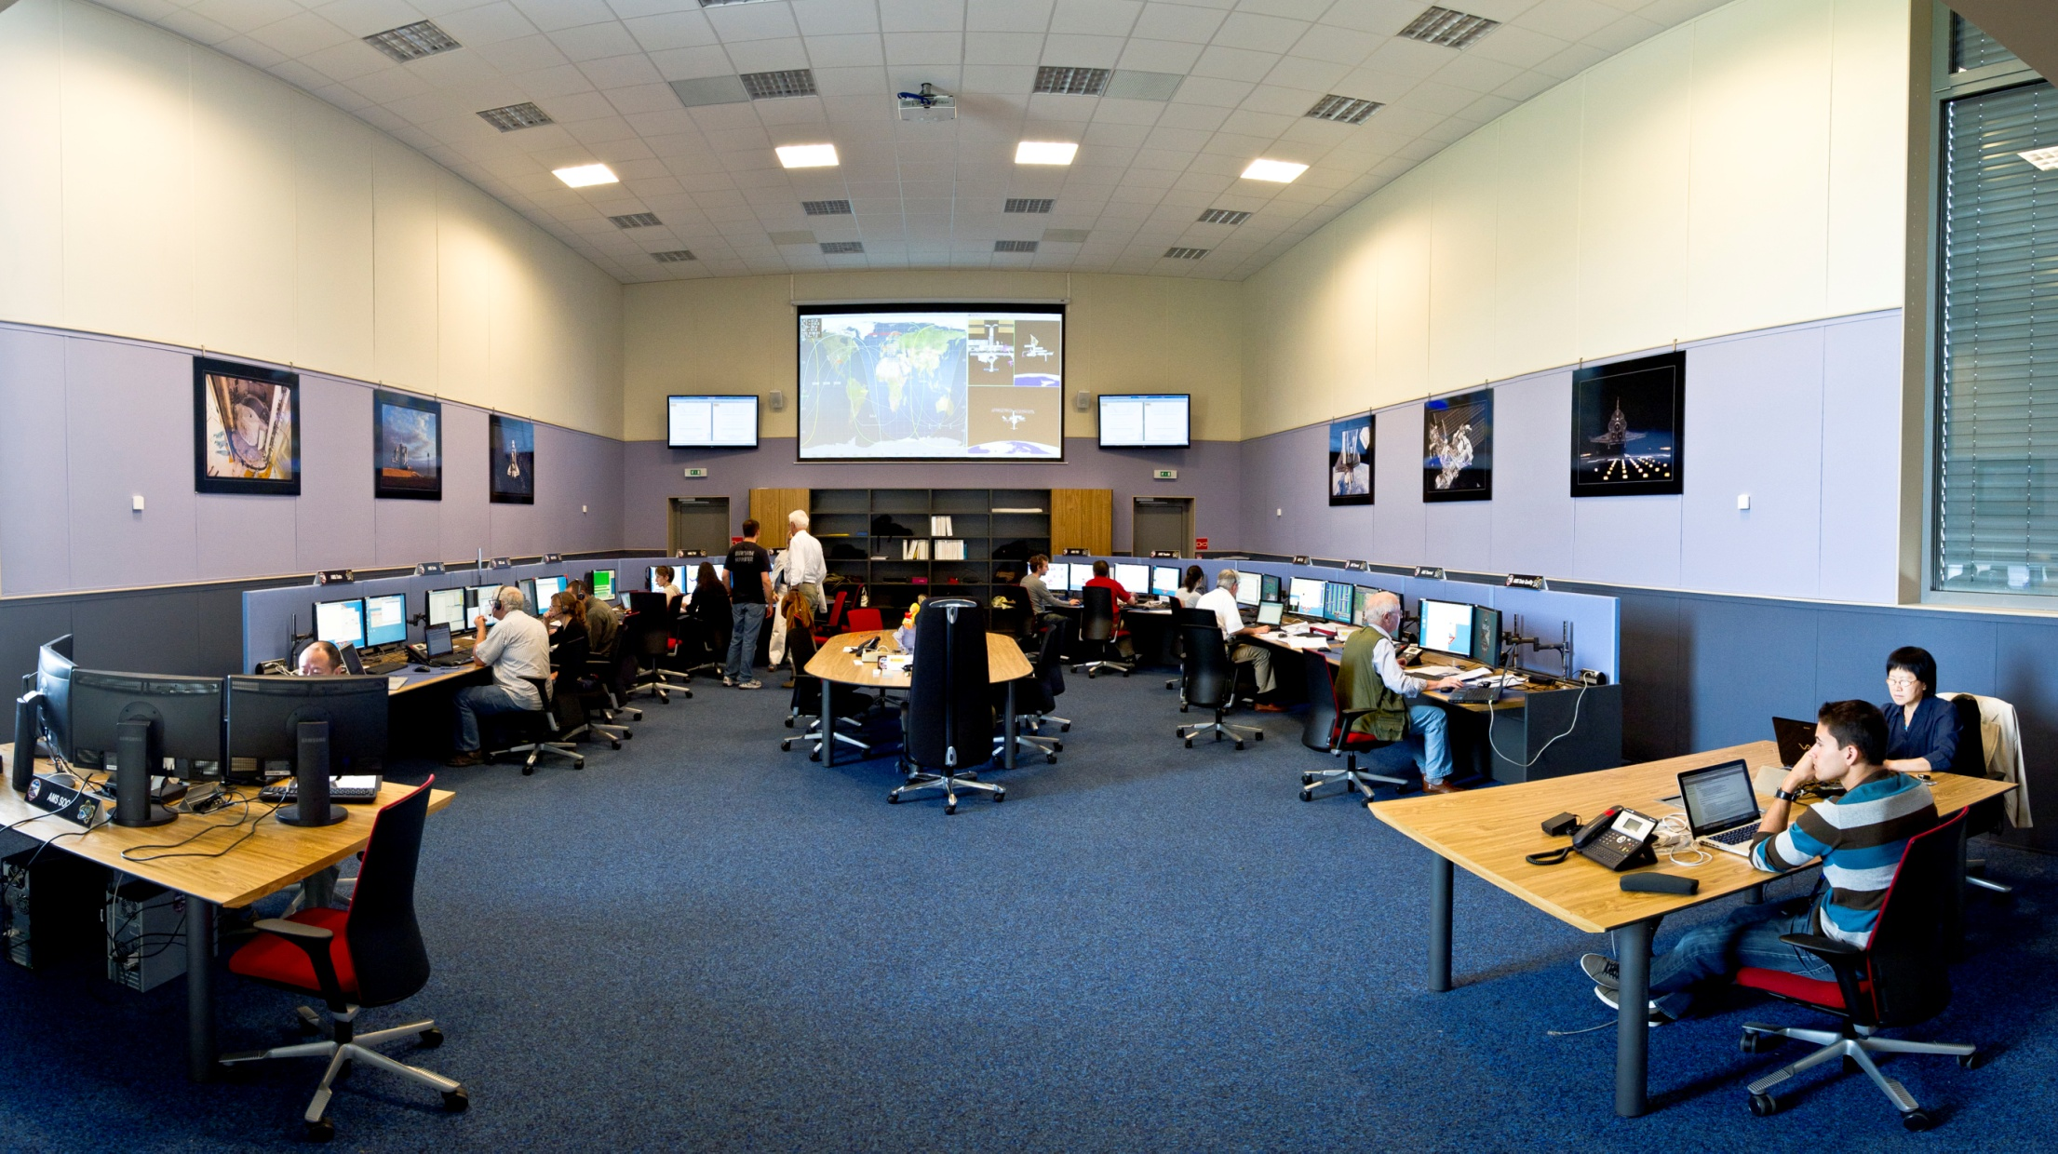
RICH OPERATION AND MONITORING
CIEMAT is currently responsible for the operaqtion and monitoring of the RICH during AMS-02 operation on the ISS.

Slide 21
RICH monitoring and commanding tools
. CIEMAT has developed the control and monitoring tools of the RICH detector: :
RICH DAQ and Power configurations and settings
Temperature evolution
Data acquisition performances (event size, read-out rates, communication between boards, integrity and self-consistency of the data…) and
RICH performances (occupancies, calibrations,…)
Readout configuration Parameters
HV settings
Slave masks
SSF state
BUSY mask
S/H time
Data Reduction configuration Parameters
Integration times
FE power control
Busy TX control
FT control
LV1 control

Slide 22
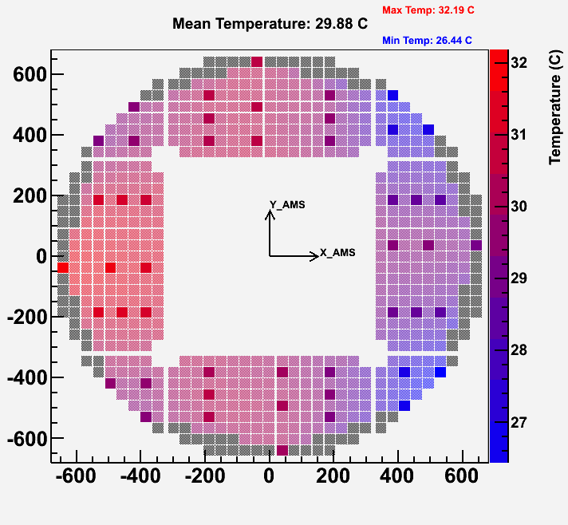
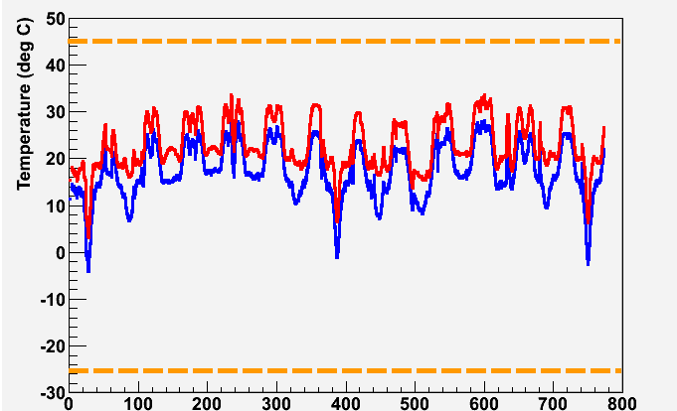
RICH OPERATION AND MONITORING: RICH Thermal
Warning alarm
RICH OPERATIVE RANGE
Max Temperature
Min Temperature
Warning alarm
Time from May 19, 2011 (days)

Slide 23
RICH OPERATION AND MONITORING: RICH Occupancy
The average number of hits per event is ~ 20-60, depending on the trigger rate at the actual position of the orbit.
RICH Event size (Byte)
Time (hour)
Channel Occupancy (Gx5)
Number of hits / ch / ev

Slide 24
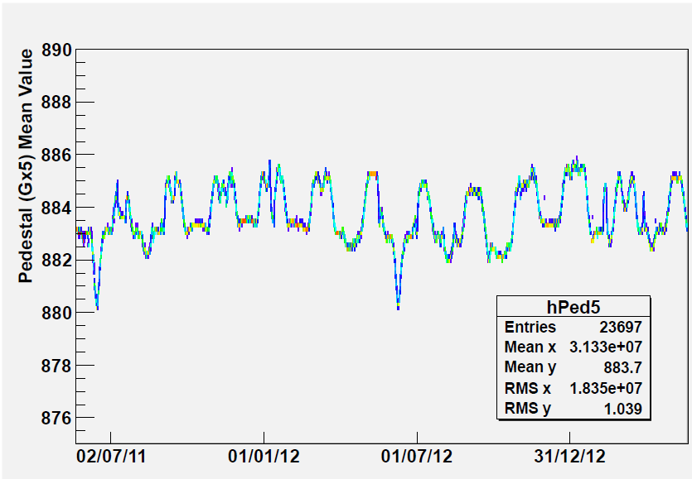
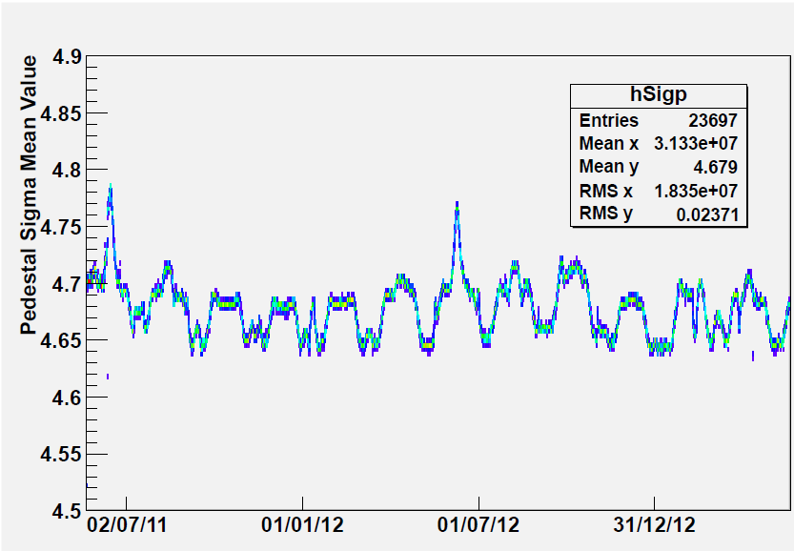
RICH OPERATION AND MONITORING: Online calib
The electrical offset (Pedestal) and noise (σ_{Ped}) of each channel varies with the temperature
Ped (Gx5)
σ_{Ped} (Gx5)
ADC Counts
ADC Counts
Δ(Ped) ~ 0.2 ADC Counts/deg C
Δ(σ_{Ped}) ~ -0.1% /deg C
Time (day)
Time (day)
Online calibration is performed every 46 minutes
(twice per orbit)

Slide 25
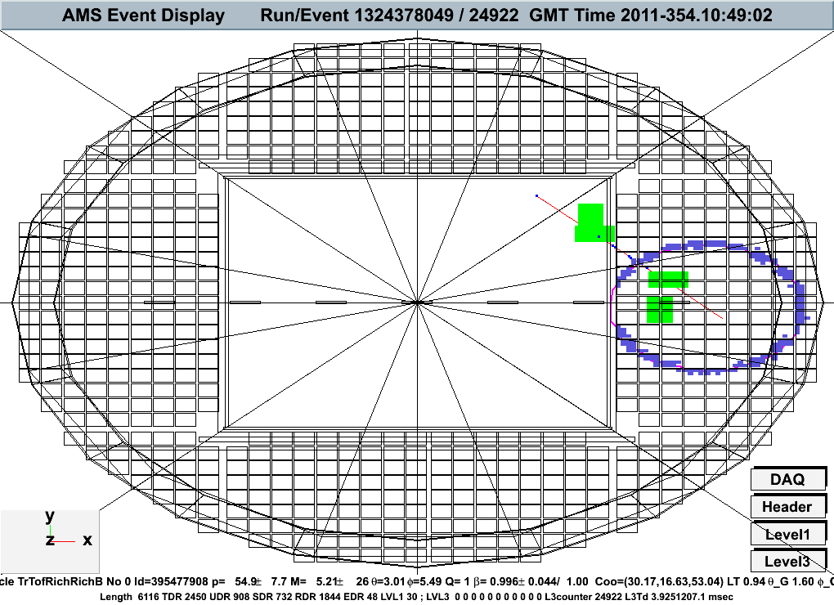
ANALYSIS ACTIVITIES IN CIEMAT
General software development
RICH Software
The CIEMAT group made a major contribution in the design and construction of the Cerenkov Detector and it took the responsibility for the development, implementation and maintenance of the offline software for the RICH
Monte Carlo Simulation
Geometry
Relevant Processes
Digitalisation
Calibration
Reconstruction
Velocity reconstruction
Charge reconstruction
Data Calibration
Analysis tools
Z = 10 (Ne)
P = 0.576 TeV/c

Slide 26
ANALYSIS ACTIVITIES IN SPAIN
General software development
Tracker
Alignment: CIEMAT group has developed a procedure to align and correct the positioning of the external Tracker layers on an event by event basis.
Tracker response simulation
MC Production
CIEMAT group has been involved in the MC production since 2003.
Physics Analysis
Positron to electron ratio and anisotropy studies
Cosmic ray Fluxes, B/C ratio, isotopes,….

Slide 27
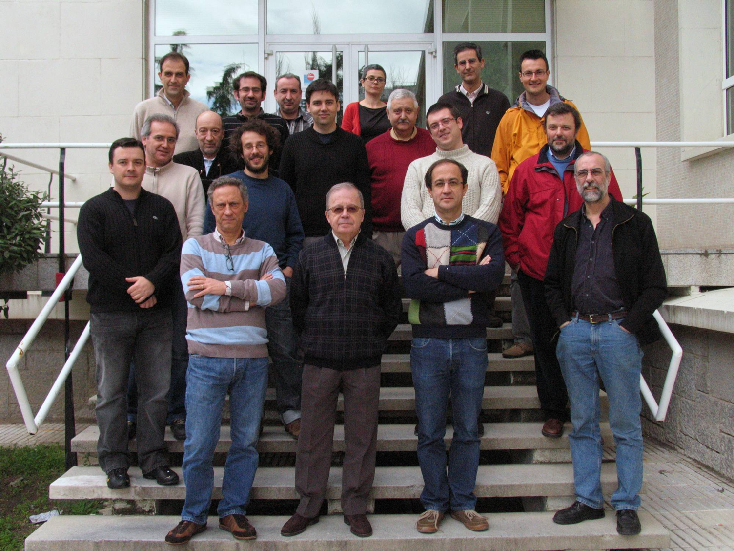
CIEMAT participation in AMS
In average, a team of around 15 persons (physicists and engineers) have been working in AMS during the last years

Slide 28
CIEMAT FUTURE ACTIVITIES
The current activities of the Astroparticle Physics Division in both Gamma Ray Astronomy (CTA) and Cosmic Ray Physics (AMS) may have a natural continuation with a participation in a project as GAMMA-400
Technologically, we can take advantage of our previous experience in design, construction and operation of space projects
Scientifically, a precise, long duration experiment in space as GAMMA-400 will provide fundamental information with gamma rays and will allow to extend the range of direct measurements of cosmic rays beyond the TeV range

