Slide 1
Cubic calorimenter for gamma400
THE SIMULATION & RECONSTRUCTION TOOL
Sergio Bottai , Barcellona 2015
Developed by florence groups for calorimenter optimization
P,e
Fluka-based MC simulation
  3,6cm CsI Scintillating crystals Scintillation Light collection efficiency and PD quantum efficiency
  Photodiode Energy deposits in the photodiodes due to ionization by particles are taken into account
  Carbon fiber support structure (filling the gaps between crystals)
  Number of crystals passed via parameter
  New dedicated versions for Cherenkov and Neutrons detection added recently (to be finalized and eventually ‘unificated’ with standard version)
e+,e-
photodiode
crystal
C++ reconstruction tools
  Noise
  Shower axis reconstructed by fit
  Lateral and longitudinal profiles respect to axis
  Point of first interaction along axis
  Length from first interaction to end of calorimeter
  ............................................................................
No MC truth is used
in the analysys

Slide 2
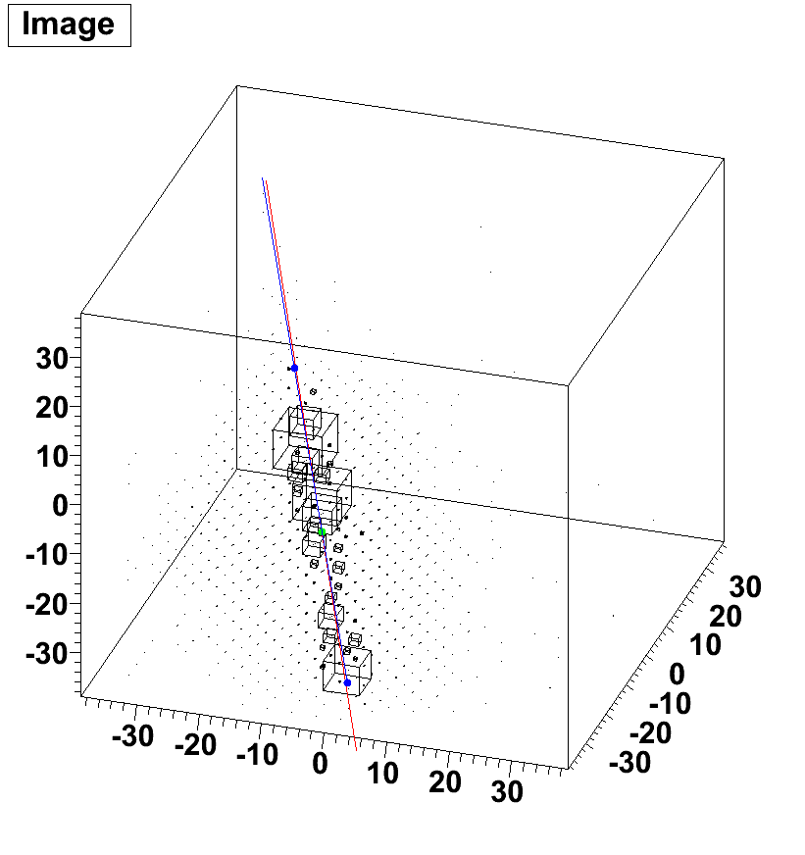
Proton

Slide 3
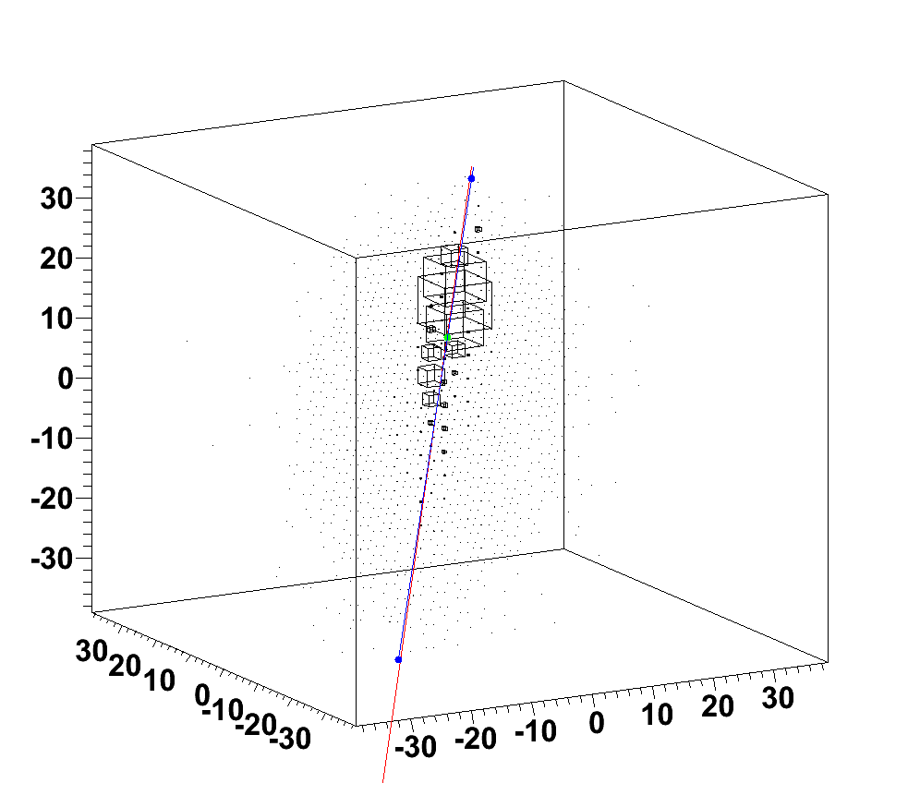
Electromagnetic Showers

Slide 4
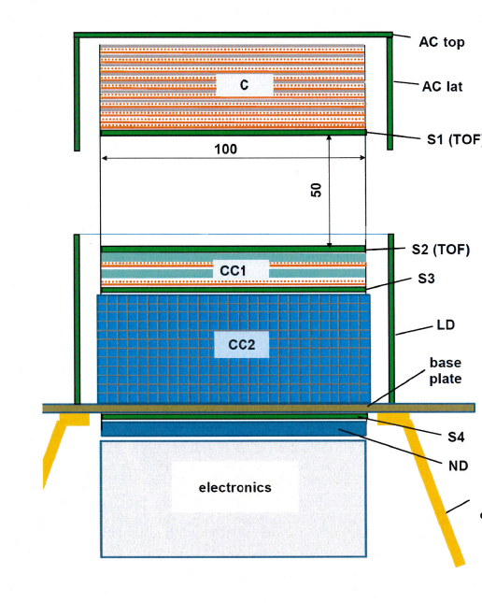
NEW SIMULATION OF G400 ‘NOT ISOTROPIC’ CUBES CALORIMETER
Calorimeter only simulation :
CC1 (2 layers of CsI)
+
CC2 (12 layers of 28X28 cubes)
Replaced for this
simulation by
CC2 (14 layers of 28X28 cubes)
Almost identical calorimetric beheaviour
respect to CC1+CC2

Slide 5
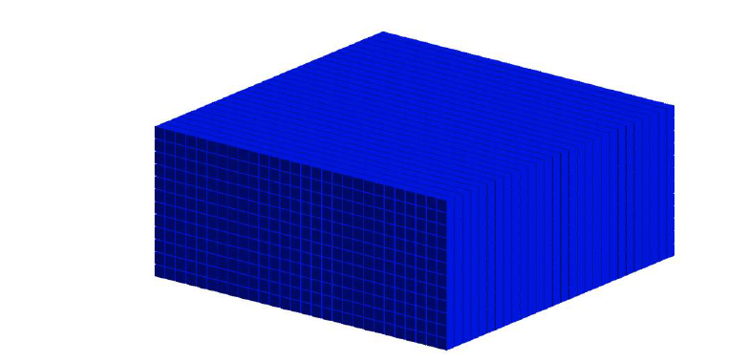
In previous studies only 20x20x20 calocube has been simulated.
Due to its symmetry only response to particles impinging top plane has been studied
For present study we have simulated the response to particles illuminating isotropically all
the ‘faces’ except for ‘bottom’ face.
28x28x14 (3.6 cm CsI cubes)
gapXY=1mm-4mm
gapZ=3mm
5 faces –> geometrical acceptance = 10.5 m² sr

Slide 6
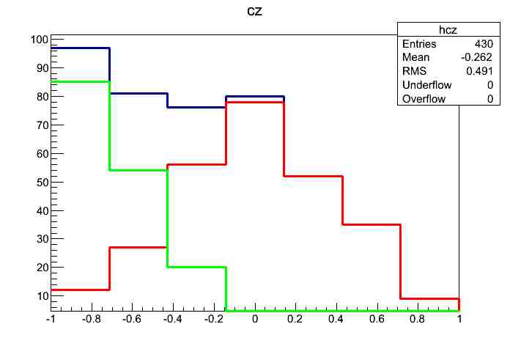
ANGULAR DISTRIBUTION AFTER ALL CUTS
Cuts : interacting protons, shower max contained in a fiducial volume...
typical efficiency ~ 50%
The particles impinging on lateral planes , after cuts, are approx 2 * top plane
Tot
Lateral planes
Top plane
cosθ
downgoing
horizontal

Slide 7
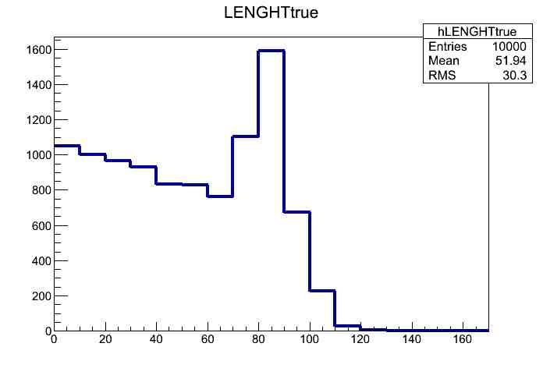
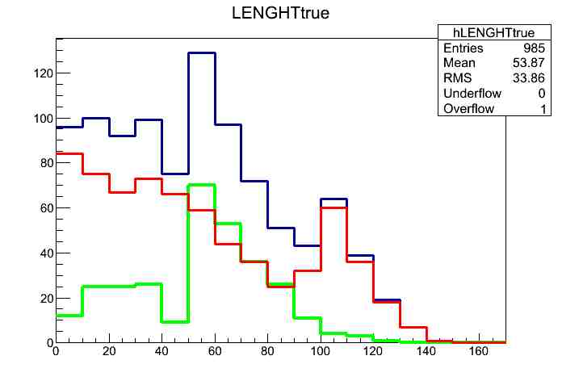
For each particle direction we consider the «length» as the segment «inside» the CALO
length
20x20x20
28x28x14
Tot
Lateral planes
Top plane
Length (cm)
Length (cm)

Slide 8
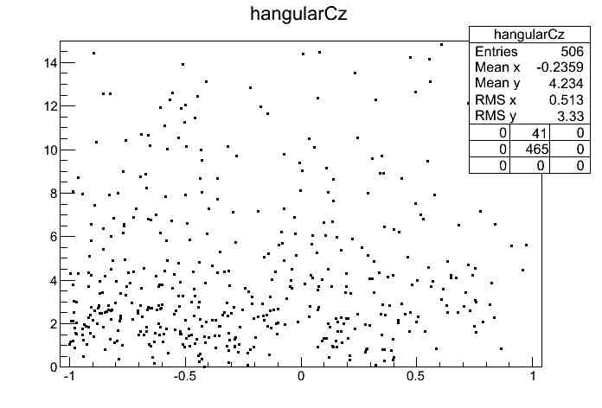
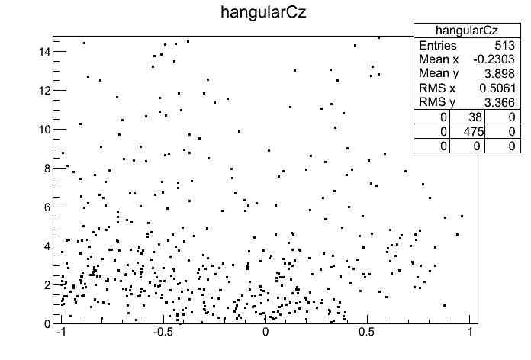
Track fitting
3 different fits with parametrization
respect to 3 different faces :
Z=cost, X=cost, Y=cost
Selection of best chi²
X,Y,tgX,tgY
Fitting parameters
10 TeV protons
Old track fitting
New track fitting
Ψ(deg)
Ψ(deg)
cosθ
cosθ
Calorimeter only
angular resolution
for 10 TeV protons ~ 3º
downgoing
horizontal
Lacks of events hitting bottom plane

Slide 9
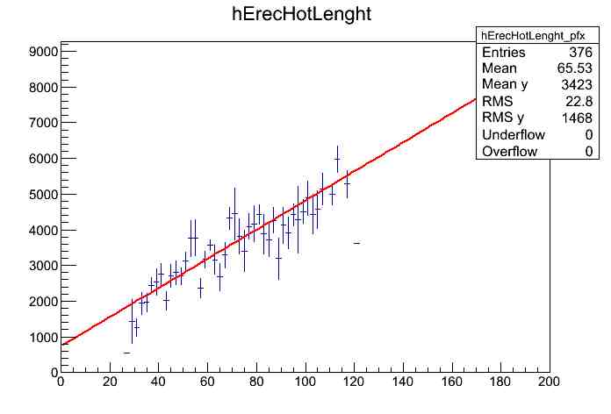
shower length
(from first interaction to end of calorimeter)
RECONSTRUCTED WITH ≈ cm resolution
Leakage is always important !
The Signal depends on the shower length
10TeV
<signal (GeV)>
each point
is average over
many events
Shower length (cm)
Reconstructed Shower length can be used for energy corrections and cuts

Slide 10
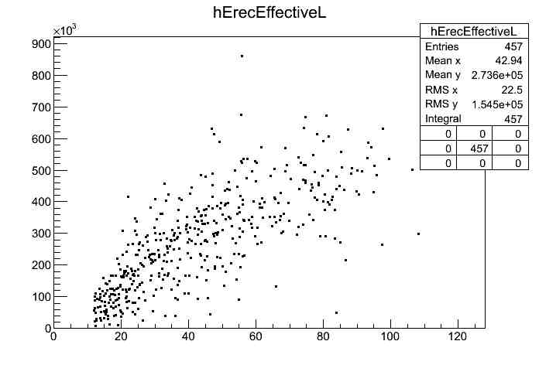
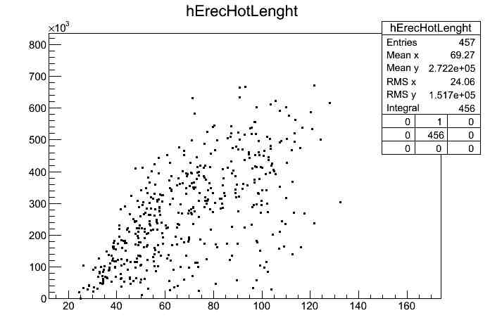
‘Effective shower lenght’ = maximal distance between crystals with signal > max/10
Effective shower lenght
shower lenght
max
Crystal signals
max/10
Distance along axis
‘Effective shower lenght’ is better than ‘shower lenght’ for quality cuts
For PeV energy is also better for energy – length ‘correction’
Signal (GeV)
Signal (GeV)
Effective shower length (cm)
shower length (cm)

Slide 11
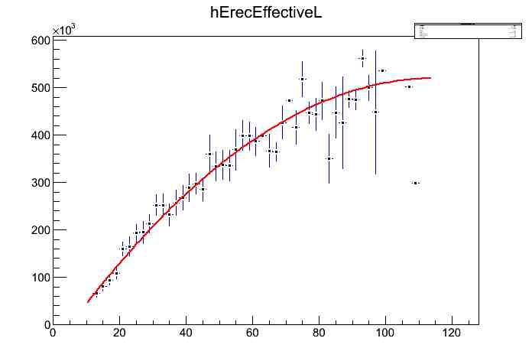
Correction using ‘shower length’ is better for TeV energies
Correction using ‘Effective shower length’ is better for PeV energies
Here we have used ‘Effective shower length’ for all energies. Hence the analysis is
optimized for the highest energies
The correction parameters depends very weekly on energies (logarithmically).
Recursive energy correction converge to the right parameters set.
1 PeV
Correction 2 deg polynomial
Signal (GeV)
Effective shower length (cm)

Slide 12
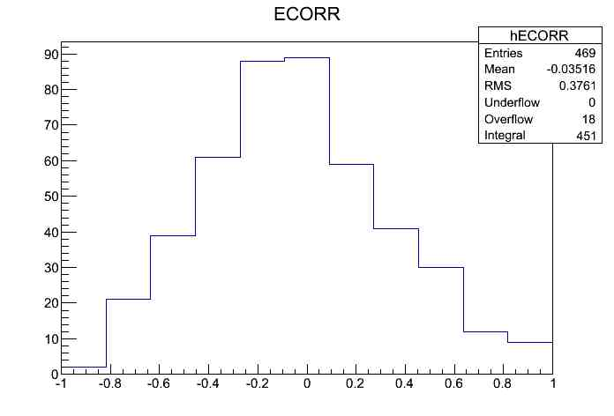
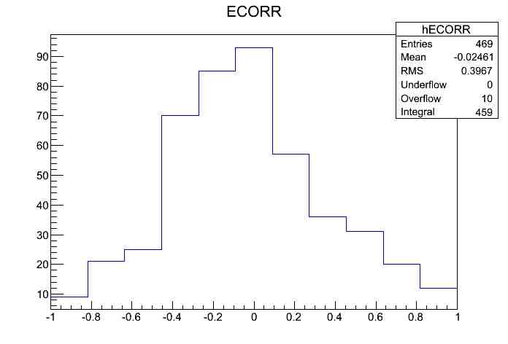
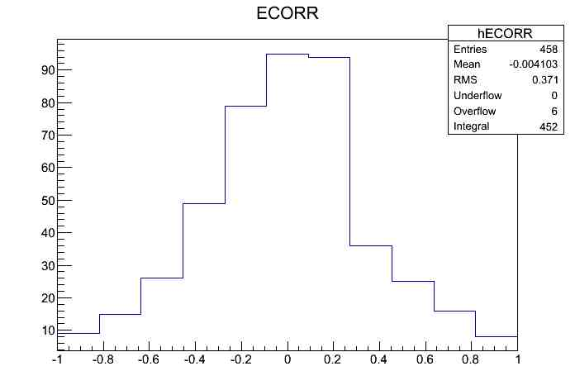
PROTON ENERGY RESOLUTION
10 TeV
100 TeV
RMS=38%
A_{eff}=4,9 m² sr
RMS=40%
A_{eff}=5 m² sr
(E-E_{true})/E_{true}
(E-E_{true})/E_{true}
1 PeV
Resolutions and A_{eff} depend
on cuts. Here are optimized for
large acceptance.
RMS=37%
A_{eff}=4,8 m² sr
(E-E_{true})/E_{true}

Slide 13
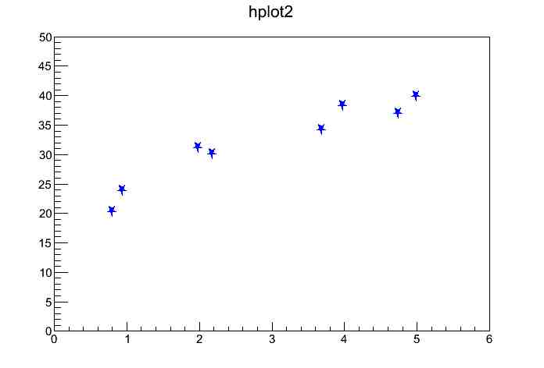
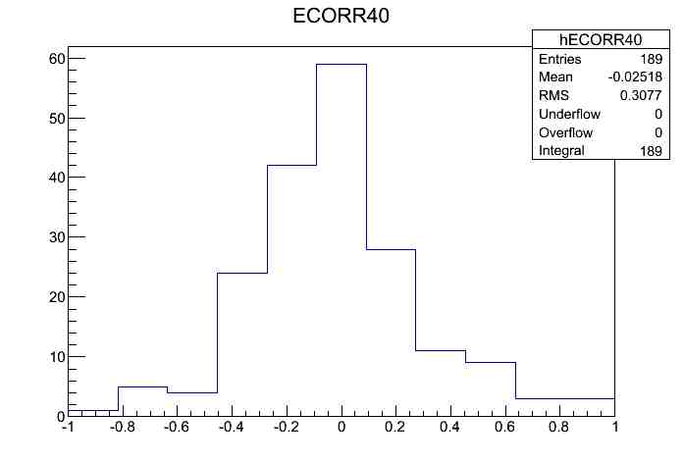
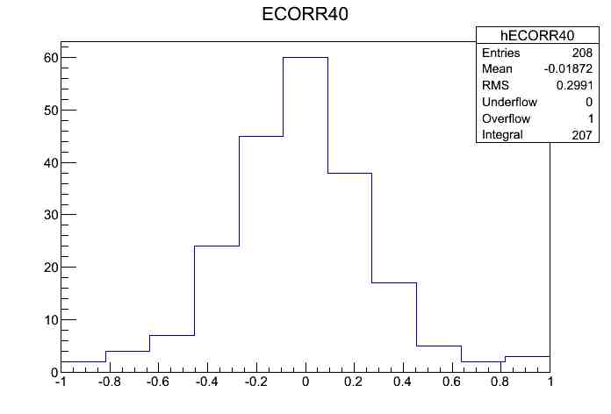
Varying the cuts
RMS %
100 TeV
1 PeV
A_{eff} (m²sr)
1100TeV
1 PeV

Slide 14
NUCLEI
100 TeV
RMS %
A_{eff} (m²sr)

Slide 15
OPTIMIZATION FOR VERTICAL GAMMAS
Without shift
Energy Resolution>3%
X-Y gap optimization
X-Y plane shift IN PROPER WAY
illumination 60x60 cm² around center to avoid lateral leackage
tungsten layer above the calorimeter to allow conversion (tracker like)

Slide 16
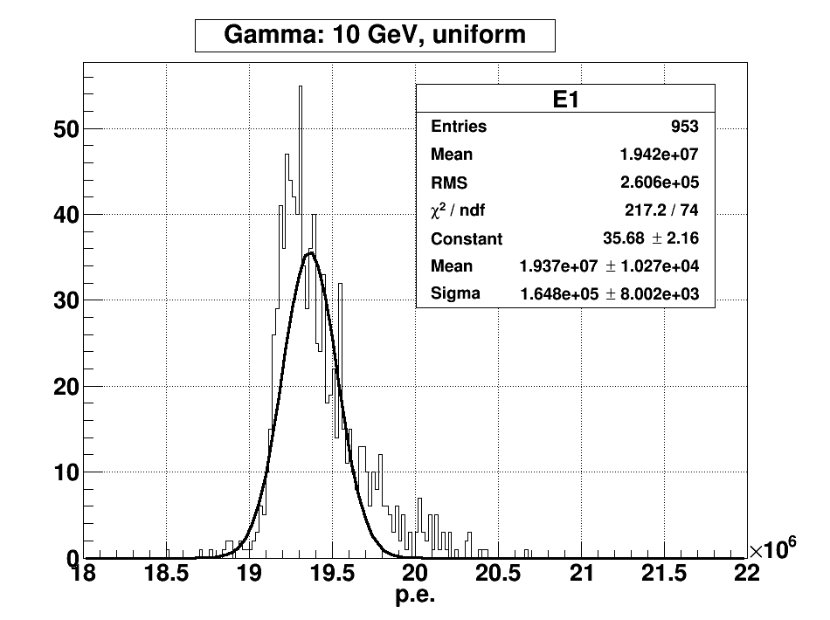
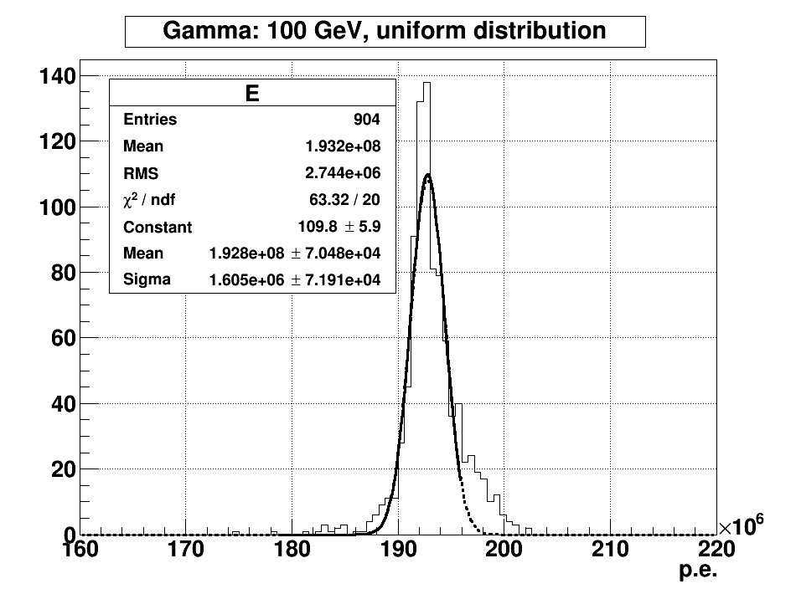
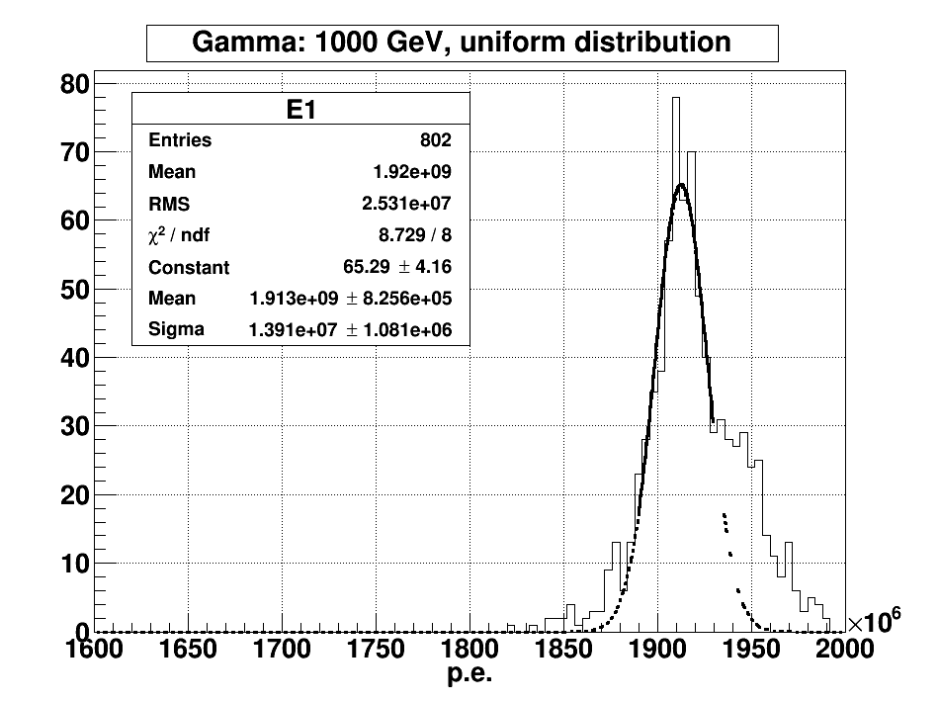
VERTICAL GAMMA RAYS - 2014 analysis
e+,e-
photodiode
1 mm X-Y gap - planes shifted - sensor on top faces
σ =0,85%
σ =0,83%
σ =0,72%
RMS=1,3%
RMS=1,4%
RMS=1,8%
The gamma rays total signal distribution for energies: 10 GeV, 100 GeV and 1 TeV. The incident position is uniform on the top of the calorimeter.
Gamma rays energy | Energy resolution σ
10 GeV | 0.86%
100 GeV | 0.83%
1 TeV | 0.73%
1mm X-Y gap is hard to obtain ( possible mechanical problems , vibrations ...... )

Slide 17
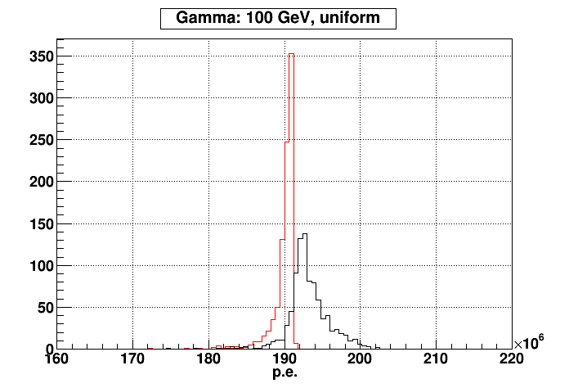
P,e
The signal due to direct ionization of photodiode (sensor)
is weak : in average ~1,7% of the signals due to crystals
but it has large fluctuations depending on x-y particle entering
point in the calorimeter.
e+,e-
photodiode
crystal
No
Sensor signal
added
The signal from sensor,
if not discriminated,
enlarge the distribution
and create the right tail
With sensor
Signal contamination

Slide 18
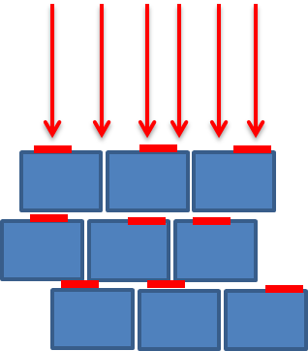
NEW RESULTS AND CONFIGURATION 2015
SENSOR ON LATERAL FACES
OPTIMIZED PLANES SHIFT
LARGER X-Y GAP (better for mechanics)
DELTA X (cm) | DELTA Y (cm)
0.801 | -1.385
-1.53 | -0.47
-0.12 | 1.59
1.58 | -0.24
-0.58 | -1.49
-1.32 | 0.9
1.17 | 1.09
0.12 | -1.59
-1.59 | 0.24
0.58 | 1.49
1.32 | -0.9
-1.17 | -1.1
-0.8 | 1.38
0 | 0
New configuration
Previous configuration
MINIMIZE THE EFFECT OF
SENSORS ON RESOLUTION

Slide 19
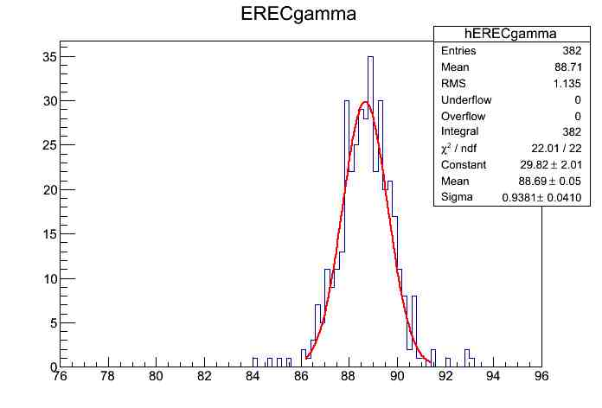
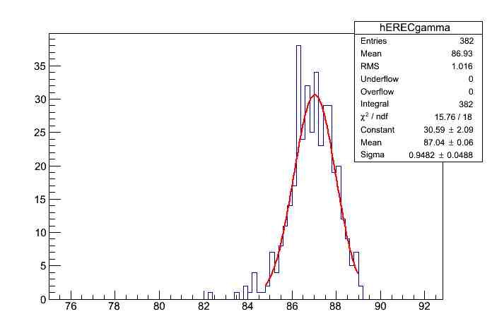
Resolution with new configuration
X-Y gap = 4mm
100 GeV gamma
100 GeV gamma
σ=1,1%
GeV
GeV
With sensor signals
Without sensors

Slide 20
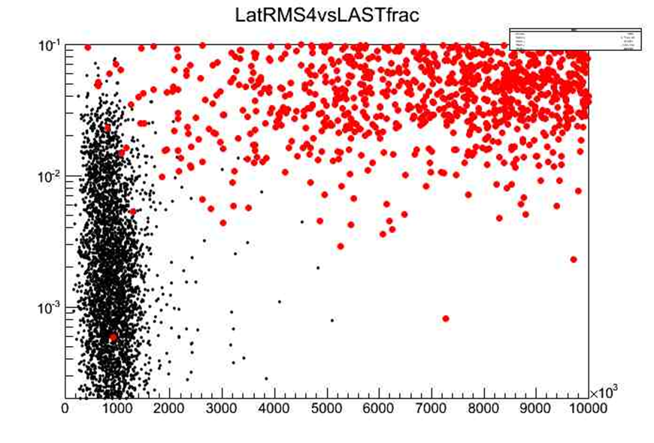

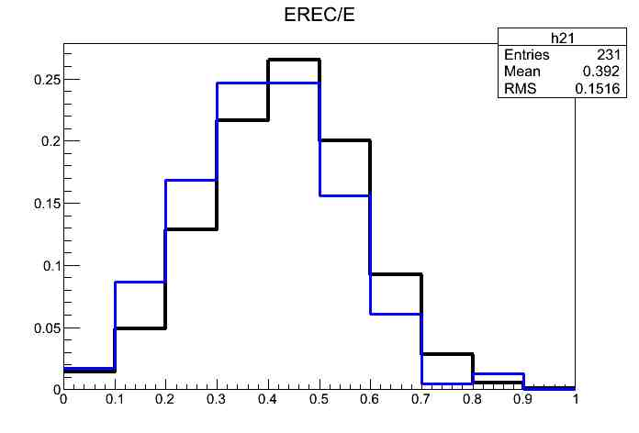


PROTON REJECTION WITH CALOCUBES (20x20x20)
The measure of the electron flux in the TeV energy range with % proton contamination demands a rejection power of the order 10⁵
PARTICLES propagation & detector response simulated with FLUKA
GEOMETRICAL CUTS FOR SHOWER CONTAINMENT
CUTS BASED ON LONGITUDINAL AND LATERAL DEVELOPMENT
155.000 PROTONS SIMULATED AT 1 TEV : ONLY 1 SURVIVE THE CUTS
THE CORRESPONDING ELECTRON EFFICIENCY IS 37% AND ALMOST CONSTANT WITH ENERGY ABOVE 500GeV
MC STUDY OF ENERGY DEPENDENCE OF SELECTION EFFICIENCY
AND CALO ENERGY DISTRIBUTION OF MISRECONSTRUCTED EVENTS
LONGITUDINAL
protons
λ1
electrons
$$\frac{dF\left(ν,λ\right)}{dν}$$
10TeV
1TeV
LatRMS4
LATERAL

Slide 21
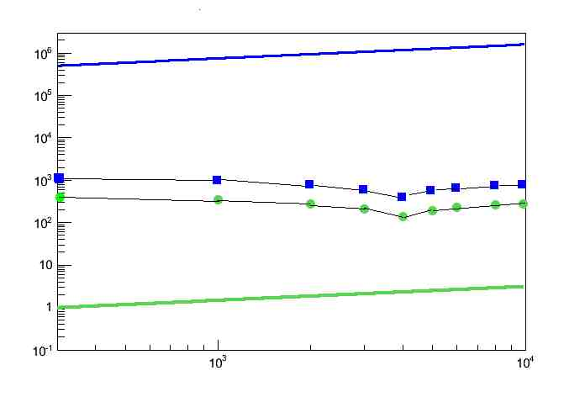
Protons in acceptance(9,55m²sr)/dE
Contamination :
0,5% at 1TeV
2% at 4 TeV
vela
E³dN/dE(GeV² ,s⁻¹ )
Electrons in acceptance(9,55m²sr)/dE
Electrons detected/dE_{cal}
Protons detected as electrons /dE_{cal}
E(GeV)
$\frac{Protons in acceptance/dE}{Protons detected as electrons/dEcal}\left(E=Ecal\right)$ = $\frac{1}{6,4 {10}^{−6} ∙0,3}$ = 0,5 x 10⁶
$\frac{Protons in acceptance/dE}{Protons detected as electrons/dEcal}\left(E=Ecal\right)$ X Electron Eff. ~ 2 x 10⁵

