Slide 1
A SUPER-WIDE FIELD OF VIEW CHERENKOV TELESCOPE
J. Cortina, R. López-Coto, A. Moralejo. R. Rodríguez
Pizza seminar
June 3rd, 2015

Slide 2
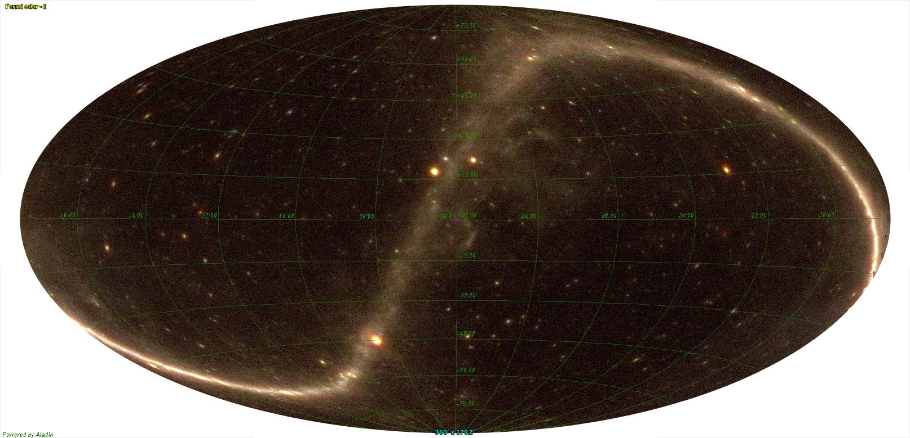
IACTs are pointing instruments
The whole sky = 42000 deg²
Fermi sky (photons in 2 years)
Field of View (FOV) of a typical IACT (HESS ~20 deg², CTA-SCT~50 deg²)
By the way, compare with “wide FOV” in optical telescopes: DECam has 4 deg², SDSS has 7 deg^{2,} LSST will have 10 deg²

Slide 3
Surveys with IACTs
Say we need 10h to achieve enough sensitivity. We would need 10000 hours to scan the whole sky: telescopes need ~10 years to collect them.
It is achievable but there are many other ideas to exploit an IACT for 10 years.
As a result only a survey of the galactic plane has been performed (HESS, about 1000 deg²). Adding all pointing observations, we may have explored ~5% of the sky.
What is in the other 95% of the sky? Active galaxies, off-plane galactic sources, dark matter clumps? It’s becoming a must to make a Full sky survey in VHE.
What it’s more, the VHE sky is changing all the time, so we would need to repeat the survey for a few years and we’d very much like to monitor it every night.

Slide 4
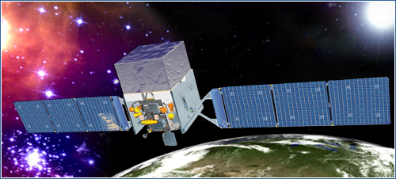
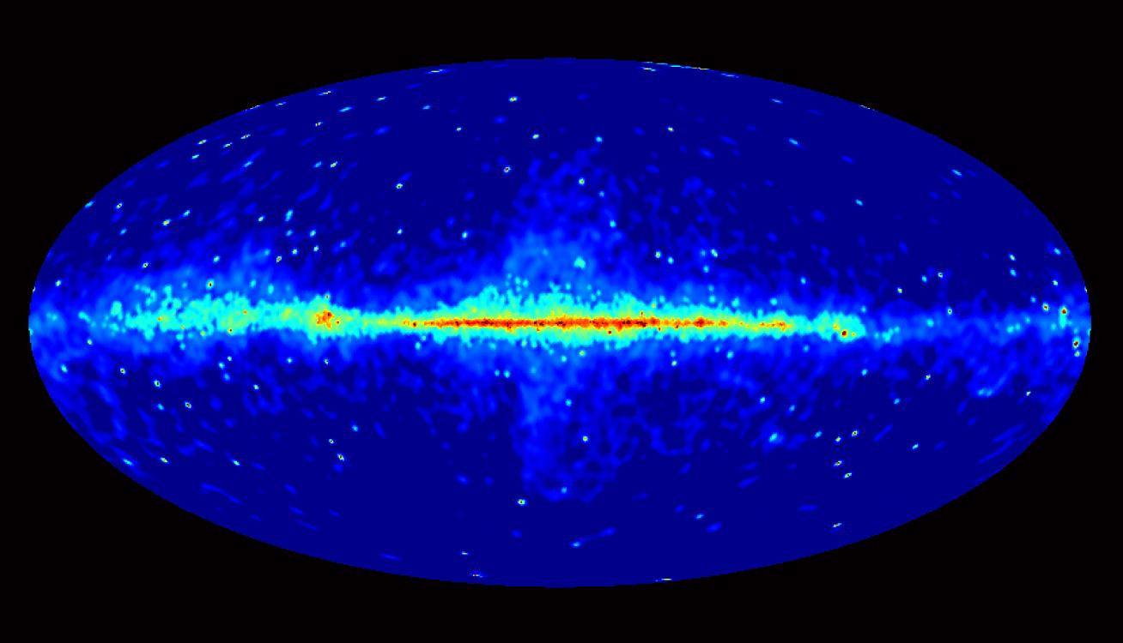
E_{γ}<10-100 GeV: space based surveys
Fermi-LAT
Taking data since 2008, scans full sky every 3h.
Has discovered thousands of sources.
Very small collection area for >10 GeV observations.
Energy range: max <100 GeV.
Angular resolution ~0.1° i.e. as good as IACTs.
No obvious replacement for Fermi-LAT in the future (>2020?)

Slide 5
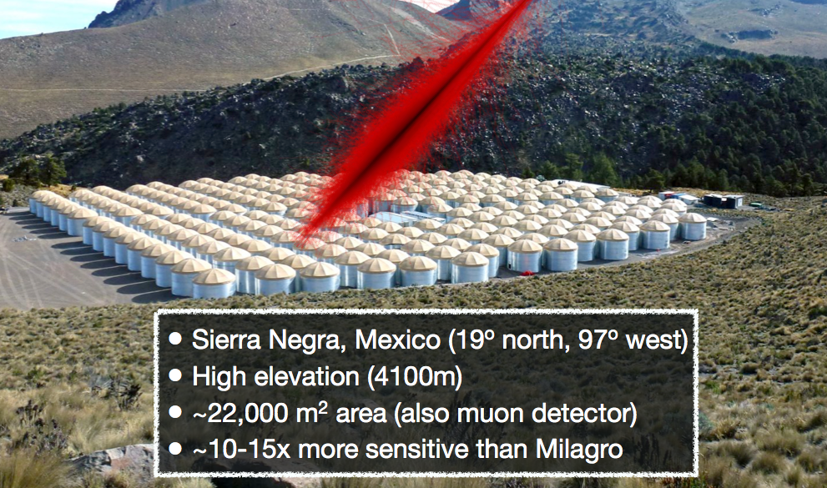
E_{γ}>1 TeV: surveys with non-IACTs
HAWC
Just started to take data
Fully operative from 2014. Sierra Negra, Mexico (19°N, 97°W).
~10-15x more sensitive than Milagro.
Angular resolution ~1°.
Hadron rejection poorer than IACTs, i.e. worse sensitivity
Energy range: >1 TeV.
Larger: HiSCORE in Russia, LHASSO in China, under construction, but targeting much higher energies

Slide 6
The archetypal wide FOV telescope: the Schmidt telescope
How to build a Schmidt:
STEP 1. Start with a spherical mirror. It has aberrations but only spherical aberrations.
ray
Radius of sphere=R
Focal length=R/2
Radius of curvature=R

Slide 7
The archetypal wide FOV telescope: the Schmidt telescope
STEP 2. Make the focal plane spherical, with center at center of mirror. All incident directions become equivalent.
ray
Radius of sphere=R
Focal length=R/2
Radius of curvature=R

Slide 8
The archetypal wide FOV telescope: the Schmidt telescope
STEP 3. As rays hit further and further away from optical axis, they get more a more defocused.

Slide 9
The archetypal wide FOV telescope: the Schmidt telescope
STEP 3. As rays hit further and further away from optical axis, they get more a more defocused. Add a “stop”.

Slide 10
The archetypal wide FOV telescope: the Schmidt telescope
STEP 3. Considering all incident directions: where shall we place the “stop”?
At the mirror’s center of curvature, so that all directions remain equivalent.
Sphere radius R
Focal length=R/2

Slide 11
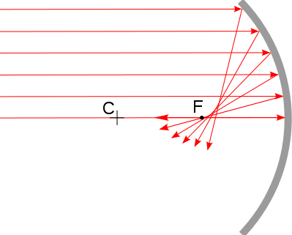
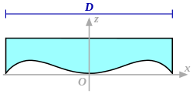
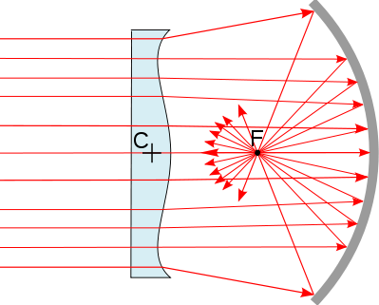
The archetypal wide FOV telescope: the Schmidt telescope
STEP 4. Add the “world-famous” Schmidt corrector plane at the stop. That eliminates spherical aberrations.

Slide 12
The archetypal wide FOV telescope: the Schmidt telescope
Well, let’s build a “Schmidt IACT”!
This has been proposed: Mirzoyan & Andersen, APP 31 (2009) 1, with D=7m mirror, FOV ø=15°, f/D=0.8, PSF RMS=1 arcmin.
Unfortunately:
For the corrector plate they propose a 7m ø PMMA Fresnel lense of 17mm max thickness: challenging!
It has chromatic aberration (yeah, it’s a lens!)

Slide 13
De-construct a Schmidt
4. Add the “world-famous” Schmidt corrector plane at the stop. That eliminates (first order) spherical aberrations.
We live with the aberration because IACT require poor optics

Slide 14
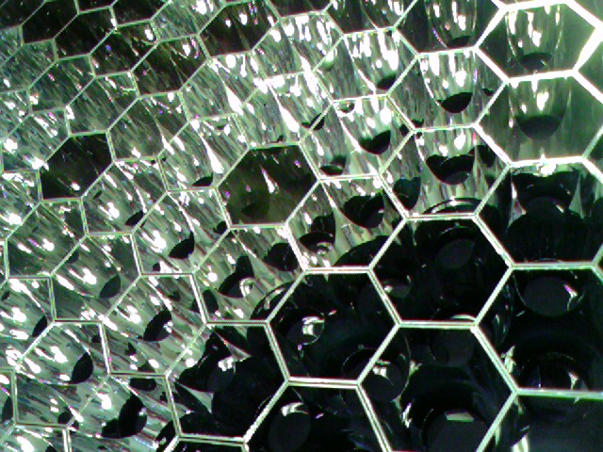
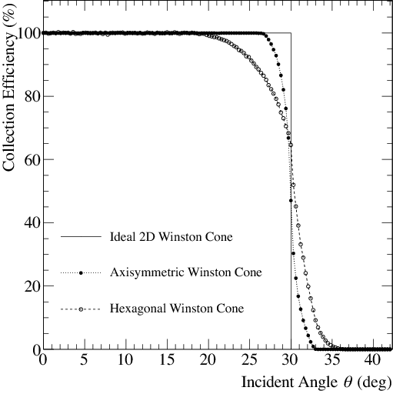
De-construct a Schmidt
STEP 3. As rays hit further and further away from optical axis, they get more a more defocused. Add a “stop”.
Implement it placing a “light concentrator” on each of the pixels
This effectively defines D

Slide 15
No limit to field of view!?!
Since there is no physical stop the aperture does not decrease as we go further and further off-axis. So we can go to any off-axis angle…. as long as we can pay for the mirror!

Slide 16
Or maybe yes…
A limit is set by the shadowing of the camera on the mirror.
Here is an example:
D=12 m, f=17 m (f/D=1.42), circular camera
➔ S_{mirror}=113 m². Plate scale=300 mm/deg
FOV ø (°) | S_{cam} (m²) | On-axis shadowing
5 | 1.77 | 1.6%
10 | 7.1 | 6.3%
15 | 16.0 | 14%
20 | 28.4 | 25%
25 | 44.4 | 40%

Slide 17
Solution: a non-circular camera
z
z
30°
2.5°
x
y
Shadowing = 4.4%

Slide 18
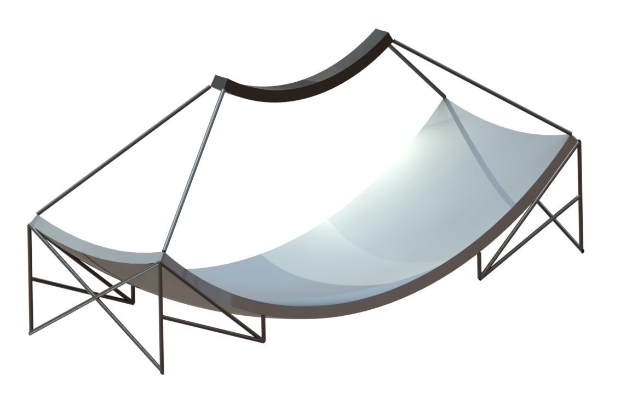
MACHETE= Meridian Atmospheric CHErenkov Telescope
Camera: rectangle of 60° (following the meridian, from south to north) x 5°.
2x
Spherical shape (through spherical facets following general spherical shape)

Slide 19
Field of view
Instantaneous (300 deg²)
Field of View (FOV) of a typical IACT (HESS ~20 deg², CTA-SCT~50 deg²)

Slide 20
Don’t move telescope! Let the sky move!
The whole sky = 42000 deg²
One year (~20000 deg²)

Slide 21
MACHETE: the actual size
15 m
17 m
you
45 m

Slide 22
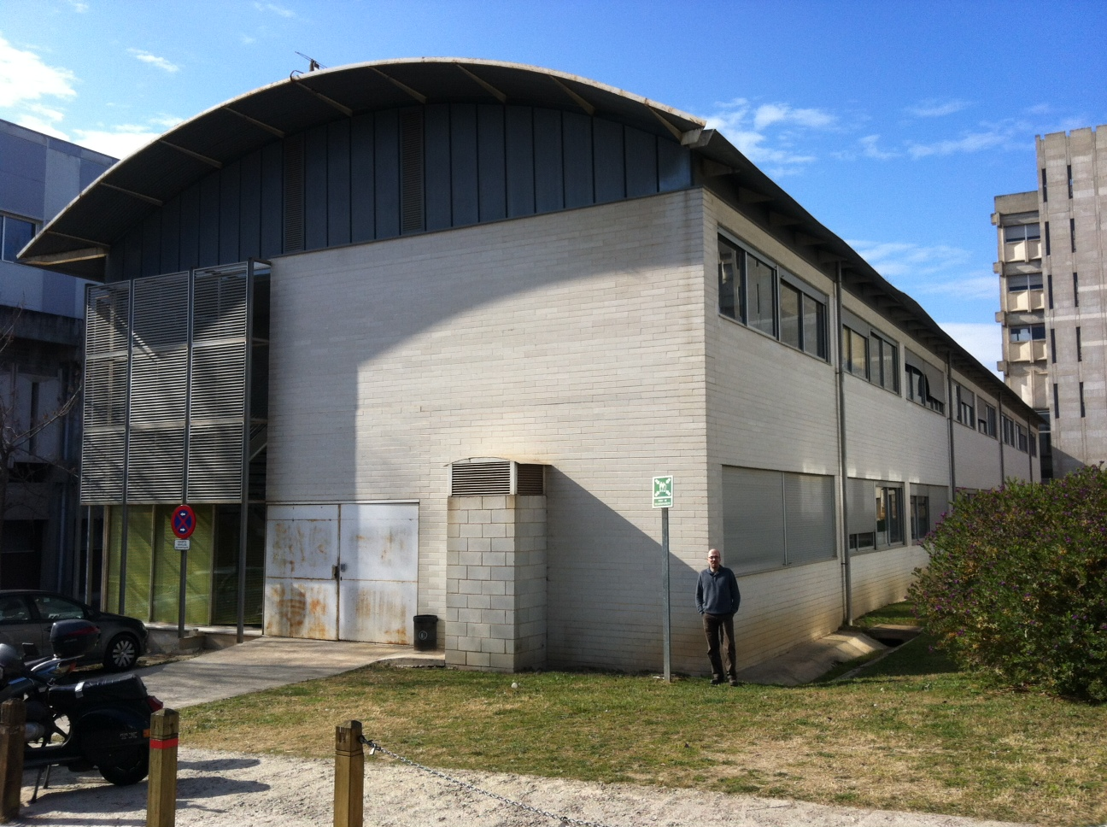
MACHETE: the actual size
15 m
17 m
you
45 m

Slide 23
Performance
Sensitivity:
1yr survey better than HAWC 5yr survey.
Reaches 0.55% crab after 5 year survey. Similar to planned CTA 1000h survey.
1 night sensitivity: 8% crab.
Submitted to Astroparticle Physics
Angular resolution: 0.1° (standard IACT, much better than HAWC)
Spectral resolution: 20-15% crab (standard IACT, much better than HAWC)

Slide 24
Physics with MACHETE
A survey of half of the sky:
New Active Galactic Nuclei.
New galactic sources, especially if built in the south.
Monitor bright VHE sources:
Unbiased light curves of AGN and galactic sources.
Establish unknown duty cycles (e.g. IC-310).
Trigger CTA and other telescopes.
The unknown:
“Dark sources” = sources emitting only in VHE.
Hadronic AGNs
Dark matter clumps?
New types of transients.

Slide 25
Credits

Slide 26
Backup

Slide 27
Sky accessible by MACHETE
Every object in ~half of the sky drifts through the camera of MACHETE.
In one year we integrate ~15 hours for every source.
Sources in ~¼ sky spend about 20 minutes every night on the FOV of the telescopes: search for daily variability for sources and issue triggers to pointing IACTs like MAGIC, CTA etc.

Slide 28
Can we make an IACT with a much wider FOV?
The most popular optics for IACTs are:
Spherical reflector shape, with spherical facets
parallel to the sphere:
Too strong spherical aberration
Parabolic reflector shape, with spherical facets
parallel to the parabola:
No spherical aberration, no aberration for small off-axis angle, but coma for large off-axis. Good timing.
Davies-Cotton, with spherical facets
not parallel to the sphere, but pointing at 2*R:
Moderate aberration at all off-axis angles. Worse timing.
ray
Radius of sphere=R
ray
Focal length=R/2
ray
Radius of sphere=R
Facet radius of curvature=R
Focal length=R/2
Focal length=R
Facet radius of curvature=R
Facet radius of curvature=2*R

Slide 29
Can we make an IACT with a much wider FOV?
The most popular optics for IACTs are:
Spherical reflector shape, with spherical facets
parallel to the sphere:
Too strong spherical aberration
Parabolic reflector shape, with spherical facets
parallel to the parabola:
No spherical aberration, no aberration for small off-axis angle, but coma for large off-axis. Good timing.
Davies-Cotton, with spherical facets
not parallel to the sphere, but pointing at 2*R:
Moderate aberration at all off-axis angles. Worse timing.
ray
Radius of sphere=R
ray
Focal length=R/2
ray
Radius of sphere=R
Facet radius of curvature=R
Focal length=R/2
Focal length=R
Facet radius of curvature=R
Facet radius of curvature=2*R
MAGIC, HESS-II, LST
VERITAS, HESS-I, MST

Slide 30
Can we make an IACT with a much wider FOV?
MST:
Pretty large FOV ø=7°.
Davis-Cotton mount with f=16 m, D=12 m (f/D=1.35).
Pixel size=0.18°.
PSF: r80%= 0.015° on-axis going up to 0.07° for off-axis=2.8°. Beyond that off-axis angle, PSF grows fast.

Slide 31
Optical parameters
I’ve optimized some of these parameters using the ray-tracing program ZEMAX and used it to calculate the PSF (which btw is not gaussian)
 | D=12m, f=17m, f/D=1.42
Plate scale | 300 mm/deg
PSF r_{80%} | 0.07° for whole FOV (MAGIC: 0.07°on-axis —0.16° at 1.8° off-axis, MST: 0.02°on-axis —0.07° at 2.8° off-axis)
ø_{pix}=2r_{80%} | 0.14° = 42 mm
Total mirror surface | 619 m²
Mirror surface viewed by a pixel | 113 m²
Camera FOV | 60° × 5° = 300 deg²
Number pixels | 20 000
On-axis shadowing | 4.4%
Δt_{max} | 3 ns

Slide 32
Camera
5°
40 pix
1.5m
60° : 500 pixels : 18m

Slide 33
Camera
5°
40 pix
1.5m
60° : 500 pixels : 18m
Showers have a typical size ~<1°, so we only need to read out a small fraction of the camera (2°x2° = 256 pixels?).
A fast local trigger identifies those channels and selects a Region of Interest (RoI).
We use an “electronic switch” to connect the RoI to a limited number of fast digitizers.

Slide 34
Use your imagination
This was just an example of an innovative technical solution which can be applied to this telescope. There are many others, because it is a very unconventional design. Just to mention a few:
Weight is not so much an issue because the telescope doesn’t move: we could go for copper cables and digitize far from the camera (internet cables reaching 100 m are now available).
Mirrors have no strong weight limitations. One can go much cheaper by using heavier technologies like a thick glass blank (<~1000 €/m²).
The mirror facets probably need to be realigned once every over 5-10 years, but how do you align them at all (LEDs hanging from a crane, photogrammetry?).
We need light concentrators with a sharp angular response function. Winston Cones? We would actually benefit from higher concentration (going to solid concentrators?)
PMTs are prohibitively expensive and only SiPM hold a promise to go <1 $/mm². When? Can we play any tricks like the “light trap”?

Slide 35
Cheap?
If MACHETE is too expensive, we just wait for standard IACTs like CTA to do the survey. Can we make it cheap enough so that it’s competitive?
Good: no need for steering mechanics, hardly any moving parts, mirrors or camera can be heavier.
Bad: 20000 pixels per telescope. 2.6 M€/telescope only for the pixels (assuming 1 $/mm²).
All in all I estimate ~10 M€ for two telescopes.
Compare to MSTs: for 10 M€ you can only build 5. Are 5 MSTs better than a 2-telescope MACHETE when it comes to surveying half of the sky? We need to know the sensitivity of MACHETE and that’s something for the next seminar.

Slide 36
SiPMs for Cherenkov astronomy
SiPMs are the future (everyone claims), but right now they have problems. Only to mention a few:
Crosstalk, afterpulses and dark current.
Still expensive: target is 1 $/mm², but right now factor 3-5 more.
PDE (photon detection efficiency) already good at blue (400-500 nm, KETEK: 60%) but not very good at UV (<300-400 nm, ~30%).
PDE is too good >500 nm! (KETEK: 50% at 500 nm, 30% at 600 nm), where there’s little Cherenkov but lots of NSB.
Not available in size>9x9 mm². Size>1.5x1.5 mm² very expensive. For an IACT with ø>10 m a pixel is typically >100 mm².

