Slide 1
Design, integration and prototype manufacturing
Hana HAVLIKOVA, Cedric GARION
20/02/2023

Slide 2
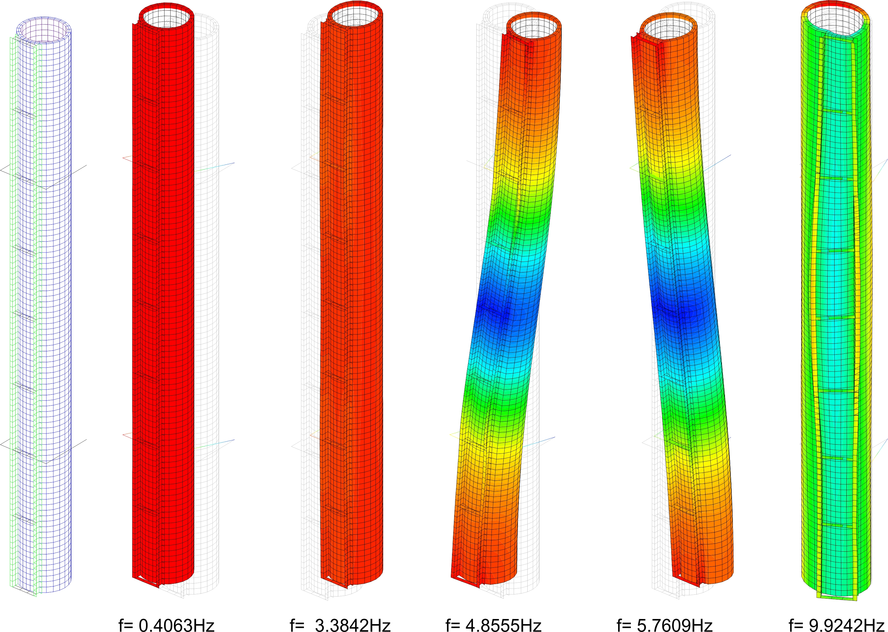
Initial vibration analysis
$$ω=\sqrt{\frac{g}{h}}$$
$$ω=\sqrt{\frac{k}{M}}$$
Hana HAVLIKOVA, Cedric GARION | Design, integration and prototype manufacturing

Slide 3
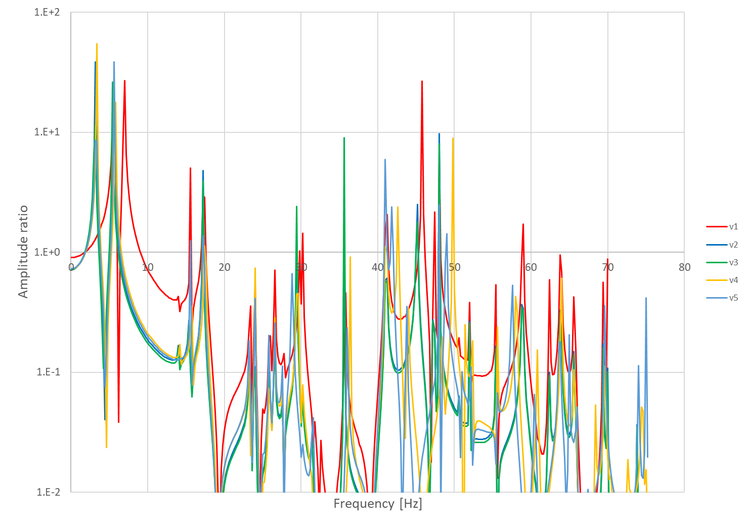
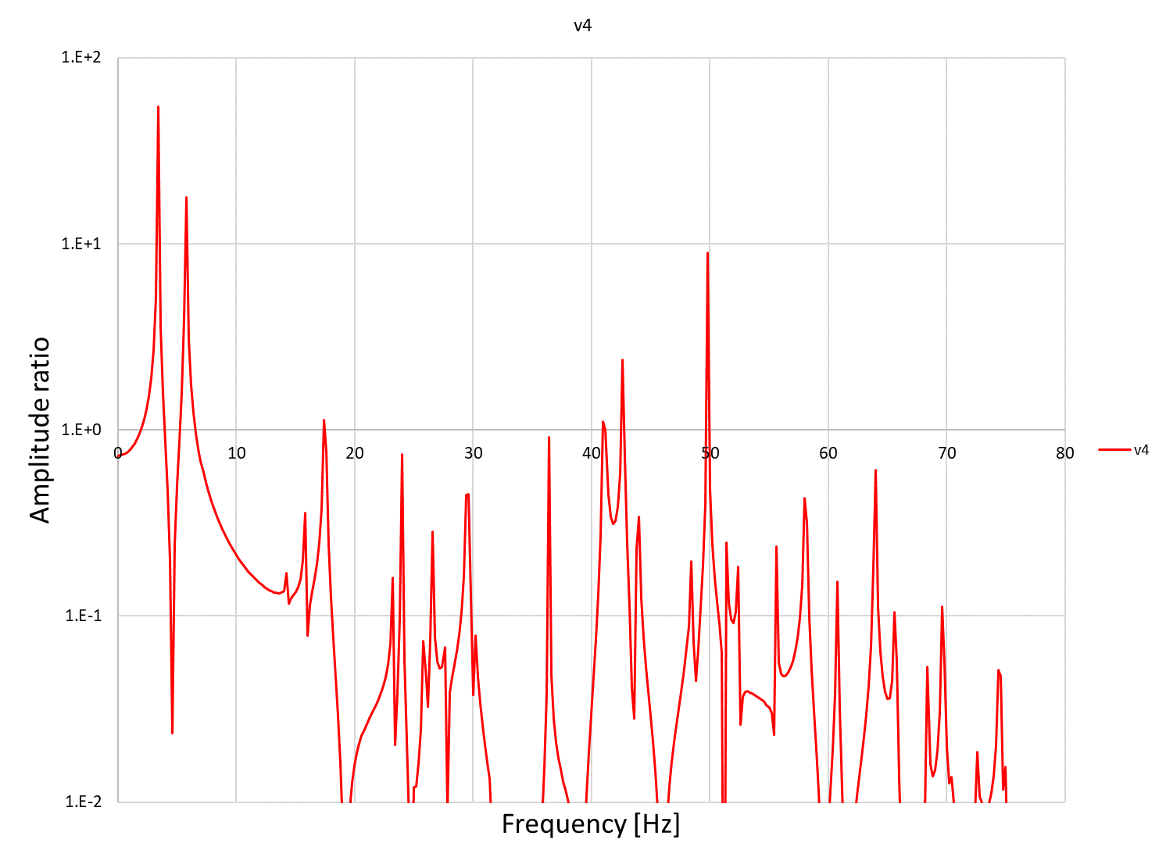
Ground motion in vertical direction

Slide 4
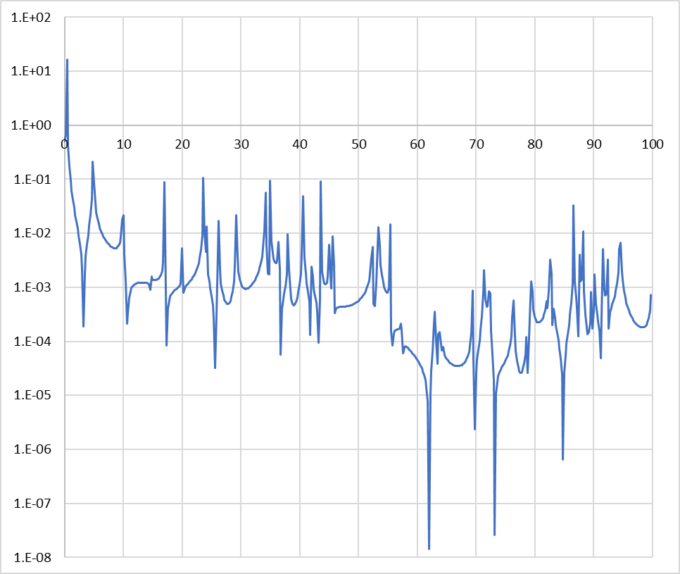
Ground motion in horizontal direction

Slide 5
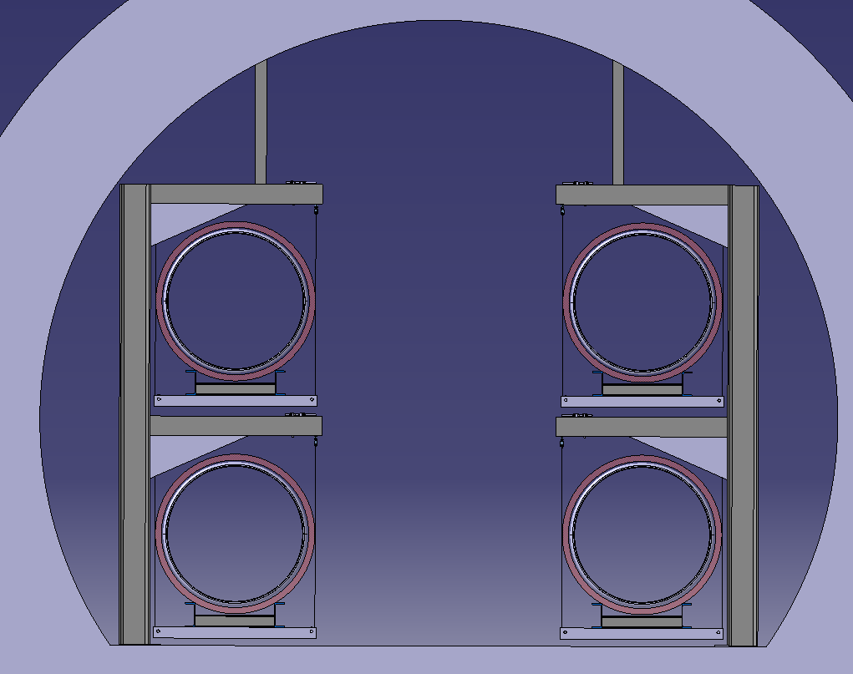
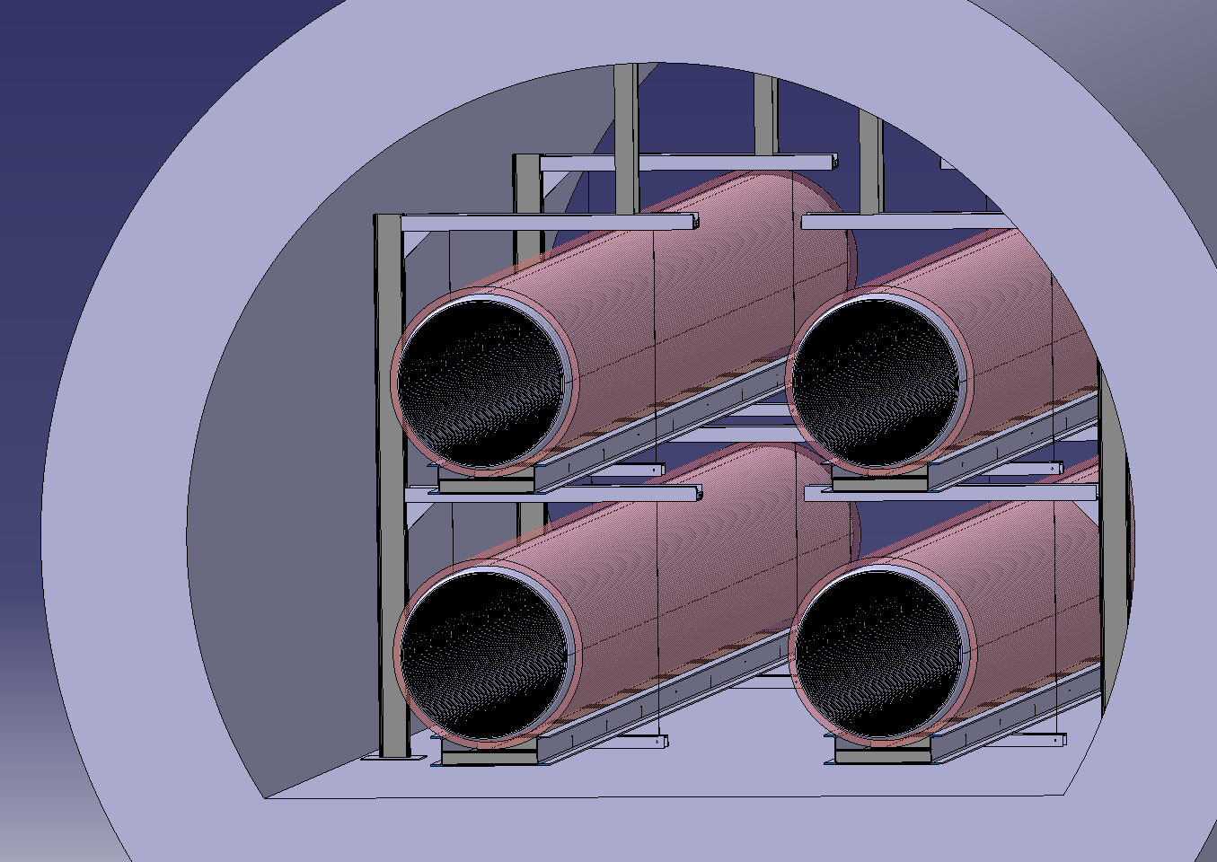
ET tunnel layout
Passage width: 1,8 m
Depending on the tunnel floor heigh
~ 1.7 m
~ 1.8 m
~3.72m
Hana HAVLIKOVA, Cedric GARION | Design, integration and prototype manufacturing

Slide 6
Thank you for your attention!

