Slide 1
a Very Interesting Presentation
Gerard Ariño Estrada
10th June 2015

Slide 2
Warning!
This presentation is a summary of the work in the VIP project and it does not contain new data or future plans

Slide 3
Something about PET

Slide 4
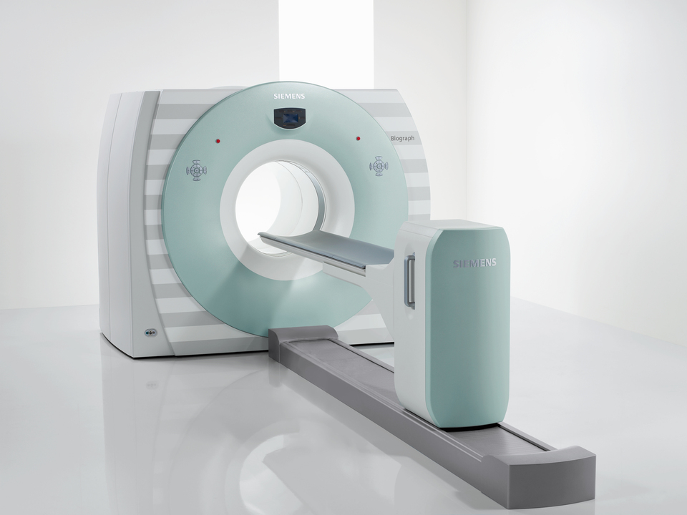
Positron Emission Tomography (PET)
Technique of nuclear medicine that uses positron emitter radioactive sources for the diagnostic of human diseases
Non-invasive techniques
Provides sensitive in-vivo measurements of physiologic processes in the body.
Used to diagnose:
Tumor metastases
Brain pathologies
Coronary pathologies
Staging and planification
of radiotherapy treatment
Study of the physiopathology
of brain diseases
Image from www.healthcare.siemens.com

Slide 5
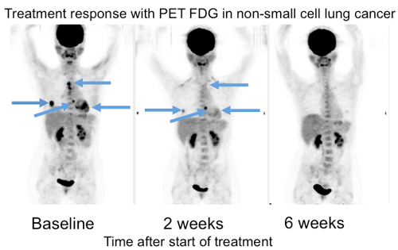
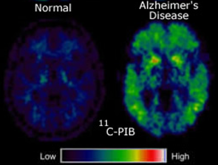
PET Images
Brain PET Image
Whole body PET (WB-PET) Image
Image from Peter E. Valk, et al. Positron Emission Tomography. Clinical Practice. Lexington KY, 2010.
These PET scans of a patient with lung cancer reveal that within just two weeks of receiving an experimental therapy, some of the metastases have responded favorably and by 6 weeks post treatment, all the metastases responded. Dr. Michael Phelps, David Geffen School of Medicine/UCLA

Slide 6
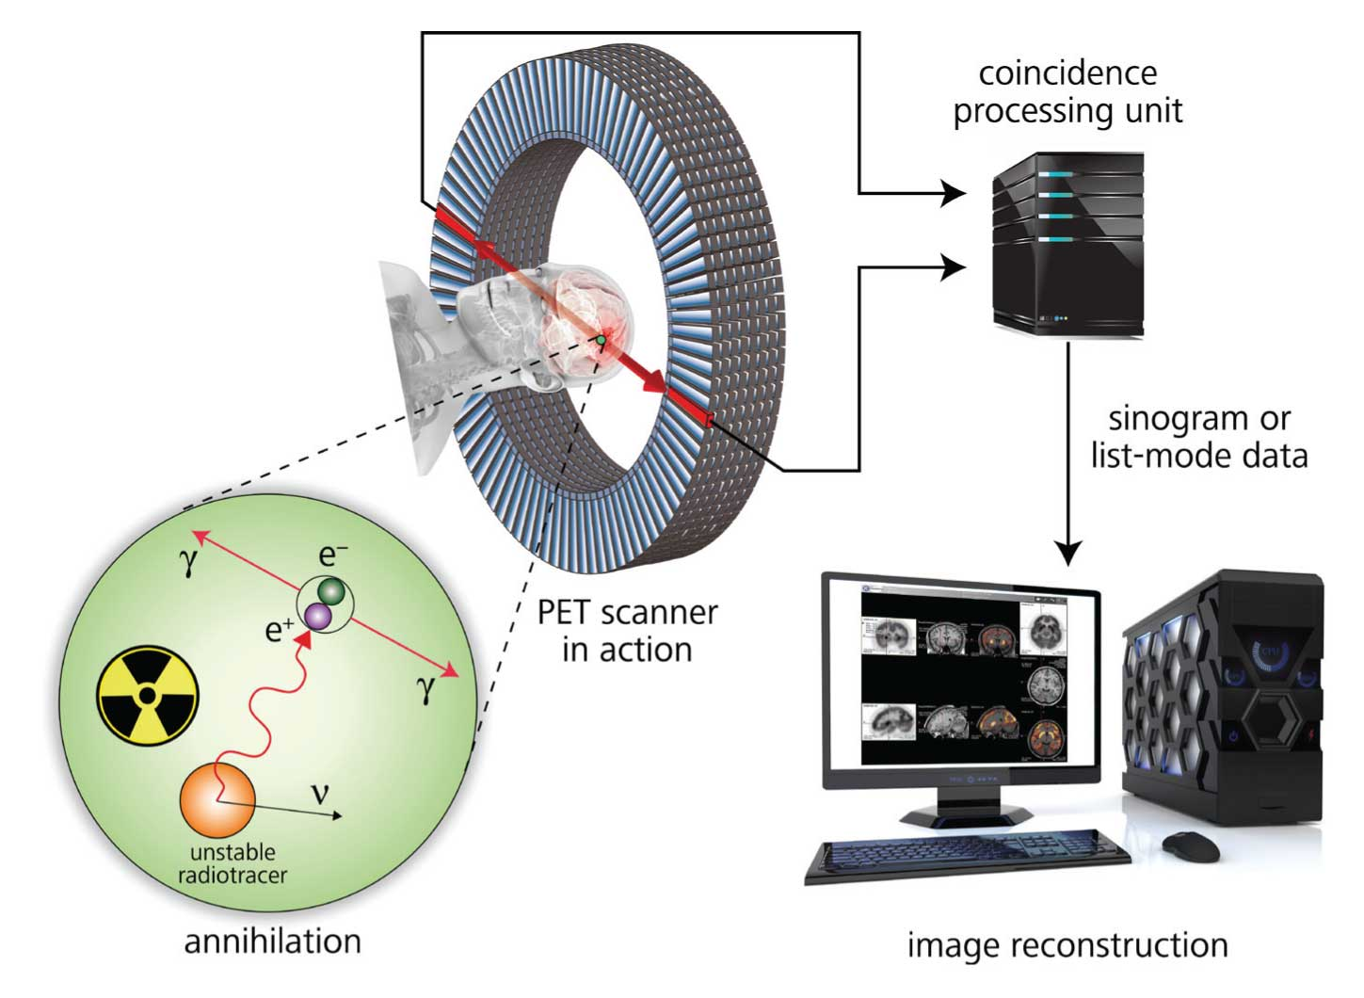
PET Technique
Positron emitter radionuclide
Positrons annihilate with electrons from the media and two 511 keV back-to-back photons are created
Both photons are detected
The position of the two detections describes a Line of Response (LOR)
The LORs acquired are reconstructed to obtain a 3D image
3
4
5
2
1

Slide 7
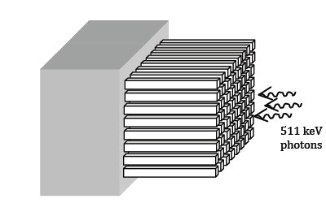
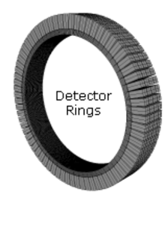
State-of-the-art Detectors for PET
PET scanner
Scintillator crystal
module
-PMT
-APD
-SiPM
z
-Good detection efficiency
-Good timing resolution (<1 ns)
-MRI compatible (APD and SiPM)
-Poor spatial resolution in z (~cm)
-Low energy resolution (>10% @511 keV)

Slide 8
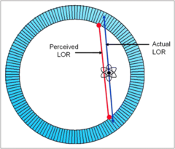
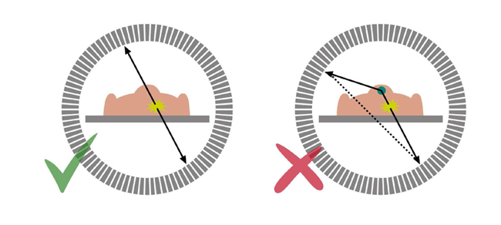
How does it affect to PET?
Spatial resolution: minimize parallax error
PARALLAX ERROR
LOR with high uncertainty!!
(blurring on the image)
Energy resolution: distinguish between true and scatter events
TRUE EVENT
SCATTER EVENT
NOISE!!!
(Lower signal-to-noise ratio (SNR))

Slide 9
Why VIP?

Slide 10
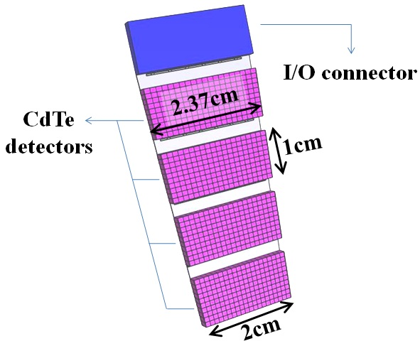
The VIP Module
-Good detection efficiency
(4 cm CdTe)
-MRI compatible
-Good spatial resolution in 3D
(<1 mm)
-Excellent energy resolution
(<2% @511 keV)
Incoming photons

Slide 11
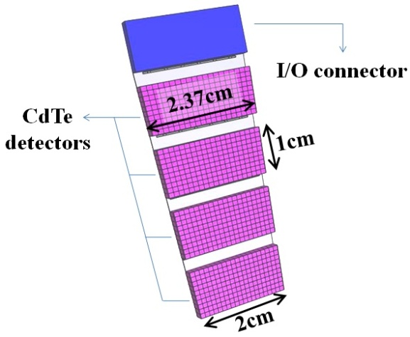
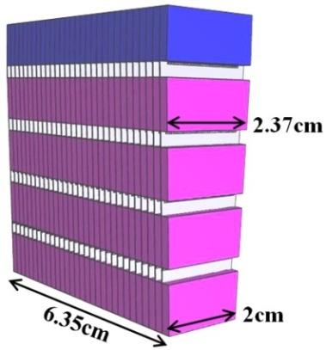
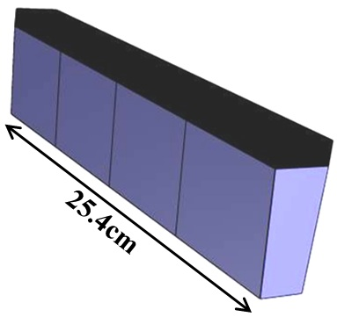
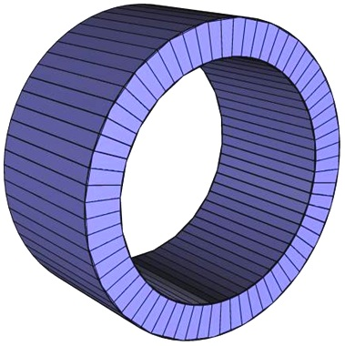
VIP-PET Scanner Design
VIP-Module
VIP-PET Simulation Parameters
Voxels | 6336000
Voxel density | 450 voxels/cm³
Axial length | 25.4 cm
Inner radius | 21 cm
Outer radius | 27 cm
Radial width | 40 mm
CdTe voxel size | 1x1x2 mm³
Coincidence time window | 20 ns
Block (30 modules)
Sector (4 blocks)
Ring (66 sectors)

Slide 12
Expected Performance VIP-PET
Scintillator crystal PET | VIP-PET
Good detection efficiency | Equivalent detector efficiency to Crystal-based PETs
Possible simultaneous PET/MRI scanner (with APD and SiPM) | Simultaneous PET/MR
>30% scatter events | <4% scatter events
Low granularity that creates a blurring on the image | Excellent spatial resolution

Slide 13
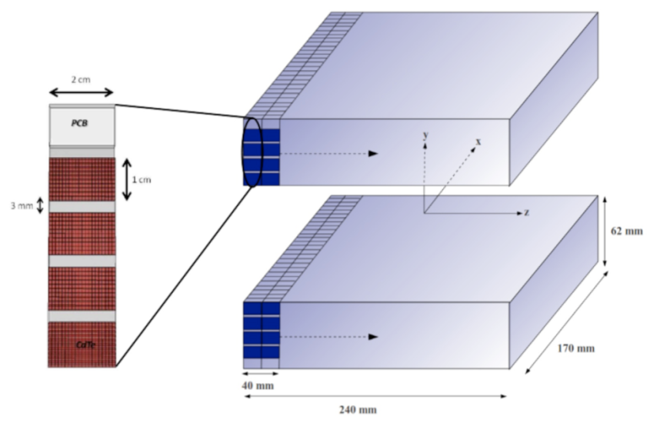
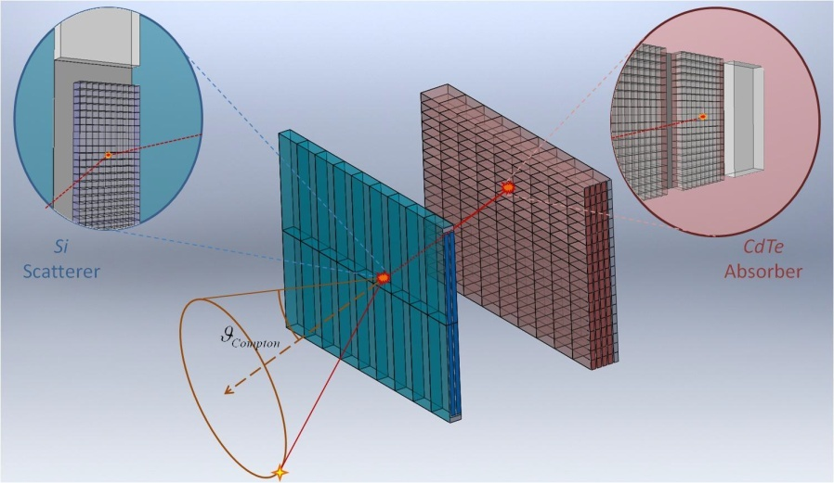
More than just PET
POSITRON EMISSION MAMMOGRAPHY
-PET principle
-Dedicated to the breast only
-Reduced size (low cost!)
Compton Camera
-Single Photon Emission Computed Tomography (SPECT) scanner
-Hadron therapy quality assurance (QA)

Slide 14
How it’s made: VIP

Slide 15
VIP Research Lines
Simulation the performance of VIP-based nuclear medicine scanners
Simulation of the charge induction in CdTe diodes
Study of reconstruction algorithms with VIP data
Development the VIP-PIX ASIC
Building and characterization the VIP-PET prototype

Slide 16
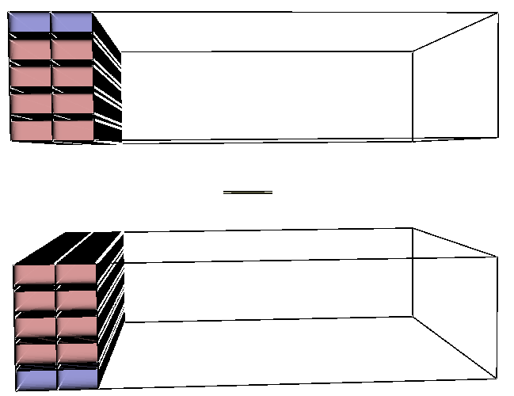
1-Simulation of VIP-based scanners
VIP-PET
VIP-PEM
VIP-Compton Camera

Slide 17
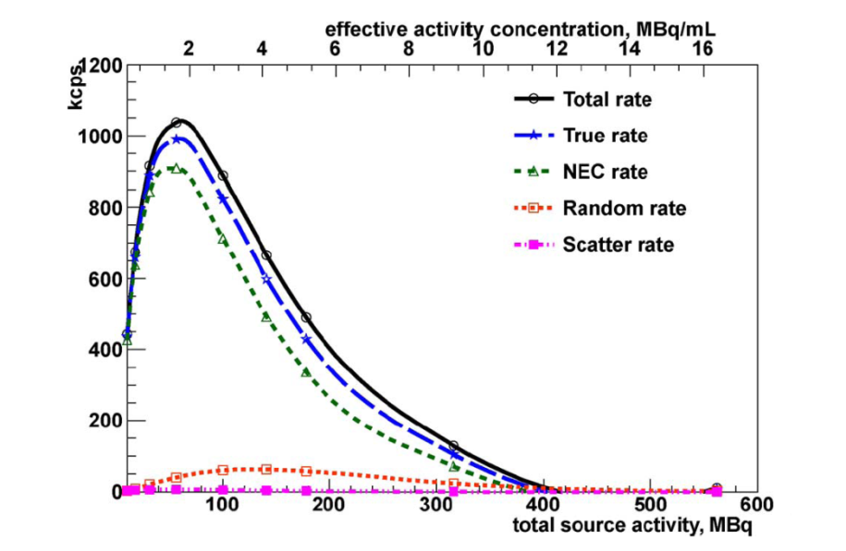
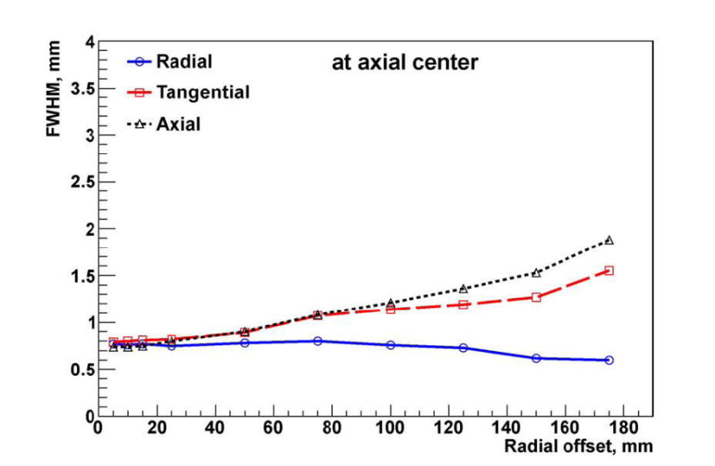
1-Simulation of VIP-based scanners
Simulation results: Sensitivity and Spatial resolution
Rate of true events over Noise Equivalent Count (NEC) rate
Energy resolution in the 3 different dimensions

Slide 18
1-Simulation of VIP-based scanners
VIP-PET Simulation Results
 | ECAT HRRT PET | VIP-PET
Scatter fraction | 45% | 3.95%
Radial res.* [mm] | 3.2 | 0.696
Tangential res.* [mm] | 3.2 | 0.902
Axial res.* [mm] | 3.4 | 1.904
*at 10 cm of the center of the field of view
Published in: E. Mikhaylova, et al. Trans. Med. Im. Vol.33, N.2, Feb 2014.
-Better signal-to-noise ratio, better contrast on the image
-Able to recognize small size objects, small size tumors
-Higher efficiency, reduced dose or scan time

Slide 19
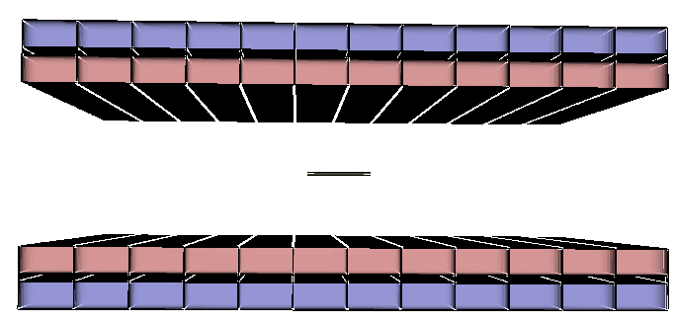
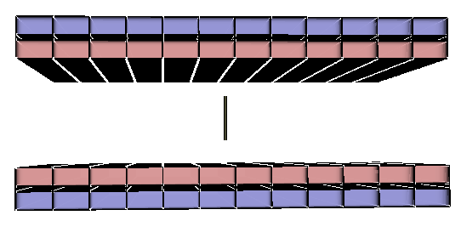
1-Simulation of VIP-based scanners
VIP-PEM Simulation Results
Resolution [mm] | PEM FLEX SOLO II | VIP-PEM
In-plane* | 2.58±0.28 | 1.10±0.10
Cross-plane* | 8.50±0.32 | 1.10±0.12
*30 cm separation between paddles
In-plane
Cross-plane
Able to detect small size objects, premature breast tumors

Slide 20
1-Simulation of VIP-based scanners
VIP-CC Simulation Results
-No commercial Compton cameras for nuclear medicine applications, so far
Published in: M. Kolstein, et al. JINST 9 C04034, 2014.

Slide 21
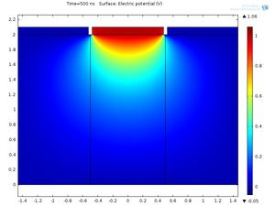
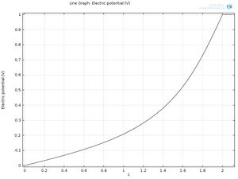
2-Charge Induction Simulation
Electric potential in the CdTe diode
Electric field in the drift direction
Drift direction of e⁻
Drift direction of e⁻

Slide 22
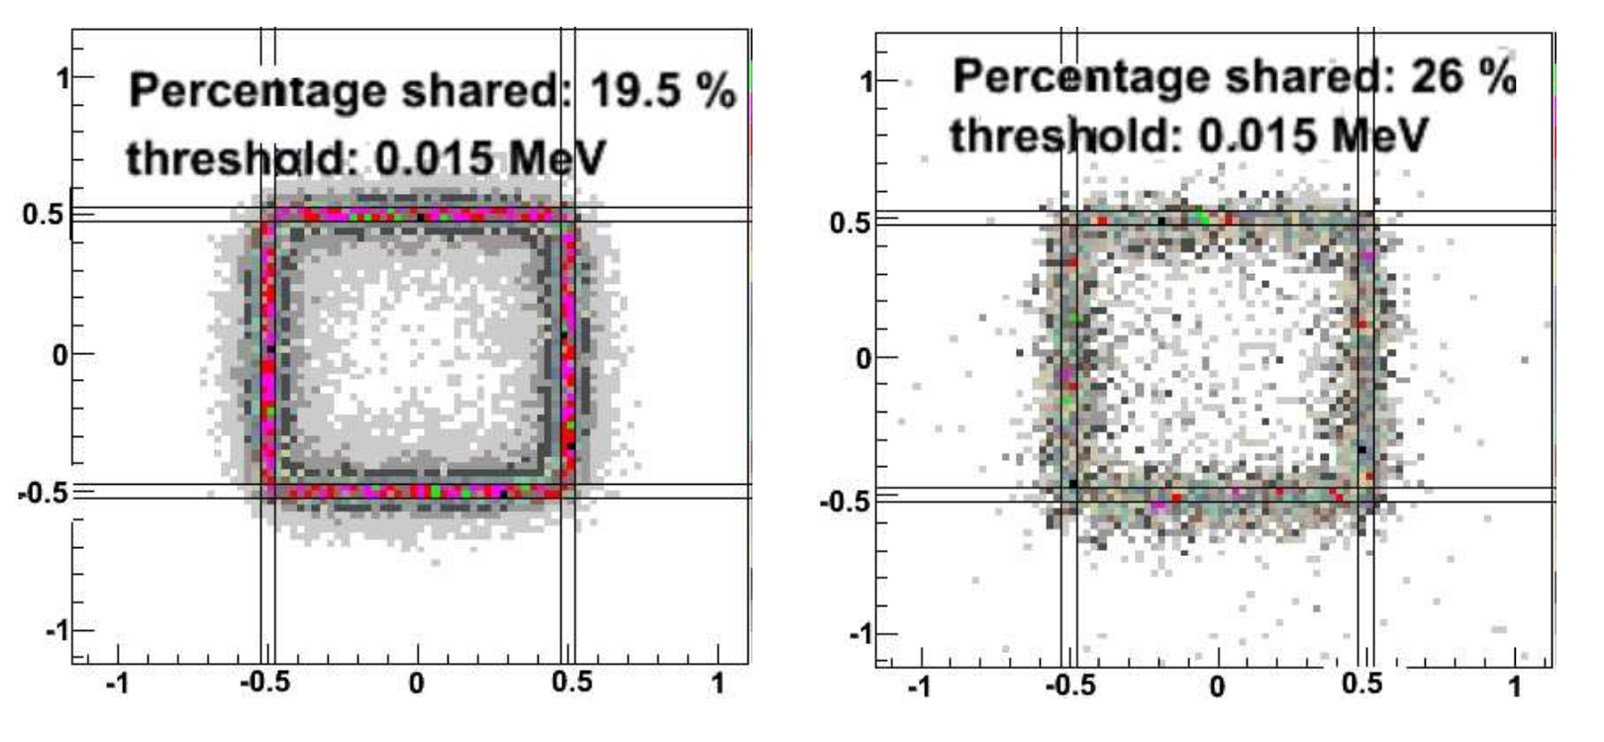
2-Charge Induction Simulation
122 keV photons
511 keV photons
Published in: M. Kolstein, et al. JINST 9 C12027, 2014.
Useful to understand charge sharing among pixels depending on the photon energy and pixel size

Slide 23
3-Image Reconstruction Algorithms
Image reconstruction algorithm to transform photon detections (E, position) into a 3D image
 | Commercial PET | VIP-PET
Channels | ~4x10⁴ | ~6x10⁶
Voxel size | ~10 mm³ | 2 mm³
Signal purity | <70% | >95%
Analytic or iterative algorithm?
Amount of voxels of your scanner?
Required CPU?
Coverage field of view?
Noise/artifacts on the image?
…

Slide 24
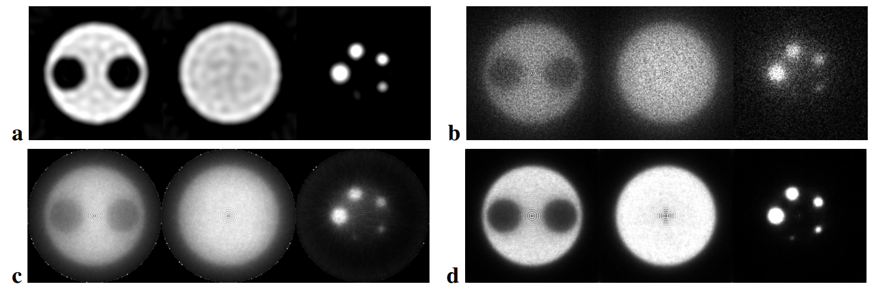
3-Image Reconstruction Algorithms
Filtered BackProjection (FBP)
Origin Ensemble (OE)
Ordered Subset Expectation Maximization (OSEM)
List-Mode OSEM (LM-OSEM)
Published in: E. Mikhaylova, et al. JINST 9 C07004, 2014.
LM-OSEM and FBP show the best performance for the VIP concept

Slide 25
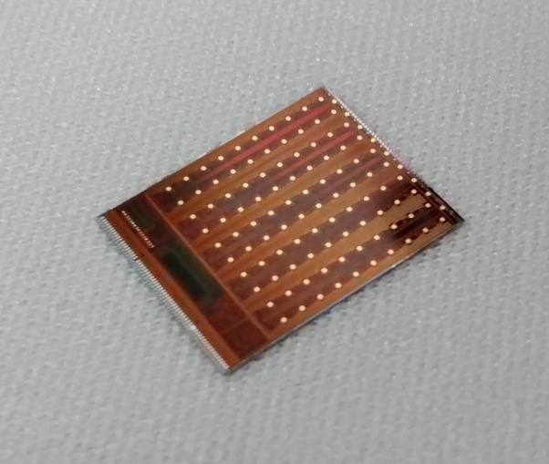
4-VIP-PIX Design and Development
How can I develop a chip?
IFAE
JUNE 2010
JUNE 2014

Slide 26
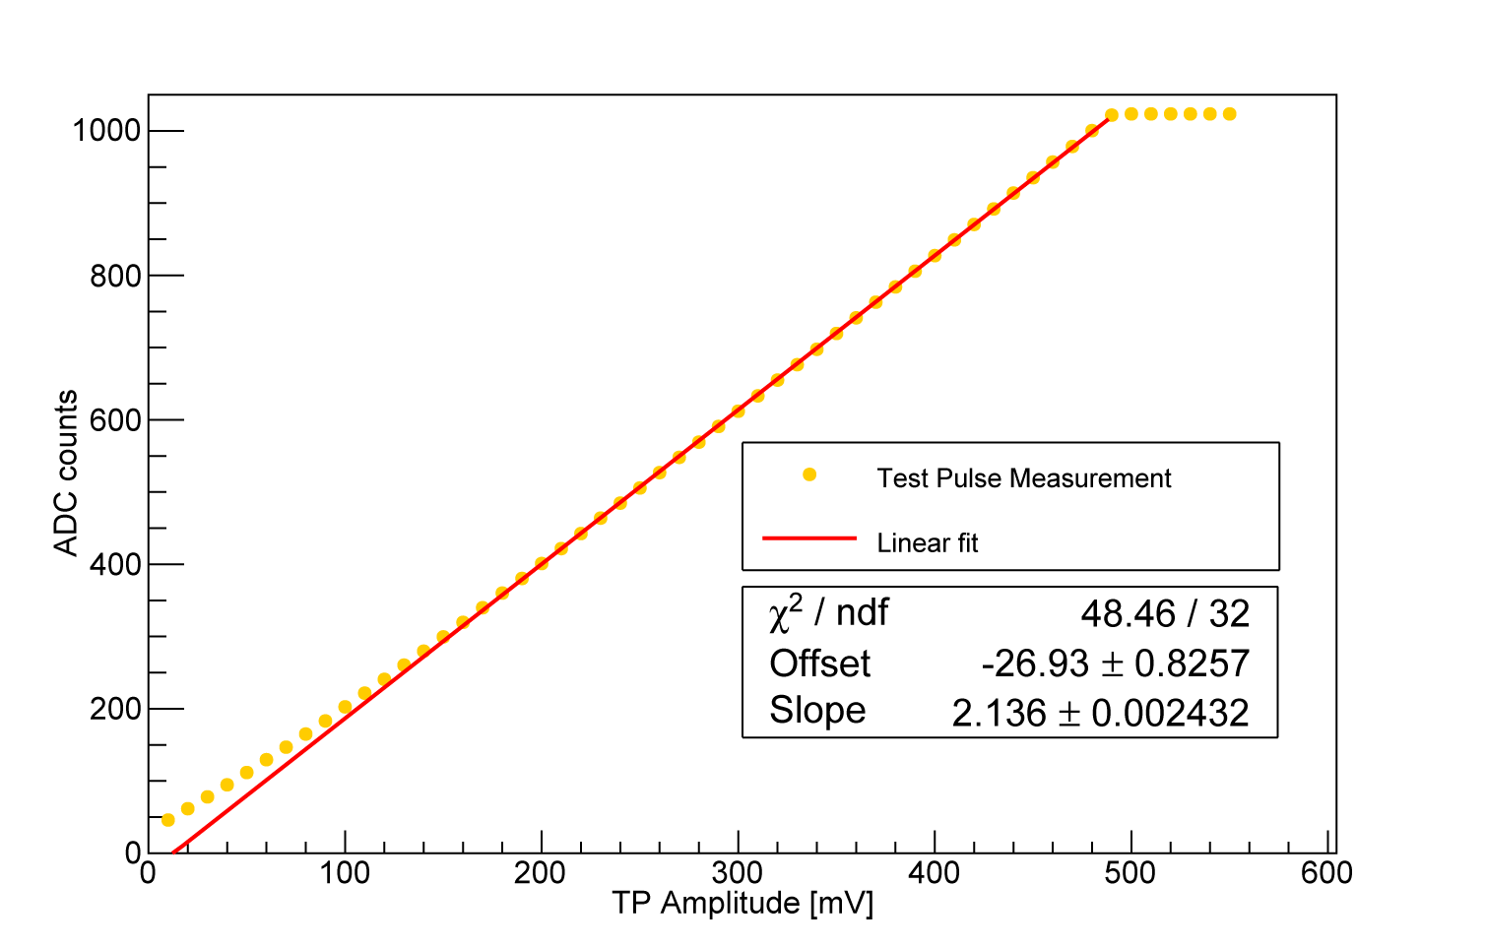
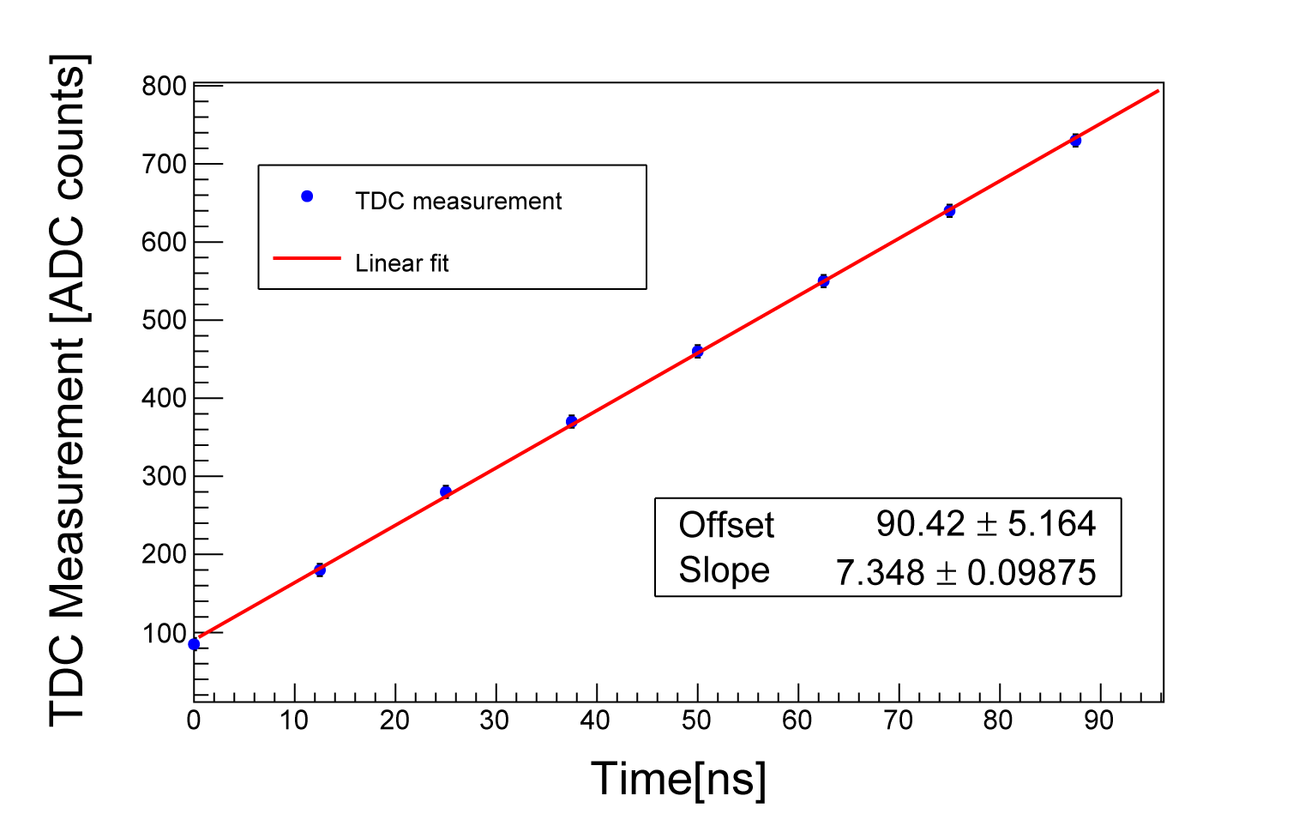
4-VIP-PIX Design and Development
VIP-PIX Main Features
Independent readout per pixel
Dynamic range up to 2 MeV
10 bit precision ADC
Energy resolution ~0.8 keV/ADC
Time resolution, 140 ns/ADC
Temperature measurement, 0.4ºC/ADC
Produces enough heat to cook a pizza

Slide 27
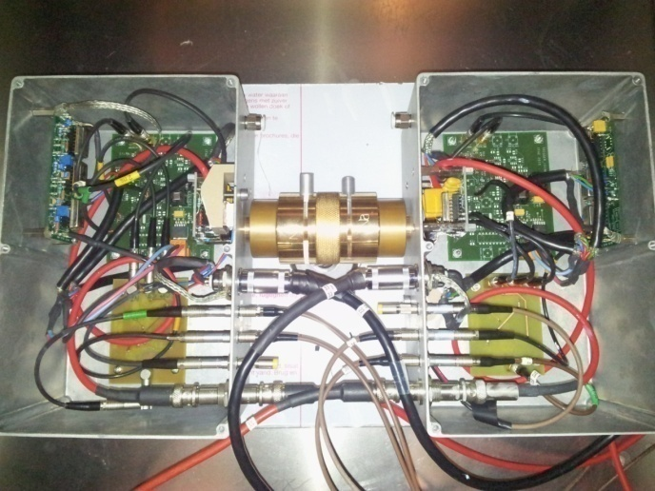
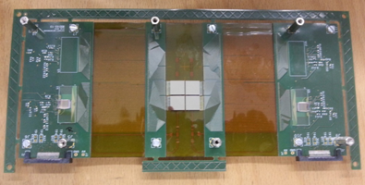
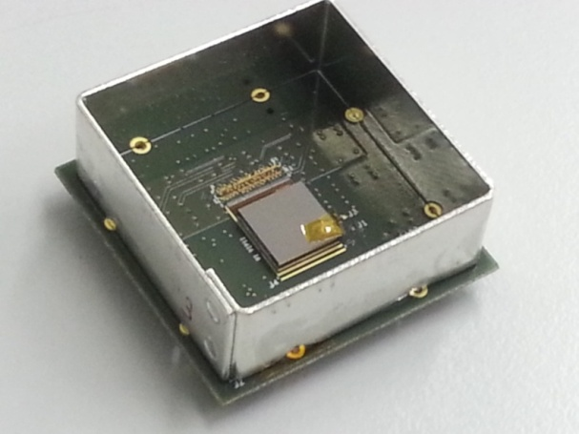
5-Detector Characterization
Single pixel CdTe
Pixelated CdTe with VATA ASIC readout
Pixelated CdTe with VIP-PIX ASIC readout

Slide 28
5-Detector Characterization
Single Pixel | Energy resolution | 3.0% @122 keV (500 V/mm, 20ºC)
 |  | 1.6% @511 keV (500 V/mm, 20ºC)
 |  | 2.6% @122 keV (1000 V/mm, -8ºC)
 |  | 1.2% @511 keV (1000 V/mm, -8ºC)
 | Coincidence time resolution | 12.5 ns FWHM (acceptance energy > 25 keV)
 |  | 6 ns FWHM (acceptance energy > 500 keV)
Pixelated VATA | Charge Sharing | 28% for VIP pixels
Pixelated VIP-PIX | Energy ADC | Precision ~0.8 keV
 | TDC | Precision <140 ps
 | Energy resolution | 3.2% @122 keV (500 V/mm, room temp.)
 |  | 2.3% @511 keV (500 V/mm, room temp.)
Published in: G. Arino, et al. JINST 8 C02015, 2013
G. Ariño-Estrada, et al. JINST 9 C05046, 2014

Slide 29
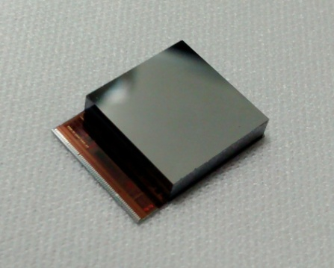
5-Detector Characterization
Detector unit with fully integrated readout!
100 pixels of 1 mm x 1 mm
VIP-PIX ASIC pixel pads attached via bump-bonding to the pixel electrodes
Independent pixel control and readout
Adjustable trigger threshold
Dynamic range up to 2 MeV
Leakage current compensation
Digitized energy measurement
Digitized timestamp
Digitized temperature measurement

Slide 30
VIP IN NUMB3RS
1 Bachelor degree project
2 Master theses
4 Ph.D. dissertations
12 Poster presentations
5 Oral presentations
10 peer reviewed conference records
2 peer reviewed publications

Slide 31
Future Work
Packaging of the full prototype: 180 FPGA, 720 CdTe diodes, 720 VIP-PIX ASICs, lot of patience, …
Test the reconstruction algorithms with real data
Images with real phantoms
Other plans that I do not know about because I am leaving in 3 weeks

Slide 32
Thank you!

