Slide 1

Cosmic Explorer, the Next-Generation of US Gravitational-Wave Observatories
Barry Barish
Caltech / UC Riverside
12 June 2023
_
Image Credit: Cal State Fullerton

Slide 2
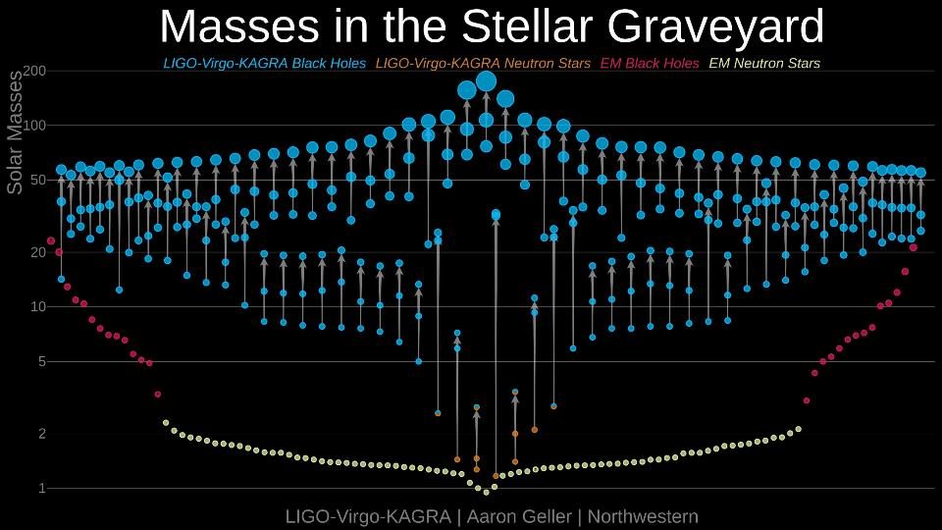
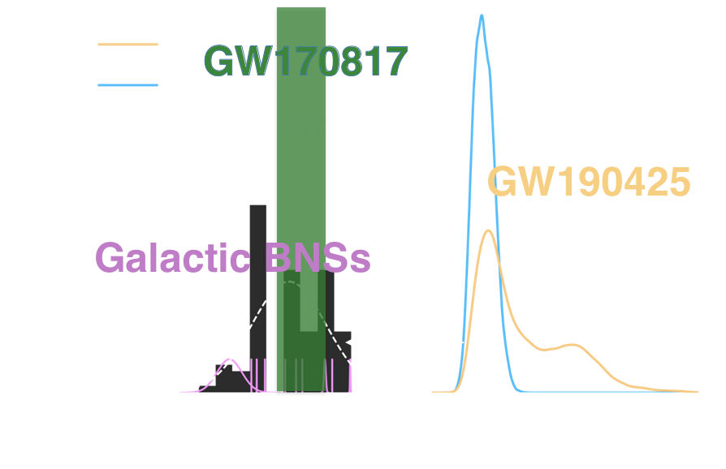
The GW Field Is Rapidly Advancing Since Discovery
Nearly 100 detected mergers BH-BH, NS-BH, NS-NS
Limit on Graviton Mass M_{g} ≤ 7.7 × 10⁻²³ eV/c²
A few Intriguing Exotic Events
NS-NS Merger – Birth of Multimessenger Astronomy

Slide 3
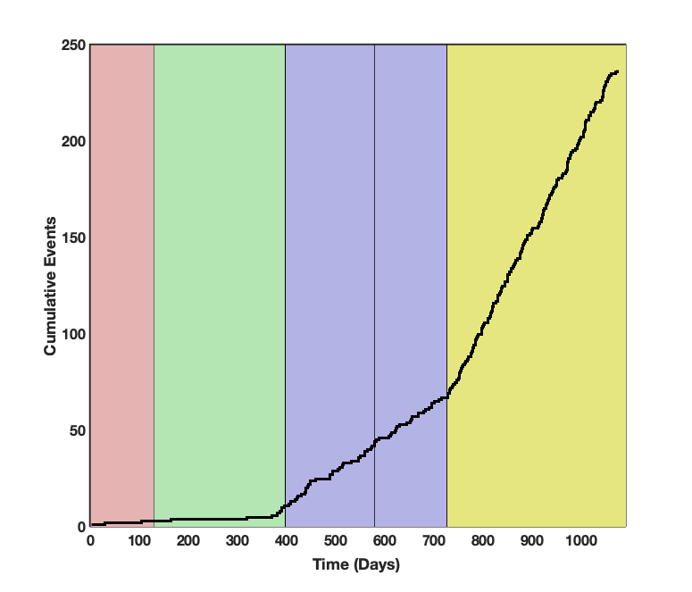
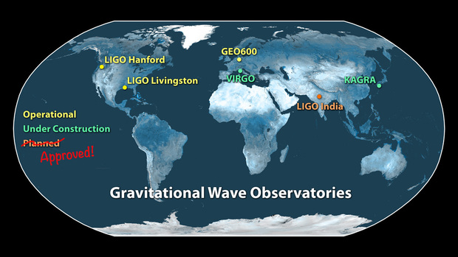
Technical/Sensitivity Advances over the Coming Decade
O3
Run Plan Over Next 5-10 Years
O2
O1
o1
Incremental Increases in Sensitivity/Rate
LIGO India Funded Last Month - $320M India + $80M U.S.

Slide 4
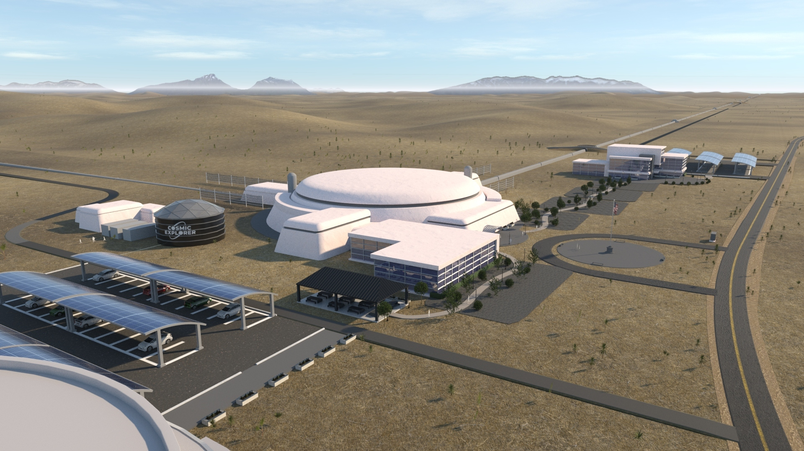
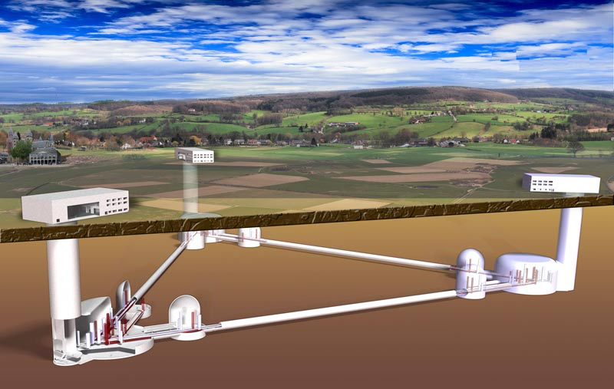
Next Generation Detectors (2030s) ~x10 aLIGO
Cosmic Explorer → x10 Advanced LIGO
The Einstein Telescope
  Deep Underground
  Site Proposals: Sardinia; Holland 10 km arms
  Triangle (polarization)
  Earths surface;
  40 km arms + 20 km arms
  Low frequency configuration
  high frequency configuration

Slide 5
CE Detector Concept
The Cosmic Explorer instrument design is based on proven LIGO technology
Development will be required to scale-up some technologies (e.g., larger mirrors, longer suspensions, …)
Vacuum system is major cost driver, so R&D ongoing to find better and cheaper solutions

Slide 6
Horizon Study Document
High-impact science in context of 2030-era astronomical observatories (Athena, Lynx, LISA, etc.)
Connects science goals to design choices
  Number of detectors and location
  Detector length and configuration
Delivered to the NSF Fall 2021:
  https://arxiv.org/abs/2109.09882
  https://cosmicexplorer.org

Slide 7
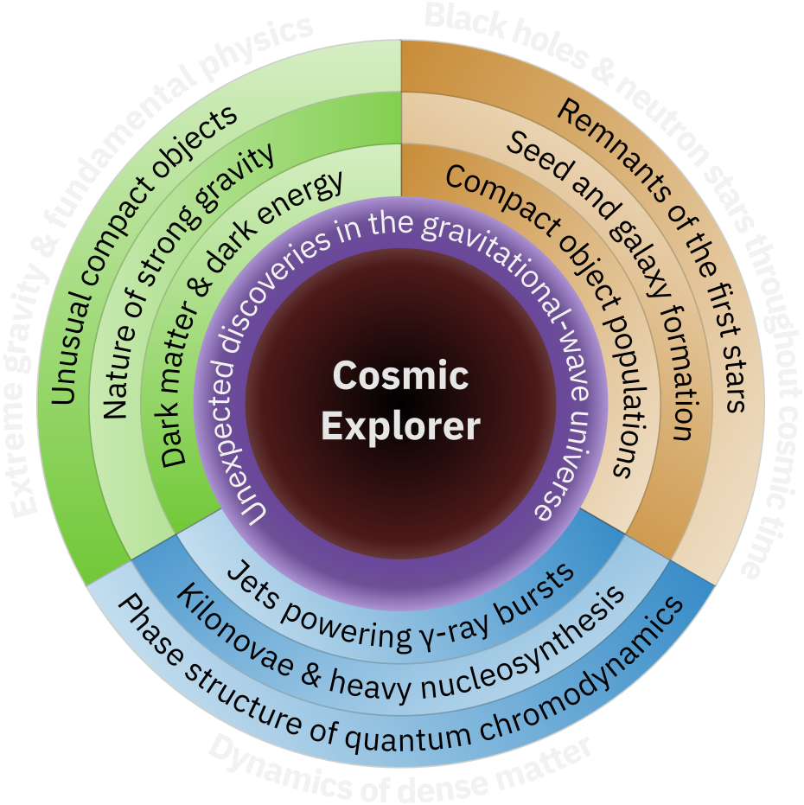
Cosmic Explorer
The Vision for Gravitational-Wave Astrophysics
Next-Generation Gravitational-Wave Observatory
  40 km and 20 km L-shaped surface observatories
  10x sensitivity of today’s observatories (Advanced LIGO)
  Global network together with
  European Einstein Telescope
Enables access to
  Stellar to intermediate mass mergers
  throughout Cosmic Time
  Dynamics of Dense Matter
  Extreme Gravity
7

Slide 8
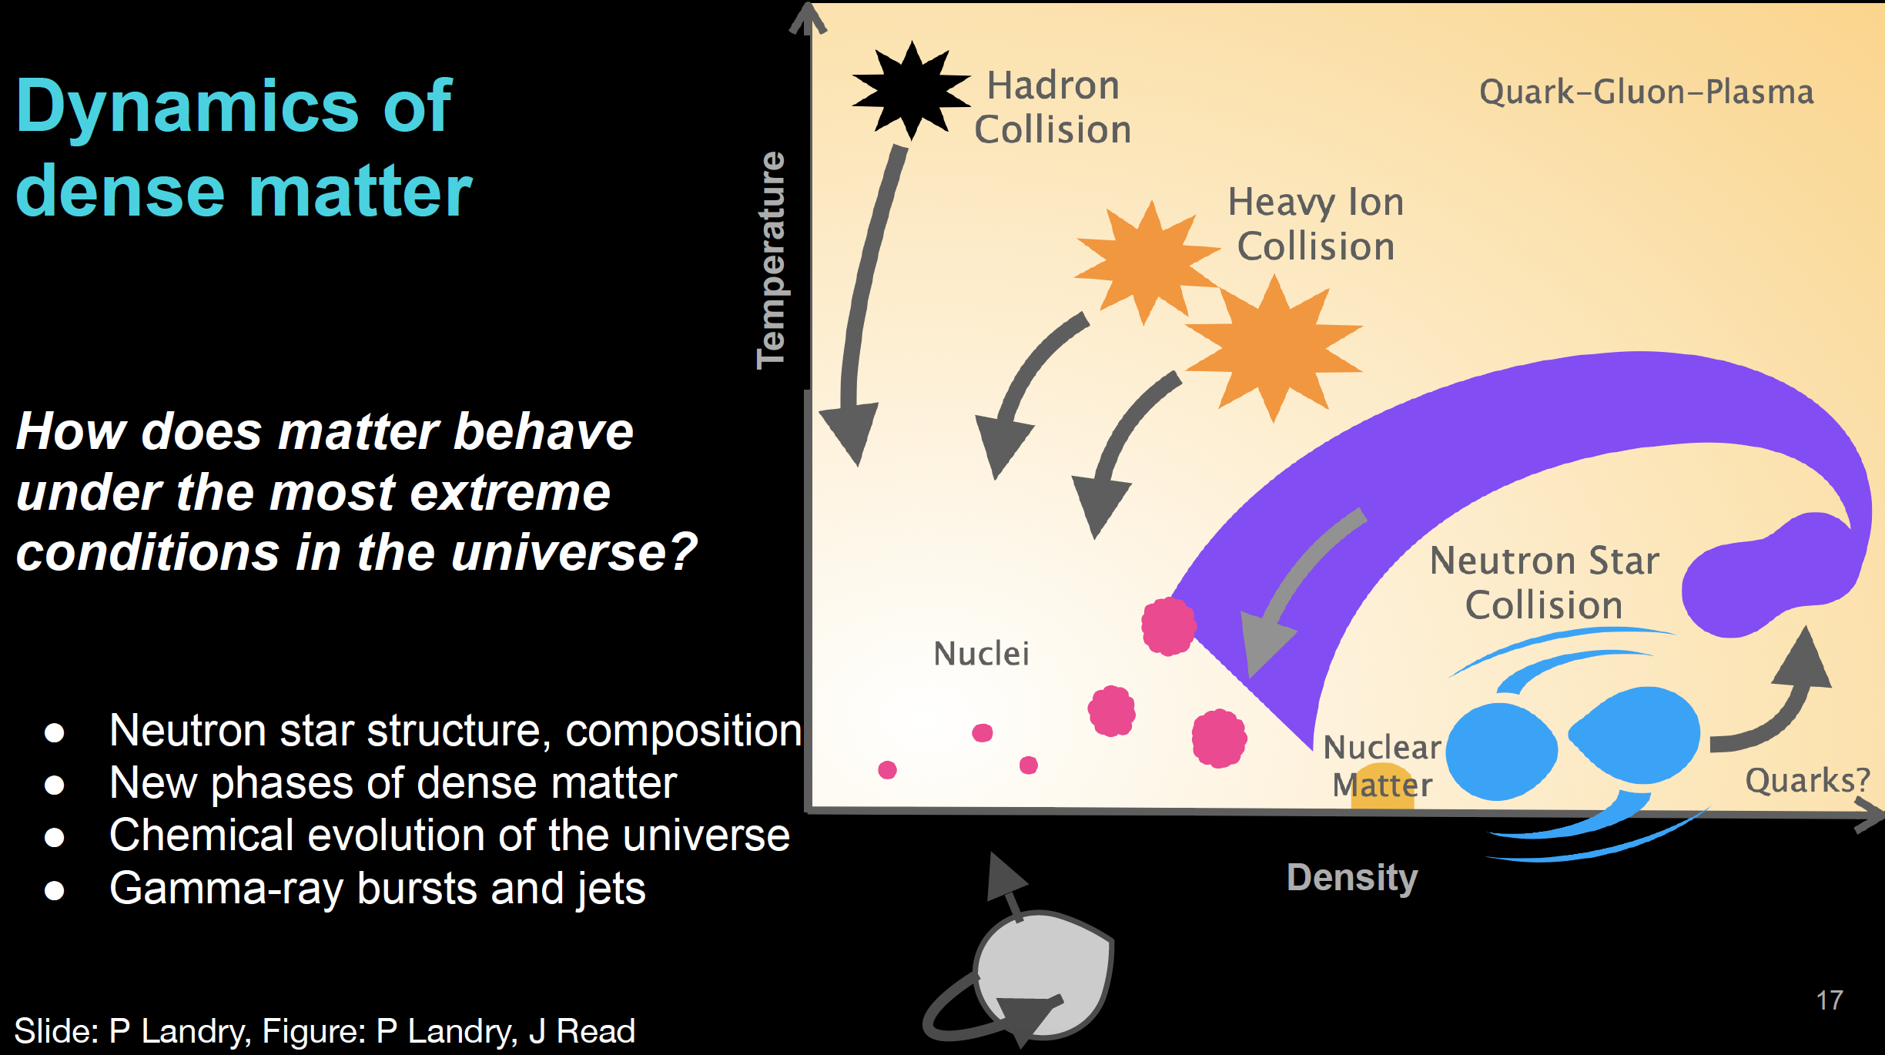

Slide 9
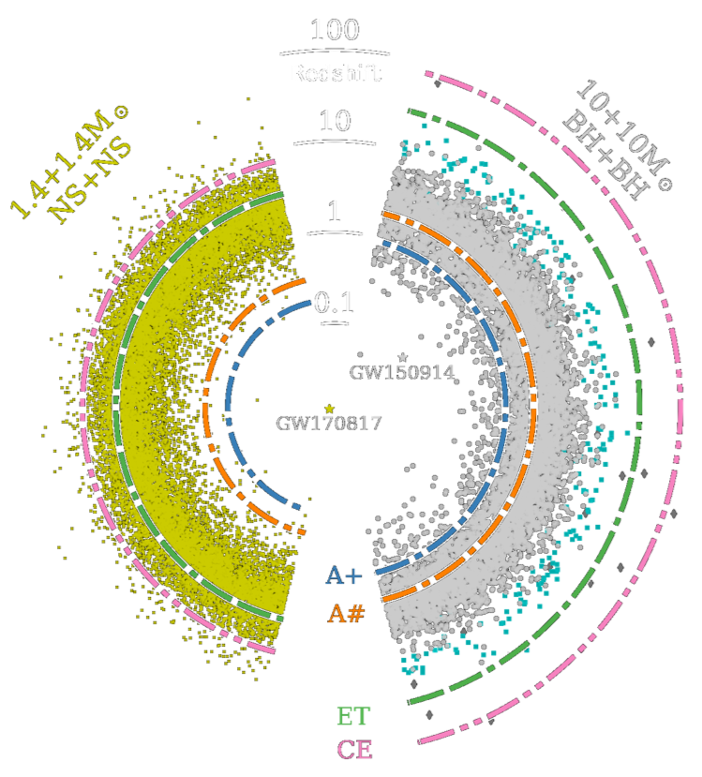
Cosmology and Precision Science with Cosmic Explorer
Expected event rate
  O(1e5) BHBH merger annually
  O(1e6) NSNS mergers annually
SNR NS-NS up to ~300 (post merger physics)
SNR BH-BH up to ~3000 precision tests of Einstein GR.
Across redshifts up to z ~ 30
  Sky localization from detector network
The full Cosmic Explorer data set will be a treasure trove for structure formation correlation studies, dark matter, dark energy signatures

Slide 11
Detector Design Parameters

Slide 12
Present Working Schedule

Slide 14
Astro2020 Decadal Survey: A Resounding Endorsement
Released in Nov 2021
Next-generation gravitational-wave observatory in the United States is "central to achieving the science vision laid out in the survey’s roadmap."

Slide 15
Snowmass Cosmic Frontier Report
5.3.3 New Opportunity: Gravitational Waves
The Cosmic Frontier community plans to incorporate Gravitational Wave Observatories in its portfolio of tools for discovery with a long term strategic vision. We will pursue EM counterparts of events detected by the growing Gravitational Wave Observatory network while launching new pathfinder (R&D) efforts to enable the HEP community to participate in the next-generation GWO project in a leading role. The new detector’s sensitivity, roughly 10 times better than the planned LIGO upgrade, requires significantly larger facilities and a number of technological upgrades. Both are challenging requirements that the HEP community is well-equipped to meet, given our experience.
This is likely a once-in-a-century opportunity for the HEP community to make new breakthroughs in an entirely new class of experiments and utilize this new opportunity
to advance on our scientific drivers at a much faster pace than previously anticipated.

Slide 16
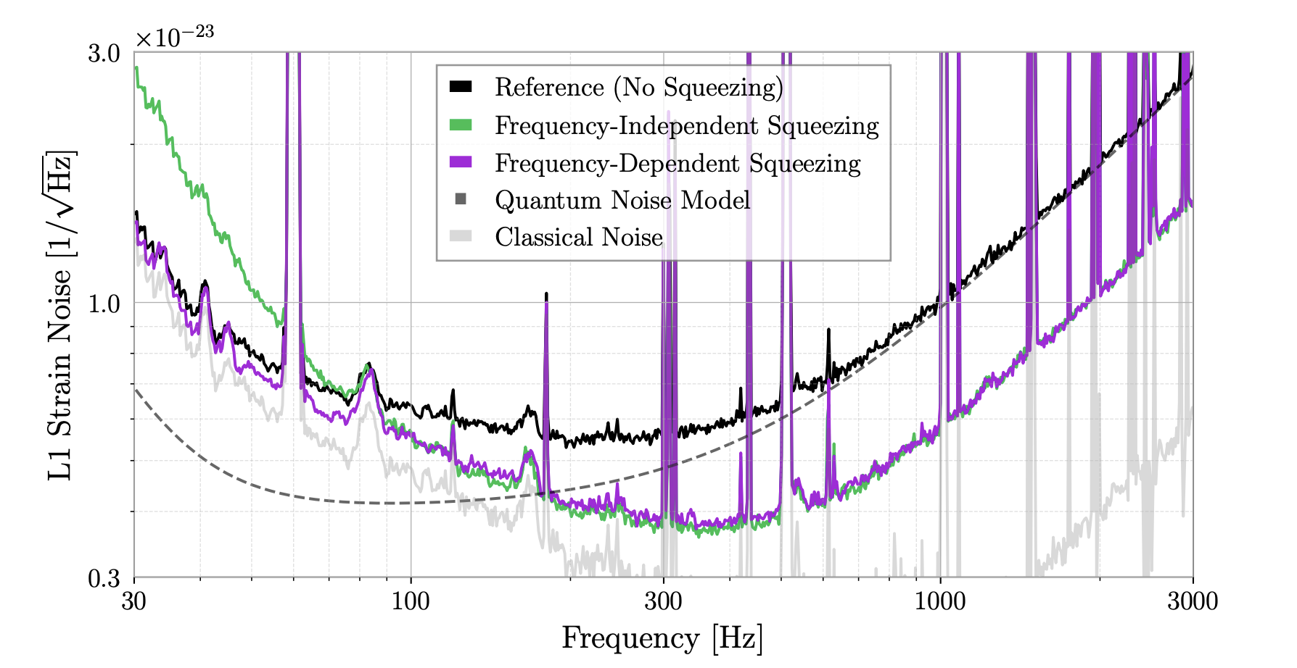
Quantum Sensors beyond the standard quantum limit
Happening right now in Advanced LIGO. Squeezers are working at both LIGO observatories!
Latest results show quantum noise reduction across the band (publication in the works…)
Paper In Preparation

Slide 17
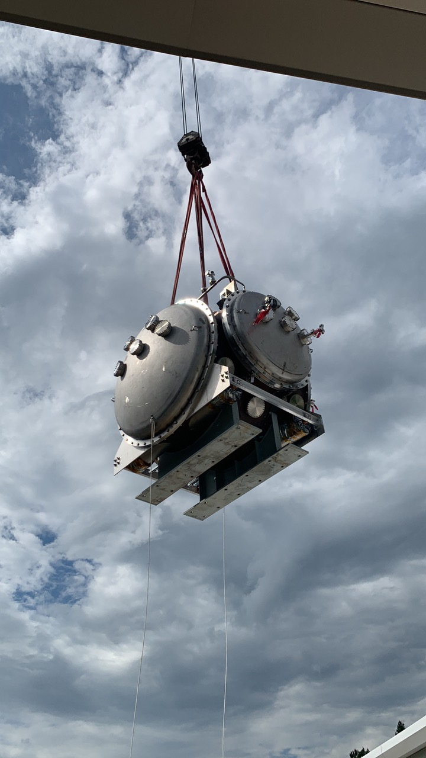
Preliminary Cost and Schedule
Cosmic Explorer for the next decade
  Conceptual Design, next 5 years ~$25M
    vacuum system R&D + design, site identification, civil engineering concepts and cost estimates, scaling up LIGO technology, etc.
    Improved cost estimates are a major output of the CD phase
  Preliminary Design, 3 years ~$50M
    site selection, detailed civil and vacuum designs, etc.
    Final budget submitted at time of Preliminary Design Review
  Final Design, 2 years ~$80M
    refinement and preparation for construction
Construction, starting early 2030s: ~$2B for 2 observatories
  Operations: ~$60M/year in 2021 USD, based on LIGO experience

Slide 18
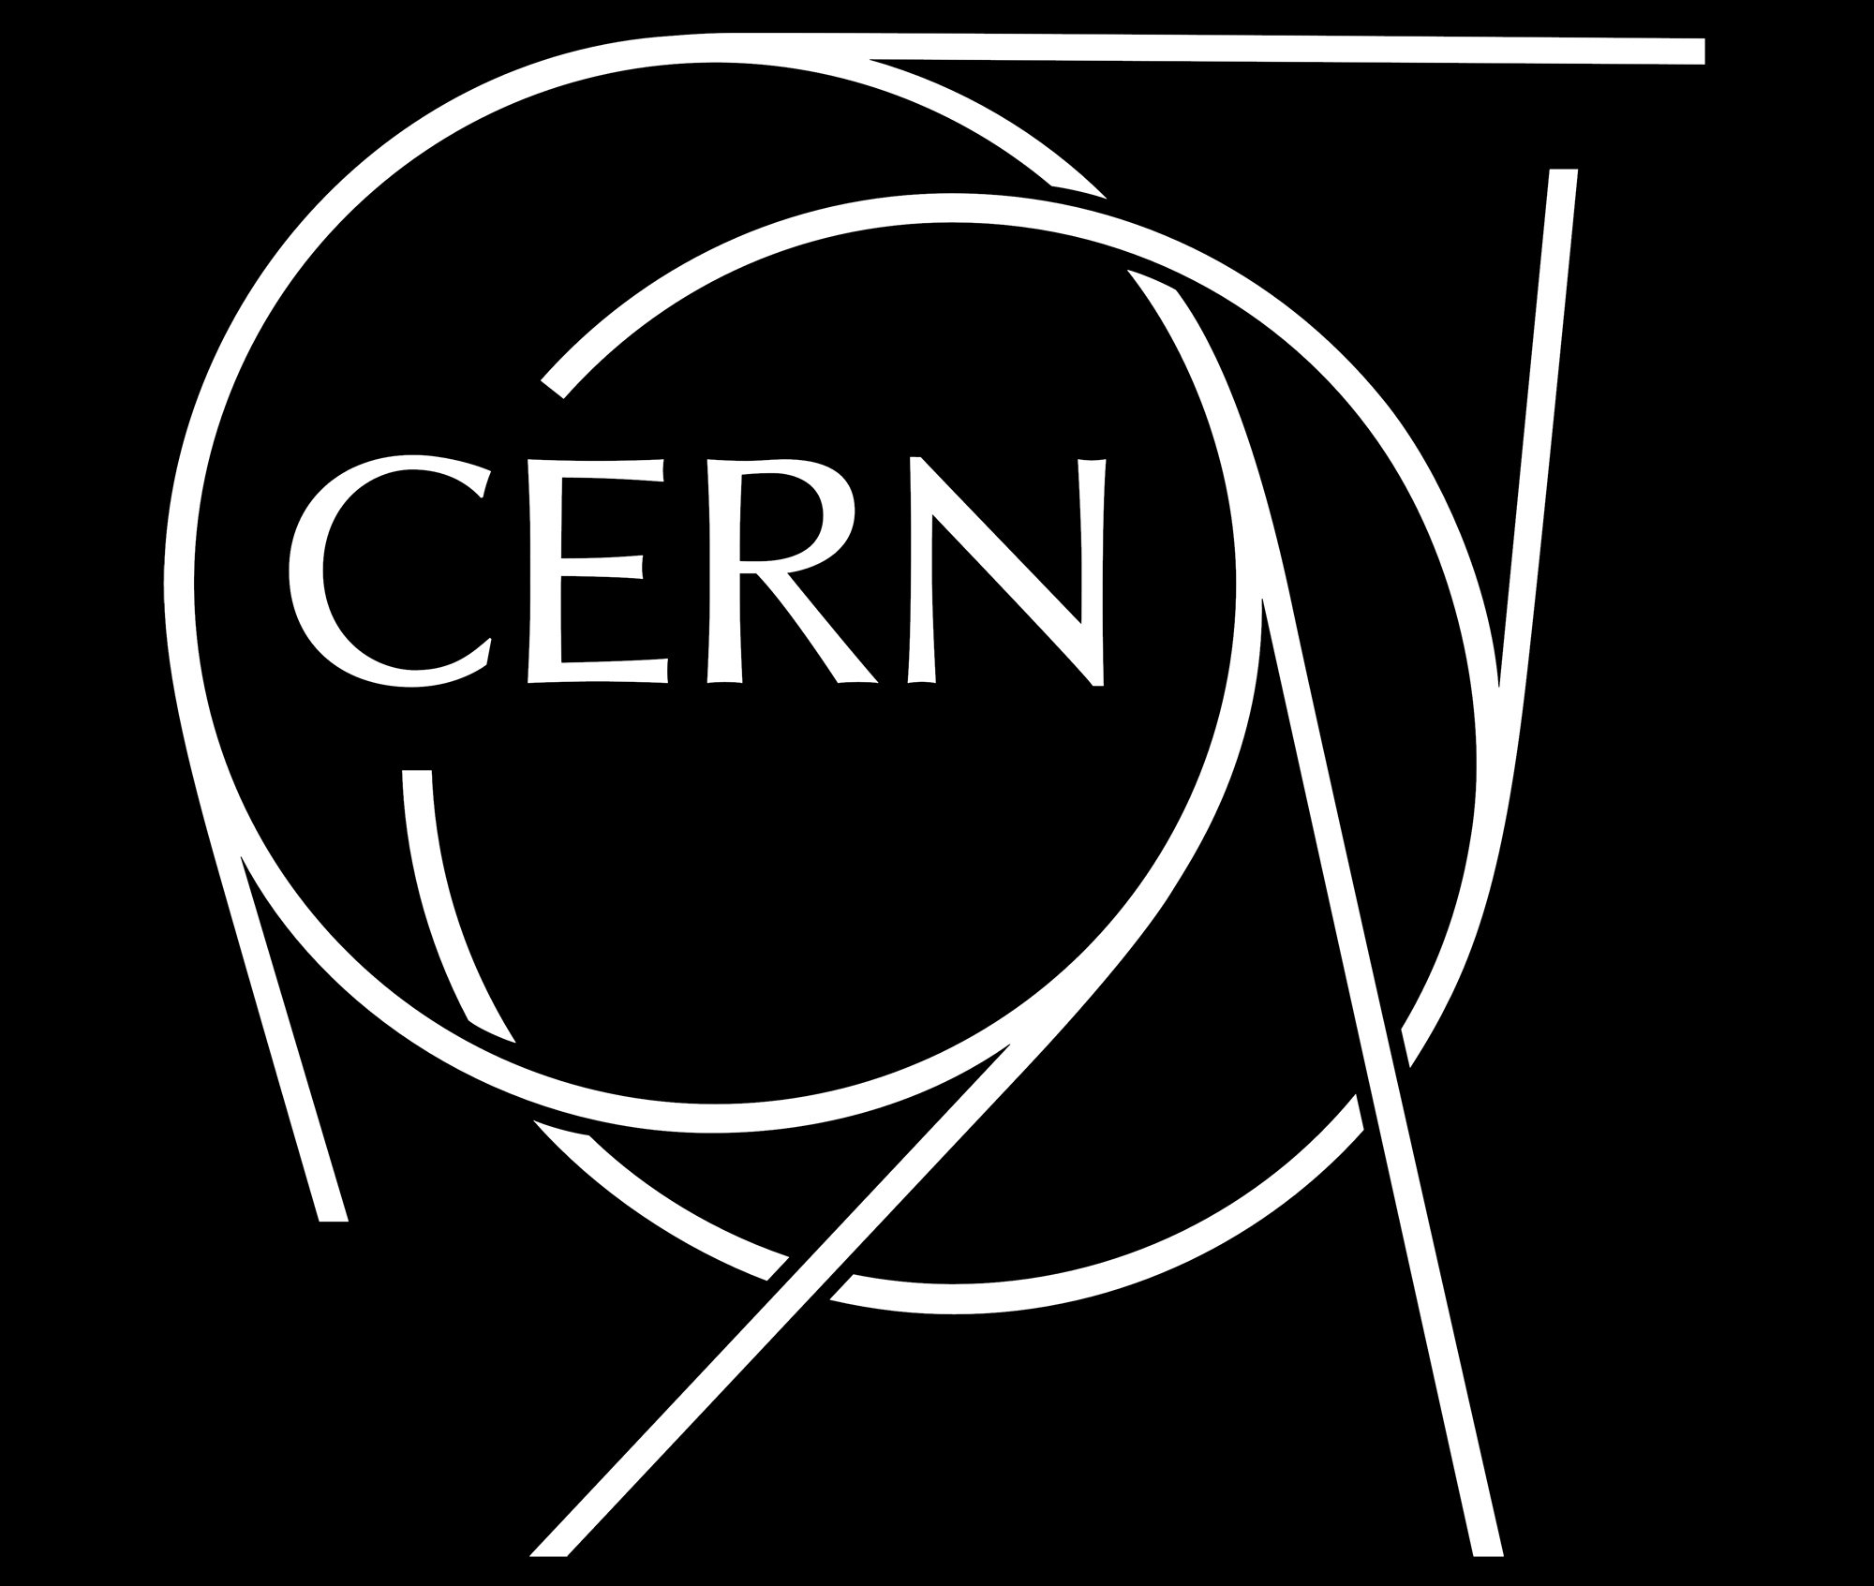
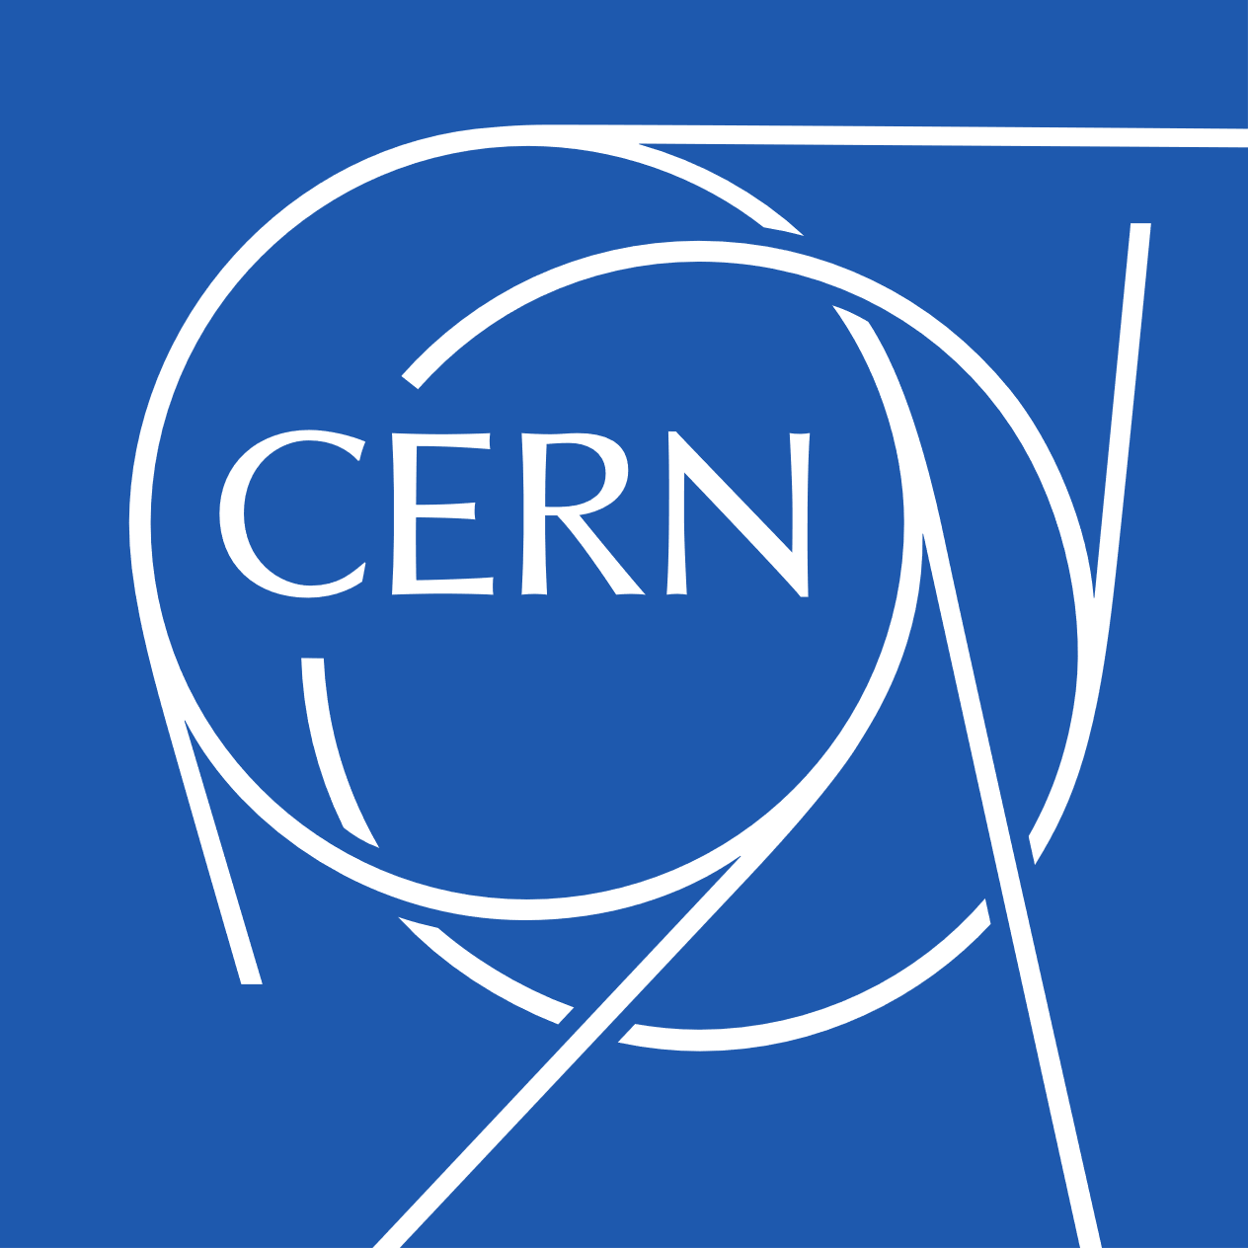

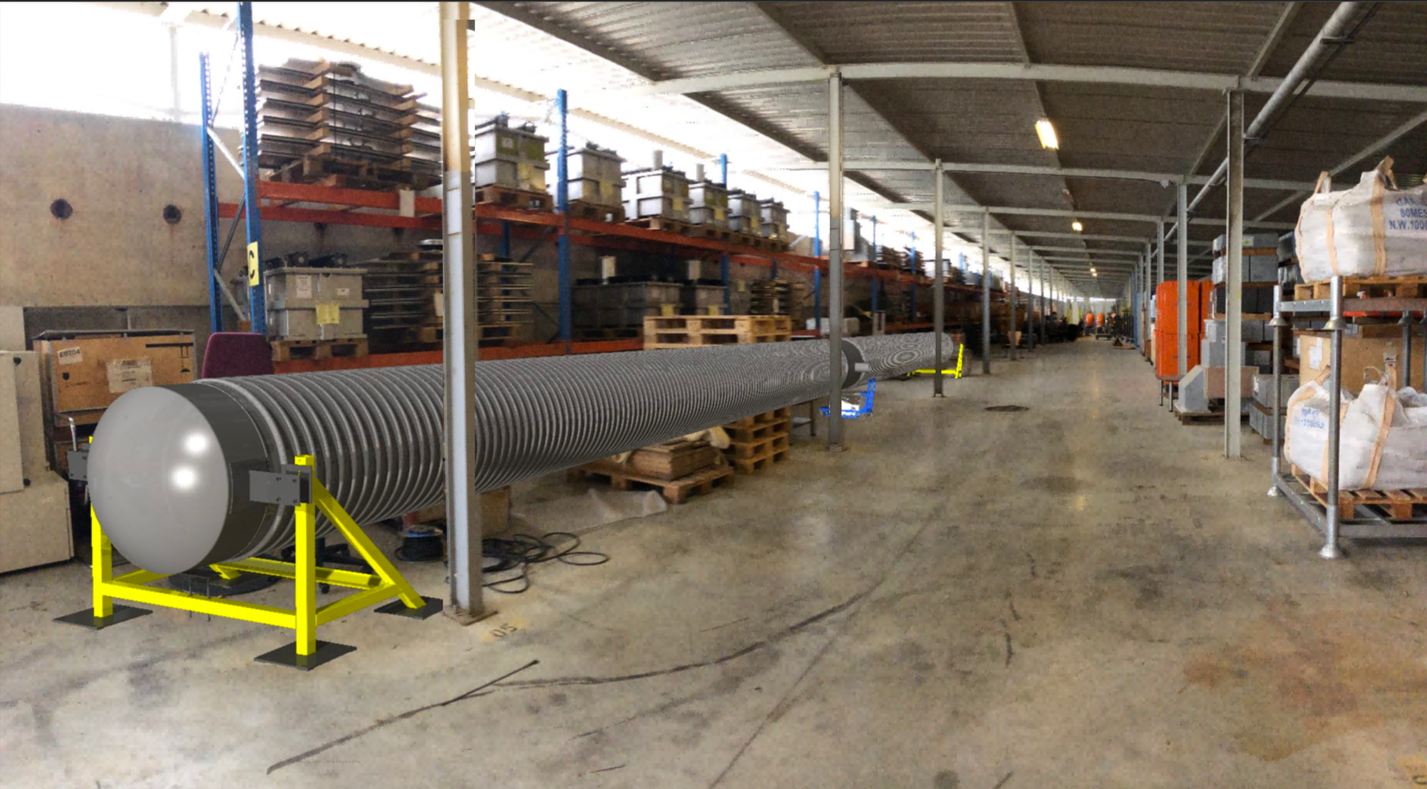
European Einstein Telescope
Collaboration with CERN
Europe / Einstein Telescope is ahead of US:
  ET is on 2021 ESFRI road map ( https://www.esfri.eu/esfri-roadmap )
  Financial pledges by Netherlands, Italy,…
  ET has an MOU with CERN for support on technical topics.
    Covers the work for the ET beampipe
    (coordinate efforts, link to CE, less expensive technical solutions)
    Leading to a beampipe pilot sector and a TDR by end of 2025.
  2nd MOU agreed on: CERN will provide support for the
  technical design for the underground structure (civil engineering)
  Discussion with CERN on other topics: safety, document management, coordination and engineering, and cooling and ventilation.
ET beampipe pilot sector
conceptual model

Slide 19
Key Points : Cosmic Explorer
Gravitational-wave Observatories are a “once-in-a-century opportunity“ for the HEP community (Snowmass CF report)
  Essential for NSF/DOE science priorities in the 2030s
  Broad overlaps with National Laboratory / DOE technological expertise
Funding priorities
  CE’s intention is to seek NSF funding through the MREFC program.
  Support/prioritization of exploratory work for GW science, and instrument R&D for GW observatories, from DOE/National Laboratories can facilitate the design phase.
  At the time of construction (2030s) a larger DOE project role may be beneficial for US community.

Slide 20
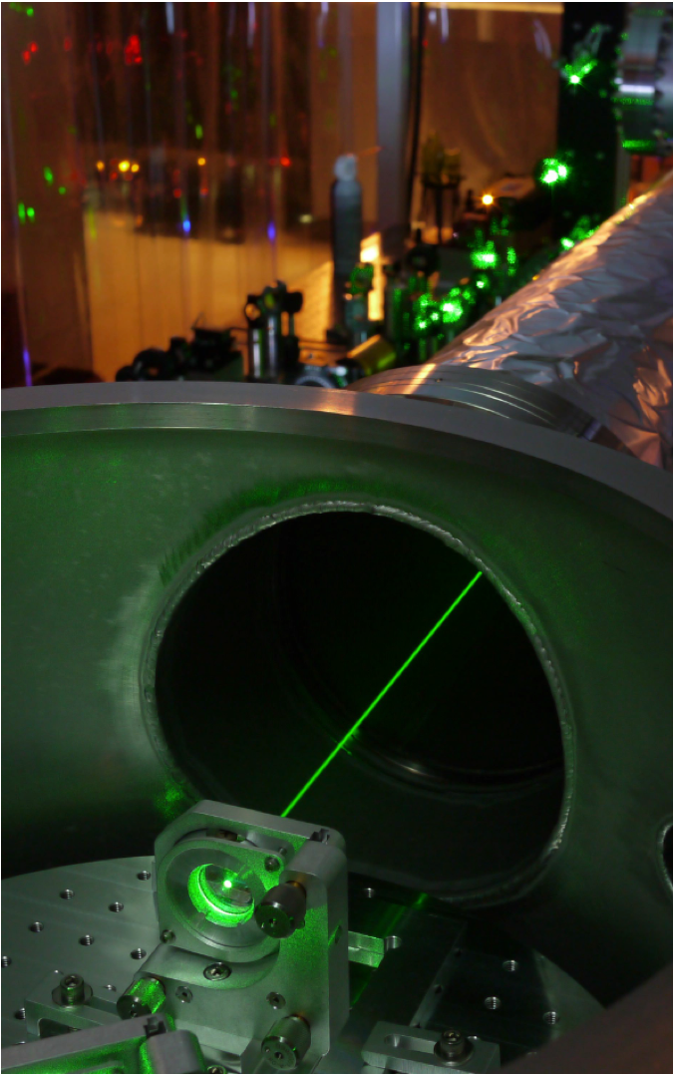
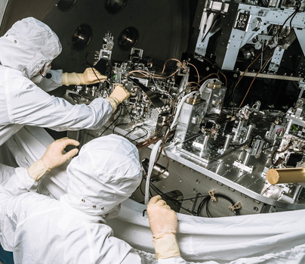
Summary
Cosmic Explorer represents
  A compelling science case for a new facility.
  It will require funding for R&D that develops new technologies over the next decade
  (Quantum Sensing, Vacuum technology, etc.)
  This will take the form of focused investments in small-scale projects that advance national initiatives in quantum information science, advanced electronics and instrumentation.
Example small-scale project:
Advanced LIGO squeezed light source.
The technology is now redefining the
LIGO’s observational rage.

Slide 21
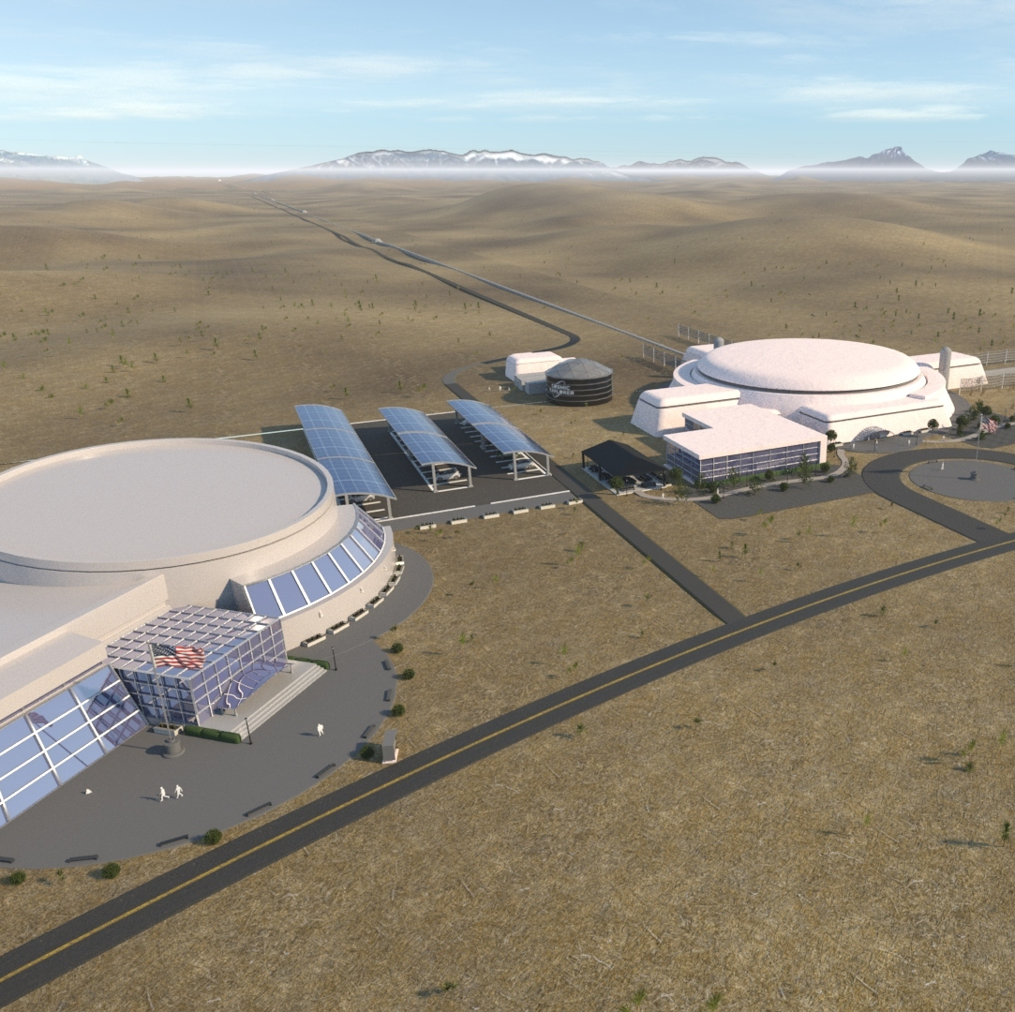
Conclusions
The GW Field is rapidly advancing.
Next-generation Cosmic Explorer is based on proven technologies, but some critical R&D related to scaling is needed (vacuum, optics, etc.)

