Slide 1
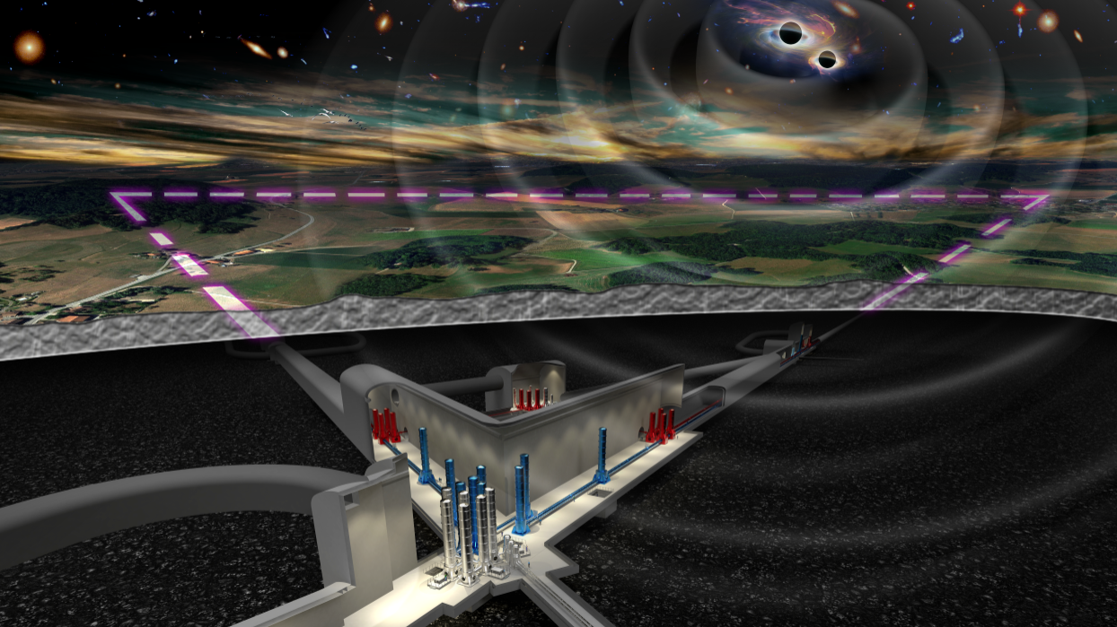

Report from the
ET Collaboration
Michele Punturo
Harald Lück

Slide 2
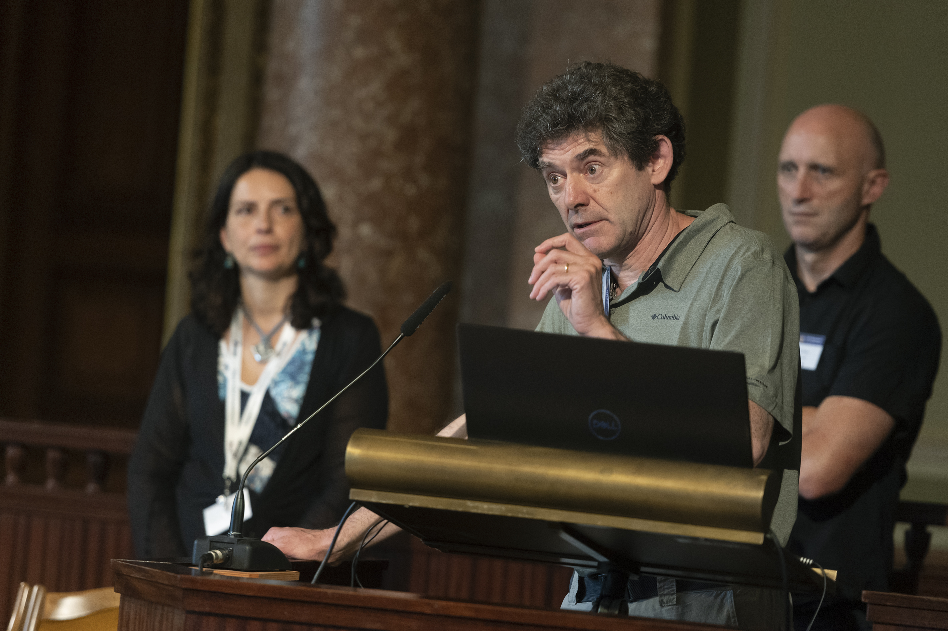
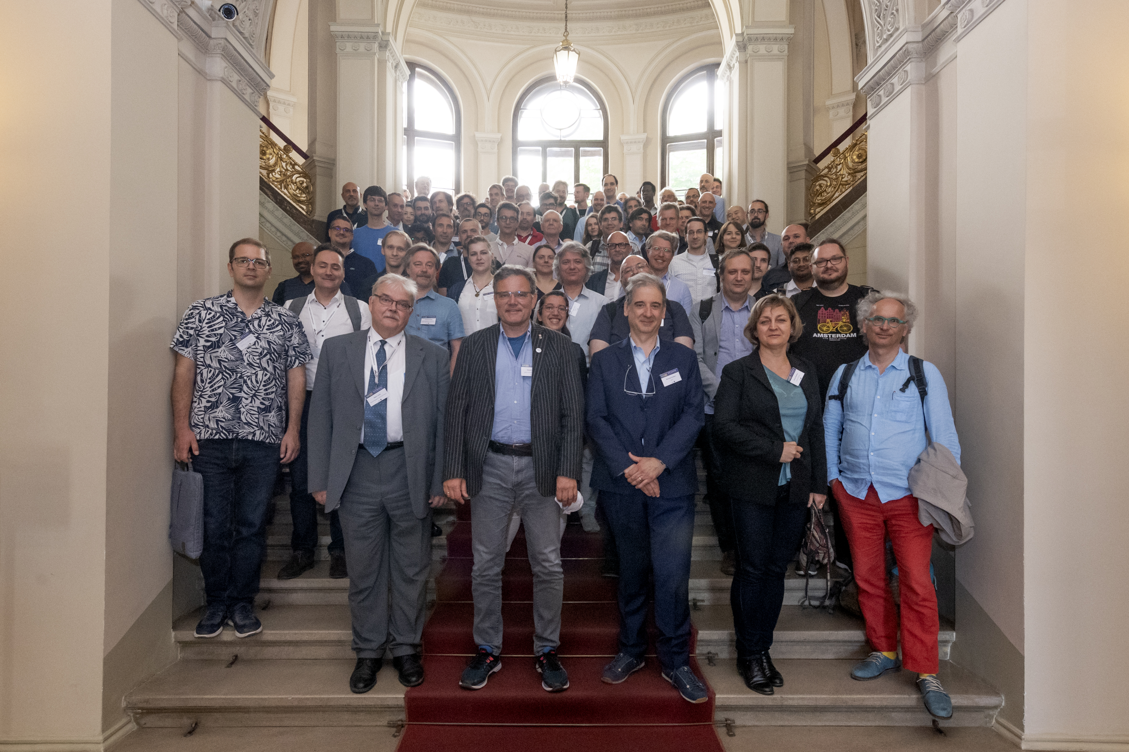
One year ago

Slide 3
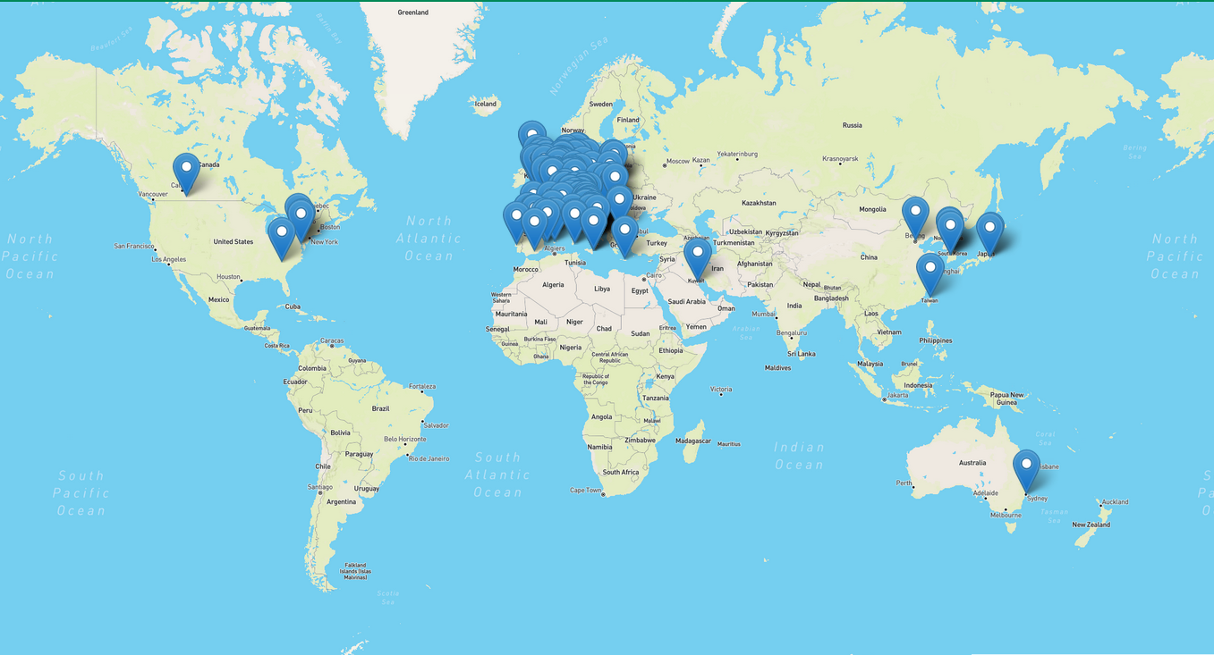
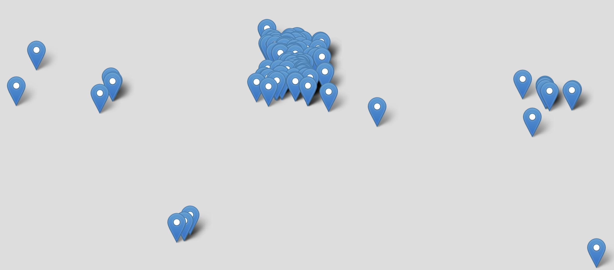
The Einstein Telescope Collaboration
ET Member‘s affiliation map
ET member database (https://apps.et-gw.eu/etmd/)
82 Research Units (+1 request pending)
1437 members (09.06.2023 09:25)
Total: 211 Institutions
in 23 Countries
Notes:
Collaboration consists of 79 research Units with about 1300 members;
Concentrated in Europe

Slide 4
ET Collaboration Demography
The data in the ETMD suffer a certain level of inaccuracy:
  Some RU leaders have not inserted their RU members
  A few ET members are not updating their information
We adopted a “particular” flavor of FTE: FRTE (full research time equivalent)
The declared FRTE need to be matched to an effective activity
  This will be a major effort in the next years and we should find a realistic method in the Bylaws
Currently we have about 295 FrTE →24% on average per member - quite low
Data from the ET Member Database (ETMDB), tool based in EGO, governing the Authorization and Authentication to the ET collaboration resources:
https://apps.et-gw.eu/etmd

Slide 5

Proto-council
Advisory Bodies
Scientific and Technical Advisory Committee
Program Advisory Board
ESFRI Coordinators
Stan Bentvelsen, Antonio Zoccoli
BGR (Board Governm. Represent.)
Policy & monitoring
BSR (Board Scient. Represent.)
Project Directorate
F. Ferroni, A. Freise
M. Martinez
ET Collaboration
CERN
MOA CERN-INFN-Nikhef
P. Chiggiato
TDR ET Vacuum Pipe
monitoring
Providing services
Policy proposals+
monitoring
CB
Collaboration Board
EB
Executive Board
  Deliverables:
  Beam pipe vacuum
  Site Preparation
  Civil Infrastructure
monitoring
Informing
reporting
managing
advisory
managing
reporting
delivering
INFRA-DEV
M. Martinez
WP1 Coordination and Management
WP2 Organization , Governance, Legal
WP3 Financial Architecture
WP4 Site Preparation
WP5 Project Office/Engineering Dept.
WP6Technical Design
WP7Transfer of Technology
WP8 Computing and Data Access
WP9 Sustainable Development Strategy
WP10 Education, Outreach, Citizen Engagement
SSB
Services and Standards Board
FNR
Forum of National Representatives
SF
Science Forum
reporting
Requirements
& competences
managing
Providing services
participating
supervisioning
Communication Office
Strategy
ISB
Instrument Science Board
EIB
Electronics/Computational Infrastructure Board
OSB
Observational Science Board
SCB
Site Characterisation Board
Project Office
setting
Engineering Department
ET Organization
Specific Boards

Slide 6

ET Specific Boards
ET Executive Board
Specific Boards
SPB
Site Preparation Board
OSB
Observation Science Board
ISB
Instrument Science Board
EIB
E-Infrastructure Board
WD1 Physical variables and characterization
Fundamental Physics
Suspensions
On-site Infrastructure
Cosmology
WD2 Geology
Optics
Distributed infrastructure
Population Studies
WD3 Bidbooks
Multimessenger Obs.
Interferometer
Software & frameworks
Synergies with GWDs
Divisions
WD4 Cost timing and risk assessment
Nuclear Physics
Vacuum and Cryogenics
PD
management
WD5 Legal and site preservation
Transient GW Sources
Active Noise Mitigation
Waveforms
WD6 Socio-Economic and environmental impact
Scientific potentials …
Civil Infrastructures
Data Analysis Platform

Slide 7
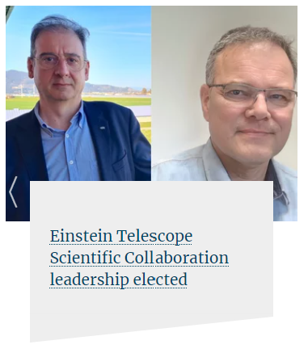
The Executive Board
On the 23rd of March, 2023
the ET Collaboration elected
the Spokesperson/Deputy Spokesperson team
The EB meets every Monday at 3pm
You can follow its activities through the meeting minutes on the ET Collaboration Technical Documentation System (TDS): https://apps.et-gw.eu/tds/ *
More info here: https://wiki.et-gw.eu/EB/WebHome *
ET Collaboration web site (since 2008): https://www.et-gw.eu/ *
Indico (all international ET coll. meetings): https://indico.ego-gw.it/category/23/ *
(*) Services provided by EGO, based on the ETMDB service (Active Directory)

Slide 9
The Observational Science Board OSB

Slide 10
The E-Infrastructure Board

Slide 11
The Site Preparation Board

Slide 12
Main activities of the ET collaboration
The activities of the ET collaboration in the last year are progressing along two parallel lines:
1) self-structuring (Bylaws, SSB committees, new RUs), …
  Under the responsibility of the Collaboration Board chaired by Eugenio Coccia
2) contribute, in synergy with the ETO, to all the needed steps toward the realization of the ET observatory
  Optimize the science return
    Define optimal ET geometry and localization
  Evolve the ET CDR toward TDRs:
    PBS (Product Breakdown Structure)
    WBS (Work Breakdown Structure)
  Develop the Enabling Technologies
    R&D activities (see Harald’s Talk)

Slide 13


Optimize the science return
In 2021 we started a process named CoBA (Cost Benefit Analysis)
Multi-Step process:
  Optimization science return: CoBA Science document
    ET-0084A-23: https://apps.et-gw.eu/tds/ql/?c=16584
  Differential comparison of the (technical, commissioning, operation) risks of the interferometers in the possible geometrical configurations
    ETRAC (ET Risk Assesment Committee)
      Work in progress (see later)
    Evaluate Risk Mitigation Strategies
  The next steps are formally under the ETO responsibility
    Civil Infrastructure construction solutions and costs (Engineering Department)
    Political and financial implications (BGR & Coordinators)

Slide 14
CoBA Science document
An impressive document of about 200 pages, realized in more than one year of work by about 80 ET collaborators and endorsed by the Executive Board
  Main target, also requested by the ET Project Directorate in order to accomplish its mandate, is the comparison of the science return for different geometries («L» vs «Δ») and orientations (aligned, misaligned).
Main achieved results are summarized in few concrete statements in the conclusions of the document
  Obviously the CoBA output impacts on the TDR (mainly on civil infrastructures)

Slide 15
Configuration Risk Assessment: ETRAC
In early 2023, the EB appointed an ET Risk Assesment Committee (ETRAC)
Its mandate has been:
  1) Define a set of risk categories and populate them by risks
  2) Define a «quantitative» metric for each of these risk categories
  3) Apply the metric to the risk categories comparing the ET configurations
Risks explicitly excluded:
Political and financial because outside the ET collaboration realm
The ETRAC is composed by members having a long standing experience in assembling, commissioning, operating and upgrading GW detectors and is chaired by a non-ET person
The ETRAC decided to only evaluate “differential” risks
The EB received the output report that is compliant with the mandate we assigned:
  We decided to internally review it in order to evaluate its completeness and correctness
  The EB also has the duty of implementing the second step of this RE-MS process:
    Risk Evaluation – Mitigation Strategy
    An offline review has been started
    It may be finalized in a full-day F2F meeting on the 14th of July at the Frankfurt airport conference center (PO invited)
Name
Edwige Tournefier
Enrico Calloni
Piero Rapagnani
Bas Swinkel
Matteo Tacca
Alessio Rocchi
Christian Olivetto
Hartmut Grote
Benno Willke
Lisa Barsotti (Chair)

Slide 16
Product Breakdown Structure
The first step towards the ET Technical Design Reports (TDRs)
is the realisation of the Product Breakdown Structure (PBS)
This activity has been driven by a committee (PBS team) composed by the Project Office and some of the chairs of the ISB and EIB (in collaboration with the SPB)
This activity heavily involved competences and human resources of the ET Collaboration, whose members filled up the PBS files
Several talks are scheduled in this meeting on this subject, please have a look at them
A. Variola​
A. Rocchi​
P. Verdier​
P. Werneke​
C. Olivetto​
G. Gemme​
D. D’Urso​
S. Hild​

Slide 17
R&D in ET
From the candidature talk→
See Harald’s talk
In the next few days we will launch a questionnaire on the R&D activities, on the received funds, on the active multi-annual R&D programs
  An ET-PP questionnaire on Industrial Liaision and Technology Transfer (see M.Morandin) has been attached to this questionnaire
The target is to realize a DB with all these info
The aim is
  to see if all the enabling technologies are covered,
  if we have an unnecessary duplication of efforts,
  what are the R&D activities to be «offered» to new potential RUs in ET?
  to prepare an international R&D plan to be presented to the funding agencies

Slide 18
Conclusions
The ET Collaboration is continuously growing. This is a positive fact:
  Human resources, young scientists
  Consolidated and new competences
  We have already a global horizon (whole Europe, South America, Asia)
But it has important requirements:
  Organization:
    The organization of the ET collaboration needs to be well structured, monitored and continuously updated
  Effectiveness:
    The effective contribution of each member of the ET collaboration needs to be evaluated
      Metric (FRTE vs FTE)
      Tools
Probably this is a point we will touch on during these two days :
  The success of the Einstein telescope is based on a strong synergy between the ET Collaboration and the ETO, as these two bodies nicely complementing each other.

