Slide 1
Technology Development and Design towards the Einstein Telescope TDRs
Michele Punturo
Harald Lück
ET PP annual Meeting 2023, Barcelona

Slide 2
How many TDRs?
All TDRs are related to each other as the systems influence each other
Detector
Vacuum System
Civil Infrastructure
E-Infrastructure
Highest priority is on those aspects that influence Infrastructure and Vacuum system
Notes:
Examples:
Physical detector dimensions influence infrastructure. the cryostats needed for the detectors have an influence on the lateral tube spacing in the tunnels.
Required laser jitter supression determines the number of IMC required.
Sensors in the tunnels (pressure gauges, RGAs, safety systems, etc.) may influence the E-infrastructure.
<the required data exchange rate between distant locations for control systems influences E-infrastructure.

Slide 3
What influences the Design(s) → TDRs?
External factors influence the technical design of the subsystems
Politics
Finances
Environmental factors
Detector
Vacuum System
Civil Infrastructure
Other global activities
Safety Requirements
E-Infrastructure
Future Plans
Available technologies
Laws and Rules
Notes:
The Designs of the Subsystems and hence the TDRs are influenced by external factors.
NN mitigation is analysed in the Collaboration. It mostly influences civil infrastructure as it will require distributing a number of sensors around the facilities and inside the underground infrastructure

Slide 4
Regular meetings of EB with PO & ED
A step towards the Detector TDR is the Product Breakdown Structure (PBS).
We have weekly meetings between SP/DSP – PO & ED in an open and constructive atmosphere

Slide 5
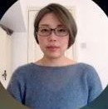
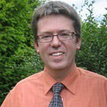
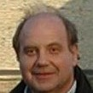
ISB-cochair
ISB-cochair
Stefan Hild
Jan Harms
Stefan Hild
Jan Harms
Division Cochair
Division Cochair
Division Cochair
Division Cochair
Division Cochair
Division Cochair
Division Cochair
Division Cochair
Division Cochair
Division Cochair
Alessandro Bertolini
Francesco Fidecaro
Edwige Tournefier
Stuart Reid
Jérôme Degallaix
Stefan Danilishin
Steffen Grohmann
Fulvio Ricci
Luca Naticchioni
Conor Mow-Lowry
Alessandro Bertolini
Francesco Fidecaro
Edwige Tournefier
Stuart Reid
Jérôme Degallaix
Stefan Danilishin
Steffen Grohmann
Fulvio Ricci
Luca Naticchioni
Conor Mow-Lowry
WP Cochair
WP Cochair
WP Cochair
WP Cochair
WP Cochair
WP Cochair
WP Cochair
WP Cochair
WP Cochair
Roberto Passaquieti
Oliver Gerberding
Alex Amato
Iain Martin
Stefan Danilishin
Teng Zhang
Antonio Pasqualetti
Soumen Koley
Francesca Badaracco
Roberto Passaquieti
Oliver Gerberding
Alex Amato
Iain Martin
Stefan Danilishin
Teng Zhang
Antonio Pasqualetti
Soumen Koley
Francesca Badaracco
WP Cochair
WP Cochair
WP Cochair
WP Cochair
WP Cochair
WP Cochair
WP Cochair
WP Cochair
WP Cochair
WP Cochair
Paola Puppo
Jan-Simon Hennig
Jessica Steinlechner
Benoît Sassolas
Paola Puppo
Jan-Simon Hennig
Jessica Steinlechner
Benoît Sassolas
Julia Casanueva
Daniel Brown
Paolo Chiggiato
Aniello Grado
Mariusz Suchenek
Rosario De Rosa
Julia Casanueva
Daniel Brown
Paolo Chiggiato
Aniello Grado
Mariusz Suchenek
Rosario De Rosa
WP Cochair
WP Cochair
WP Cochair
WP Cochair
WP Cochair
WP Cochair
WP Cochair
Giles Hammond
Flavio Travasso
Margherita Turconi
Benno Willke
Hartmut Grote
Annalisa Allocca
Giles Hammond
Flavio Travasso
Margherita Turconi
Benno Willke
Hartmut Grote
Annalisa Allocca
Irene Fiori
Irene Fiori
WP Cochair
WP Cochair
WP Cochair
WP Cochair
WP Cochair
WP Cochair
WP Cochair
WP Cochair
Chrsitophe Collette
Alberto Gennai
Keiko Kokeyama
Michal Was
Chrsitophe Collette
Alberto Gennai
Keiko Kokeyama
Michal Was
Bas Swinkels
Loïc Rolland
Christian Day
Roberto Cimino
Bas Swinkels
Loïc Rolland
Christian Day
Roberto Cimino
Paolo Ruggi
WP Cochair
WP Cochair
WP Cochair
WP Cochair
WP Cochair
WP Cochair
Division Cochair
Franco Frasconi
Joris van Heijningen
Giacomo Ciani
Henning Valbruch
Thierry Pradier
Laura Nuttall
Franco Frasconi
Joris van Heijningen
Giacomo Ciani
Henning Valbruch
Thierry Pradier
Laura Nuttall
Steffen Grohmann
Steffen Grohmann
WP Cochair
WP Cochair
WP Cochair
WP Cochair
WP Cochair
WP Cochair
Alessio Rocchi
Martin van Beuzekom
Lucia Trozzo
Nicolas Arnaud
Alessio Rocchi
Martin van Beuzekom
Lucia Trozzo
Nicolas Arnaud
Piero Rapagnani
Steffen Grohmann
Piero Rapagnani
Steffen Grohmann
WP Cochair
WP Cochair
Livia Conti
Mario Martinez
Livia Conti
Mario Martinez
Suspensions
Optics
Interferometer
Vacuum and Cryogenics
Active Noise Mitigation
Notes:
The ISB is quite a large board
The preparations for the Detector TDR are mostly done by ISB
So far, work is largely inner-divisional but cross-divisional activities are ramping up
As the desings of subsystems influence eahc other (similar to what was mentioned before)

Slide 6
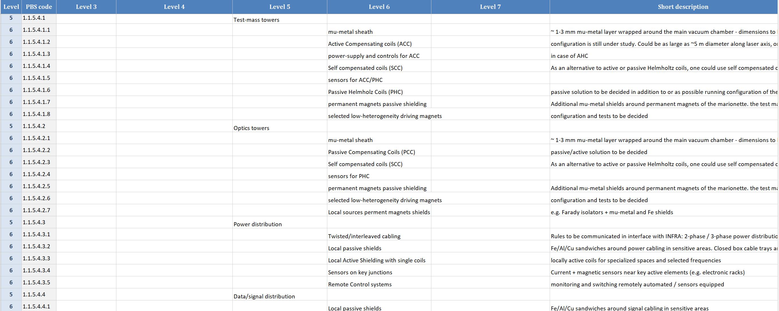
Recent / current / upcoming ISB Activities
Regular meetings of all ISB divisions to discuss sub-system designs, R&D progress, instrument science
More than 1000 entries in the first PBS version contributed by the ISB (of course, changes will still be made, and a finer structure is required)
R&D / activities survey: soon an online form will be filled by all RUs to get a complete overview of R&D activities

Slide 7
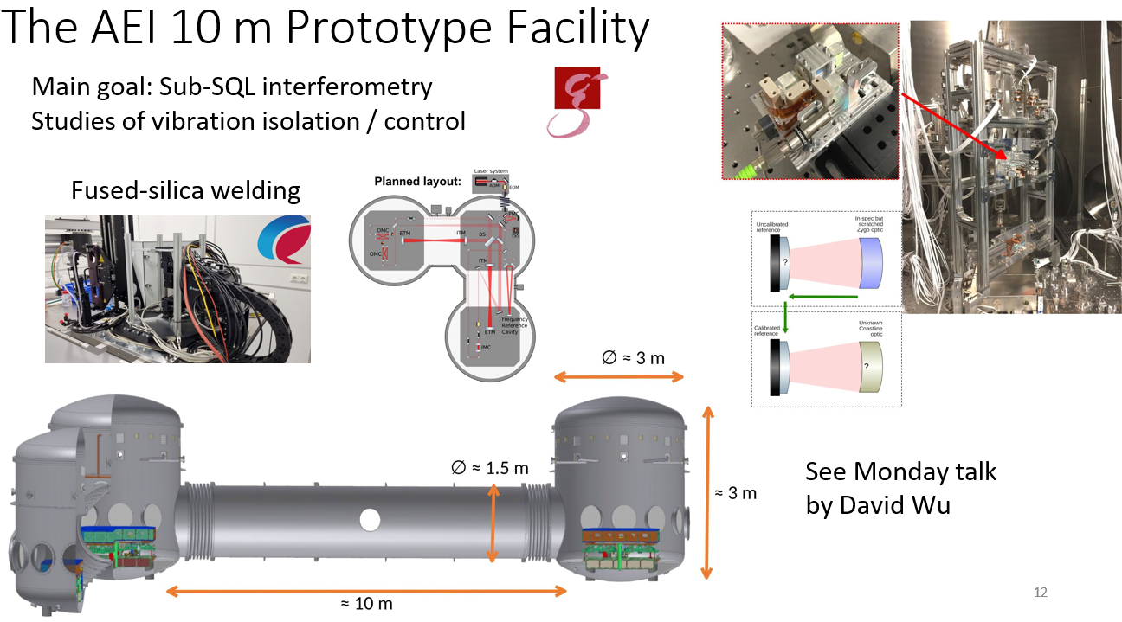
Major R&D Facilities in ET

Slide 8
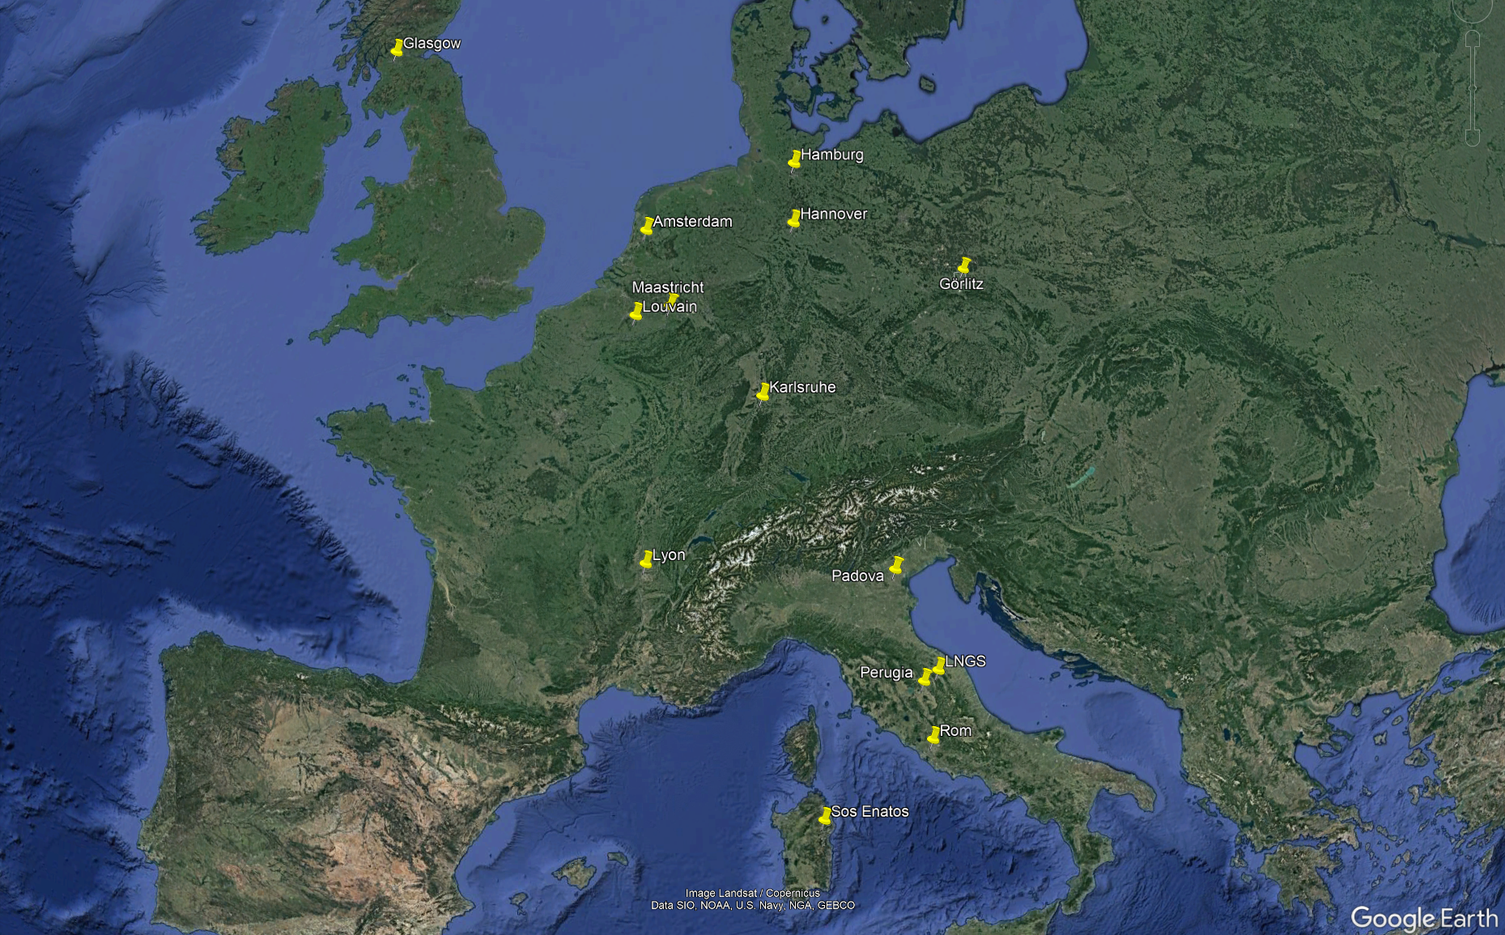
Major R&D Facilities in ET (incomplete)
Notes:
We have got a good numer of large research facilities scattered over the participating countries.
This map only shows a rather random and incomplete selection, i.e. those R&D ´facilities that were presented at the last ET Symposium.

Slide 9
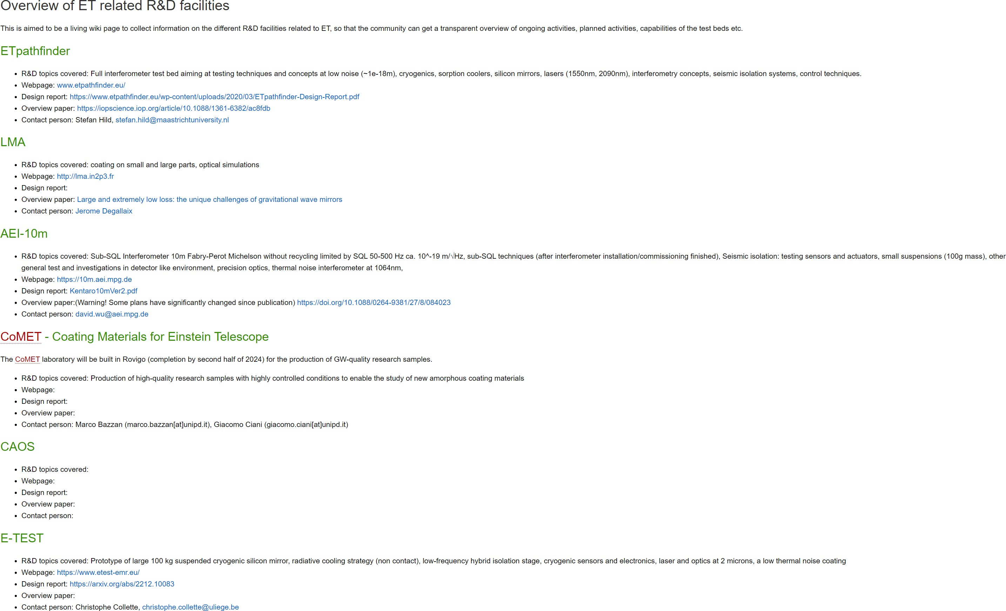
Wiki page for R&D Facilities
https://wiki.et-gw.eu/ISB/R_and_D_facilities
For the database the results from the online survey (to be launched soon) will be used.
Notes:
In parallel to the survey, we are preparing a wiki page on R&D

Slide 10
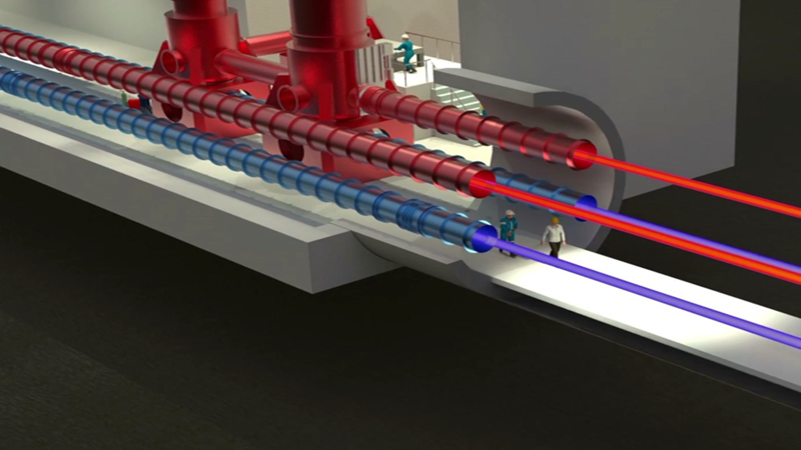
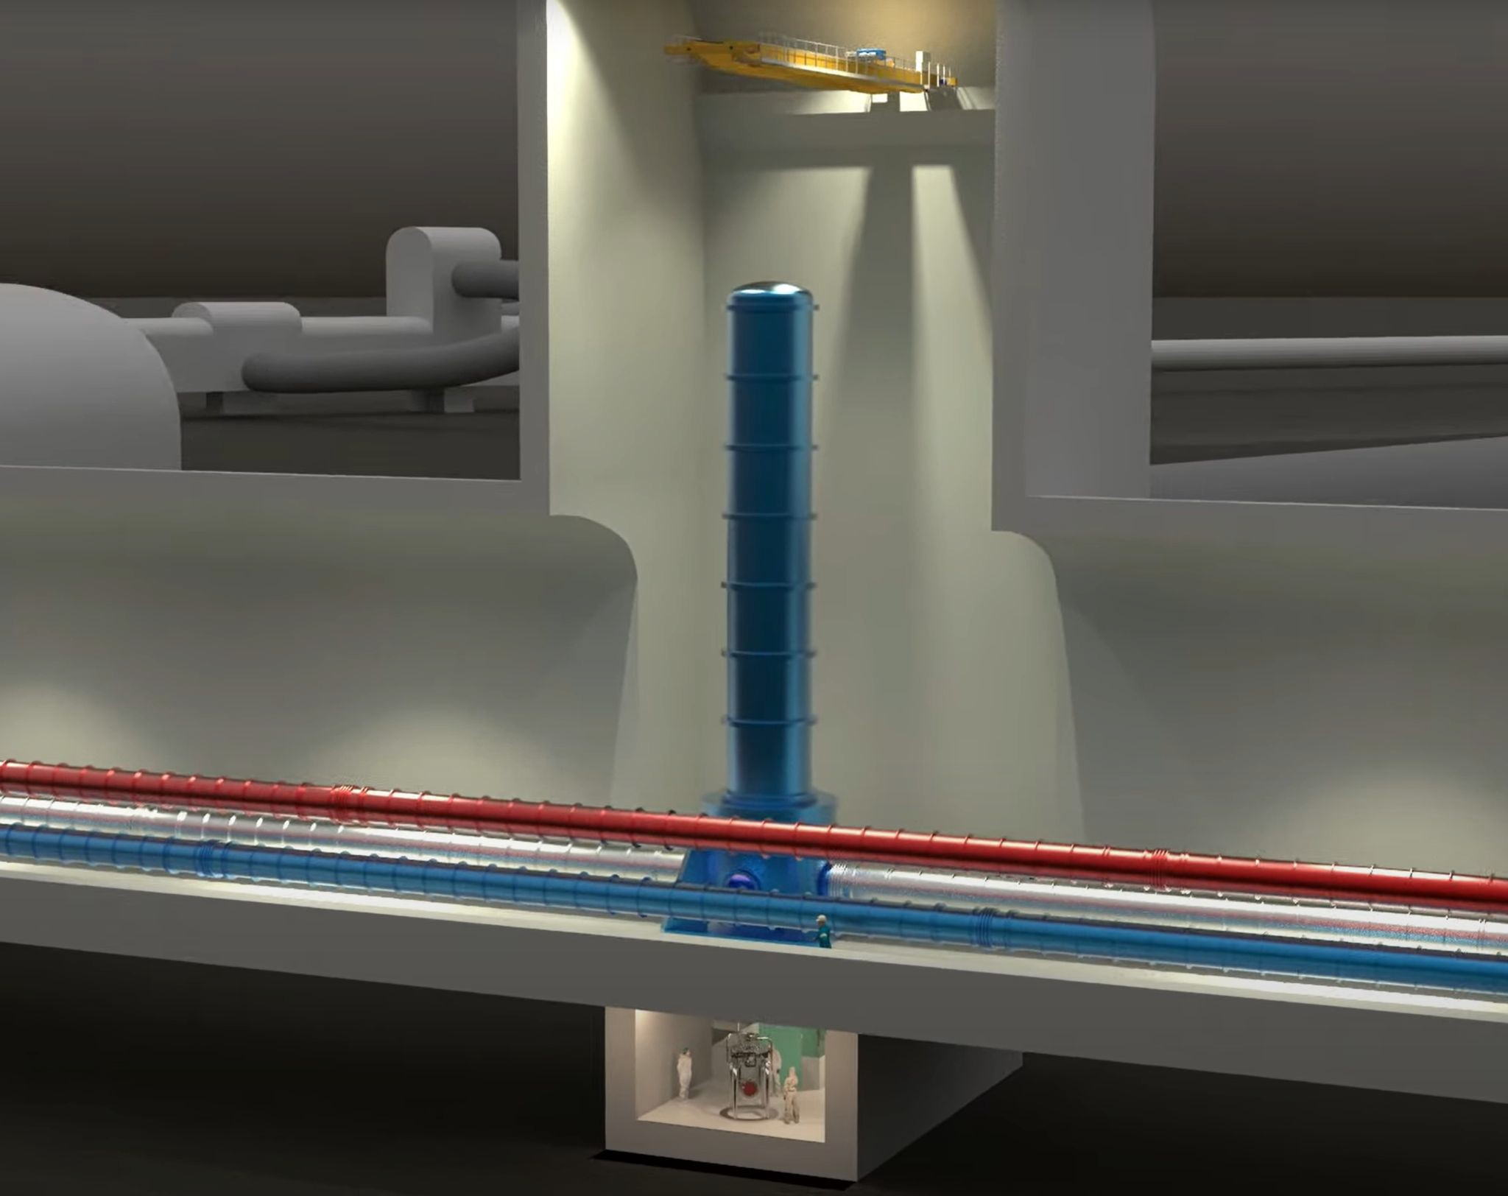
Hot Topics Session
Reasons for a hot topic discussion:
Identify such topics with large impact on infrastructure/costs
Foster activities for pushing these forward
Have a discussion on
what is needed (conceptual design, full demonstrator, etc) to take the technology/design/concept as a reference/baseline design for ET?
Topic examples:
Vacuum tube diameter and space required in the tunnel cross-section?
Cleanrooms under the test masses?
Cryogenic cooling technique?
Size/length of caverns vs flexibility to shift towers around?
Do we really need 17m tall super-attentuators (if so, how can we deal with their tilt coupling?)
What length is required for the filter cavities?
How many and what input Mode Cleaners are needed?
….
Work is currently underway on all the answers required for the TDRs

Slide 11
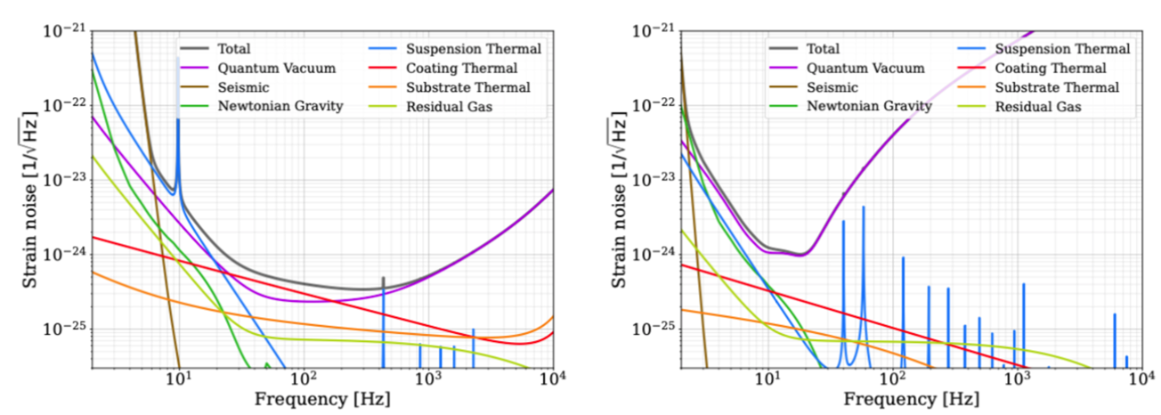
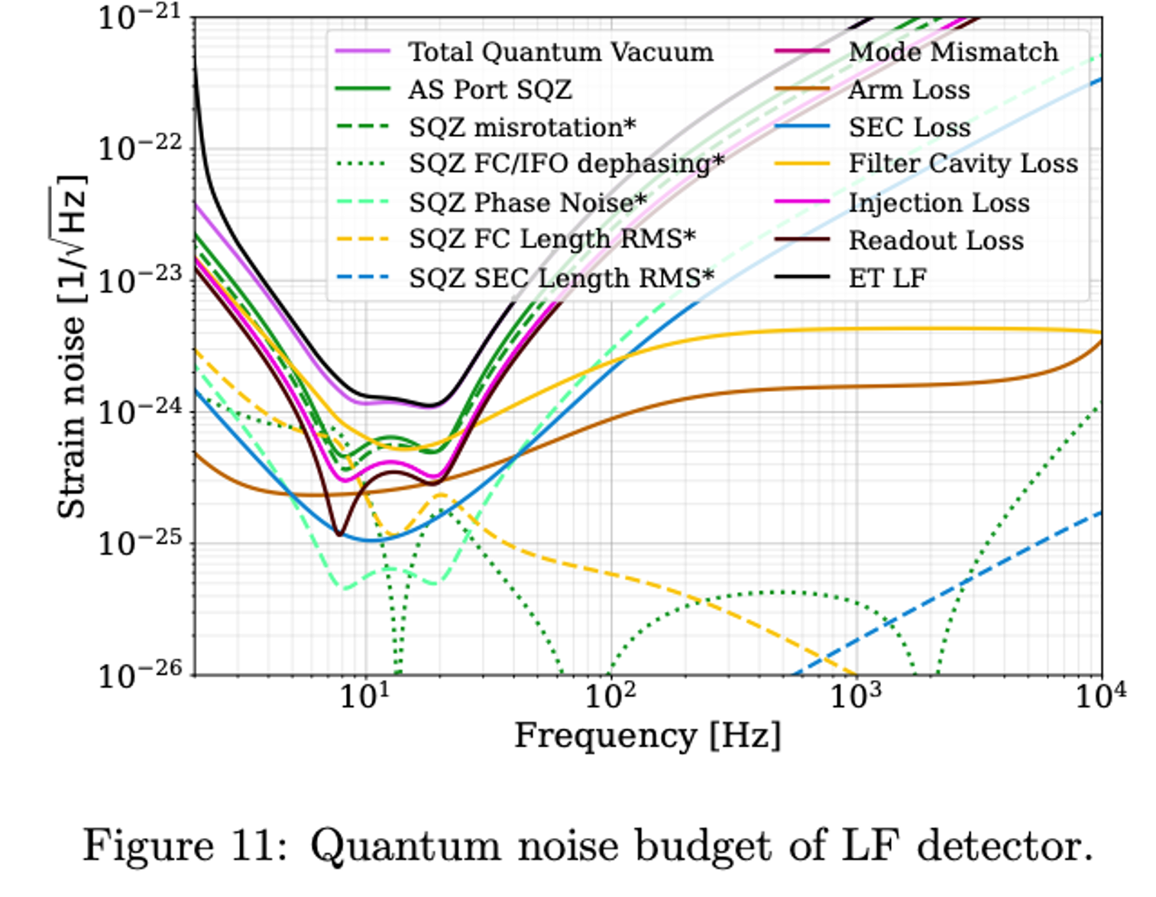
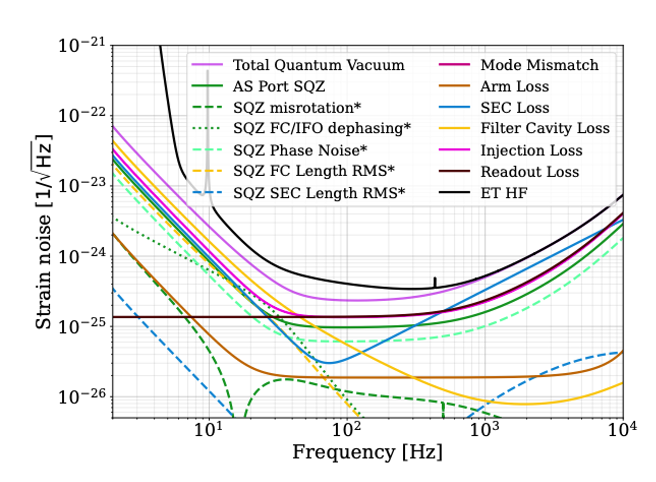
ET Sensitivity Curve
Goal：
More accurate simulations and new developments → we need an update of the sensitivity curve
Recover/revise ET D
A chance to reconsider the design (has to go through solid change request procedure)
Materials：
A GWINC model is available at https://gitlab.et- gw.eu/et/isb/interferometer/ET-NoiseBudget
An update document is available at https://www.overleaf.com/read/qjrcqmyvhrkv
Next steps:
Verification and consequences
Filter cavities challenging
Probably better ET-HF coatings available
New strategies for shortening SA
how does HOM coupling from mode mismatch influecnce squeezing requirements
…
Notes:
The whole nopise budget of ET has been recreated with the latest knowledge and tools.
This led to some potential changes we woul dmake, which have to pass a change request procedure, which we will define together with the PO.

Slide 12
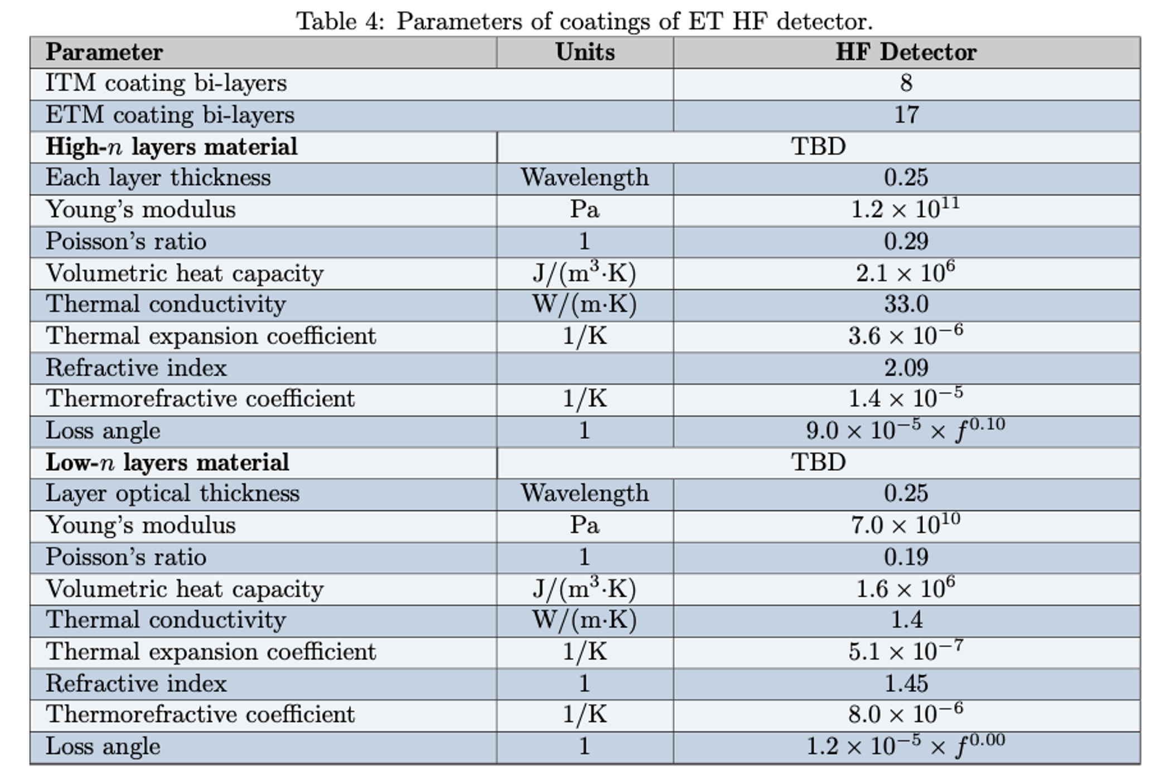
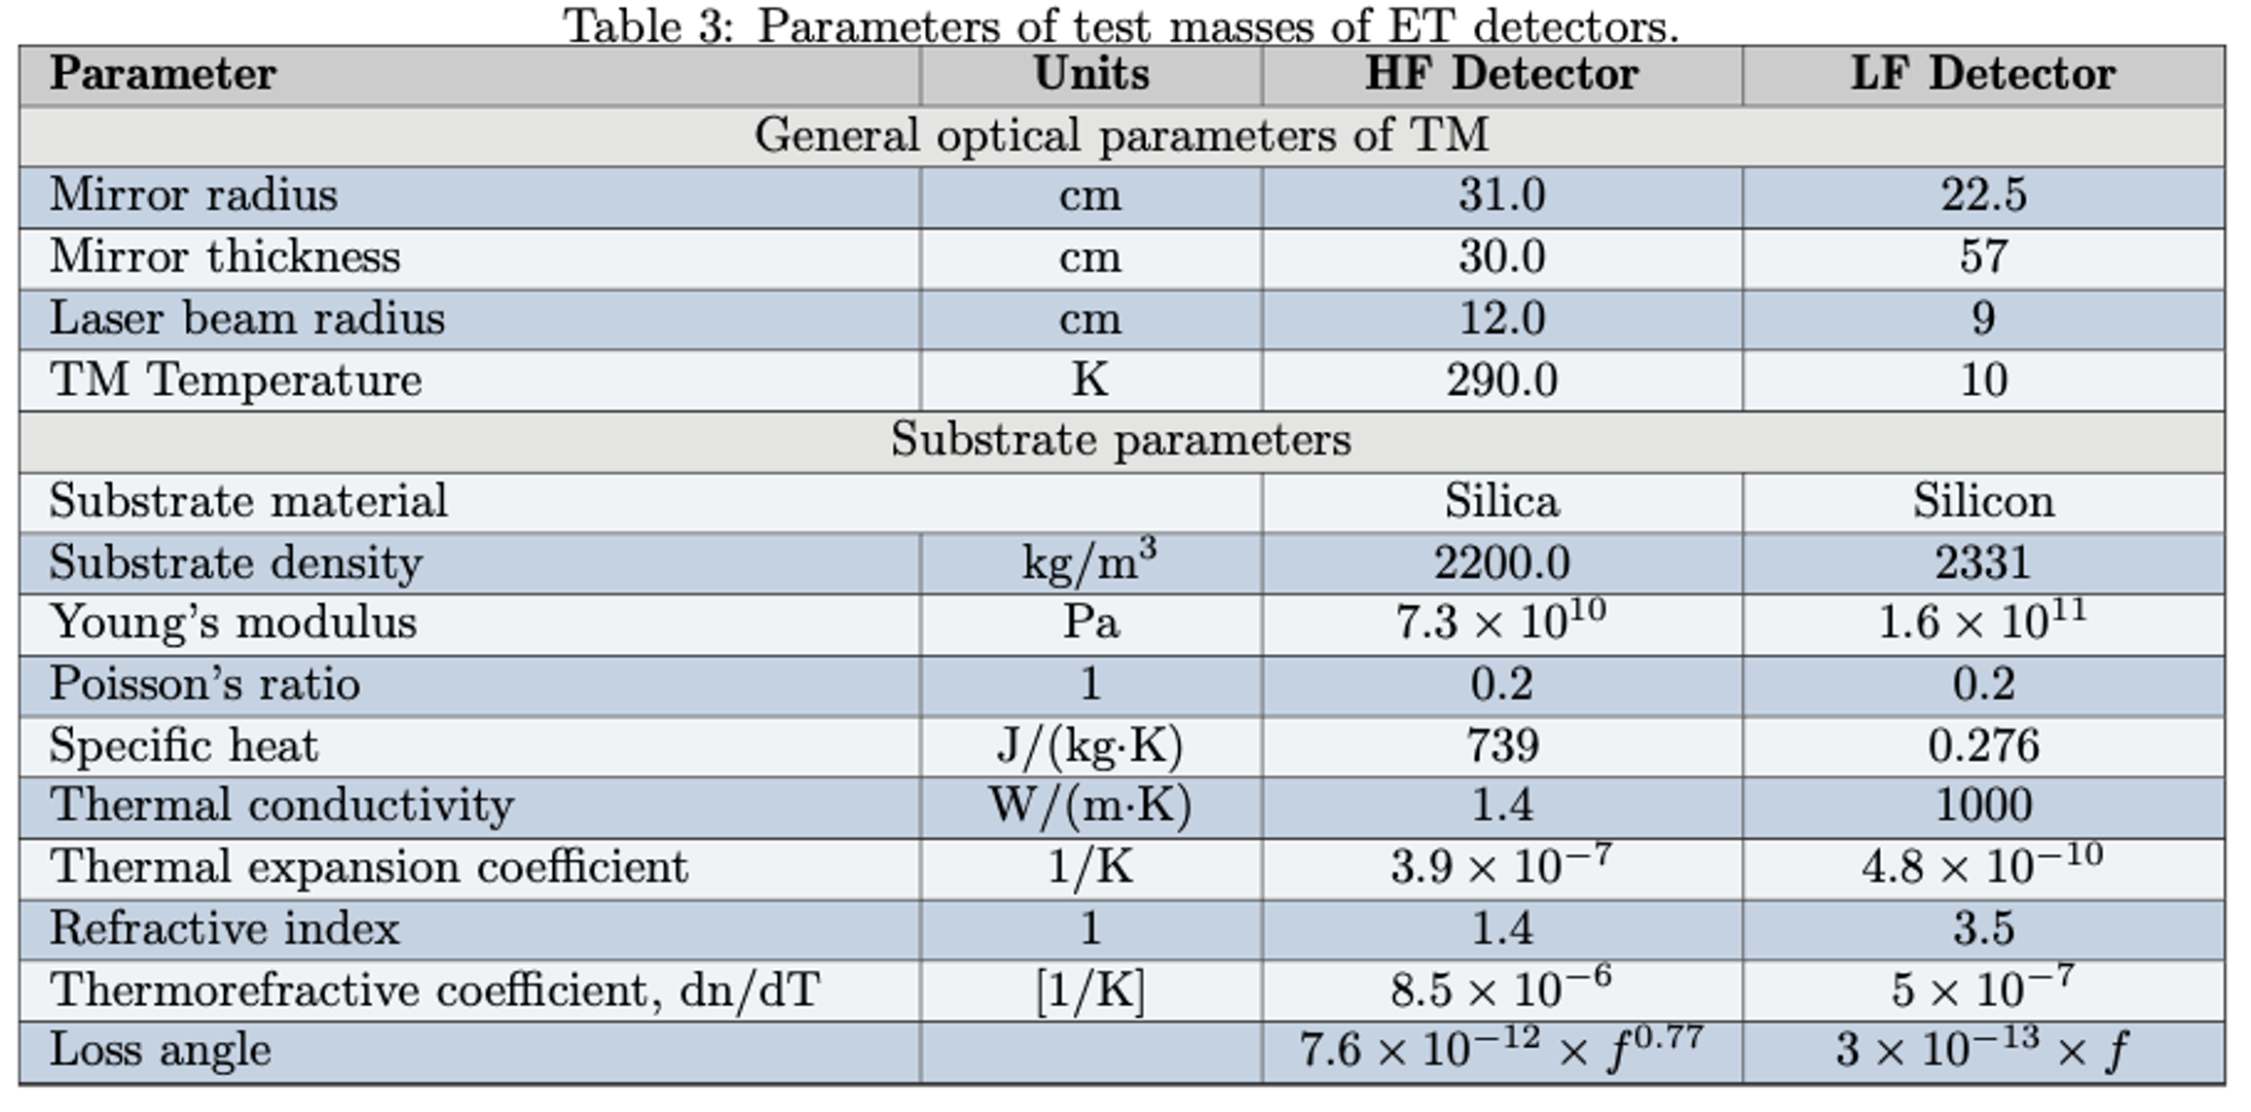
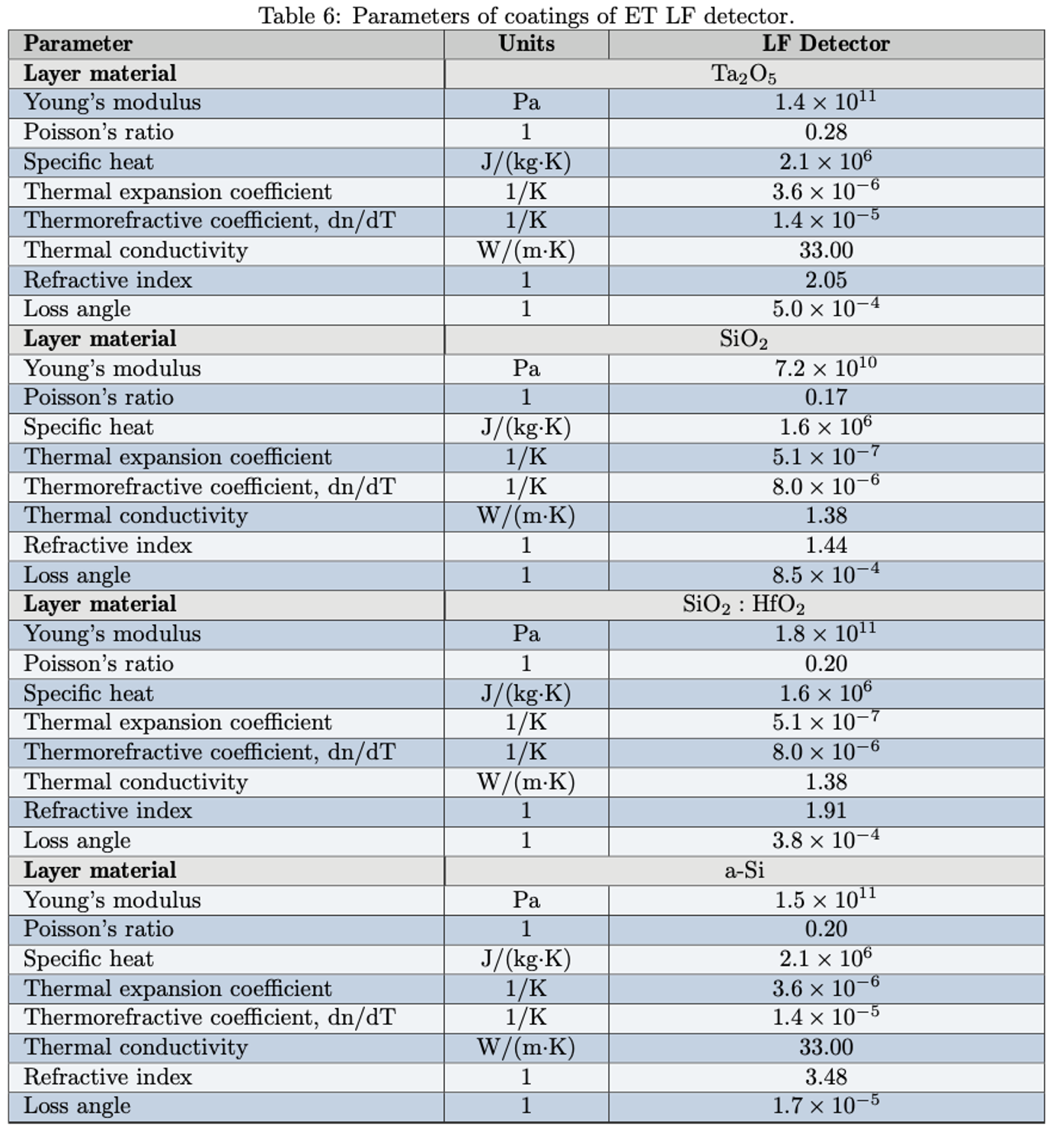
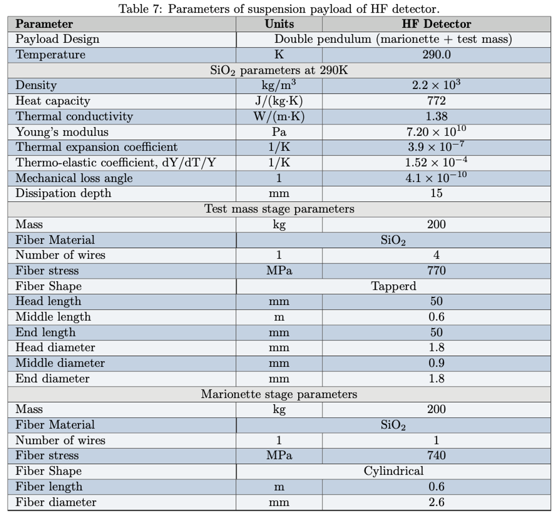
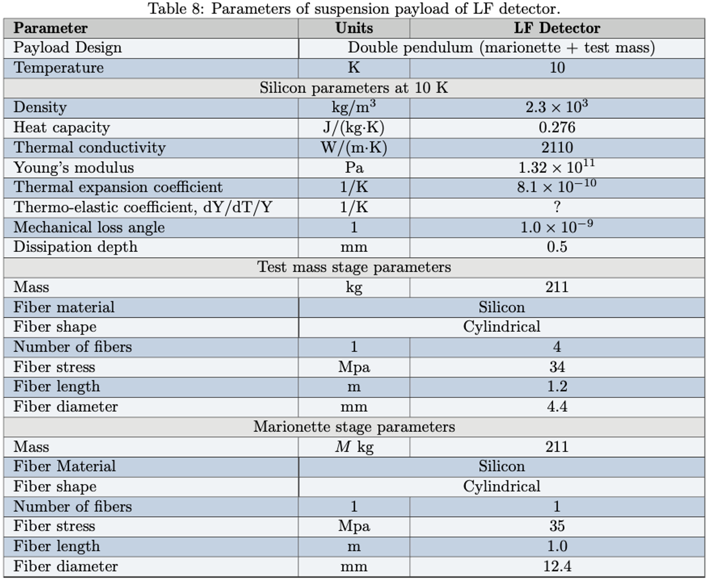
→ Parameter lists for all detector subsystems

Slide 13
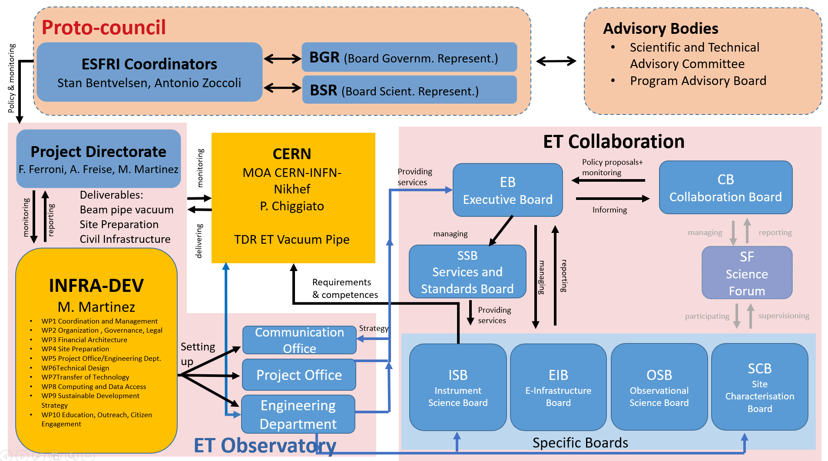
Site Preparation / Characterisation

Slide 14
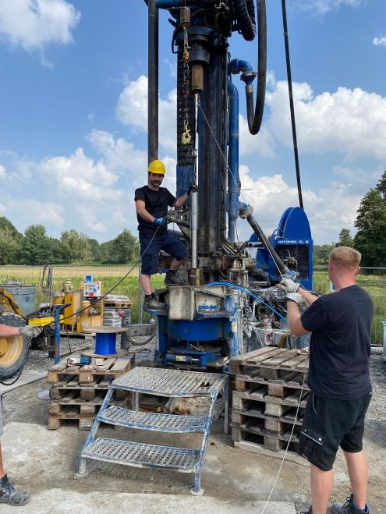
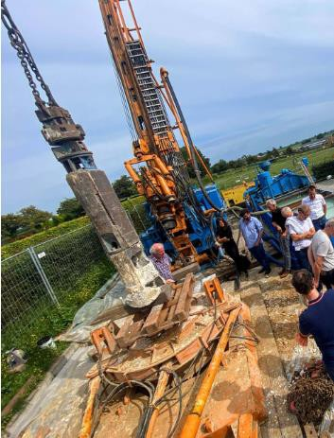
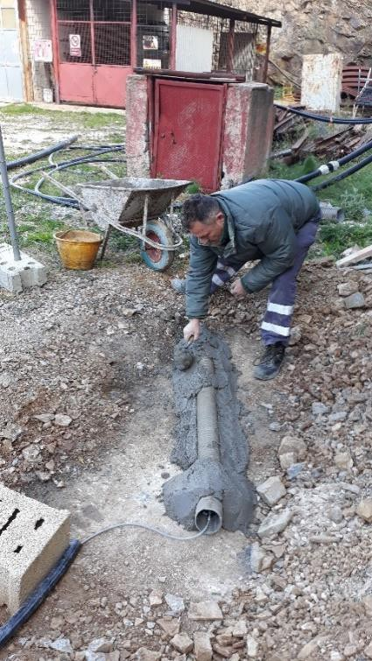
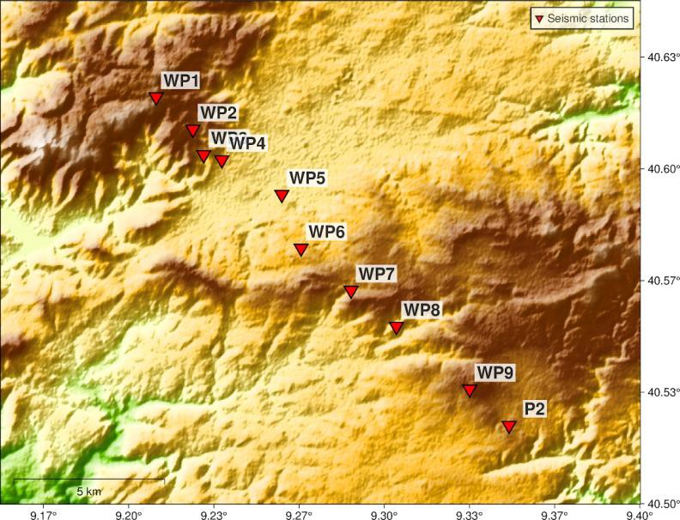
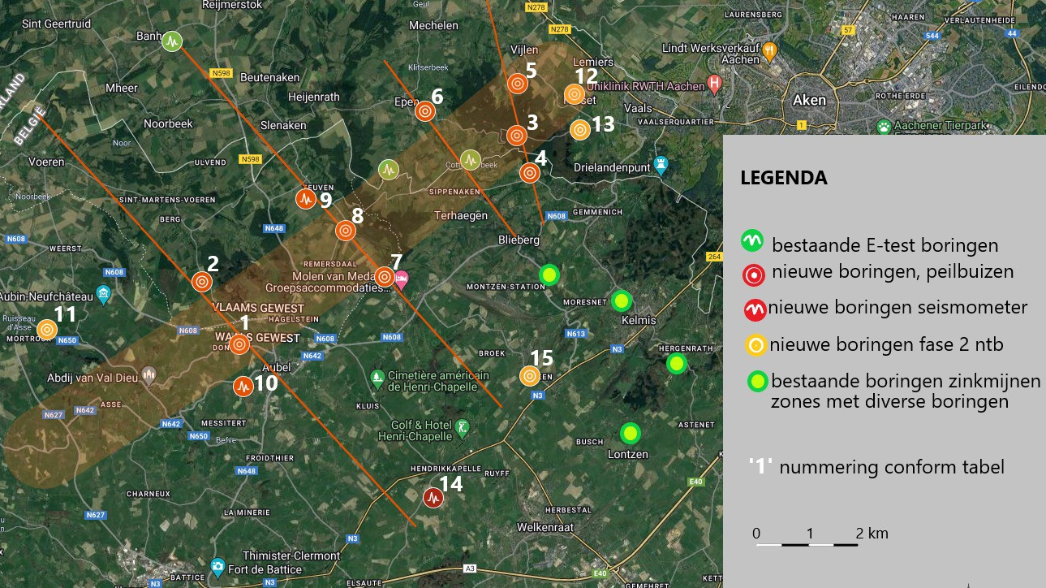
Site Characterisation/Preparation Board
ET Collaboration
Project Directorate
WD1
physical variables & characterisation
WD2
geology
WD3
bidbooks
WD4
costs, schedules &
risk assessment
WD5
legal issues &
site preservation
WD6
socio-economic & environmental impact
WP1.1
seismic noise
WP2.1
structural geology
WP1.2
gravimetry geodynamics
WP2.2
hydro-geology
WP1.3
magnetic noise
WP2.3
geophysics
WP1.4
other env. noise
WP2.4
geotechnics
5
Slide source. ET Symposium; W. Walk & D. D’Urso, modified

Slide 15
Next Steps
TDR A
Define breakdown of TDR into sub-TDRs
Not all detector aspects need to be defined at the time Infrastructure and Vacuum System TDRs must be mature
Define structure of TDRs
Produce skeletons of TDR
Connect skeletons to parameter DB
Fill skeletons with Content
Urgent to define timeline for all!
Intro
Sub_sec 1
Sub_sec 2
Chapter 1
Sub_sec 1
Sub_sec 2
Chapter 2
Sub_sec 1
Sub_sec 2
Chapter 1
Sub_sec 1
Sub_sec 2
Intro
Sub_sec 1
Sub_sec 2
Chapter 1
Sub_sec 1
Sub_sec 2
Chapter 2
Sub_sec 1
Sub_sec 2
Chapter 1
Sub_sec 1
Sub_sec 2
ISB
Intro
Sub_sec 1
Sub_sec 2
Chapter 1
Sub_sec 1
Sub_sec 2
Chapter 2
Sub_sec 1
Sub_sec 2
Chapter 1
Sub_sec 1
Sub_sec 2
TDR

