Slide 1
ET-PP INFRA-DEV WP5 Progress Report Barcelona, June 12th 2023
R.Flaminio
A.Freise
R.Saban

Slide 2
WP5 Outline
a short reminder of the objectives and the plan we had last year for
The Project Office
The Engineering Department
the progress since last year
Where are we today with the PO and the ED
The consultation within ET with other Work Packages
The investigations for a possible collaboration with CERN on a number of topics
where do we go from here : a plan for the coming year(s)

Slide 3
a short reminder …

Slide 4
a short reminder …
WP5 is the Project Office and the Engineering Department

Slide 5
The Project Office The pillars
The Project Office needs the following three Project Management pillars to be able to fulfil its mandate
The Configuration PBS, Requirements, Design, Parameters, Layouts, TDR
The Schedule WBS, Risk register, Financial Plan
The Cost Estimate PBS, WBS, TDR, Risk register, Financial plan
Courtesy Alessandro Variola

Slide 6
The first step: The Product Breakdown Structure – the WG
An ad hoc Working Group was appointed by the Executive Board and the Project Directorate.
Its mandate and the rules for the procedures are detailed in ET-0026A-23 in TDS.
Plenary meetings take place every month, each body builds up its own bit of the PBS.
Once the PBS is completed, the Technical Coordinator, will be in charge of the cross verification and the final editing.
The composition of the WG
Alessandro Variola, Head​ of the Project Office
Alessio Rocchi, Project Office Technical Coordinator​
Patrick Werneke, Head​ of the Engineering Department
Christian Olivetto, Project Office Configuration Manager​
Luca Latronico, Project Office Quality Manager​
Jan Harms, Co-chair​ of the Instrument Science Board
Stefan Hild, Co-chair​ of the Instrument Science Board
Patrice Verdier, Co-chair​ of the Electronics Infrastructure Board
Domenico D’Urso, Co-chair​ of the Site Preparation Board
Courtesy Alessandro Variola

Slide 7
The Product Breakdown Structure – the outcome
The WG had four plenary meetings and produced a close-out document, (ET-0170A-23) describing:​
The goals​ of the PBS
The strategy​ which was followed
The rules for the procedures
The PBS management plan​
The PBS related roles​
The traceability method​
The proposed nomenclature
Three PBS items have so far been defined by the Project Office and the Collaboration working closely together. These are :
Interferometers 908 units
Civil Infrastructures 707 units,
E-Infrastructures 71 units.
Courtesy Alessandro Variola
All the documentation related to the PBS is available in the ET Wiki:​
https://wiki.et-gw.eu/Main/PBSWorkingGroup/WebHome

Slide 8
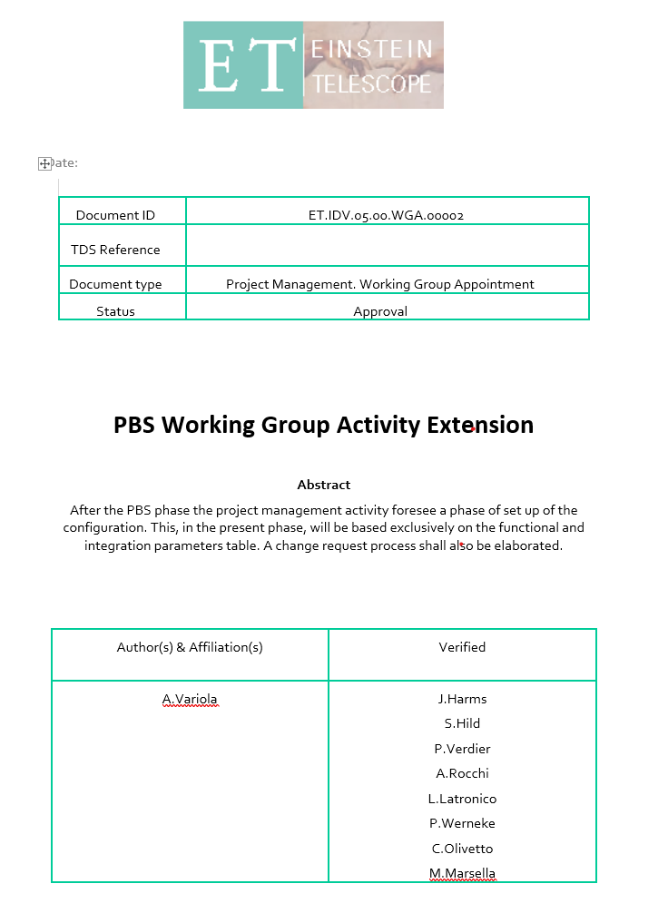
Building up the Configuration
Work has already started as an extension of the activity of the PBS WG. A document describing the mandate, the rules and the proposed activity has been prepared and verified. It will be referenced in TDS.
Given the priorities, the configuration process started with two parameter classes for each PBS unit:
Functional parameters
Integration parameters
The methodology will follow the one used for the PBS, which implies the need for a configuration database.
An agile ‘design phase’ change request process will be proposed.
Courtesy Alessandro Variola

Slide 9
a short reminder …

Slide 10
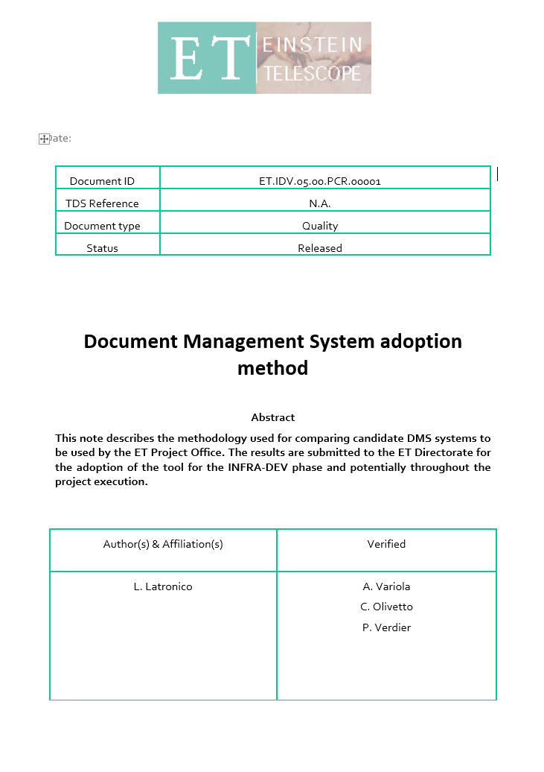
Selecting a computer assisted environment for documentation
The Project Office set the availability of a document lifecycle tool as the priority.
The features, the compatibility and the characteristics of four different systems were extensively analysed and compared to the requirements
Atrium (CNRS)
EDMS (CERN)
ESS-DTL DMS, based on Alfresco@INFN
TDS (Virgo and ET Collaboration)
and a report was sent to the Project Directorate.
Courtesy Alessandro Variola
PLM analysis and CAD survey are the next steps which will be integrated in the general configuration context.

Slide 11
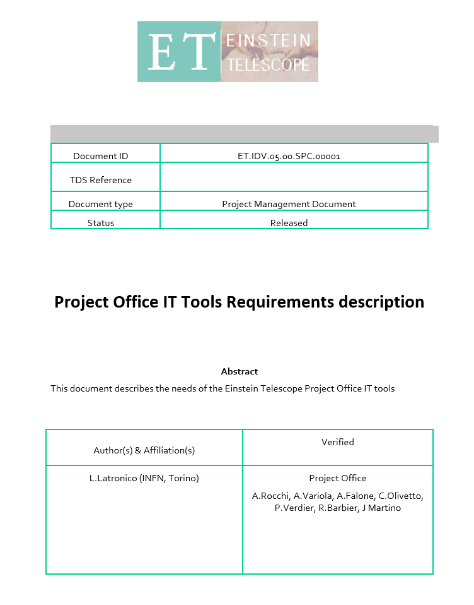
The deliverables of the Project Office

Slide 12
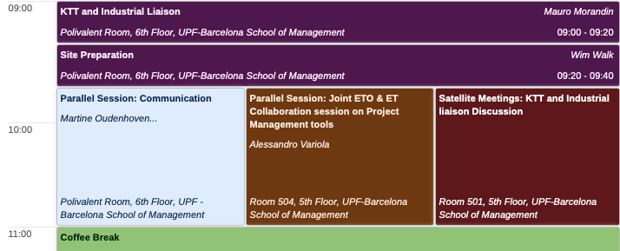
The session on the Project Management Tools

Slide 13
a short reminder …

Slide 14
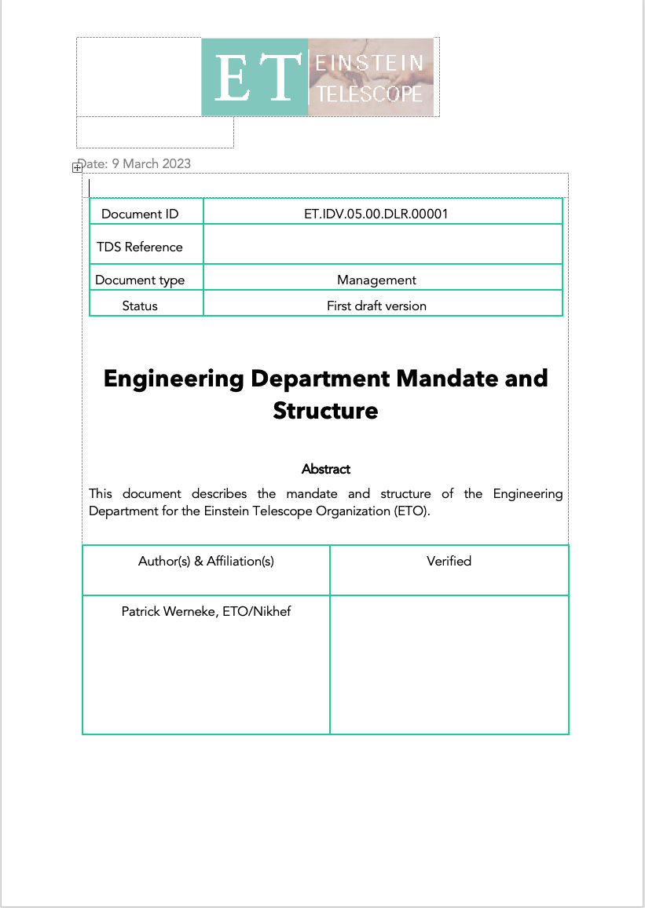
The fields of competence of the ED
Access Control
Cooling
Cryogenics
Electricity Distribution
Site Monitoring
Vacuum
Ventilation
Civil Engineering
Surface
Underground
Shafts
Mechanical Engineering
Technical Coordination in the Field
Transport and Handling

Slide 15
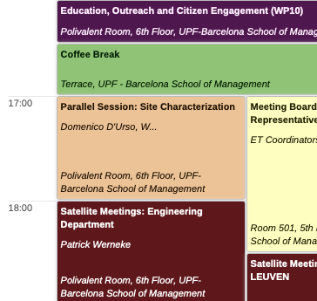
The session on the ED this afternoon
Organization of the Engineering Department | Patrick Werneke
Activities of the Civil Engineering | Maria Marsella
Courtesy Patrick Werneke
Interference of the Beampipe and Civil Infrastructures | A working session

Slide 16
The consultations within ET with other Work Packages
The Executive Board and the ISB | for steering Project Office activities and the data collection
Liaison Group of WP7 | to provide input for the Innovation Plan
In preparation for the procurement activity of the Engineering Department, once the ideas on the style of the governance mature, other domains, like procurement processes, should be explored.

Slide 17
The on-going investigations for a possible collaboration with CERN on a number of topics
Safety | A one day seminar was organised at CERN to assess whether or not the CERN HSE Unit could become an inspirational model for a similar unit for the Einstein Telescope. See report ET-0208A-23 in TDS.
Engineering Data Management System | Discussions are ongoing, but two meetings already took place, to explore the functionalities and the setting up of a possible collaboration.
Engineering Department | A meeting at CERN is organised for October 18th 2023 to explore possible fields of collaboration with the Engineering Department there.

Slide 18
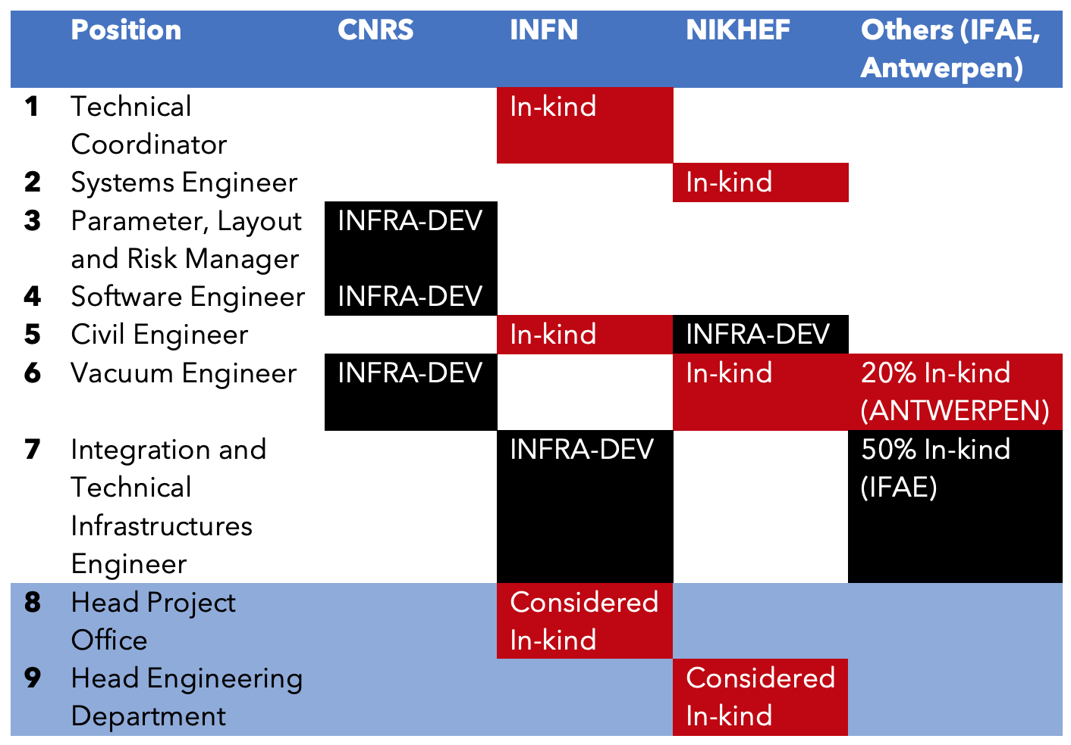
Personnel
In office
In office
Still vacant, recruitment
process was re-launched
Recruited in Paris
Still vacant
Still vacant, recruitment
process was re-launched
Recruited in Annecy
Recruited
Still vacant, recruitment
process was re-launched
In office
In office
After almost one year, three INFRA-DEV PP positions remain vacant despite repeated recruitment attempts !

Slide 19
In-kind personnel
CNRS In-kind
Parameter, Layout, Risk Christian Olivetto, Joseph Martino
Software environment Remi Barbier, Patrice Verdier
INFN In-kind
Technical Coordinator Alessio Rocchi 80%
Civil Engineer Maria Marsella and her team 100%
Head of the Project Office Alessandro Variola 80-100%
Quality Manager Luca Latronico 25%
Joined during the course of this year
NIKHEF In-kind
Head of the Engineering
Department Patrick Werneke
Vacuum Engineer Marije Barel
Systems Engineer remains to be recruited

Slide 21
… where do we go from here ?
Catch up with what we have failed to deliver. In particular, the recruitment of the resources funded by INFRA-DEV.
Continue to develop the activities of the Project Office and the Engineering Department closely working together with the Collaboration
As we progress with the definition of the modus operandi of the Project Office and of the Engineering Department, new needs for human and material resources come into focus.

Slide 22
Acknowledgments
Alessandro Variola
Rémi Barbier
Luca Latronico
Maria Marsella
Joseph Martino
Christian Olivetto
Alessio Rocchi
Patrice Verdier
Patrick Werneke
Domenico D’Urso
Gianluca Gemma
Jan Harms
Stefan Hild
Harald Lück
Michele Punturo
Patrick Werneke
Marije Barel
Maria Marsella
Benoit Delille
Julia Double
Katy Foraz
Angela Goehring-Crinon
Sonja Kleiner
Joanne Madden
Rui Samoes
Jean-Philippe Tock
David Widegren
Engineering
Department
Activities
Paolo Chiggiato
Luigi Scibile
CERN
Project Office Activities
… and Mario Martinez-Pérez

