Slide 1




ET beampipe activities at CERN: status report and plan
Paolo Chiggiato on behalf of the ET vacuum team at CERN
June 12th, 2023

Slide 2
Content
The approved agreement and its objectives.
The CERN team and collaborations.
The main achievements since September 2022 by work package.
Plan for the next twelve months.
Conclusions.

Slide 3
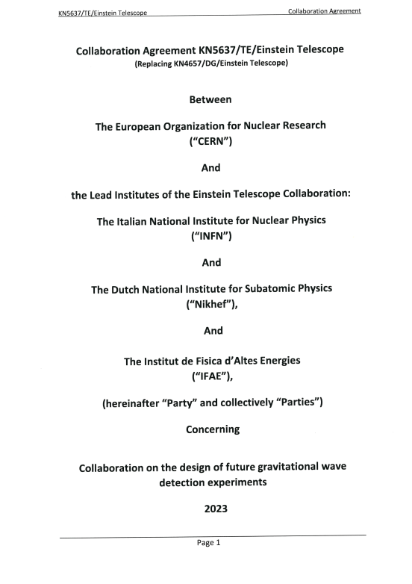
The approved agreement.
The general agreement
  The CERN contribution to the ET study was set up in 2019 in a collaboration agreement with INFN and Nikhef. This year, IFAE has also joined the agreement.
  This is the framework for addenda in specific topics of common interest.

Slide 4
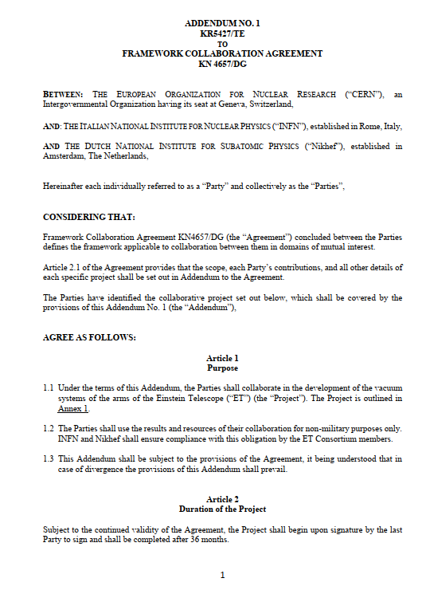
The approved addendum.
The specific agreement (addendum)
  On July 2022, INFN, Nikhef and CERN signed an addendum about CERN contribution to ET beampipes.
  On a practical basis, CERN activities started on September 2022.
  The main objectives are:
      Coordinate the contributions of all Parties involved in the study of ET beampipes.
      Preparation and writing of the ‘Technical Design Report’ for the vacuum systems of the ET’s arms, including cost estimations.
      Design, manufacturing, assembling, and tests of a pilot sector of the selected ET-beampipe vacuum systems.
      Contact and sharing of information with Cosmic Explorer

Slide 5
The work structure.
WP5:
installation
WP6:
vacuum
WP1: engineering
WP2:
production
WP3:
treatments
WP4:
transport
Installation procedure and interface with other systems
Choice of vacuum pumps and valves
Design and engineering of the vacuum chamber
Choice of materials and manufacturing technology
Choice of post-manufacturing treatments
Handling and logistics
WP7:
prototyping
WP8:
coordination
Each work package will provide input for the TDR and cost estimation.
The work packages are interconnected and they need active coordination.
WP1, WP2 and WP6 are the most advanced as they started before the signature of the addendum.
Installation and test of a pilot sector
Coordination of the different work packages and contribution of collaborators

Slide 6
The CERN team
Name | Competences | Workpackage
Cedric Garion | Structural mechanics | WP1
Carlotta Accettura | Mechanical design | WP1
Ana Teresa Perez | Metallurgy | WP2/WP8
Gilles Favre | Manufacturing | WP2
Audrey Vichard | Welding | WP2
Stefano Sgobba | Metallurgy | WP2
Manjunath Dakshinamurthy | Metallurgy | WP2
Leonel Ferreira | Surface treatments | WP3
Mauro Taborelli | Surface analysis | WP3
Name | Competences | Workpackage
Luigi Scibile | Premises and logistics | WP4&WP5
Gregory Pigny | Vacuum control | WP6
Giuseppe Bregliozzi | Vacuum engineering | WP6
Carlo Scarcia | Vacuum engineering | WP2/WP6
Jose Ferreira | Vacuum modeling | WP6/WP7
Alice Michet | Vacuum measurement | WP6
Jan Hansen | Mechanical engineering | WP7
Ivo Wevers | Vacuum measurement | WP6/WP7
Paolo Chiggiato | Coordination | WP8
By contract, during the three-year agreement, two FTE/y of CERN staff and two CERN fellows work for ET.

Slide 7
Collaborations
Institute | Subject | Type of agreement | Contacts
CNRS LAPP | Mechanical design | Informal collaboration Chair of WP1 | Guillaume Deleglise
CNRS IJCLab | Design of ‘baseline solution’ | Informal collaboration | Denis Reynet/G. Iaquaniello
IFAE | Baffles design and integration | Framework agreement | Mario Martinez/Marc Andres
Nikhef | Pumping modules | Framework agreement | Martijn van Overbeek / Patrick Werneke
U. Gent | Pipeline solution | Informal collaboration (Post-doc at CERN) | Leo Kestens / Alexey Gervasyev
U. Aachen | Supervision of a PhD student | Gentner programme | Achim Stahl
INFN | Magnetic measurements | Framework agreement (PhD student at CERN) | Aniello Grado
Uni. Antwerp | In preparation… |  | Nick Van Remortel
Cooperation with industries: Aperam, Arvedi, SAES, Agilent Vacuum…

Slide 8
Main achievements of WP1
WP1: engineering
Four designs have been considered:
    Baseline: Virgo-like solution adapted to ET tunnel (G. Iaquaniello, CNRS).
    Corrugated wall: 1.3-mm thick wall with regular corrugations (C. Garion).
    Double wall chamber with thermal insulator between the two walls (G. Deleglise, CNRS).
    Pipeline (US collaborators).
For the first two, we have a detailed:
    thermal-structural analysis;
    vibration modal analysis;
    design of different support systems (rigid and suspended);
    positioning in the tunnel.
The double wall solution is under investigation.
The pipeline option is being studied in collaboration with the University of Gent.

Slide 9
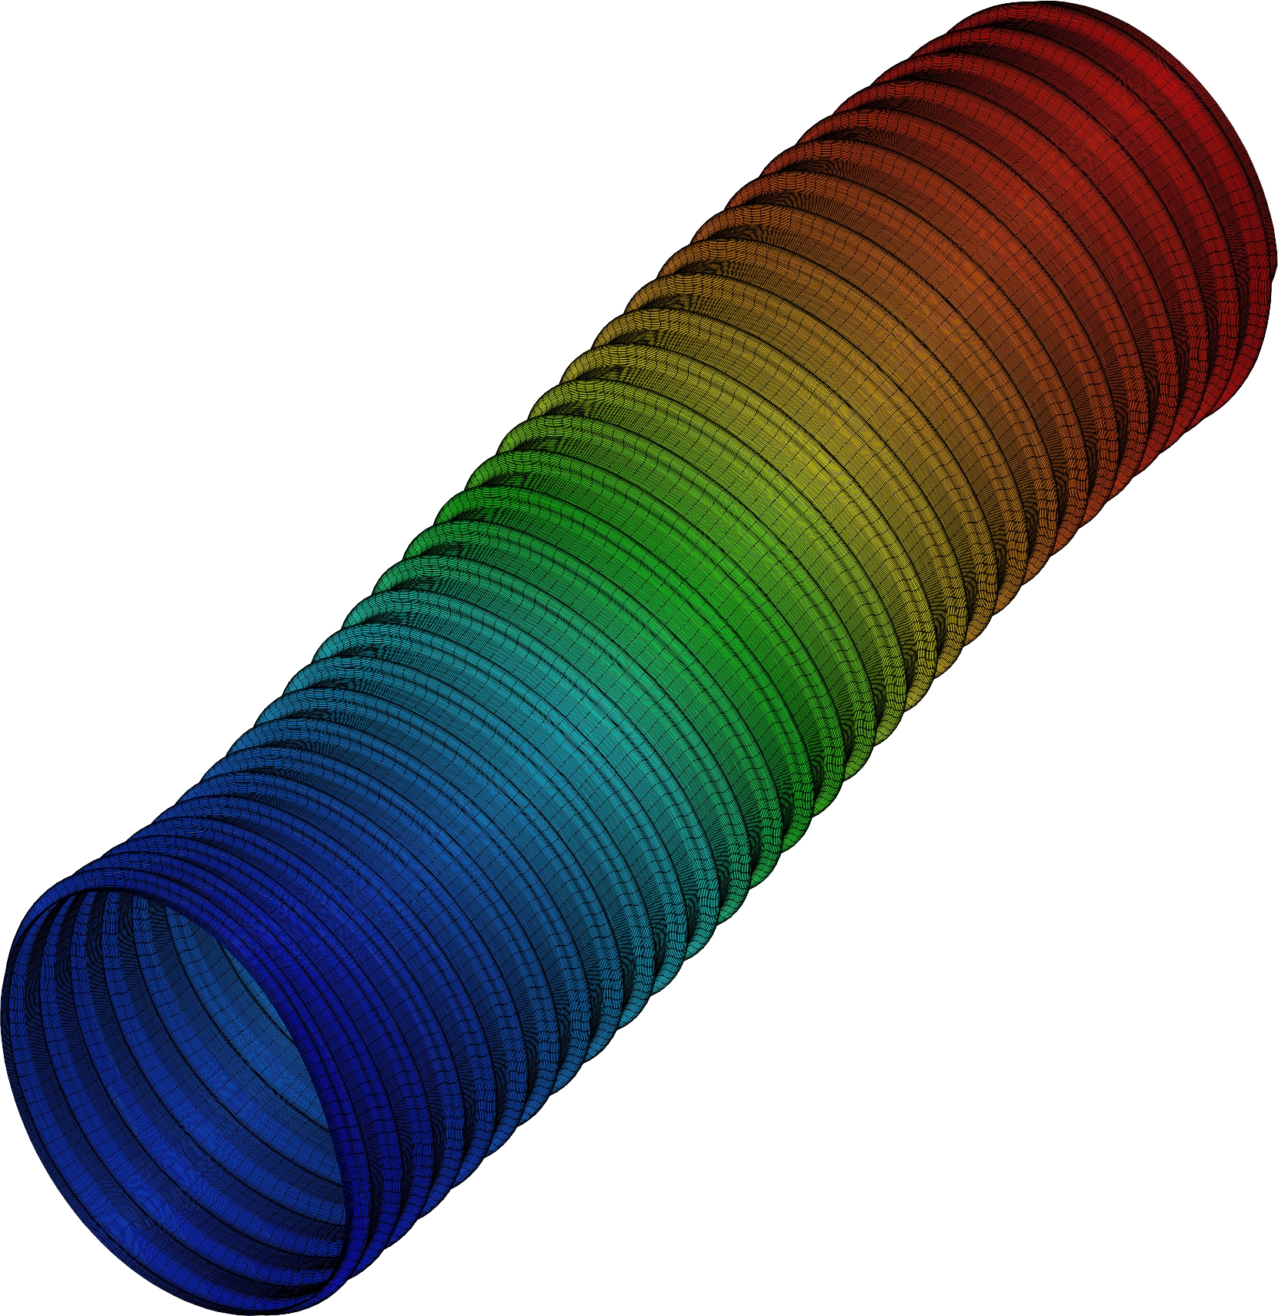
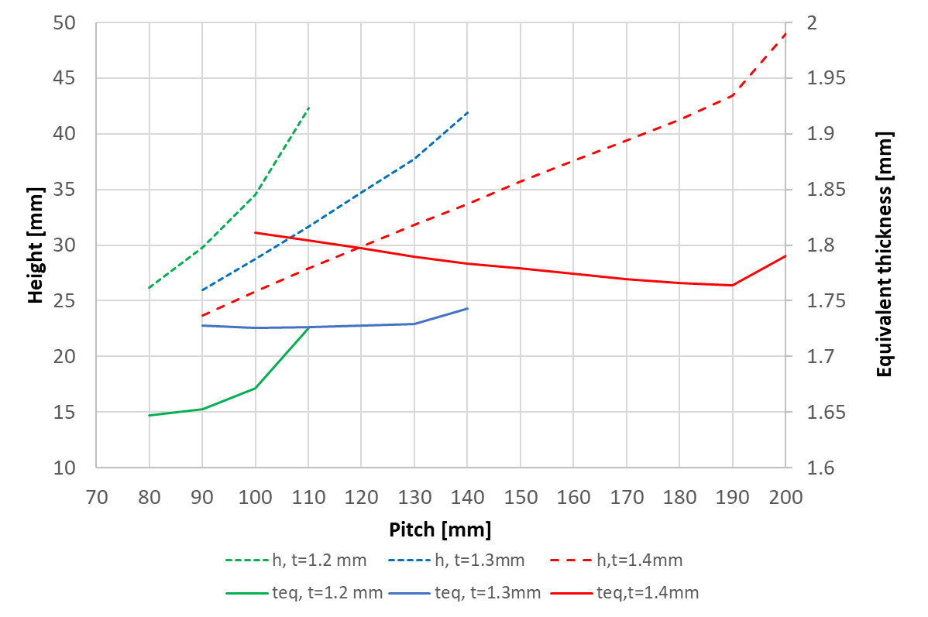
Main achievements of WP1: stability studies
Specific weight: 48 kg/m
3600 mm
Wall thickness in the range 1.2-1.5 mm can be considered for a buckling differential pressure of 3 bars.
p
1.3 mm thick wall chamber is a good compromise with a 120 mm pitch and 35 mm corrugation height. Possible optimisation with other constraints.
t
h
Cedric Garion
2h

Slide 10
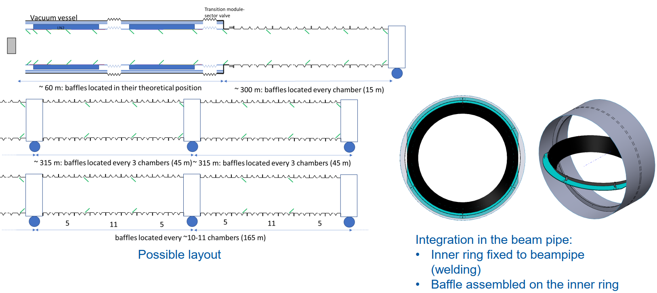
Main achievements of WP1: baffles positioning
Cedric Garion and Mario Martinez’s team

Slide 11
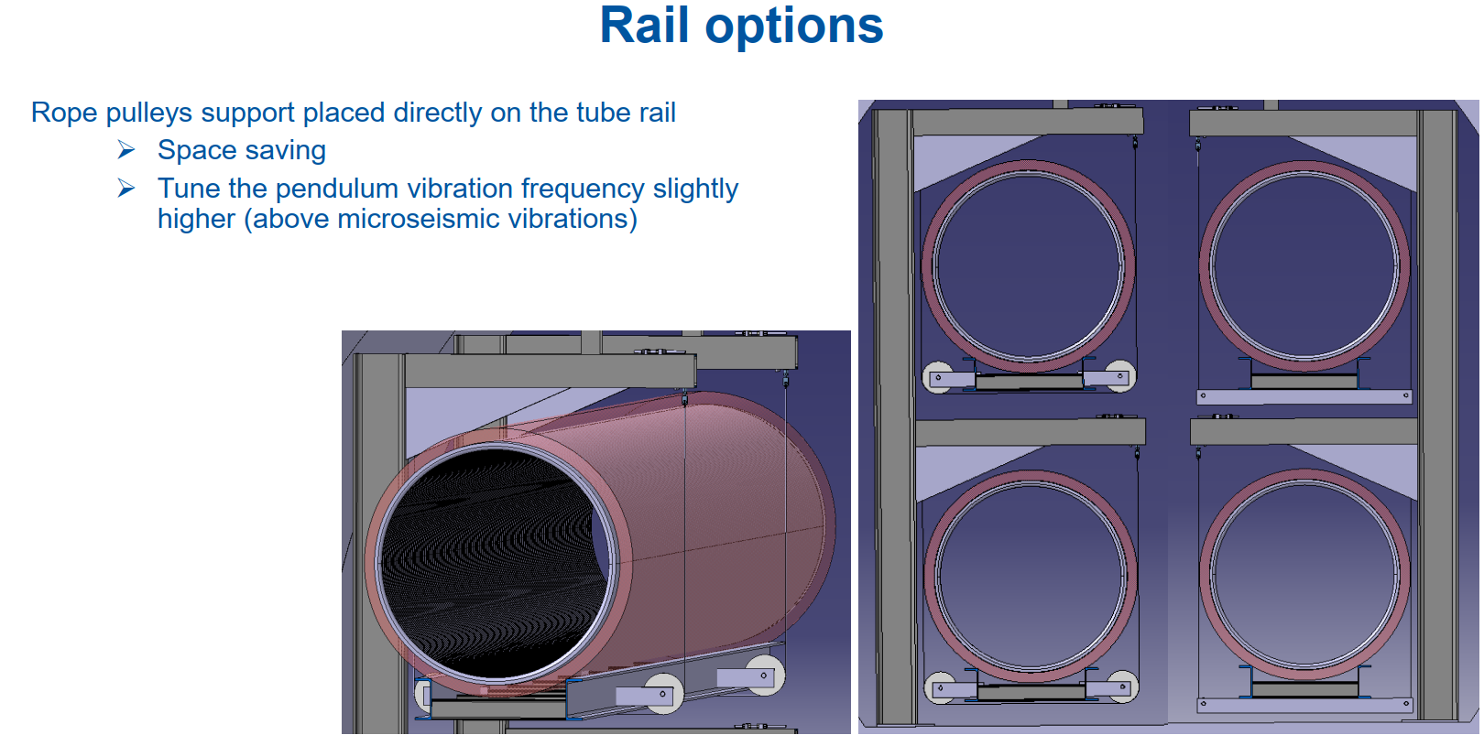
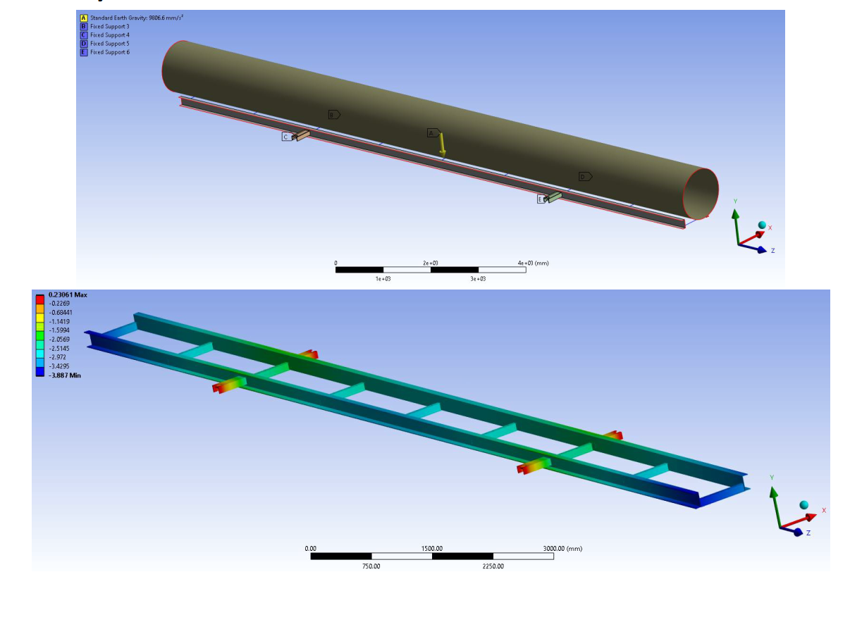
Main achievements of WP1: beampipe support
Example of installation in the tunnel on corrugated beampipe that are placed on rail suspended by fibre ropes.
This solution aims to reduce the transmission of vibrations to the baffles and to lower the frequency of the first eigen mode (but slightly higher than the microsismic frequency ≈ 0.3 Hz).
Cedric Garion and Hana Havlikova

Slide 12
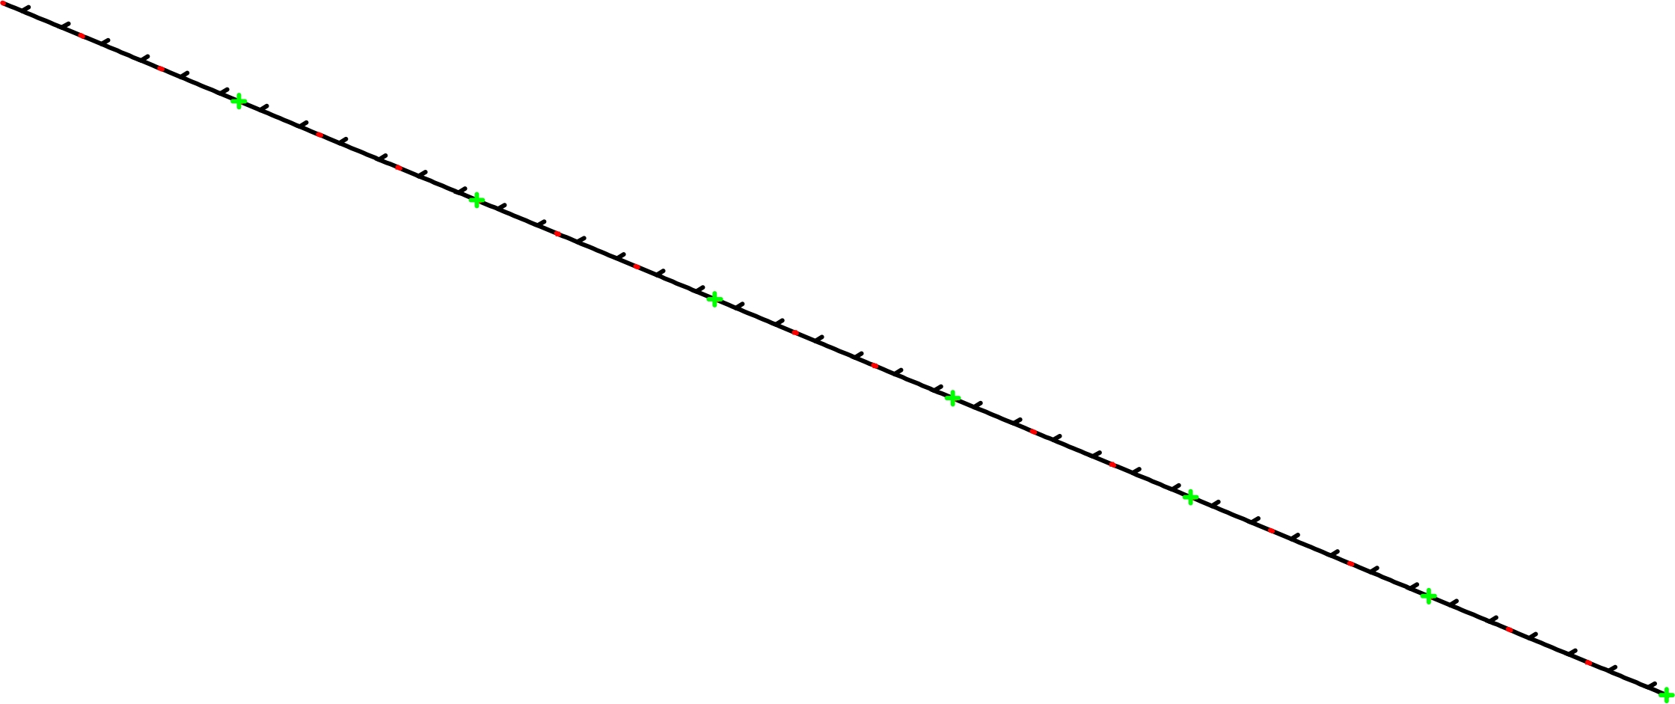
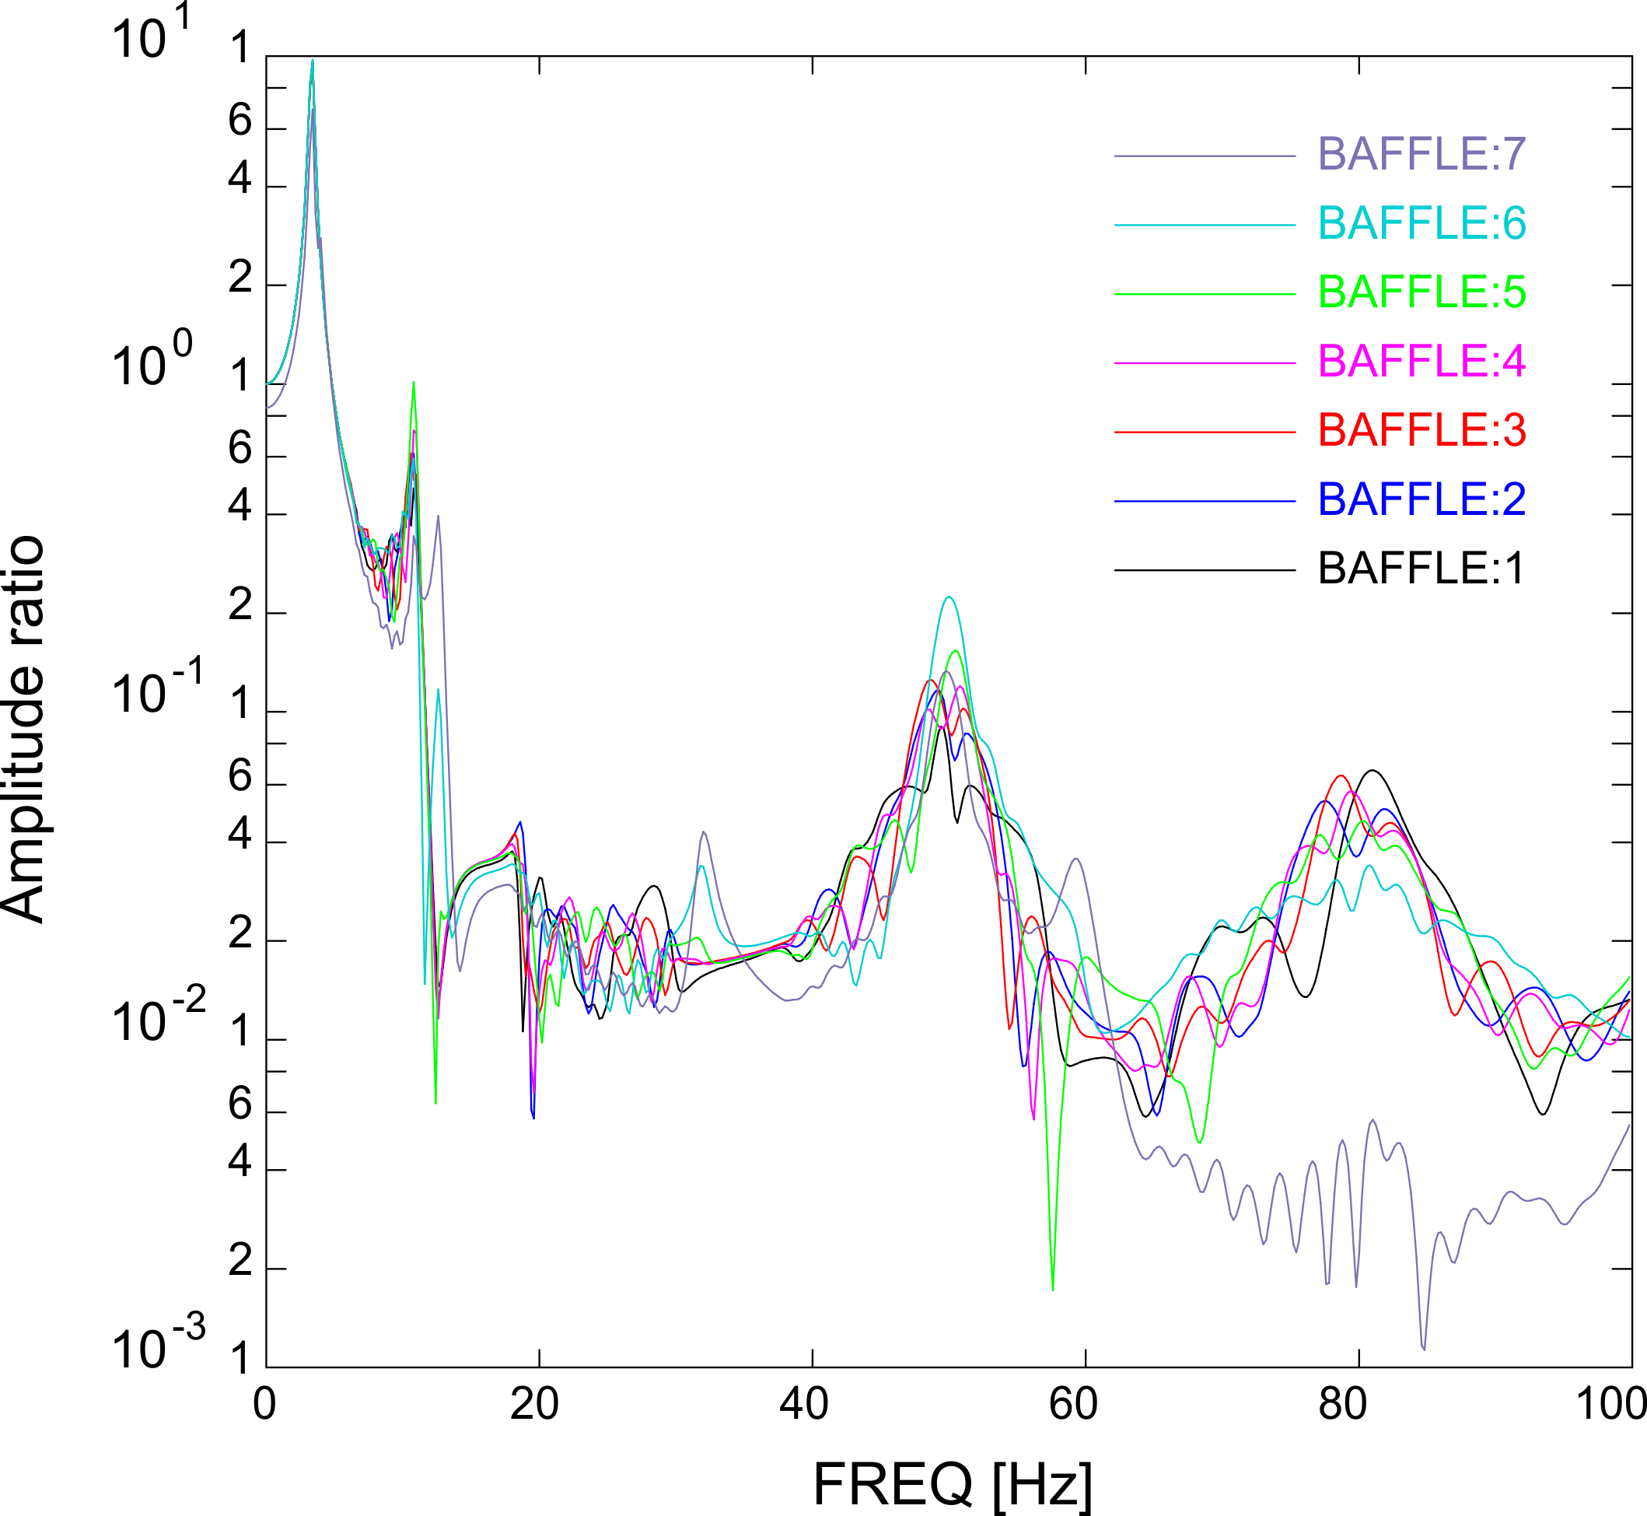
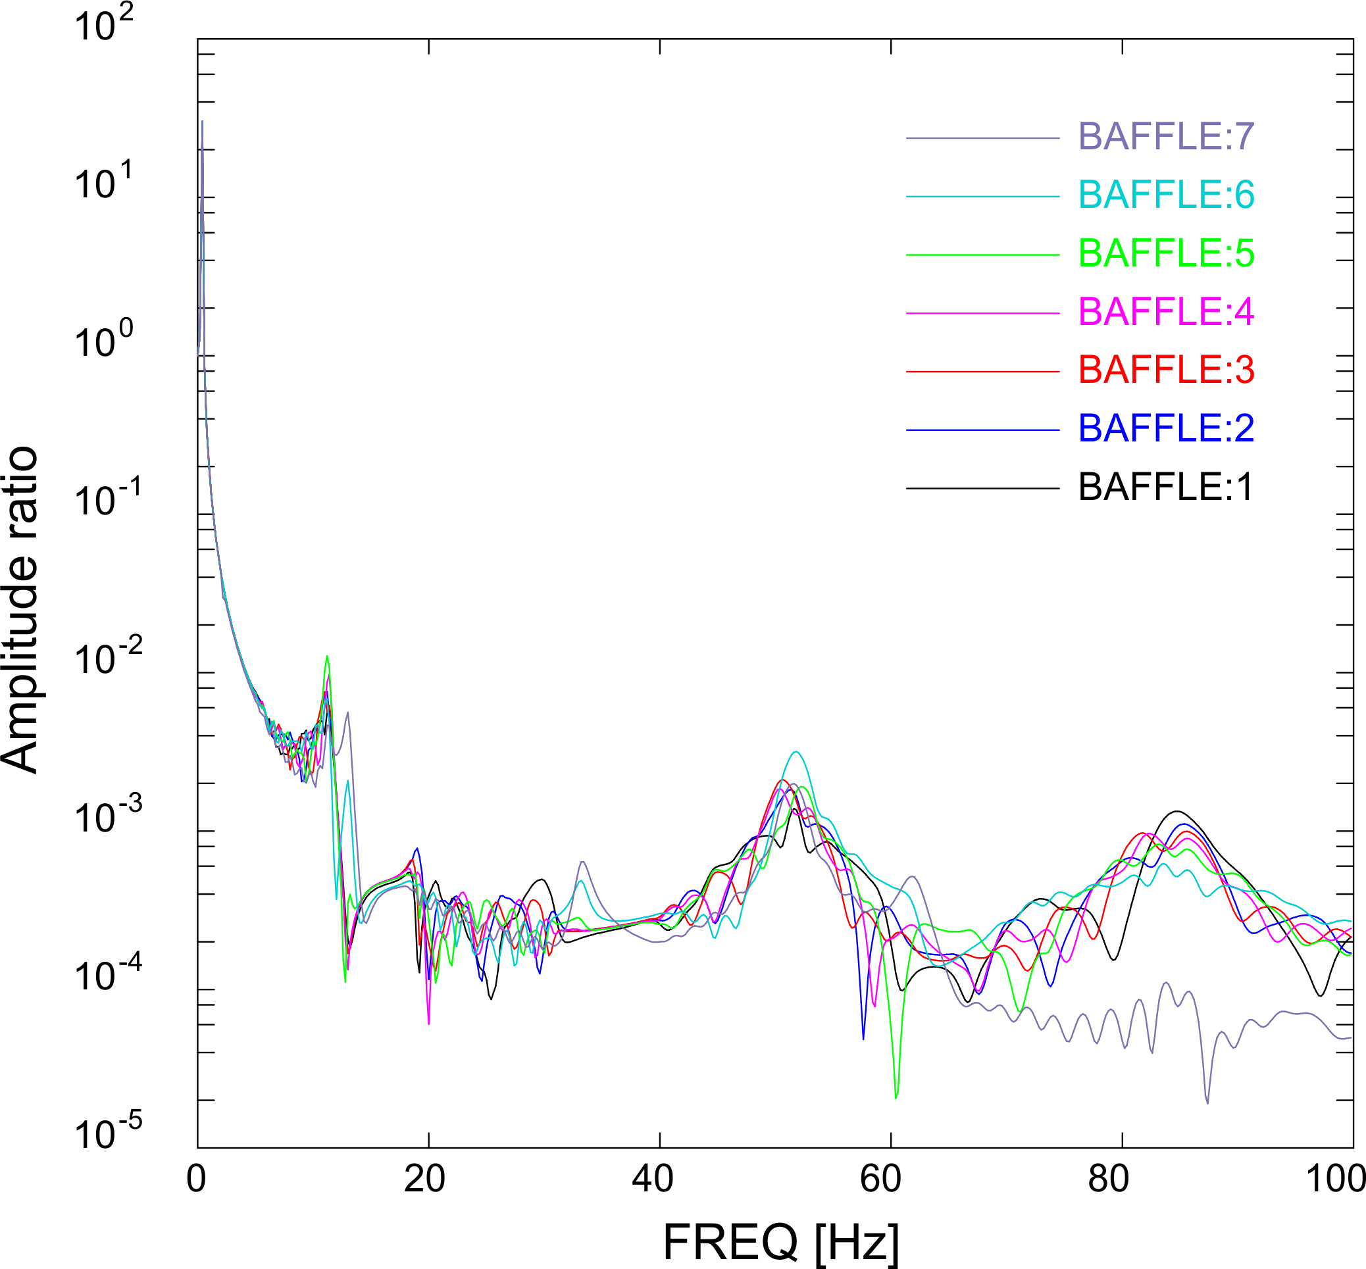
Main achievements of WP1: modal analysis
First eigen modes driven by pendulum (0.4-0.5 Hz) and spring/mass (3.4 Hz) vibrations, in horizontal and vertical directions, respectively; and then by beam bending.
Instrumentation module (200 kg)
Baffle (every 3 chambers, 12 kg)
Equivalent beam for vacuum chamber + supporting frame
Rope length is optimized to avoid amplification of microseismic vibrations.
The vacuum pipe, 315 m long, has been modeled in 1D considering equivalent stiffnesses and lump masses for baffles and instrumentation modules,
Rope
Equivalent beam for vacuum chamber
Instrumentation module
The transfer functions between ground motion and baffles have been estimated along the pipe considering different boundary conditions (decoupling of the intr. module, phase shift, damping).
Low transfer functions ground/baffle are obtained if a decoupling of the instrumentation module is implemented.
Cedric Garion
Vertical transfer function
Horizontal transfer function

Slide 13
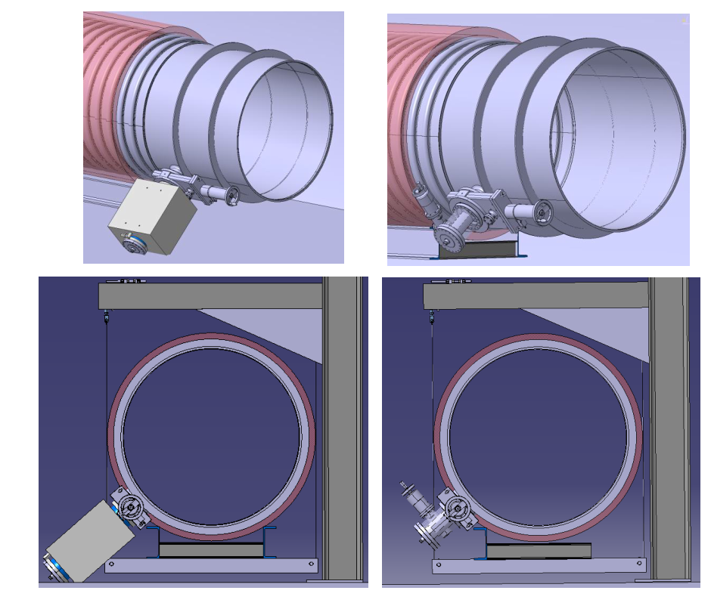
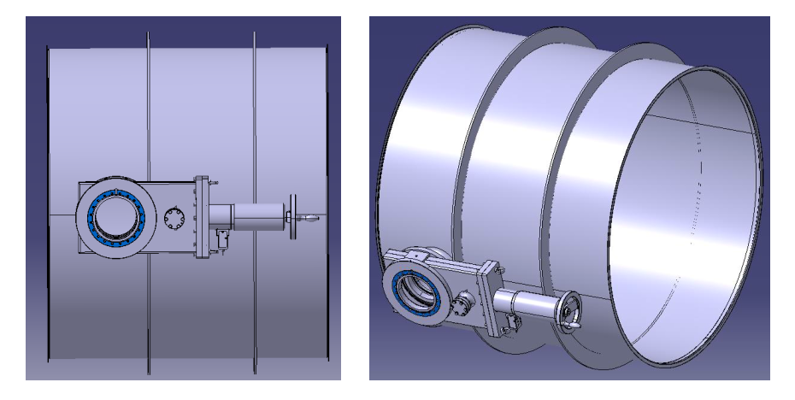
Main achievements of WP1: pumping modules
Straight tubes, initial assumptions:
3-4 mm thick, 1-m long
Stiffeners
Gate valves DN160 and DN100
Integration issue with large ion pumps (500 l/s).
Cedric Garion

Slide 14
Main achievements of WP2
WP2: materials & manufacturing
An extensive campaign of outgassing measurements has shown that some ferritic steels fulfil the ET requirements, even without air or vacuum firing.
Bakeout at low temperatures for relatively long time is enough to reduce water vapour to the limit required by ET.
Pre-prototypes (40-cm diameter) are being fabricated in three different materials (AISI304L, Mild Steel, AISI 430).
Metallurgical analysis of several samples of different grades. Identification and analysis of an issue with the welding of AISI 430. Another ferritic stainless steel has been proposed (AISI 444)
Discussions with steel makers.

Slide 15
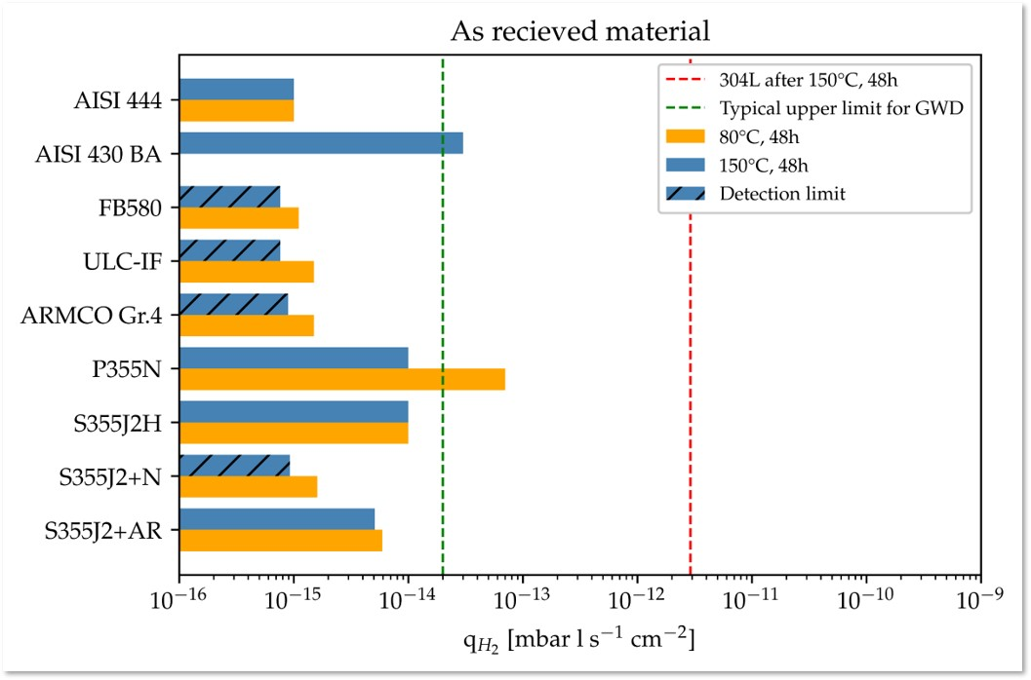
Main achievements of WP2: material selection
Outgassing measurement of several samples of different grade and geometry.
Without high temperature degassing treatments, H₂ outgassing rates of the tested ferritic steels (Body-Centred Cubic structure) are at least two orders of magnitude lower than the ones of austenitic stainless steel (AISI 304L, Face-Centred Cubic structure).
Low temperature (i.e., lower than 150°C) bakeout are sufficient to achieve the ET’s target.
H₂
Carlo Scarcia and Ivo Wevers

Slide 16
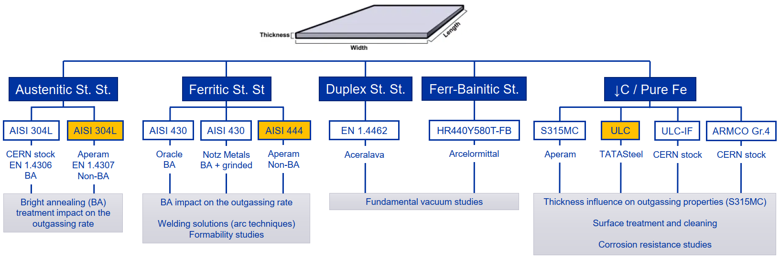
Main achievements of WP2: material selection
Ana Teresa Perez and M. Dakshinamurthy
Material selection will impact manufacturing strategy, cleaning, installation procedure and inspection plans, but also future actions like service maintenance, and cost.
AISI 304L is 1.5 and 4 times more expensive than AISI 430 and S315MC, respectively
However, material cost per kg is not always the most important economic consideration.

Slide 17
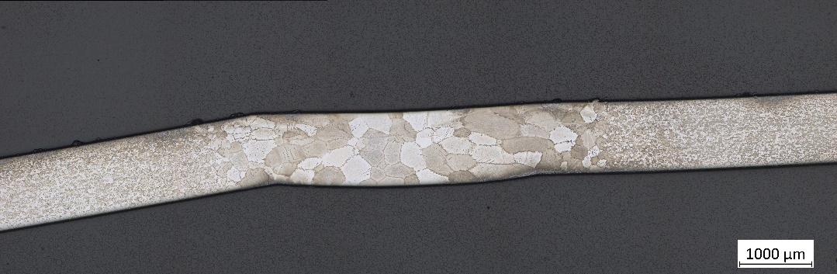
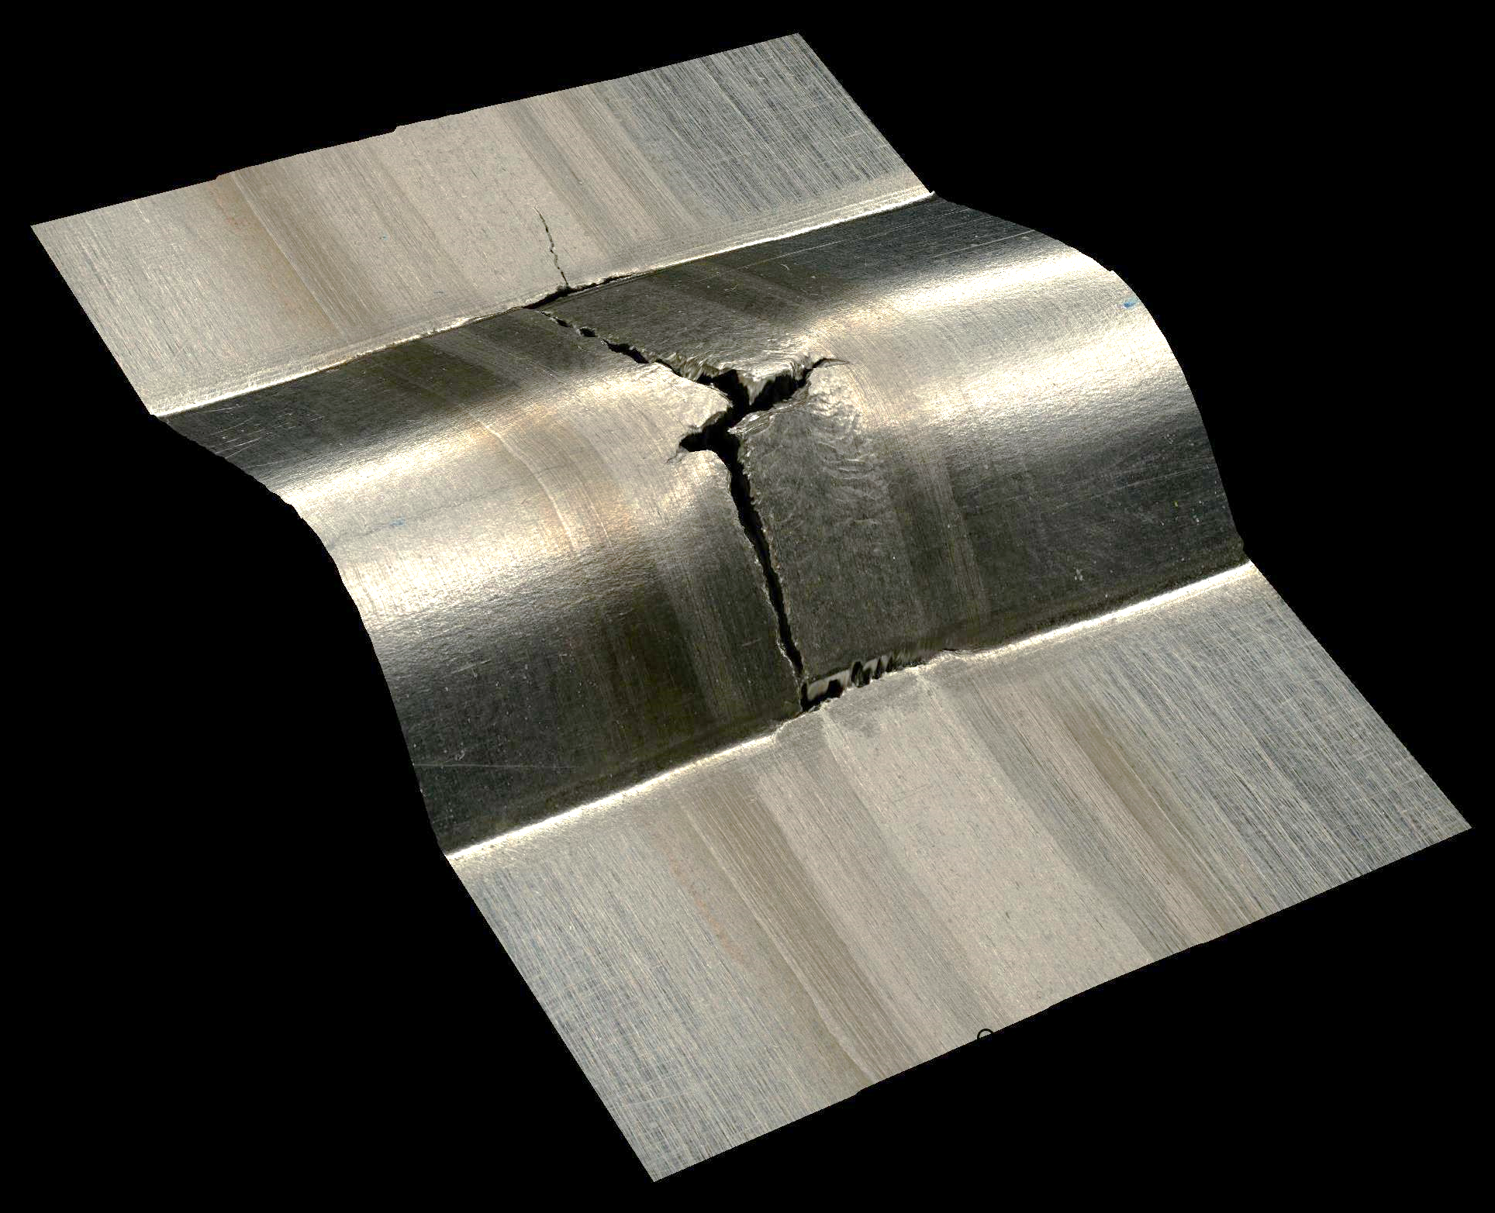
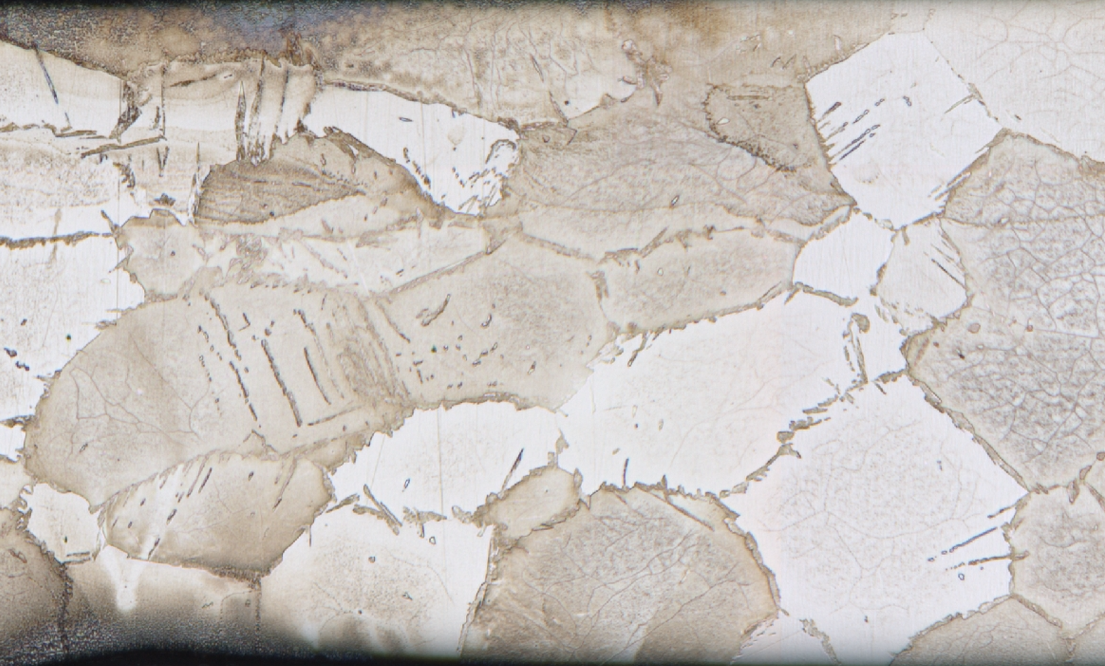
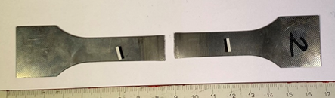
Main achievements of WP2: welding characterisation
Weld
BM
weld
AISI 430
Weld
1 mm
Martensite
Identification and analysis of an issue with TIG-welded AISI 430: grain coarsening, martensite precipitation at the δ ferrite grain boundaries, brittle failure during tensile tests, hardness increase in the fusion zone.
Now focusing on AISI 444 (Nb added), fully ferritic at all temperatures.
Ferrite grains
Two-phases microstructure: δ + intergranular M
Ana Teresa Perez and M. Dakshinamurthy

Slide 18
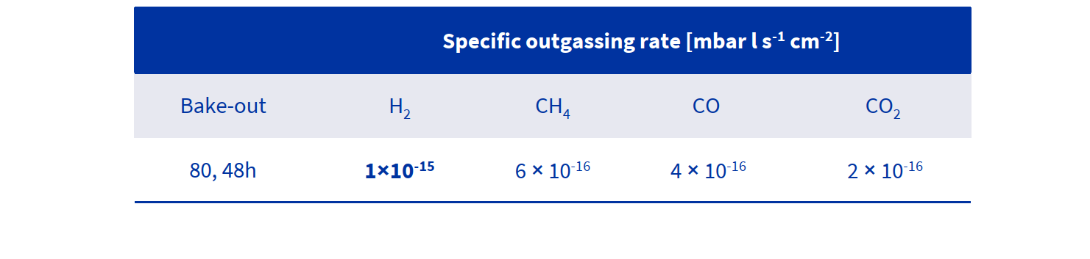
Main achievements of WP2: AISI 444
Outgassing rates after bakeout at 80°C for 48 h (9000 cm² of measured surface area)
Carlo Scarcia

Slide 19
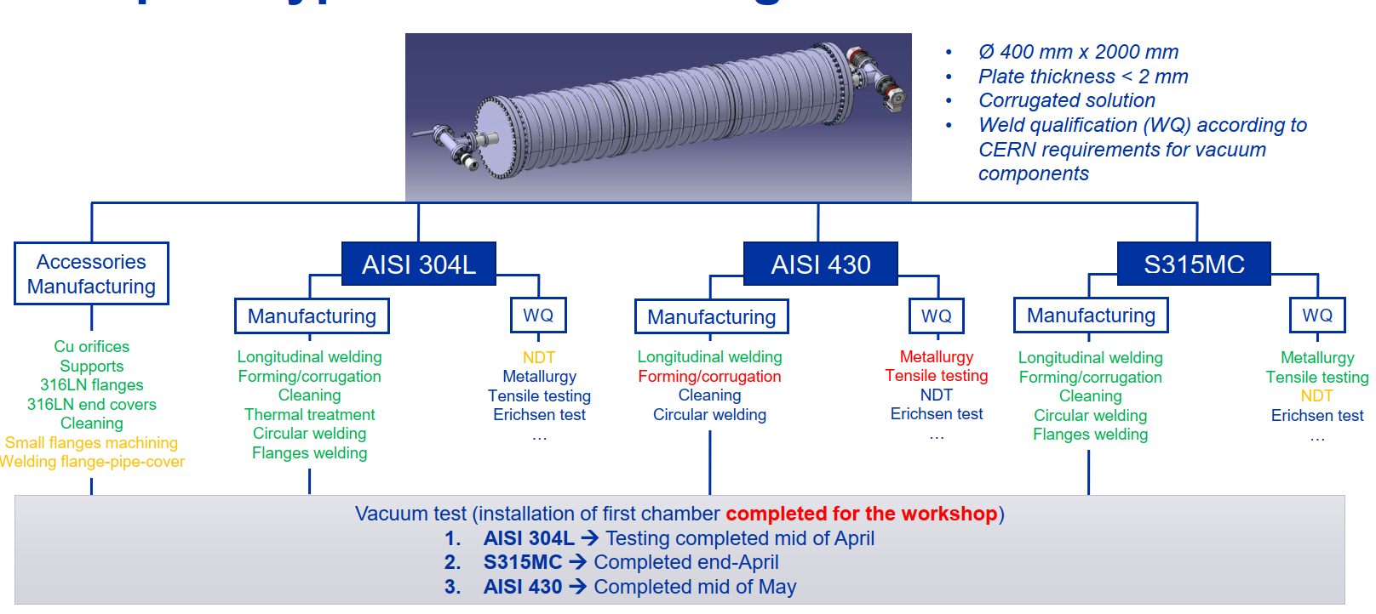
Main achievements of WP2: pre-prototypes
AISI 444
Tests to be completed by June 15th
Chamber ready for measurement
AISI 444 → Sheets just arrived from Aperam
Audrey Vichard & M. Dakshinamurthy

Slide 20
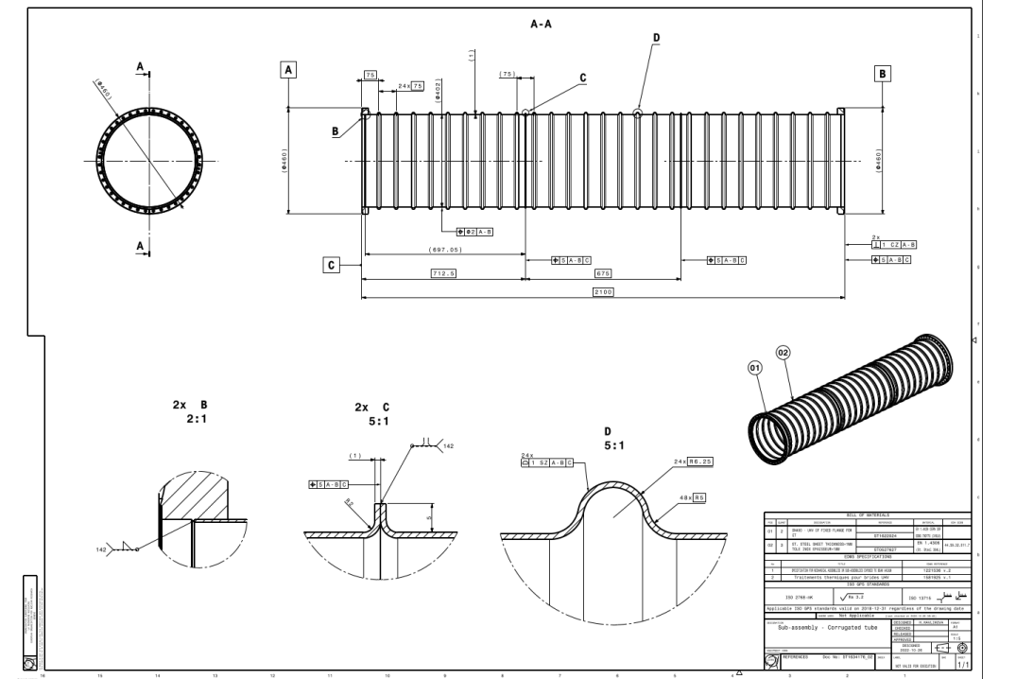
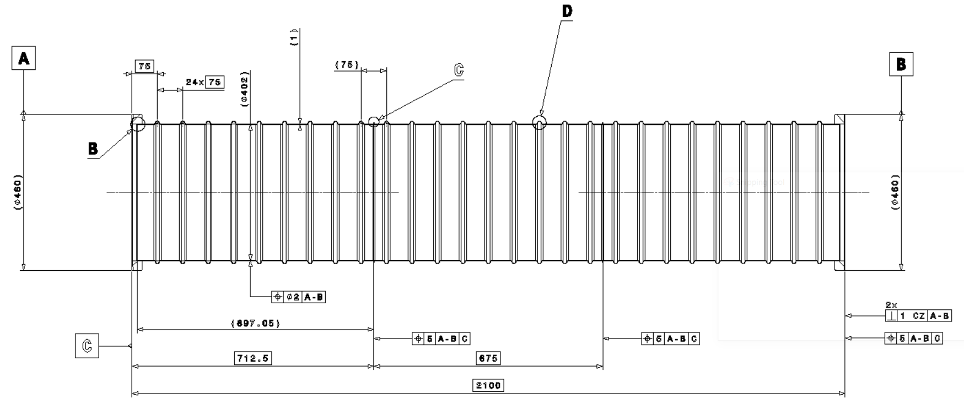
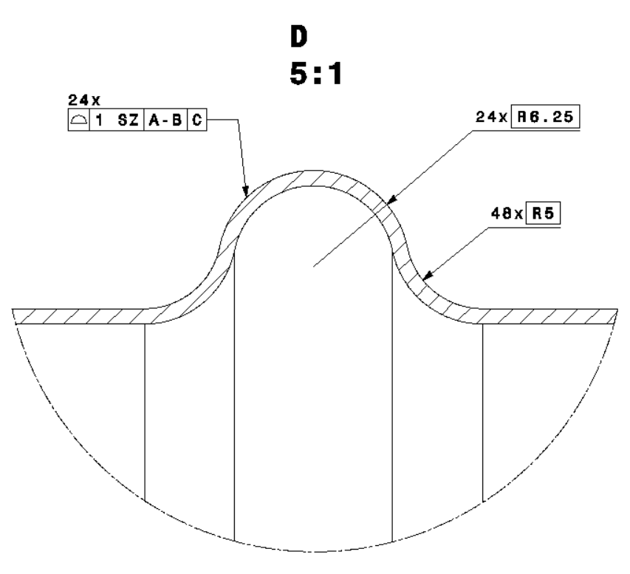
Main achievements of WP2: pre-prototypes
Corrugated pipe with thin wall (thickness in the order of 1.3 mm)
  Three segments of 675 mm, total length of 2.1 m
  Internal diameter: 402 mm
6 mm
Cedric Garion and Fabrice Santangelo

Slide 21
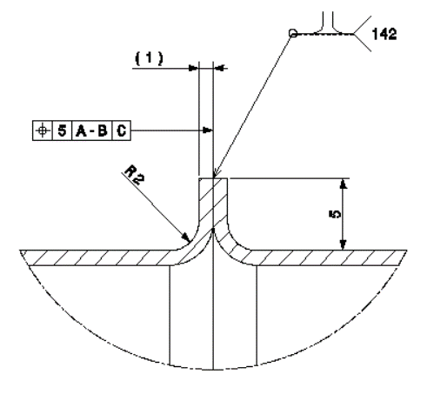
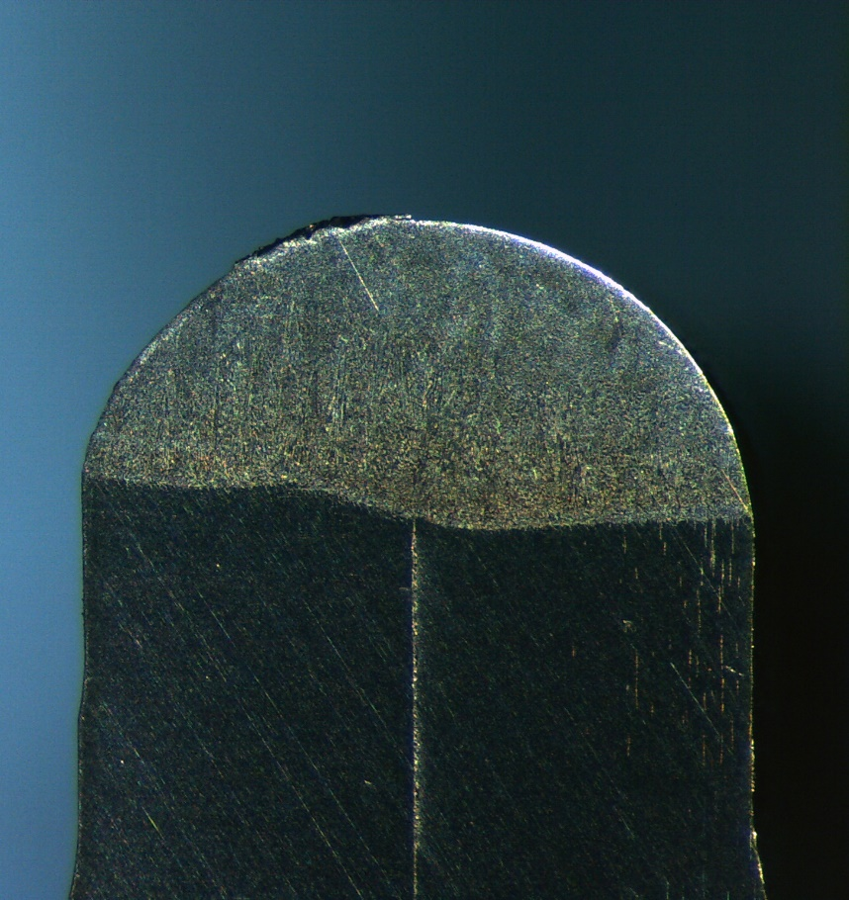
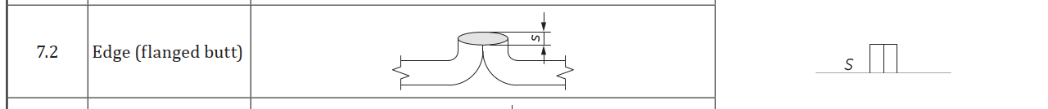
Main achievements of WP2: pre-prototypes
Joint design for segments assembly: “lips” type
  Main benefits:
    No baking gas required
    No filler metal required
    “Easy” adjustment of parts to be welded (use of positioning and clamping tool)
    Possibility to cut & reweld
    Less risk of pollution inside the chamber when cutting
  Limitations:
    Control of the weld quality: only visual inspection possible
    Volume trapped between lips: potential outgassing (virtual leaks) & liquid retention (pollution)
  Targeted weld throat: equal to base material thickness (t)
Gilles Favre
S: weld throat ≤ t
ISO 2553: Symbolic representation on drawings -Welded joints
t

Slide 22
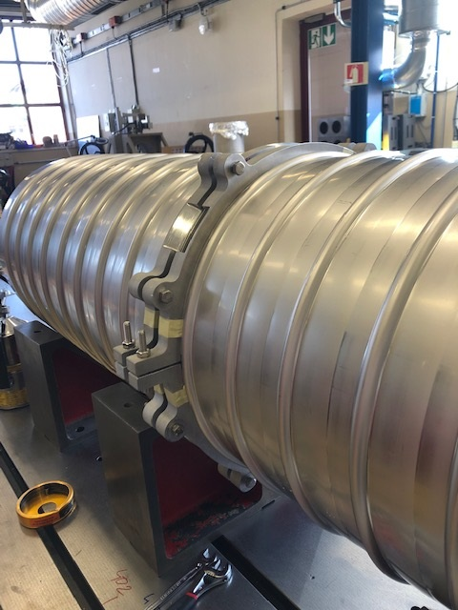
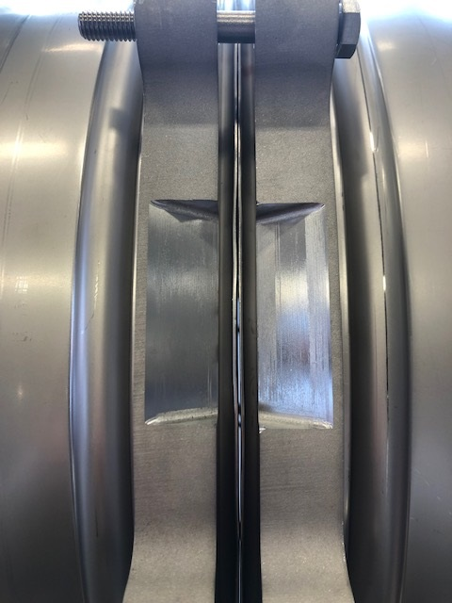
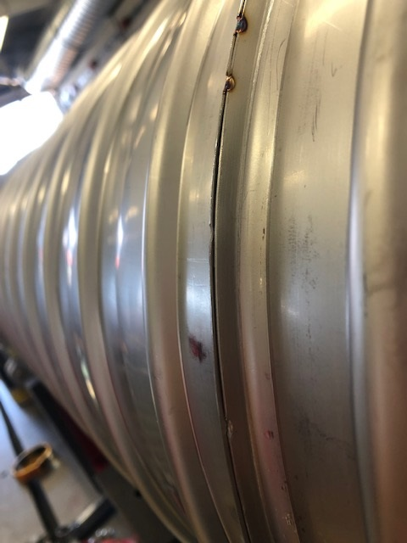
Main achievements of WP2: pre-prototypes
Butt welding of the segments lips:
  TIG manual welding of the segments using a positioning & clamping tool
  Visual inspection
Nominal
→ Root porosity
→ Lack of penetration
Dedicated clamping tool required to ensure close contact between lips (zero gap) with proper alignment
Offet
Gilles Favre

Slide 23
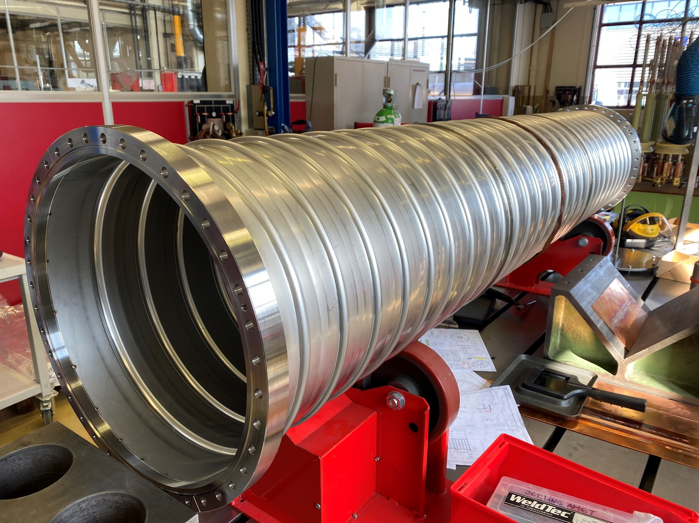
Main achievements of WP2: pre-prototypes
Austenitic stainless steel: AISI 304L
  Good weldability
  Good formability
A vacuum firing (950 °C – 2h ) has been applied to the 304L chamber to be in the best possible conditions for UHV application.
304L pre-prototype will be the reference in our comparative study with ferritic steels.
→ 304L: UHV tests nearly concluded
Gilles Favre

Slide 24
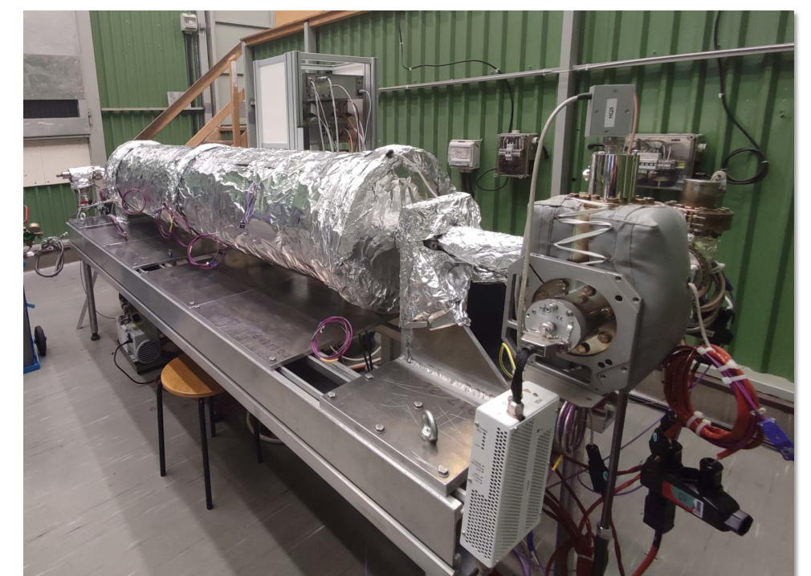
Main achievements of WP2: pre-prototypes
A dedicated measurement bench was designed and manufactured at CERN.
As the outgassing rates are very low (in 10⁻¹⁴ mbar l/(s cm²) range and lower), pressures might be limited by the instrumentation and other elements of the pumping system.
Carlo Scarcia and Ivo Wevers

Slide 25
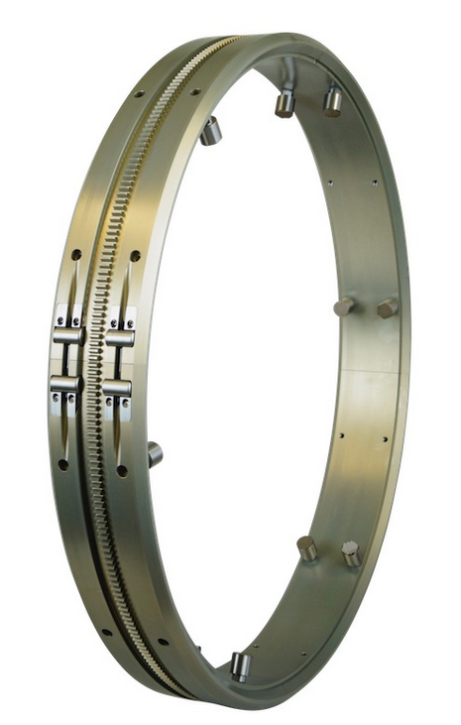
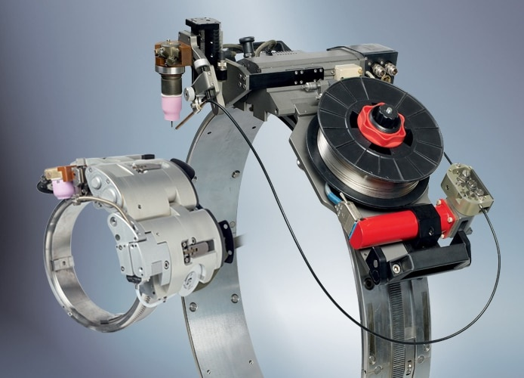
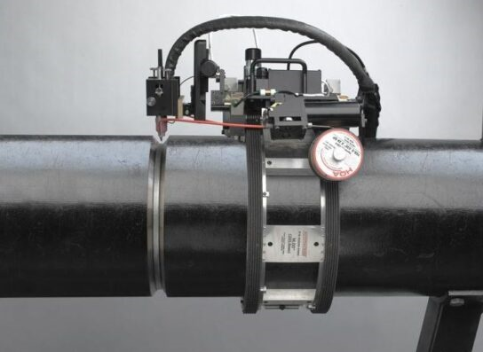
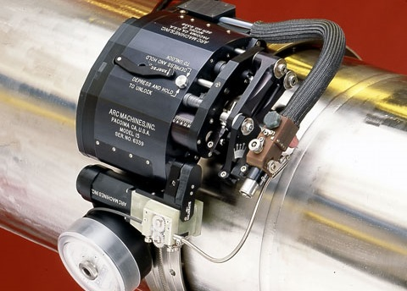
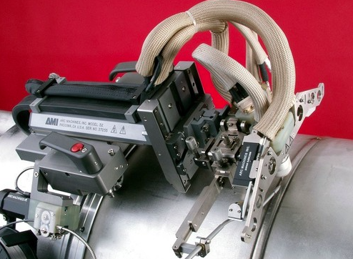
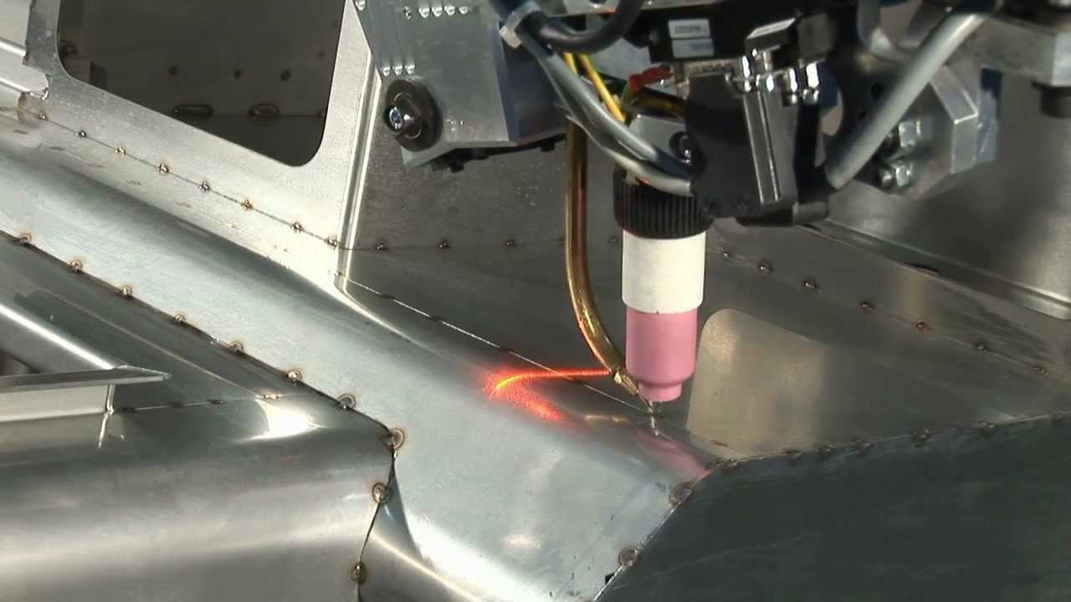
Main achievements of WP2: welding in the tunnel
Examples of automatic welding machines
- Track ring to guide the welding heads
- Seam tracking (camera, sensor) can help to ensure proper alignment of the welding head w.r.t. the joint
Track ring
Laser seam tracking
Gilles Favre

Slide 26
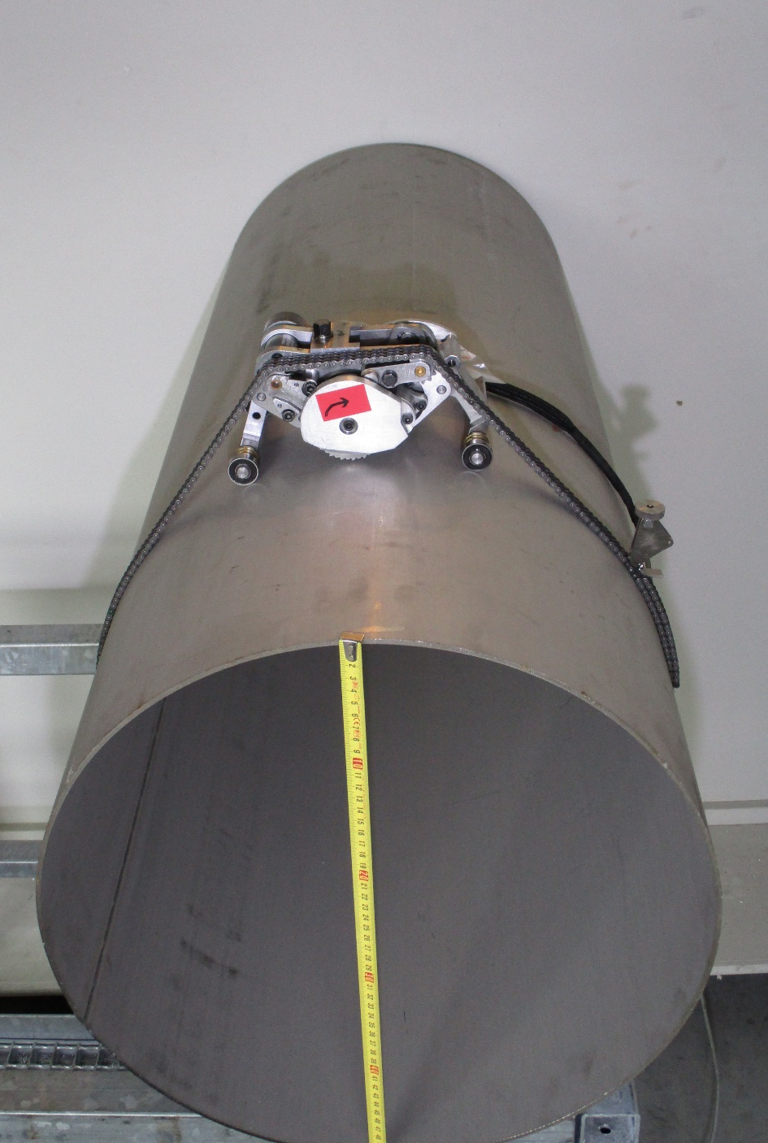
Main achievements of WP2: welding in the tunnel
Replacement of a damaged pipe
  Use of an orbital cutting machine
    Procedure shall be optimised to minimize the reduction of “lips” height after cutting (TBD numbers of welding & cutting sequences required)
    Adjacent pipes shall be movable to allow removal of the defective pipe and installation of the new one with high precision positioning to reach the nominal configuration required for “lips” welding (zero gap).
Example of light and compact orbital milling machine developed at CERN for pipe cutting
Gilles Favre

Slide 27
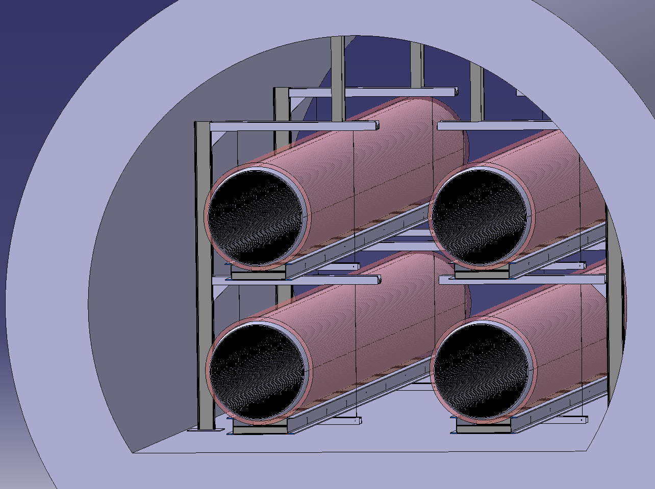
Main achievements of WP2: welding in the tunnel
Free space is required around joints to be welded. It should be sufficient for:
  Mechanized welding & cutting machines installation & operation
  Technicians intervention
    Visual inspections
    Manual repairs
    Installation of insulation
    …
  As first estimate
    400 mm free space for machines could be sufficient
    500 mm for technicians interventions would be recommended
Gilles Favre

Slide 28
Main achievements of WP3
WP3: post-manufacturing treatments
Cleaning of pre-prototype vessels: cleaning procedures and effective treatments.
Procedure for cleanliness assessment.
Contact with the industry for cleaning of pilot sector.
Thinking about an assessment matrix for ET beampipes.

Slide 29
Main achievements of WP3: pre-prototype cleaning
Degreasing in aqueous alkaline solution:
- NGL GP 17.40 SUP at 20 g/l
- Temperature: 60 +/- 5 °C
- Ultrasonic agitation: 25 kHz at 3.6 W/l
- Time: 60 minutes (20’ with US)
Rinsing with demineralised water (> 0.5 Mohm.cm):
- Jet rinsing to remove the detergent solution;
- Immersion x 2
Drying:
- Filtered air jet to remove main
water retentions
- Drying in atmospheric oven at 60 °C
for 1 hour
Packing: PE bag
Three substrates:
304 L
444
Mild steel S315 MC
Degreasing with solvent (Dualene 1601S)
in a closed machine:
- Jet degreasing at room temperature
- Immersion degreasing at > 50 °C
- Vapour phase degreasing
- Drying in vacuum (~ 10 mbar)
Cycle duration: 3.3 h (P7) x 2
Packing: PE bag
Leonel Ferreira

Slide 30
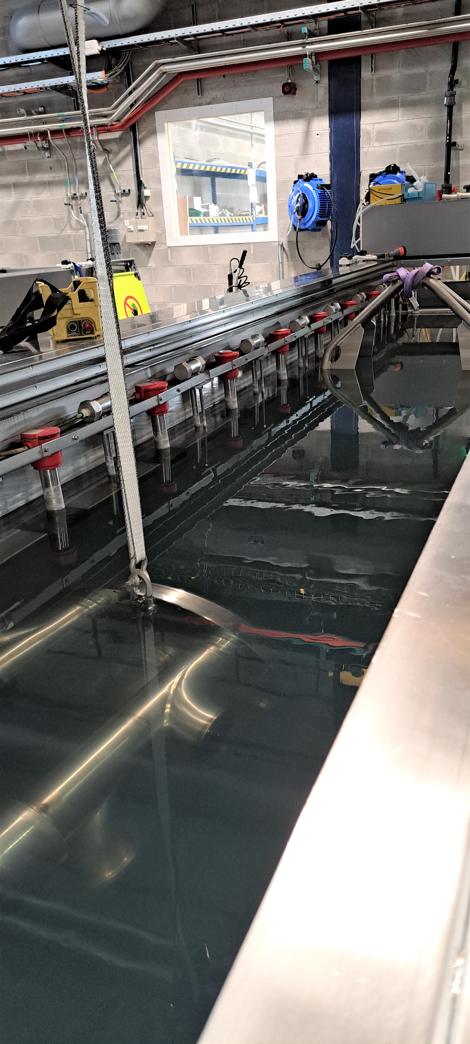
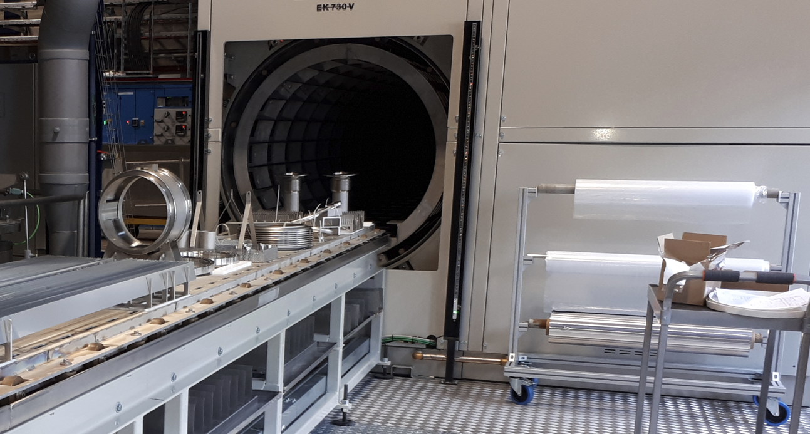
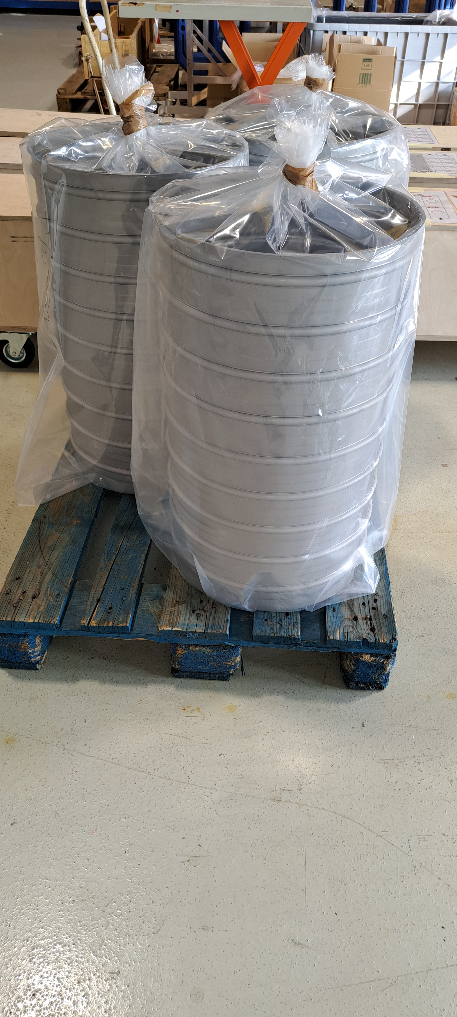
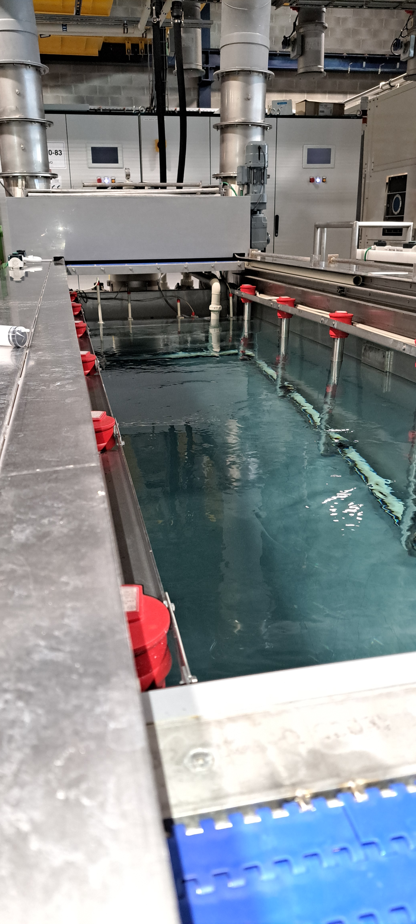
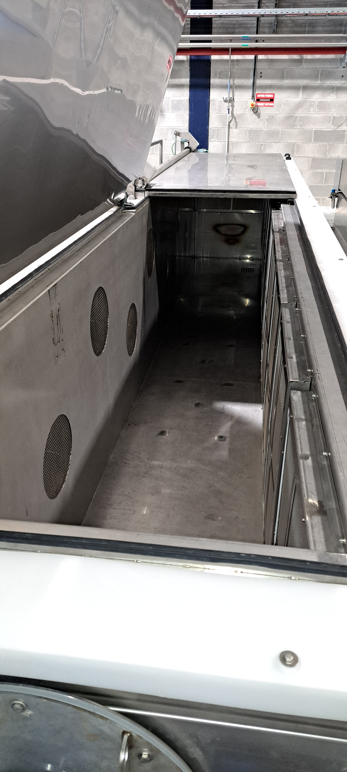
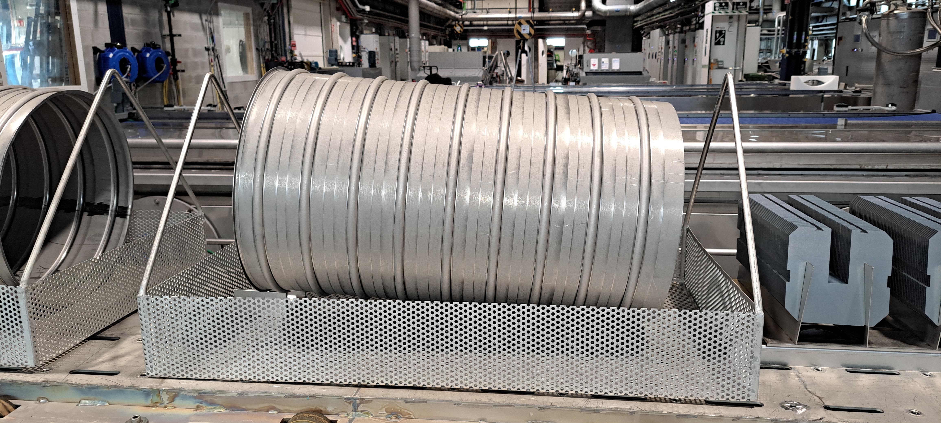
Main achievements of WP3: pre-prototype cleaning
Detergent cleaning
Solvent cleaning

Slide 31
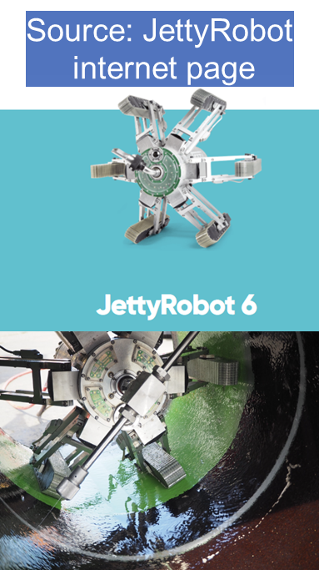
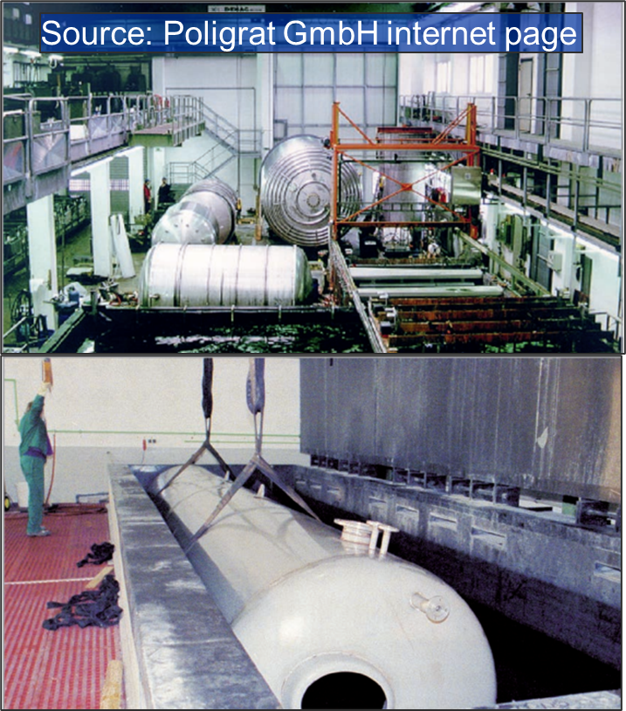
Main achievements of WP3: pilot sector cleaning
Cleaning of the pilot-sector beampipes (~ 2x 1000 mm Ø x 50000 mm L): 2nd Semester 2024
As CERN is not equipped to process parts with 1.0 m Ø, we are looking for industrial partners
Outsourcing to service providers:
  Poligrat GmbH
  JettyRobot s.r.o.
To be assessed
Other contacts through manufacturers of cleaning facilities:
ECOCLEAN GmbH
HEMO GmbH
Firbimatic Spa
Leonel Ferreira

Slide 32
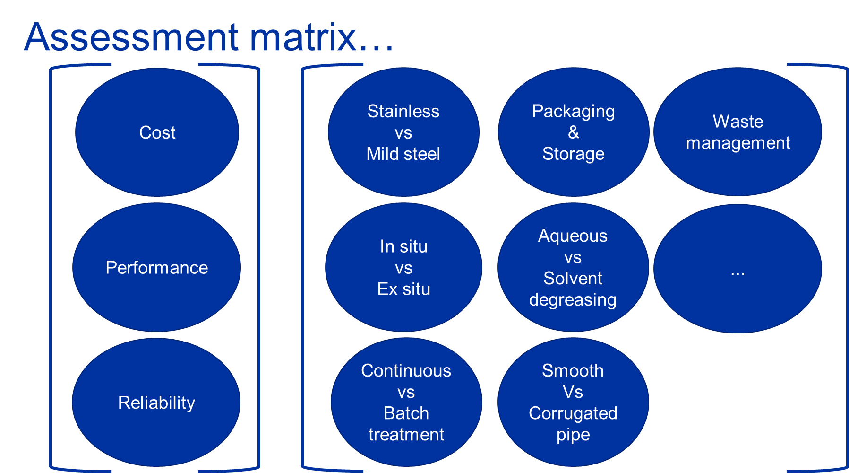
Main achievements of WP3: Assessment matrix for ET
Leonel Ferreira

Slide 33
Main achievements: WP4 and WP5
WP4 & 5: Logistics and installation
First draft for leak detection procedure of single vessels and installed beampipe.
Installation process considerations.
Participation in the ETO’s PBS.
Consideration about storage and transport.

Slide 34


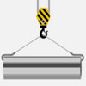

Main achievements of WP4&5:off-site manufacturing
Material Bakeout @450°
Transport
X [m] section pipe preparation
Leak testing
Cleaning
Transport
Warehouse storage
Transport
Site buffer storage
x 12 10⁻⁶ [m] / X (= 8000 for X = 15)
Heavy handling
Potential parallel activtiy
Potential Parallel operation
Design dependence
Welding, assembly and transport of 312.5 m sections
Vacuum systems installation and testing
Leak testing
5km (10km)
Bakeout @150°
Vacuum pumping
x 16 (x32)
x 2 (x1)
x 12
Option 1 (Option 2)
x 12
Option 1: 10km sector
Option 2: 5km sector
TUNNEL
Beam pipe ready for operation

Slide 35
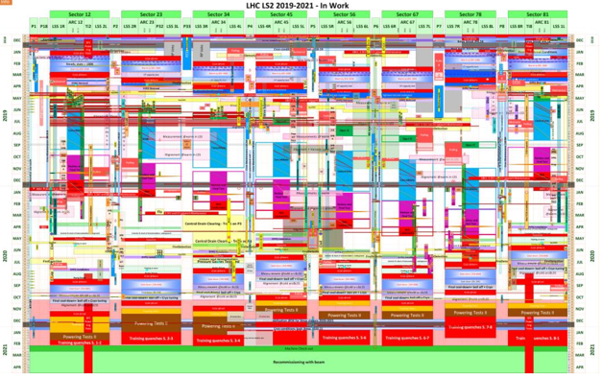
Main achievements of WP4&5: schedule
    Schedule for the ET beampipe installation
    How:
      Gathering information to setup an activity list, production rates, and potential parallelisms.
      Building a master schedule and a time-location diagram to highlight the scheduling constraints for the various options.
    Analysis of constraints between sequences and parallel
    activities (technical and safety feasibility).
Time-location: LHC example
Luigi Scibile

Slide 36
Main achievements of WP4&5: schedule
Time-Location diagram for ET
Luigi Scibile

Slide 37
Main achievements of WP4&5: schedule
Hypothesis:
Two circular welds per working day per team, 10 circular welds per week per team
Beam tube length: 14 m
Teams working simultaneously in a tunnel side: maximum two teams.
Installation and test activities only during standard working hours.

Slide 38
Main achievements of WP4&5: schedule
M+P access
Triangle version
M+P
M+P
5 km
5 km
Team 1
Team 2
10000 m/14=714 welds per line -> ≈4 x 750 welds per line, including pumping modules, ≈ 3000 welds per triangle side, 9000 for the whole triangle; therefore 900 team.weeks of mechanical installation are needed.
With 6 welding teams (2 per side): ≈3 years of mechanical installation
Minimum beampipe production rate: 12 tubes/working day. This will imply parallel manufacturing and testing benches.
The teams would have to travel a maximum of 5 km to reach the working point. If the installation started from the centre of the triangle side, the transport of personnel would happen in an empty tunnel (time required: maximum 10-15 minutes to reach the installation front).

Slide 39
M+P
L version
M+P
M+P
7.5 km
7.5 km
Team 1
Team 2
As the total length of the beampipes is identical in the two options (i.e. 120 km), for two L we have 9000 welds and 900 team-weeks of mechanical installation.
450 team-weeks of mechanical installation for one L; 225 team-weeks per L side.
With 4 teams per site (2 in each L side), it would needs ≈ 2 years + a few months for a whole L.
If the installation is performed at the same time in the two sites, 8 teams are needed: 2 years and a few months to complete the whole beampipe installation.
If 8 (4+4) teams worked in parallel, 16 vacuum chambers would have to be manufactured/tested/cleaned in a working day (challenging).
The teams would have to travel a maximum of 7.5 km to reach the working front. If the installation started from the centre of the L side, the transport of personnel would happen in an empty tunnel (time required: maximum 15-20 minutes to reach the installation front).

Slide 40

Main achievements of WP4&5: schedule
In our present technical study, we do not consider a material and personnel access in the centre of the triangle side; the same would apply to the L option.
Are escape shafts in the middle of the tunnels necessary? If only the technical aspects are considered, the additional access is not necessary in the two options. However, safety considerations could lead to a different conclusion. As a comparison, in the present study of the FCC tunnel the distance between access points is 9 km or 11 km (see pictures here below; fire doors are used in the sectors). If the same choice was applied to ET, this would mean that no access shaft in the middle of the triangle would be required for safety reason.
Data from Timothy Watson: FCC week 2023

Slide 41
Main achievements of WP6
WP 6: Vacuum
Models for pressure decrease during pumpdown: influence of bakeout temperature and time.
Evaluation of pressure profile and optimisation of pumping scheme during and after bakeout.
Selection of instrumentation and option for control of bakeout and regular operation.
Impact of bakeout on the temperature of the tunnel air; ongoing selection of thermal insulation.
Simulation of the impact of leaks on pressure profile.
Ongoing measurements of vacuum chambers: ultimate pressure.

Slide 42

Main achievements of WP6: bakeout
Auxiliary NEG pumping during bakeout (SAES proposal): simulation of bakeout time and NEG pump distance on ultimate pressure of water vapour.
Carlo Scarcia

Slide 43

Main achievements of WP6: bakeout
Carlo Scarcia and José Ferreira

Slide 44

Main achievements of WP6: bakeout
Ongoing studies for the selection of the thermal insulator
Carlo Scarcia

Slide 45

Main achievements of WP6: bakeout
The reported data are only an example of the ongoing activities.
Carlo Scarcia

Slide 46

Main achievements of WP6: bakeout
Temperature of the tunnel air during bakeout
Carlo Scarcia and Marco Morrone

Slide 47

Main achievements of WP6: pumping scheme
Carlo Scarcia, Giuseppe Bregliozzi and Ivo Wevers

Slide 48




Module A
TMP pumping during pumdown
Module B
Auxiliary pumping during bakeout
Module D
Ion pumping
Module C
NEG pumping for ultimate pressure
Carlo Scarcia, Giuseppe Bregliozzi and Ivo Wevers

Slide 49




Module A
TMP pumping during pumdown
Module B
Auxiliary pumping during bakeout
Module D
Ion pumping
Module C
NEG pumping for ultimate pressure
Carlo Scarcia, Giuseppe Bregliozzi and Ivo Wevers

Slide 50



Main achievements of WP6: pressure profiles
Calculated
Requirements
The calculated values are based on measured outgassing rates. Those for CH₄, CO and CO₂ are measurement limits.
The outgassing rates of the valves are not included in this calculation. They could be the leading source of gas.
Carlo Scarcia

Slide 51

Main achievements of WP6: impact of leaks
Carlo Scarcia

Slide 52



Main achievements of WP6: cost optimisation
The ultimate total pressure is plotted as a function of bakeout time-temperature and pumps distance.
The parametric plot can be extended taking into account the insulation thickness and material, and heating current.
Each point in the plot corresponds to a cost. The final result will be to find the minimum of the cost function. Work ongoing…
Carlo Scarcia and José Ferreira

Slide 53
Main achievements of WP7
WP 7: Pilot sector
Selection of two possible CERN’s sites.
Pros and cons of the two sites; final selection.
Discussion and compromise with the present owners of the selected building.
List of activities for the next months, including services and dedicated tents to moderate temperature excursion.
CAD model of the pilot sector in the selected building.

Slide 54



Main achievements of WP7: possible areas
TT1 tunnel
Bulding 973
Jan Hansen and Luigi Scibile

Slide 55

Main achievements of WP7: pros and cons
 | Advantages | Disadvantages | Summary
TT1 tunnel | Tunnel like environment Stable temperature and humidity | Difficult transport with max lenght to ~ 7m -> cannot test the full process (cleaning, bakeout, etc,) on an ET-like tube. Not possible double tube setup Availability to start civil works not before Q4 2024 Co-activity with the survey testing campaigns Cost for Civil Engineering (cutting pillars) and electrical distribution depending on tunnel area Special supports depending on tunnel area (inclination) | Deal breaker?
B973 | Available from Q1/Q2 2024. Easy access/installation. Sufficient space for double tube setup. | Potential cost to have a constant humidity and a temperature within +/-3 degrees during the measuring campaign (to be verified with data taking period/profiles) Potential cost of renting a storage tent. | Easy fit!
Jan Hansen

Slide 56


Main achievements of WP7: integration
  Double tube installation: side by side or stacked tubes.
  Possible infrastructure: tube assembly area and test area
Possible assembly area
Test area
0.4 m
1.4
Jan Hansen and Fabrice Santangelo

Slide 57




Main achievements of WP7: integration
Tent volume with constant temperature
Tent and structure
Air flow
Vacuum chamber support

Slide 58

Main achievements of WP7: planning
Main deliverable: provide design report by end 2025
 | 2023 |  |  |  | 2024 |  |  |  | 2025 |  |  |  | 2026
 | Q1 | Q2 | Q3 | Q4 | Q1 | Q2 | Q3 | Q4 | Q1 | Q2 | Q3 | Q4 | Q1 | Q2 | Q3 | Q4
Design report
Removal and cleaning of B973
Finalize required infrastructure (tent)
Installation of infrastructure
Design of support, tube, bakeout, controls
Ordering
Manufacturing and cleaning
Assembly
Test program
Block choice of bakeout method
Jan Hansen

Slide 59
Main achievements of WP7: measurement planning
Foreseen measurements
  Installation and alignment of supports and tubes
  Welding and assembly
  Leak detection scenarios: assembly and operation
  Pumping down time and bakeout time scaled from 5km to 45m tube
  Residual gas analyses
  Temperature during NEG activation and bakeout (tunnel and vessel)
We are open for other experimental measurements.
  Dust concentration inside tube and on the baffles ?
  Dust displacement inside the tube (from vacuum to atmospheric pressure)?
  Alignment of baffles inside the tube ?
  Vibration transfer function: supports, tubes and baffles ?
Jan Hansen

Slide 60

Main achievements of WP7: bakeout concept
Gregory Pigny
Paolo Chiggiato | ET beampipe activities at CERN
June 12th, 2023

Slide 61


Main achievements of WP7: manufacturing scenarios
Fabrication of the pilot sector (foreseen in 2024)
  Objective is to manufacture two 50 m long chambers, 1 m diameter, ideally based on 15-m long segments.
  Contact with industry for existing solutions to be adapted for UHV application. May require a significant time for weld quality improvement.
  An alternative could be the manufacturing of “short segments” (of the order of 1.5 m in length)
    - technology already available from bellows manufacturers;
    - could also be produced at CERN.
Gilles Favre

Slide 62
Main achievements of WP8
WP 8: Coordination
General coordination in CERN, with ETO and with ET collaboration.
GWD beampipe workshop (03-2023).
Regular meetings with USA colleagues involved in CE vacuum study.

Slide 63

Main achievements of WP8: workshop

Slide 64

Main achievements of WP8: workshop
Published in the July-August issue of the CERN Courier (paper version)

Slide 65
Main achievements of WP8: contacts with CE
Regular bi-monthly meeting with GWD vacuum expert in USA.
NIST, LIGO-Caltech, LIGO-MIT, WM University and Jefferson Lab
Alman H Al-Allaq, Alena Ananyeva, Bill Cooke, Daniel Henkel, Dennis Manos, Douglas Beringer, Emmanuel Mr. Newsome, Fred Dylla, Harry Eller, James Fedchak, Jon Feicht, Lisa Barsotti, Marcy Stutzman, Matt Poelker, Md Abdullah Mamun, Melinda Fuente-Garcia, Reiner Weiss.

Slide 66

Plan for the next 12 months

Slide 67
Plan for the next 12 months
WP1: selection of design for pilot sector.
WP1: manufacturing drawings for beampipe and supports of pilot sector.
WP2: selection, characterisation and purchasing of the material for the pilot sector.
WP2: quality assurance plan for the selected material.
WP2: manufacturing procedure and selection of manufacturers; order sent.
WP3: cleaning procedure for the pilot sector; selection of companies.
WP4 & WP5: in-situ vs. ex-situ production; draft of installation procedure; main interference with other services; time-place planning.
WP6: conclude characterisation of pre-prototypes; vacuum and bakeout material selection and purchasing for pilot sector; procedure for pilot sector; advanced layout for ET.
WP6: leak detection procedure for pilot sector.
WP7: space and services for pilot sector are ready.
WP8: organisation of the second workshop; finalisation of collaboration agreement with U. Antwerp and U. Gent; hiring of a doctoral student and fellow. First comprehensive cost analysis.
The keyword for the next 12 months is ‘pilot sector’!

Slide 68
Conclusions
The first 9 months of the agreement were productive in terms of technical results. The CERN’s team involved in ET beampipes is officially launched.
Our main challenge is to be ready next year with the pilot sector.
Today, we have a better view of the interference with the other services and we can elaborate draft of effective planning for the installation. Dust control consideration are going to be included in our analysis.
The relation with the ETO is excellent. The contacts with the ET collaboration are fruitful and necessary as we (CERN) lack of knowledge and experience in the operation of GWD.
Thanks for your support!

