Slide 1
ET Computing

Slide 2
Organization
ET Collaboration
EIB: E-Infrastructure Board
ET Organization
WP8 Computing and Data Access
Div 1: Software, frameworks, data challenge sup.
Andres Tanasijczuk (Univ. Cath. Louvain)
Div 2: Services and collaboration support
Antonella Bozzi (EGO)
Div 3: Computing, data model, resource estimation
Gonzalo Merino (PIC)
Div 4: Multimessenger alerts infrastructure
Steven Schramm (Univ. de Genève)
TT: Technology tracking working group
Sara Vallero (INFN Torino)
Task 8.1: T0 data center
Patrice Verdier (CNRS)
Task 8.2: Computing and data model
Tassos Fragkos (Univ. de Genève)
Task 8.3: Resources estimation
Silvio Pardi (INFN)
Task 8.4: Data access implementation design
Nadia Tonelli (BSC)
Stefano Bagnasco, Patrice Verdier, Nadia Tonello, Achim Stahl

Slide 3
Services and Collaboration Support
Sept.: 2021: Investigation (questionaire to whole ET) → prioritized list of services; schedule
Administration | Identity management E-mail lists Membership database Internal communication Document service Central calendar Speakers database … | Top Top High High Medium Low Low
Scientific | Software repository Ticket-system Data base Data management system Computing resources … | High Medium Low Low Low
Outreach | Web-pages Public data … | High Low

Slide 4
Services and Collaboration Support
Sept.: 2021: Investigation (questionaire to whole ET) → prioritized list of services; schedule
Administration | Identity management E-mail lists Membership database Internal communication Document service Central calendar Speakers database … | Top Top High High Medium Low Low
Scientific | Software repository Ticket-system Data base Data management system Computing resources … | High Medium Low Low Low
Outreach | Web-pages Public data … | High Low

Slide 5
Services and Collaboration Support
Sept.: 2021: Investigation (questionaire to whole ET) → prioritized list of services; schedule
Administration | Identity management E-mail lists Membership database Internal communication Document service Central calendar Speakers database … | Top Top High High Medium Low Low
Scientific | Software repository Ticket-system Data base Data management system Computing resources … | High Medium Low Low Low
Outreach | Web-pages Public data … | High Low

Slide 6
Next Step: AAI
Authentication and Authorization Infrastructure
Infrastructure → It will run in the background
Authentication → Identifies you (central login!). Today: Password management
Future: Two-factor authentication
Authorization → Manages the access priveliges
Who is authorized to read/edit which data?
Needs compatibility with existing/emerging infrastructuers (i.e. WLCG).

Slide 7
Next Step: AAI
Authentication and Authorization Infrastructure
membership data base
AAI
wiki
tds
indico
e-mail lists
…
…
…
…
…
…

Slide 8
Next Step: AAI
Authentication and Authorization Infrastructure
Status:
Lead partner: Cyfronet (Kraków)
Installation supported by EGO
Decided for KeyCloak
Installation planned for this summer (unless EGO resources are needed for O4)

Slide 9
Next Step: Document Cloud
Editing and Exchange of Documents between Members
Status:
Potential cloud solutions identified
Tomorrow, first presentation of the candidates
Installation in 2023

Slide 10
Problem: Personnel
6 to 8 active persons: planning/coordination (chairs)
2 FTE from ET-PP: Development of the computing model and data access policy
~ 0.5 FTE from EGO: services
→ not enough to install and maintain the required services
A few offers from collaborators:
→ experts on specific services
We urgently need people for
Installation of new services
Maintenance of existing services
User support

Slide 11
Discussion with ET-O
Do we need a computing office in ET-O?
Access of members of ET-O to the collaboration services?
Access of members of the collaboration to ET-O services?
Dedicated service requests from ET-O (CERN services?)
Is CERN willing to provide services for ET-O (cost)?
Is CERN willing to provide services for all of ET (cost)?
Coordination between multiple service providers (EGO & CERN)
Identical services from multiple providers (i.e. indico)

Slide 12
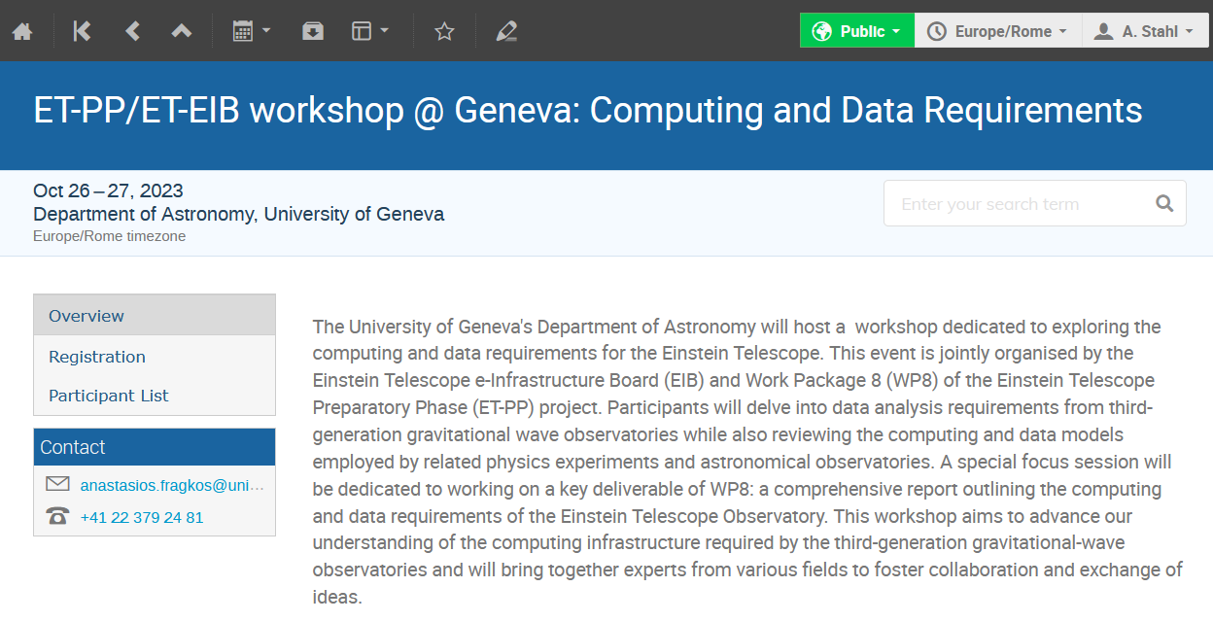
WP8-Workshop: Computing Models
Workshop on Computing Models
October 26th/27th, Geneva
„Collect the Input for the development of the ET Computing Model“
Please register:
https://indico.ego-gw.it/event/590/

Slide 13
Thanks
ET Computing

