Slide 1
Communication, Outreach and Citizen Engagement ET – PP WP10
Dorota Rosinska (UW), Vincenzo Napolano (EGO)
ET-PP Annual Meeting, Barcelona 12th June 2023

Slide 2
WP10 Tasks
WP10, in close collaboration with WP1, will establish procedures for coordination of outreach and communications across national networks and WPs. It will create, disseminate and curate high-quality promotional materials on ET science and technology,and design educational resources on ET science and technology
10.1 Establish a network of communications and outreach points of contact, with robust procedures for gathering and disseminating news updates and outreach materials.
10.2 Develop and maintain ET Consortium website and social media platforms, supported by high-quality promotional materials on ET science and technology
10.3 Develop strategic plan for ET Consortium engagement with the scientific community, funding agencies,politicians and other key stakeholders.
10.4 Develop a sustainable mentorship and training programme for ET Early Career Researchers (ECR)

Slide 3
How can we do this to promote ET in the most efficient way? - a discussion during previous Barcelona meeting
1. Principles and procedures for gathering and disseminating news updates – network of POCs
2. How to ensure smooth and efficient information flow to and from WP10? (local and global communication)
3. How can WP10 best support ET-PP comms strategy?
4. What does each WP / Board see as their key comms & outreach goals and needs?
(we have already input from WP7 and discussion with WP1, WP4, WP8 and OSB)
5. Scope of the ET website and social media accounts? (focusing on targets)
6…

Slide 4
WP10 update
May 2023,Vincenzo Napolano (EGO) is the new co-convenor of WP10, who took over from Martin Hendry
- WP10 is formed by a large community with huge experience on outreach and communication activities in the framework of LIGO/Virgo and LISA gravitational wave experiments
30 experts from 15 countries (FTE, in-kind contributions, ~100 PM)
Collaborating institutions: UW, EGO, UKRI, AEI, NIKHEF,IFAE (University of Valencia), INFN, NCBJ, Wigner ..
1st July 2023 – 0.5 FTE Communications and Outreach officer (EC) at UW, Y. Hoika will support WP10 activities
1.07-31.12.2023 - 0.15 FTE C&O officer at UW (national funds - MNiSW) M. Jakubiak
since May 2023 – collaboration with Martine Oudenhoven, the communication advisor at NIKEF
→ great potential to significantly increase social awareness of the ET project.

Slide 5
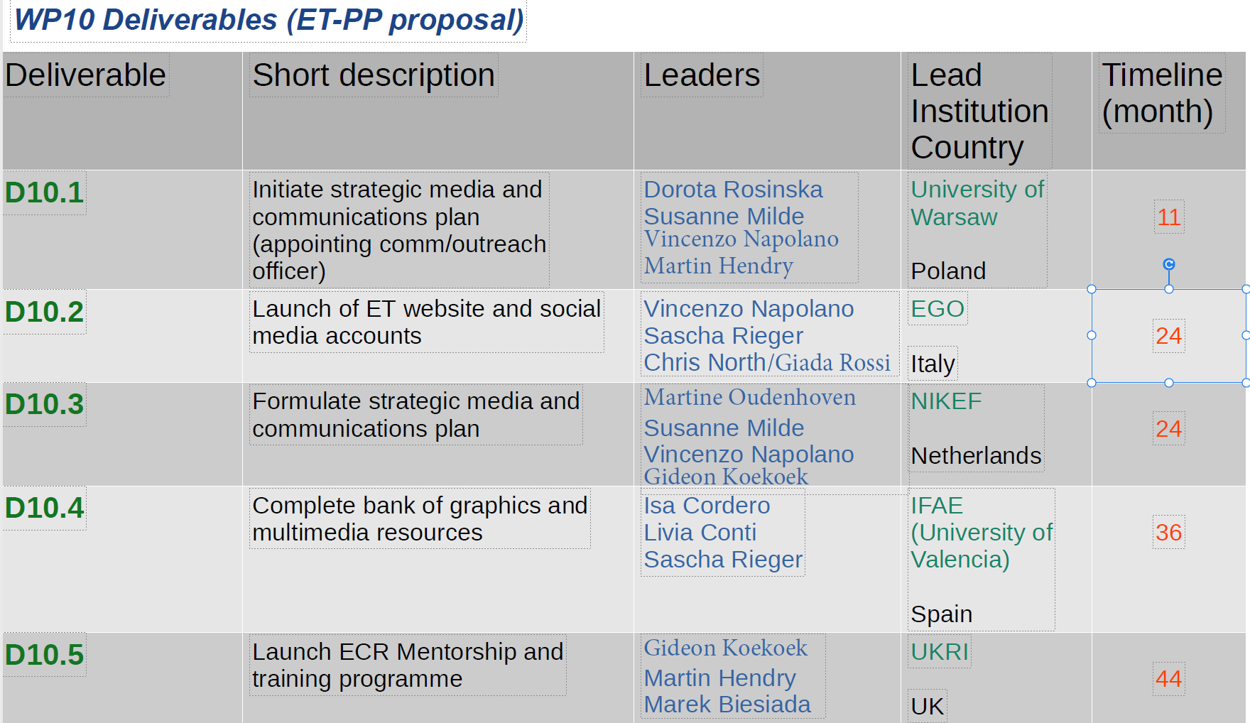

Slide 6
WP10 update
Task/Deliverables coordinators confirmed and priorities identified
October 2022-March 2023 bi-weekly WP10 teleconf (at ET WIKI recordings)
Since March 2023 monthly WP10 (experience of SKA, LISA,LIGO/VIRGO/EGO, CE, Dutch BH Consortium Education Programme
Bi-weekly WP10 coordinators teleconf
Workshop 27-28th May D1+D3 coordinators on communications
Discussions with the management and WP1, WP7, WP8 and WP9
Several WP10 coordinators workshops in person or hybrid:
July 2022, Communication and outreach Meeting at EGO
November 2022, Communication and outreach Meeting at EGO
May 2023, Communication and outreach Meeting at Cagliari, discussions with WP8 and OSB

Slide 7
Procedure and policies
A work plan will be drawn up for the different deliverables, for which leadership group(LG) approval will be sought.
Once the plan has been approved, the actions will be implemented, with periodic checks with the LG on results and impact.
The various deliverables and action areas (web, media, outreach, education...) will be designed and implemented by the WP10 subgroups, which will interact directly with LG.
There will be periodic all hands meetings for keeping all updated. Since we need clear and timely feedback from the leadership on plans and actions, a leadership group (LG) in charge of these choices needs to be quickly defined. (taking into account the complexity of the international ET initiative)

Slide 8
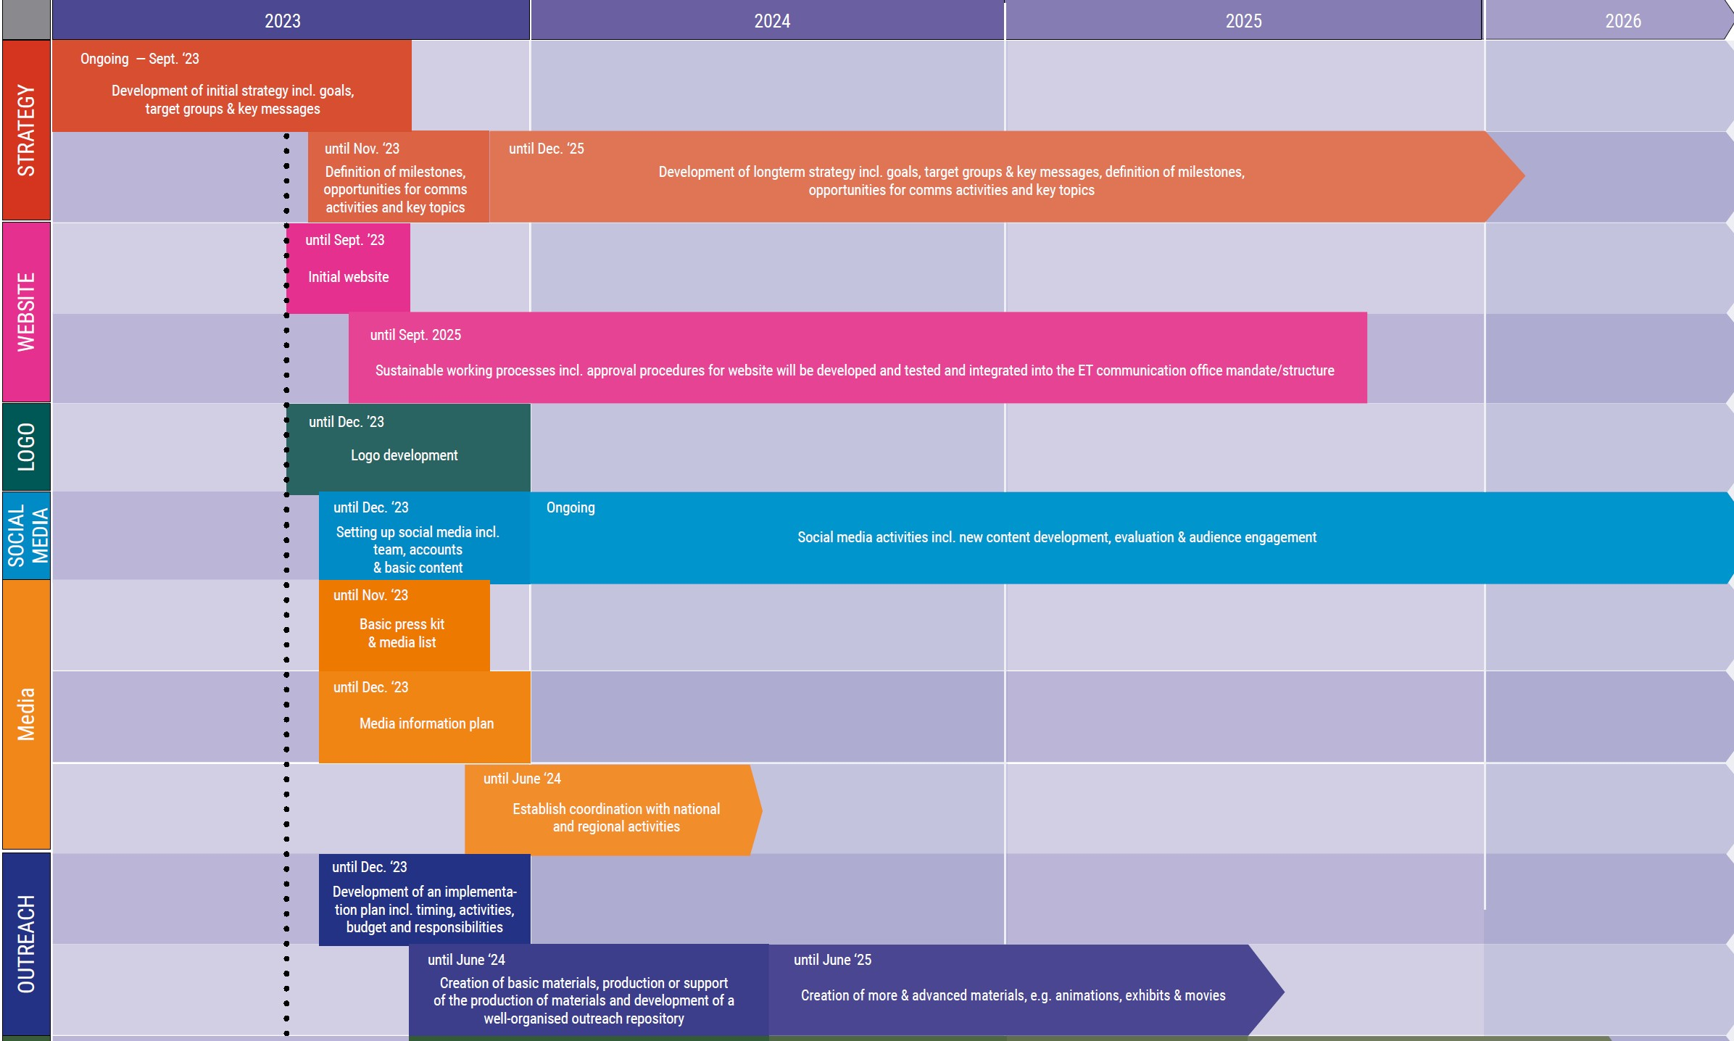

Slide 9
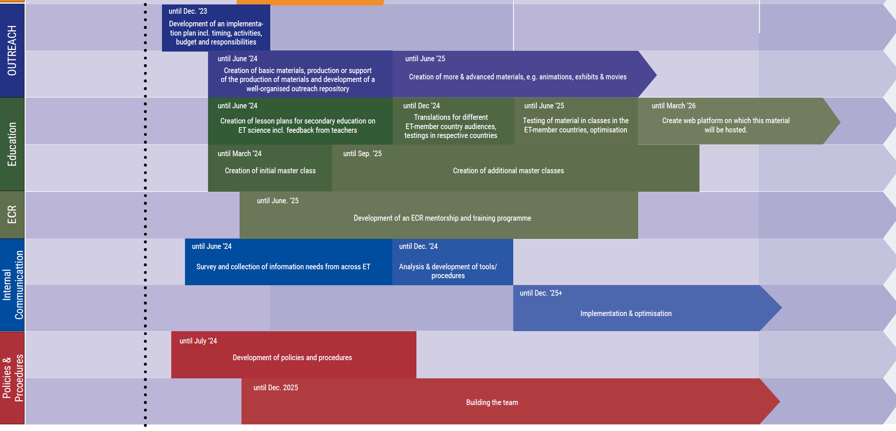

Slide 10
Toward a communication strategy
GOALS
Secure the support of national and international stakeholders for the realization of the project.
Keep the community and the public informed, convinced and engaged with consistent messaging.
Secure broad long-term support in all areas.
Get the best people involved.
TARGETS
policy makers (national and international),
economic stakeholders
relevant international and national media.
local communities
scientific community These are still very broad objectives and targets, which we will define through the next communication actions, identifying hierarchies and priorities among them.

Slide 11
Communication Expertise
One of the ultimate goals of WP10 will be to ensure (at the end of the project) the formation of a communication that will
develop, evaluate and maintain communications planning in close collaboration with ETO, ETC and the stakeholders
provide services for internal and external communications
advise ET leadership in all areas of communications
interconnect parties involved in ET We must now start preparing the ground to create a group/office in which ETO, ET Collaboration and the Funding Agencies can work together, design and implement jointcommunication actions.

Slide 12
Communication Tools
There are some standard communication tools, which we must quickly make available. This will also trigger reflection on the preliminary contents and messages to be conveyed:
Website. Plan of implementation ready for approval. We foreseen the publication in 4/5 months
Social Media. Plan for policies and implementation in preparation. We would like to start in 4/5 months from now.
Media Comm. Plan and Press Kit. This requires probably a further internal clarification of the objectives and messages of a sovra-national media communication at the present stage and will take several months. We must clearly distinguish between tools and content. In some cases we can define the tools before or in parallel with the content, in others not.

Slide 13
Agenda, messages, contents
The definition of messages and contents will go through different steps and depend on project developments, communication opportunities and strategic milestones.
Communication alone is obviously not able to solve the current magmatic situation.
In the coming months we will have to define, together with the leadership, strategic directions and a plan for possible project milestones, around which it might be appropriate to create a supranational communication.
National institutions will have their own communication agenda: between these agendas and supranational one there cold be a Win-Win interplay, however different the objectives may be.
There is no conflict in principle between supranational and national communication initiatives. -> For more details see the communication session tomorrow 9.40 am Polivalent Room, 6th Floor

Slide 14
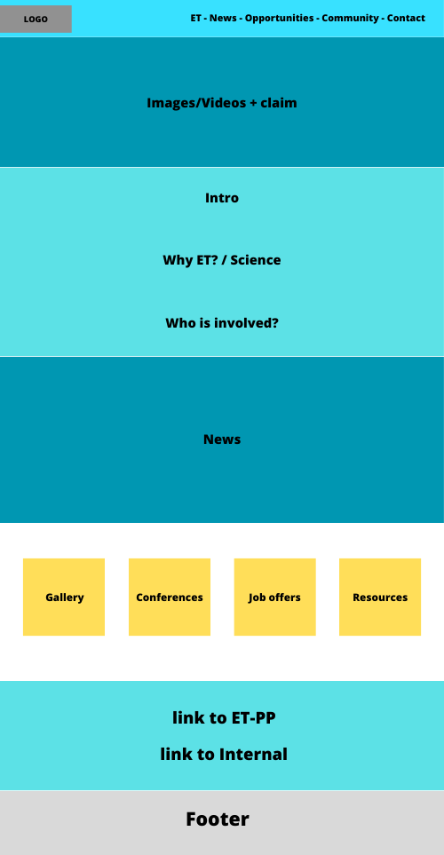
THE ET.eu WEBSITE
The ET website will serve the function of providing an institutional presentation and an initial outline of the scientific content.
It is targeting mainly those who who have become aware of ET through other routes: social media, mainstream media, social and professional contexts…
The homepage and the content of the site (in this first phase) should then address three main audiences:
Relevant Stakeholders (wider scientific community, policy makers…)
Media
General Public
The objective is to represent the joint and supranational effort of the GW community for Einstein Telescope, both as ETO and ET Collaboration?
An implementation plan with objectives, targets, preliminary navigation tree and homepage layout, timeline, and budget is ready.

Slide 15
The Einstein Telescope
(Europe-wide)
Should appear as one, even though behind the screens there are different entities
Communication ‘entities’ Einstein Telescope
National communities
(in countries that are not a potential site)
Scientific collaboration
ET Organi- sation
(The) Einstein Telescope
Also need to ensure commitment/
support, but on a different level than potential host countries
Potential site/bid Sardegna (including local/regional projects)
Potential site/bid EMR (including local/regional projects)
Potential site/bid Sachsen (including local/regional projects)
The potential sites are ‘special cases’ with very specific communication needs and aspects. E.g. building a hostconsortium with local/regional stakeholders, different level of commitment from governments, more dialogue with local/regional stakeholders to ensure their support etc. This means that they are really different entities/identities in practice.

Slide 16
Should appear as one, even though behind the screens there are different entities
The Einstein Telescope
(Europe-wide)
ET-PP is thinking about (new) logo, should be shared for ‘ET Europe’
LOGOS
National communities
(in countries that are not a potential site)
Scientific collaboration
ET Organi- sation
(The) Einstein Telescope
Also need to ensure commitment/
support, but on a different level than potential host countries
Potential site/bid Sardegna (including local/regional projects)
Potential site/bid EMR (including local/regional projects)
Potential site/bid Sachsen (including local/regional projects)
The potential sites are ‘special cases’ with very specific communication needs and aspects. E.g. building a hostconsortium with local/regional stakeholders, different level of commitment from governments, more dialogue with local/regional stakeholders to ensure their support etc. This means that they are really different entities/identities in practice.
-> For more details see the communication session tomorrow 9.40 am, Polivalent Room, 6th Floor

