Slide 1
Material for discussion on
Interfaces/Interferences between the beampipe and civil infrastructure
Initial plans for installation, length of beampipes, welding location, logistics, etc.
Luigi SCIBILE for the ET-CERN collaboration
ET-PP INFRA-DEV Annual Meeting, Barcelona, 12-13 June 2023

Slide 2

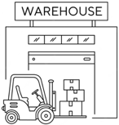

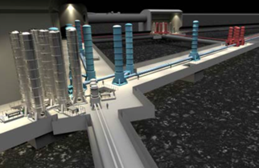
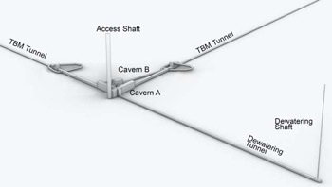


Interfaces/Interferences between the beampipe and civil infrastructure: Overview
    The interreferences/interfaces between the beampipe and the civil infrastructure have to be identified throughout the beampipe lifecycle.
Transport
Transport
Tunnel
installation and commissioning
Operation and Maintenance
Decommissioning
Heavy handling
Manufacturing
Materials
Transport
Transport
Manufacturing

Slide 3
Interfaces/Interferences between the beampipe and civil infrastructure: Overview
    Road network(s): depending on manufacturing strategy (on-site/off-site).
Transport
Transport
Tunnel
installation and commissioning
Operation and Maintenance
Decommissioning
Heavy handling
Manufacturing
Materials
Transport
Transport
Manufacturing

Slide 4
Interfaces/Interferences between the beampipe and civil infrastructure: Overview
    Building(s): depending on manufacturing strategy (on-site/off-site)
Transport
Transport
Tunnel
installation and commissioning
Operation and Maintenance
Decommissioning
Heavy handling
Manufacturing
Materials
Transport
Transport
Manufacturing

Slide 5
Interfaces/Interferences between the beampipe and civil infrastructure: Overview
    Shaft(s)*: specifications depends on beampipe length (using⁺ 15 meters )
Transport
Transport
Tunnel
installation and commissioning
Operation and Maintenance
Decommissioning
Heavy handling
Manufacturing
Materials
Transport
Transport
Manufacturing
(*) Assuming no inclined tunnel access
(⁺) Note that in ET design report update 2020 pipe lenght is 20 meters

Slide 6
Interfaces/Interferences between the beampipe and civil infrastructure: Overview
    Caverns: Interfaces/Interferences depend on beampipe length and width for the transport during the installation and for the eventual replacement of a tube section in case of failure.
Transport
Transport
Tunnel
installation and commissioning
Operation and Maintenance
Decommissioning
Heavy handling
Manufacturing
Materials
Transport
Transport
Manufacturing

Slide 7
Interfaces/Interferences between the beampipe and civil infrastructure: Overview
    Tunnel: Interfaces/Interferences depend on many factors (see separate slides).
Transport
Transport
Tunnel
installation and commissioning
Operation and Maintenance
Decommissioning
Heavy handling
Manufacturing
Materials
Transport
Transport
Manufacturing

Slide 8
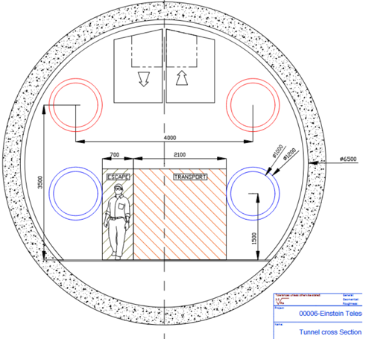
Interfaces/Interferences between the beampipe and the tunnel: cross section
    Space required for the supporting structure, for welding and future inspections (min 400mm), for gate valves, for pumping modules and related control units (depending on design installation).
400
500
800
800
800
2720
2460
1100
1100
1100

Slide 9
Interfaces/Interferences between the beampipe and the tunnel: cross section
    Space required for welding and future inspections (min 400mm)
400
500
800
800
800
2720
2460
1100
1100
1100

Slide 10
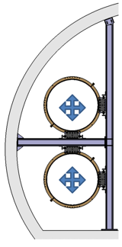

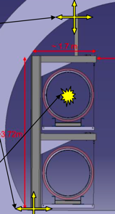
Interfaces/Interferences between the beampipe and the tunnel: cross section
    Space required for supporting structure (assuming that the support infrastructure will be installed along with the tubes).
400
400
800
800
2720
2720
2180
1100
1100
2180

Slide 11
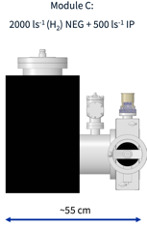

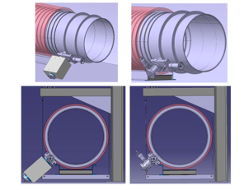
Interfaces/Interferences between the beampipe and the tunnel: cross section
    Space required for pumping modules (up to 550mm)
400
500
800
800
2720
2460
1100
1100
1100

Slide 12
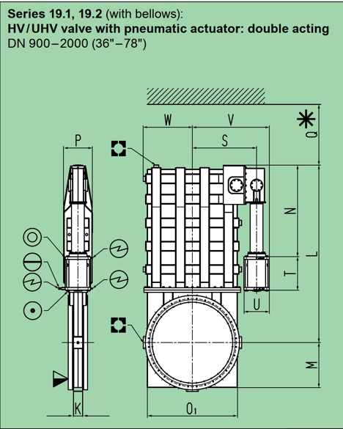
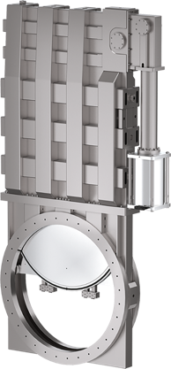
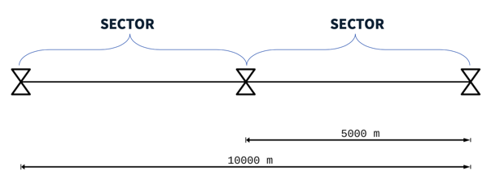
Interfaces/Interferences between the beampipe and the tunnel: cross section
Space required for sectional gate valves (DN1000)
1565 (W+V) x 2751 (L +M) x 356 (P) mm
+ 140 mm (Q)
800
1100

Slide 13
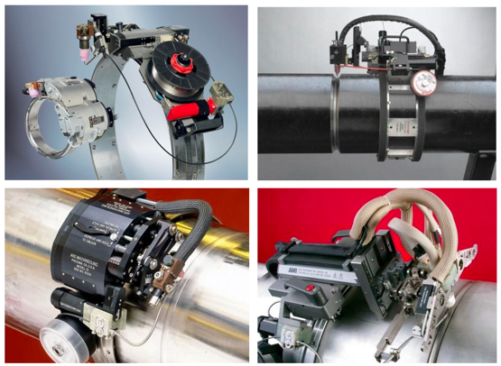
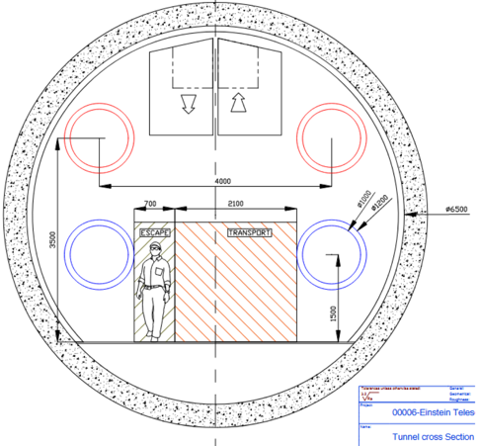
Interfaces/Interferences between the beampipe and the tunnel: Transport/Weldings/Logistics
    During the installation of the tubes, transport will take place in the tunnel within the allocated space during the nights (Reduce co-activity, enhance safety and prepare the work for the day shift)
    Assuming two circular welds per working day per team, 10 circular welds per week per team
    The current welding strategy is to be carried out at the final location. A clean tent will be moved to the welding location to allow the removal of the tubes clean seals before the welding.
400
800
2720
1100

Slide 14
Interfaces/Interferences between the beampipe and the tunnel: Questions?
    Fire fighting equipment (water - DN200 pipe?)
    Cable trays for communication equipment?
    Ventilation and smoke extraction?
    Presence of alcoves/enlargements?

Slide 15
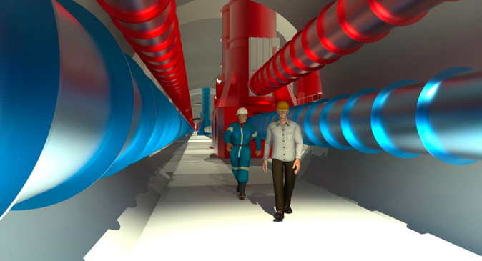
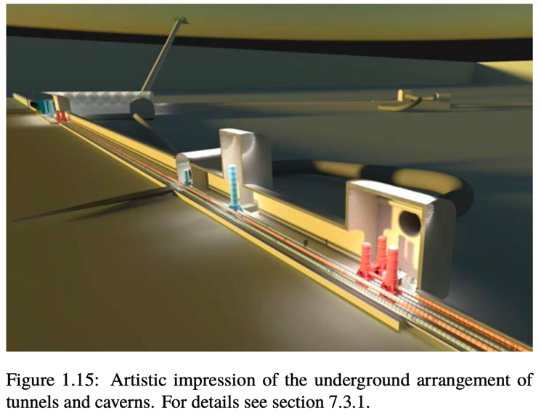
Interfaces/Interferences between the beampipe and the tunnel: Questions?
    Space required to dismount a part of the beampipe in case of serious issues once the towers are mounted?

Slide 16
Installation and logistics scenarii

Slide 17


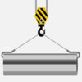

Installation and logistics: off-site manufacturing
Material Bakeout @450°
Transport
X [m] section pipe preparation
Leak testing
Cleaning
Transport
Warehouse storage
Transport
Site buffer storage
x 12 10⁻⁶ [m] / X (= 8000 for X = 15)
Heavy handling
Potential parallel activtiy
Potential Parallel operation
Design dependence
Welding, assembly and transport of 312.5 m sections
Vacuum systems installation and testing
Leak testing
5km (10km)
Bakeout @150°
Vacuum pumping
x 16 (x32)
x 2 (x1)
x 12
Option 1 (Option 2)
x 12
Option 1: 10km sector
Option 2: 5km sector
TUNNEL
Beam pipe ready for operation

Slide 18
Installation and logistics: on-site manufacturing
Material Bakeout @450°
Transport
X [m] section pipe preparation
Leak testing
Cleaning
Site buffer storage
x 12 10⁻⁶ [m] / X (= 8000 for X = 15)
Heavy handling
Potential parallel activtiy
Potential Parallel operation
Design dependence
Welding, assembly and transport of 312.5 m sections
Vacuum systems installation and testing
Leak testing
5km (10km)
Bakeout @150°
Vacuum pumping
x 16 (x32)
x 2 (x1)
x 12
Option 1 (Option 2)
x 12
Option 1: 10km sector
Option 2: 5km sector
TUNNEL
Beam pipe ready for operation

Slide 19
Installation and logistics: in-tunnel manufacturing
Material Bakeout @450°
Transport
Manufacturing can only start after the completion (or partial completion) of the underground infrastructure.
Heavy handling
Potential parallel activtiy
Potential Parallel operation
Design dependence
X [m] section pipe preparation
Leak testing
Cleaning
Welding, assembly and transport of 312.5 m sections
Vacuum systems installation and testing
Leak testing
5km (10km)
Bakeout @150°
Vacuum pumping
x 12 10⁻⁶ [m] / X (= 8000 for X = 15)
x 16 (x32)
x 2 (x1)
x 12
Option 1 (Option 2)
x 12
Option 1: 10km sector
Option 2: 5km sector
TUNNEL
Beam pipe ready for operation

Slide 20
Installation and logistics: in-tunnel quasi-continuous
Material Bakeout @450°
Transport
Manufacturing can only start after the completion (or partial completion) of the underground infrastructure.
Heavy handling
Potential parallel activtiy
Potential Parallel operation
Design dependence
X [m] section pipe preparation
Leak testing
Cleaning
Welding, assembly and transport of 312.5 m sections
Vacuum systems installation and testing
Leak testing
5km (10km)
Bakeout @150°
Vacuum pumping
x 12 10⁻⁶ [m] / X (= 384 for X = 312.5)
x 16 (x32)
x 2 (x1)
x 12
Quasi-continuous
Option 1 (Option 2)
x 12
Option 1: 10km sector
Option 2: 5km sector
TUNNEL
Beam pipe ready for operation

Slide 21
Installation sequence, logistics and timelines/schedules - Options
    One option (on-site manufacturing) analysed for the installation sequence with a feasible logistics using a time-location diagram.
    It only represents a preliminary overview. It will be updated once a more complete Work Breakdown Structure (WBS), activity list and production rates will be available
    It provides a method (1) to study the technical and safety feasibility of potential parallelisms and (2) to highlight scheduling constraints for the eventual options.
Time-location example:
ET four tubes in one arm

Slide 22
Timelines/schedules – example

Slide 23
Timelines/schedules – example
32 sectors x ARM
Up to 8 Parallel Teams
45 months from start installation to @ vacuum.

