Slide 1
Long-Baseline Neutrino Oscillation Experiments and the Role of the Near Detector
Thorsten Lux

Slide 2

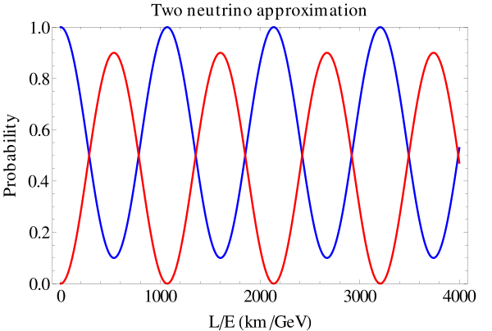

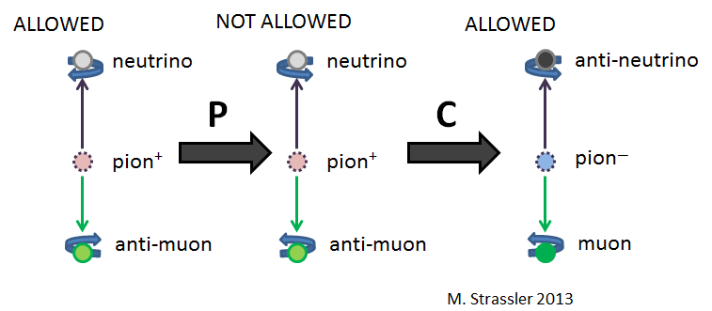
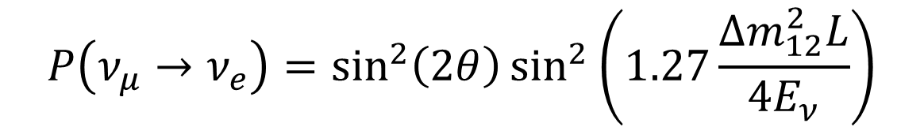
Quick Reminder: 2 Neutrino Oscillations
$$P\left(ν_{μ}→ν_{e}\right)=\sin^{2}\left(2θ\right)\sin^{2}\left(1.27\frac{{Δm}_{12}^{2}L}{4E_{ν}}\right)$$
What would CP Violation imply?
Measure oscillations with neutrinos and anti-neutrinos
Might help to understand why more matter than anti-matter in the Universe
$$P\left(θ_{μ}^{L}→θ_{e}^{L}\right)≠P\left(\overline{θ_{μ}^{R}}→\overline{θ_{e}^{R}}\right)$$

Slide 3

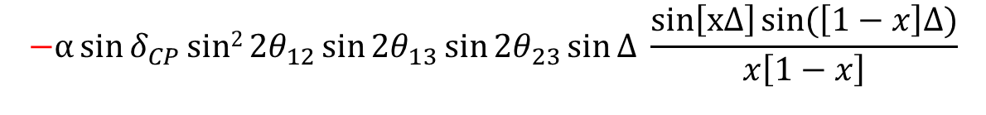

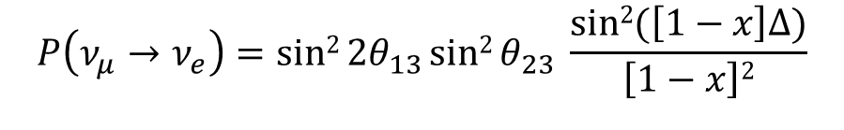


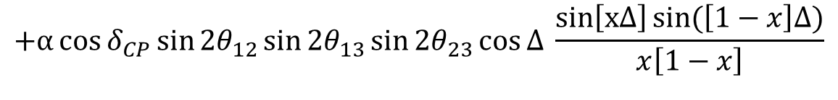
Quick Reminder: Oscillation Probabilities for 3ν
$$P\left(ν_{μ}→ν_{e}\right)=sin2{2θ_{13}sin2{θ_{23} \frac{sin2{(\left[1−x\right]∆)}}{\left[1−x\right]2}}}$$
Leading term
$$−α\sin{δ_{CP}}sin2{2θ_{12}\sin{{2θ}_{13}}sin{{2θ}_{23}\sin{∆} \frac{sin\left[x∆\right]{\sin{(\left[1−x\right]∆)}}}{x\left[1−x\right]}}}$$
CP violating term
$$+α\cos{δ_{CP}}sin{2θ_{12}\sin{{2θ}_{13}}sin{{2θ}_{23}\cos{∆} \frac{sin\left[x∆\right]{\sin{(\left[1−x\right]∆)}}}{x\left[1−x\right]}}}$$
CP conserving term
For :
“-” => “+”
replace δ and x with -δ and -x
$$P\left(\overline{θ_{μ}^{R}}→\overline{θ_{e}^{R}}\right)$$
$$x=\frac{2\sqrt{2}G_{F}n_{e}E_{θ}}{∆m_{31}^{2}}, α=\left|\frac{∆m_{21}^{2}}{∆m_{31}^{2}}\right|≅\frac{1}{30}, ∆=\frac{∆m_{31}^{2}L}{{4E}_{θ}}$$
$δ_{CP}$ = 0 implies violating tem vanishes!

Slide 4
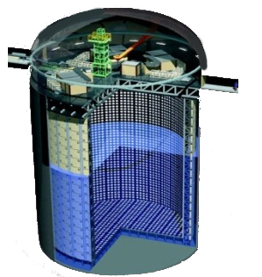
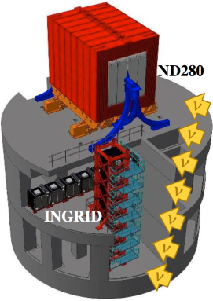
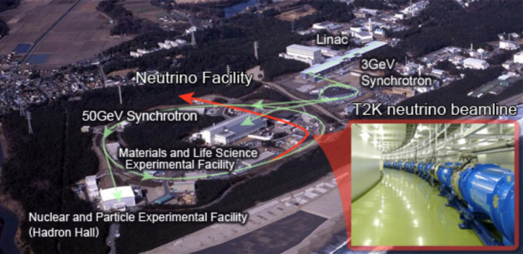
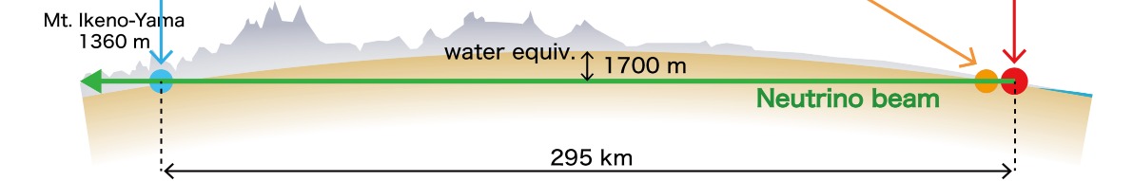
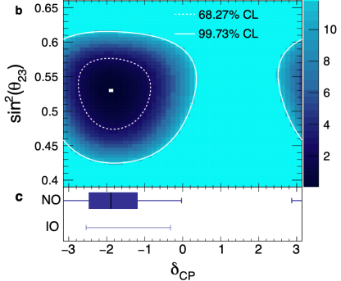
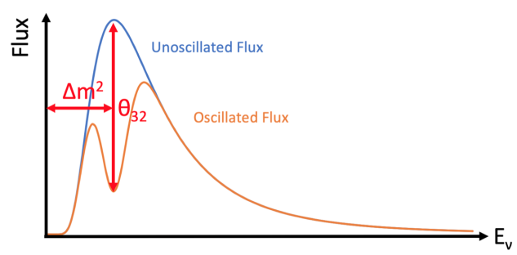
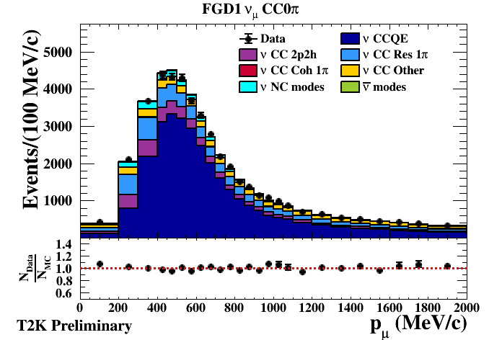
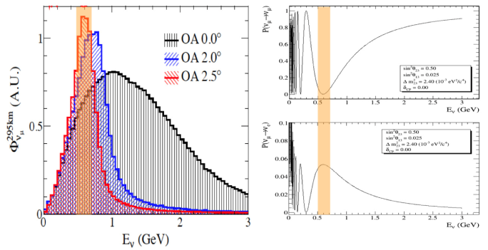



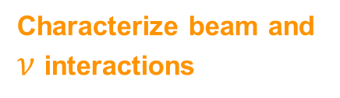
LBNO Experiment Concept
Far detector
Super Kamiokande
Near detector
complex
J-PARC
Neutrino Beam
@SK
@ND280
@J-PARC
Measure oscillated beam
Characterize beam and $ν$ interactions
Create Neutrino’s off-axis beam
$ν_{μ}$ or ${\overline{ν}}_{μ}$
$ν_{μ}$ $→$ $ν_{μ}$
$ν_{μ}$ $→$ $ν_{e}$

Slide 5



What do we need?
To extract the oscillation parameters, we need the oscillation probability
We should measure:
  Disappearance probability:
  Appearance probability: (β=τ normally not accessible)
Wide range of E_{ν} to measure the shape of P well
Ideal would be pure ν_{α} flux initially
P is in fact not directly measurable but is given by:
Some problems:
Flux also not direct observable, no pure ν_{α} flux, we also do not know so well E_{ν} and more …
$$P\left(ν_{α}→ν_{α}\right)$$
$$P\left(ν_{α}→ν_{β}\right)$$

Slide 6
What do we have (ideally)?
Detectors provide event rates:
ND provides the no oscillated flux on the FD via:
Then P is given by:
Number of target isotopes given by detector
Neutrino flux, depends on E_{ν}
Cross-section (interaction probability), depends on E_{ν}, target isotope
Takes into account geometrical differences

Slide 7
What do we have (ideally)?
Detectors provide event rates:
ND provides the no oscillated flux on the FD via:
Then P is given by:
Number of target isotopes given by detector
Neutrino flux, depends on E_{ν}
Cross-section (interaction probability), depends on E_{ν}, target isotope
Takes into account geometrical differences
No, not at all! We have detector effects!

Slide 8
Real World Detector
P depends on true E_{ν} but a detector provides E_{ν}^{reco}
Energy migration described by matrix:
Additional detector effects/efficiencies which depend on E_{ν}/E_{ν}^{reco}:
Both require an excellent understanding of the detector response
Different for every interaction process
Event rate at FD is then:
Event rate at ND is then:
More complicated but you still extract the oscillation parameters from comparing the near detector and the far detector neutrino spectrum!
ND

Slide 9
Analysis Concept: νe Appearance
A lot of uncertainties have to be taken into account!

Slide 10
Neutrino Beam Generation
Neutrino beam is tertiary beam
Proton beam, hadron production, magnetic horn system, … contribute to neutrino flux uncertainties
Some of these uncertainties controlled by beam monitors and external experiments
Hard work to reduce uncertainties in knowledge of neutrino flux!

Slide 11
T2K Neutrino Flux
Neutrino flux not mono-energetic but shows broad spectrum
No pure ν_{μ} beam but contaminations to be accounted for in analysis
But: ν_{e} contamination useful to measure cross-section for appearance in FD
Also wrong-sign contamination
T2K/HK neutrino flux peaks at about 650 MeV

Slide 12
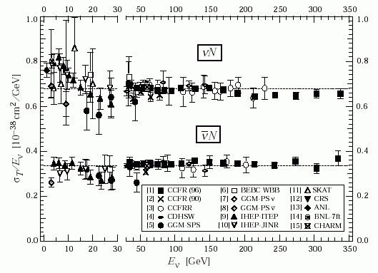
Neutrino Cross-Sections: Motivation
Uncertainties in neutrino and anti-neutrino cross-sections affect CP Violation measurement
Muon (anti-)neutrino cross-section well measured at ND and used to extrapolate to electron (anti-)neutrino cross-section at FD => enough for current experiments but not for future high statistics experiments
Need <3% relative error on these cross-sections
Cross-sections depend on target material. ND280 measures mainly on CH => need to measure on water for future

Slide 13
Neutrino Cross-Sections

Slide 14
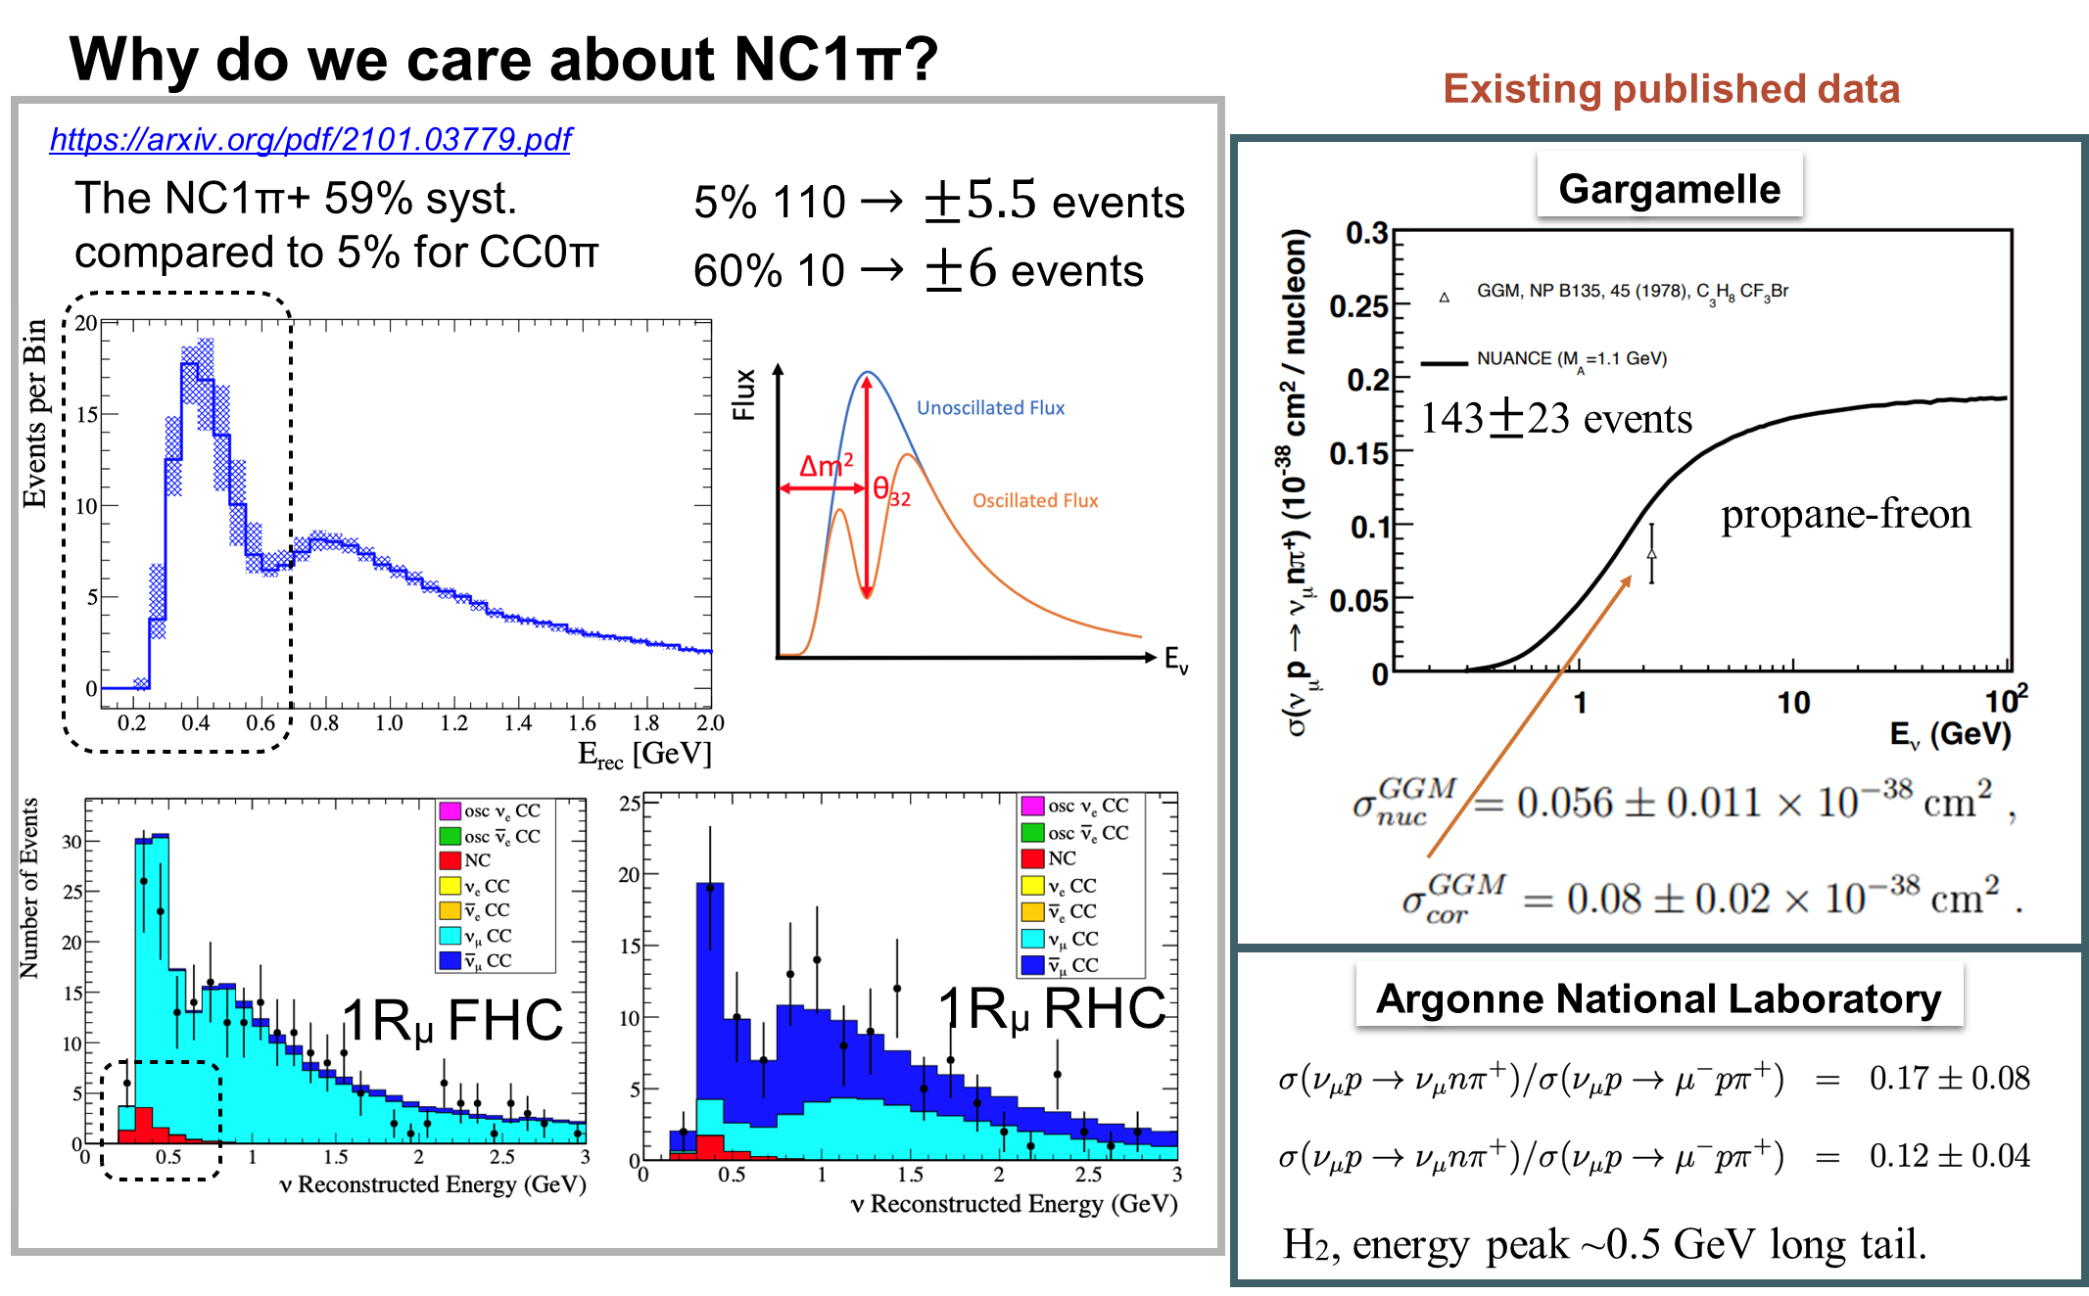
T2K Analysis: NC1π+

Slide 15
Energy Measurement: Could be so simple …
Remember: We need the oscillation probability as function of the true neutrino energy!
ν_{μ}/ν_{μ} enters the detector, exchanges a W-boson with a neutron/proton and in the final state we have a negative/positive muon and proton/neutron
Energy reconstruction trivial for QE case:
Small but relevant problem: We have normally no H target and for sure no free neutrons!
Interactions need to take into account many nuclear effects

Slide 16
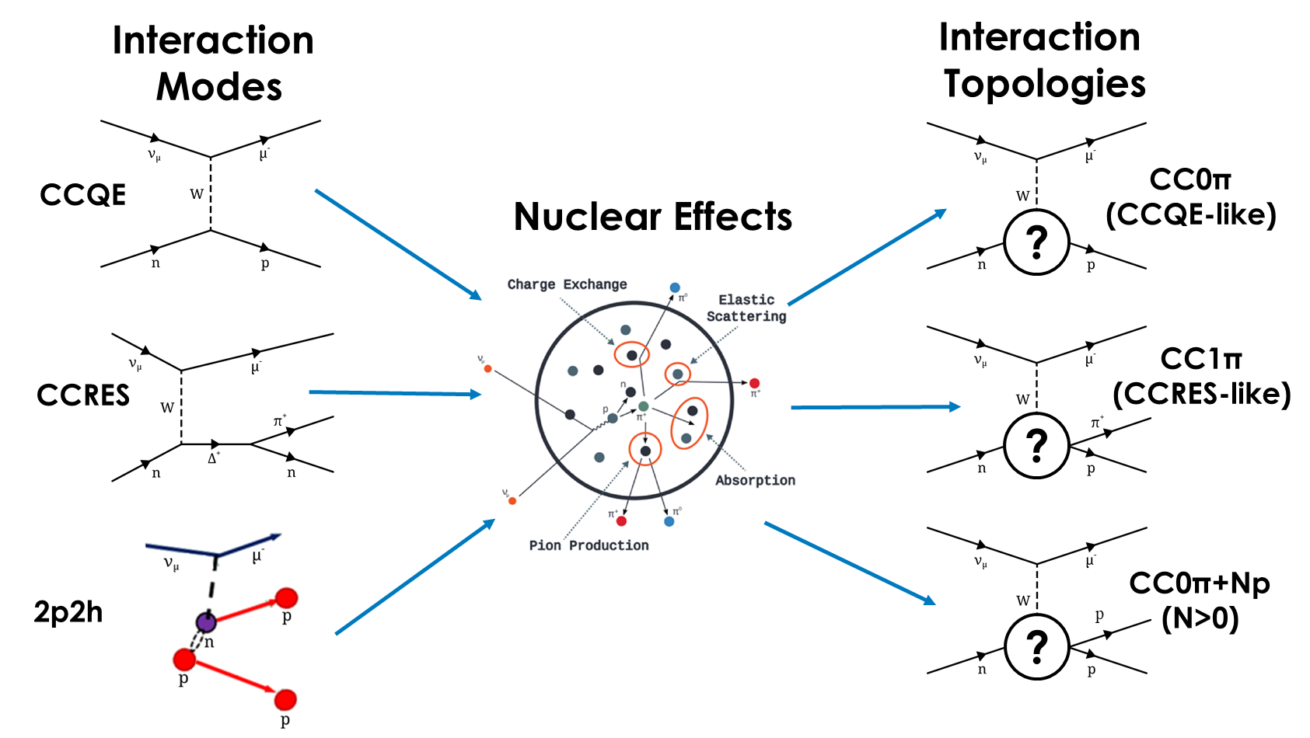
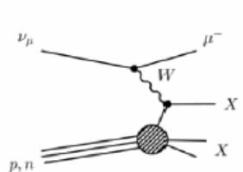
Interaction Modes and Interaction Topologies
Relevant for neutrino oscillations
Seen by detector
DIS

Slide 17
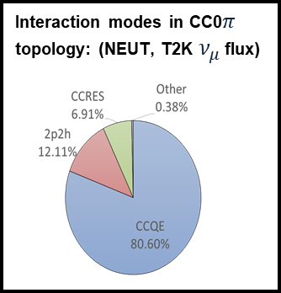
Final State Interactions
Probability depends on target! => Ideally measure with same target in ND and FD!
Might affect reconstructed neutrino energy

Slide 18
Fermi Motion
Previous equations for energy reconstruction only valid for stationary nucleons
Nucleons move inside nucleus => Fermi motion
Energy at interaction vertex is not well defined
Reconstructed energy is smeared around true value
Large effect for small neutrino energies
Several models for energy of nucleons in nucleus considered:
  Relativistic Fermi Gas (RFG) => bad
  Local Fermi Gas (LFG) => good
  Spectral functions => very good

Slide 19
Energy Reconstruction
Kinematic approach:
Simple and nice but only useful for CCQE events
Does not take into account FSI effects
Some particles might be “invisible” eg below Cherenkov threshold
Ideal method for WCD

Slide 20
Energy Reconstruction
Calorimetric approach:
Measure the energy of all outgoing particles and sum them to reconstruct neutrino energy
Better estimation but far from perfect
Problem are neutral particles, especially neutrons, carrying away energy undetected
LAr TPC approach (DUNE) and ND280
No detector effects

Slide 21
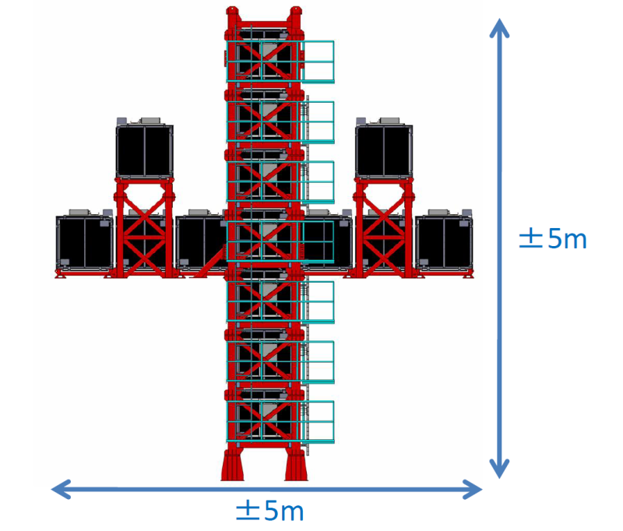
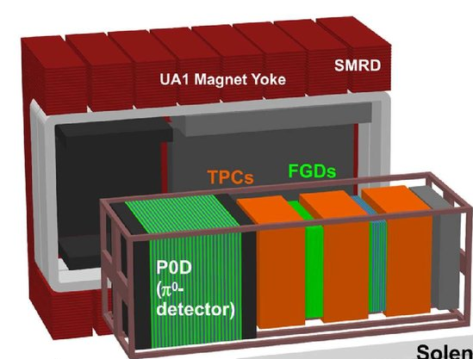
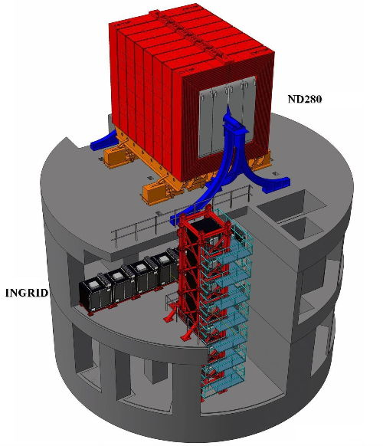
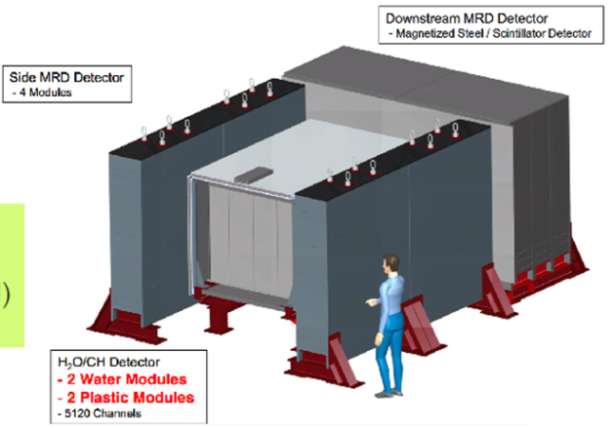
Several T2K Near Detectors
ND280:
Off-axis 2.5
Magnetized
Cross-sections
2+2 tonne target mass (mainly CH)
0.2T
ECal
ECal
INGRID:
On-axis
Monitoring beam direction and flux
Others:
WAGASCI
NINJA
Off-axis 1.5

Slide 22
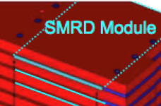
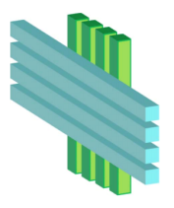
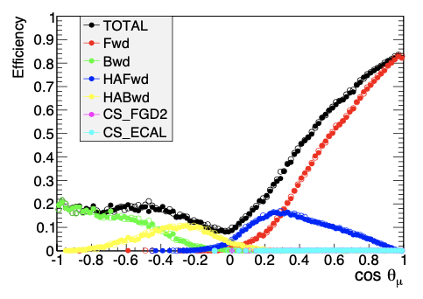
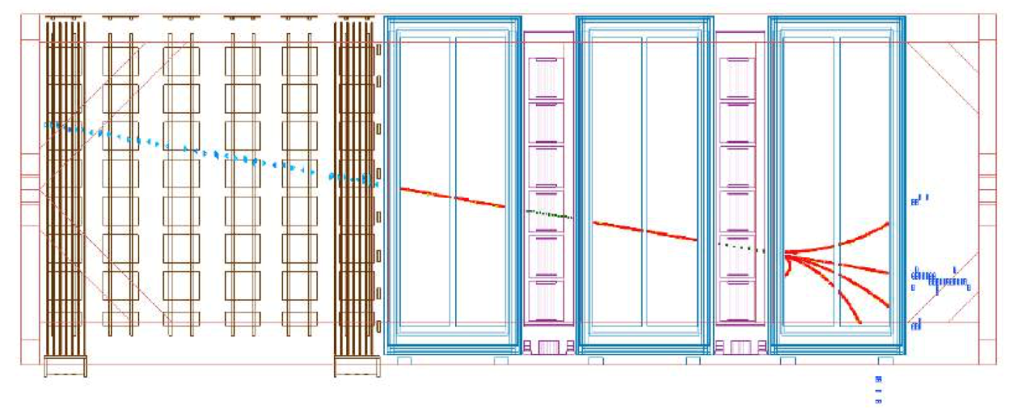
The ND280 detector (2009-2022)
Current ND280 sketch
Current limitations
0.2T
Tracks w/o TPCs (high angle).
Tracks w/o TPCs (low momentum).
Limited timing information => no direction information
No neutron info
Poor electron/photon separation
High detection threshold for protons
ECal
ECal
FGD
Event display of basket elements
CC-inclusive
P0D
TPC1
TPC2
TPC3
FGD1
FGD2
NC
CC
Bad purity for topologies different CC0π

Slide 23
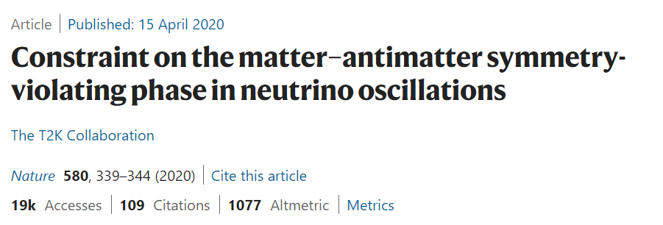
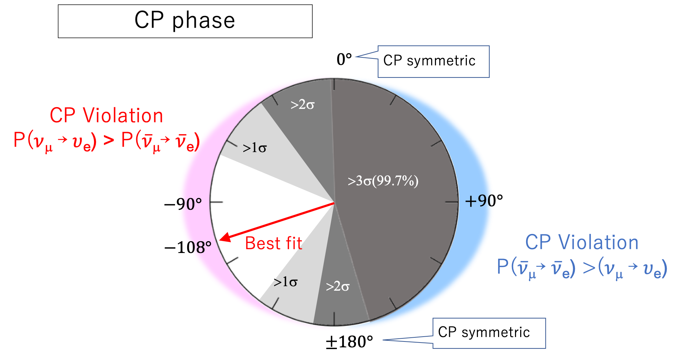
Some T2K Results
T2K experiments reported first measurement of δCP
Large region of δCP>0 rejected at 99.7% level
Best fit result close to maximal CP violation
δCP=0 excluded at 3σ, δCP=180 excluded at >2σ
More key results in the past: First νe appearance measurement (Phys. Rev. Lett. 112, 061802)

Slide 24
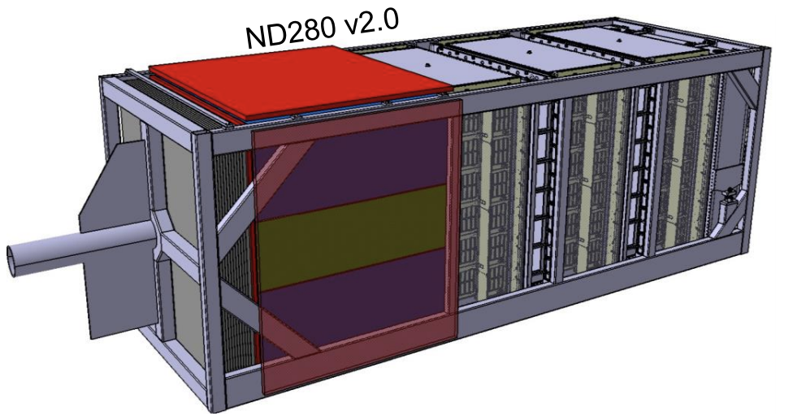
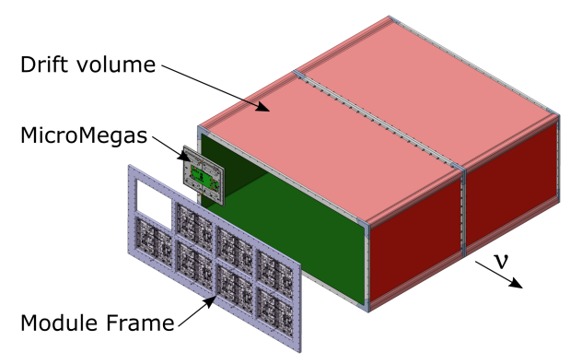
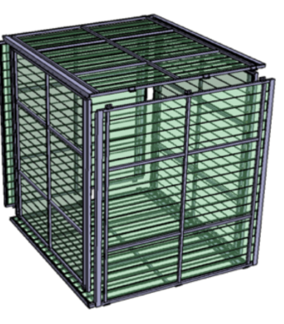
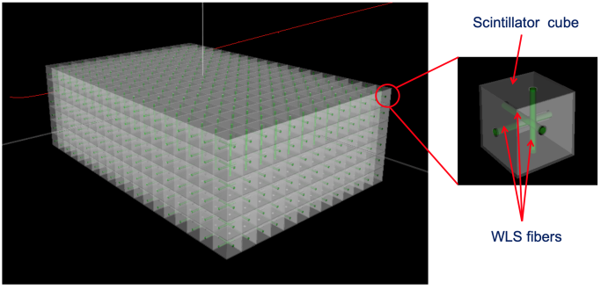
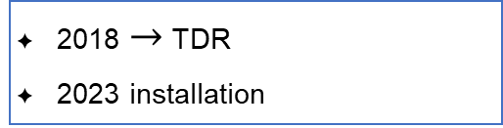
The upgraded ND280 detector
Replace P0D by new subdetectors
ToF
Milestones
top HA-TPC
2018 $→$ TDR
2023 installation
SuperFGD
      arXiv:1901.03750
bottom HA-TPC
2 High Angle TPCs
1 SuperFGD
6 ToF panels
90cm
1cm³
180cm
80cm
182 cm
192cm
56cm
8 ERAM
New read-out concept
Novel detector concept
JINST 13, P02006 (2018)
150 ps time resolution resolution
NIM A 957 163286 (2020)
      JPS Conf. Proc. 27, 011005 (2019)
JINST 15 P12003 (2020)
Bad purity for topologies different CC0π

Slide 25
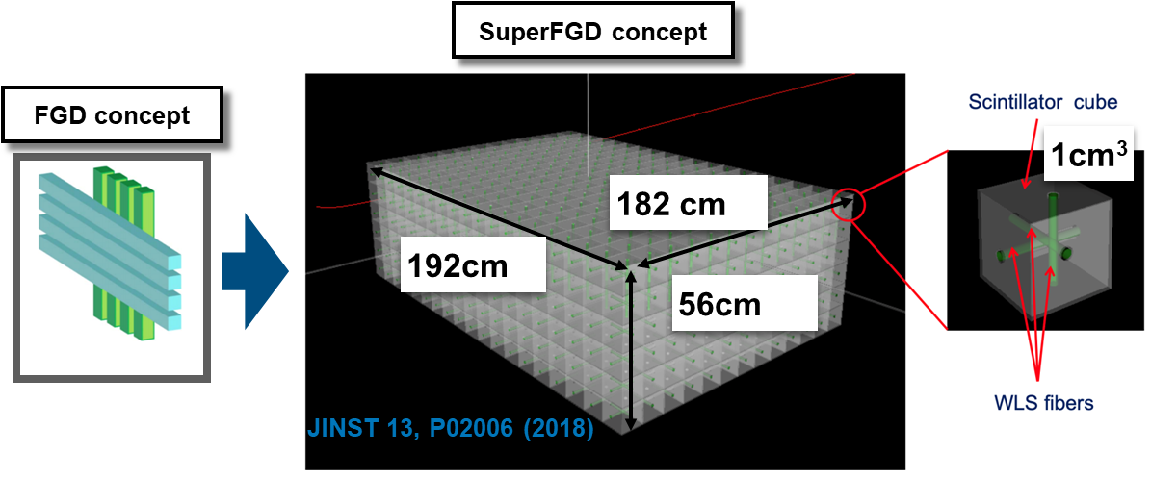
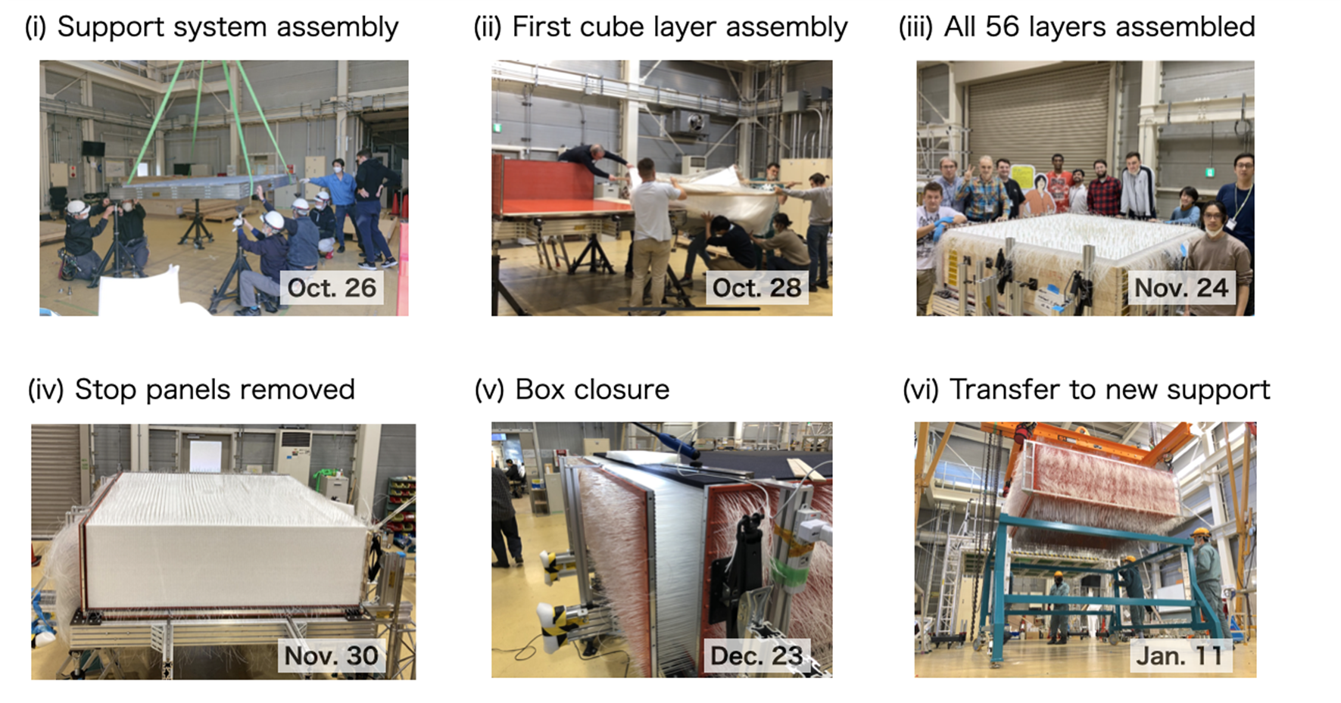
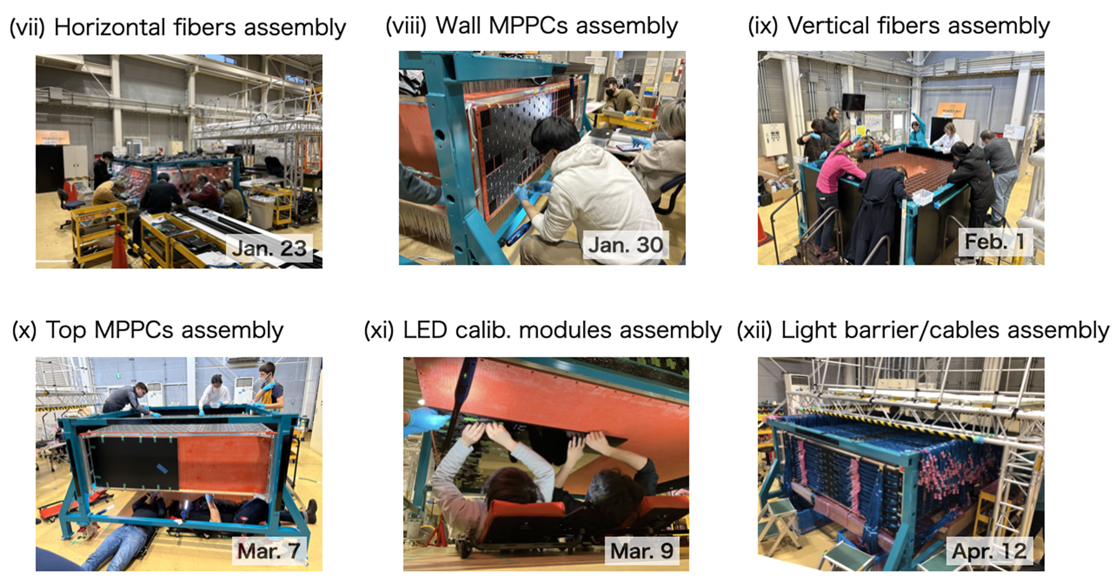
SuperFGD
Novel scintillator tracker based on 2 million cubes
Allows 3D reconstruction of the events
60k fibers/MPPC (as much as the current ND280)
Assembly was a challenge including key material from Russia
2 tonne neutrino target (double as now)

Slide 26
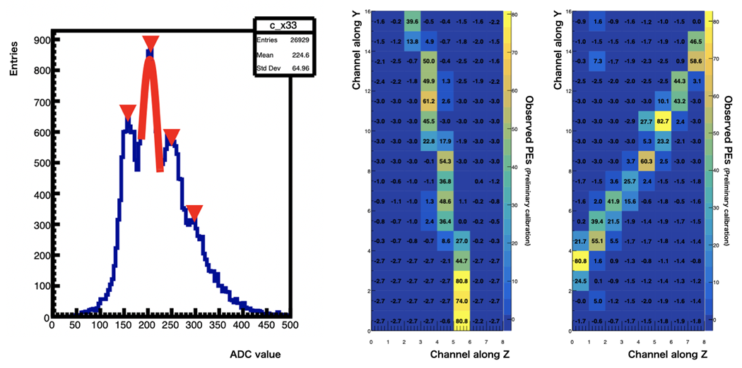
SuperFGD
It works! First cosmics seen in April 2023!

Slide 27
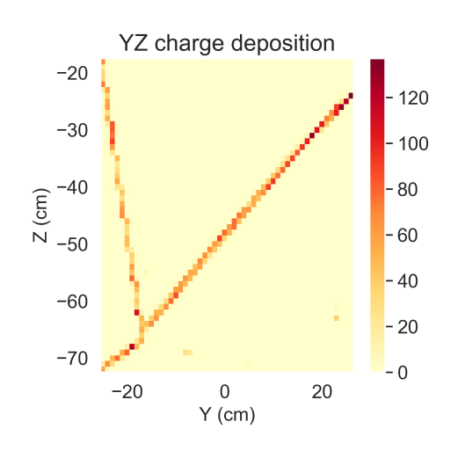
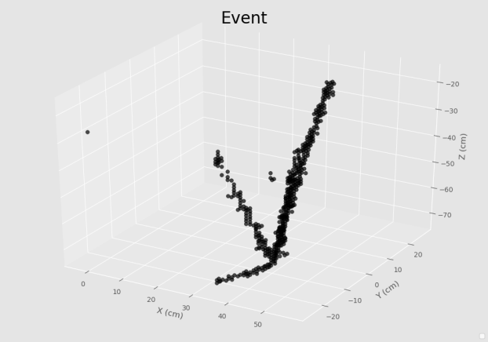

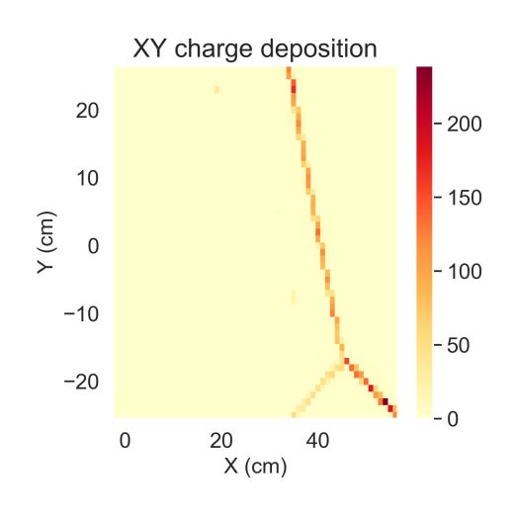
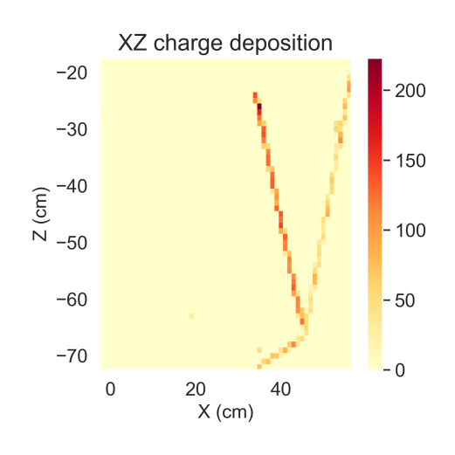
3 2D views combined to full 3D event
ML partly used
Testbeam event

Slide 28
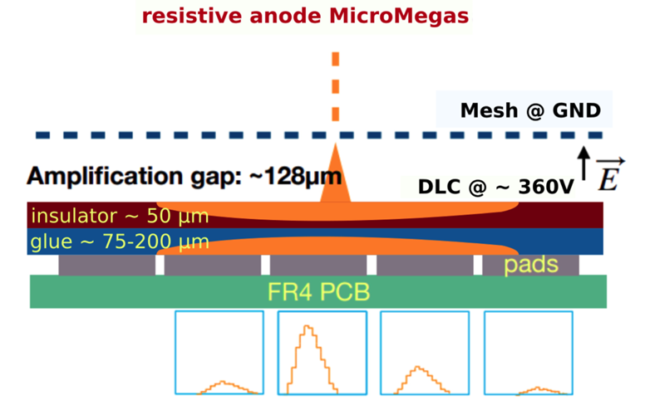
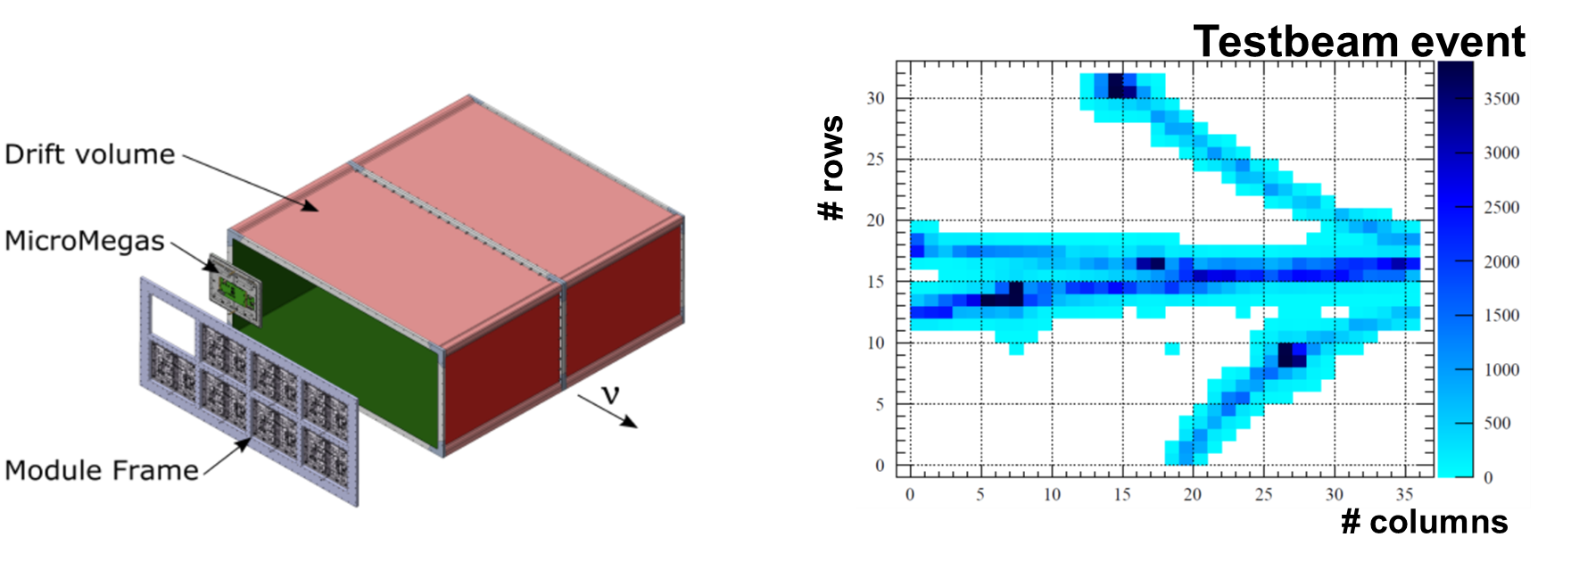
HA-TPC
2 HA-TPCs assembled out of field cage halves with central cathode
Resistive Anode MM (ERAM) readout
Composite material walls
Both a novelties for full-size TPCs
Particle identification + momentum measurement
CERN contribution

Slide 29
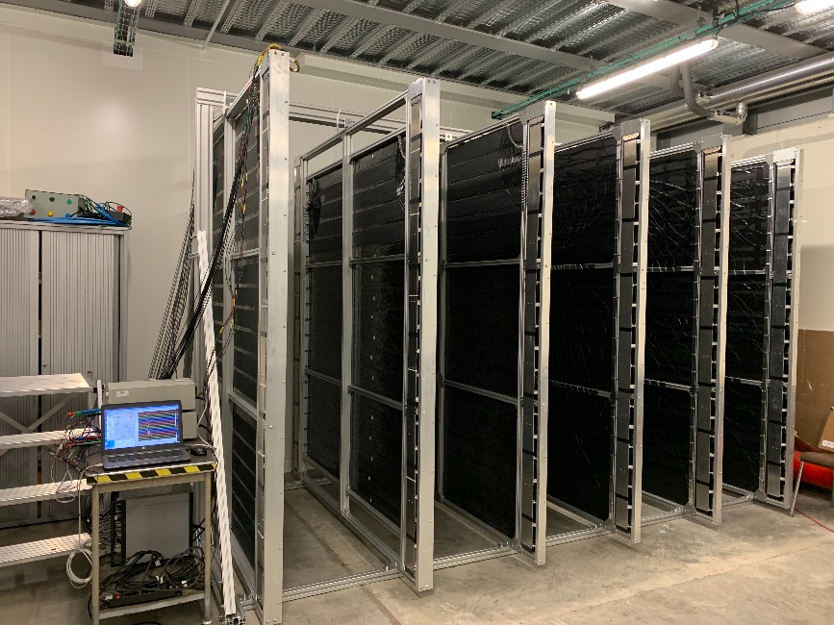
TOF
6 modules (2.3x2.5 m2) mounted each with 20 bars
Double sided readout with 12 SiPMs per side
Tested in several testbeams
Excellent time resolution of 150 ps achieved
Currently quality control of all modules using cosmics
Important to determine direction of particles
?
0.2T
ECal
ECal

Slide 30
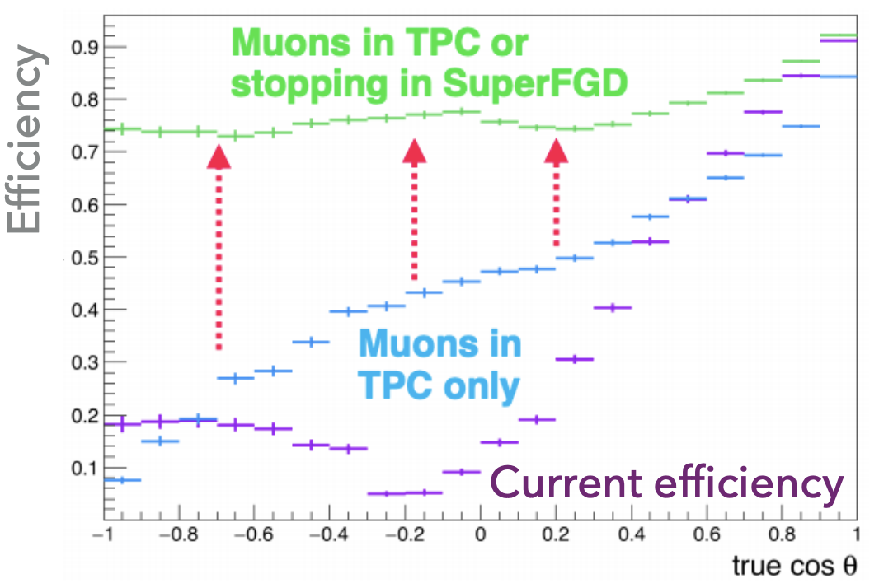
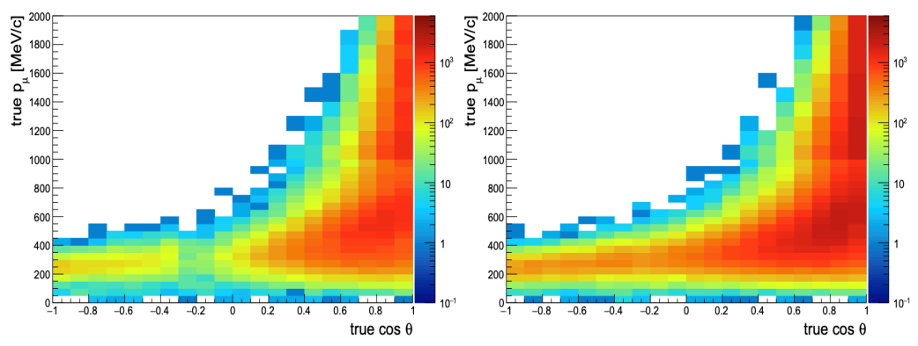
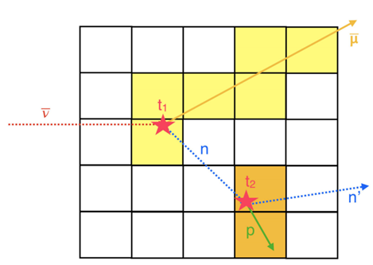
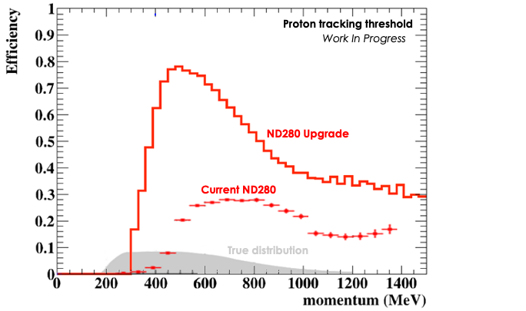

Physics Impact
Upgraded ND280 covering similar phase space coverage as SuperKamiokande
Significant lower energy threshold
Neutron detection capability
Systematic uncertainty reduced from 6 to 4%
Much better cross section measurements and FSI understanding!
ND280
SK
ND280 UP
30

Slide 31

Delta CP in HyperK

Slide 32
HK and ND280: What is needed?
must be measured at theoretical uncertainty of 3%
Cross section on water instead of carbon as in current ND280
Work on HK ND280++ Upgrade slowly starting

Slide 33
ND280 vs IWCD
 | ND280++ | IWCD | Advantages
Target | CH + H2O | H2O | H2O gives less systematics but not fully sensitive
Mass | 4t (now) / 10t (++) | 300t | Larger mass more statistics
Magnet | Yes | No | Better Particle Identification
Energy threshold | Low | High | Low helps to study FSI
Distance | 280 m | 800 m | Larger distance less extrapolation uncertainty to FD
Angle | Fixed (2.5º) | Moveable | Measure cross-sections and flux at different angles reduces uncertainties
Technology | Multi-detectors | WCD | WCD might introduce less detector uncertainties
ND280 and IWCD are complementary!

Slide 34
Summary
Extracting oscillation parameters and CP violating phase from data, is highly complex process
Near detector is the crucial detector for CP Violation measurement (cross-sections, energy reconstruction, FSI effects, background (eg NC1pi+), …)
Upgraded ND280 will provide important information e.g. with more information about FSI crucial for energy reconstruction
IWCD will be very useful to reduce uncertainties further and complementary to ND280
HK will be a high statistics experiment and in contrast to now being limited by systematic uncertainties
ND280 Upgrade++ for HK is under consideration
There are possibilities to join the efforts e.g. on event reconstruction level

Slide 35
Backup

Slide 36
Neutrino Oscillation Theory
Based on some basic assumptions:
3 mass eigenstates (“true neutrinos”): ν_{1,2,3} relevant for transport
3 flavour eigenstates: ν_{e,μ,τ} relevant for production/detection via weak force
Relation between both eigenstates defined by PMNS matrix U
PMNS matrix: 3 mixing angles, 1 CP violating phase
Flavour oscillations possible if m_{1,2,3}≠0 and not identical

Slide 37
PMNS Matrix
Useful representation of the PMNS matrix:
Probability of oscillation from flavour α to flavour β after distance L:
Pontecorvo-Maki-
Nakagawa-Sakata
Atmospheric
Reactor/accelerator
Solar

Slide 38



2 Neutrino Oscillations
Reasonable simplification in many cases: 2 neutrino oscillations
Instead of 3 mixing angles only one:
$\left(\begin{matrix}νe \\ νμ\end{matrix}\right)=\left(\begin{matrix}\cos{θ} & \sin{θ} \\ −\sin{θ} & \cos{θ}\end{matrix}\right)\left(\begin{matrix}ν1 \\ ν2\end{matrix}\right)$
Starting with pure ν_{μ} beam we might detect after distance, L, ν_{e} in the beam
Probability:
$$m_{1}^{2}−m_{2}^{2}$$
$$P\left(ν_{μ}→ν_{e}\right)=\sin^{2}\left(2θ\right)\sin^{2}\left(1.27\frac{{Δm}_{12}^{2}L}{4E_{ν}}\right)$$
Neutrino energy

Slide 39


T2K-II (2023-2026)
New subdetectors for ND280
beam power upgrade: 0.5 MW → 750 kW (→ 1.3 MW HyperK)
statistics: 3E21 POT (2018) → 1E22 POT (2026)
aim: systematics from 5-6% to 4%
Aim for CPV observation in optimal scenario at 3σ
ToF

Slide 40

More complications: Matter Effects
Even without CP violation, there is:
Neutrinos cross the Earth and there are only electrons but no positrons!
Corresponds to additional potential V:
GF: Fermi const., ne: electron number, sign depends on neutrinos or anti-neutrinos
Depends on mass hierarchy in addition: normal preferred at 3σ level by SK atmospheric neutrinos
Weak forward scattering
$$P\left(θ_{μ}^{L}→θ_{e}^{L}\right)≠P\left(\overline{θ_{μ}^{R}}→\overline{θ_{e}^{R}}\right)$$
V $= ± \sqrt{2}G_{F}n_{e}$

Slide 41



2 Approaches: Large Baseline
L > 1000 km
Use wideband neutrino energy beam => on-axis
Use high energy (E_{ν}>2 GeV) 1st maximum for mass hierarchy
Use low energy 2nd maximum for CP violation
CP Conserved
CP Violated
1st
2nd
2nd
1st

Slide 42



2 Approaches: Shorter Baseline
L ≈ few hundred km
Baseline so short that matter effects have almost no impact
Focus on 1st maximum => E_{ν}<1 GeV
Aim on maximal flux at E_{ν}^{max} => off-axis configuration
To improve sensitivity use mass hierarchy from
other measurements or add another detector
at larger L
(Hyper-KK)

Slide 43
Near Detector and Uncertainties
More complicated to extract but ND provides:
To measure cross-sections, we need to now the neutrino flux
One single ND, cannot provide both independently
Best approach constraint flux initial uncertainty by external data
ND also provides information about Final State Interactions (see later)
Significant uncertainties which can be grouped in 3 types:
  Flux uncertainties
  Cross-section uncertainties
  Detector uncertainties

Slide 44
Proton Beam
The quality of the proton beam affects the neutrino flux
3 most relevant parameters are:
  Beam intensity
  Beam position
  Beam profile
Intensity: e.g. by current transformers with precision < 0.5% (NUMI), < 2.7% (T2K, aiming on 2%)
Positon and profile: by segmented secondary emission monitors with precision on 100-200 μm level or by optical transition radiation monitors < 500 μm
Measurement close to target crucial

Slide 45
Hadron Production
Hadron production is a major uncertainty for the neutrino flux
Knowledge of meson production double differential cross-section in function of angle and momentum needed
Cannot be obtained in-situ but dedicated experiments are needed
Several experiments doing this measurement over the last decades with different targets and proton energies

Slide 46
NA61/SHINE

Slide 47
Proton Interactions
Most data in the past was taken with thin data
Real target is long
High probability of secondary integrations in target
Or in surrounding material
Large effect for wrong-sign neutrinos
Solution: take data with exact replica of neutrino target

Slide 48

Magnetic Horn System
Mesons leaving the target are mixture of matter and anti-matter
Need a system to be able to select one charge polarity
Magnetic horn developed by S. van der Meer
Creates a magnetic field focussing one polarity and defocussing the other polarity depending on current orientation
Suppresses wrong-sign flux contribution to below 1%
Normally several horns in series for
better flux quality

Slide 49
Magnetic Horn System: Uncertainties
Usual flux uncertainties are coming from mis-alignment of horns, current variations 320 kA +/- 1 kA
Minor contribution to flux uncertainty
But started to look in two possible new sources:
  Horn needs to be cooled and water can accumulate in horn and not easy to measure in-situ => water absorbs/scatters pions
  Huge amount of charge particles produced => might change magnetic field locally

Slide 50

Decay Tunnel
Behind horns, a decay tunnel is situated
Length depends on beam energy: 675 m for NUMI beam peaking 2 GeV, 100 m for T2K beam peaking at 0.6 GeV
Either vacuum or filled with He to minimize interactions in tunnel
Might introduce uncertainties depending on E_{ν} for F_{FD/ND}
ND sees extended tunnel, while FD sees point source
Depends ultimately on position of ND

Slide 51
Secondary Beam Monitors
Beam dump stops all particles except muons and neutrinos
Si and IC detectors to monitor muon flux and profile
Hadron monitors normally not possible due to radiation
R&D on new muon beam monitors ongoing e.g. CT to estimate wrong-sign component

Slide 52
Neutrino Parent Particles
Most of the beam neutrinos are produced from pions/kaons directly from primary proton interaction
But significant fraction also from secondary interactions
Kaons contribute mainly to high energy tail of E_{ν}
Several, well known decay channels contribute to neutrino flux production
!

Slide 53
Beam Uncertainties

Slide 54


Binding Energy and Pauli Blocking
Nucleons the neutrino interacts with are inside nucleus
To kick them out a binding Energy is needed
E_{b}/ε_{n} ≈ 25 MeV => shift in reconstructed energy if not taken into account
Cross-section altered by Pauli blocking
Nucleons are fermions => forbidden to excite nucleons to fully occupied energy level
forbidden

Slide 55


2p2h
Previous measurements indicated too large CC0$$ cross-section
Solution: neutrino not interacting with 1 nucleon but coherently with 2 (2 particle 2 holes)
Significant cross-section contribution in the range of several hundred MeV to few GeV
Affects energy reconstruction
2p2h

Slide 56

On-axis vs Off-axis flux
On-axis means along the axis of the original proton beam
E_{ν} spectrum depends on off-axis angle:
Overall flux reduced but can be chosen to peak at expected oscillation maximum
Contamination from Kaons at high energies suppressed
Uncertainties: small error in beam direction, translates to relevant uncertainty in neutrino flux!
(for pions)

Slide 57
Studying FSI Effects
Momentum conservation needs to be fulfilled
Especially it must be valid:
p^{l}_{T} = - p^{N}_{T}
IF there are no nuclear effects
Transverse kinematics variables allow to study FSI effects

Slide 58
Studying FSI Effects

Slide 59
Studying FSI Effects
Theoretically could allow to separate interactions on H and C => but no detector effects in plot

Slide 60






Physics benefits
Improvement in statistics
JPARC upgrades to increase beam power
Integrated POT
ND280 upgrade
2010-20: ~3·10²¹ POT
2022-26: ~1·10²² POT
target mass
1ton
2ton
FGD1+FGD2: 2ton
SuperFGD: 2ton
~8x more data than so far in ND280.
good for OA but also a lot of data with upgraded modules to study $ν$ interactions
0.5MW
1.3MW
x2.6 more power
Improvement in systematics
      arXiv:1901.03750
current ND280(%)
upgraded ND280(%)
PARAMETER
SK flux norm.
(0.6<E$ν$<0.7 GeV)
MAQE
$ν_{μ}$ 2p2h norm.
2p2h shape on C
MARES
FSI (π absorption)
Key to rule out CP conservation 3$σ$ and beyond!
~6%
~4%
Bad purity for topologies different CC0π

