Slide 1
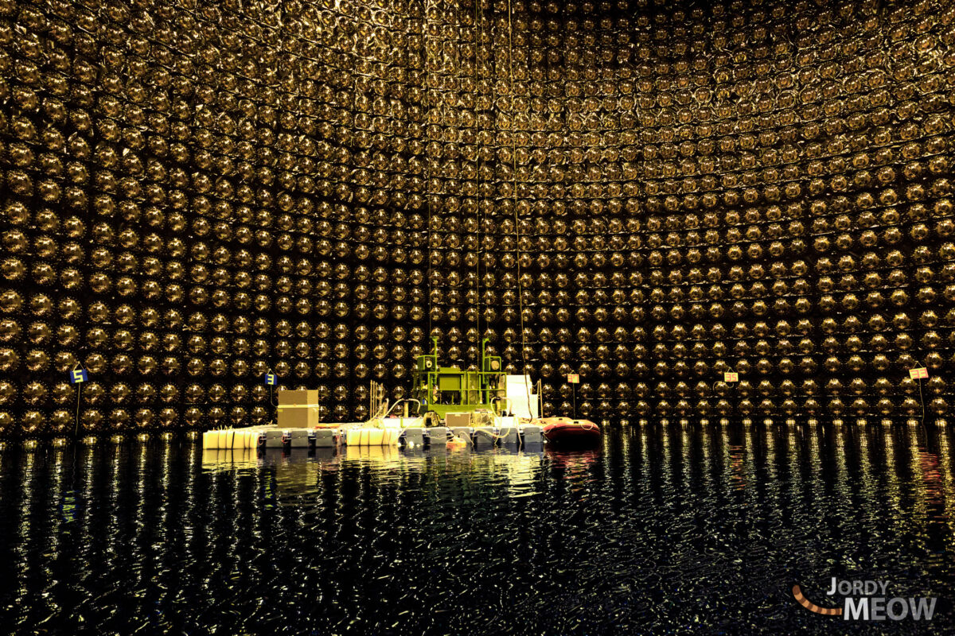
Hyper-K High Energy Physics Summary
M.P. Casado
Hyper-K physics Workshop at DIPC, 14 Jun. 2023

Slide 2
Contents
Introduction
Neutrino Oscillations
Current measurement of CPV phase
Physics Potential in HK
Neutrino Classification
Long baseline Physics
Atmospheric ν’s
Conclusion

Slide 3
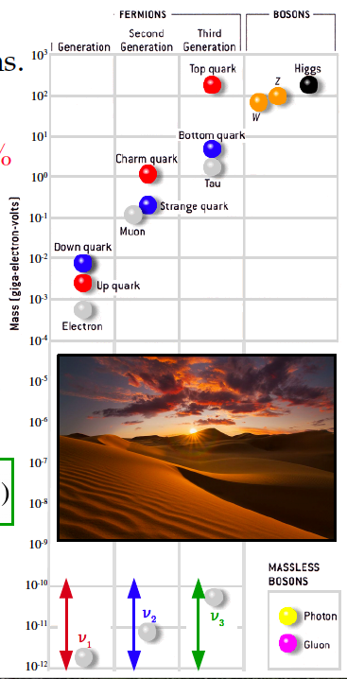
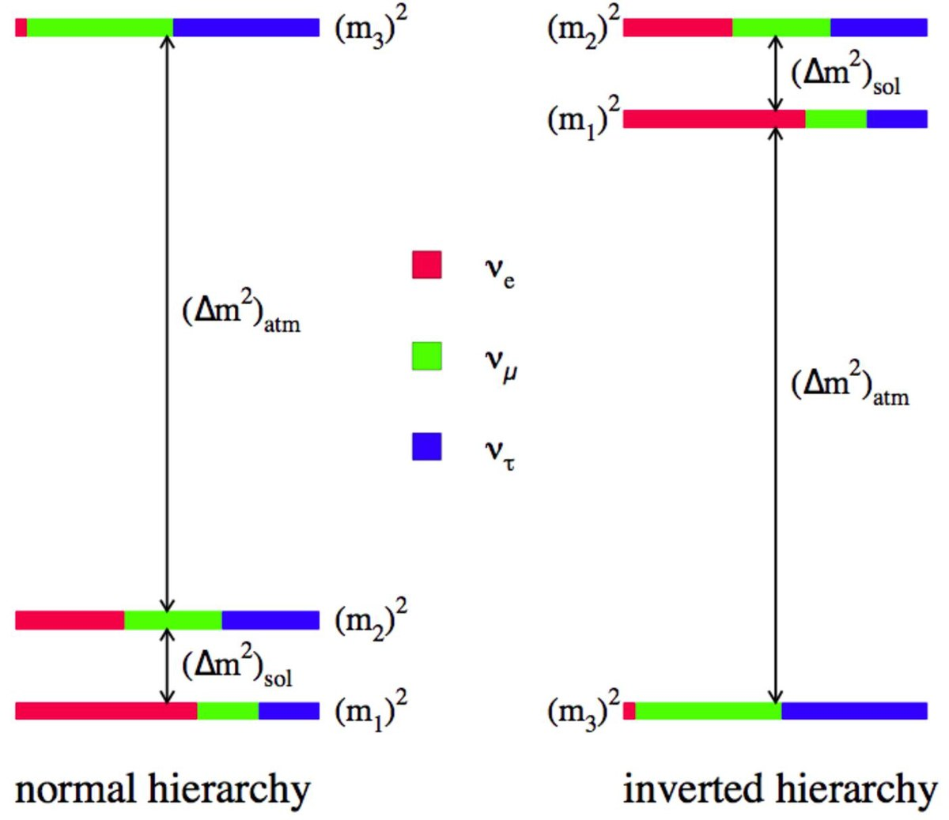
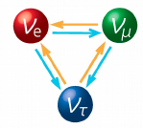
Nature of neutrinos
1. ν’s are the only known neutral leptons
interact through weak (and grav.) interactions
1 light year of lead to stop 50% ν!
2. ν’s are extremely (suspiciously?) light.
Absolute mass uknown, only upper limits.
6 order of magnitude < other SM masses.
Is the origin of ν mass ≠from other particles?
3. ν’s oscillate
The 3 neutrino flavours can change to other ones.

Slide 4
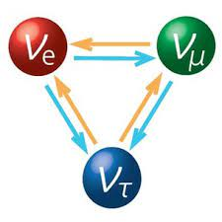
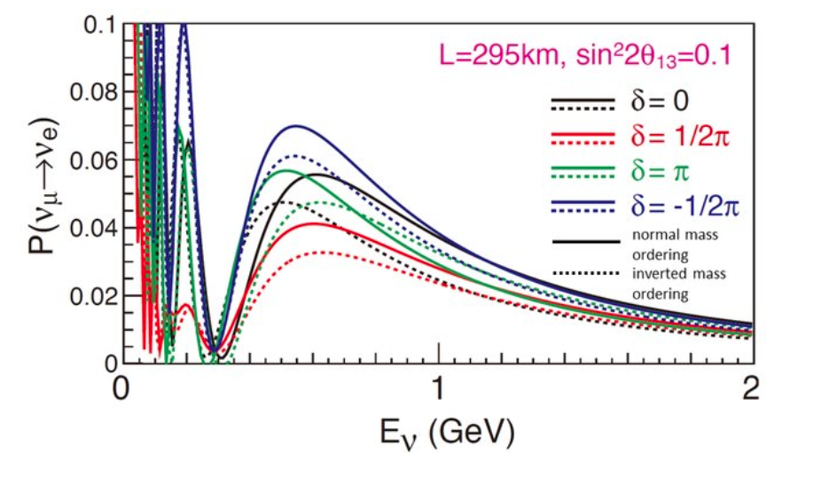
Neutrino oscillations
Measure probability
Survival
Appearance
Result
Mixing angle
Mass differences

Slide 5
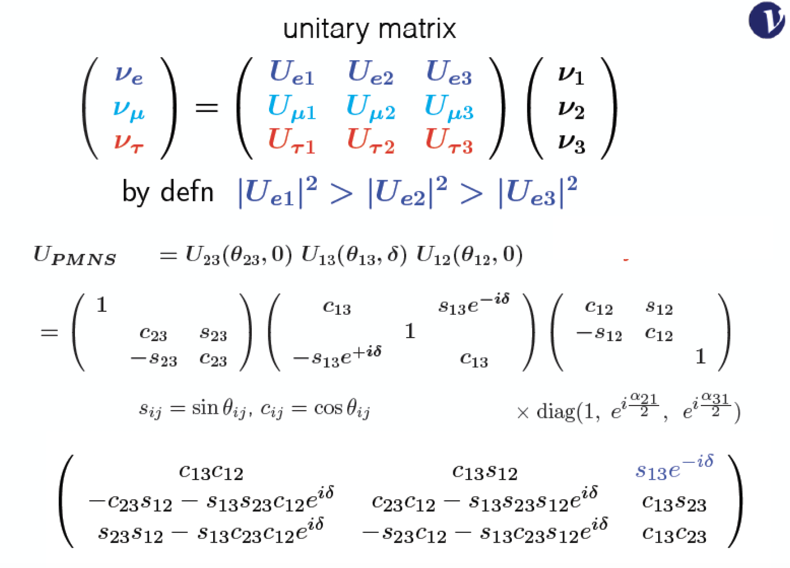
Neutrino Oscillations
Pontecorvo-Maki-Nakagawa-Sakata Matrix (analogous to CKM matrix)
In total 6 parameters to determine
3 angles
2 mass differences
1 CP violation phase
Oscillation probability

Slide 6
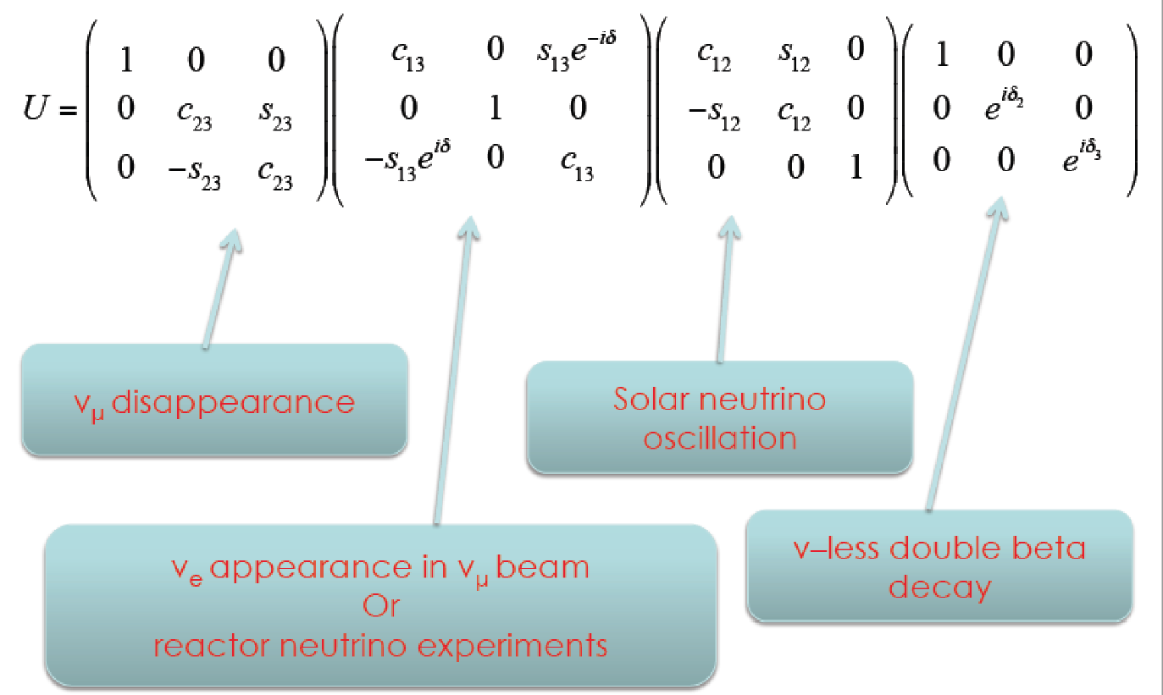
Neutrino Oscillations
Covered by HK

Slide 7
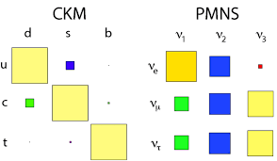
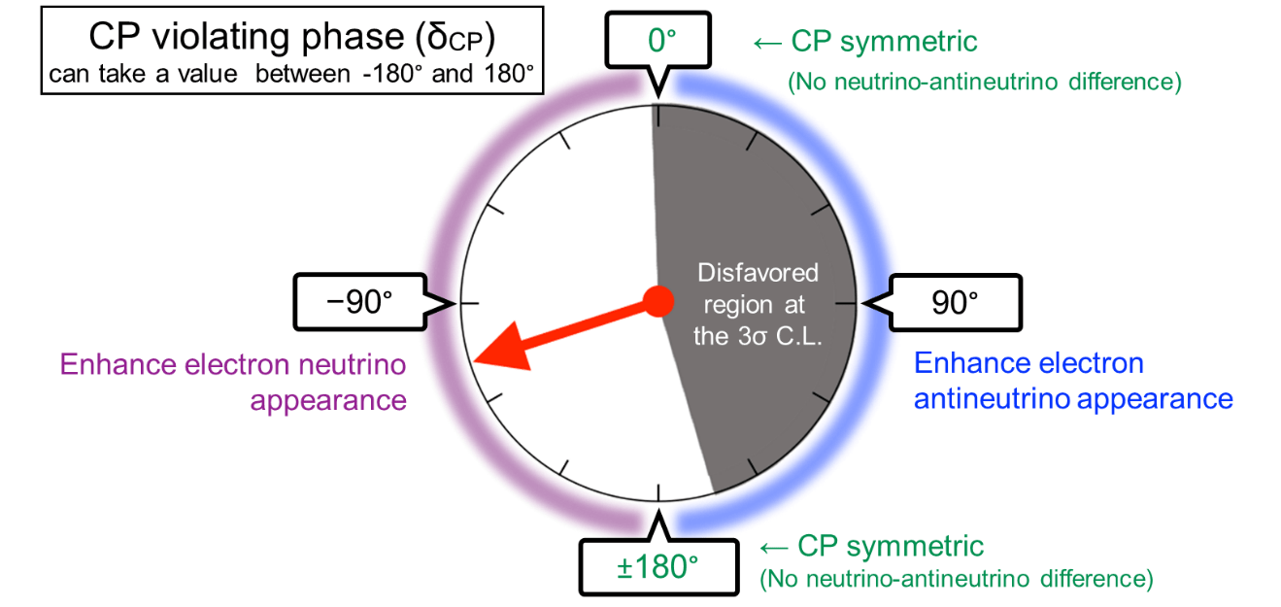
Current measurement of CPV phase
Three-flavor neutrino mixing is confirmed
CP violation phase (δ_{CP}) can be measured
Hyper-Kamiokande and Dune collaborations in coming years
Importance of CP violation measurement
Understand matter/antimatter asymmetry in the universe
SM presents some CP violation in quark sector but it is not enough to explain observed proportion of matter/antimatter.
Nature 580, 339–344 (2020) (T2K collaboration)

Slide 8
Physics potential in HK

Slide 9
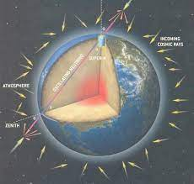
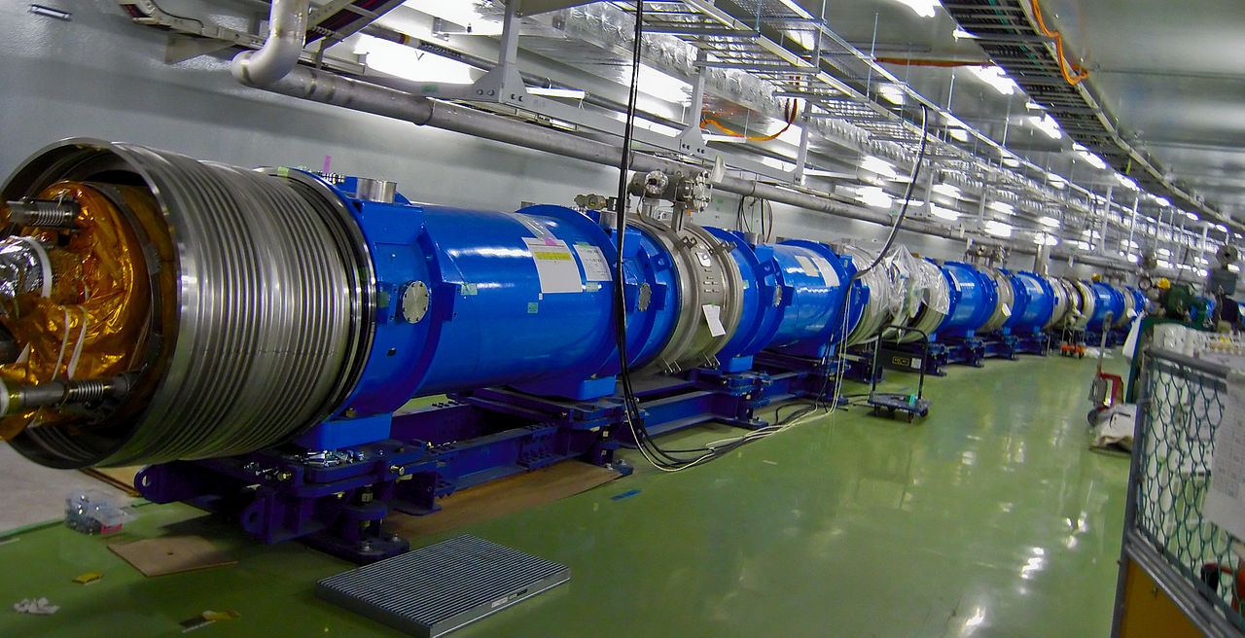
Neutrino classification
Solar neutrinos
Neutrino energy: up to 3.5-15 MeV
Flight length: ~10⁸km
Supernova neutrinos
Neutrino energy: 10-20 MeV
Flight length: ~10-100 kpc
Atmospheric neutrinos
Neutrino energy: 100 MeV – 1 TeV
Flight length: 10km – 10⁴km
Long-baseline (T2K as an example)
Neutrino energy: peaked at 0.6 GeV
Flight length: 295 km fixed
Low energy ν’s
High energy ν’s

Slide 10
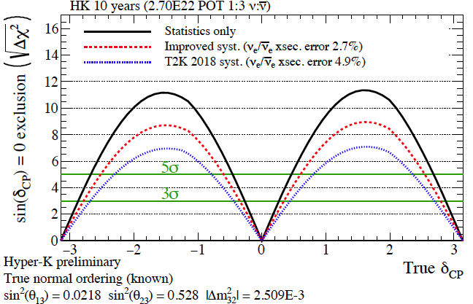
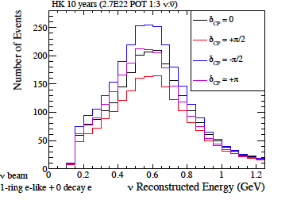
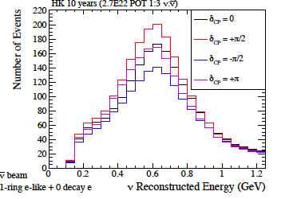
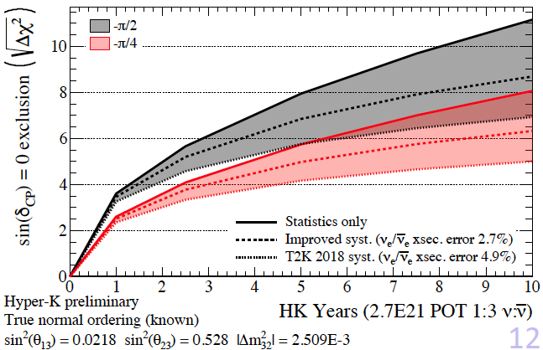
Long Baseline Physics - δ_{CP}
Probe CP-violation through comparison of
$P\left(ν_{μ}⟶ν_{e}\right)$and $P\left({\overline{ν}}_{μ}⟶{\overline{ν}}_{e}\right)$
Select 1 ring e-like events in far detector
10 years running, 1:3 $ν:\overline{ν}$ run plan
>1000 $ν_{e}$ and ${\overline{ν}}_{e}$ signals
Assume normal mass ordering is known -> Projected sensitivity based on T2K systematics plus improvements for Hyper-K
After 10 HK-years, 61% of true δ_{CP} values can be excluded at 5 σ.
Neutrino 2022

Slide 11
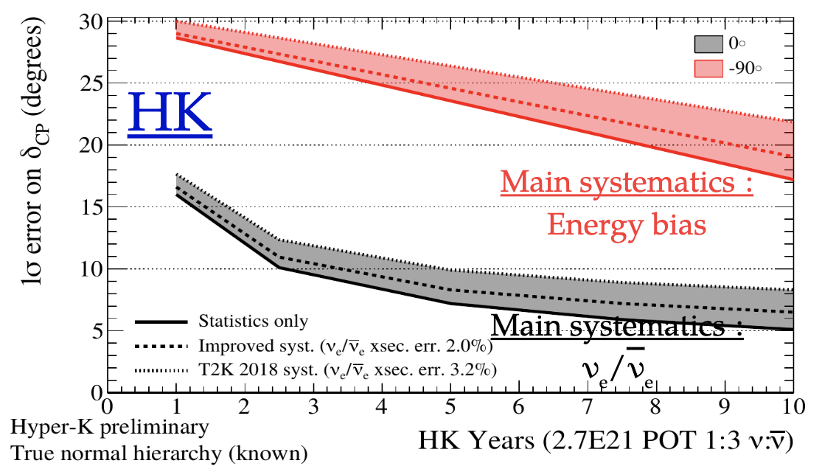
Precise measurement of δ_{CP}
After CPV is determined, accurate measurement of δ_{CP} will be crucial
−> Maximal CPV, leptogenesis, symmetries of leptón’s generations …
HK will be key experiment to measure δ_{CP} and constrains CP-violation in the next 20 years
Conference of the 2 infinities (2023)

Slide 12
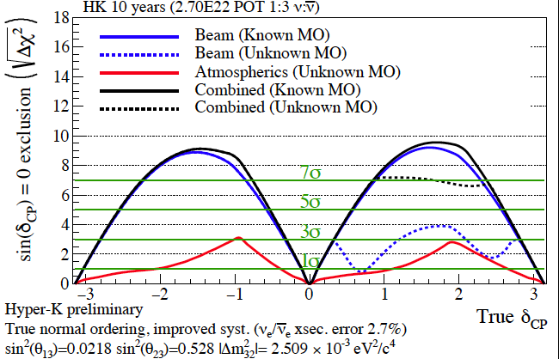
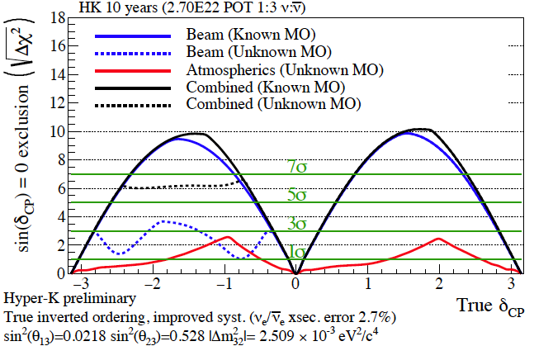
Mass Ordering
Effect of MO in beam measurements and atmospheric observations
Neutrino 2022

Slide 13
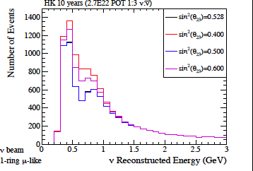
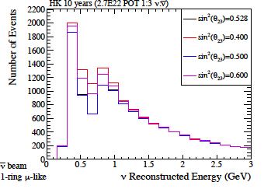
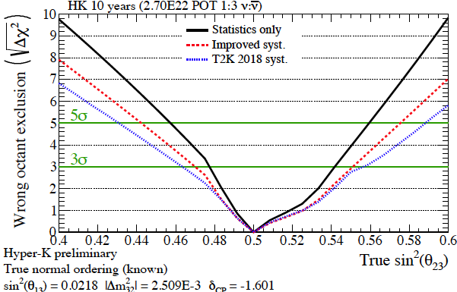
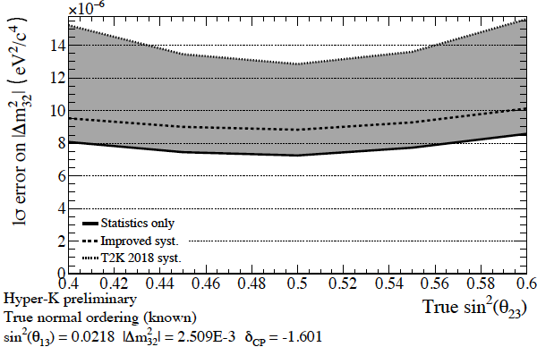
$\sin^{2}θ_{23}$ and $Δm_{32}^{2}$
Probe 2-3 mixing through dip in
$P\left(ν_{μ}⟶ν_{μ}\right)$and $P\left({\overline{ν}}_{μ}⟶{\overline{ν}}_{μ}\right)$
Select 1 ring μ-like events in far detector
10 years running, 1:3 $ν:\overline{ν}$ run plan
Wrong octant can be excluded at 3sigma for true
$\sin^{2}θ_{23}<$ 0.47 and true $\sin^{2}θ_{23}>$ 0.55
1σ resolution of $Δm_{32}^{2}$ as a function of true $\sin^{2}θ_{23}$
Neutrino 2022

Slide 14
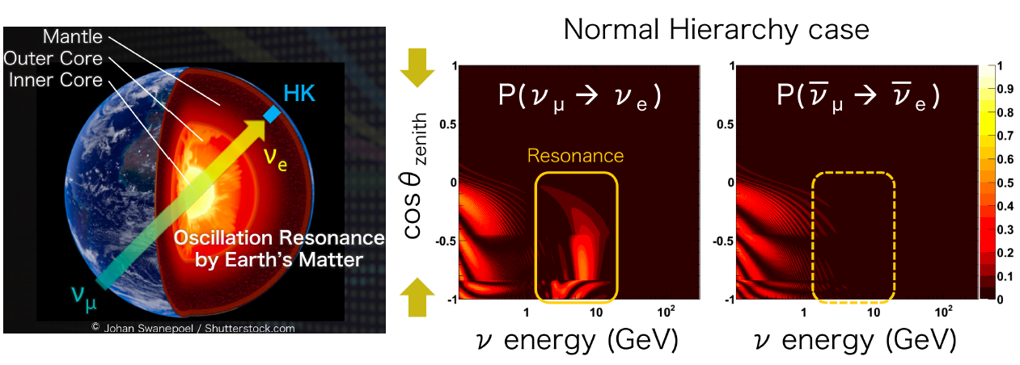
Atmospheric neutrinos
Mass-ordering can be measured through matter effects
−> The longer the baseline, the higher the effects
Mass ordering determined with upward-going multi-GeV ν_{e} sample: atm. baseline ≤ 13000 km >> 295 km accelerator baseline
Conference of the 2 infinities (2023)

Slide 15
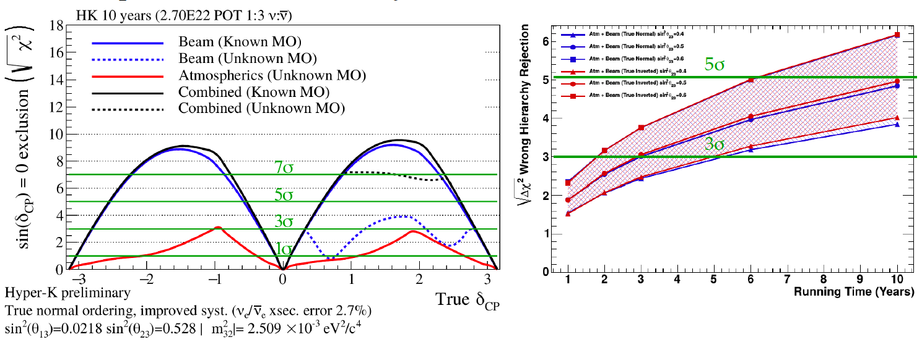
Combination of atmospheric + beam ν
Even if MO is not known when HK starts
−> Sensitivity to CPV is little affected if we add atmospheric ν.
MO would be determined by:
−> HK after ≥ 6-10 years via atmospheric.
Conference of the 2 infinities (2023)
Notes:
On the right sensitivity to mass ordering (blue true normal, red true inverted). The different markers indicate different sin2 theta_23 values.

Slide 16
Conclusion
Hyper-K has a rich and diverse physics program, including an ambitious long-baseline neutrino oscillation physics agenda.
The fiducial volumen of Hyper-K, combined with the upgrade of the J-PARC neutrino beam, will allow this program to gather unprecedented statistics.
Systematic effects need to be precisely controlled and understood.
If CP violation occurs in neutrino oscillations, Hyper-K will be able to detect it within the first few years of operation.
Combining beam and atmospheric neutrinos will further enhance Hyper-K sensitivity to CP violation, regardless of the neutrino mass ordering.
Hyper-K will also perform precision measurements of neutrino oscillation parameters.
Developing robust analysis methods and calibration strategies.

Slide 17
Back-up

