Slide 1
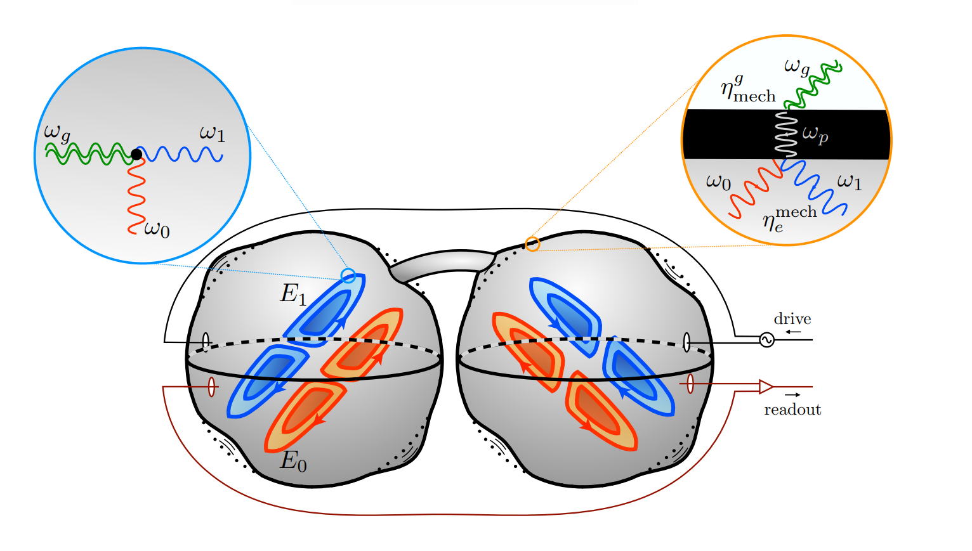
Electromagnetic cavities as GW detectors: theoretical background and optimal configuration for Earth's rotation
Àlex Garcia Herranz (UB) and Claudi Vall Müller (UB)
Advisor: Dr. Diego Blas

Slide 2
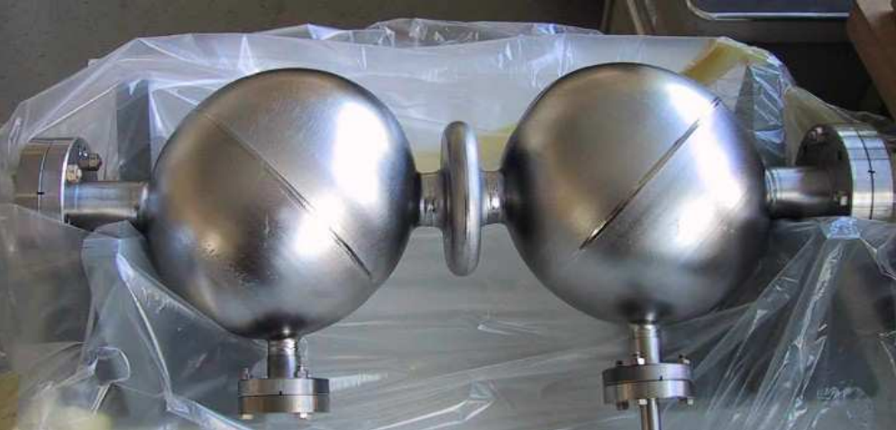
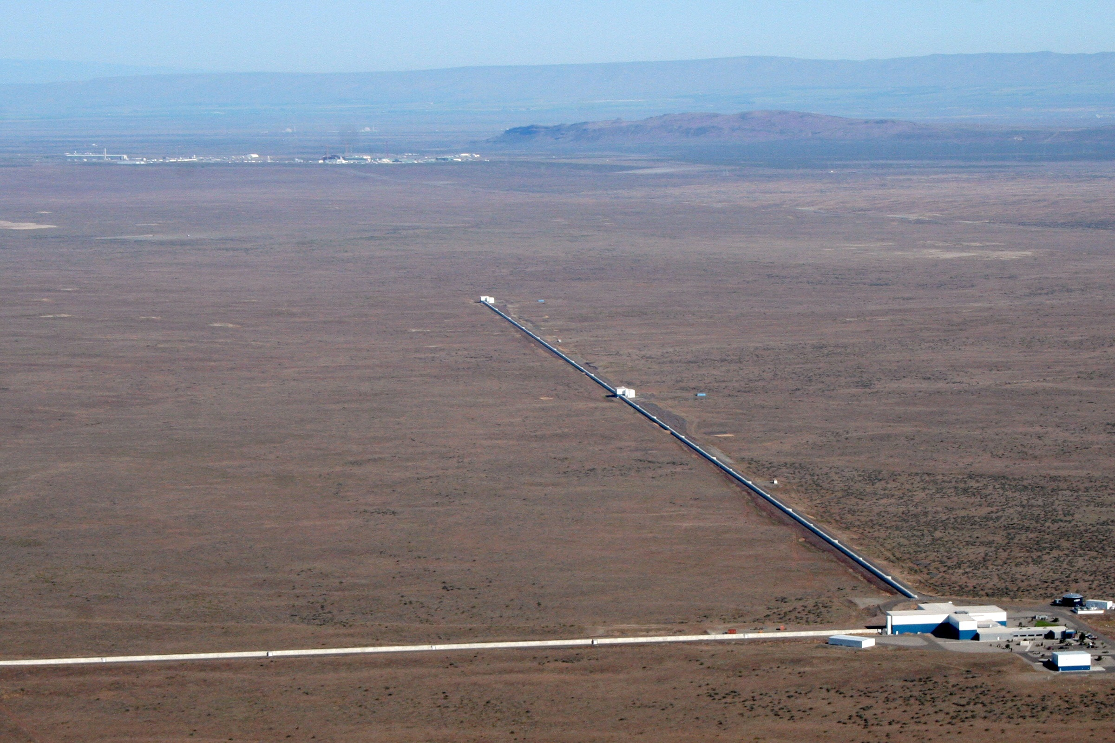
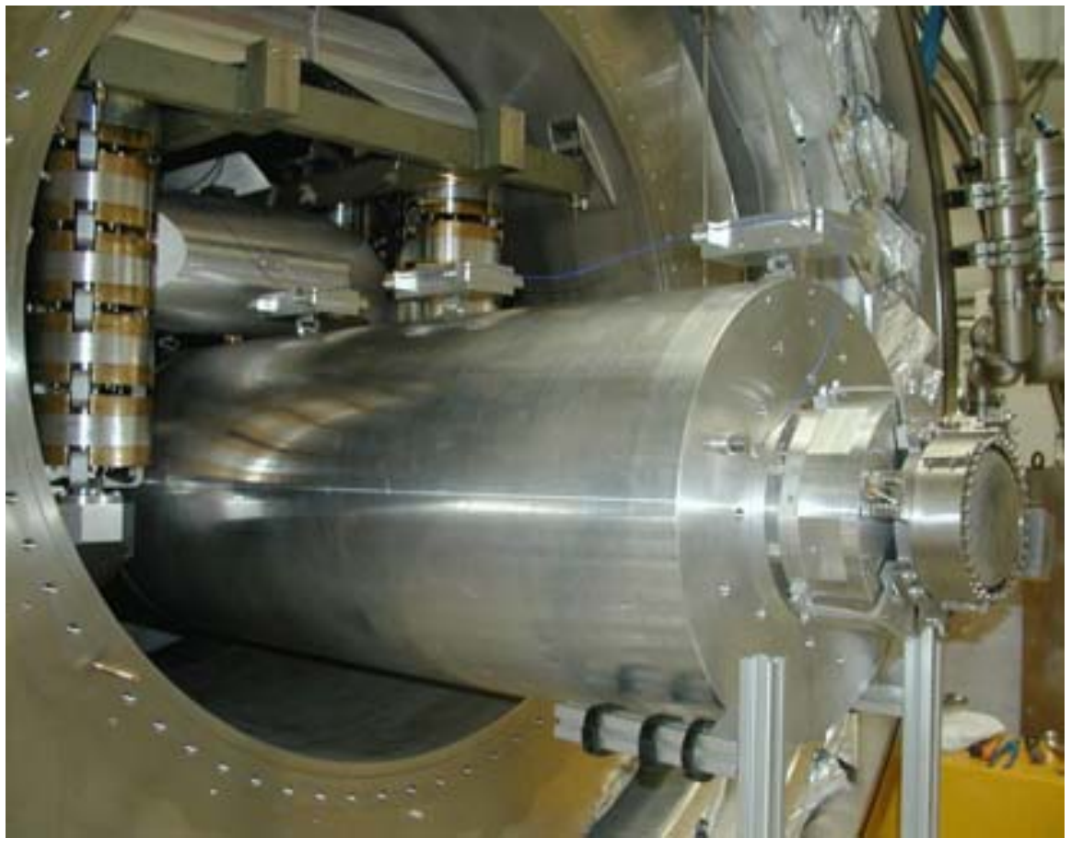
Historical Background
MAGO (Microwave Apparatus for Gravitational waves Observation)
LIGO (Hanford) https://web.archive.org/web/20170614214509/http://www.ligo.org/multimedia/gallery/lho-images/Aerial5.jpg
AURIGA (INFN)
https://home.infn.it/en/
[Ballantini et al., arXiv:gr-qc/0502054 2005]
Cheaper and more compact method
GW changes boundary conditions of a previously pumped electromagnetic mode
Measurable electric field perturbation!
MAGO 2.0: Superconducting Cavities as GW detector
[Berlin et al., arXiv:2303.01518 2023]
29th of November 2023
IFAE Summer Fellowship Programme 2023
Àlex Garcia Herranz and Claudi Vall Müller
1/7

Slide 3
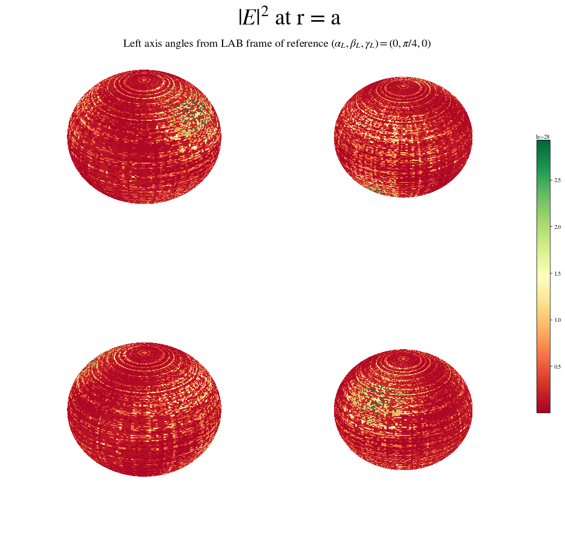
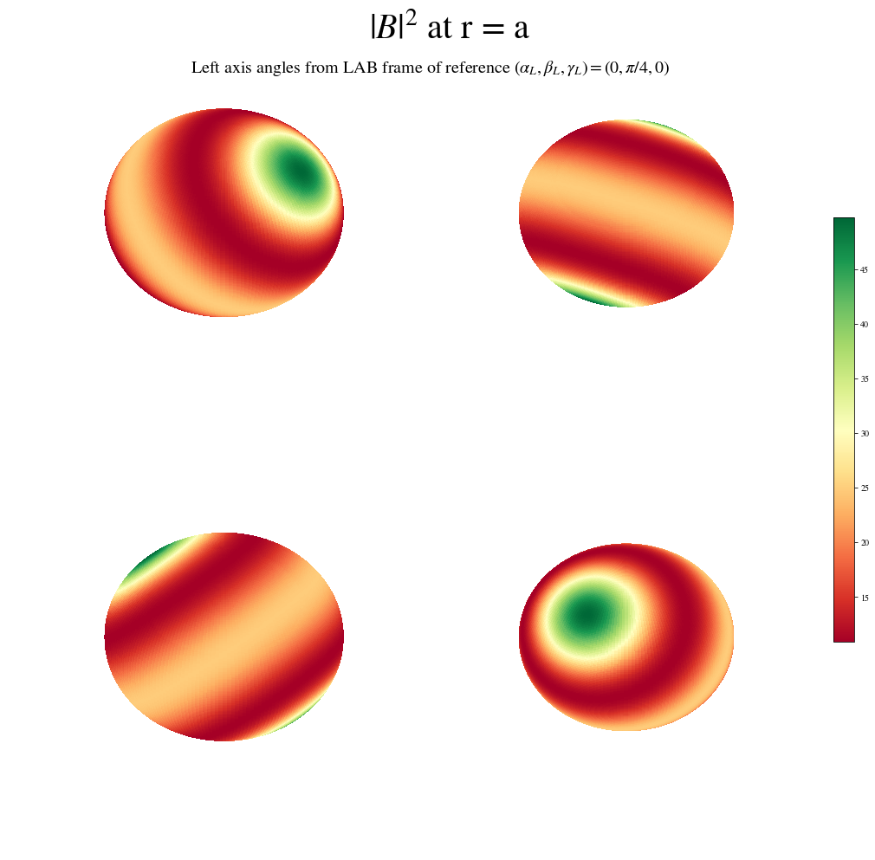
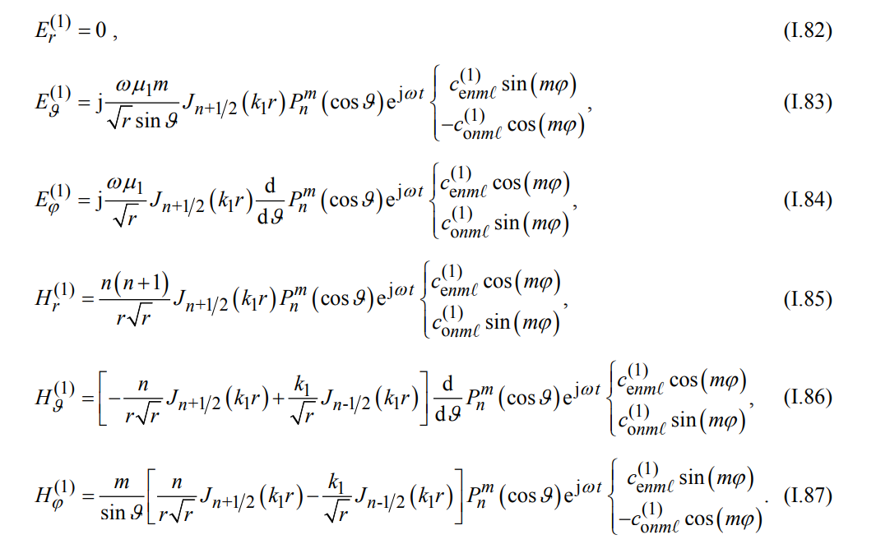
Setup and Physical Background
Sphere as easiest geometry. Problem: high energy gap between modes
[Ingo Wolff 2017]
https://www.researchgate.net/publication/318015366_Electromagnetic_fields_in_spherical_microwave_resonators_-_fundamental_mathematics
Second spherical cavity for closer modes higher sensitivity
29th of November 2023
IFAE Summer Fellowship Programme 2023
Àlex Garcia Herranz and Claudi Vall Müller
2/7

Slide 4
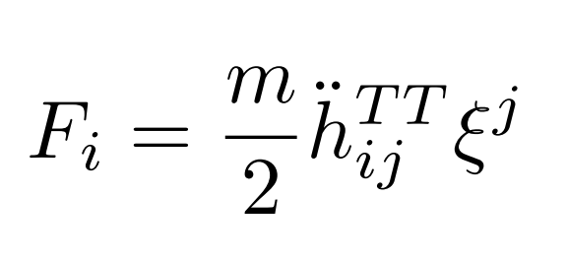
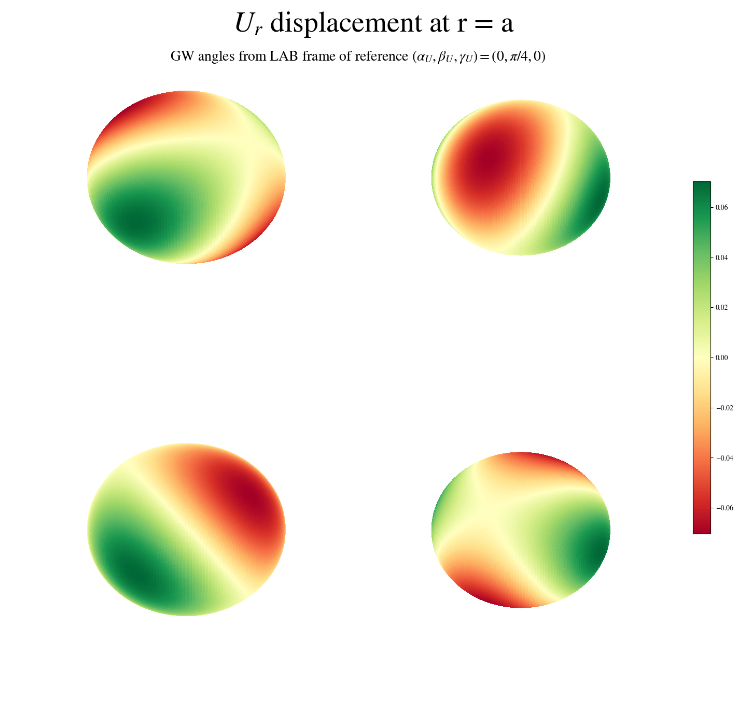
Mechanical Perturbation
Newtonian force for free particles
[Michele Maggiore 2007]
https://doi.org/10.1093/acprof:oso/9780198570745.001.0001
Theory of elasticity
212 Mechanical Mode
[Berlin et al., arXiv:2303.01518 2023]
29th of November 2023
IFAE Summer Fellowship Programme 2023
Àlex Garcia Herranz and Claudi Vall Müller
3/7

Slide 5
Perturbation Theory
Propose solution
Boundary conditions + Maxwell’s equations
5 pages of equations
[Berlin et al., arXiv:2303.01518 2023]
29th of November 2023
IFAE Summer Fellowship Programme 2023
Àlex Garcia Herranz and Claudi Vall Müller
4/7

Slide 6
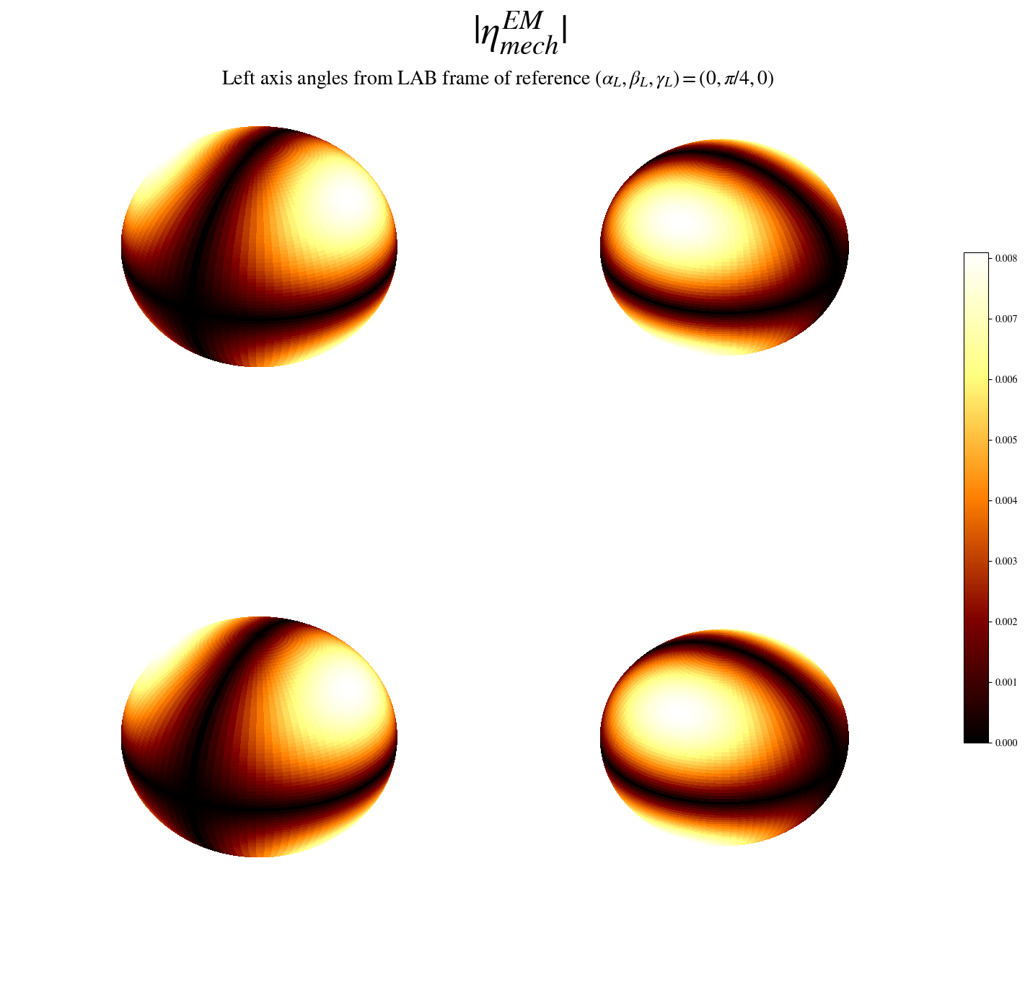
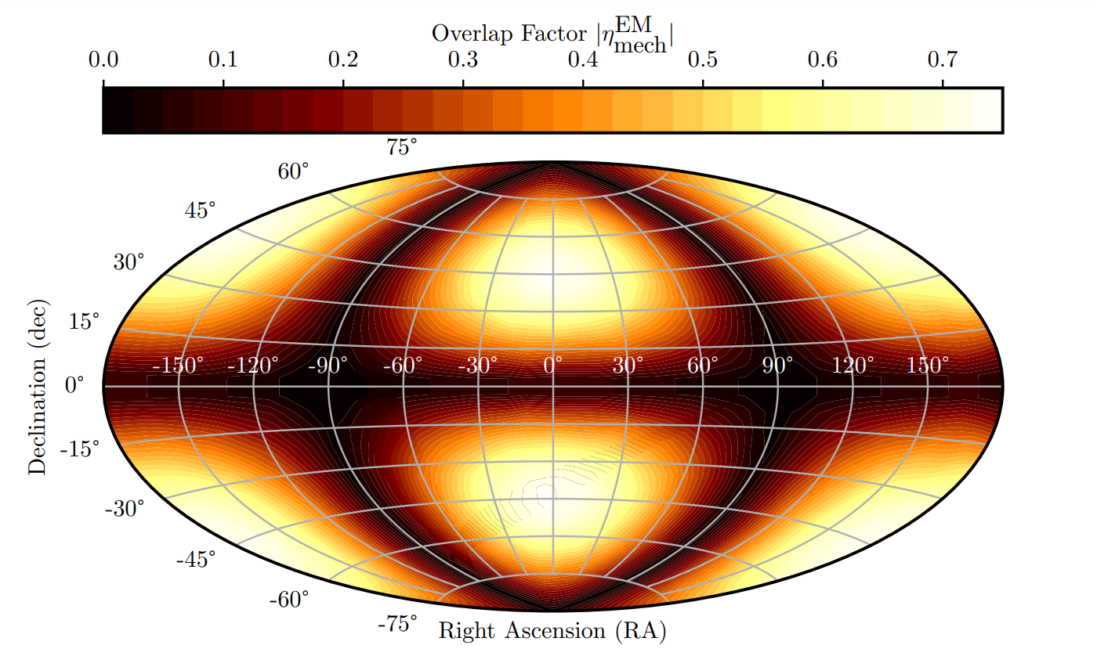
EM-Mech Coupling Factor
[Berlin et al., arXiv:2303.01518 2023]
29th of November 2023
IFAE Summer Fellowship Programme 2023
Àlex Garcia Herranz and Claudi Vall Müller
5/7

Slide 7
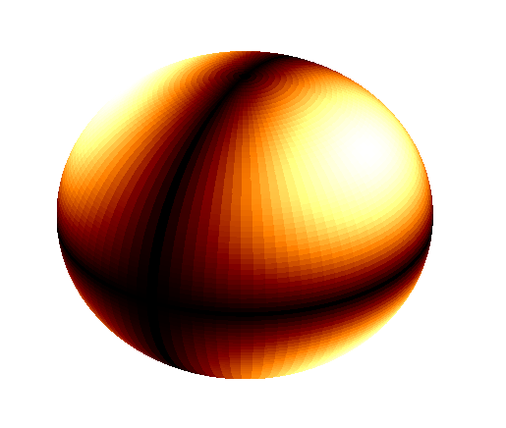
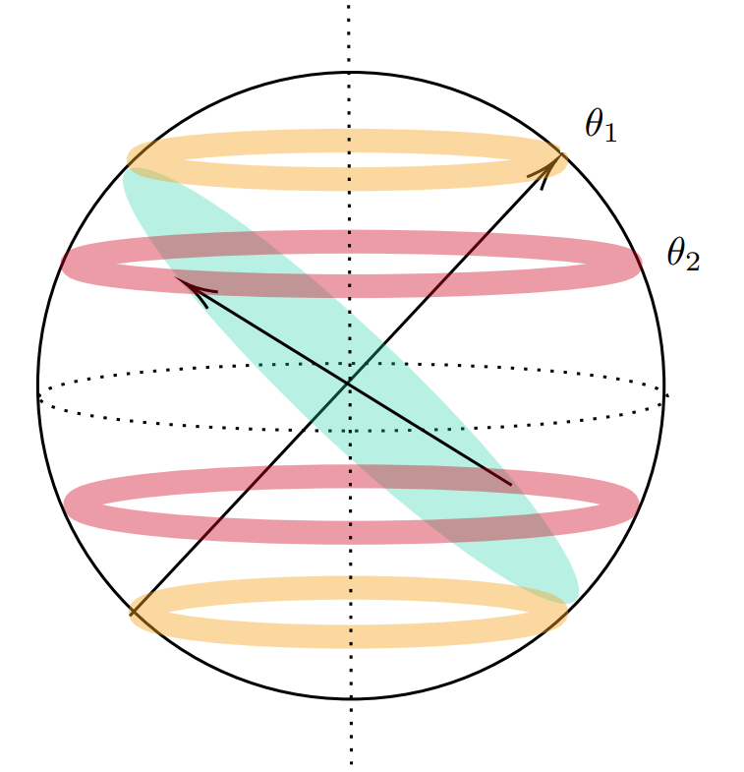
Effect of the Earth’s Rotation
Antennas close to the equator without overlapping
Constant sensitivity windows
Non-constant sensitivity windows
29th of November 2023
IFAE Summer Fellowship Programme 2023
Àlex Garcia Herranz and Claudi Vall Müller
6/7

Slide 8
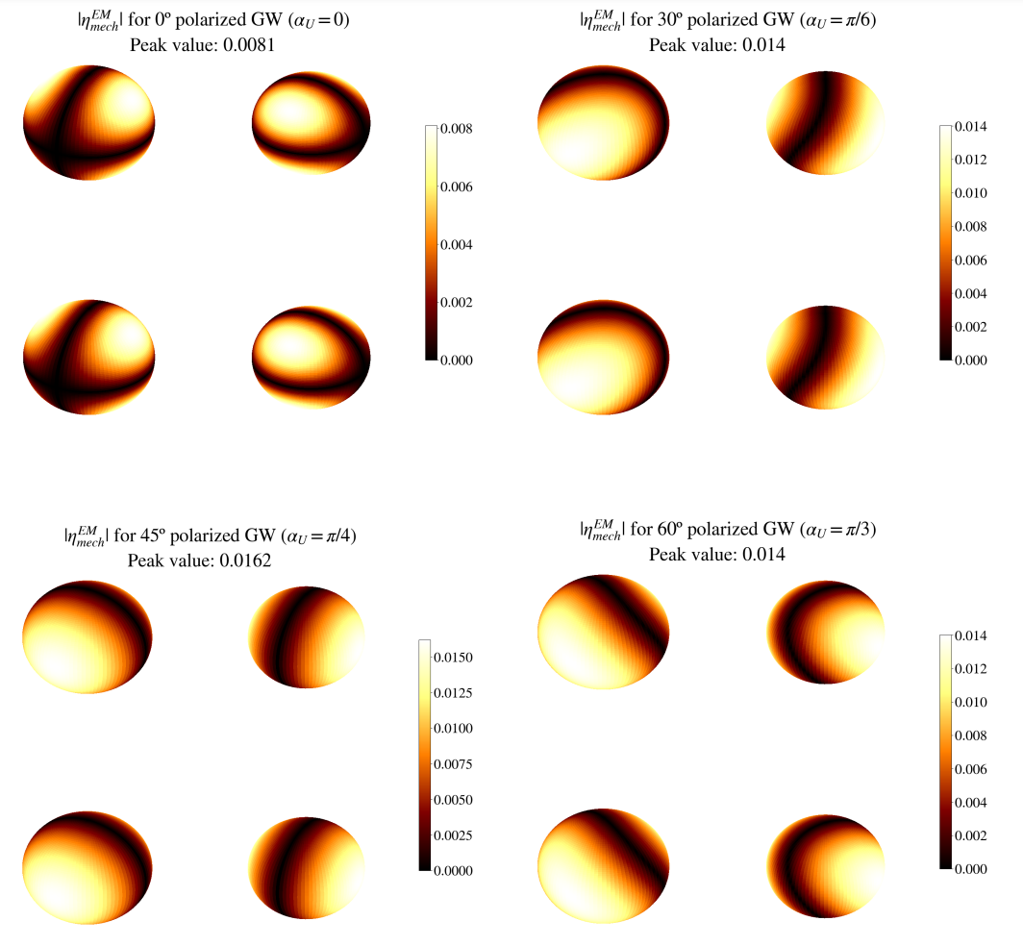
Gravitational Wave Polarization
29th of November 2023
IFAE Summer Fellowship Programme 2023
Àlex Garcia Herranz and Claudi Vall Müller
7/7

Slide 9
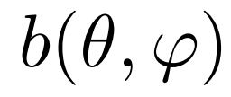
Conclusions and Future Work
Source of error in coupling factor magnitude
Location of the source’s position
Optimal configuration for particular examples of
29th of November 2023
IFAE Summer Fellowship Programme 2023
Àlex Garcia Herranz and Claudi Vall Müller

