Slide 1


ET-PP
1st review meeting
WP6 Activities
Project: 101079696 — ET-PP — HORIZON-INFRA-2021-DEV-02
ET-0499A-23
Horizon Europe: Coordination
and Support Actions
14/12/2023
Grant agreement: Nº 101079696

Slide 2
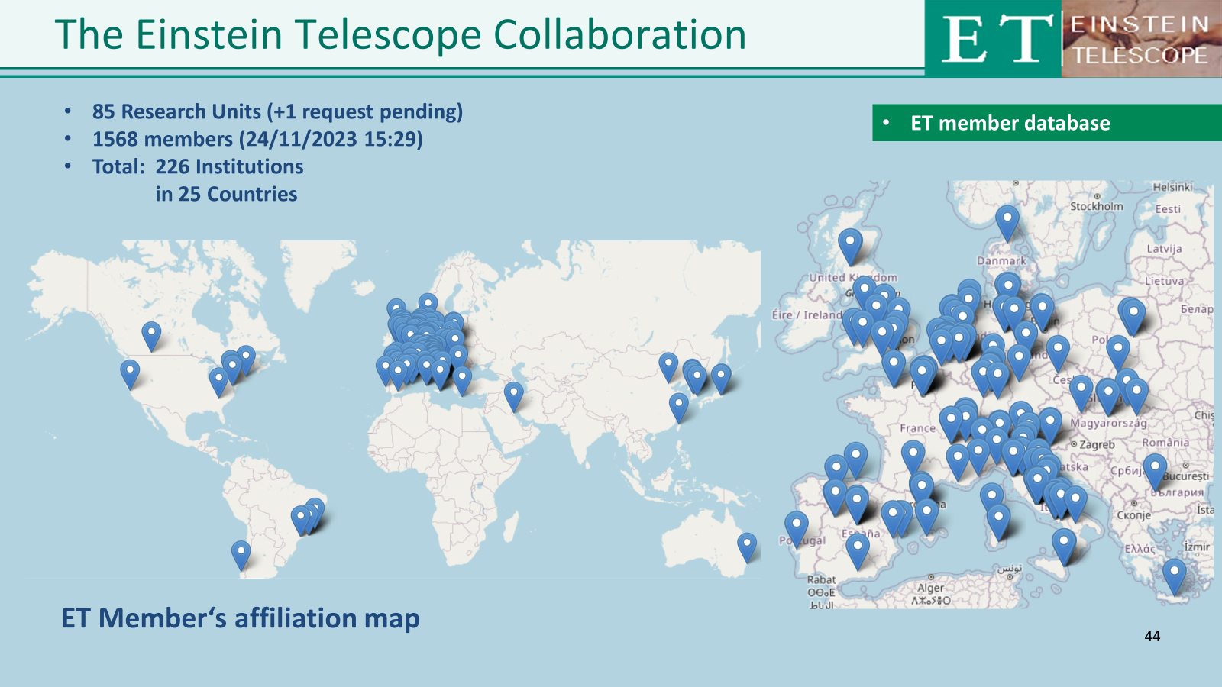
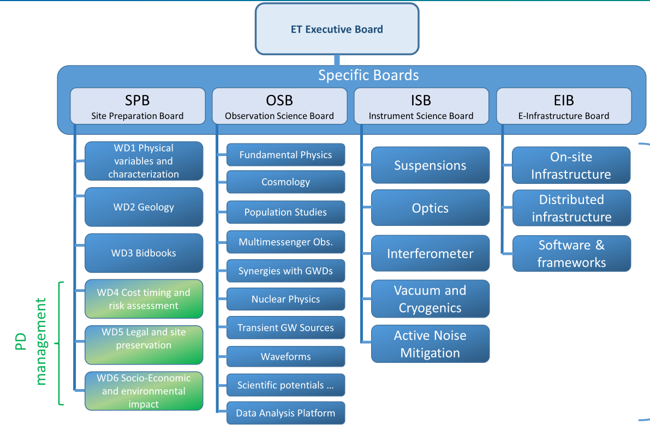
WP 6: Introduction and objectives
From the ET-PP GA
Composition of WP6
Chairs of the WP6:
Michele Punturo,
Spokesperson of the Einstein Telescope Collaboration ​
Harald Lück, Deputy Spokesperson of the Einstein Telescope Collaboration​
Paolo Chiggiato,
CERN vacuum team leader
No direct financial support for WP6 in ET-PP
ET-EB chairs are currently 2/3 of the
ET-PP WP6 chairs
14/12/2023
Project: 101079696 — ET-PP, 1st review meeting

Slide 3
WP 6: Introduction and objectives
From the ET-PP GA
The objectives of WP6 defined in the ET-PP GA are corresponding to the realisation of the key scientific documents of the ET project:
  The Science Case
  The detector and the research infrastructure Technical Design Report (TDR) (with different levels of detail)
  The pipe vacuum system Technical Design Report
  The Data Management Plan & Data Access Policy for ET
14/12/2023
Project: 101079696 — ET-PP, 1st review meeting

Slide 4
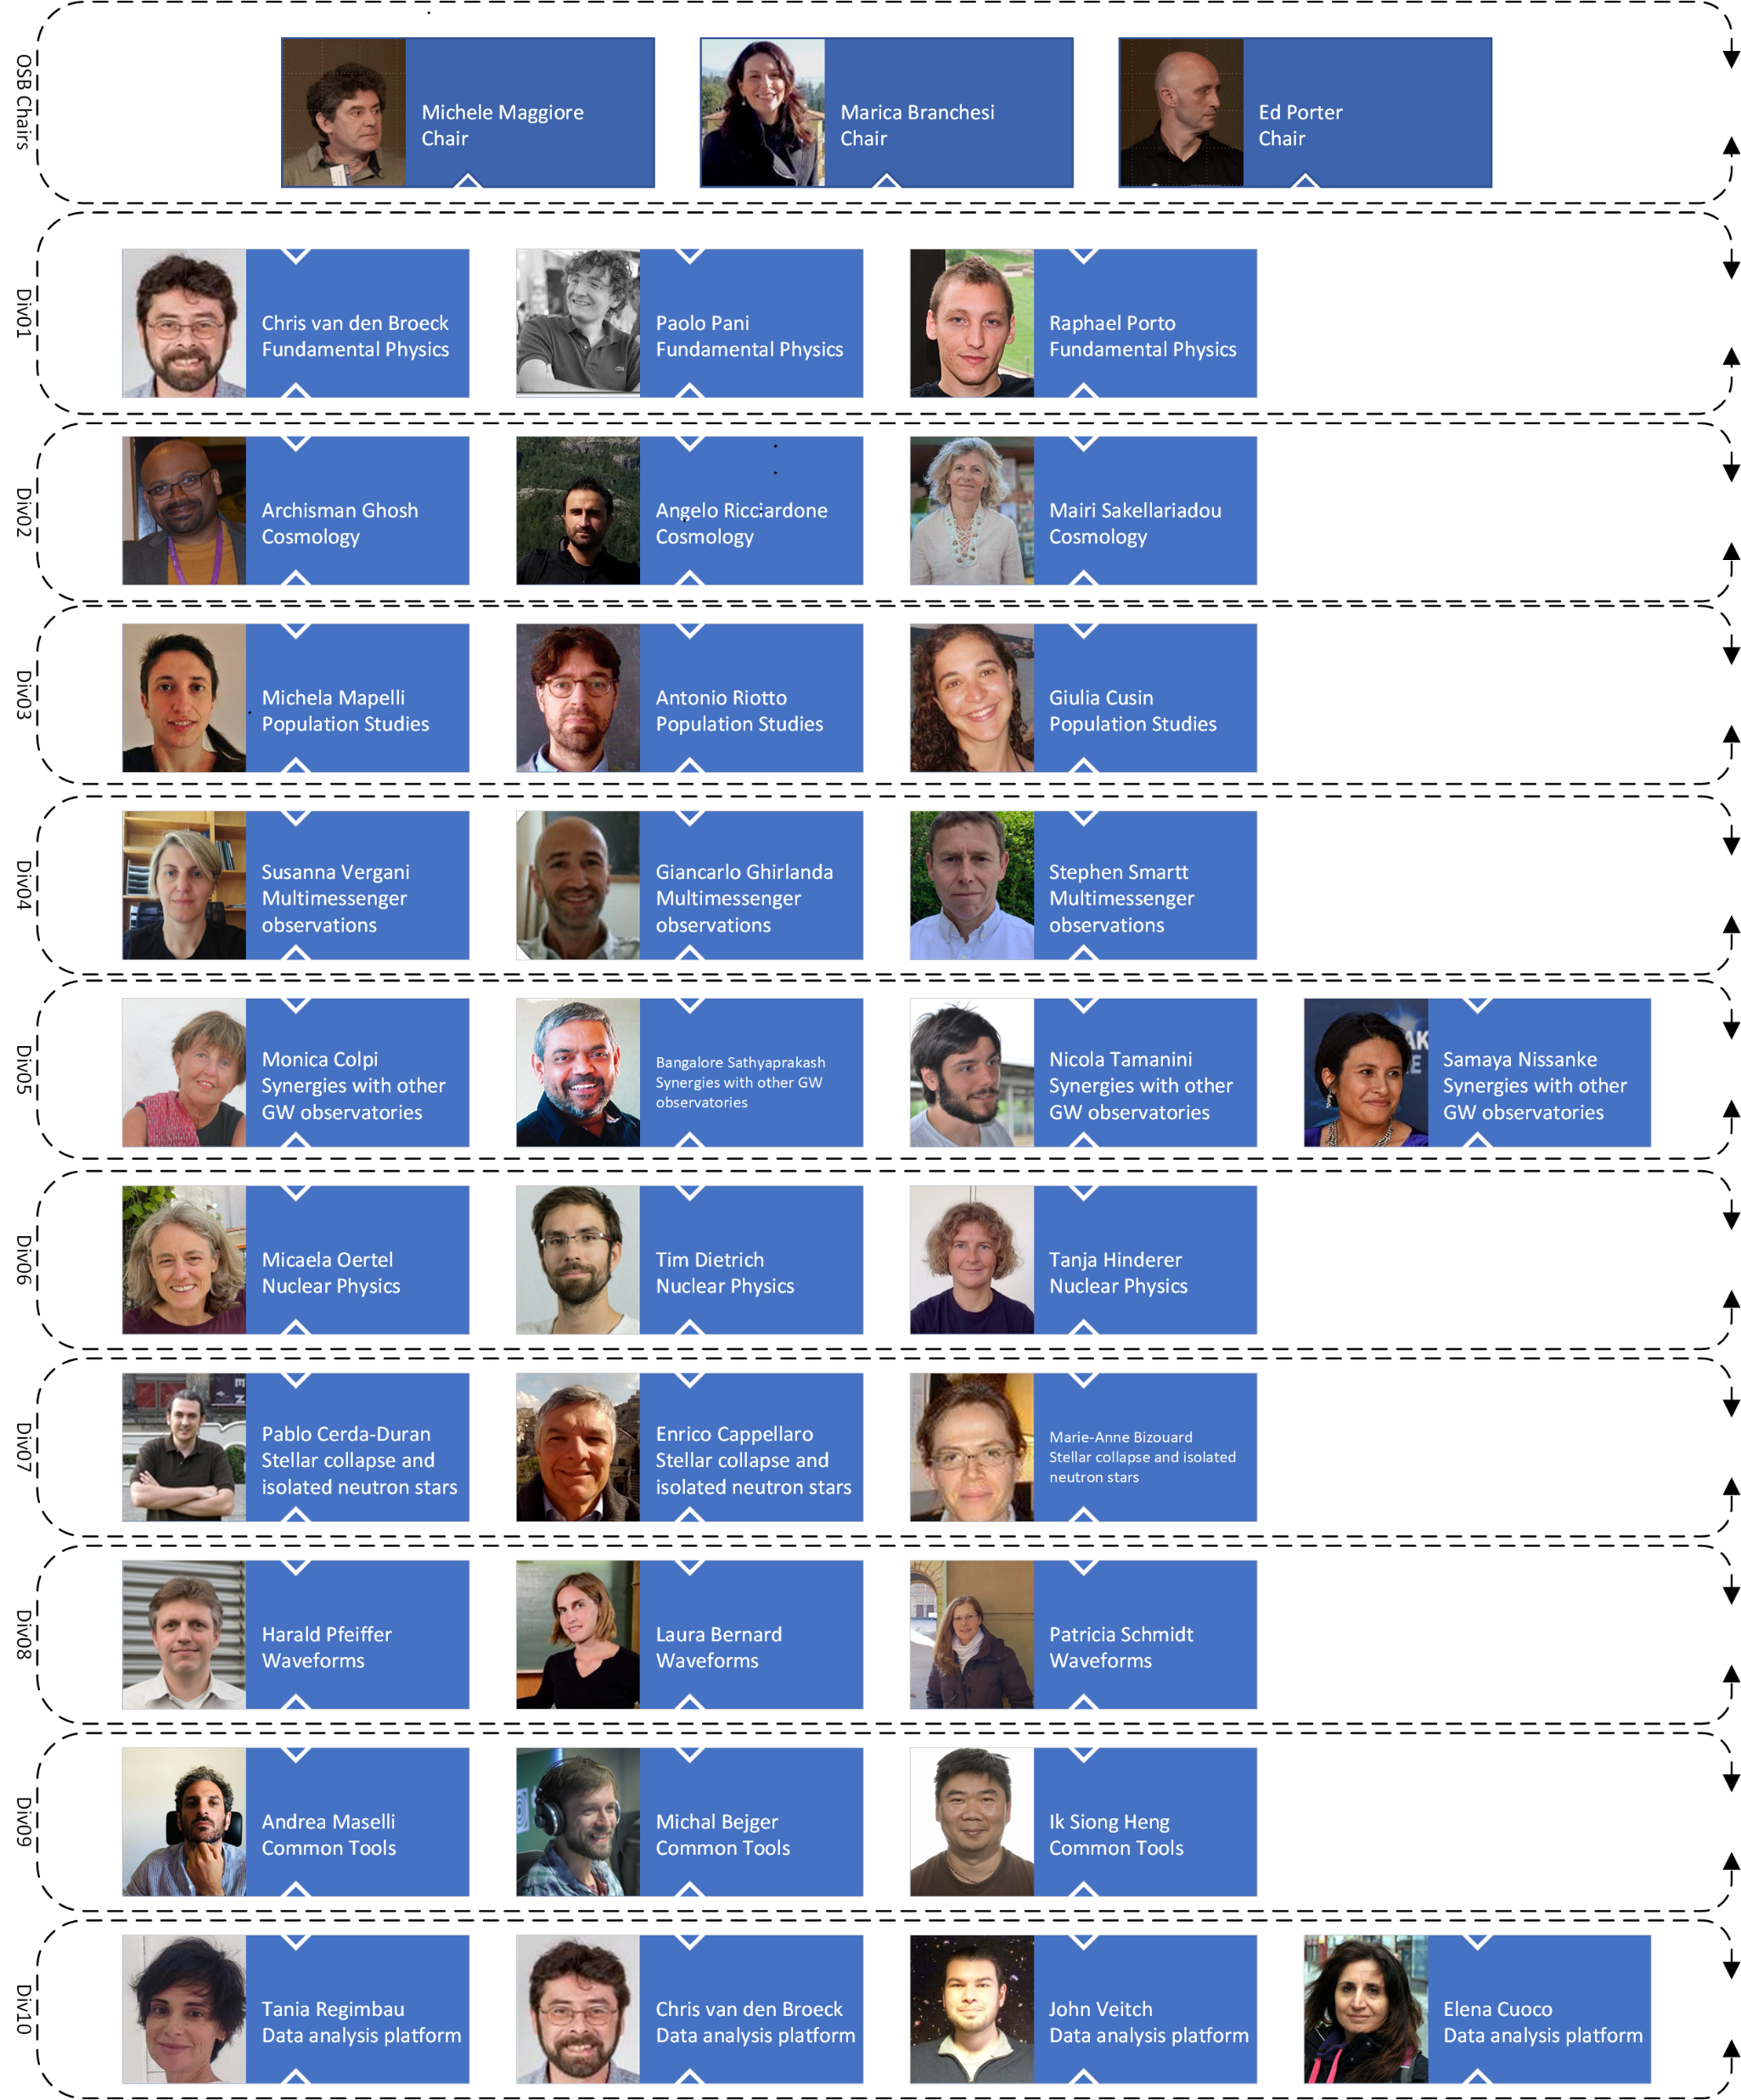
WP 6: Tasks
OSB
Considering the particular nature of WP6, acting as a bridge toward the complex system of activities in the ET Collaboration, no explicit tasks were defined in the GA
But the set of deliverables declared in the GA clearly defines the task structure “projected” by the Collaboration in WP6:
  Production of the ET Refined Science Case
    This task ends with the deliverable 6.1 (M18).
    It is produced by the ET Collaboration Observational Board
14/12/2023
Project: 101079696 — ET-PP, 1st review meeting

Slide 5
WP 6: Tasks
Vacuum pipe design
  This task is the result of a complex set of activities under the coordination of CERN, structured in an MOU between CERN, IFAE, INFN and Nikhef and involving some groups of the ET collaboration
  See Paolo Chiggiato talk
14/12/2023
Project: 101079696 — ET-PP, 1st review meeting

Slide 6
WP 6: Tasks
Research Infrastructure Design
  The task is to produce the technical design of ET's civil and technical infrastructures
  It is an iterative process producing 2 deliverables D6.3 (M24) and D6.5 (M40)
  (the RI TDRs with different levels of maturity)
  The achievement of its targets is pursued by the ET-Organization (ETO) and supported by an advisory agreement with CERN
Engineering Department
Civil
Engineering
Technical Infrastructure
Mechanical Engineering
Logistics and Installation
Coordination and Integration
14/12/2023
Project: 101079696 — ET-PP, 1st review meeting

Slide 7
WP 6: Tasks
Detector Design
  This task is to produce a preliminary version of the
  technical design of the ET detectors
  It ends with the production of the deliverable 6.4 (M24)
  It is realised in a collaborative effort of the ET Collaboration
  Instrument Science Board and the ETO Project Office
14/12/2023
Project: 101079696 — ET-PP, 1st review meeting

Slide 8
WP 6: Tasks
Data Management Plan (DMP) and Data Access Policy (DAP)
This complex task aims to define the ET policy for data access and the consequent DMP (D6.6, M46)
Several actors have to play in synergy to achieve the expected result
  The scientists have to optimize the data access policy to maximize the science return of ET
  Agencies have to optimize the usage of public resources
  Technical bodies (EIB and WP8) have to design an efficient DMP for ET
Considering the global nature of the GW science, the international scenario plays a crucial role in the definition of the DMP and DAP
14/12/2023
Project: 101079696 — ET-PP, 1st review meeting

Slide 9


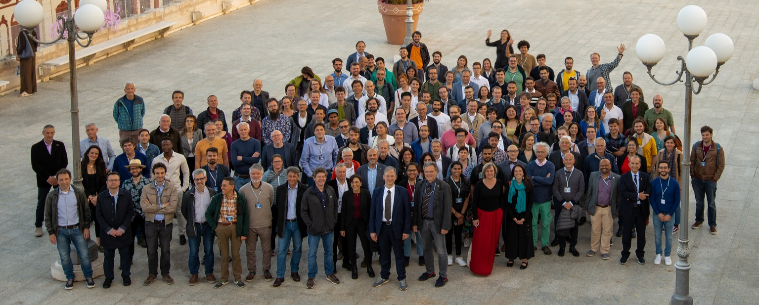

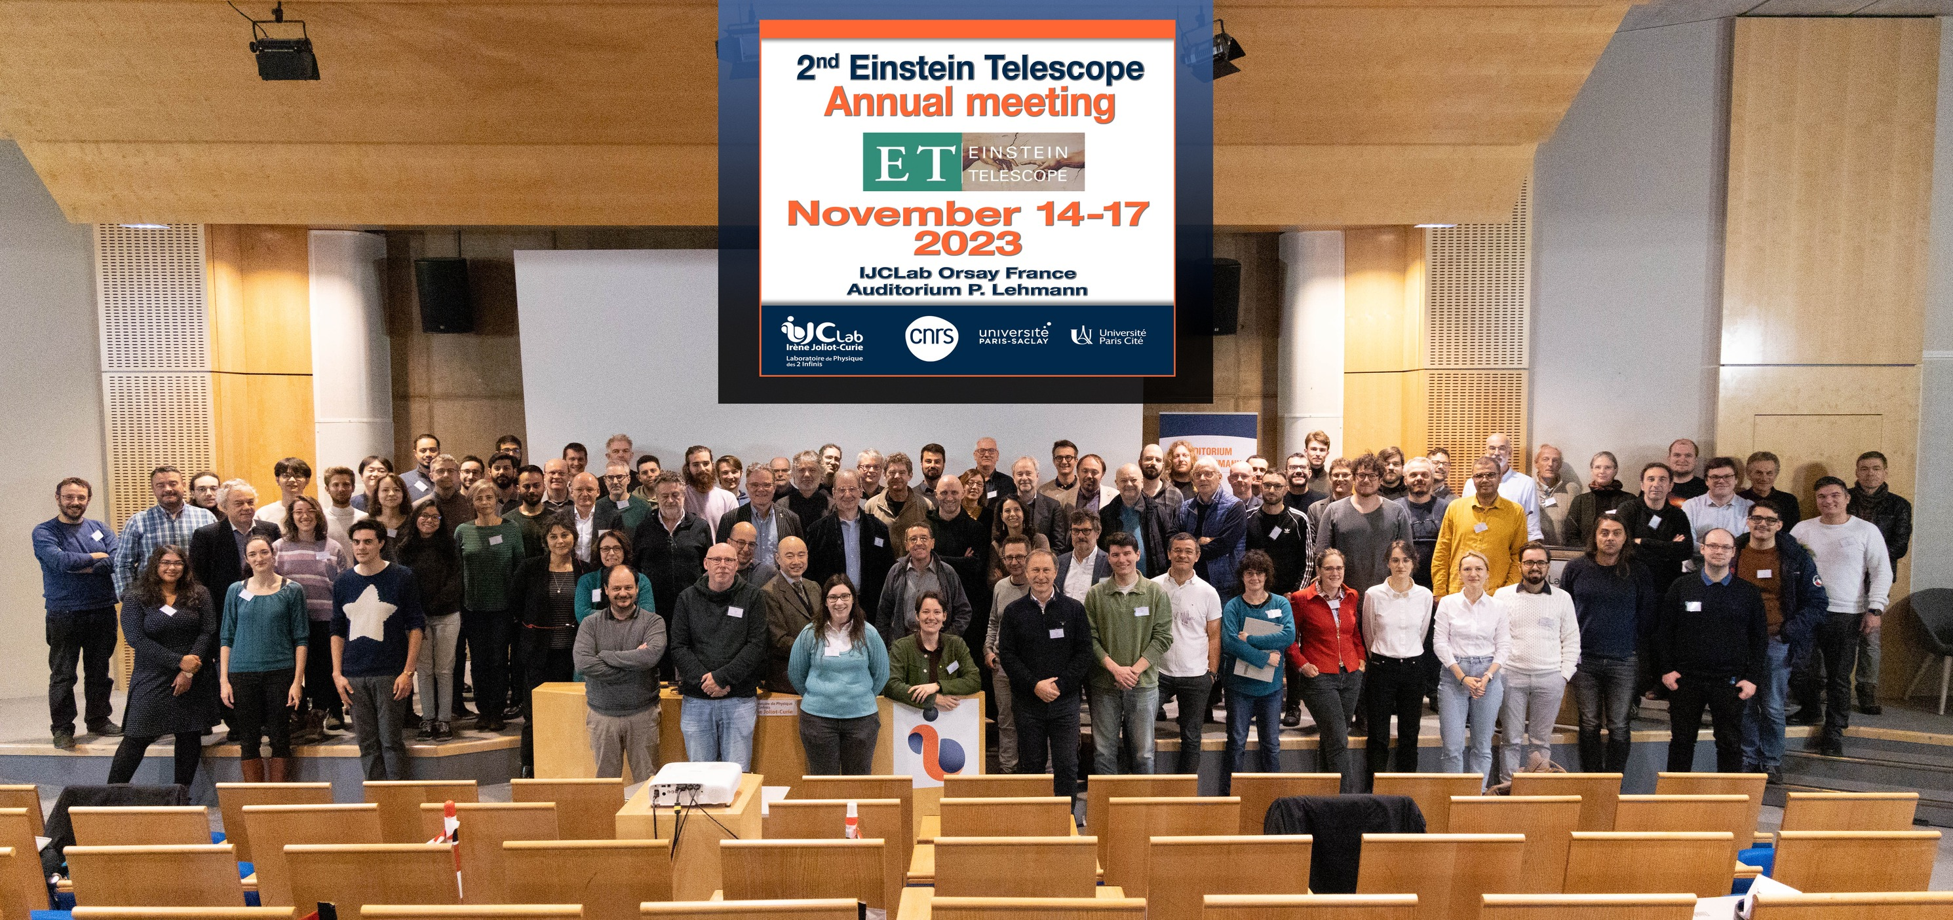
WP 6: Deliverables and milestones
Milestones:
WP8 driven
WP8 driven
14/12/2023
Project: 101079696 — ET-PP, 1st review meeting

Slide 10

WP 6: Deliverables and milestones
Deliverables:
  D6.1 Refined Science Case
    The refined Science Case in the ET Collaboration jargon is named «Blue Book» and it is part of the «natural» activities of the OSB in ET
    Its production is in progress
    A first implementation of the Blue Book is the paper (already published)
    «Science with the Einstein Telescope: a comparison of different designs» Marica Branchesi et al JCAP07(2023)068, DOI 10.1088/1475-7516/2023/07/068, arXiv:2303.15923 [gr-qc]
    No risks identified, no deviations expected
14/12/2023
Project: 101079696 — ET-PP, 1st review meeting

Slide 11
WP 6: Deliverables and milestones
Deliverables:
  D6.2 Vacuum pipe design
    See Paolo Chiggiato report
14/12/2023
Project: 101079696 — ET-PP, 1st review meeting

Slide 12

WP 6: Deliverables and milestones
Deliverables:
  D6.3 Preliminary RI TDR
    This activity has been moved from the Collaboration to ETO responsibility
    Risks identified are given in the following SWOT analysis
Strength: The Engineering Department of the ETO is growing and is taking a leading role in this activity It is the first RI iteration | Weakness: This activity does not involve any of the chairs of this WP, since now it is under the responsibility of the ETO
Opportunities: The RI Product Breakdown Structure is the first step toward the preliminary TDR; we can profit of this achievement to not loose momentum National host teams activities can support the process | Threats: The uncertainty about the geometric design of ET and the lack of a common roadmap for defining the geometric design of ET are hampering progress in this area Achieving this deliverable within M24 could be difficult, although possible
14/12/2023
Project: 101079696 — ET-PP, 1st review meeting

Slide 13

WP 6: Deliverables and milestones
Deliverables:
  D6.4 Preliminary DET TDR
    Risks identified defined in the following SWOT analysis
Strength: We have completed the first step toward the TDR: the PBS We are working with the PO to build on the PBS all the procedures to get from the PBS to the TDR It is the first iteration toward the TDR (“preliminary”) | Weakness: Some of the ISB divisions are lamenting a lack of human resources (under investigation)
Opportunities: Having already achieved (PBS), the next step is already defined (the parameter table). We have the opportunity to complete it in time for the deliverable | Threats: The uncertainty about the geometric design of ET and the lack of a common roadmap for defining the geometric design of ET are hampering progress in this area
14/12/2023
Project: 101079696 — ET-PP, 1st review meeting

Slide 14
WP 6: Deliverables and milestones
Deliverables:
  D6.5 RI TDR
    Risks identified defined in the following SWOT analysis
Strength: ETO-ED should be strongly structured at that time The ETO-CERN agreement on civil infrastructures is a strength element for this activity, considering the know-how on civil infrastructures at CERN | Weakness: None of the chairs of this WP have a direct role, at international level, in this deliverable and activities are managed outside the realm of WP6
Opportunities: Some of the national activities should be concluded on Dec. 25 and they can provide a lot of documentation for D6.5 | Threats: The uncertainty about the geometric design of ET and the lack of a common roadmap for defining the geometric design of ET are hampering progress in this area The timeline defined in the MOU with CERN is currently incompatible with D6.5 timing
14/12/2023
Project: 101079696 — ET-PP, 1st review meeting

Slide 15
WP 6: Deliverables and milestones
Deliverables:
  D6.6 RI TDR
    Activity to be started
14/12/2023
Project: 101079696 — ET-PP, 1st review meeting

Slide 16
WP 6: Contribution from each partner
% PMs used = 12,5
14/12/2023
Project: 101079696 — ET-PP, 1st review meeting

Slide 17
WP 6: Outlook and perspectives
The major objective of WP6 is to advance in and complete the PBS2TDR process
It passes through
  the implementation of the parameter tables in the PBS
  The creation of a relational database that organises all this info
  The drafting of the TDR documents
Crucial for the successful completion of these steps is the definition of a shared, coherent and realistic-but-aggressive ET roadmap
14/12/2023
Project: 101079696 — ET-PP, 1st review meeting

Slide 18
ET-PP
1st review meeting
Project: 101079696 — ET-PP — HORIZON-INFRA-2021-DEV-02
Horizon Europe: Coordination
and Support Actions
14/12/2023
Grant agreement: Nº 101079696

