Slide 1


The cosmic high-energy frontier
A view to the next decade
January 12, 2015
Barcelona
Christian Spiering, DESY Zeuthen

Slide 2
Messengers & Goals

Slide 3
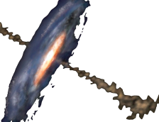
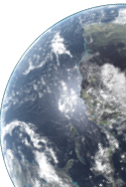
p, e
e
p
ν
p_{100 EeV}
γ

Slide 4
p, e
e
p
ν
p_{100 EeV}
p + p(γ) → π⁰ + X
γ
γ + γ
π± + X
μ + ν_{μ}
e + ν_{μ} + ν_{e}
e + γ (Inverse Compton) → e + γ

Slide 5
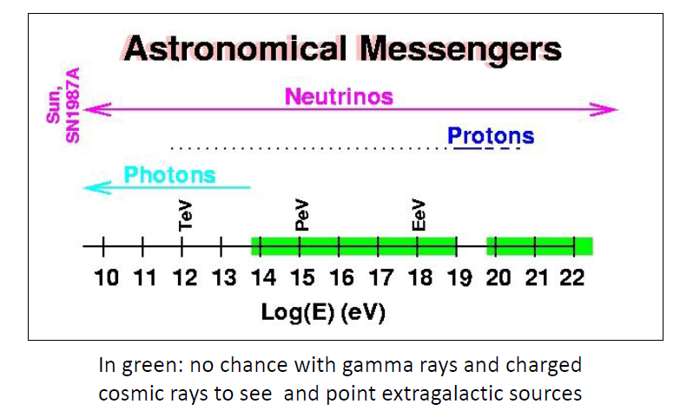
Principally accessible energy regions

Slide 6
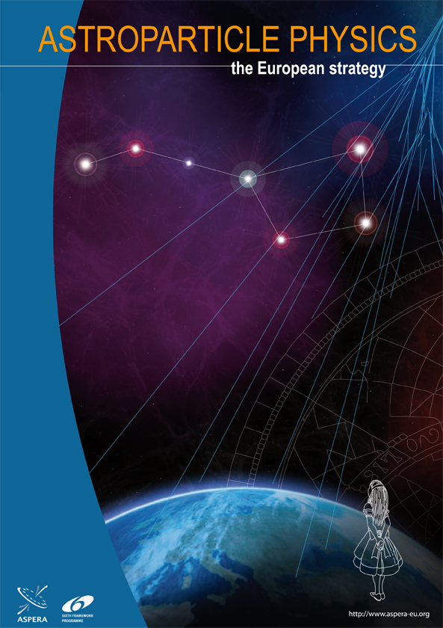
Charged
Cosmic
Rays
Gamma
Rays
Sources of
Cosmic Rays
Neutrinos

Slide 7
The questions: Astrophysics & Cosmology
  Cosmic particle acceleration and propagation
    How and where are cosmic particles accelerated?
    How do they propagate – within and outside the Galaxy?
    What is their impact on the environment (Galaxy formation, Earth system, biology, …)?
  Probing extreme environments
    Processes close to black holes and neutron stars
    How do supernovae explode, role of neutrinos?
    Processes in relativistic jets, winds and radio lobes
    Understanding cosmic magnetic fields
  Cosmic Evolution

Slide 8
The questions: Particle Physics & Basic Laws
  Standard Model
    Understanding forward physics at LHC
    pp and ν cross sections at highest energies
    Charm production at highest energies
    Neutrino oscillations , mass hierarchy (ORCA & PINGU)
    …
  Beyond the Standard Model & Basic Laws
    Dark matter: SUSY WIMPs, Q-balls, magnetic monopoles …
    Violation of Lorentz invariance
    New particle physics at extreme energies
    Sterile neutrinos
    …

Slide 9
EeV cosmic rays
approaching a turning point?

Slide 10
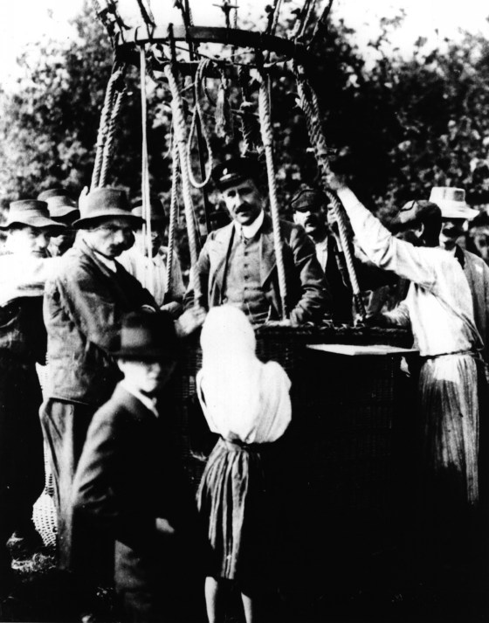
Viktor Hess
1912

Slide 11
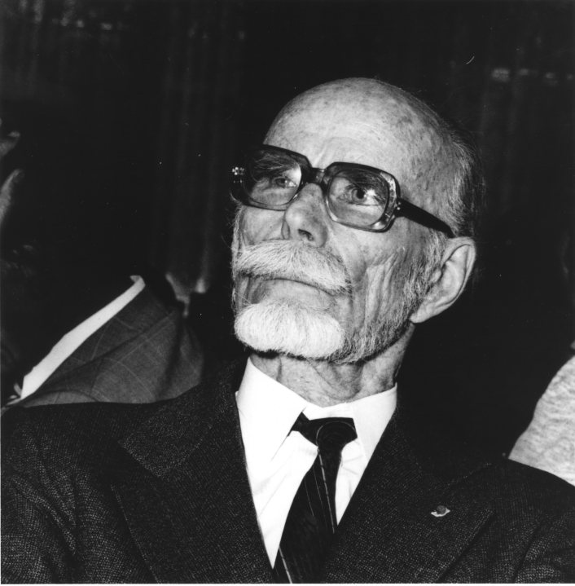
Pierre Auger
1939

Slide 12
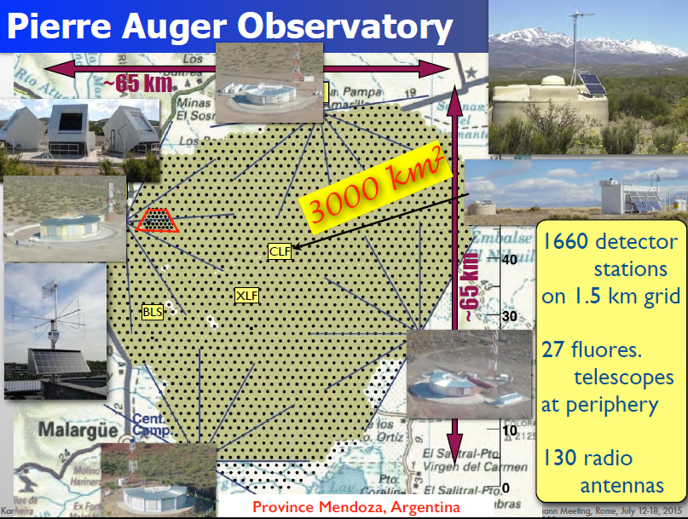

Slide 13
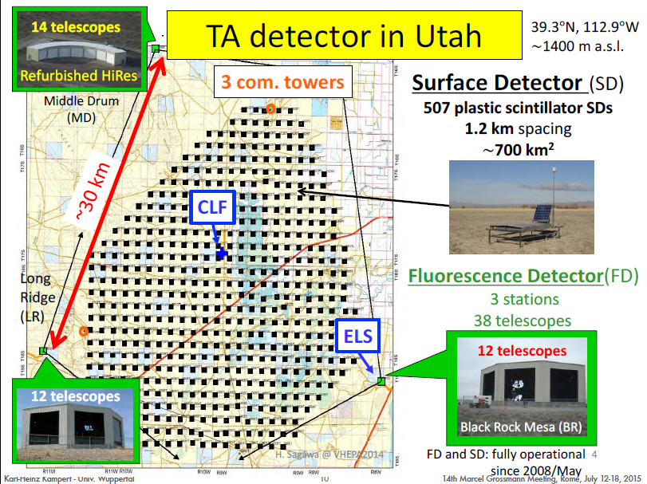
700 km²

Slide 14
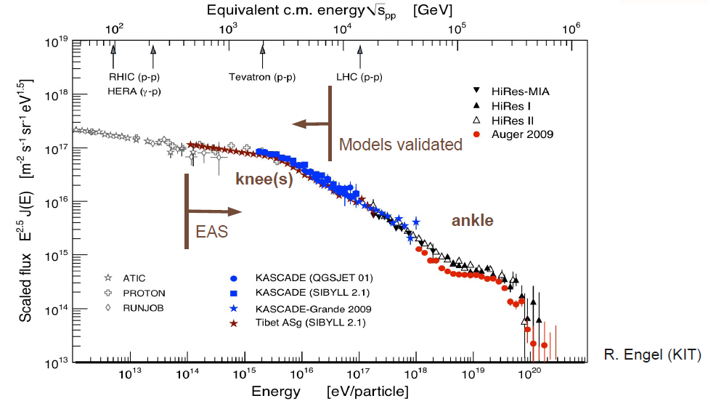
Spectrum of Cosmic Rays

Slide 15
Spectrum of Cosmic Rays
accelerators
satellites,
balloons
air shower
arrays
Auger

Slide 16
Spectrum of Cosmic Rays
accelerators
satellites,
balloons
air shower
arrays
Auger
Current models
tuned here

Slide 17
Cosmic Rays and LHC
pp inel. cross section at sqrt(s)=57 TeV
Compare to QCD and Glauber model, tuning EAS simulations

Slide 18
Cosmic Rays and LHC
Cooperation of particle- and CR-physicists has been intensified over the last years.
Extremely useful for understanding CR nature
Accelerator data helped improving shower models. Tools of CR community will also help better understanding HE particle interactions: models sometimes better than HEP models
Need common approach to understand muons in CR
NA61/SHINE (SPS Heavy Ion and Neutrino Experiment): important input data for cosmic ray and neutrino experiments.

Slide 19
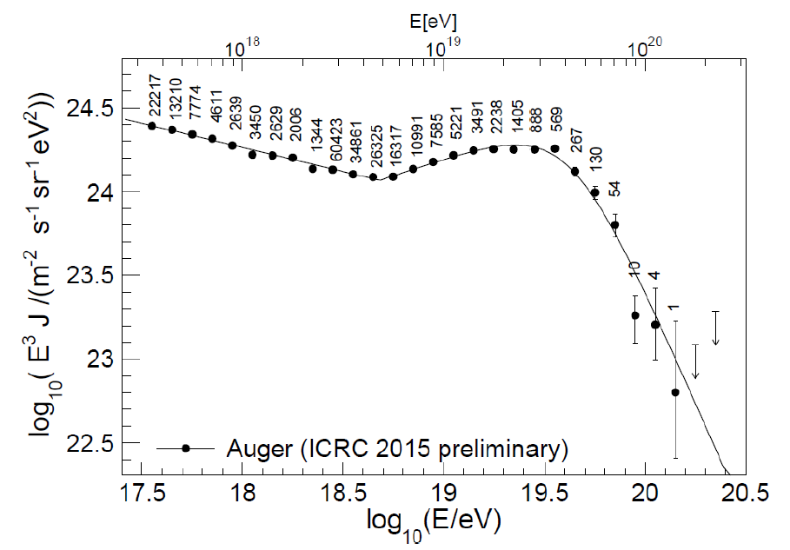
Cut-off at highest energies confirmed, but …
… is that the GZK cut-off?
… or do the sources just run out of power?
190 000 events

Slide 20
Cut-off: how to undestand ist nature
Need a better mass determination to check how the cut-off depends on particle mass
Need more statistics and first point sources to check how the cut-off depends on distance

Slide 21
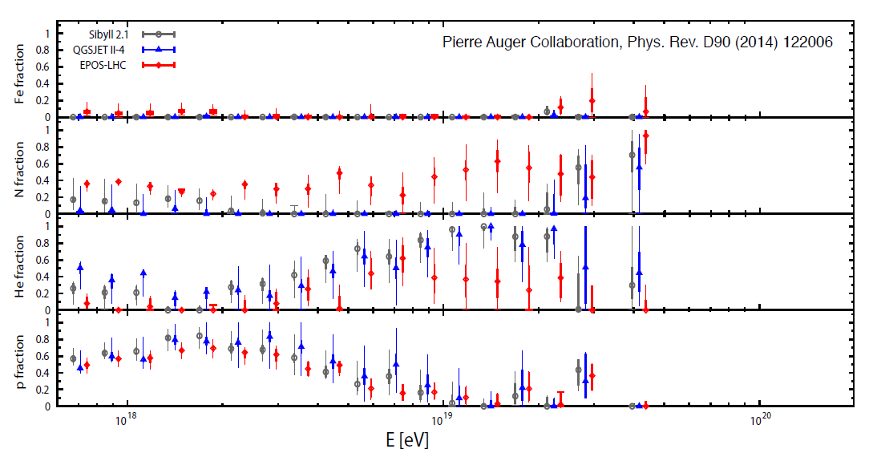
Can we do astronomy?
Need protons -- heavy nuclei too strongly deflected.
Presently derived proton contribution seems disappointingly small (~10%)
Is that the final word? Could well be 30% !!
Need better mass determination and more statistics above 3 × 10¹⁹ eV!

Slide 22
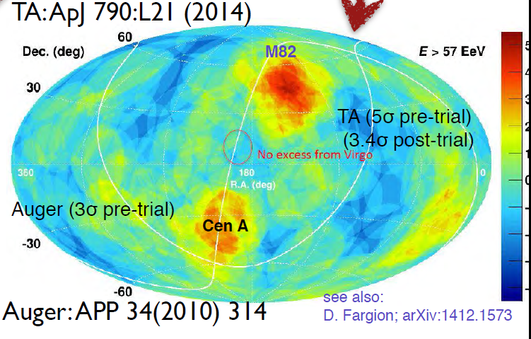
Point Sources: Tantalizing hot spot at TA

Slide 23
Auger and TA upgrades
AugerPrime
  improve measurement of mass composition !!
  no area extension
  upgrading water tanks with scintillators on top + new electronics
  → better event-to-event composition measurement, into cut-off region
  → in-depth study of muon excess, CR models, …
  raising Fluorescence Detector duty cycle by 10-15% → more hybrid events
Telescope Array upgrade
  more statistics for hot spot !!
  increasing array from 700 km² to 2800 km² (approved in Japan April 2014)
  2 new Fluorescence detectors (proposal submitted in USA)

Slide 24
What after results with upgraded arrays?
Ultrahigh-energy cosmic ray physics is at a turning point
High-energy cut-off has been clearly confirmed, but nature unclear
No point sources, but hot spot TA + “warm” spot Auger
Detection and study of point sources was one of the two primary goals of Auger/TA. Would also be the primary motivation for any future EeV CR experiment – ground based arrays of the 30 000 – 90 000 km² class or the space based JEM-EUSO.
Key to move ahead in both directions: more precise mass assignment of individual events and the separation of a proton event sample which is minimally polluted by heavier nuclei.

Slide 25
What after results with upgraded arrays?
If proton component < 5-10%: Next-generation detectors would fail by definition to identify point sources. That would very likely herald the end of the race towards astronomy with charged cosmic rays.
If the proton component would be much higher than the presently estimated 10%, or if even point sources could be identified, the path towards cosmic ray astronomy would be open.
AugerPrime extremely important for the future of the full field: For small cost → guidance, whether CR physics at highest energies should be continued or whether it will have reached its natural end.
In the most positive case, AugerPrime or TA would detect first point sources and break through a long-standing wall.
A larger detector could later study these sources in more detail.

Slide 26
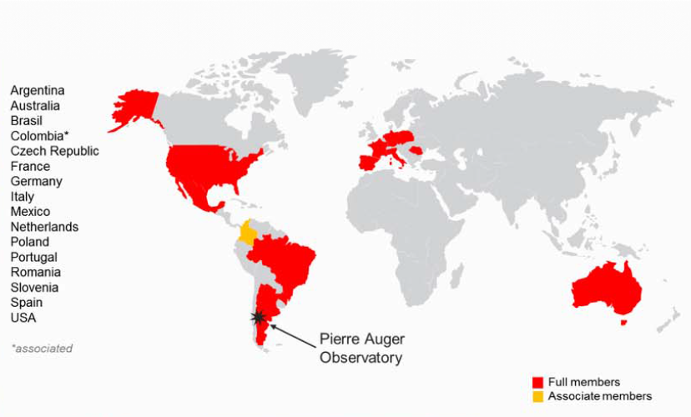
The Auger Collaboration

Slide 27
The Auger Collaboration and AugerPrime
Funding for AugerPrime approved
  (by now > 50%)

Slide 28
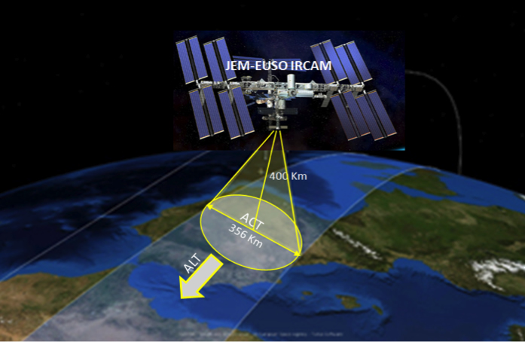
JEM-EUSO

Slide 29
Cosmic ray science below 10¹⁸ eV

Slide 30
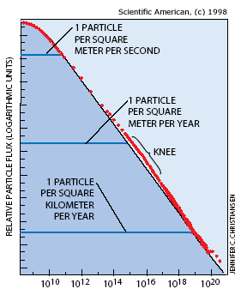
Satellites and balloons
Satellites (and balloons)
  indirect dark matter search
  cosmic specrum and mass composition (direct measurement)
  Heavy (anti-) nuclei
Detectors:
  Pamela, AMS, 2015: CALET, DAMPE
1-10 km² air shower arrays
  Galactic CR, transition extragal. CR
  understand EAS models↔ LHC
Detectors:
  (ARGO/YBJ, KASCADE-Grande), AMIGA
  TAIGA (Siberia)
  LHHASO (Tibet)

Slide 31
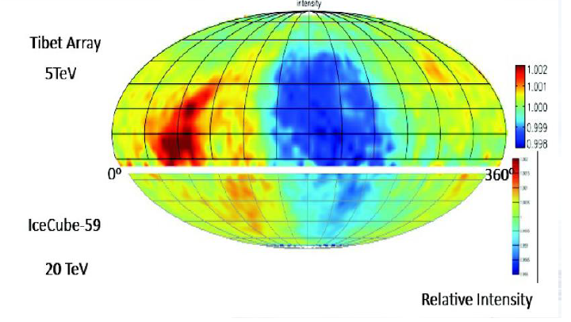
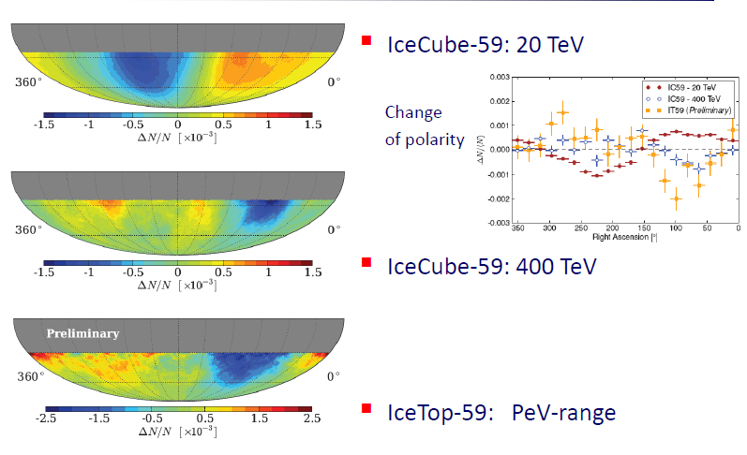
Example: CR anisotropies at 5 – 5000 TeV
On scales down to 3°-5°
Origin unclear
→ HAWC, LHHASO, TAIGA
Still much to do!

Slide 32
Gamma rays
a blossoming field

Slide 33
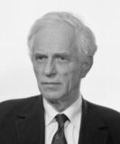
Alexander Chudakov
1965

Slide 34
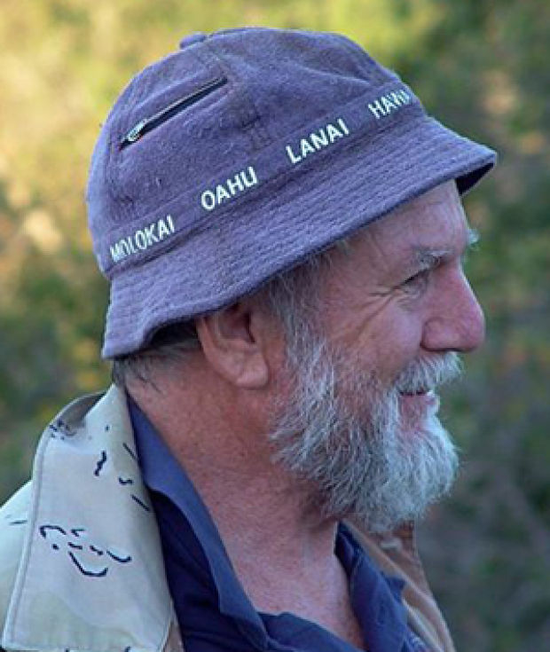
Trevor Weekes
1989

Slide 35
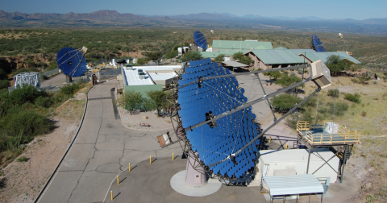
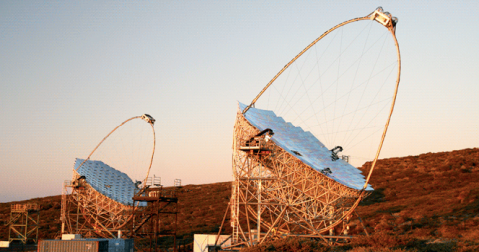
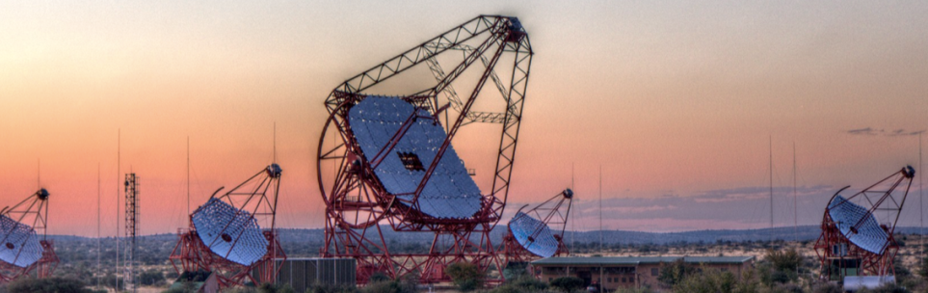
3rd generation Imaging Air Cherenkov telescopes
VERITAS, USA
MAGIC, La Palma
H.E.S.S., Namibia

Slide 36
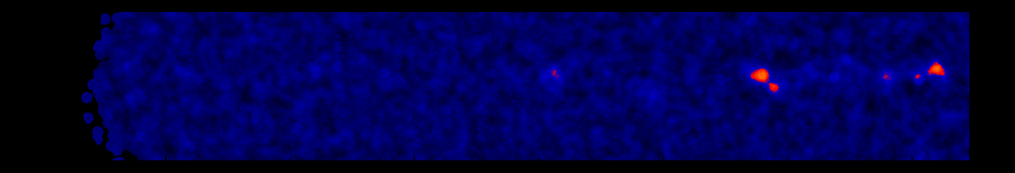
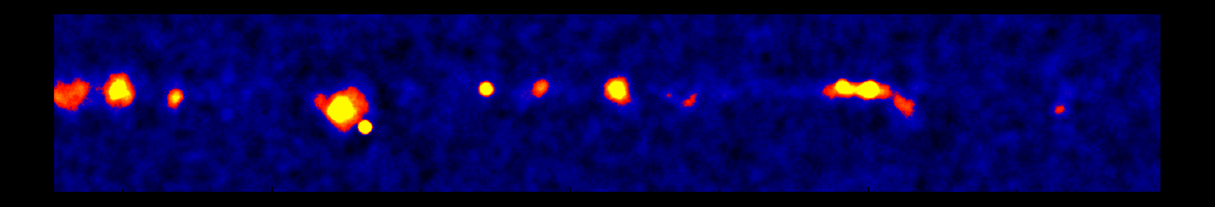
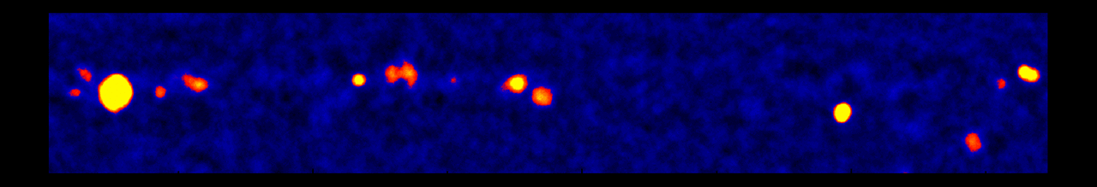
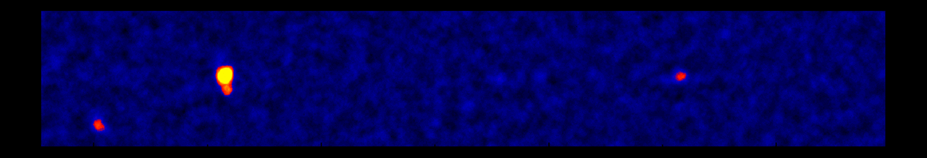
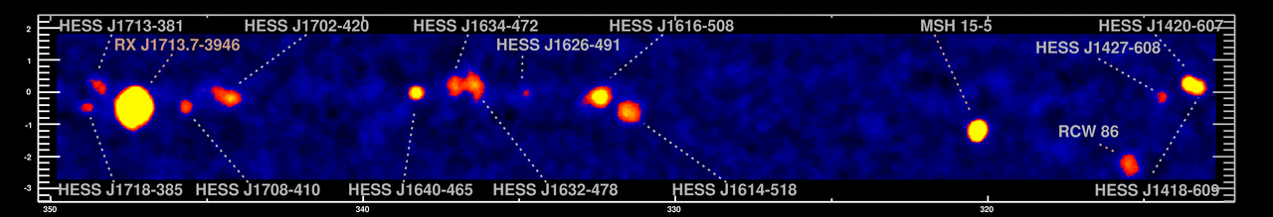
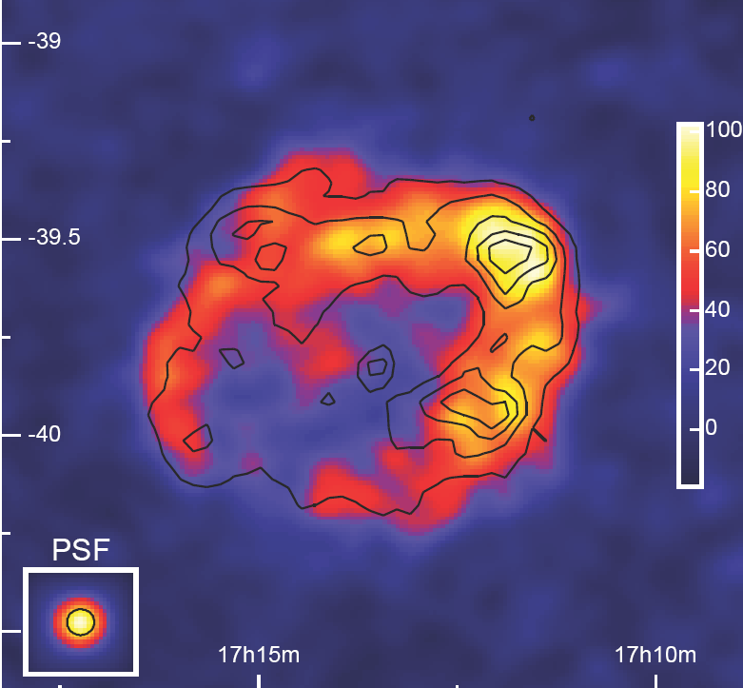
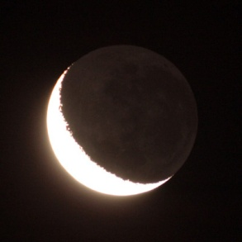
The Sky at TeV-Energies
H.E.S.S.-Scan of the galactic plane
0.5°
RX J1713.7-3946
1989: 1 Source
1996: 3 Sources
2005: 80 Sources
2015: 150 Sources
Moon

Slide 37
It‘s going to be like classical astronomy !
Periodicities/Variability: from ms to years
Energy-coverage: over several decades
Source position: on the arc-second level
Morphology : few arc-min level (even energy-dependent!)
0.5°
RX J1713.7-3946
1989: 1 Source
1996: 3 Sources
2005: 80 Sources
2015: 150 Sources
Moon

Slide 38
It‘s going to be like classical astronomy !
PLUS:
Physics beyond the Standard Model
  Indirect Dark Matter Search
  Test of Lorenz Invariance
  …
Cosmology
  Measurement of EBL
  VHE Standard Candles → dark energy ?

Slide 39
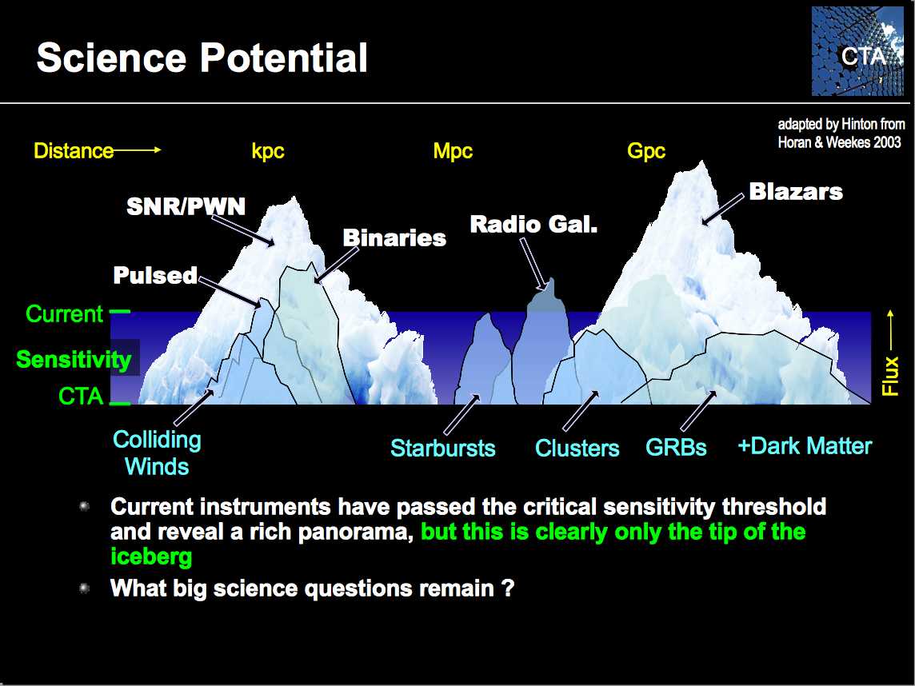

What‘s next?

Slide 40
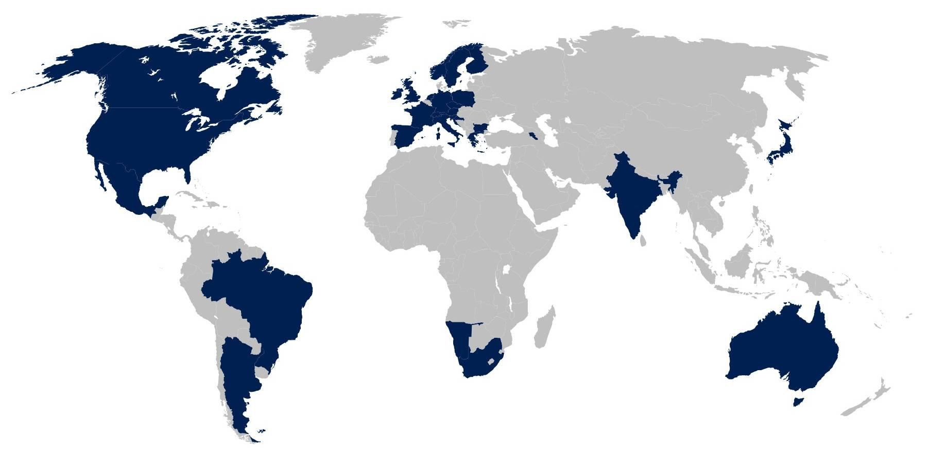
The CTA Collaboration
29 countries
78 institutes

Slide 41
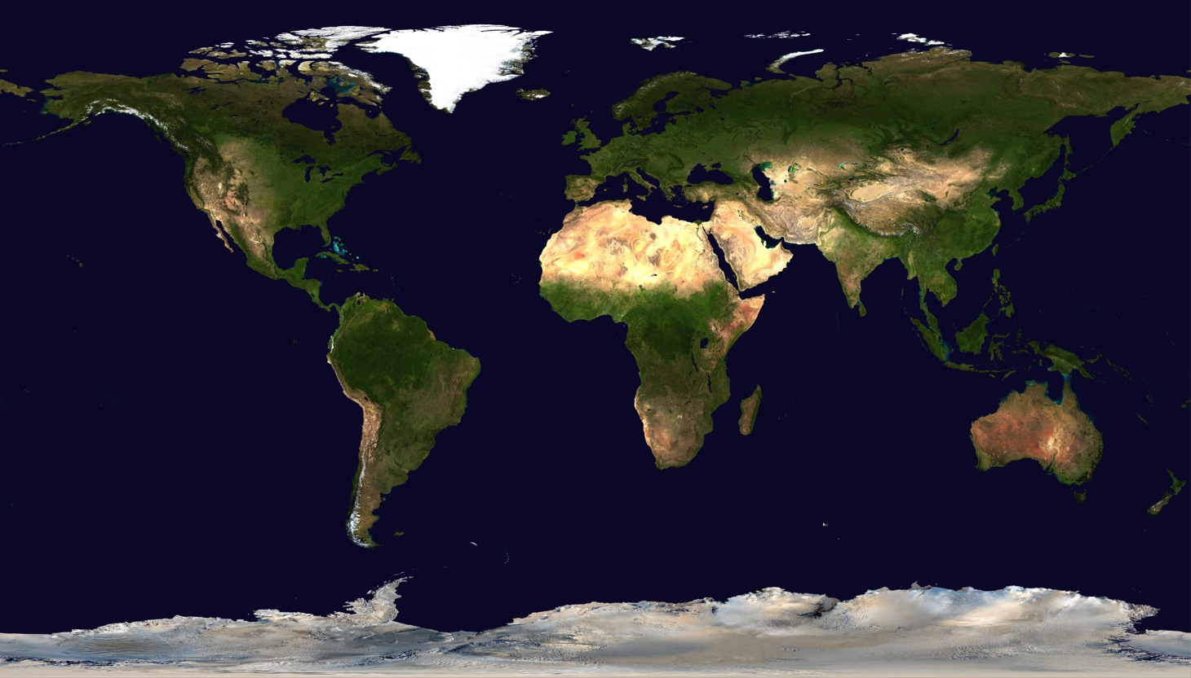
Site selection
North: Mexico and Spain
Final negotiations on La Palma
(40 M€ !)
+30
-30
South: ESO/Chile and Namibia
Final negotiations on ESO site

Slide 42
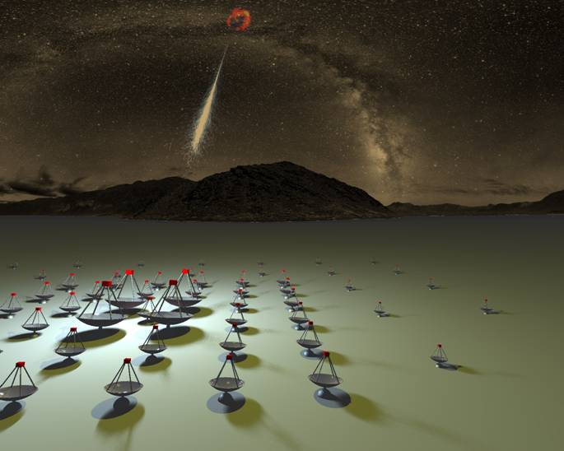

Low energy section
Energy threshold of
some 10 GeV
Medium energy section
mCrab sensitivity in
the 100 GeV – 10 TeV
domain
High energy section
10 km² area at
multi-TeV energies
(only for
Southern Site)
W. Hofmann

Slide 43
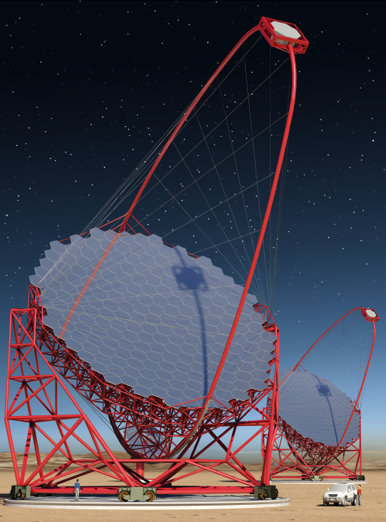
Large Size Telescopes LST
23 m diameter (389 m²)
Camera 4.5º field of view
Carbon-fiber structure for 20 s positioning
4 LSTs at South
4 LSTs at North
Prototype = 1st telescope

Slide 44
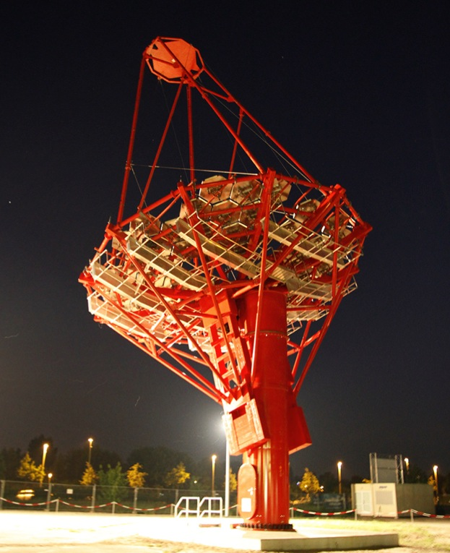
Medium Size Telescopes MST
12 m diameter (100 m²)
Camera 8° field of view
25 MSTs at South
15 MSTs at North
Prototype operational (Berlin)
Will be complemented by dual-mirror version (USA)

Slide 45
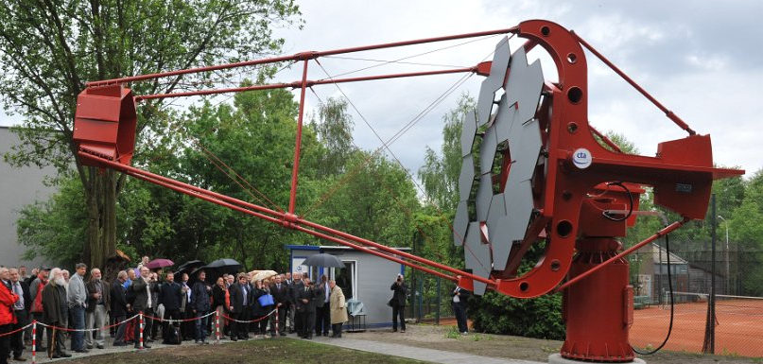
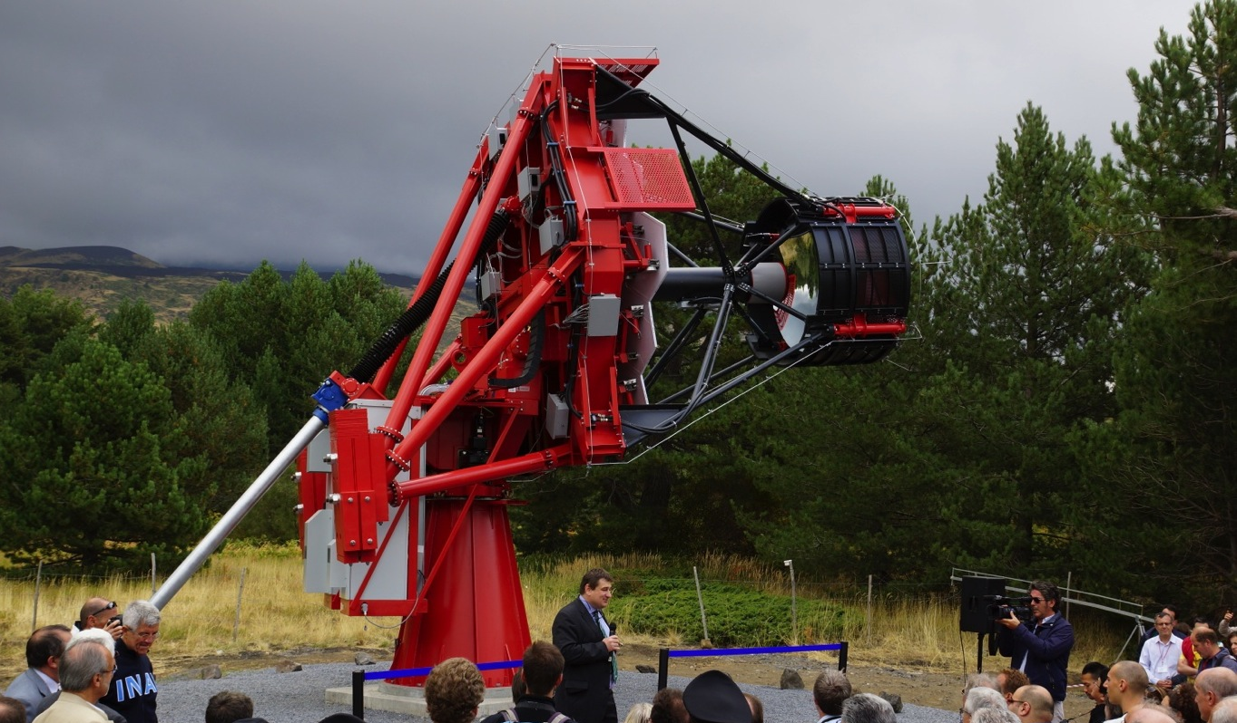
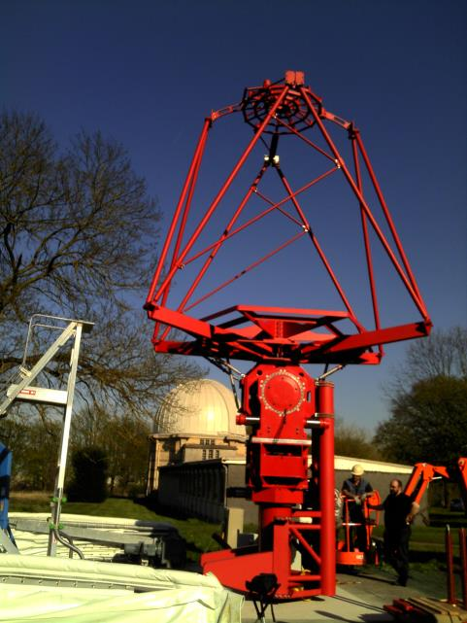
Small Size Telescopes
70 SSTs for South site, Different designs under consideration
Single mirror design
  SST-1M
Dual mirror design
  ASTRI
  GATE

Slide 46
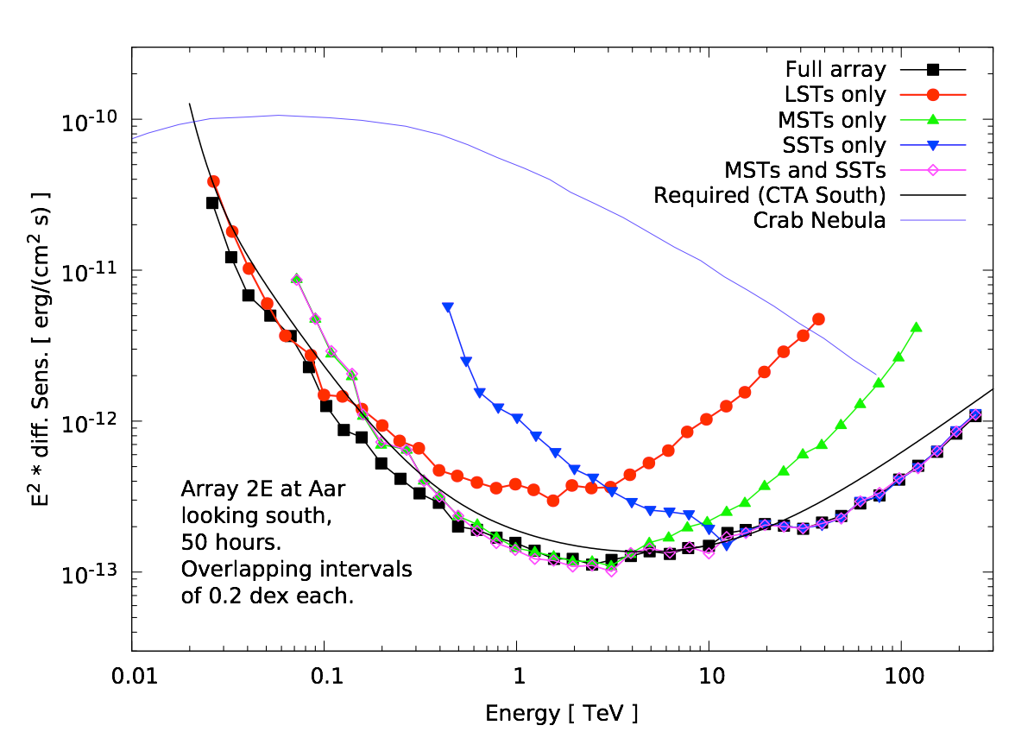
Sensitivity: factor 10 @ 1-10 TeV, extension to LE & HE
background and
systematics limited
LST
νF_{ν}
(erg/cm²s)
background limited
MST
Looking deep!
SST
rate (=area) limited

Slide 47
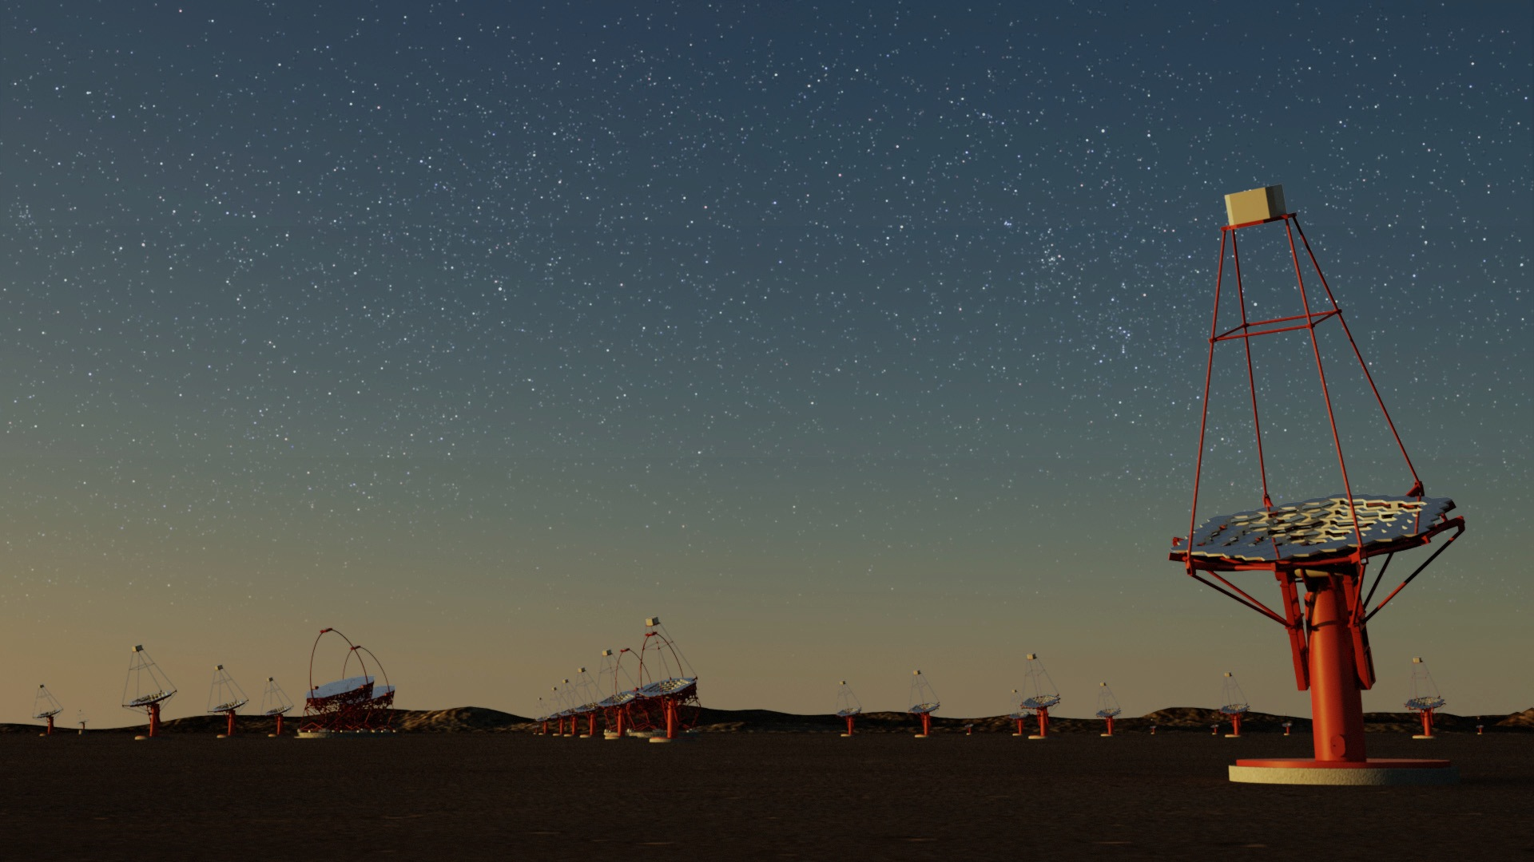

Huge improvement in all aspects
  Factor ~10 in sensitivity,
  Much wider energy coverage,
  Much better resolution & field-of-view, full sky, …
User facility / proposal-driven observatory
€200-300M investment
  Including everyone from H.E.S.S., MAGIC and VERITAS
This is the future of ground based gamma-ray astronomy with Air Cherenkov Telescopes
ESFRI

Slide 48
CTA schedule (as of early 2015)
Pre-Construction Phase
2014-2015
Deploy ~10%
of telescopes
Pre-Production Phase
2016-2017
Mass deployment
Production Phase
2018-2020 (?)

Slide 49
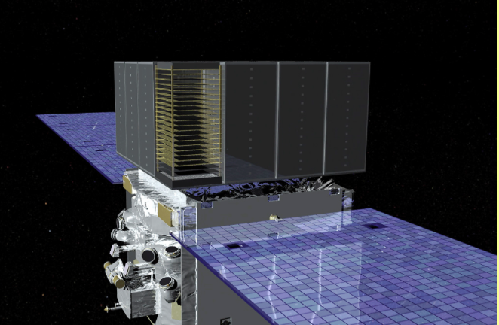
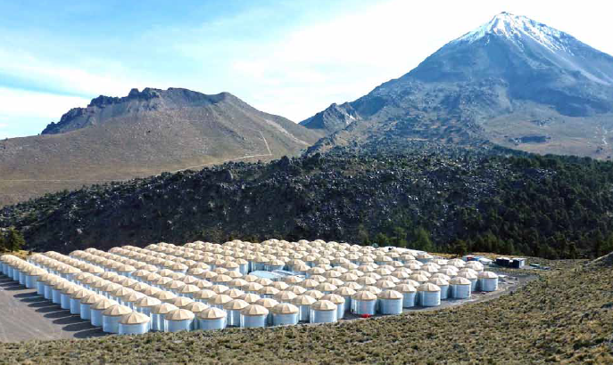
Fermi and HAWC:
Fermi-LAT
Wide angle detectors
Best sensitivity at GeV
Follow-up satellite?
Best sensitivity around 10 TeV
250 water tanks, 22 000 m²
will be upgraded with distant water tanks and a few small IACTs
Also: HAWC South?
HAWC

Slide 50
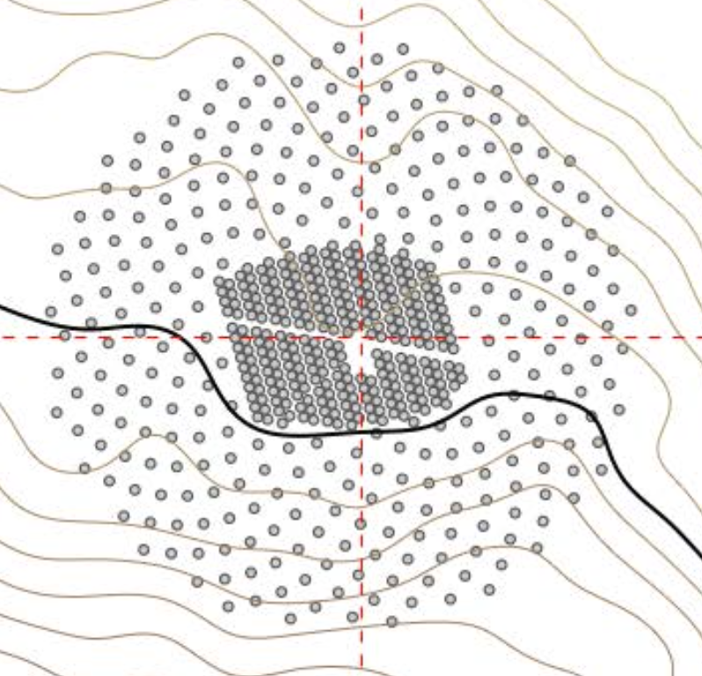
Fermi and HAWC:
Fermi-LAT
Wide angle detectors
Best sensitivity at GeV
Follow-up satellite?
HAWC

Slide 51
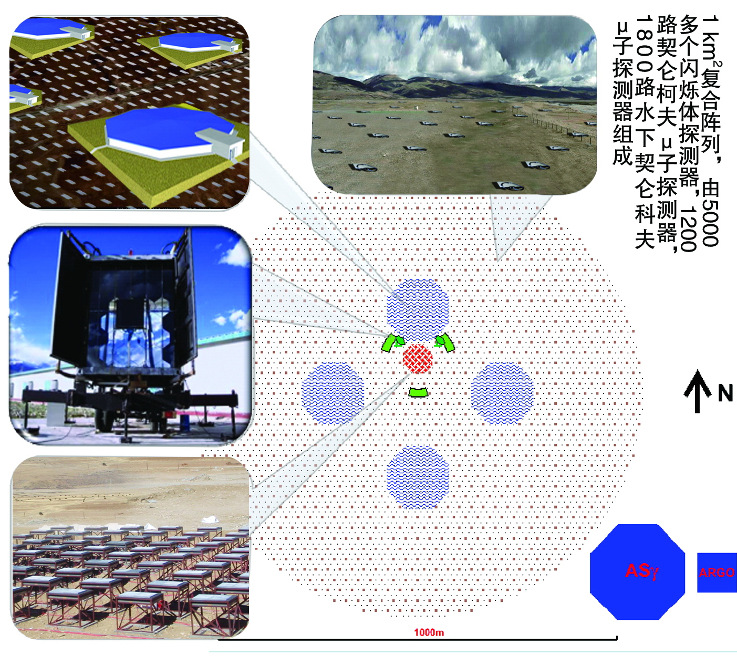
LHHASO in Tibet
6700 scintillator
stations
4 water Cherenkov Detectors (+ µ counters)
Fluorescence
detectors
Burst detectors
+ 24 IACTs

Slide 52
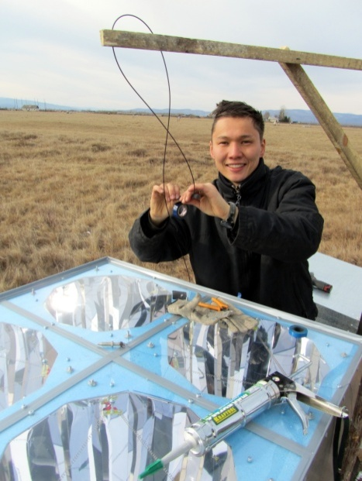
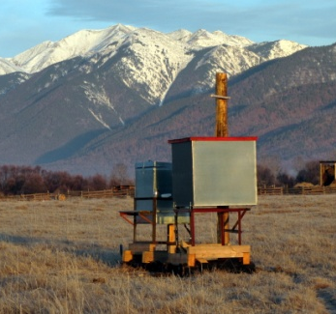
TAIGA in Siberia
Combination of
  wide angle timing array
  few small Imaging Telescopes
  Timing array:
  good γ/hadron aqt high energies, cheap
  Imaging telescopes:
  help γ/hadron separation at lower energies
4 PMTs

Slide 53
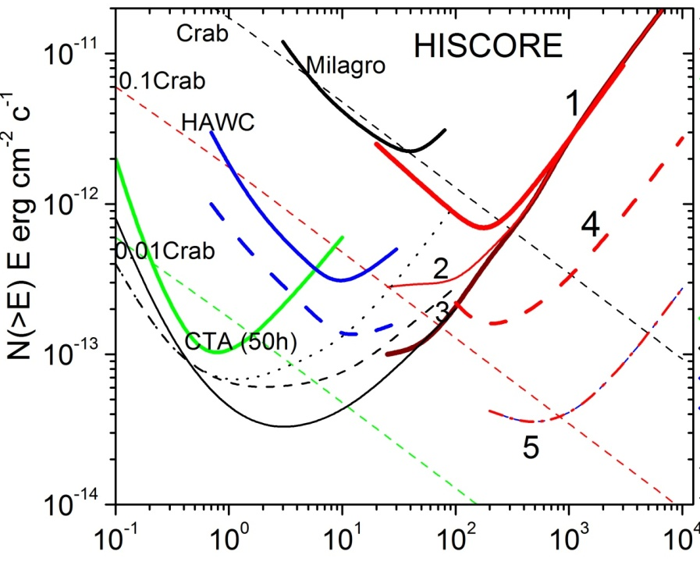
LHHASO and TAIGA: find galactic Pevatrons !
TAIGA
1 – 1 km² basic design . will be completed in 2016
2 – 1 km², larger PMTs
3 – 1 km² + IACTs
4 – 10 km²
5 – 100 km²
LHAASO: Brown dashed
Approved, to be built until 2021

Slide 54
Summary on Gamma Rays
CTA will open a new era in gamma-ray astronomy
It will be flanked by wide-angle arrays like HAWC (TeV range) and LHAASO, TAIGA (reaching into PeV range)
Follow-up of Fermi satellite is still open

Slide 55
He neutrino astronomy
Window opened, landscape uncharted

Slide 56
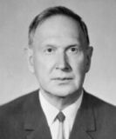
Moisej Markov
1960

Slide 57
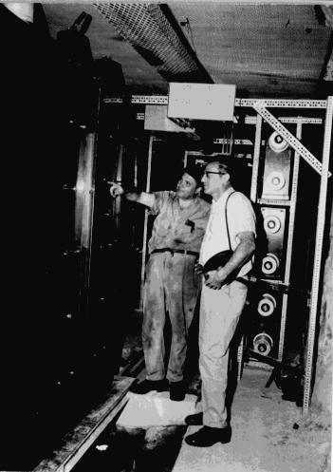
Fred Reines
1965

Slide 58

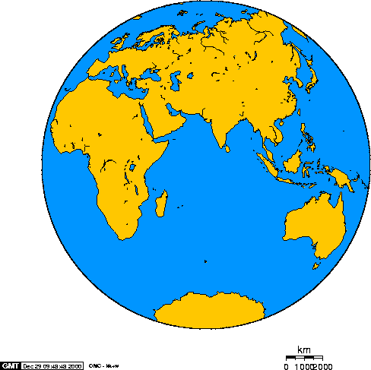
The devices
Baikal
Antares
AMANDA
IceCube

Slide 59

The pioneer: NT200 in Lake Baikal
3600 m
1366 m
8 strings
192 PMTs
Height 72 m
Diameter 42 m

Slide 60

ANTARES
2500m
885 PMTs
12 strings
Operating in final
configuration
since 2008
450 m
70 m

Slide 61

IceCube Neutrino Observatory
IceTop air shower detector
81 pairs of water Cherenkov tanks
IceCube
86 strings including 8 Deep Core strings
60 PMT per string
DeepCore
8 closely spaced strings
1450m
~220 ν/day
Threshold
- IceCube ~ 100 GeV
- DeepCore ~10 GeV
2450m
2820m

Slide 62


Special search for neutrinos with E_{ν} > 500 TeV
IC79/IC86 2.8 σ
Ernie Bert
~1.04 PeV ~ 1.14 PeV

Slide 63

Follow-up Analysis: HESE (High Energy Starting Event)
First evidence for an extra-terrestrial h.e. neutrino flux
2 yrs data, 28 evts 4.1σ
Science 342 (2013)
3 yrs data, 37 evts 5.9σ
Phys.Rev.Lett. 113:101101 (2014)
4 yrs data, 54 evts ~ 7σ
Threshold ~ 30 TeV

Slide 64




Follow-up Analysis: HESE (High Energy Starting Event)
First evidence for an extra-terrestrial h.e. neutrino flux
2 yrs data, 28 evts 4.1σ
Science 342 (2013)
3 yrs data, 37 evts 5.9σ
Phys.Rev.Lett. 113:101101 (2014)
4 yrs data, 54 evts ~ 7σ
”Bert”
1.04 PeV
Aug. 2011
”Ernie”
1.14 PeV
Jan. 2012
”Big Bird”
2 PeV
Dec. 2012

Slide 65

3 years through-going muons
The highest energy muon in 2009-12
(IC 59+79+86)

Slide 66

New: The highest energy of all !

Slide 67

Energy spectrum Φ = Φ₀ × E_{ν}^{γ}
Different analyses find different (but statistically compatible) spectral indices
→ need more statistics
→ need independent measurement with different systematics
→ need KM3NeT and Baikal-GVD!

Slide 68

Flavor composition: what do we expect?

Slide 69

Flavor composition: what do we measure?
preliminary
the best fit flavor composition disfavors 1:0:0 at source at 3.6 σ

Slide 70


IceCube 4 years pre-trial significance skymap
North
South
Only upper limits
178 000 upward μ from ν interaction
216 000 downward µ from CR showers

Slide 71

But may be we are close!
Markus Ahlers VLVNT 2015

Slide 72
The future of high-energy neutrino astronomy

Slide 73
Baikal, Mediterranean Sea, South Pole
GVD
KM3NeT
(ARCA + ORCA)
GNN
IceCube Gen2
HEA +PINGU + ….

Slide 74
Gigaton Volume Detector
Baikal GVD

Slide 75


GVD: Phase 1 (2020) and Phase 2 (~2025)
GVD-1: 0.4 km³
  12 clusters with 8 strings each
  Cluster diameter 120 m
  Height 520 m
  36 OMs per string
GVD-2: ~ 1.5 km³

Slide 76

2015: First cluster of GVD versus NT200

Slide 77
KM3NeT
ESFRI

Slide 78

Original idea: 6 blocks at 3 locations: 6 x 0.6 km³
115 strings per block
18 DOMs per string
31 PMTs per DOM
France
Italy
Greece

Slide 79

Phase 1 (2017):
France
7 strings, small spacing
- Feasibility test for ORCA
Italy
24 strings, 124 m spacing
Demonstrate principle
- Physics on the 3-4 times Antares scale

Slide 80

Phase 2: ORCA and ARCA (2020?)
France
ORCA
ARCA
Italy
ORCA: determination of the Neutrino Mass Hierarchy (NMH)
ARCA: IceCube physics, but with better angular resolution and
from the Northern hemisphere

Slide 81

KM3NeT Phase 2: diffuse fluxes
Sensitivity to IceCube HESE signal
… plus first galactic sources ?

Slide 82


ORCA/PINGU: neutrino mass hierarchy
Deep Core has proven that neutrino telescopes in natural media can do precision neutrino physics. Threshold ~10 GeV.
PINGU/ORCA: measure NMN with atmospheric neutrinos via effects of matter oscillations. Need threshold ~ 3 GeV
DeepCore potentially

Slide 83

ORCA/PINGU: neutrino mass hierarchy

Slide 84
IceCube Gen2

Slide 85
The IceCube Gen2 facility: conceptual drawing
  PINGU : low energy, mass hierarchy
  High Energy Array (HEA) - 100 TeV- PeV scale neutrinos
  Cosmic Ray Array (CRA) - veto array for HEA - cosmic ray physics
  Radio Array (RA) - > 100 PeV - BZ (GZK) neutrinos

Slide 86

The IceCube Gen2 facility: conceptual drawing

Slide 87
Global timeline
2014 2015 2016 2017 2018 2019 2020 2021 2022 2023 2024
KM3NeT-1 constr.
KM3-ARCA construction
Relevant physics
ORCA
2 (1) x 0.6 km³
+ 1 x 0.4 km³
GVD 1.cluster
GVD-1 construction
Relevant physics
IceCube: more and better data.Relevant physics all the time
5-10 km³
Gen2 construction (finish 2028)
Gen2: R&D + preparatory phase
PINGU
Relevant physics

Slide 88
Global timeline
2014 2015 2016 2017 2018 2019 2020 2021 2022 2023 2024
towards full
KM3NeT/ARCA
(3-4 km³)
towards GVD-2
(1.5 km³)
KM3NeT-1 constr.
KM3-ARCA construction
Relevant physics
ORCA
5 km³
GVD 1.cluster
GVD-1 construction
Relevant physics
IceCube: more and better data.Relevant physics all the time
5-10 km³
Gen2 construction (finish 2028)
Gen2: R&D + preparatory phase
PINGU
Relevant physics

Slide 89
Conclusions HE neutrinos
Cosmic high-energy ν discovered !
Opened new window, but landscape not yet charted: no point sources identified up to now
Remaining uncertainties on spectrum and flavor composition
Point sources in reach!
Need larger detectors, also with different systematics and at the Northern hemisphere.
Next logical step: KM3NeTPhase2 + GVDPhase1
Next logical step on NMH: ORCA (later PINGU)
~2028: A Global Neutrino Observatory (KM3NeT-GVD-IceCube-Gen2,) full sky with > 5 km³

Slide 90
Gravitational waves
Breakthrough in 2016/17

Slide 91

Albert Einstein
1918

Slide 92

Joseph Weber
1958

Slide 93

The GW spectrum (credit NASA)

Slide 94



Merging Neutron Stars

Slide 95










The current GW network of interferometers
GEO, Hannover, 600 m
LIGO Hanford, 4 km: aLigo, 4 km
TAMA, Tokyo 300 m
KAGRA 3km
being started
aVirgo, Pisa 3 km
LIGO Livingston, 4 km
Notes:
The first generation of GW detectors forms a world wide network that jointly takes data and analyzes them in a common effort.
Three detectors in the US: Washington 4km & 2km
Louisiana 4km. Negotiations to move one of the Washington ones to India. Decision next summer
three kilometer long one in Italy: Virgo
German British GEO600 Germany.
LCGT a 3km cryogenic interferometer is being constructed in Japan in the Kamioka mine.

Slide 96

The GW network in 4-5 years
GEO, Hannover, 600 m
LIGO Hanford, 4 km: aLigo, 4 km
LIGO India
KAGRA 3km
aVirgo, Pisa 3 km
LIGO Livingston, 4 km
GW Australia ?
Notes:
The first generation of GW detectors forms a world wide network that jointly takes data and analyzes them in a common effort.
Three detectors in the US: Washington 4km & 2km
Louisiana 4km. Negotiations to move one of the Washington ones to India. Decision next summer
three kilometer long one in Italy: Virgo
German British GEO600 Germany.
LCGT a 3km cryogenic interferometer is being constructed in Japan in the Kamioka mine.

Slide 97
Gravitational Waves
A few to ~ hundred of sources per year
Adv Virgo/ Adv LIGO
Virgo/LIGO

Slide 98
Gravitational Waves
aLIGO: since Sept 2016 observation (together with GEO-600)
aVirgo: observation will start in Summer/Autumn 2016
Adv Virgo/ Adv LIGO
Virgo/LIGO

Slide 99

Gravitational Waves
Already now 80 Mpc
for NS-NS mergers !
0.01-10 mergers per year
Adv Virgo/ Adv LIGO
Virgo/LIGO

Slide 100
What after discoveries ?
First discoveries with LIGO (VIRGO) will impact
R&D for further upgrades
Detectors in India and Australia
Search strategy for astrophysical sources & GW network strategy
Worldwide funding situation for GW science
… in particular
Einstein Telescope, E.T.
eLISA

Slide 101

> 2025
1000 to 100 000 sources per year

Slide 102

L I S A
Lisa Pathfinder will reach LP at January 22
Testrun starting at March 3
eLISA 2034
(just a funding question, technically it could start 2028)

Slide 103
Summary

Slide 104
A great decade behind:
High-energy neutrinos:
  Extraterrestrial neutrinos discovered
  Proof of precision oscillography with HE neutrinos
High-energy gamma rays:
  ~ 150 sources, new mechanisms, morphology and and and and …
Cosmic rays:
  Cut-off confirmed, TA hot spot (?)
  medium energies: fruitful connections to LHC, small-scale anisotropies
Record limits on numerous BSM phenomena
GW: from 1st generation to advanced interferometers

Slide 105
A greater decade ahead:
High-energy neutrinos:
  Charting the HE neutrino sky, real start of HE neutrino astronomy
  Precision oscillography, mass hierarchy
High-energy gamma rays:
  CTA: „quantum leap“ in gamma astronomy, level of classical astronomy
Cosmic rays:
  AugerPrime and TA-upgrade will define a turning point in CR physics
  Start astronomy with cosmic rays?
All: Detect first BSM phenomena (Dark Matter?)
Start gravitational wave astronomy. Final proof GTR!

Slide 106

THANK YOU FOR YOUR ATTENTION

Slide 107
end

Slide 108





Crab Nebula pulsed emission
In P1 and P2 pulsed emissionup to 1 TeV (ICRC 2015)
33 ms
MAGIC
arXiv:1402.4219
Bridge
emission
Light cylinder:
ωr = c; r ~ 1600 km
Inside light cylinder:
field co-rotates,
pulsed emission
Outside:
e.m. wave emission
0.1 1 10 100 1000 GeV

Slide 109


Displaying Cosmic Particle Accelerators
Ground based
gamma telescopes
satellites
E² dN/dE
Radio Optical X-ray Gamma-ray
Production
  protons: pion-decay: π⁰ → γγ
  electrons: Inverse Compton Scattering: e± γ → e± γ

Slide 110

An example: LIGO Upgrade timeline

Slide 111
CTA schedule as of early 2015
Deploy ~10% of tels.
Mass deployment
Pre-Construction Phase
2014-2015
Pre-Production Phase
2016-2017
Production Phase
2018-2020 (?)
7/2016
First telescopes
on site (earliest)
Pre-Construction Phase 2014-2015
4/2014
Site
narrowing
South
7/2014
CTAO GmbH
founded
3/2015
Site
narrowing
North
6/2015
Critical
Design
Review
8/2015
Site
decision
South
Site
decision
North
Founding
Agreement

Slide 112

Upper limits and 5σ discovery potential
100 TeV cut-off

Slide 113
Neutrinos from GRB
Flux
ε_{b}
t ~ t90 → ?
t ~
-100 →-10s
t ~ 0 → t90
Energy →
Energy

Slide 114


Neutrinos from GRB Astrophys. J. 805, L5 (2015) & arXiv:1412:6510
506 GRB
One single low-significance coincidence, consistent with atmospheric background
IceCube has ruled out neutron escape models
ε_{b}
γ, ν
distant GRB
Energy →

Slide 115


Follow-up observations all-sky devices → pointing devices
ANTARES
IceCube

Slide 116

Optical and X-ray follow-up
Look for multiplets (≥ 2ν within 100 sec) from the same direction (< 3.5°)
Send on-line alert to the North
Robotic telescopes or Swift point to that direction
3 years
  298 doublets, no triplets
  30 PTF alerts, 21 SWIFT alerts

Slide 117



Slide 118
Resolving the sources of the diffuse flux
Marek Kowalski
arXiv:1411.4385
Φ_{diffuse}∝ L・ρ
1%

Slide 119
Resolving the sources of the diffuse flux
Galaxy Clusters

Slide 120


Oscillations of atmospheric neutrinos
Muon neutrino survival probability
Vertically upward
Oscillations
to sterile ν
Non-standard
oscillations due
to VLI
ANTARES/DeepCore
δc/c = 10⁻²⁷
Standard
oscillations
VLI
AMANDA
90%, 95%, 99%
SK + K2K
90%
Horizontal
IceCube
10y, 90%

Slide 121
Oscillations of atmospheric neutrinos
Muon neutrino survival probability
Vertically upward
cosmic
ray
ANTARES/DeepCore
ν
Earth
L
θ
Horizontal

Slide 122

HESE skyplot, 3 years

Slide 123


HESE skyplot, 4 years
18 %

Slide 124

Through-going muons, IC-79/86
3.9σ

Slide 125



Putting all together
Global fit
Flux:
at 100 TeV
Spectral index:

Slide 126

KM3NeT Phase 2: point source sensitivity
2,
2,
  For specific flux assumptions for
  Supernova Remnants
  (modeled using γ-ray results) Kelner et al., Phys.Rev. D74 (2006) 034018
  → 3σ detection in ~5 years
IceCube sensitivity
at the time KM3NeT-2
has operated 3 years

Slide 127

Gravitational Waves
A few to several tens of sources per year
Adv Virgo/ Adv LIGO
Virgo/LIGO

Slide 128
Content
  The messengers
  EeV charged cosmic rays: approaching a turning point?
  Cosmic ray science below 10¹⁸ eV
  Gamma rays – a blossoming field
    H.E.S.S., MAGIC & Co. → CTA, HAWC
  HE neutrinos: window opened, landscape uncharted:
    the case for KM3eT & Co.
  Gravitational Waves: breakthrough in 2016/17 and beyond
  The multi-messenger concept
  Resumé

Slide 129
The multi-messenger concept

Slide 130

Range of cosmic rays and gamma rays

Slide 131
Perspective for cosmic rays at highest energies
Exposure
(km² sr year)
10⁷
JEM-EUSO
(space)
30,000 km²
10⁶
Note: early 2013 – TUS (Russia)
This slide I made 4½ years ago …
10⁵
Auger-South
10⁴
HiRes
AGASa
Fly‘s eye
Telescope Array
10³
10²
1985 1990 1995 2000 2005 2010 2015 2020 2025 2030
year

Slide 132
The questions: Particle Physics
  High energy cosmic rays
    Understanding forward physics at LHC
    pp cross sections at highest energies
    Exotics (topological defects, …)
  High energy neutrinos
    Oscillations physics, mass hierarchy (future with ORCA & PINGU)
    Sterile neutrinos
    Neutrino cross sections
    Indirect dark matter, magnetic monopoles
  High energy gamma rays
    Indirect dark matter
    in yellow: positive results. In blue: upper limits or no deviation from SM

Slide 133

IceCube 4 years But: we may be close!
Crab Nebula
model excluded
The most realistic model:
can be tested with 2 x
present sensitivity (2016)
model
almost
excluded

