Slide 1
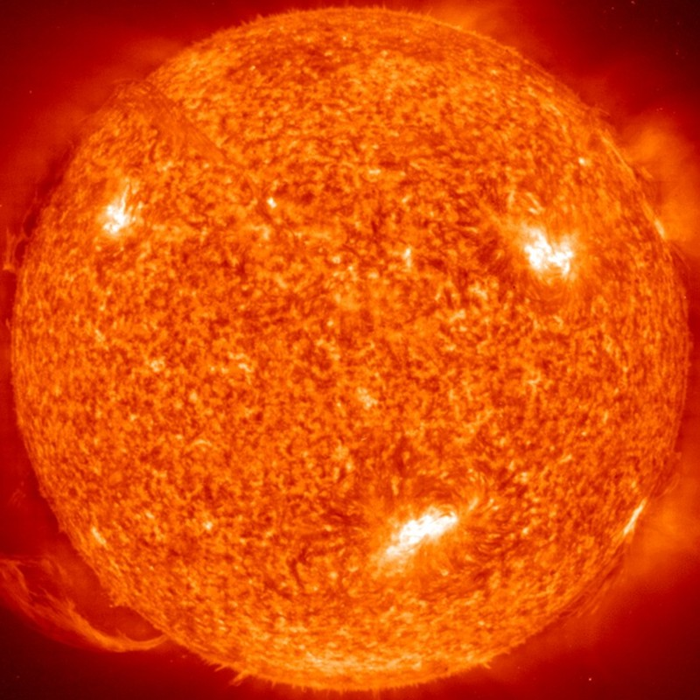
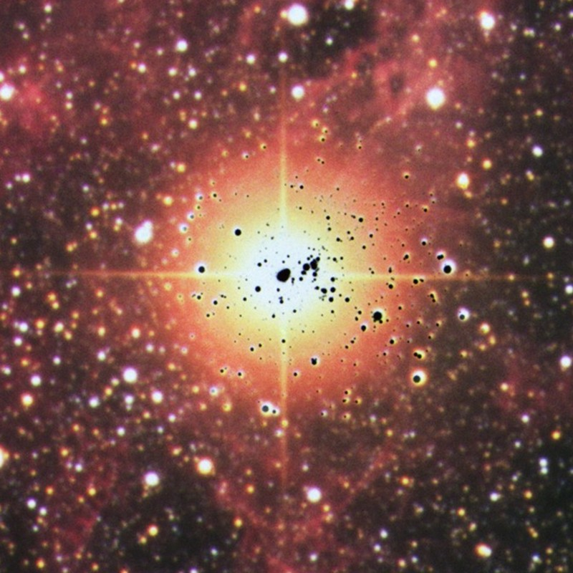
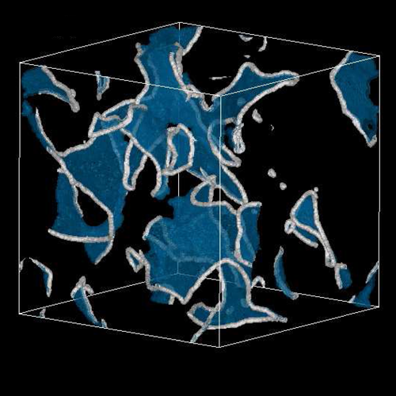
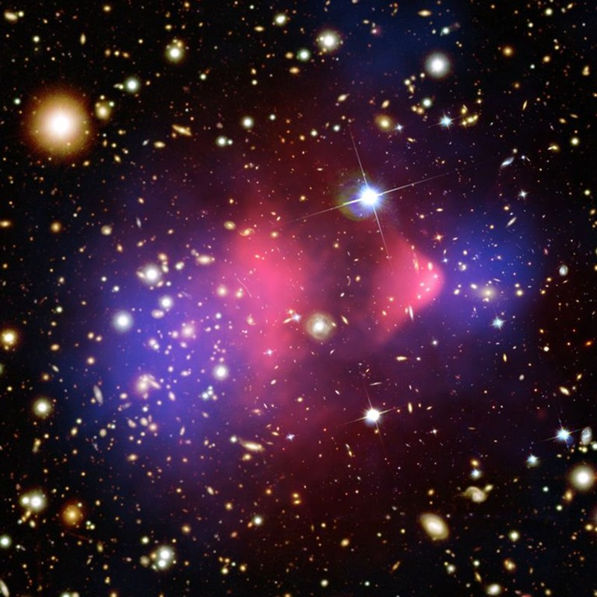
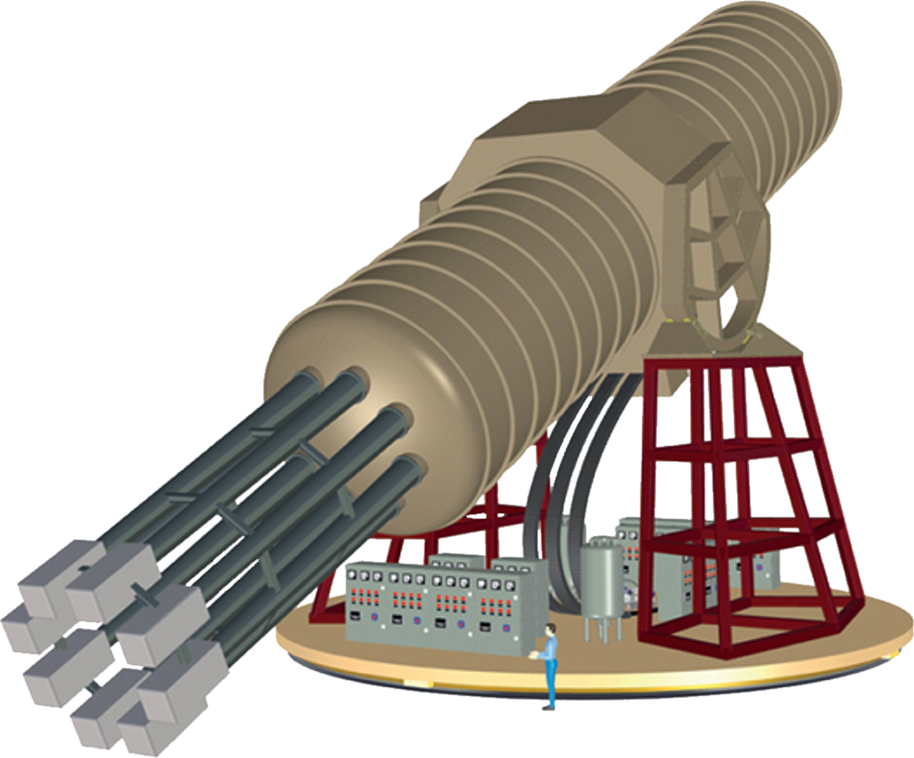
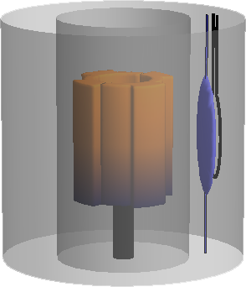


Axion Landscape
Solar Axions
Supernova 1987A
Early Universe
Dark Matter
Long-Range Force
Georg Raffelt
Max Planck Institute for Physics, Munich

Slide 2
































High- and Low-Energy Frontiers in Particle Physics
Cosmological
constant
QCD
scale
Electroweak
scale
GUT
scale
Planck
mass
Cosmic rays
$${10}^{−6}$$
$${10}^{−3}$$
$$1$$
$${10}^{3}$$
$${10}^{6}$$
$${10}^{9}$$
$${10}^{12}$$
$${10}^{15}$$
$${10}^{18}$$
$${10}^{21}$$
$${10}^{24}$$
$${10}^{27}$$
eV
“for the theoretical discovery of a mechanism that contributes to our understanding of the origin of mass of subatomic particles, and which recently was confirmed through the discovery of the predicted fundamental par-ticle, by the ATLAS and CMS experiments at CERN’s Large Hadron Collider”
22 μg
“for the discovery of neutrino oscillations, which shows that neutrinos have mass”
2015
2013
T. Kajita
A. McDonald
F. Englert
P. Higgs

Slide 3
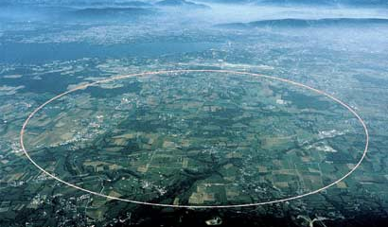

High- and Low-Energy Frontiers in Particle Physics
Cosmological
constant
QCD
scale
Electroweak
scale
GUT
scale
Planck
mass
$${10}^{−6}$$
$${10}^{−3}$$
$$1$$
$${10}^{3}$$
$${10}^{6}$$
$${10}^{9}$$
$${10}^{12}$$
$${10}^{15}$$
$${10}^{18}$$
$${10}^{21}$$
$${10}^{24}$$
$${10}^{27}$$
eV
CERN
“Intensity Frontier”
(feeble interactions)
Low-E Frontier
High-Energy Frontier
New 750 GeV boson?
few-sigma hint @ CMS & ATLAS
dozens theory papers since 15 Dec 16

Slide 4


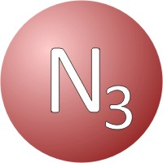
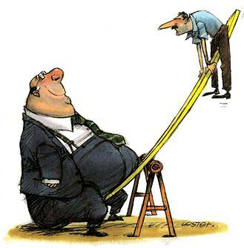

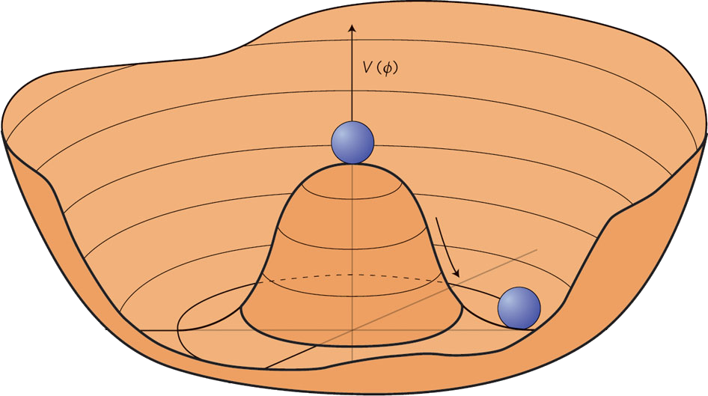


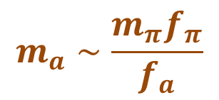
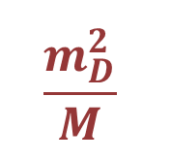



High- and Low-Energy Frontiers in Particle Physics
Cosmological
constant
QCD
scale
Electroweak
scale
GUT
scale
Planck
mass
$${10}^{−6}$$
$${10}^{−3}$$
$$1$$
$${10}^{3}$$
$${10}^{6}$$
$${10}^{9}$$
$${10}^{12}$$
$${10}^{15}$$
$${10}^{18}$$
$${10}^{21}$$
$${10}^{24}$$
$${10}^{27}$$
eV
Heavy right-handed
neutrinos
(see-saw mechanism)
$$\frac{m_{D}^{2}}{M}$$
$$m_{D}$$
$$M$$
WIMP dark matter
(related to EW scale, perhaps SUSY)
Axion dark matter (related to Peccei-Quinn symmetry)
$$m_{a}∼\frac{m_{π}f_{π}}{f_{a}}$$
$$m_{π}{, f}_{π}$$
$$f_{a}$$

Slide 5
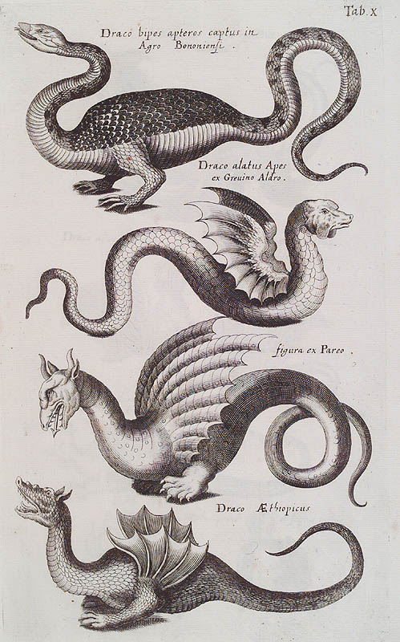
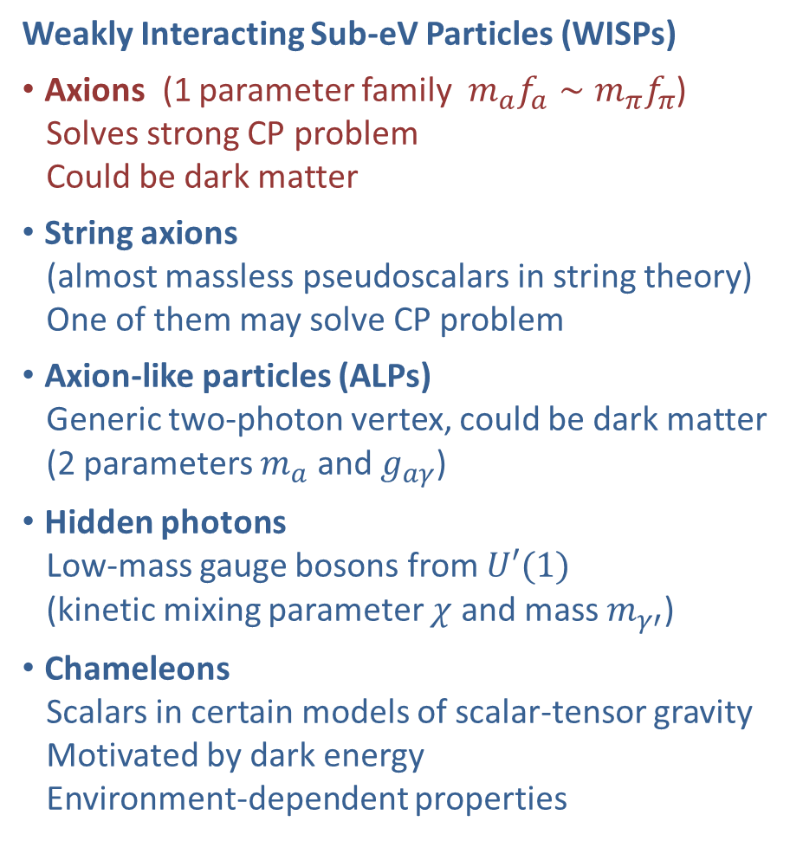
Bestiarium of Low-Mass Bosons
Weakly Interacting Sub-eV Particles (WISPs)
• Axions (1 parameter family $m_{a}f_{a}∼m_{π}f_{π}$)
Solves strong CP problem
Could be dark matter
• String axions
(almost massless pseudoscalars in string theory)
One of them may solve CP problem
• Axion-like particles (ALPs)
Generic two-photon vertex, could be dark matter
(2 parameters $m_{a}$ and $g_{aγ}$)
• Hidden photons
Low-mass gauge bosons from $U′(1)$
(kinetic mixing parameter $χ$ and mass $m_{γ′}^{}$)
• Chameleons
Scalars in certain models of scalar-tensor gravity
Motivated by dark energy
Environment-dependent properties

Slide 6
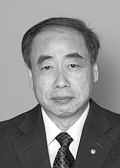
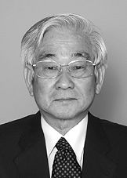
CP Violation in Particle Physics
Discrete symmetries in particle physics
C – Charge conjugation, transforms particles to antiparticles
violated by weak interactions
P – Parity, changes left-handedness to right-handedness
violated by weak interactions
T – Time reversal, changes direction of motion (forward to backward)
CPT – exactly conserved in quantum field theory
CP – conserved by all gauge interactions
violated by three-flavor quark mixing matrix
All measured CP-violating effects derive
from a single phase in the quark mass matrix
(Kobayashi-Maskawa phase),
i.e. from complex Yukawa couplings
Cosmic matter-antimatter asymmetry
requires new ingredients
M. Kobayashi
T. Maskawa
Physics Nobel Prize 2008

Slide 7
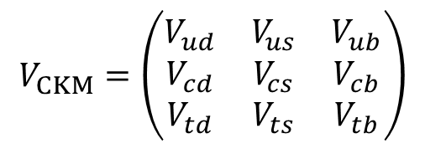
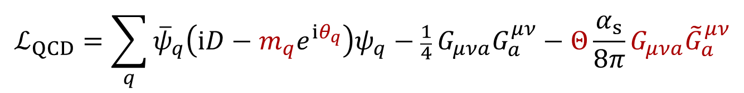
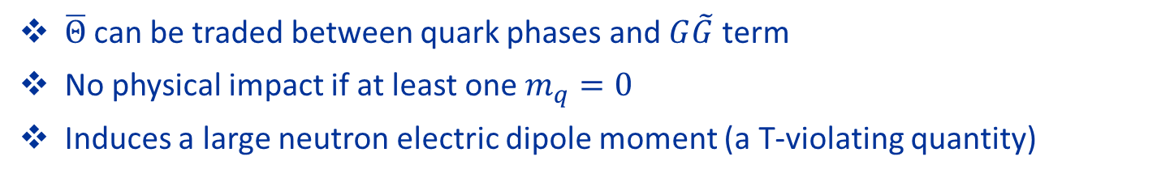

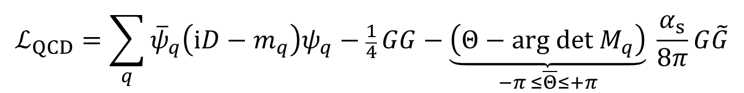
The CP Problem of Strong Interactions
Real quark
mass
Phase from
Yukawa coupling
Angle
variable
CP-odd
quantity $∼E⋅B$
$$ℒ_{QCD}=\sum_{q}{{\overline{ψ}}_{q}\left(iD−m_{q}e^{iθ_{q}}\right)ψ_{q}−\frac{1}{4}}G_{μνa}G_{a}^{μν}−Θ\frac{α_{s}}{8π}G_{μνa}{\tilde{G}}_{a}^{μν}$$
Remove phase of mass term by chiral transformation of quark fields
$$ψ_{q}→e_{}^{−iγ_{5}θ_{q}/2}ψ_{q}$$
$$ℒ_{QCD}=\sum_{q}{{\overline{ψ}}_{q}\left(iD−m_{q}\right)ψ_{q}−\frac{1}{4}}GG−\underset{−π ≤\overline{Θ}≤+π}{\underbrace{\left(Θ−\text{arg} \text{det} M_{q}\right)}} \frac{α_{s}}{8π}G\tilde{G}$$
$\overline{Θ}$ can be traded between quark phases and $G\tilde{G}$ term
No physical impact if at least one $m_{q}=0$
Induces a large neutron electric dipole moment (a T-violating quantity)
Experimental limits: $\left|\overline{Θ}\right|<{10}^{−11}$ Why so small?

Slide 8


Strong CP Problem
QCD vacuum energy $V(Θ)$
$$Λ_{QCD}^{4}$$
Equivalent
Equivalent
$$Θ$$
$$−2π$$
$$−π$$
$$+π$$
$$+2π$$
• CP conserving vacuum has $Θ=0$ (Vafa and Witten 1984)
• QCD could have any $−π≤Θ≤+π$, is “constant of nature”
• Energy can not be minimized: $Θ$ not dynamical
Peccei-Quinn solution:
Make $Θ$ dynamical, let system relax to lowest energy

Slide 9

The Pool Table Analogy (Pierre Sikivie 1996)
Gravity
Pool table
Symmetric
relative
to gravity
Axis
Symmetry
broken
Floor
inclined
f_{a}
New degree
of freedom
→ Axion
$$\overline{Θ}$$
Symmetry
dynamically
restored
(Weinberg 1978, Wilczek 1978)
(Peccei & Quinn 1977)

Slide 10
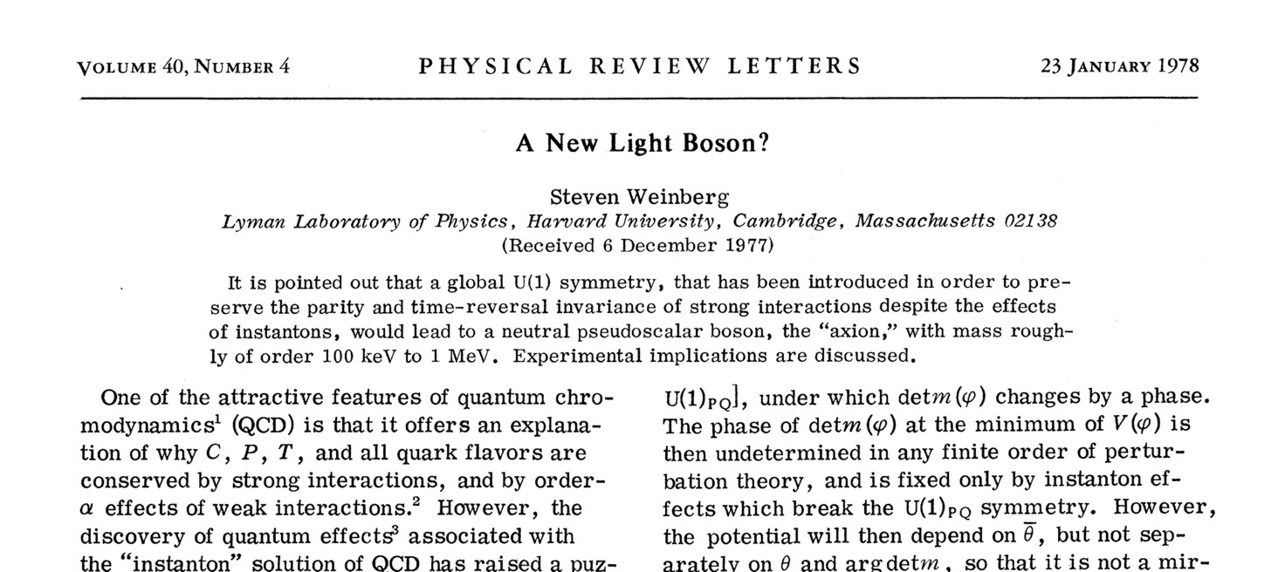
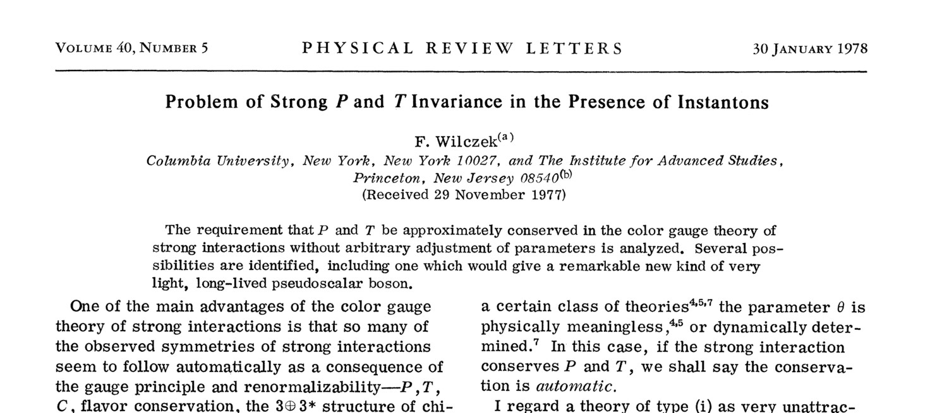
37 Years of Axions

Slide 11

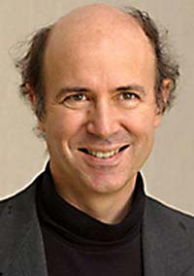
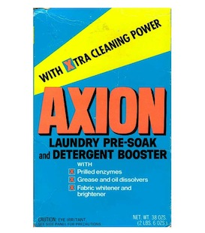

The Cleansing Axion
Frank Wilczek
“I named them after a laundry
detergent, since they clean up
a problem with an axial current.”
(Nobel lecture 2004)

Slide 12

Arthur Godfrey

Slide 13
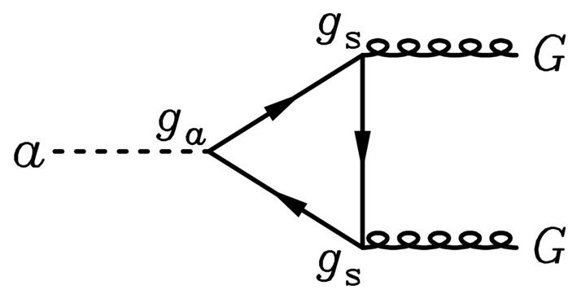
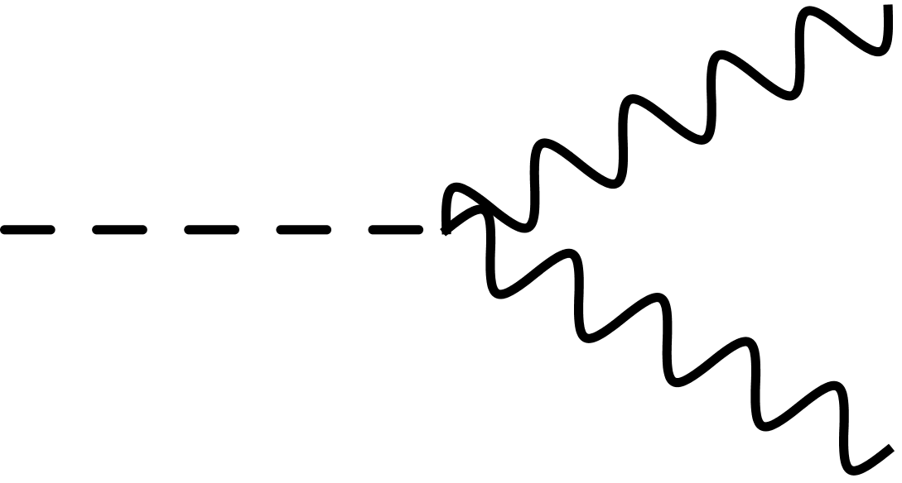
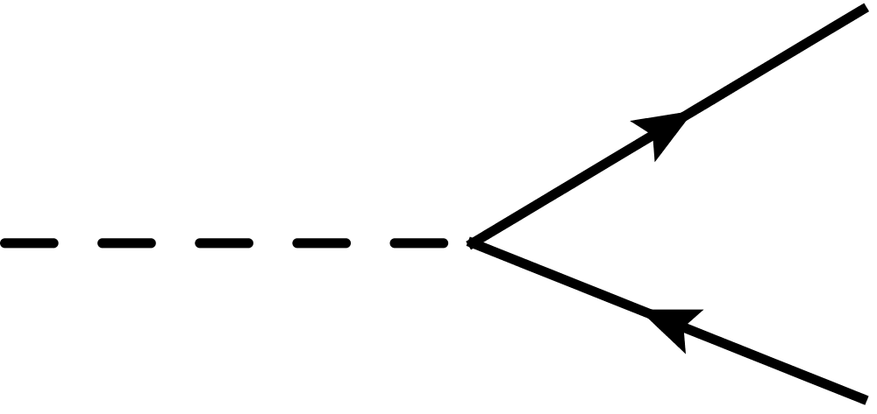




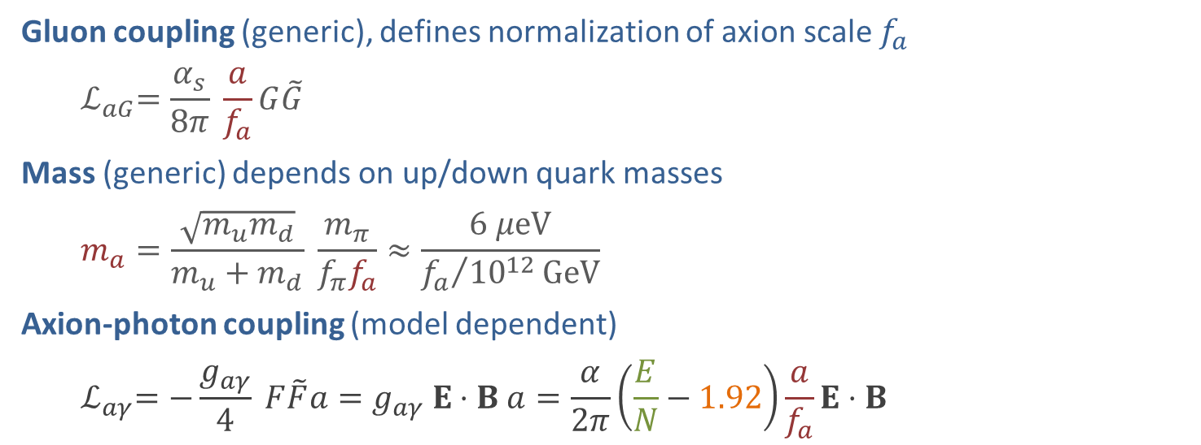


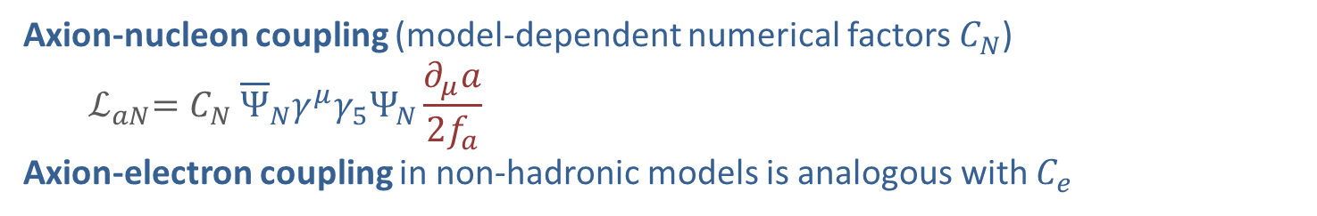

Phenomenological Axion Properties
Gluon coupling (generic), defines normalization of axion scale $f_{a}$
$${ ℒ}_{aG}=\frac{α_{s}}{8π} \frac{a}{f_{a}}G\tilde{G}$$
Mass (generic) depends on up/down quark masses
$$m_{a}=\frac{\sqrt{m_{u}m_{d}}}{m_{u}+m_{d}} \frac{m_{π}}{f_{π}f_{a}}≈\frac{6 μeV}{{f_{a}}/{{10}^{12}}GeV}$$
Axion-photon coupling (model dependent)
$${ ℒ}_{aγ}=−\frac{g_{aγ}}{4} F\tilde{F}a=g_{aγ} E⋅B a=\frac{α}{2π}\left(\frac{E}{N}−1.92\right)\frac{a}{f_{a}}E⋅B$$
Generic from $a$-$π$-$η$ mixing
$$γ$$
$$a$$
Model-dependent,
E/N = 0 (KSVZ), 8/3 (DFSZ), many others
$$γ$$
Axion-nucleon coupling (model-dependent numerical factors $C_{N}$)
$${ ℒ}_{aN}=C_{N} {\overline{Ψ}}_{N}γ^{μ}γ_{5}Ψ_{N}\frac{∂_{μ}a}{2f_{a}}$$
Axion-electron coupling in non-hadronic models is analogous with $C_{e}$
$$f$$
• Axial-vector current
• Spin-dependent int’n
$$a$$
$$f$$

Slide 14
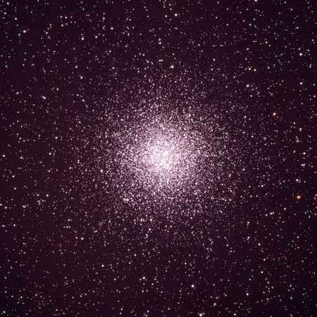
Axion Bounds
m_{Planck}
f_{a}
10¹⁸
10¹⁵
10¹²
10⁹
10⁶
GeV
peV
neV
μeV
meV
eV
m_{a}
Astrophysical Bounds
(Energy loss of stars)
Opportunities for detection
Supernova 1987A
Globular Cluster

Slide 15
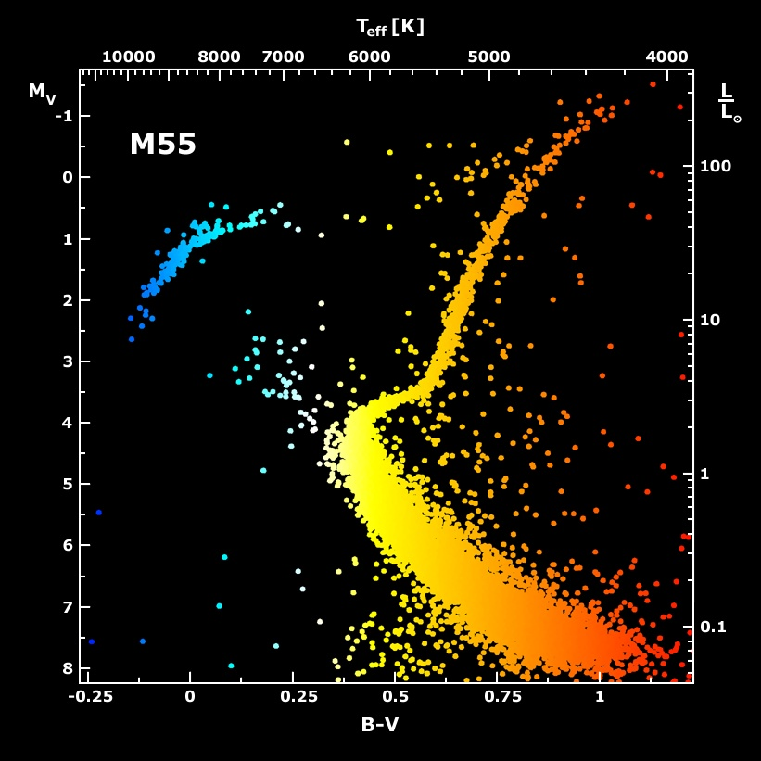
Galactic Globular Clusters

Slide 16
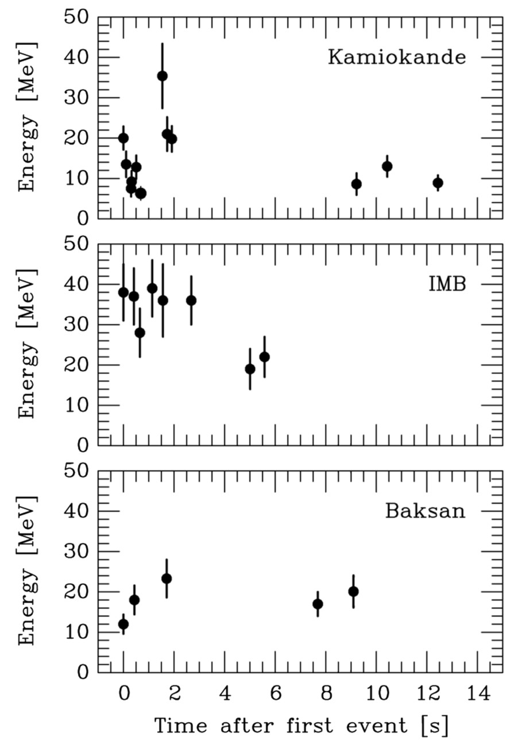
Supernova 1987A Energy-Loss Argument
SN 1987A neutrino signal
Neutrino
sphere
Volume emission
of new particles
Neutrino
diffusion
Emission of very weakly interacting
particles would “steal” energy from the
neutrino burst and shorten it.
(Early neutrino burst powered by accretion,
not sensitive to volume energy loss.)
Late-time signal most sensitive observable

Slide 17
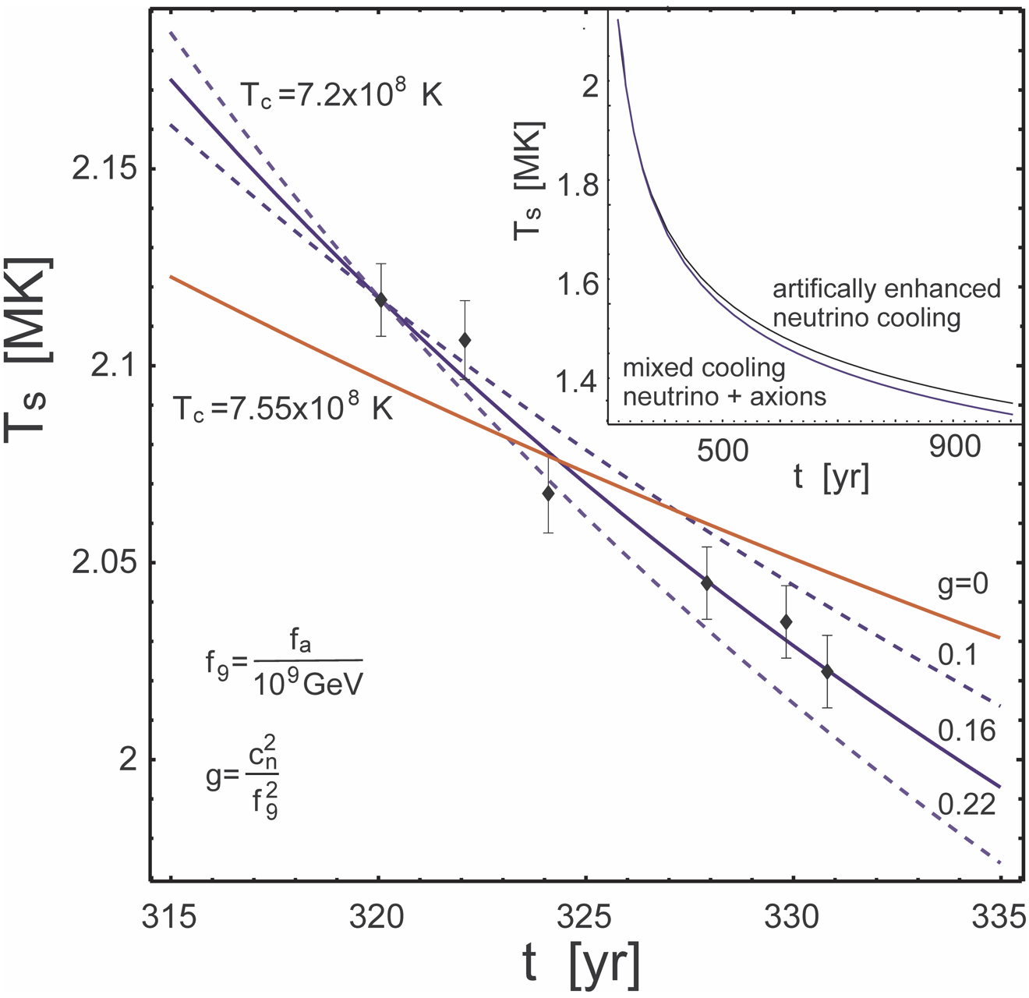
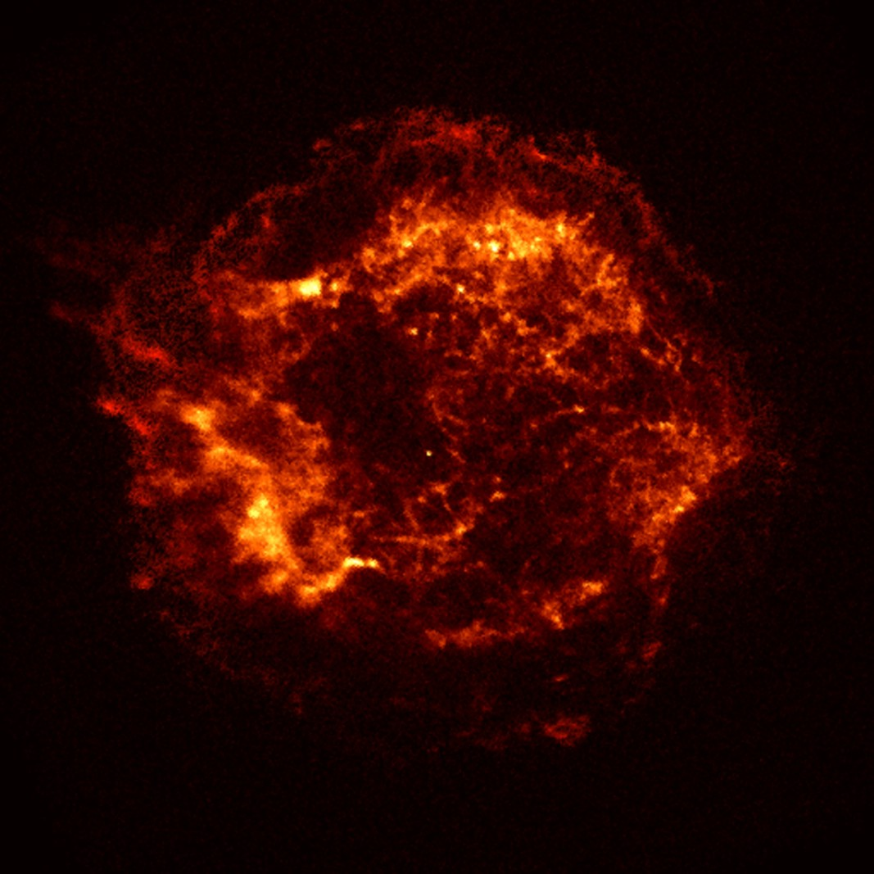

Cooling of Neutron Star in Cas A
Chandra
x-ray
image of
non-pulsar
compact
remnant
$${C_{n}m}_{a}∼2.4 meV$$
Measured surface temperature over 10 years reveals unusually fast cooling rate
• Neutron Cooper pair breaking and formation (PBF) as neutrino emission process?
• Evidence for extra cooling (by axions)?
Leinson, arXiv:1405.6873

Slide 18
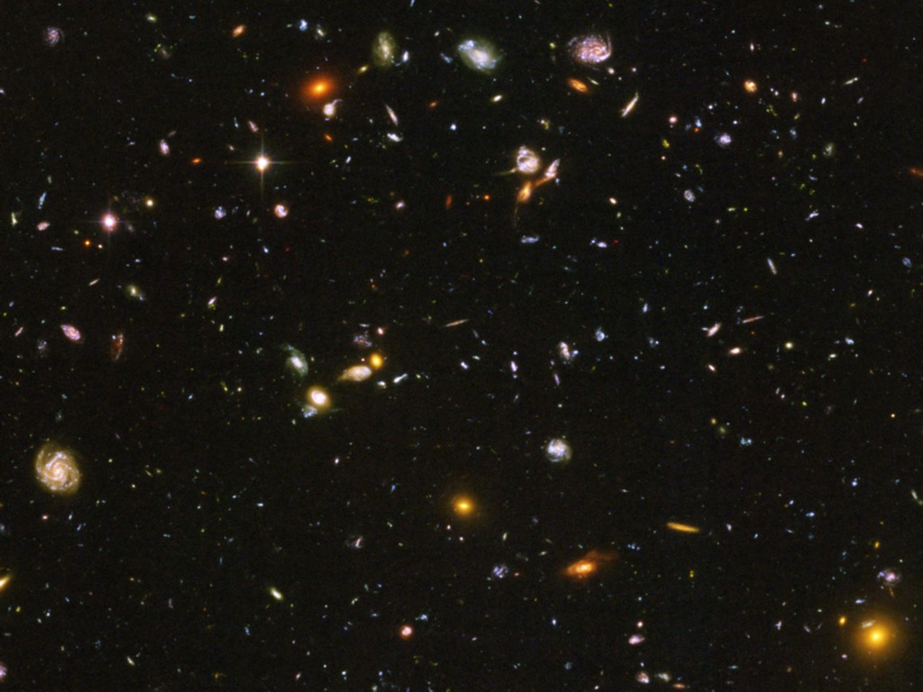

Pie Chart of Dark Matter of the Universe
Dark Energy 70%
(Cosmological Constant)
Neutrinos
0.1−0.4%
Ordinary Matter 5%
(of this only about
10% luminous)
Dark Matter
25%

Slide 19
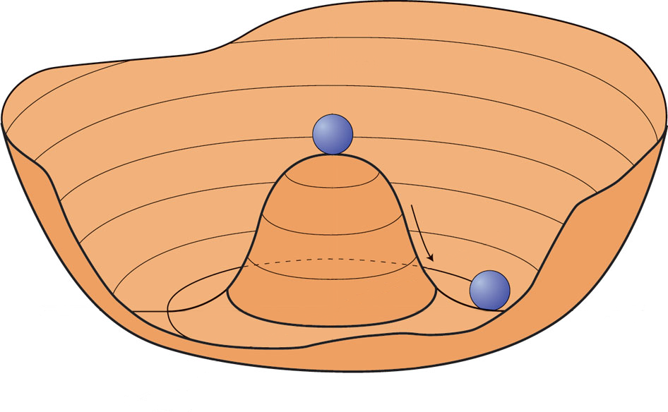
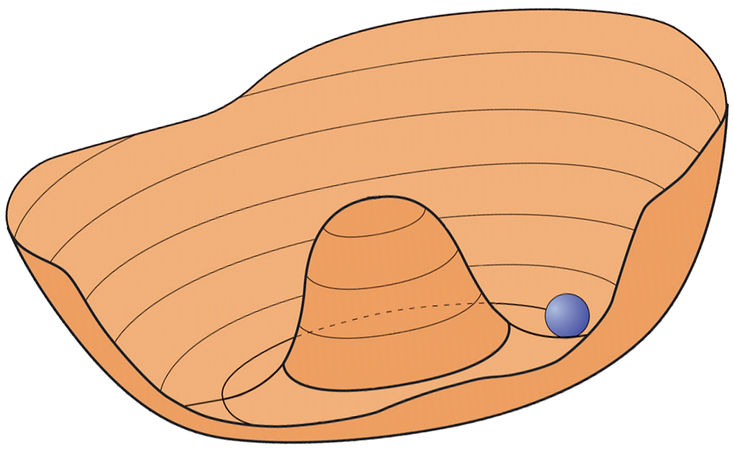

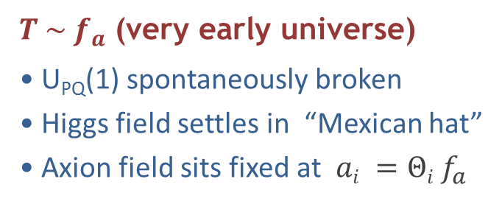




Creation of Cosmological Axions by Re-alignment
$T \sim f_{a}$ (very early universe)
U_{PQ}(1) spontaneously broken
Higgs field settles in “Mexican hat”
Axion field sits fixed at $ai =Θi f_{a}$
$$V(a)$$
$$a$$
$T \sim 1 \text{GeV}$ ($H \sim {10}^{−9}$ eV)
Axion mass turns on quickly
by thermal instanton gas
Field starts oscillating when
$ma ≳ 3H$
Classical field oscillations (axions at rest)
$$V(a)$$
$$a$$
$$\overline{Θ}=0$$
Axions are born as nonrelativistic, classical field oscillations
Very small mass, yet cold dark matter

Slide 20
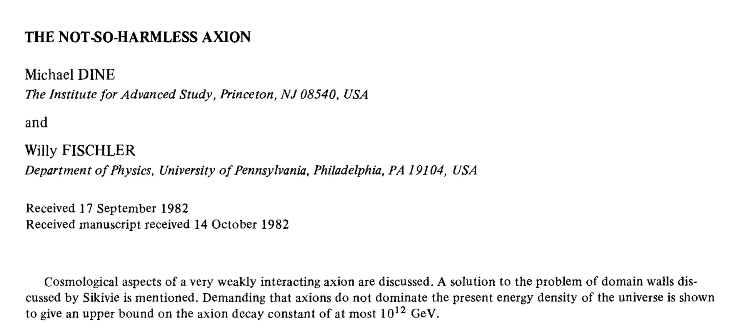
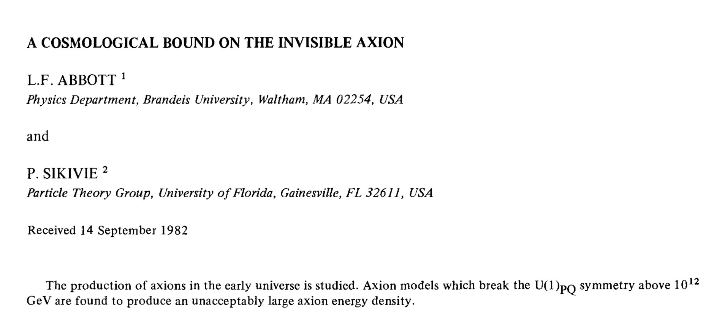
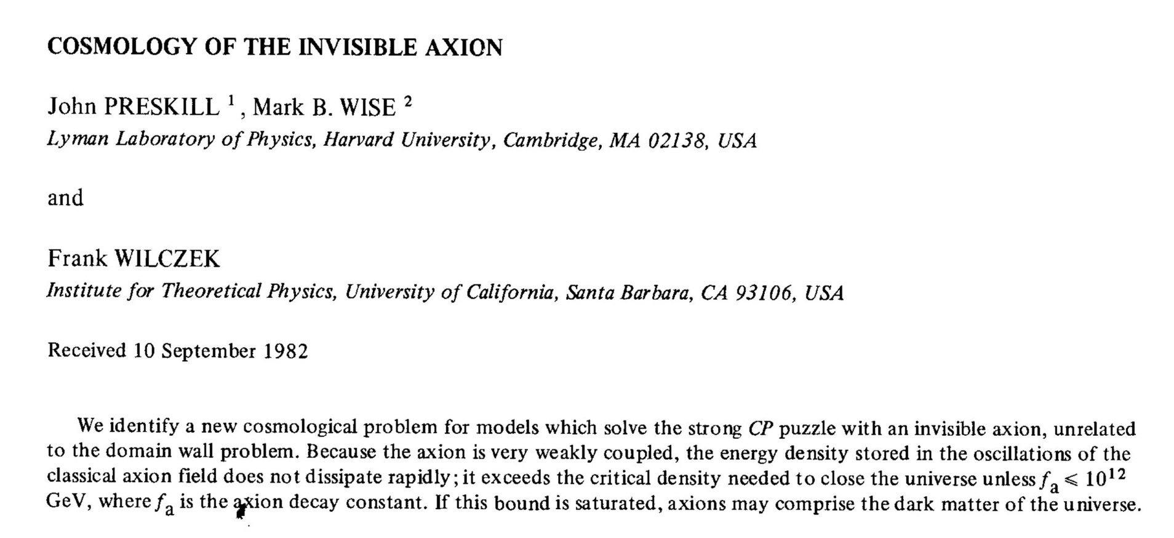
Axion Cosmology in PLB 120 (1983)

Slide 21
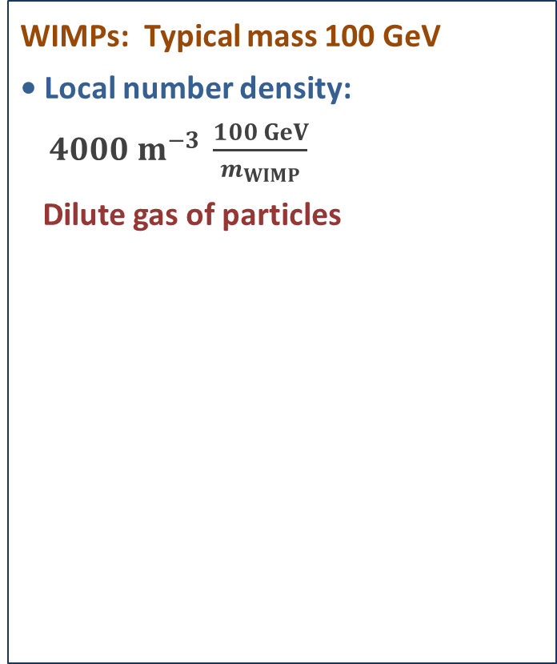
Galactic WIMP vs Axion Dark Matter
Local dark matter density around 0.4 GeV/cm³
WIMPs: Typical mass 100 GeV
• Local number density:
$4000 m^{−3} \frac{100 GeV}{m_{WIMP}}$
Dilute gas of particles
Axions: Typical mass 10 μeV
• Local number density:
$4×10^{19} m^{−3} \frac{10 μeV}{m_{a}}$
• Typical galactic virial velocity:
$v_{gal}∼10^{−3} c$
• Typical de Broglie wavelength
(“localisation”)
$λ∼\frac{2π}{m_{a}v_{gal}}∼100 m \frac{10 μeV}{m_{a}}$
• Typical occupation number
$f∼10^{25} {\left(\frac{10 μeV}{m_{a}}\right)}^{4}$
Highly degenerate Bose gas!

Slide 22
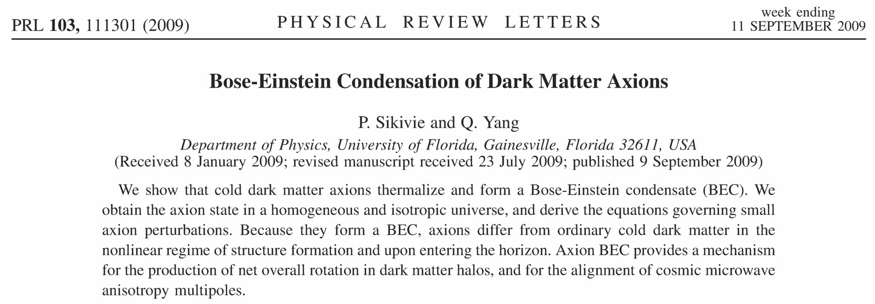
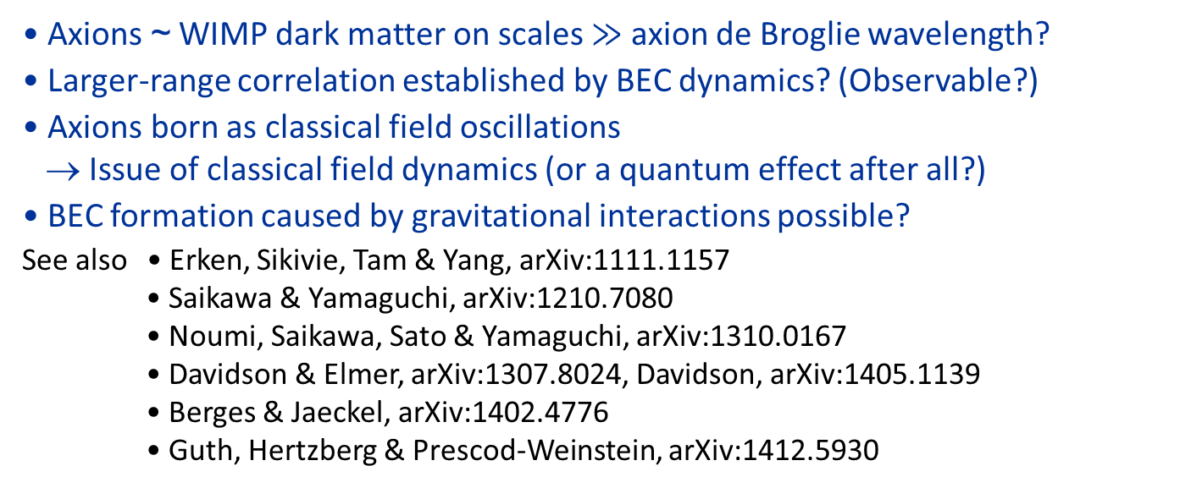
BEC Formation
~150 citations
• Axions ~ WIMP dark matter on scales $≫$ axion de Broglie wavelength?
• Larger-range correlation established by BEC dynamics? (Observable?)
• Axions born as classical field oscillations
→ Issue of classical field dynamics (or a quantum effect after all?)
• BEC formation caused by gravitational interactions possible?
See also • Erken, Sikivie, Tam & Yang, arXiv:1111.1157
• Saikawa & Yamaguchi, arXiv:1210.7080
• Noumi, Saikawa, Sato & Yamaguchi, arXiv:1310.0167
• Davidson & Elmer, arXiv:1307.8024, Davidson, arXiv:1405.1139
• Berges & Jaeckel, arXiv:1402.4776
• Guth, Hertzberg & Prescod-Weinstein, arXiv:1412.5930

Slide 23






Axion Dark Matter Driving Oscillators
$$Λ_{QCD}^{4}$$
Axion dark matter:
Relic oscillations of QCD Θ term
• Drives oscillating neutron EDM
• Drives oscillating E-field in
microwave cavity w/ B-field
$$Θ=a/f_{a}$$
$$−π$$
$$+π$$
n
Axion-induced
electric field
oscillating with
$$ω=m_{a}$$
External
static
B-field
Neutron electric dipole moment
oscillating with $ω=m_{a}$

Slide 24

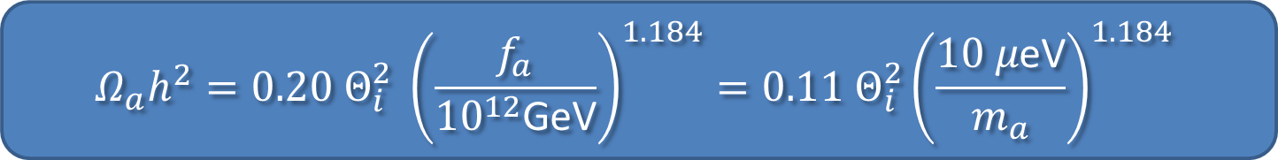



Cold Axion Populations
Cosmic axion
string
Scenario 1
• Cosmic inflation first
• PQ symmetry breaking at $T∼f_{a}$
• Every causal patch has different random $Θ_{i}$
• Topological defects at interfaces
• Axion dark matter from
- average re-alignment
- cosmic-string (CS) & domain-wall (DW) decay
Random
$Θ_{i}$ values
1.12
0.01
0.37
1.93
0.63
2.01
0.17
3.14
1.57
Scenario 2
• Cosmic inflation after PQ symmetry breaking
• All axions from re-alignment of one random
$Θ_{i}$ in our patch of the universe
• Allows large $f_{a}$ if $Θ_{i}≪1$ (“anthropic” case)
$$Θ_{i}=1.57$$
$$Ω_{a}h^{2}=0.20 Θ_{i}^{2} {\left(\frac{f_{a}}{{10}^{12}\text{GeV}}\right)}^{1.184}=0.11 Θ_{i}^{2}{\left(\frac{10 μ\text{eV}}{m_{a}}\right)}^{1.184}$$

Slide 25
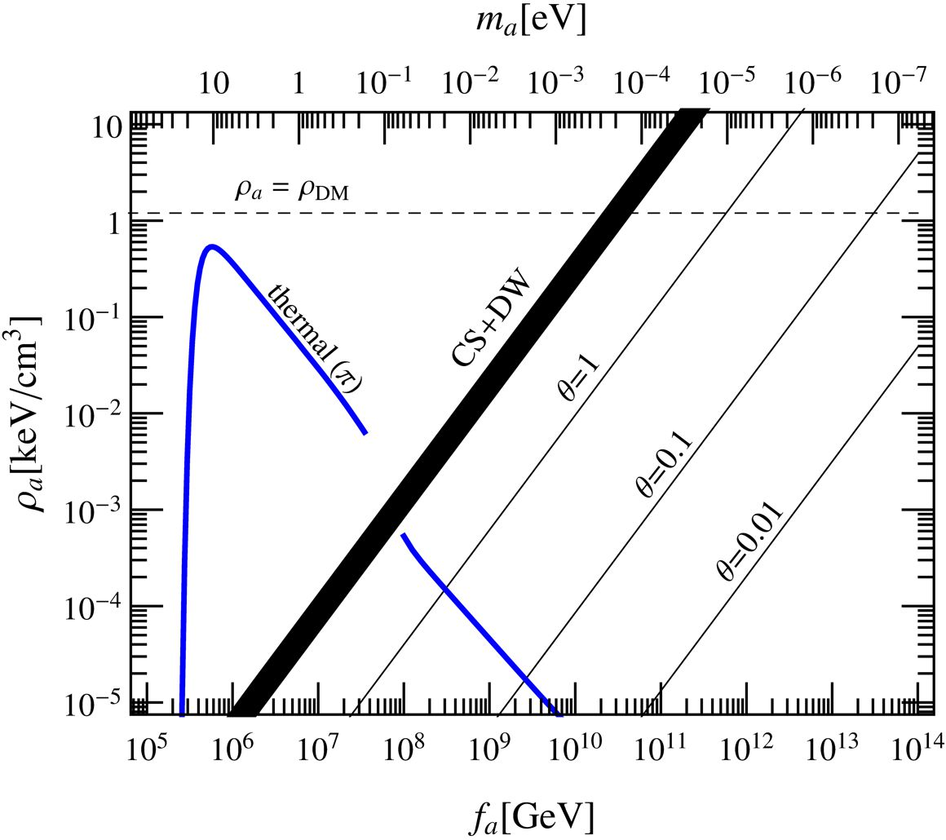
Axion Dark Matter Density
Partly excluded by
cosmic HDM bounds
& Euclid sensitivity
[arXiv:1502.03325]
Hot DM
Cold DM
Javier Redondo 2014
Realignment
Cosmic Strings & Domain Walls

Slide 26
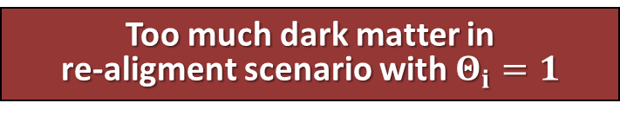
Axion Dark Matter Parameters
m_{Planck}
f_{a}
10¹⁸
10¹⁵
10¹²
10⁹
10⁶
GeV
peV
neV
μeV
meV
eV
m_{a}
kHz
MHz
GHz
THz
ν_{a}
Too much dark matter in
re-aligment scenario with $Θ_{i}=1$
Axion
DM
Astrophysical Bounds
(Energy loss of stars)
Θ_{i} could be anything 0–2π
(“anthropic range”)
Worry about isocurvature fluctuations

Slide 27
Creation of Adiabatic vs. Isocurvature Perturbations
Inflaton field
Axion field
De Sitter expansion imprints
scale invariant fluctuations
De Sitter expansion imprints
scale invariant fluctuations
Slow roll
Reheating
Inflaton decay → matter & radiation
Both fluctuate the same:
Adiabatic fluctuations
Inflaton decay → radiation
Axion field oscillates late → matter
Matter fluctuates relative to radiation:
Entropy fluctuations

Slide 28
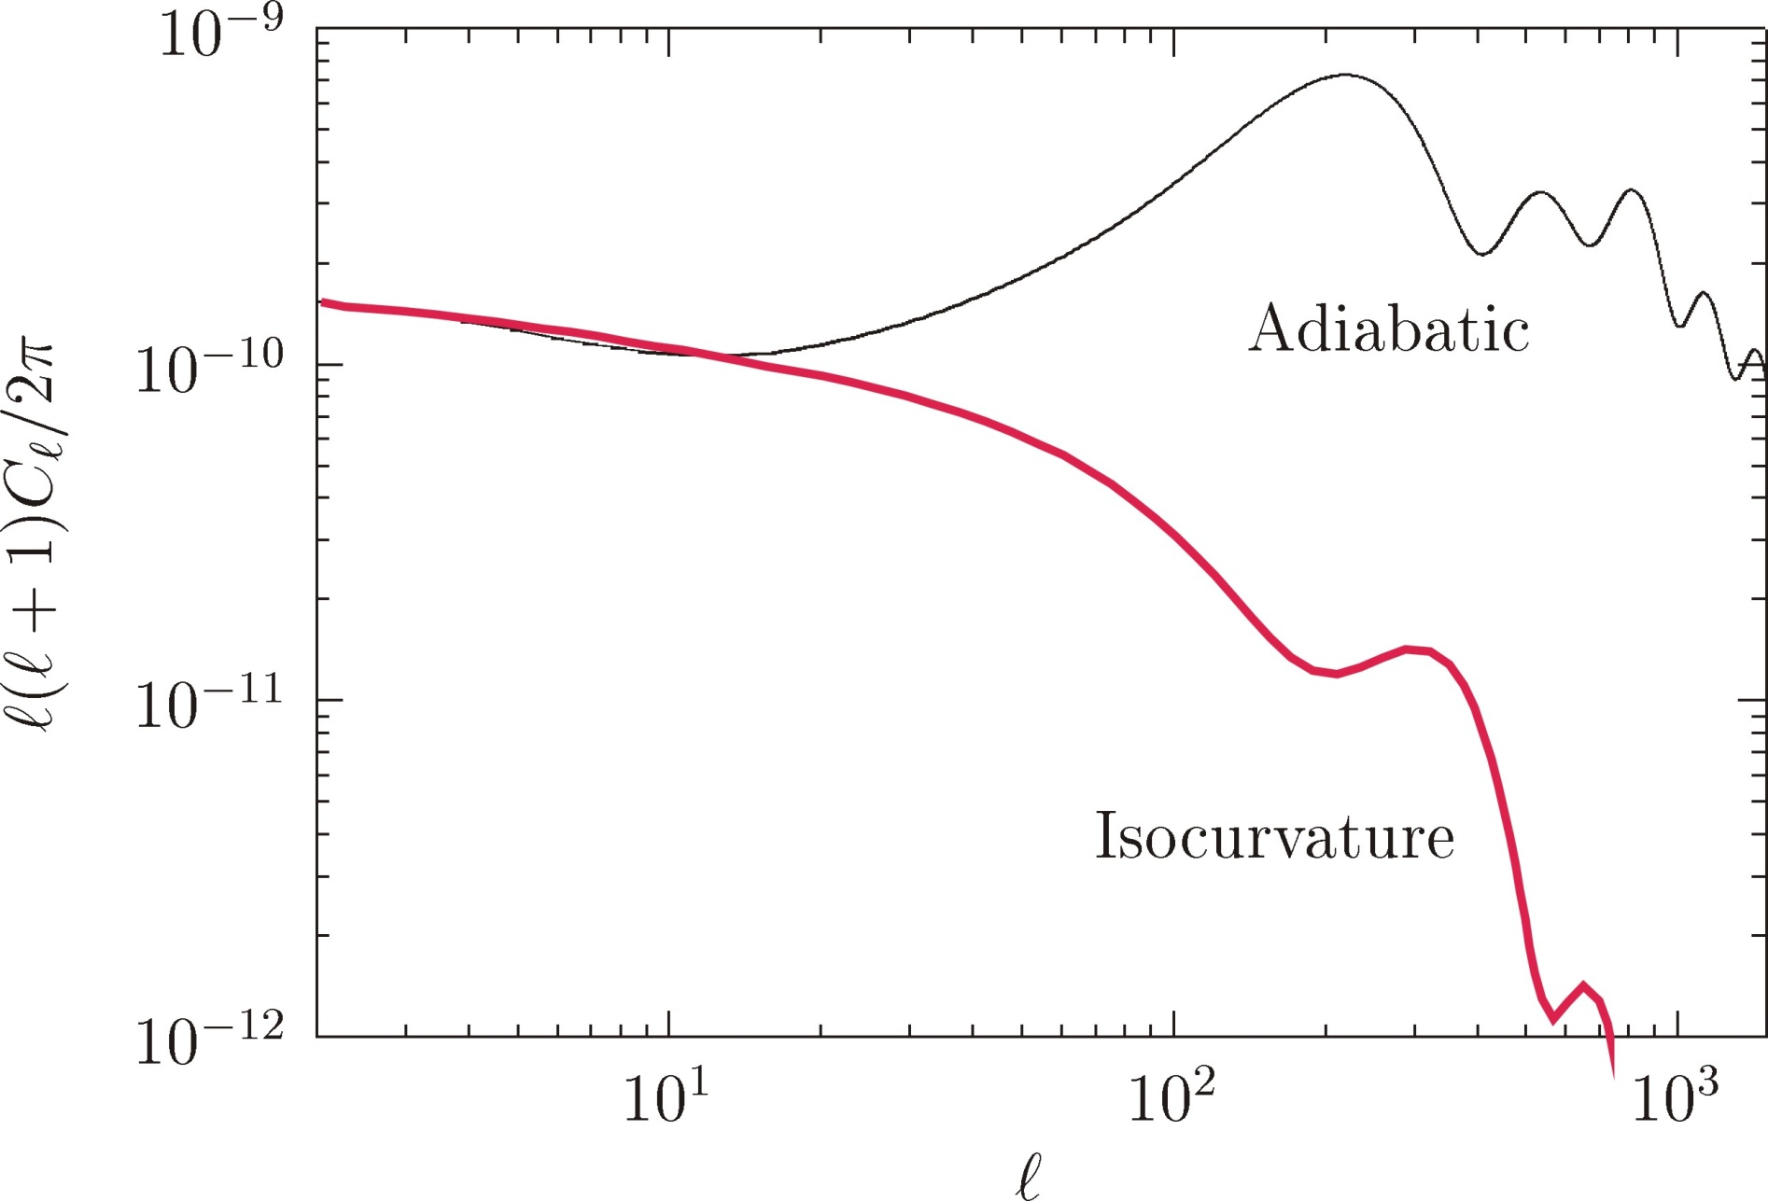
Adiabatic vs. Isocurvature Temperature Fluctuations
Adapted from Fox, Pierce & Thomas, hep-th/0409059

Slide 29
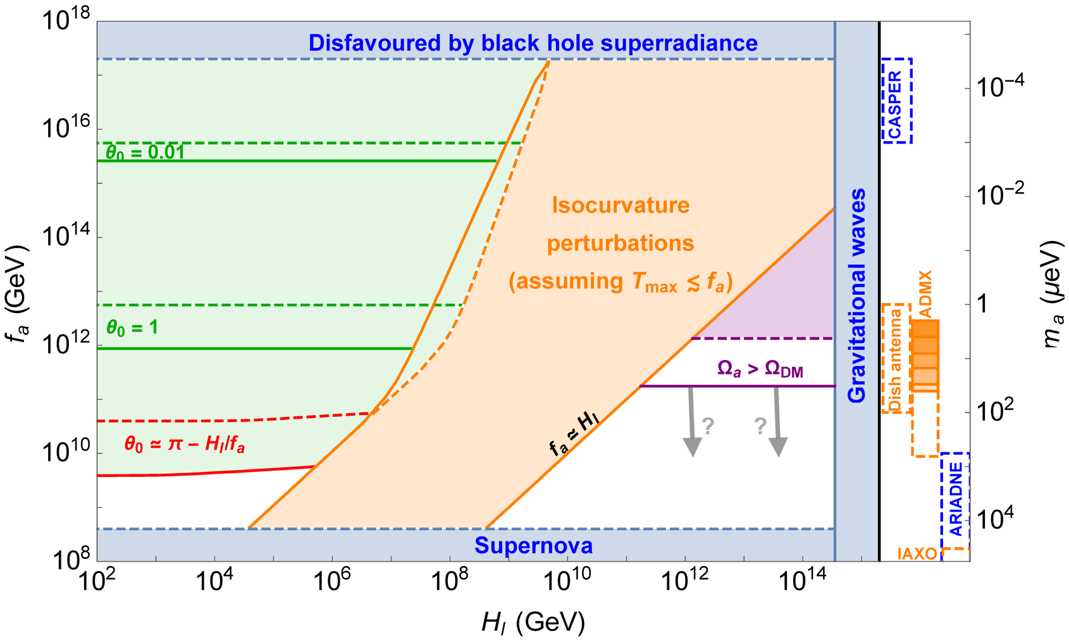
Isocurvature Constraints
Hubble expansion rate during inflation H_{I} (GeV)
Grilli di Cortona et al., “The QCD axion, precisely”, arXiv:1511.02867

Slide 30
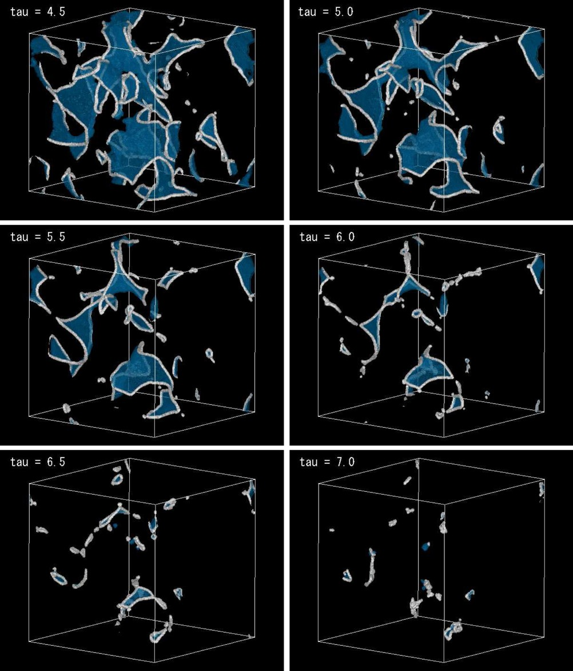

Axion Production by Domain Wall and String Decay
Recent numerical studies of collapse
of string-domain wall system
$$Ω_{a}h^{2}=\left(8.4±3.0\right){\left(\frac{f_{a}}{{10}^{12}GeV}\right)}^{1.19}$$
$$×{\left(\frac{g_{∗,1}}{70}\right)}^{−0.41}\left(\frac{Λ}{400 MeV}\right)$$
Implies a CDM axion mass of
$$m_{a}∼300 μeV$$
Hiramatsu, Kawasaki, Saikawa &
Sekiguchi, arXiv:1202.5851 (2012)
More recently by the same group
$$m_{a}∼90−140 μeV$$
Kawasaki, Saikawa & Sekiguchi,
arXiv:1412.0789 (PRD 2015)

Slide 31
Axion Dark Matter Parameters
m_{Planck}
f_{a}
10¹⁸
10¹⁵
10¹²
10⁹
10⁶
GeV
peV
neV
μeV
meV
eV
m_{a}
kHz
MHz
GHz
THz
ν_{a}
Too much dark matter in
re-aligment scenario with $Θ_{i}=1$
Axion
DM
Astrophysical Bounds
(Energy loss of stars)
Too much dark matter in
cosmic string and domain wall scenario
Axion
DM

Slide 32


Axion Dark Matter from Topological Defects
Editor’s suggestion
Diversity of scenarios for
cosmic axion production
depending on
domain-wall index N_{DW}
and phase parameter δ
of the bias term

Slide 33
Axion Dark Matter Parameters
m_{Planck}
f_{a}
10¹⁸
10¹⁵
10¹²
10⁹
10⁶
GeV
peV
neV
μeV
meV
eV
m_{a}
kHz
MHz
GHz
THz
ν_{a}
Axion Dark Matter possible
for different early-universe scenarios of production
Astrophysical Bounds
(Energy loss of stars)
Opportunities for detection

Slide 34




Experimental Tests of Invisible Axions
Primakoff effect:
Axion-photon transition in external
static E or B field
(Originally discussed for $π^{0}$
by Henri Primakoff 1951)
Pierre Sikivie:
Macroscopic B-field can provide a
large coherent transition rate over
a big volume (low-mass axions)
Axion helioscope:
Look at the Sun through a dipole magnet
Axion haloscope:
Look for dark-matter axions with
a microwave resonant cavity
Two-photon vertex generic for
$π^{0}$, $η$, axion-like particles (ALPs), gravitons

Slide 35


Search for Galactic Axions (Cold Dark Matter)
Dark matter axions
Velocities in galaxy
Energies therefore
m_{a} = 1−100 μeV
v_{a} ≈ 10⁻³ c
E_{a} ≈ (1 ± 10⁻⁶) m_{a}
Microwave Energies
(1 GHz ≈ 4 μeV)
Axion Haloscope (Sikivie 1983)
Axion Signal
Power
B_{ext} ≈ 8 Tesla
Thermal noise of
cavity & detector
Microwave
Resonator
Q ≈ 10⁵
Frequency
m_{a}
Power of galactic axion signal
Primakoff Conversion
a
γ
$$4×{10}^{−21}\text{W} \frac{V}{0.22 {\text{m}}^{3}} {\left(\frac{B}{8.5 \text{T}}\right)}^{2}\frac{Q}{{10}^{5}}×\left(\frac{m_{a}}{2π \text{GHz}}\right) \left(\frac{ρ_{a}}{5×{10}^{−25} {\text{g}\text{/}\text{cm}}^{3}}\right)$$
Cavity
overcomes
momentum
mismatch
B_{ext}

Slide 36

Axion Dark Matter Experiment (ADMX) – Seattle
Adapted from Gray Rybka

Slide 37

SQUID Microwave Amplifiers in ADMX
Adapted from Gianpaolo Carosi

Slide 38

ADMX Gen 2

Slide 39
Axion Dark Matter Parameters
m_{Planck}
f_{a}
10¹⁸
10¹⁵
10¹²
10⁹
10⁶
GeV
peV
neV
μeV
meV
eV
m_{a}
kHz
MHz
GHz
THz
ν_{a}
Too much dark matter in
re-aligment scenario with $Θ_{i}=1$
Axion
DM
Astrophysical Bounds
(Energy loss of stars)
Too much dark matter in
cosmic string and domain wall scenario
Axion
DM
ADMX
Taking data

Slide 40


Axion Dark Matter Search with Transition Radiation
Dark matter axion field producing photons at dielectric interface (in B-field!)
(Jaeckel & Redondo, PRD 88 (2013) 115002, arXiv:1308.1103)
“Seed project” at MPI Physics:
Test practical boost factor with a setup
that contains up to five exchangeable
discs (diameter ~200 mm) with
high-ε material that can be positioned
using motor drives with a precision of
a few μm

Slide 41



Center for Axion and Precision Physics (CAPP)
Yannis
Semertzidis
15 Oct 2013
The plan is to launch a competitive Axion Dark Matter Experiment in Korea, participate in state-of-the-art axion experiments around the world, play a leading role in the proposed proton electric-dipole-moment (EDM) experiment and take a significant role in storage-ring precision physics involving EDM and muon g–2 experiments.
http://capp.ibs.re.kr

Slide 42


Searching for Axions in the Anthropic Range
CASPEr experiment
Precise magnetometry to measure
tiny deviations from Larmor frequency
Graham & Rajendran, arXiv:1101.2691
Budker, Graham, Ledbetter, Rajendran & Sushkov, arXiv:1306.6089

Slide 43



NMR Experiment
ARIADNE: Axion Resonant InterAction DetectioN Experiment
A.Geraci, A.Arvanitaki, A.Kapitulnik, Chen-Yu Liu, J.Long, Y.Semertzidis, M.Snow
(to be supported by NSF and/or DoE?)

Slide 44



Axion Searches
m_{Planck}
f_{a}
10¹⁸
10¹⁵
10¹²
10⁹
10⁶
GeV
peV
neV
μeV
meV
eV
m_{a}
kHz
MHz
GHz
THz
ν_{a}
Taking
data
CASPEr
Astrophysical Bounds
(Energy loss of stars)
ARIADNE

Slide 45
Looking for axion-like particles (ALPs)

Slide 46

Search for Solar Axions
Axion Helioscope
(Sikivie 1983)
Primakoff
production
Axion flux
N
γ
a
a
γ
Magnet S
Axion-Photon-Oscillation
Sun
Tokyo Axion Helioscope (“Sumico”)
(Results since 1998, up again 2008)
CERN Axion Solar Telescope (CAST)
(Data since 2003)
Alternative technique:
Bragg conversion in crystal
Experimental limits on solar axion flux
from dark-matter experiments
(SOLAX, COSME, DAMA, CDMS ...)

Slide 47

Pointing a Magnet to the Sun
By CAST student Sebastian Baum

Slide 48

CERN Axion Solar Telescope (CAST)

Slide 49

CAST Results

Slide 50



Parameter Space for Axion-Like Particles (ALPs)
Two parameters:
- ALP mass $m_{a}$
- ALP-$γ$ coupling $g_{aγ}$
Weinberg Wilczek
“standard axion”
Model dependence
(KSVZ, DFSZ, …) broadens
the “axion line”
$$Γ_{a→γγ}=\frac{g_{aγ}^{2}m_{a}^{3}}{64π}$$

Slide 51




Parameter Space for Axion-Like Particles (ALPs)
CAST exclusion range
End of solar
spectrum
Large $m_{a}$, $a$-$γ$-oscillations
suppressed
$a$-$γ$-oscillations enhanced
with He filling ($m_{γ}∼m_{a}$)
Maximal mixing
(“coherent”, small $m_{a}$)

Slide 52

Parameter Space for Axion-Like Particles (ALPs)
ALPS-II at DESY

Slide 53

Any Light Particle Search II (ALPS-II) at DESY
ALPS-I (finished)
ALPS-IIa (2014)
ALPS-IIb (2015)
ALPS-IIc (2017)
ALPS-II Technical Design Report, arXiv:1302.5647

Slide 54


Shining TeV Gamma Rays through the Universe
Figure from a talk by Manuel Meyer (Univ. Hamburg)

Slide 55



Next Generation Axion Helioscope (IAXO) at CERN
Need new magnet w/
– Much bigger aperture:
$\sim 1 \text{m}2$ per bore
– Lighter (no iron yoke)
– Bores at T_{room}
• Irastorza et al.: Towards a new generation axion helioscope, arXiv:1103.5334
• Armengaud et al.:
Conceptual Design of the International Axion Observatory (IAXO), arXiv:1401.3233

Slide 56

Parameter Space for Axion-Like Particles (ALPs)
- Improvement by
a factor of 30
- Leaping into
uncharted territory
Pushing generic
ALP frontier
QCD Axion
meV frontier

Slide 57
Axion Searches
m_{Planck}
f_{a}
10¹⁸
10¹⁵
10¹²
10⁹
10⁶
GeV
peV
neV
μeV
meV
eV
m_{a}
kHz
MHz
GHz
THz
ν_{a}
Taking
data
IAXO
CASPEr
Astrophysical Bounds
(Energy loss of stars)
ARIADNE

Slide 58










Axion and Axion-Like Particle Searches
ARIADNE
WISP
DMX
(DESY)
Center for Axion & Precision Physics (Daejon, Korea)
MAGIC
ADMX-HF
(Yale)
Axion Dark Matter
Experiment
(UW, Seattle)
H.E.S.S.
IAXO Proposal
(CERN)
CASPEr, perhaps @ HIM (Mainz)
Fermi LAT
CAST @ CERN

Slide 59

Dow Jones Index of Axion Physics
inSPIRE: Citation of Peccei-Quinn papers or title axion (and similar)
It’s a bull market,
buy shares!

