Slide 1
Lusatia
a site for ET?
Untermarkt Görlitz with Neptune Fountain
Christian Stegmann,
ET-PP INFRA-DEV Annual Meeting
Barcelona, June 17, 2024
View through Upper Lusatia to the Landeskrone in Görlitz Photo: Mario Förster
The town of Bautzen in Lusatia

Slide 2
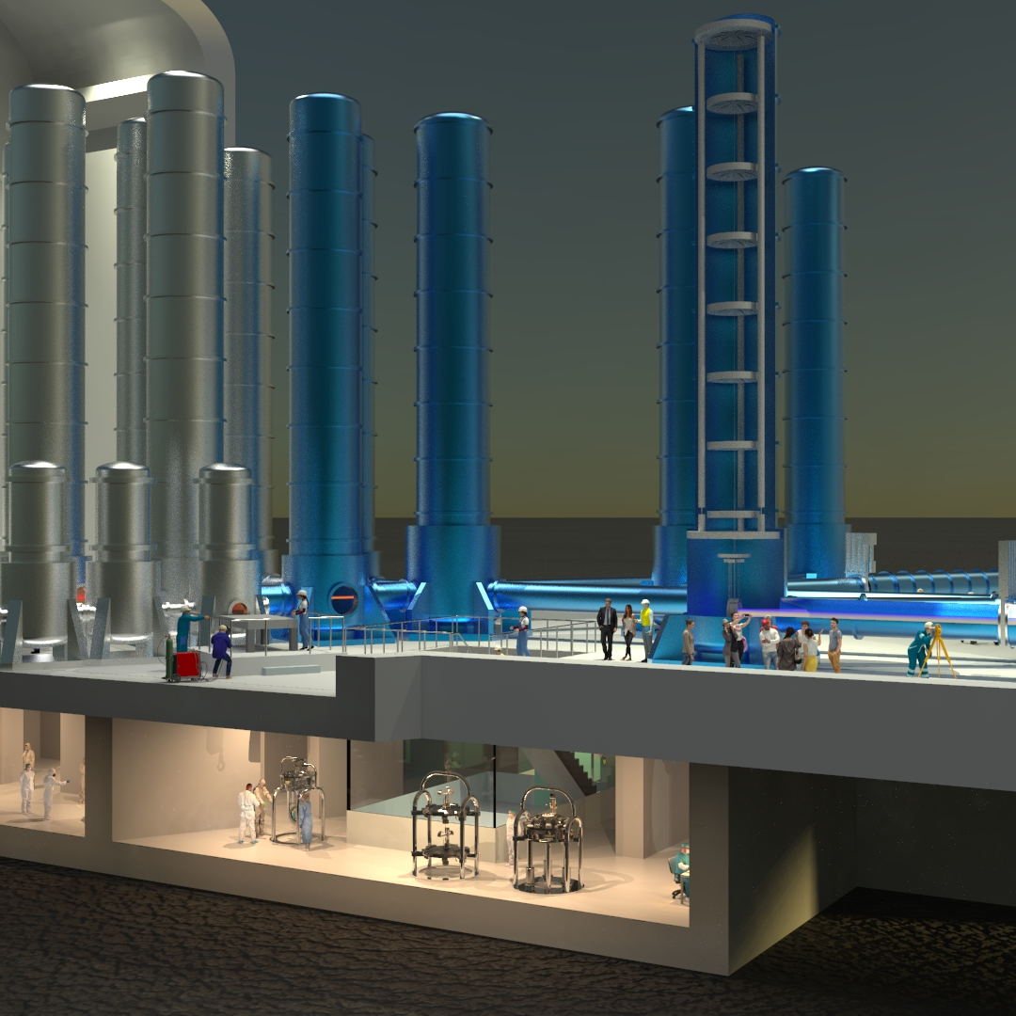
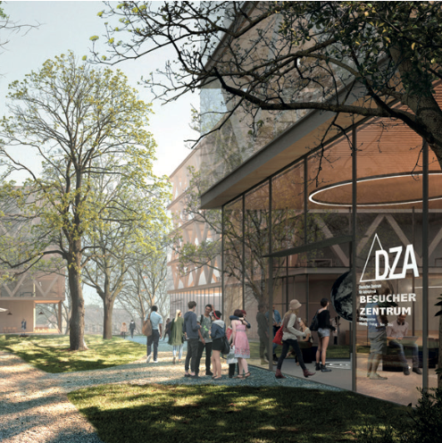
The German Center for Astrophysics (DZA)
A new large scale research center to be founded
The Low Seismic in the Lusetai Granite
The DZA Campus on the Kahlbaum site in Görlitz
NIKHEF

Slide 3
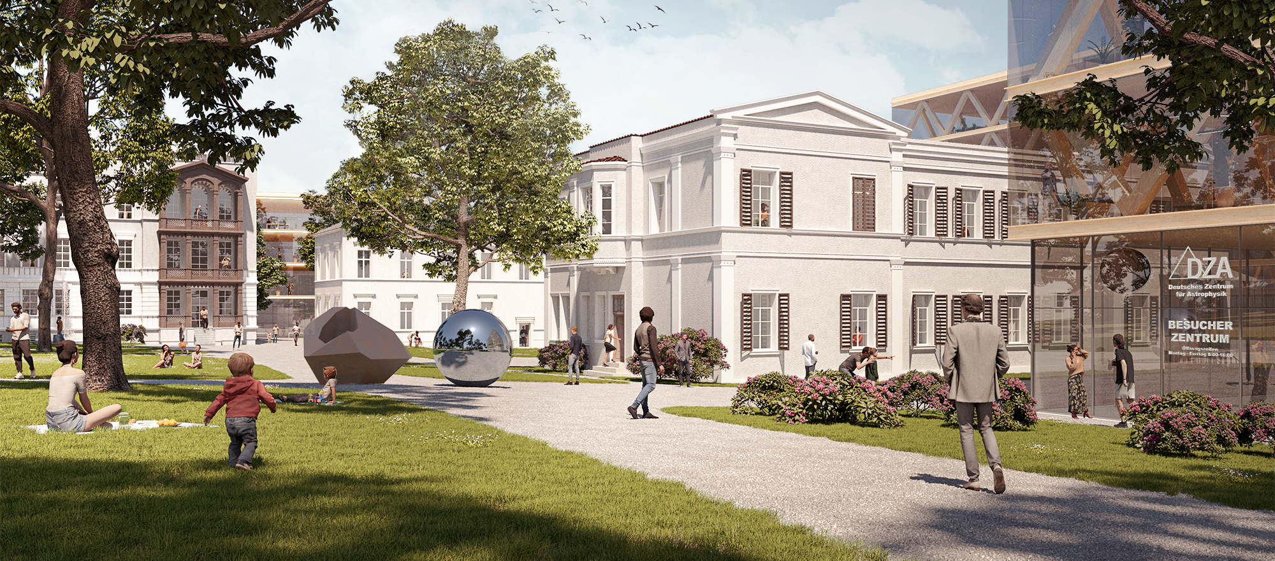
The DZA
A landmark on the German-Polish border
Visualisation of the DZA campus in Görlitz

Slide 4
The DZA
A new large scale research center with one research focus on gravitational wave astronomy

Slide 5
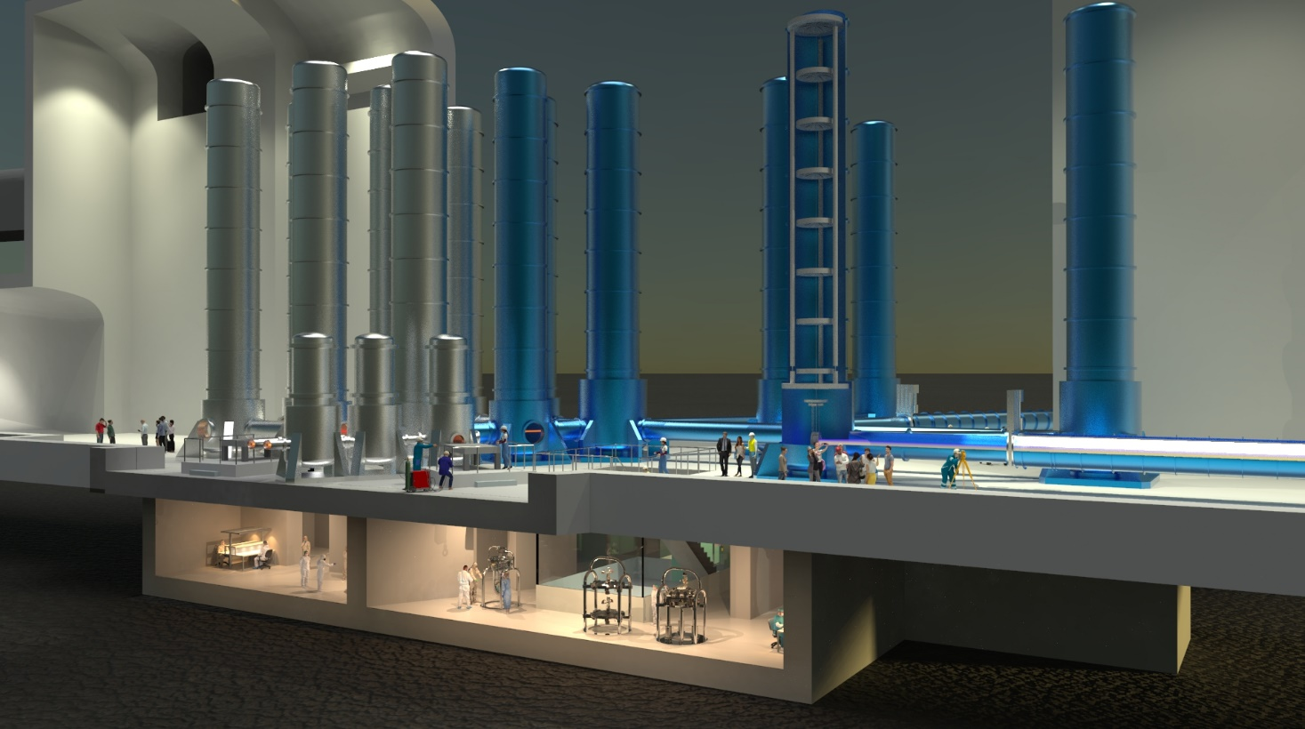
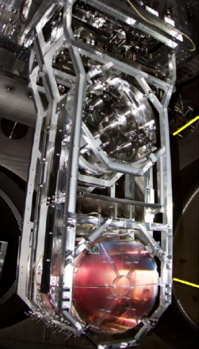
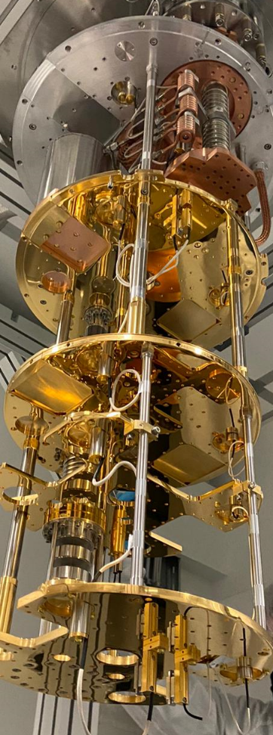
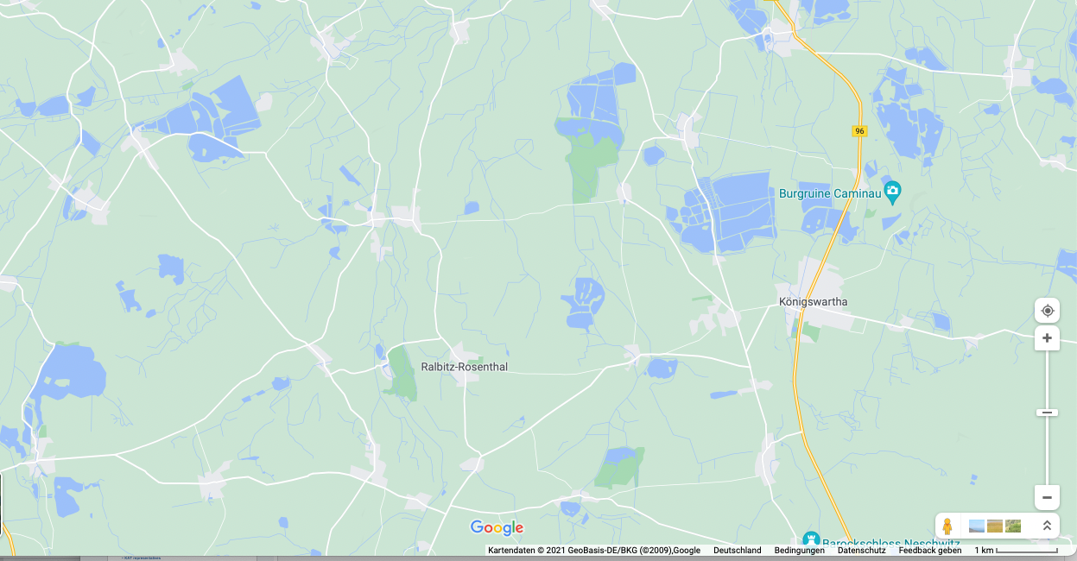
The Low Seismic Lab
Innovation platform of approx. (40 x 30 x 30) m³ in 200m depth in the Lusatian granite
with a square kilometre 3D seismometer array.
Metrological validation of advanced seismic isolation concepts on a large scale
The place for future "deep tech":
Technology development for gravitational wave astronomy
Adaptive seismic noise reduction
Subnanometer microscopy and photolithography
Quantum computing experiments
Astrophysics with accelerators
Visualisation a corner of ET, NIKHEF
Low-Seismic Lab in
einem seismischen Käfig

Slide 6
Earthquake probability
European SHARE map,
past 475 years
Giardini et al, 2013
Lausitz
ET site candidate
ET site candidate

Slide 7
A site for ET?
Several ciriteria are relevant for the site decision and can be roughly divided into four categories
Category | Lusetia
1. Can the scientific programme be carried out by ET at this location? | (promising)
2. Can ET be built at this site cost-efficiently and with calculable risks? | unknown
3. Can ET be operated at this location for decades? | unknown
4. Is there political support and financial commitment for the site? | We will know in a few weeks
Notes:
The site decision should only be made after a thorough examination of the first three categories, as these are decisive for the duration and costs of ET.

Slide 8
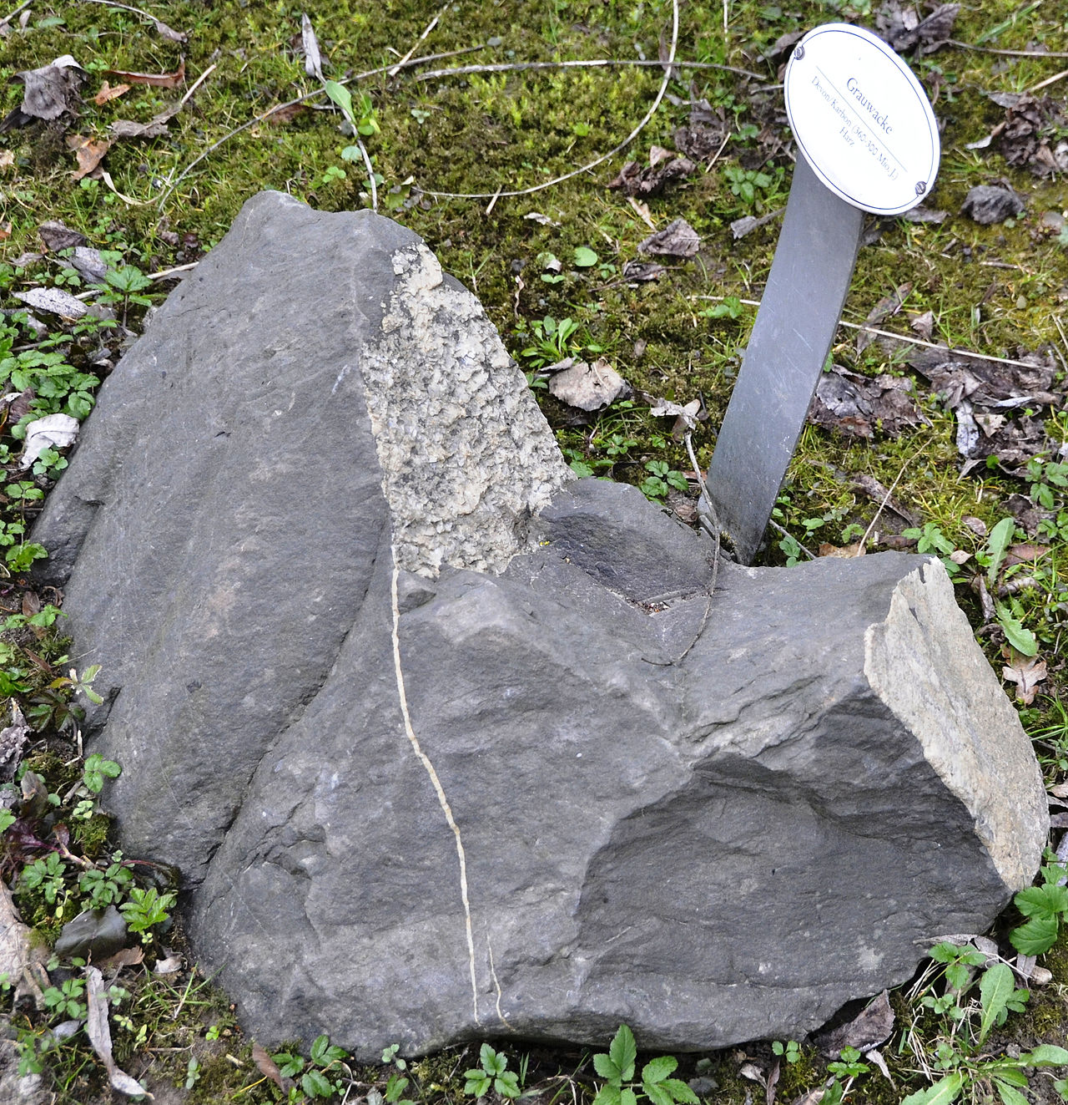
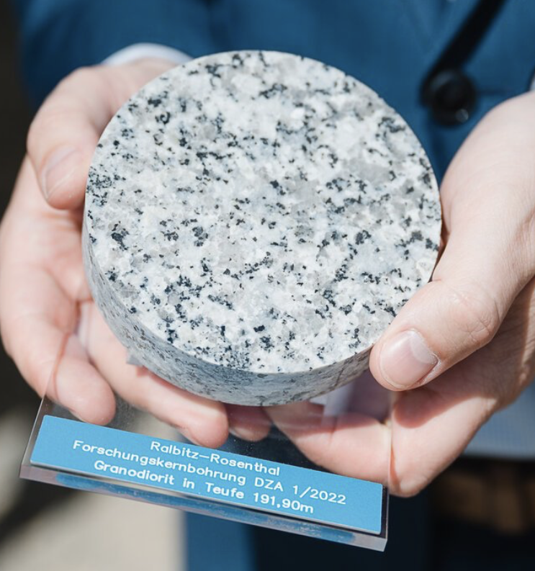
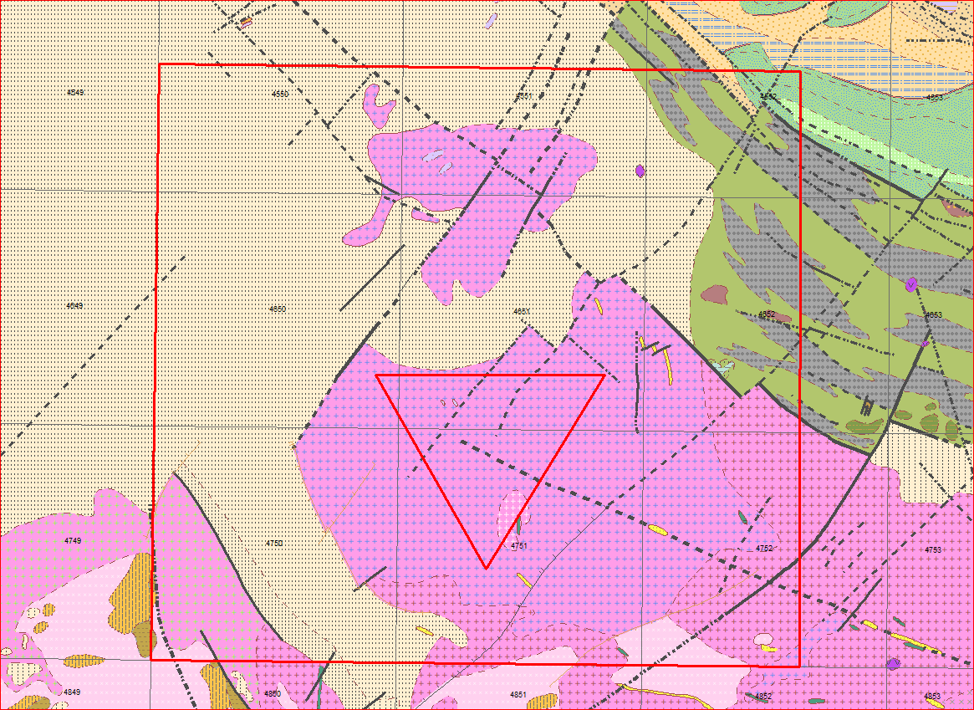
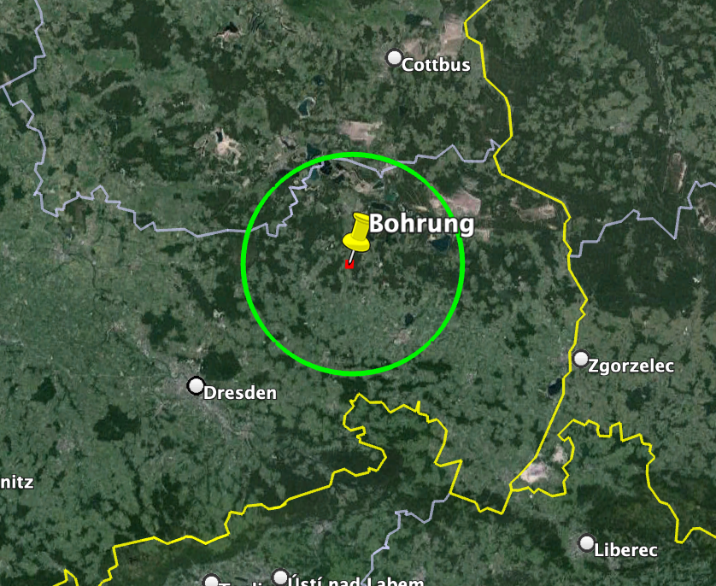
The Lusatia region
A largely monolithic and smooth granodiorite block with an extension of at least 20 kilometres
Greywake
Granodiorite
K2
Blattgrenze
Grauwacken
(Jungproterozoikum,
Kamenz-Gruppe)
C1
Görlitzer
Schiefergebirge
D1
O3-D
?
Biotit-Granodiorit (Typ Kamenz)
(mk-gk)
← Biotit-Monzogranit
(Typ Horka)
Biotit-Granodiorit
Biotit-Granodiorit (fk-mk)
(Typ Königsbrück, mk)
Zweiglimmer-
Blattgrenze
Granodiorit
Courtesy Andreas Rietbrock

Slide 9
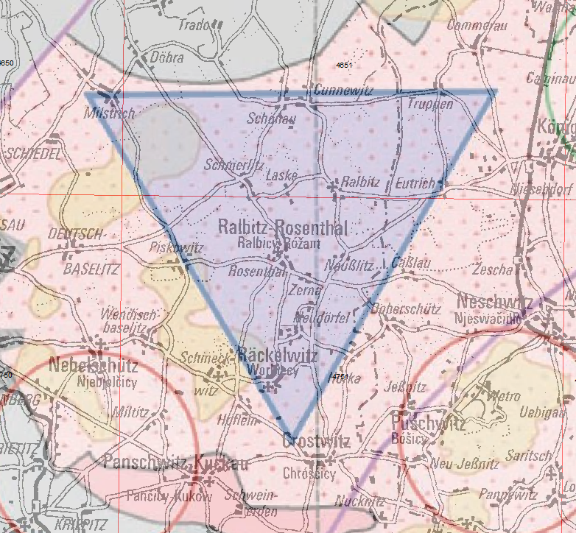
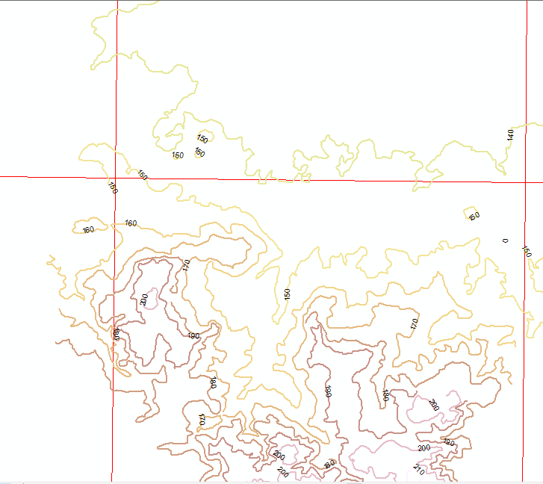
The Lusatia region – Topography
Topography
2 km
2 km
Courtesy Andreas Rietbrock

Slide 10
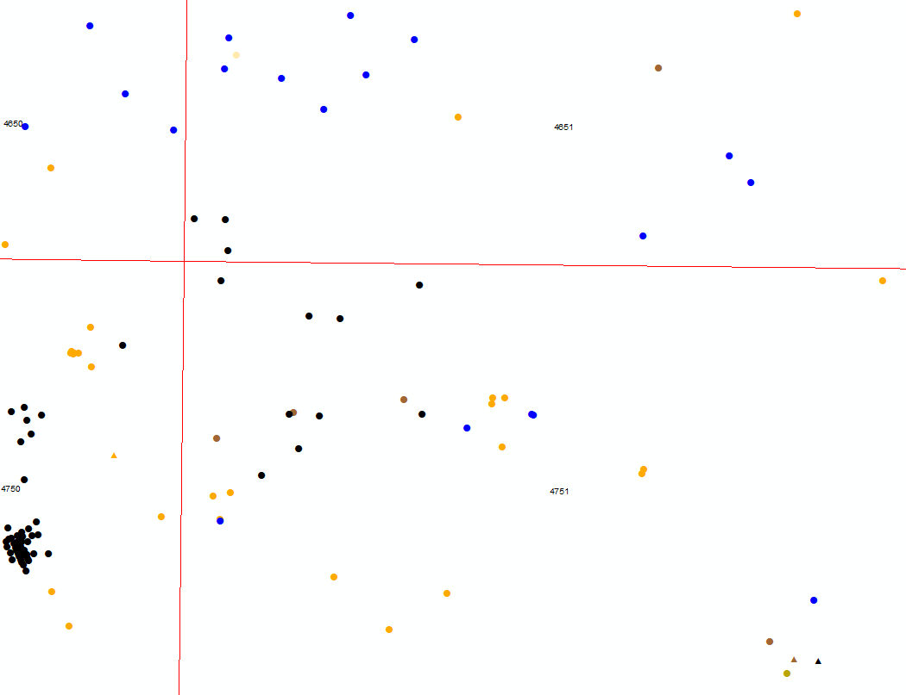
The Lusatia region – Geological characteristics
Gelände-
oberkante
90
80
Quartinary
90,2
86,2
78
90,6
83,2
80
79,2
50
89,6
Tertiär
Tertiary/Caoline
86,1
Kaolin
86,25
+
+
+
88
Weathering layer
+
+
+
109,8
88,3
128,9
90
+
+
+
90
100
100
+
+
+
110
+
+
+
140
Granodiorit
130
120
+
+
+
2 km
130
+
+
+
150
+
+
+
Courtesy Andreas Rietbrock

Slide 11
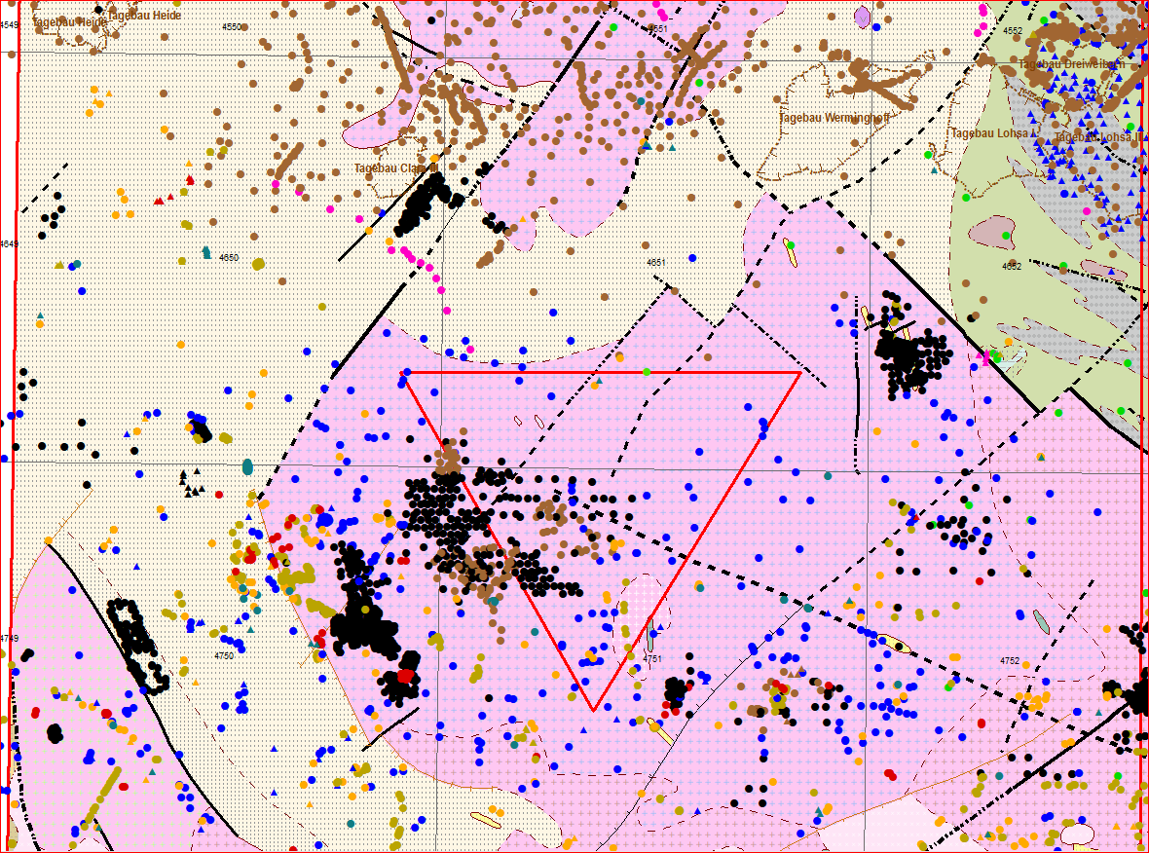
The Lusatia region
Extremely well documented by drilling
16.500 documented drillings
ca. 4000 reaching top of basement (shown here)
all available in digital form
➔ Extremely rich data set
Courtesy Andreas Rietbrock

Slide 12
The drill site in Cunnewitz

Slide 13
The drill site in Cunnewitz
Seismometer in operation for over a year
250 m
180 m
Drill cores
DZA master thesis at Bergakademie Freiberg

Slide 14
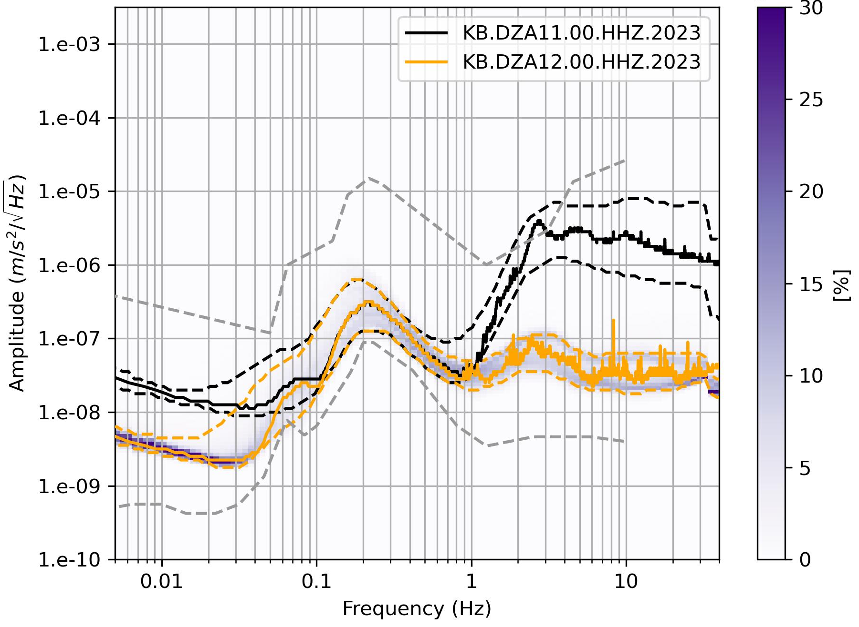
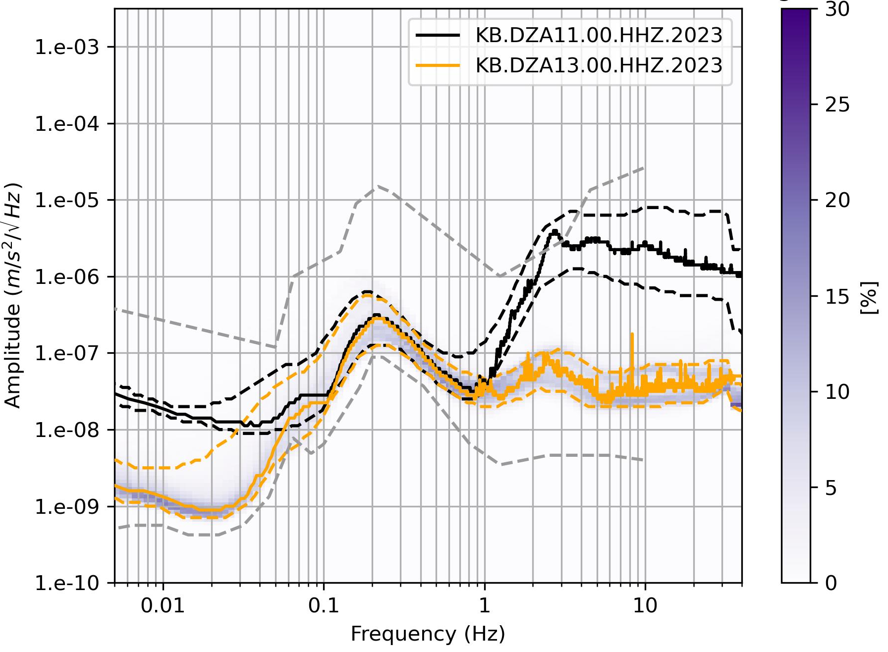
Lausitz – Comparison surface to borehole
Spring 23 to Nov. 23; borehole with lower amplitudes (100), clear day/night cycle
170m
220m
Courtesy Andreas Rietbrock

Slide 15
Lausitz – Comparison surface to borehole
Spring 23 to Nov. 23; borehole with lower amplitudes (100), clear day/night cycle
DZA11 - surface
DZA12 - borehole
Courtesy Andreas Rietbrock

Slide 16
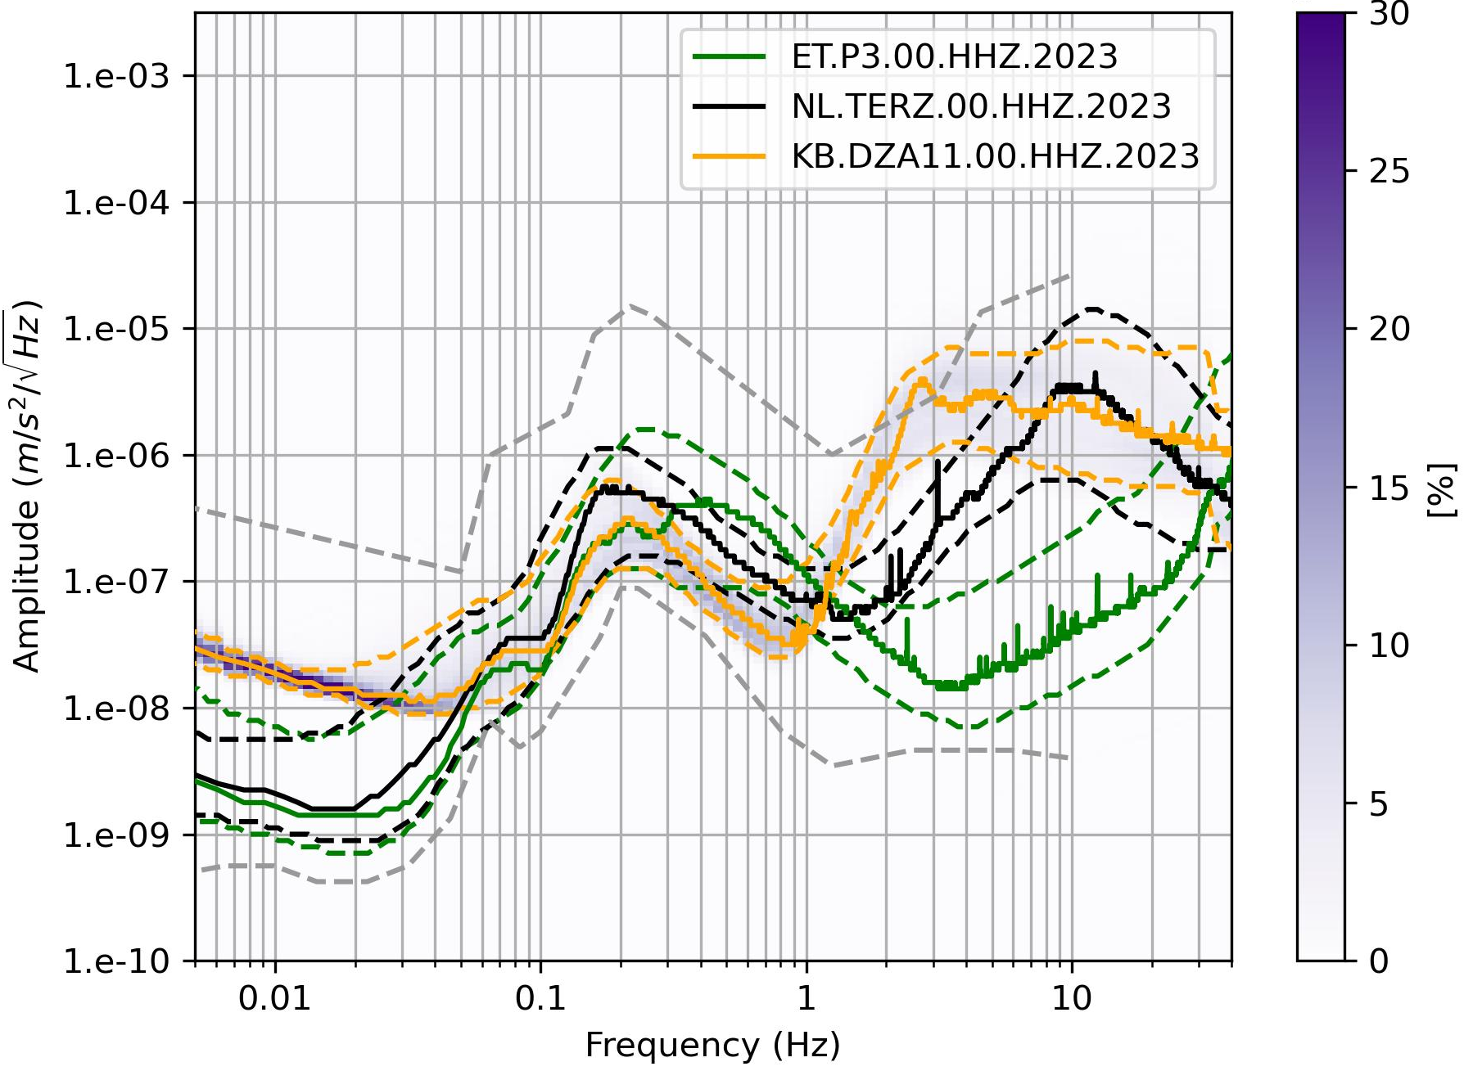
Comparison surface stations 2023
Lower amplitudes at Sardinia P3 for frequencies higher than 2Hz,
but higher noise levels between 0.3 Hz and 1Hz in comparison to EMR and Lausitz
Courtesy Andreas Rietbrock

Slide 17
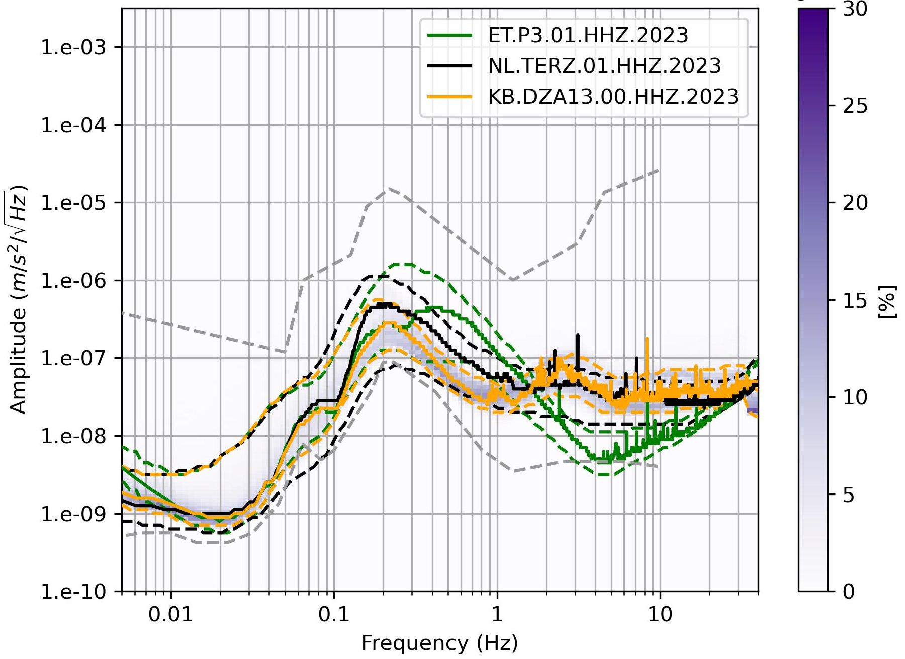
Comparison borehole stations 2023
Sardinia P3 up to a factor of10 below Euregio and Lausitz around 4 Hz
Euregio TERZ and Sardinia P3 higher values than Lausitz DZA13 from 0.15Hz to 2 Hz
Sardinia P3 rise of amplitude for frequencies higher 4 Hz due to instrumental noise
Courtesy Andreas Rietbrock

Slide 18
What is currently happening in Lusetia
Extensive investigations for the DZA's Low Seismic Lab
Passive seismological experiment for the determination of the 3D shear wave model
Deploy 100 seismic stations to measure the temporal variation of seismic noise and operated for at least 1 year.
Conduct high-resolution 2D reflection seismic surveys of geological structures
Acquire 2 km long reflection seismic profiles and intersecting near the drilling location DZA-01 for calibration. Perform detailed studies at future drilling locations.
Analysis of the physical parameters of the drill cores
focusing on the Lusatian granodiorite and tectonic structures.
Update the geological/hydrological map of the granite stock
Develop a geological/tectonic model using data from the archive from the Lusatian Geological Survey.
Measurement of seismic noise at three additional boreholes
to qualify the spatial and temporal noise level in Lusatia.
Integrated Lusatian subsurface model and characterization of seismic noise

Slide 19
Geophysical exploration: passive (lead GFZ)
High resolution 3D S-wave velocity model
Characterising of the ambient noise field
Deployment finishes this week
100 statins will be recording for one year
Courtesy Andreas Rietbrock

Slide 20
Geophysical exploration: passive (lead GFZ)
High resolution 3D S-wave velocity model
Characterising of the ambient noise field
Deployment finishes this week
100 statins will be recording for one year
Courtesy Andreas Rietbrock

Slide 21
Interim conclusion of the geological investigations
A site investigation team was established between GFZ, TUBAF, LfULG, Frauenhofer, KIT, DZA, …
There is a wealth of geological drilling data, collected in East Germany, all available in digital form.
Geophysical/geological site investigations are well under way, first robust models later in the year.
“All exploration work done so far point out that the mapped granodiorite at depth is well suited for an Einstein Telescope” – Andreas Rietbrock
…

Slide 22
Lustatia as a site for ET?
4. Is there political support and financial commitment for the site?
We have prepared a proposal for a study to comprehensively assess
the geological and geophysical conditions in Lusatia (already underway),
the feasibility and costs of underground and surface structures and infrastructure,
the socio-economic impacts,
the expected operating costs of the infrastructure and
the legal framework.
Expected results
Geological report: Comprehensive presentation of the geological conditions.
Technical report: Detailed presentation of the construction and operating scenarios with complete cost analyses.
Economic and social impact report: Comprehensive analysis of the regional impact.
The Saxon state government is considering whether to support the proposal for the study.

Slide 23
Backup

Slide 24
Further planned GWD research activities at DZA
Lab space @ Alstom in Görlitz is being prepared, among others, for optical materials research and characterisation for 3G GWD
Examples
Large diameter silicon optics metrology and characterisation
Bulk silicon characterisation and handling of large (ET-scale) optics
Planning of the Low Seismic Lab,
First drafts of floor plans and access
Down selection of experiments for 3G GWD (incl. suspensions, cryogenics, controls) and for nuclear astrophysics
Underground lab space for quantum computing research, sub-nm microscopy and lithography,…
Scoping the “seismic cage” for real-time 3D seismic measurements and control
Preparations are underway to implement a group in GW Astronomy.

