Slide 1
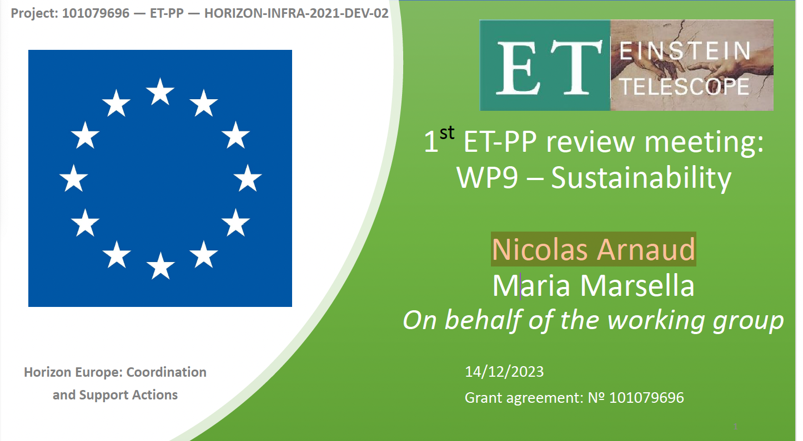

ET-PP INFRA-DEV Annual Meeting
17-18 June 2024

Slide 2
WP9 - Development of a sustainability strategy for ET
Minimize the global carbon footprint of the Einstein Telescope (ET)
ET carbon footprint assessment
Optimization of the ET energy consumption
Evaluate landscape, environmental and societal impact
Assessing and minimizing the ET impact on the environment
Environmental management approach
Strategy for the reclamation, reuse and recycling of the excavated materials
Contribute to sustainable goals
strong multidisciplinary approach
addressing other science-based targets
climate change mitigation

Slide 3
WP9 - Major challanges
Identify all sustainability topics relevant to ET and define standard metrics and indicators
Encourage the research community to raise awareness on sustainability
Establish a methodology to measure the impact and Identify best practices for mitigation actions
Follow the rapidly evolving references and understand and implement innovations
Work aligned within the whole ET community (tech.&manag. boards, WPs, ETO, local teams, etc.)
Favour an open approach beyond ET research, industry, social sciences
Start collaborations with other community to examine bottom-up approaches (CERN, universities, research centres, etc.)
Exact location not yet determined to allow detailed studies (WP9 can provide guideline to local team to deepen locally the assessement.

Slide 4
WP 9: Deliverables and milestones
 | Deliverable | Lead participant | Type | Delivery date (months)
D9.1. | ET Sustainable Development of Implementation Strategy | CNRS | Report | 18 - 29/02/2024
D9.2. | ET Environmental impact assessment and mitigation strategy | INFN | Report | 24 - 31/08/2024
D9.3 | ET CO2 footprint ET assessment and mitigation strategy | EGO | Report | 36 -31/08/2025
 | Milestone | Delivered | Status | Note
M9.1 | Preliminary Sustainability Plan (PSP) | October 2023 | Under revision | June 2024 - new version for internal review October 2024 – Delivery to EC
M9.2 | ET sustainability workshop | November 2023 | Writing report | Anticipated respect to timing (feb 2024) All the material already available

Slide 5
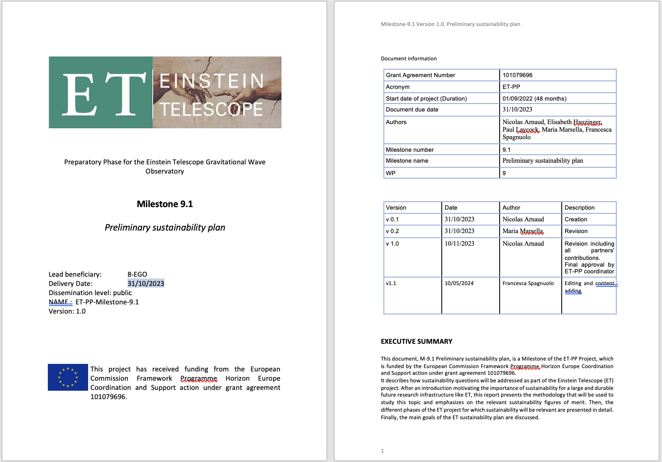

Slide 6

Preliminary Sustainability Plan- PSP (M9.1 - Milestone)
The Plan cannot include a quantitative assessment of indicators/parameters
On-going activity (EGO, INFN) to improve and broaden the content of the draft version of the PSP, available here for inputs and suggestions: https://docs.google.com/document/d/1MR1LsPOO16LiG0pWmx0yxI6Y0RhQsPWr/edit
Internal deadline for revision by experts/professionals (CERN or external consultant) June 24
New delivery date to EU in October 24

Slide 7
WP 9: Outlook and perspectives
Actions in place (June 2024)
EGO open a call for position on a sustainability expert and will recruit in 2024 – INFN is recovering the budget assigned to the vacant position to issue a 1.5/2 year contract on smart energy solution (shared with WP5)
Additional in-kind people involved within ET-PP and the collaboration (link to ETO and local teams, help building a background knowledge for the future
Established links other WPs and attracted more people
Preparing specification for a contract assignment (2 step activity review, identify weakness and support the develop of the final plan) to be proposed by INFN
Action identified in 2023 Annual meeting
Dedicated person to be recruited
Involvement of more people within ET-PP, ETO and the ET collaboration (including research units) -
Liaisons with other WPs (starting with computing), departments/working groups (engineering), technical and scientific boards
WP9 periodic meetings - Thursday at 10 (Rome time)
ZOOMhere https://us02web.zoom.us/meeting/tZAtfu6hqzIjGtffZNLw7PSDOvC8ARJK5k0X/ics?icsToken=98tyKuGsrjItE9GcuRmERpwIAor4KPPwmFhEjbdbmiXLLzcEUjDSGfRhapNNOvOF

Slide 8
WP9 - Participants and roles
Francesca Spagnuolo | EGO | EU Program & Gender Equality Plan Manager
Massimo Carpinelli | EGO | EGO Director – GW research infrastructure
Maria Marsella | INFN | Long term sustainability
Nicolas Arnaud | EGO/CNRS | Computing and environmental sustainability
Robert Galler | MUL | Reuse of excavation material
Elisabeth Hauzinger | MUL | Reuse of excavation material
Florent Robinet | CNRS | Computing
Andreas Haugs | KIT | planning sustainability and green energy of research infrastructure
Francesca Scipioni | INFN (Roma1 Sapienza) | Smart/green energy solutions (hydroelectric, sea-waves, etc.)
Jacopo Di Cave | INFN (Roma1 Sapienza) | Mitigating impact of wind energy farm
Anita Di Giulio | INFN (Roma1 Sapienza) | Excavation optimizations, treatments and reuse of excavation material
Flavia Ferranti | INFN (Roma1 Sapienza) | Climate changes and natural hazards
Monica Marzario | INFN (Roma1 Sapienza) | Land use assessment and monitoring

Slide 9
WP10 – Contribute to prepare communication materials and organize dedicated dissemination events; support for drafting texts on website page "Sustainability for ET”
WP8 - Link established at the Sustainability Workshop in Novembre 2023, renewed at Maastricht 2024 Symposium, TBC at the WP8 meeting in Naples July, 9 2024
WP5 - ETO - Civil and mechanical engineering; framework study for setting up an environmental and energy due diligence for whole ET RI; identification of environmental mitigation measures in construction and operation phases; etc.)
WP7 - Innovation and Industrial engagement – Organize a joint meeting on sustainability issues for large civil infrastructure, to favour best practice and enforce industrial engagement (in discussion)
WP9 - Interaction with other WPs
Notes:
In questa slide, inserisco le principali attività che stiamo svolgendo ad EGO

Slide 10

Define contents collect offers and quotes for a subcontract (INFN) to obtain a comprehensive assessment of ET sustainability strategy
Focus and bring value on the difference areas
Support for the positioning of the project in the European and international panorama
Exploiting innovative approach to optimize processes
Responsibilities
Development and implementation of sustainability strategies
Conducting stakeholder engagement programs
Methodological support in the drafting of sustainability reports ESG research and benchmarking
Carrying out ESG Due Diligence

Slide 11

Parallel Session on Sustainability
16 June 2024
How to reach a quantitative approach for the indicators/parameters to be included in the Preliminary Sustainability Plan ?
Discuss the content and deadline(s) for the delivery of the ET Sustainable Development Implementation Strategy (D9,1, CNRS)
Propose a meeting with CERN (attendees; content; possible dates) to discuss sustainability issues and identify /involve a contacts

Slide 12
What we are doing @EGO
Coordinating the revision to improve the initial sustainability plan to be resubmitted in October 2024
Organize weekly WP9 internal meetings to discuss progress and problem within the WP
call for interest for a sustainability expert @EGO focused on the assessment of the CO2 footprint of the future RI and the mitigation strategy to minimize its environmental impacts https://www.ego-gw.it/blog/2024/05/09/et-pp-sustainability-expert/
Notes:
In questa slide, inserisco le principali attività che stiamo svolgendo ad EGO

Slide 13
What we are doing @INFN
Work on sustainability aspects topics relevant for E T different phases: the design construction phase; operation phase, (including various upgrades along the years. Contribute to the strategy for excavated material
Development of a collective methodology to implement ET sustainability plan (smart energy, environmental, social, and territorial impact) - Liaisons with the socio-economic impact analysis
Analyse measurable values, helping to calculate the sustainable and environmental impact of a business (KPI, ESG, DNSH, )
Notes:
In questa slide, inserisco le principali attività che stiamo svolgendo ad EGO

Slide 14
What we are doing @CNRS
ET Sustainability Workshop - Done in Paris ET-syposium - Report in a .pdf format and ET-PP project template to be uploaded in the SEDIA portal by October
Lead the sustainable development implementation Strategy
Enforce the collaboration with WP8 (meeting organized in Napoli to discuss computing sustainability (CNRS)
Notes:
In questa slide, inserisco le principali attività che stiamo svolgendo ad EGO

Slide 15
What we are doing @MUL
Analyze and define an overall strategy for the reclamation, reuse and recycling of the excavated materials
identify site-specific parameters since a lot depends on geology and the regional market/industry
Strategy to keep anthropogenic pollution of excavated material to a minimum (excavation method)
Identify possible reuse scenarios for the excavation material which have a low impact on environment
Notes:
In questa slide, inserisco le principali attività che stiamo svolgendo ad EGO

Slide 16

  Preparedness on aspects of sustainability non recovery or mitigation (e.g. CERN)
  Long-term vision for a research infrastructure from which to learn and transfer knowledge
Notes:
Criteria defined by the Italian government to ensure environmental sustainability in public procurement. The criteria include technical specifications to reduce the environmental impact of products and services purchased by public authorities

