Slide 1
ET-PP WP8 Computing and data model Slides prepared by Alba Gonzalvez together with EIB chairs and WP8 work package leaders

Slide 2
EiB-WP8 organization
ET-PP WP8 – ET EiB
Chairs: Stefano Bagnasco (INFN Torino) , Patrice Verdier (IP2I-IN2P3)
Division 1:
Software, frameworks, and data challenge support
Andres Tanasijczuk (UC Louvain)
Division 2:
Services and Collaboration Support
Antonella Bozzi (EGO)
Division 3:
Computing and data model, Resource Estimation
Gonzalo Merino (PIC)
Division 4:
Multimessenger alerts infrastructure
Steven Schramm (Université de Genève)
TTG: Technology Tracking working Group
Sara Vallero (INFN Torino)
Chairs: Achim Stahl, Nadia Tonello
Task 8.1
T0 data center Patrice Verdier (IP2I-IN2P3)
Task 8.2
Computing and Data Model
Anastasios Fragkos (Geneva)
Task 8.3
Resources Silvio Pardi (INFN Napoli)
Task 8.4
Data Access Implementation
Nadia Tonello (BSC)

Slide 3
ET-PP WP8 Computing and Data models
ET-PP WP8 – ET EiB
 | Workshops | WPs | Due date
M8.1 | Workflows Requirements collection and constraints: computing and data |  | Sep 2023 | Oct 2023
M8.2 | Computing Infrastructures availability for ET workflows, characteristics and sustainability | WP9 | Aug 2024
M8.3 | On site infrastructure, computing and data model | WP6 | Aug 2025
M8.4 | Low latency and offline workflows and computing model | WP6 | Dec 2025
M8.5 | Data management, access, policy and implementation | WP2, WP6 | July 2026
WP8
milestones
 |  | Lead | Due date
D8.1 | Computing and Data Requirements | UniGe | Feb 2024 | Feb 2024
D8.2 | Computing and Data Model | UniGe | Feb 2026
D8.3 | Data Access Implementation Guidelines | IFAE | July 2026
.
WP8 Deliverables

Slide 4
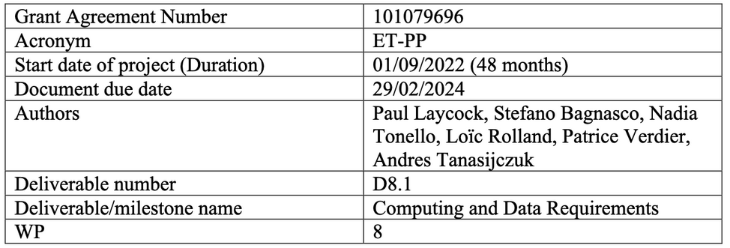
Computing and data requirements (D8.1)
ET-PP WP8 – ET EiB
Introduction
1.1 Scope
1.1.1 Low latency pre-merger alerts
1.2 Future ET Computing Model
1.3 Template for requirements collection
2. ET Science drivers of computing requirements
2.1 Low latency science drivers
3. Computing requirements
3.1 Computing and data processing requirements
3.1.1 Online requirements
3.1.2 Low latency requirements
3.1.3 Offline requirements
3.2 Collaboration Algorithms
3.3 Collaboration Support
3.4 Data Management
4. Computing requirements summary tables
4.1.1 Online requirements tables
4.1.2 Low latency requirements tables
4.1.3 Offline requirements tables
5. Computing and software expertise
6. Technological assessment
7. Conclusions
Taken from the D8.1 summary: “The summary for the computing resources expected for ET is given in section 4. These numbers are expected to evolve and will be tracked with MDCs so that ET can accurately predict its computing needs. Nevertheless, the baseline scenario presented here represents a significant but modest computing challenge compared to that faced by the HL-LHC experiments. The greatest challenge for ET will be training and retaining sufficient software and computing expertise to be able to leverage common tools, and create and maintain the bespoke solutions needed by ET over the long lifetime of the experiment.”
Structure of the document

Slide 5
Computing and data requirements (D8.1)
ET-PP WP8 – ET EiB
ONLINE
LOW-LATENCY
Full bandwidth
raw
Low-lat. search
pipelines
• DAQ
• Monitoring
• Detector control
• Automation
• h(t) reconstruction
Bulk data
raw
Alert generation
system
• Sky localization
• Parameter estimation
Uncalibrated
aggregated h(t)
Event DB
Alerts
OFFLINE
Calibrated
aggregated h(t)
Offline data processing
Derived data
Reduced
datasets
• Deep searches • Precise parameter estimation
• Frequency-domain searches
Figure credit: Stefano Bagnasco

Slide 6
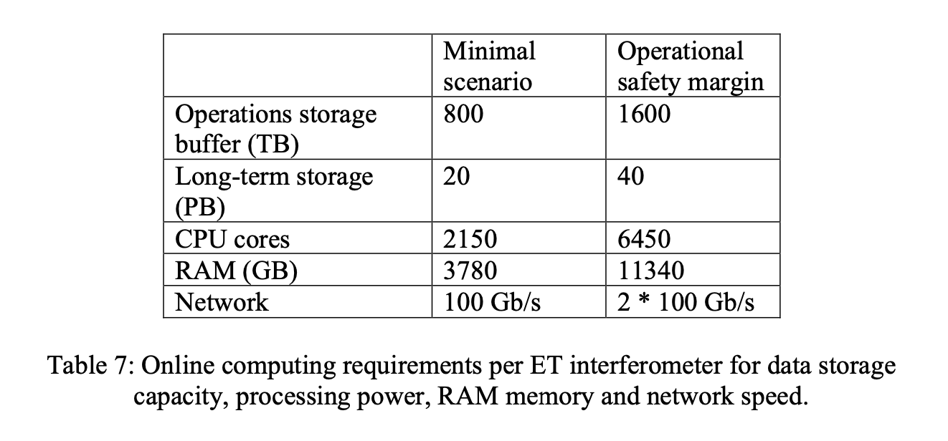
Computing and data requirements (D8.1)
ET-PP WP8 – ET EiB
ONLINE
Full bandwidth
raw
• DAQ
• Monitoring
• Detector control
• Automation
• h(t) reconstruction
Bulk data
raw
Uncalibrated
aggregated h(t)
Calibrated
aggregated h(t)
Reduced
datasets
Figure credit: Stefano Bagnasco

Slide 7
Computing and data requirements (D8.1)
ET-PP WP8 – ET EiB
LOW-LATENCY
Low-lat. search
pipelines
Alert generation
system
• Sky localization
• Parameter estimation
Event DB
Alerts

Slide 8
Computing and data requirements (D8.1)
ET-PP WP8 – ET EiB
OFFLINE
Offline data processing
Derived data
• Deep searches • Precise parameter estimation
• Frequency-domain searches

Slide 9
ET-PP WP8 Computing and Data models
ET-PP
 | Workshops | WPs | Due date
M8.1 | Workflows Requirements collection and constraints: computing and data |  | Sep 2023 | Oct 2023
M8.2 | Computing Infrastructures availability for ET workflows, characteristics | WP9 | Aug 2024 | July 2024
M8.3 | On site infrastructure, computing and data model | WP6 | Aug 2025
M8.4 | Low latency and offline workflows and computing model | WP6 | Dec 2025
M8.5 | Data management, access, policy and implementation | WP2, WP6 | July 2026
WP8 milestones
 | Deliverables | Lead | Due date
D8.1 | Computing and Data Requirements | UniGe | Feb 2024 | Feb 2024
D8.2 | Computing and Data Model | UniGe | Feb 2026
D8.3 | Data Access Implementation Guidelines | IFAE | July 2026
.
WP8 Documents

Slide 10
EiB-WP8 second workshop in preparation
ET-PP WP8 – ET EiB
M8.2 Computing Infrastructures availability for ET workflows, characteristics
Host: University of Napoli (Silvio Pardi, Task Leader 8.3 Resources)
Date: 8-9-10 July 2024
Remote connection option available for those unable to attend in person
Proposed schedule: Monday noon to Wednesday afternoon
Agenda draft
Indico link: https://indico.ego-gw.it/event/723/
WP8+EiBDiv3, with the contribution of WP9.
Computing resources (following the requirements coming from MDCs etc. )
Sustainability of the different options
Inviting external experts from WLCG (LHC computing) and technology tracking
Please register ASAP if interested

Slide 11
OSCARS proposals
ET-PP WP8 – ET EiB
First call Submission deadline: 15th May
It was a coordinated, team effort from EIB and WP8. ETAP: PI Paul Laycock, MADDEN: PI Federica Legger, Co-I: Andres Tanasijczuk ; also including Stefano Bagnasco and Lia Lavezzi in the writing team
ETAP (Université de Genève) Access to multiple ESCAPE DataLakes. Rich metadata service integration Access to multiple rich metadata instances A lightweight CRM service monitoring the VRE, useful for monitoring and measuring MDCs
MADDEN (INFN-TO & Université Catholique de Louvain) Multi-RI DataLake managed with Rucio, simulating data exchange with CE
Development and test of RucioFS (POSIX FUSE mount of the Rucio catalogue)
Extend RucioFS to support advanced metadata Strong synergy with Virgo O5
Second OSCARS call (November?)
Streaming data for LL?
Something IVOA-related?

Slide 12
…coming soon
MDCs closer collaboration
ET-PP WP8 – ET EiB
Feedback on ET Symposium
Establish better communication between OSB Div10-EiB for MDCs.
Agreement on the need to set clear goals and deliverables for future MDCs.
Discussion on establishing common resources for benchmarking different approaches and best practice guidelines within groups. Might consider a task force to manage MDCs and gather feedback on resources and tools.
Proposal for code reviews to expedite progress. Plans to draft guidelines for software engineering and code management
Plans to circulate a document describing activities and solicit input from interested parties.

Slide 13
…coming soon
Tool evaluation kits
ET-PP WP8 – ET EiB
We will create a matrix to identify urgent functionalities and tools needed.
Independent packaged parts of the final architecture
Provide limited functionalities, possibly some as mere demonstrators
To be released to users (i.e., they MUST be functional)
Different implementations may exist, with different tools/technologies used to provide same functionality
Integration of existing tools, no excessive bespoke developments, to map “kits” onto smallish projects
Examples:
ESCAPE Datalake + RucioFS for data distribution
IAM-basedAAI
ESCAPE Datalake + VRE interactive data analysis
OSDF + INFNCloud interactive data analysis
“Packaged” and quality-tested MDC data generation tool
Paul’s rich metadata tool

Slide 14
WP9 session: Sustainability aspects of computing
ET-PP WP8 – ET EiB
Sustainability aspects of computing will be a major theme of the July workshop in Napoli
Hardware sustainability
Consider the carbon pollution emitted during the creation and disposal of ET on-premise computing devices.
Maximize the lifespan of the ET-fully-dedicated hardware
Maximize the utilization time of the shared devices (cloud)
Software efficiency
Expertise for code optimization, parallelization and scalability
Profiling and maintenance of code
Adaptation to heterogenous technology and its evolution
Energy awareness
Power Usage Effectiveness of computing centers
Energy proportionality: energy consumption and effective work done (i.e. inefficient code)
Baseline (Idle states) consumption awareness (i.e. disk data usage)
Transparency regarding the sources of energy employed (clean, green, renewable).

Slide 15
Thank you!

