Slide 1




ET beampipe activities at CERN: status report and plan
Ana Teresa Perez Fontenla on behalf of the ET vacuum team at CERN
June 17th, 2024

Slide 2
Content
CERN participation in ET beampipe studies
  The approved addendum
  The work structure
  The team
  The networking
  The main achievements
  Work currently on-going
  Plan

Slide 3
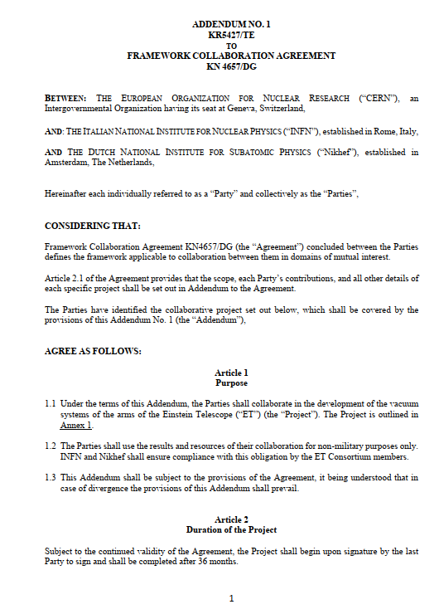
The approved addendum
The specific agreement
  On July 2022, INFN, Nikhef and CERN signed an addendum about CERN contribution to ET beampipes.
  On a practical basis, CERN activities started on September 2022 and will last three years.
  The main objectives are:
      Coordinate the contributions of all Parties involved in the study of ET beampipes.
      Preparation and writing of the ‘Technical Design Report’ for the vacuum systems of the ET’s arms, including cost estimations.
      Design, manufacturing, assembling, and tests of a pilot sector of the selected ET-beampipe vacuum systems.
      Contact and sharing of information with Cosmic Explorer

Slide 4
The work structure
WP1: Engineering
WP2:
Production
WP3:
Treatments
WP4:
Transport
Design and engineering of the vacuum chamber
Choice of materials and manufacturing technology
Choice of post-manufacturing treatments
Handling and logistics
WP5:
Installation
WP6:
Vacuum
WP7:
Prototyping
WP8:
Coordination
Installation procedure and interface with other systems
Choice of vacuum pumps and valves
Installation and test of a pilot sector
Coordination of the different WP + collaborators contribution
Each work package will provide input for the TDR and cost estimation

Slide 5
The team
Name | Competences | WP
Cedric Garion | Structural mechanics | WP1
Carlotta Accettura | Mechanical design | WP1
Ana Teresa Perez Fontenla | Coordination & Metallurgy | WP2/WP8
Gilles Favre | Manufacturing | WP2
Stefano Sgobba | Metallurgy | WP2
Manjunath Dakshinamurthy | Metallurgy | WP2
Leonel Ferreira | Surface treatments | WP3
Mauro Taborelli | Surface analysis | WP3
Luigi Scibile | Premises & logistics | WP4/WP5
Name | Competences | WP
Gregory Pigny | Vacuum control | WP6
Giuseppe Bregliozzi | Vacuum engineering | WP6
Carlo Scarcia⁽¹⁾ | Vacuum engineering | WP2/WP6
Purnalingam Revathi⁽²⁾ | Vacuum engineering | WP6
Jose Ferreira | Vacuum modeling | WP6/WP7
Alice Michet | Vacuum measurement | WP6
Jan Hansen | Mechanical engineering | WP7
Ivo Wevers | Vacuum measurement | WP6/WP7
Paolo Chiggiato | Coordination | WP8
University of Aachen (Gentner Programme)
University of Antwerp
By contract, during the three-year agreement: Two FTE/y of CERN staff + Two CERN fellows work for ET

Slide 6
The networking
Institute | Subject | Type of agreement | Contacts
CNRS LAPP (F) | Mechanical design | Informal collaboration | Guillaume Deleglise
IFAE (ES) | Baffles design and integration | Framework agreement | Mario Martinez/Marc Andres
Nikhef (NL) | Pumping modules | Framework agreement | Martijn van Overbeek / Patrick Werneke
U. Gent (B) | Pipeline solution | Informal collaboration | Leo Kestens / Alexey Gervasyev
U. Gent (B) | Corrosion of ferritic st-st steels | Contract | Elien Wallaert
U. Aachen (D) | Supervision of a PhD student | Gentner programme | Achim Stahl
INFN (I) | Magnetic measurements | Framework agreement (PhD student at CERN) | Aniello Grado
Uni. Antwerp (B) | Installation and commissioning of the ET pilot sector | Collaboration agreement | Nick Van Remortel
PIEP, Univ. do Minho (PT) | Flame retardant insulation foam for thermal insulation during bakeout. | Collaboration in preparation | Pedro Mimoso
Cooperation with industries: Aperam, Arvedi, SAES, Agilent Vacuum…

Slide 7
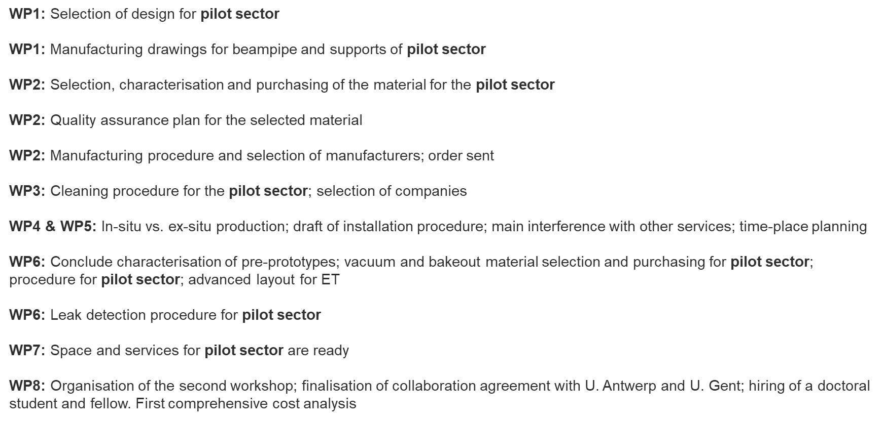
Start of the Contract
End date of the Contract
The main
achievements
01-08-2022
45%
31-07-2025
Annual plan presented at ET-PP event in 2023
Courtesy of P. Chiggiato

Slide 8



Start of the Contract
End date of the Contract
The main
achievements
01-08-2022
65%
31-07-2025

Slide 9
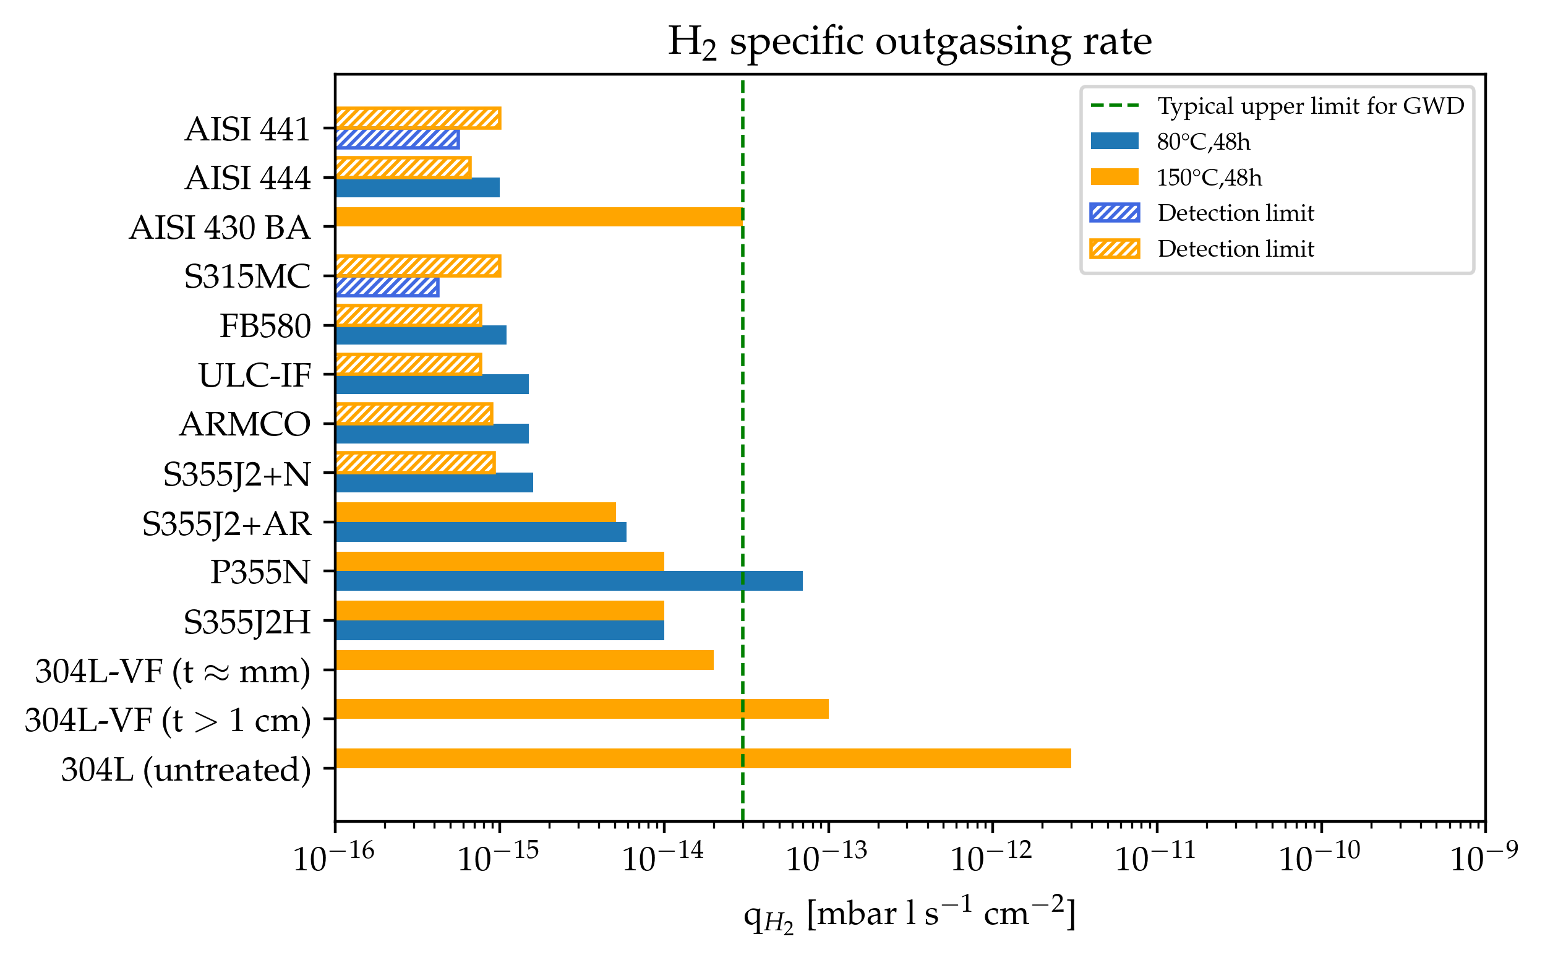
Start of the Contract
End date of the Contract
2022 - Main
achievements
01-08-2022
65%
31-07-2025
Mild steel
Ferritic StSt
Ferritic StSt
Firing not needed to attain requirements
Mild steel
Courtesy of C. Scarcia
Austenitic StSt
Measurement error: ±40%; Detection limit: 50% of background

Slide 10
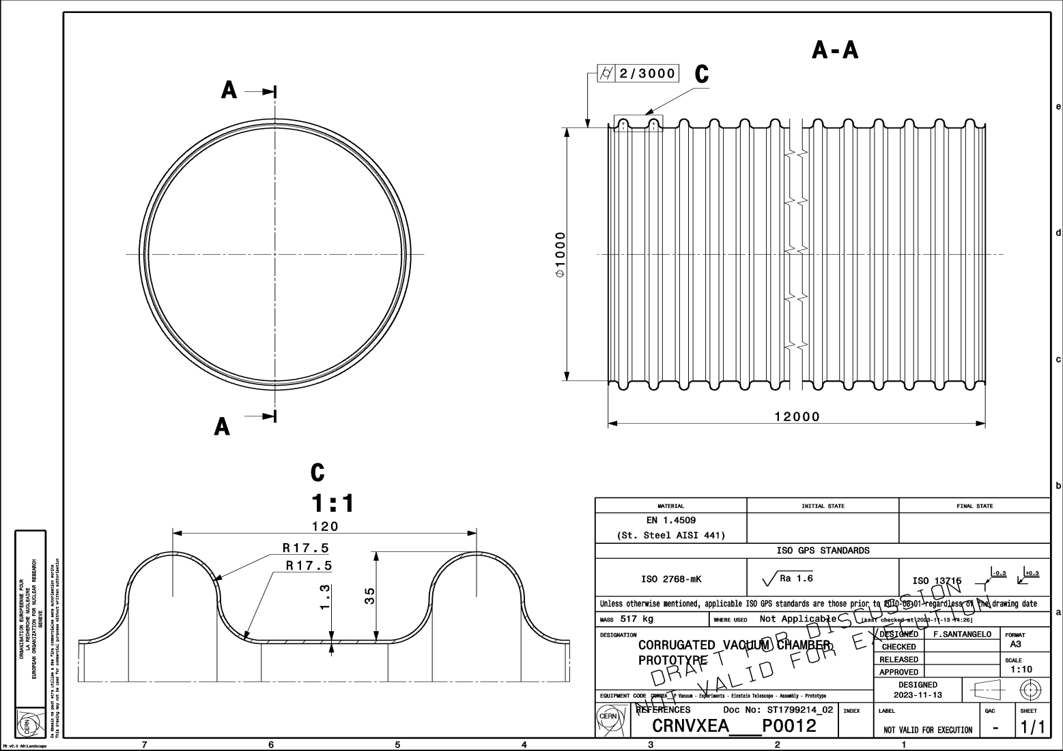
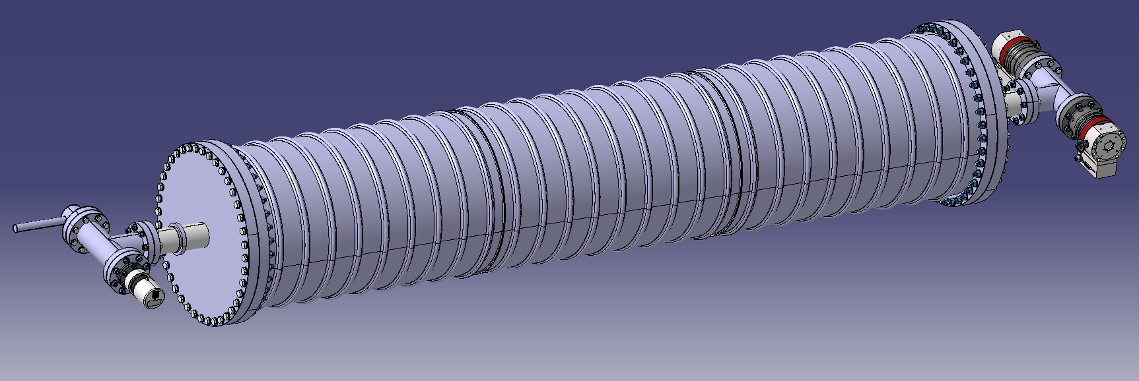
Start of the Contract
End date of the Contract
2022 - Main
achievements
01-08-2022
65%
31-07-2025
Design of a corrugated beampipe
Design of the pre-prototypes
Proposal for a vacuum layout & control system
Courtesy of C. Garion
Ø 400 mm x 2000 mm
Plate thickness < 1.5 mm
Corrugated pipe with thin wall
Standard (AISI 304L)/Alternative materials

Slide 11
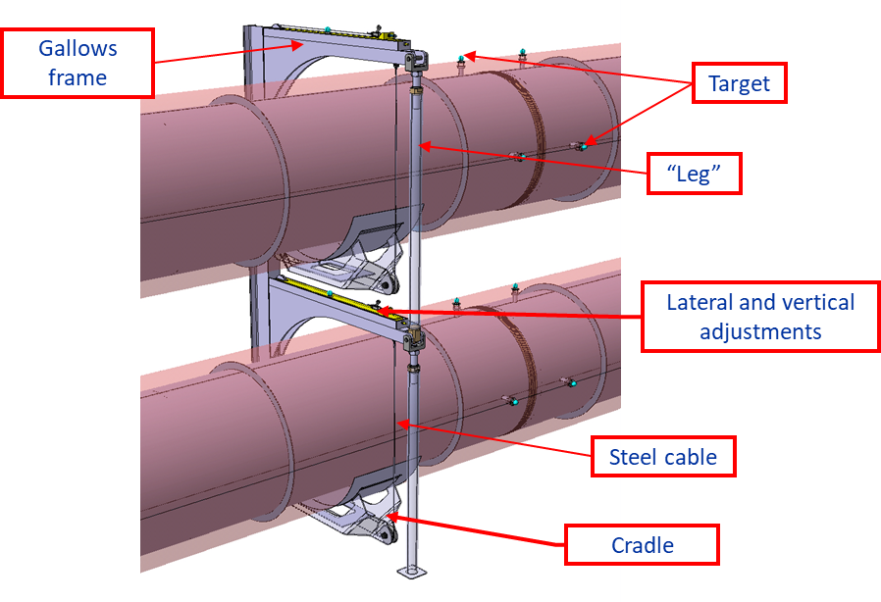
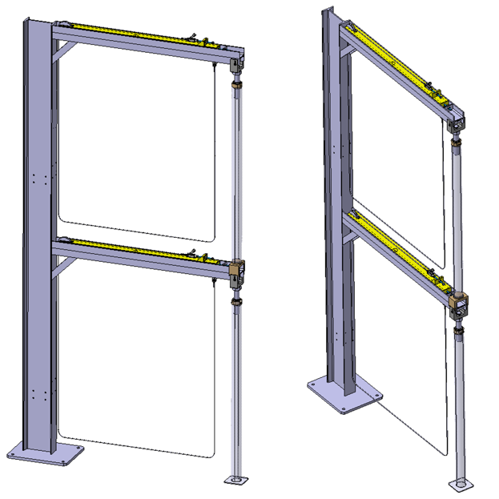
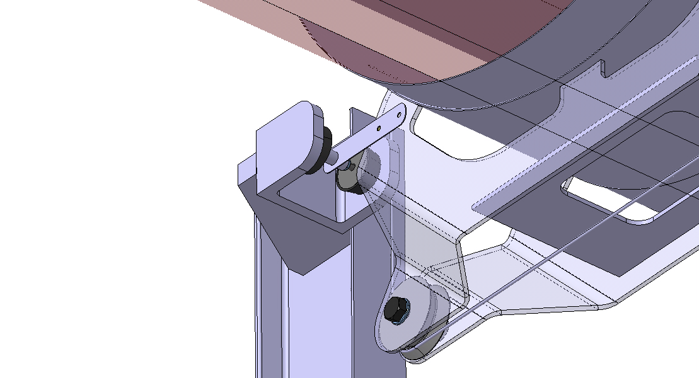
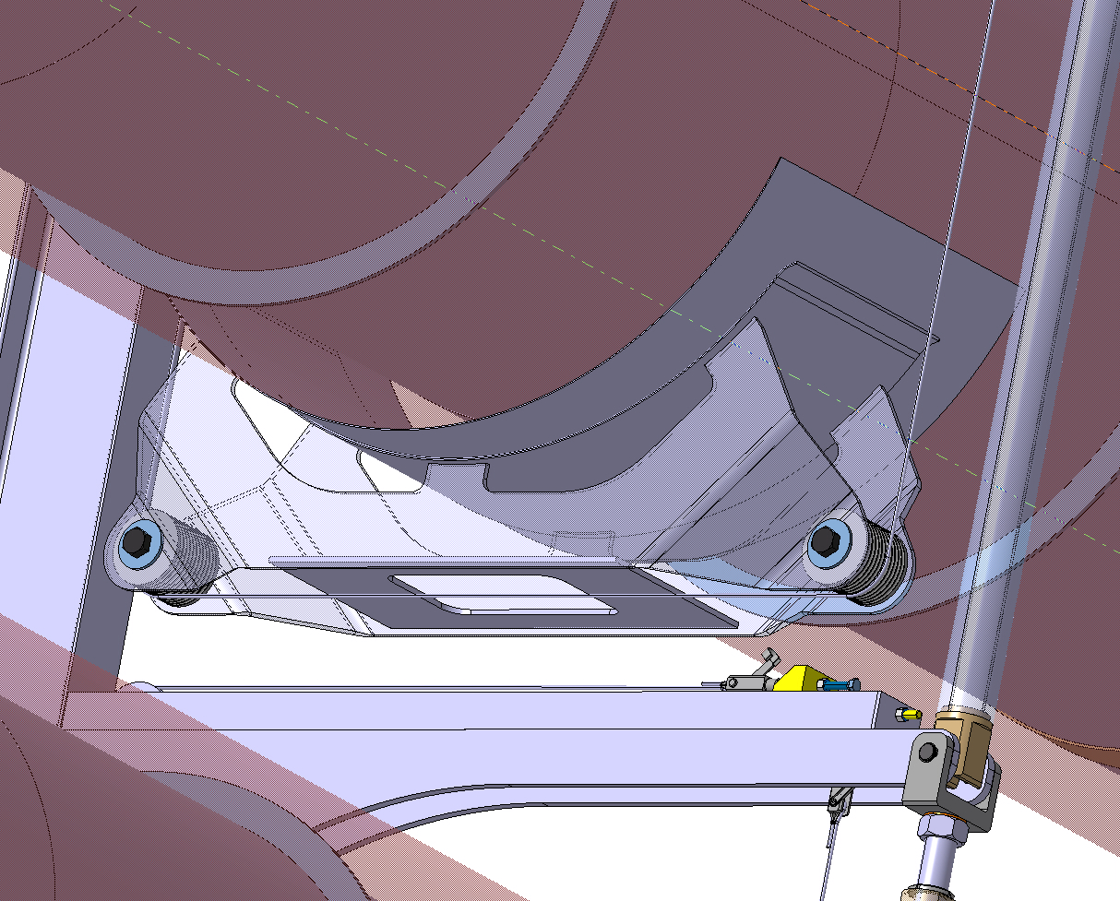
Start of the Contract
End date of the Contract
2023 - Main
achievements
01-08-2022
65%
31-07-2025
Support system and vibration analysis
Light” supports based on standard beams with additional legs
Vacuum chambers suspended by cables
Conceptual design of dampers
The insulated vacuum chambers lies on the cradle
Notes:
Vibrational analysis of the suspended vacuum chambers has been carried out, with emphasis on the impact of the bellows, cables and supports.

Slide 12
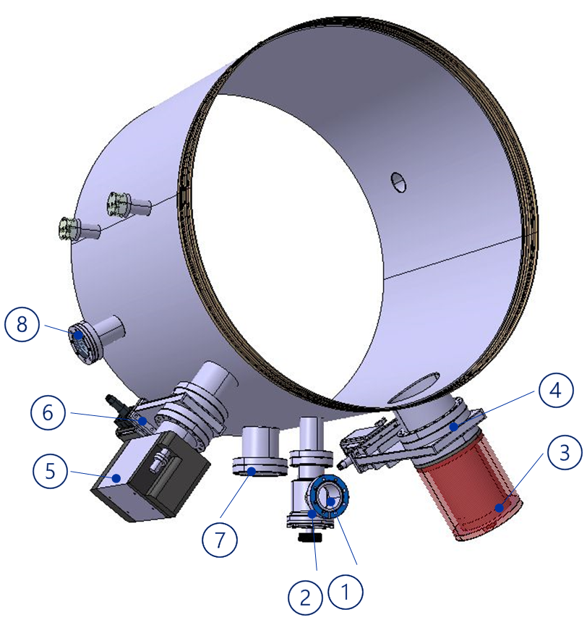
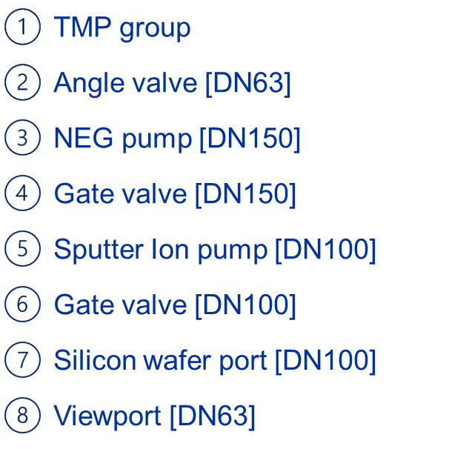
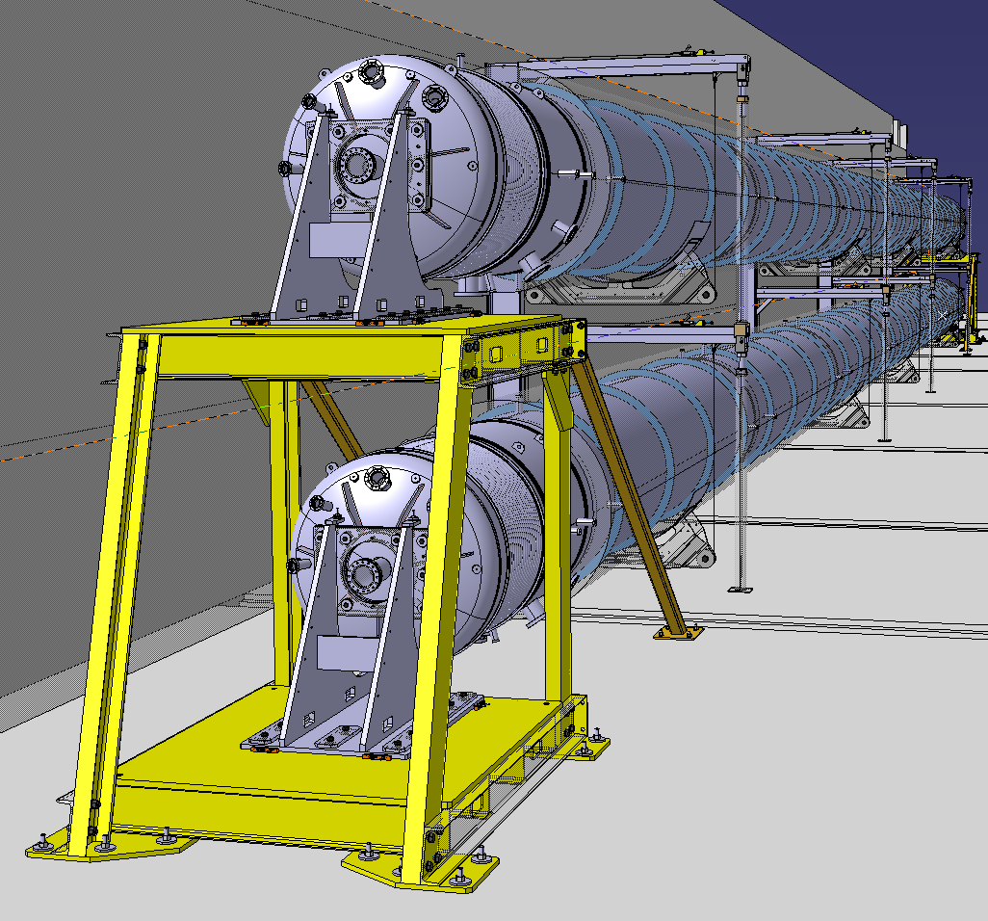
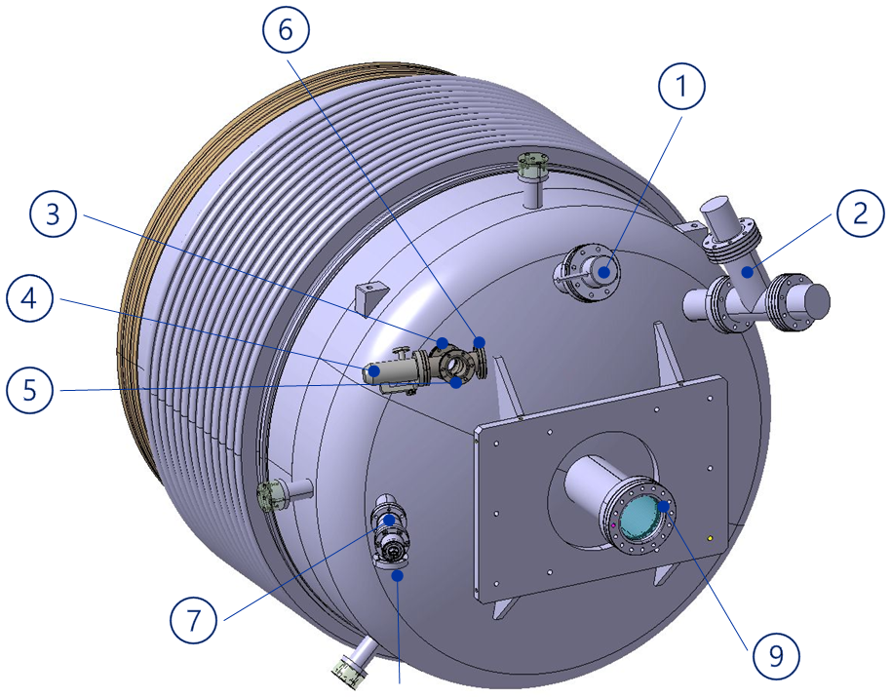
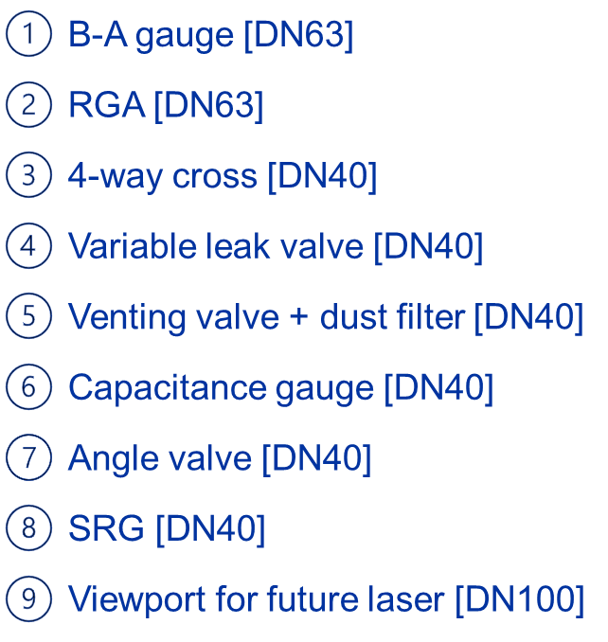
Start of the Contract
End date of the Contract
2023 - Main
achievements
01-08-2022
65%
31-07-2025
Integration of the ET pilot sector in CERN building
Planning for pilot sector stablished
Pilot sector: design, integration, bakeout
Pumping modules
& integration
Choice of the space
for the pilot sector
Notes:
Vibrational analysis of the suspended vacuum chambers has been carried out, with emphasis on the impact of the bellows, cables and supports.

Slide 13
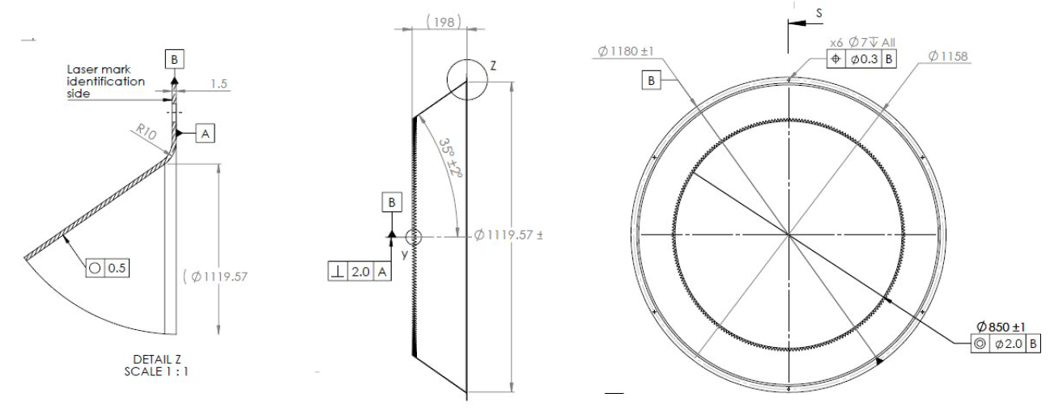
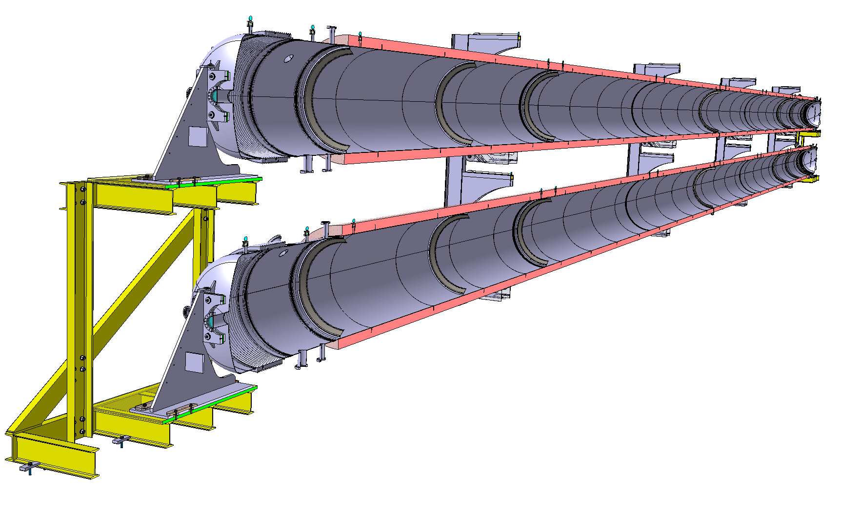
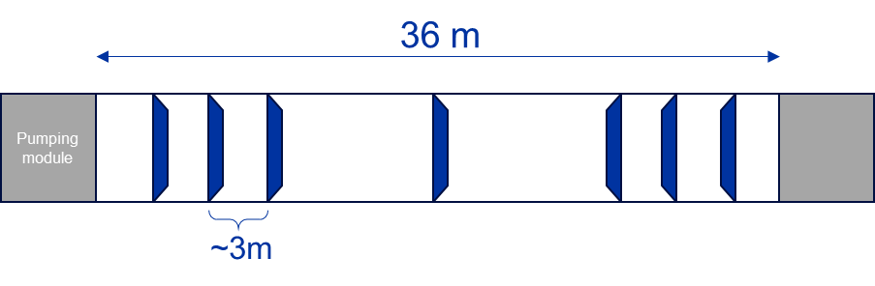
Start of the Contract
End date of the Contract
2023 - Main
achievements
01-08-2022
65%
31-07-2025
Design of baffles integration in pilot sector
Courtesy J. Mundet (IFAE), for information
Design and procurement by IFAE
Number and position of baffles being refined
Notes:
Vibrational analysis of the suspended vacuum chambers has been carried out, with emphasis on the impact of the bellows, cables and supports.

Slide 14
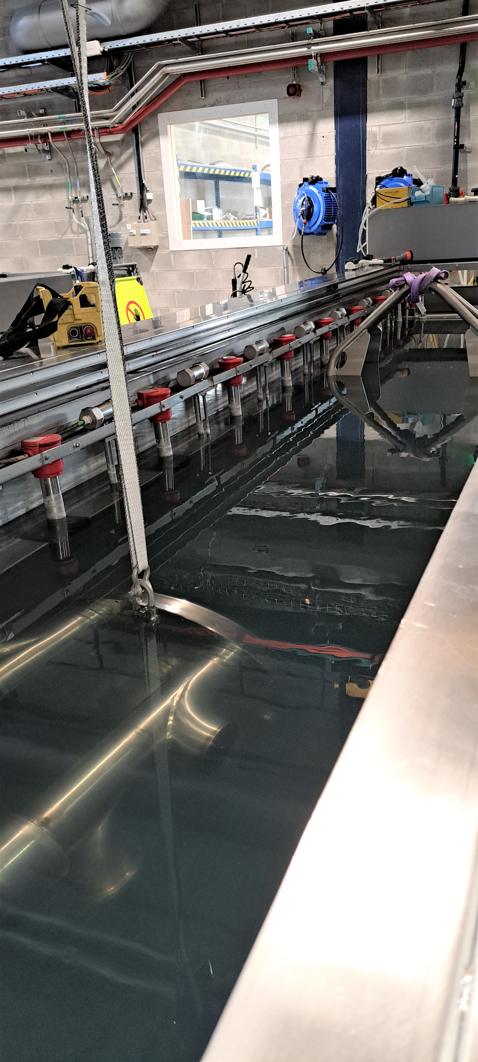
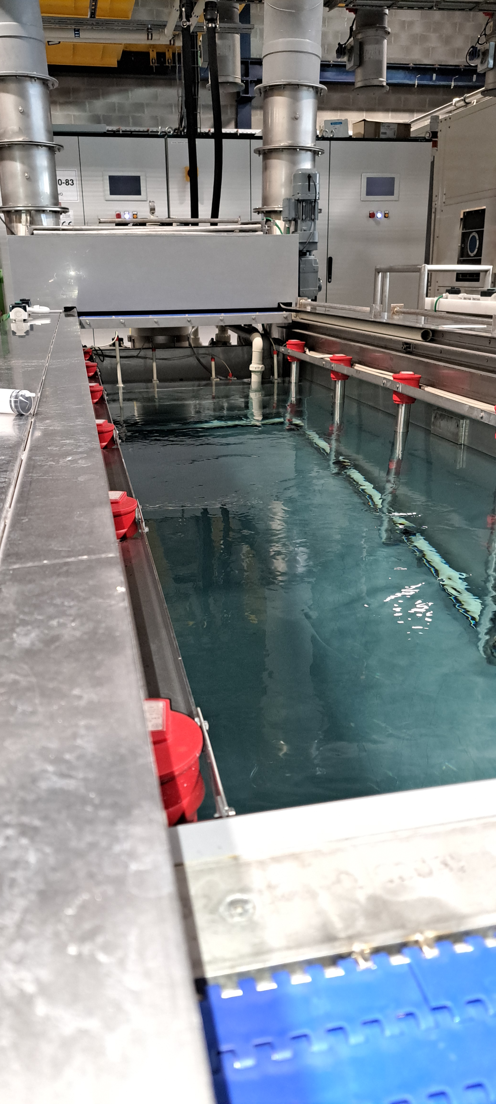
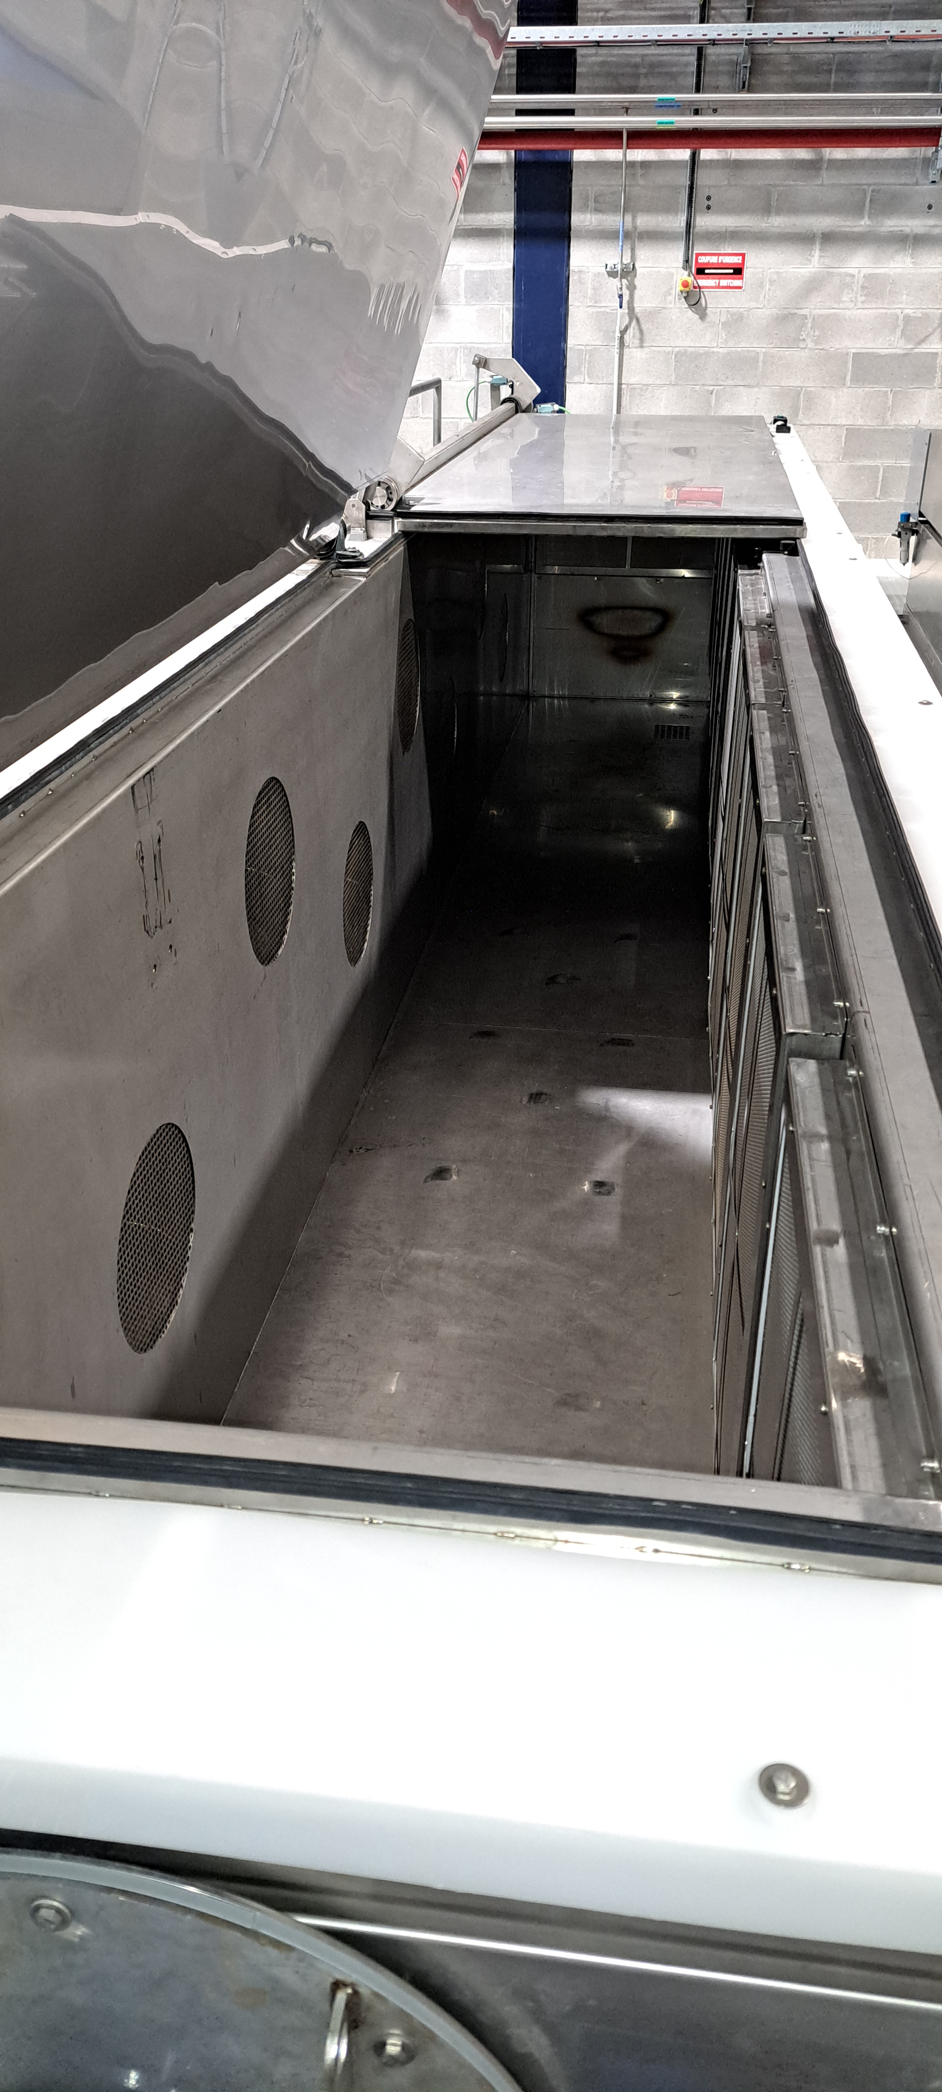
Start of the Contract
End date of the Contract
2023 - Main
achievements
01-08-2022
65%
31-07-2025
Courtesy of L. Ferreira
Strategy for surface cleaning
First cleaning test results
Cleaning assessment: facilities and procedure. Example for ferritic stainless steel
Immersion detergent
degreasing
Immersion rinsing
In demineralised water
Drying in atmospheric
oven

Slide 15
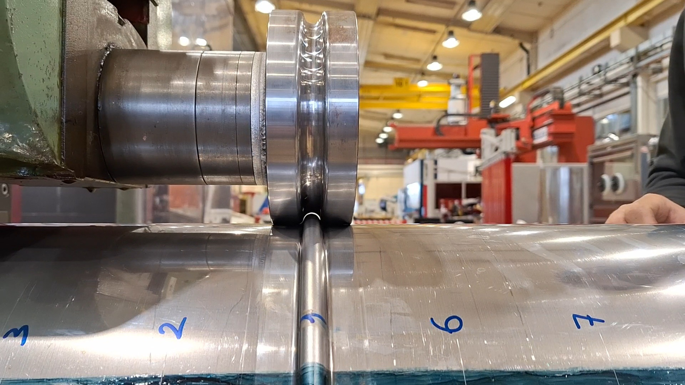
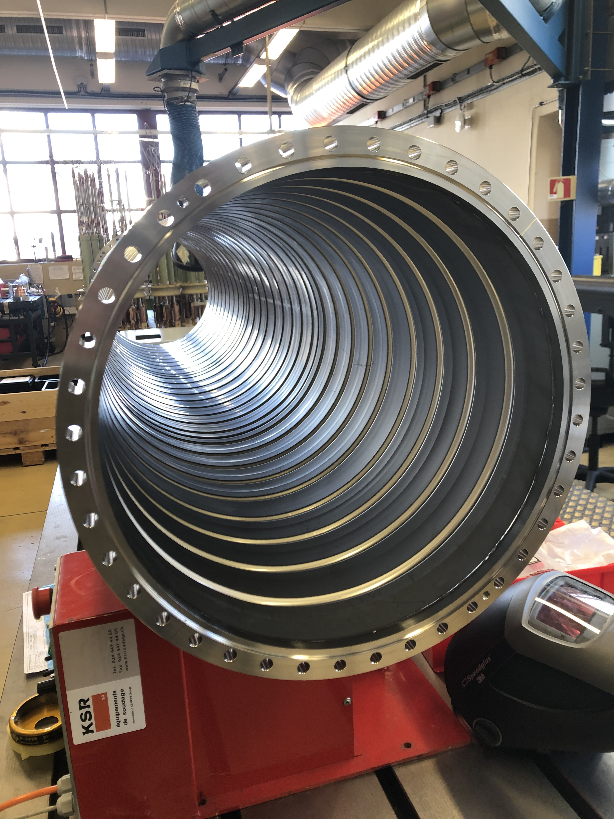
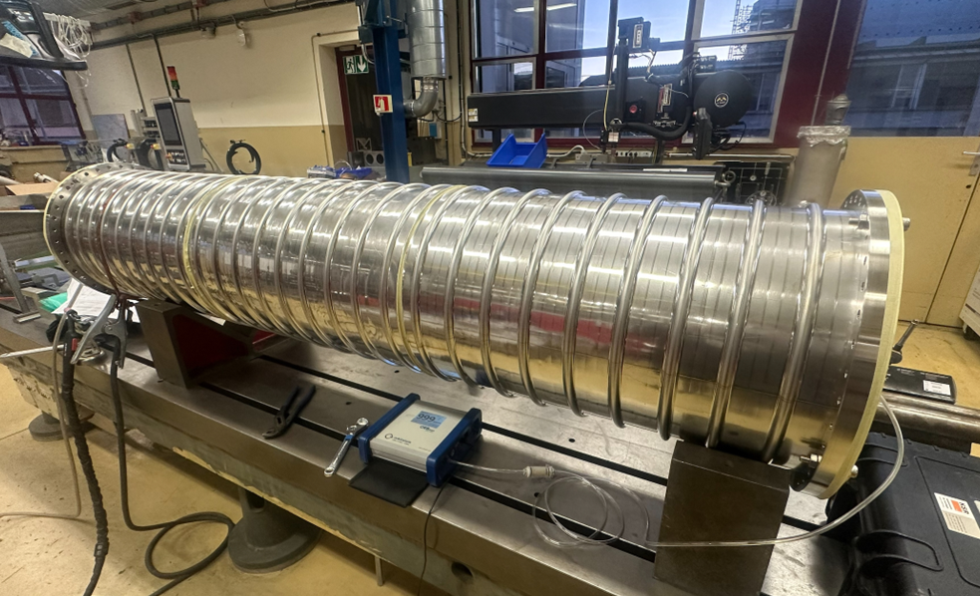
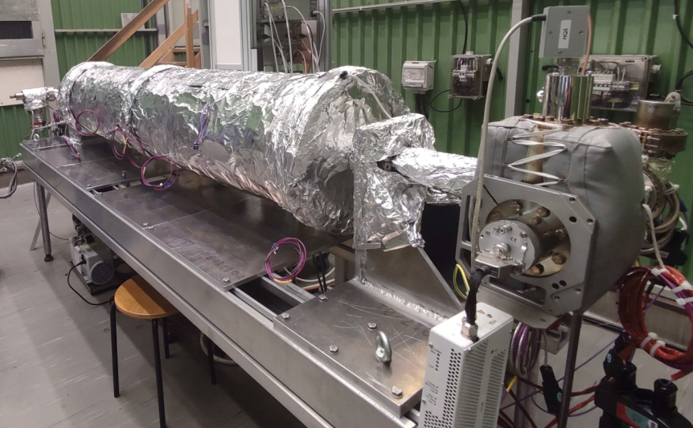
Start of the Contract
End date of the Contract
2023 - Main
achievements
Workshop at CERN
01-08-2022
65%
31-07-2025
Pre-prototype 304L*
Pre-prototype Mild steel
Courtesy of G. Favre
Manufacturing
WQ
Longitudinal welding
Forming/corrugation
Cleaning
Thermal treatment*
Circular welding
Flanges welding
NDT
Metallurgy
Tensile testing
bending test

Slide 16
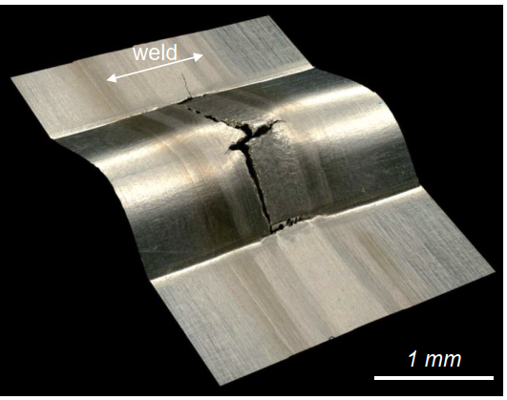
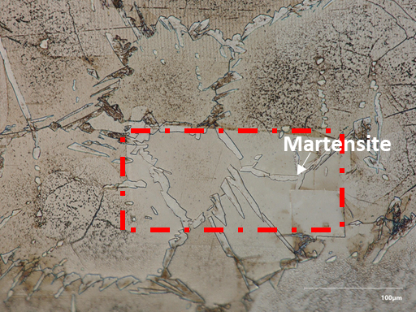
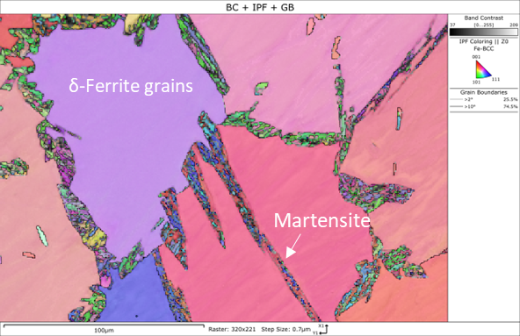
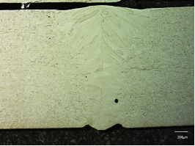
Start of the Contract
End date of the Contract
2023 - Main
achievements
Workshop at CERN
01-08-2022
65%
31-07-2025
AISI 441 (stabilized grade)
Lower %C than AISI 430
Laser welding
Reduction in grain coarsening
Better formability (corrugation)
Welding studies on ferritic StSt grades alternative to AISI 430
Weldability improved with AISI 441
AISI 430 TIG Autogenous weld resulted in two-Phase microstructure: δ Ferrite + intergranular Martensite
AISI 441 Laser welding
Crack on the TIG weld after corrugation
Optical Image
SEM and EBSD
Optical Image
Notes:
sheet metal coil, 4 mm thickness and 1.5 m width.

Slide 17
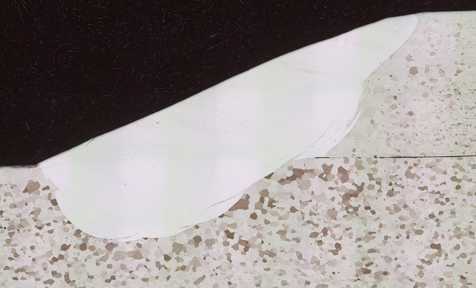
Start of the Contract
End date of the Contract
2024 - Main
achievements
Peers review
01-08-2022
65%
31-07-2025
Proposed a new pipes connection
Pre-prototype Ferritic StSt grade AISI 441
External sliding welding sleeve:
(2 mm thickness same StSt grade)
Sleeve length TBD
Overlap TBD
Fillet weld
Vacuum chamber wall
Gap between segments TBD

Slide 18
Start of the Contract
End date of the Contract
2024 - Main
achievements
Peers review
01-08-2022
65%
31-07-2025
The review aimed to:
Provide peer advice on the validity and maturity of choices made for the ET beampipe pilot sector, encompassing materials and their qualification, design, fabrication, vacuum systems, and bakeout procedures.
Evaluate the proposed support system and provide constructive feedback for enhancement.
Assess the feasibility and effectiveness of the proposed baffle integration within the sector.
Review the proposed experimental program and offer guidelines for potential extension and improvement.
Evaluate and provide comprehensive guidance on the dust control plan.
Assess the maturity of the study to facilitate the launch of price enquiries for fabrication processes.
Notes:
Peers review of the options proposed for the beampipe pilot sector

Slide 19
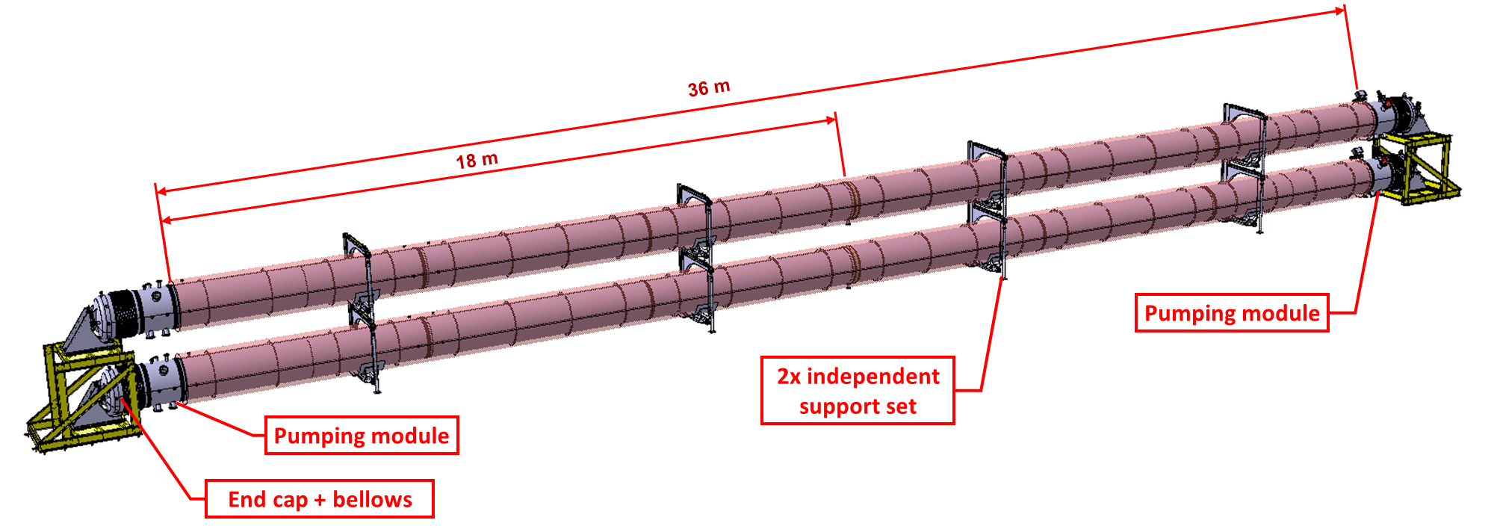
Start of the Contract
End date of the Contract
2024 - Main
achievements
Peers review
01-08-2022
65%
31-07-2025
  ET beampipe pilot sector: conceptual design
  Two independent vacuum chambers of around 18 m will be transported and installed individually
  Each pipe is suspended on independent supports and can be aligned vertically and laterally
  Each endcap can be aligned laterally, vertically and longitudinally
  Decoupling between the end covers and the chambers is done by hydroformed bellows
Notes:
Peers review of the options proposed for the beampipe pilot sector

Slide 20
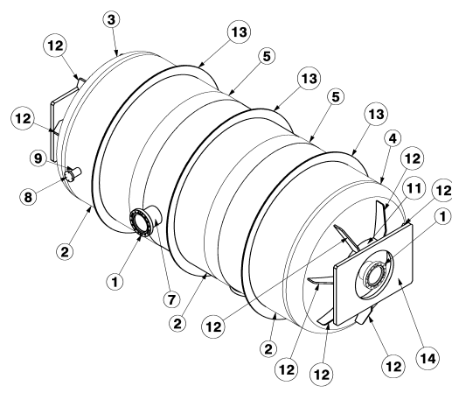
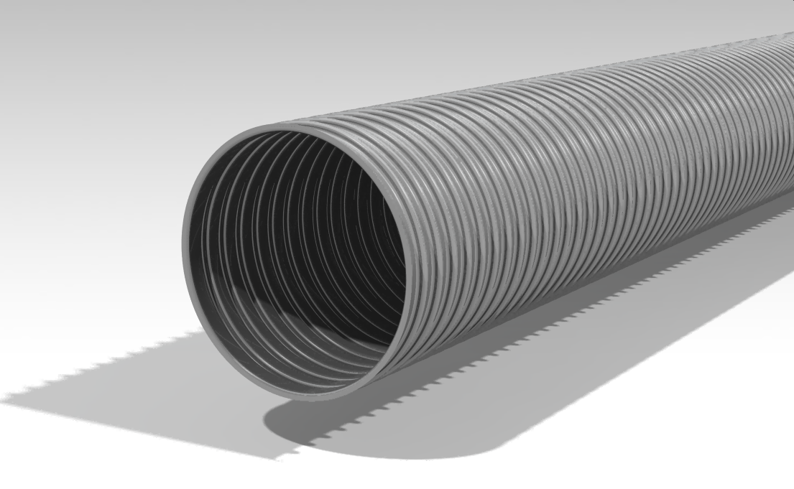
Start of the Contract
End date of the Contract
2024 - Main
achievements
Peers review
01-08-2022
65%
31-07-2025
  ET beampipe pilot sector: conceptual design
  The retained solution for the first phase is the reinforced smooth (Virgo-like) pipes → longitudinal welds → Externalized
  The technology based on corrugated tube will be assessed for UHV applications in parallel
  Units of Ø 1 m, 6 m long and 4 mm thickness → Preliminary mock-up to be produced at CERN
  Purchasing of AISI 441 coils for the pilot sector (> 12-week lead-time)
Preliminary mock-up
3 segments Ø 850 mm, 500 mm length
(rolled & welded cylinders)
  Optimize welding parameters, surface quality evaluation
  Cleanliness, dust evaluation, reparation, virtual leaks …
6 m long units - Reinforced smooth pipe
Corrugated pipe
Notes:
As it is not corrugated, TIG, plasma or laser are perfectly applicable for the ferritic grades

Slide 21
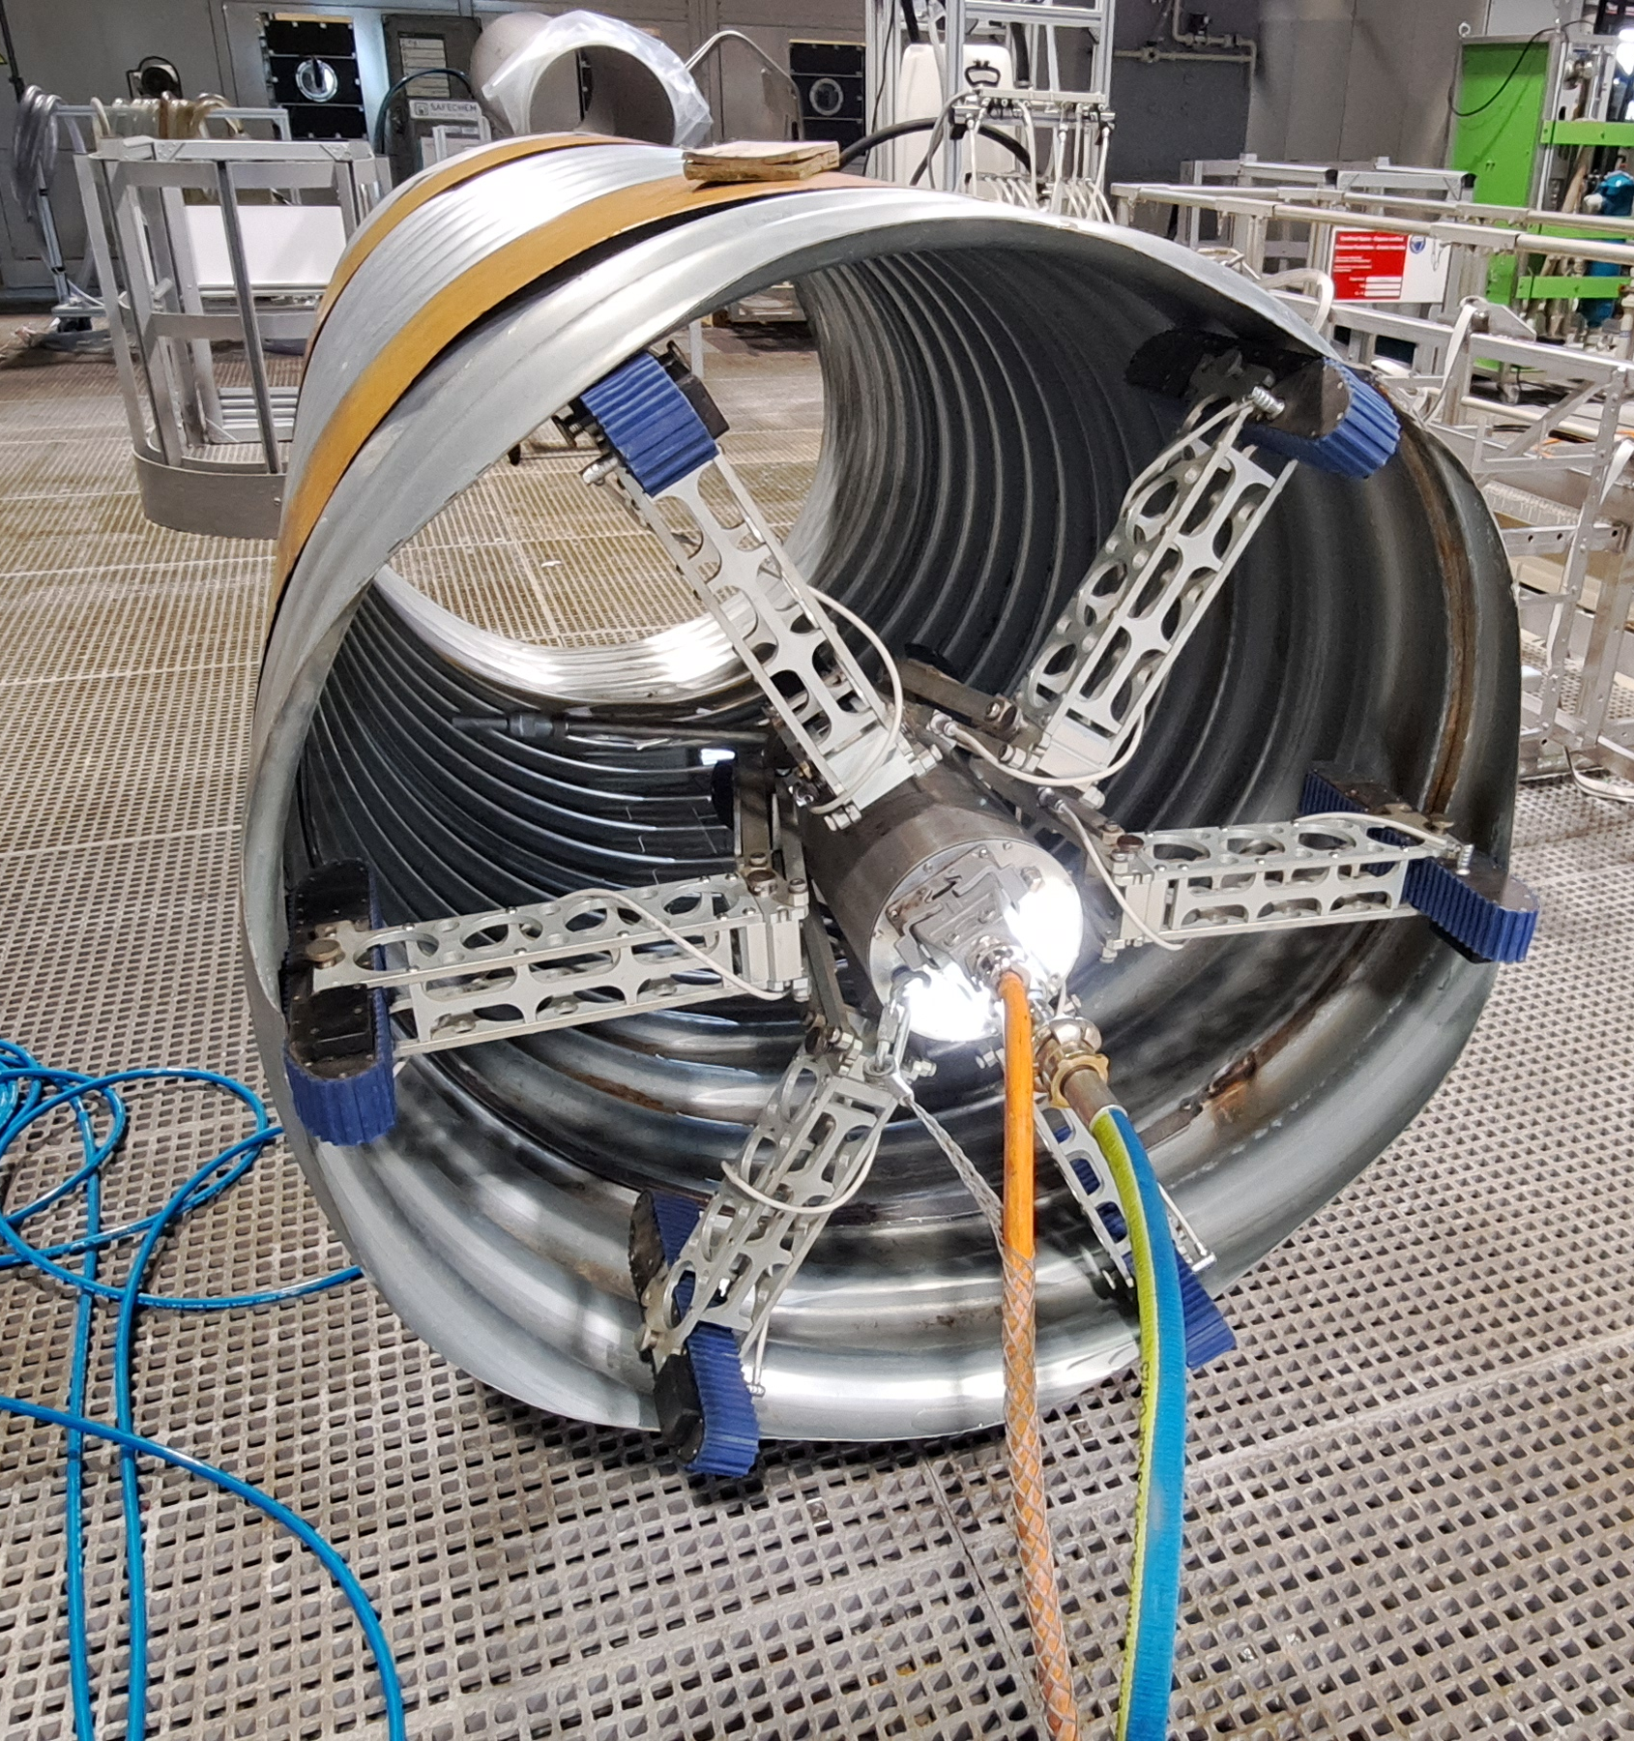
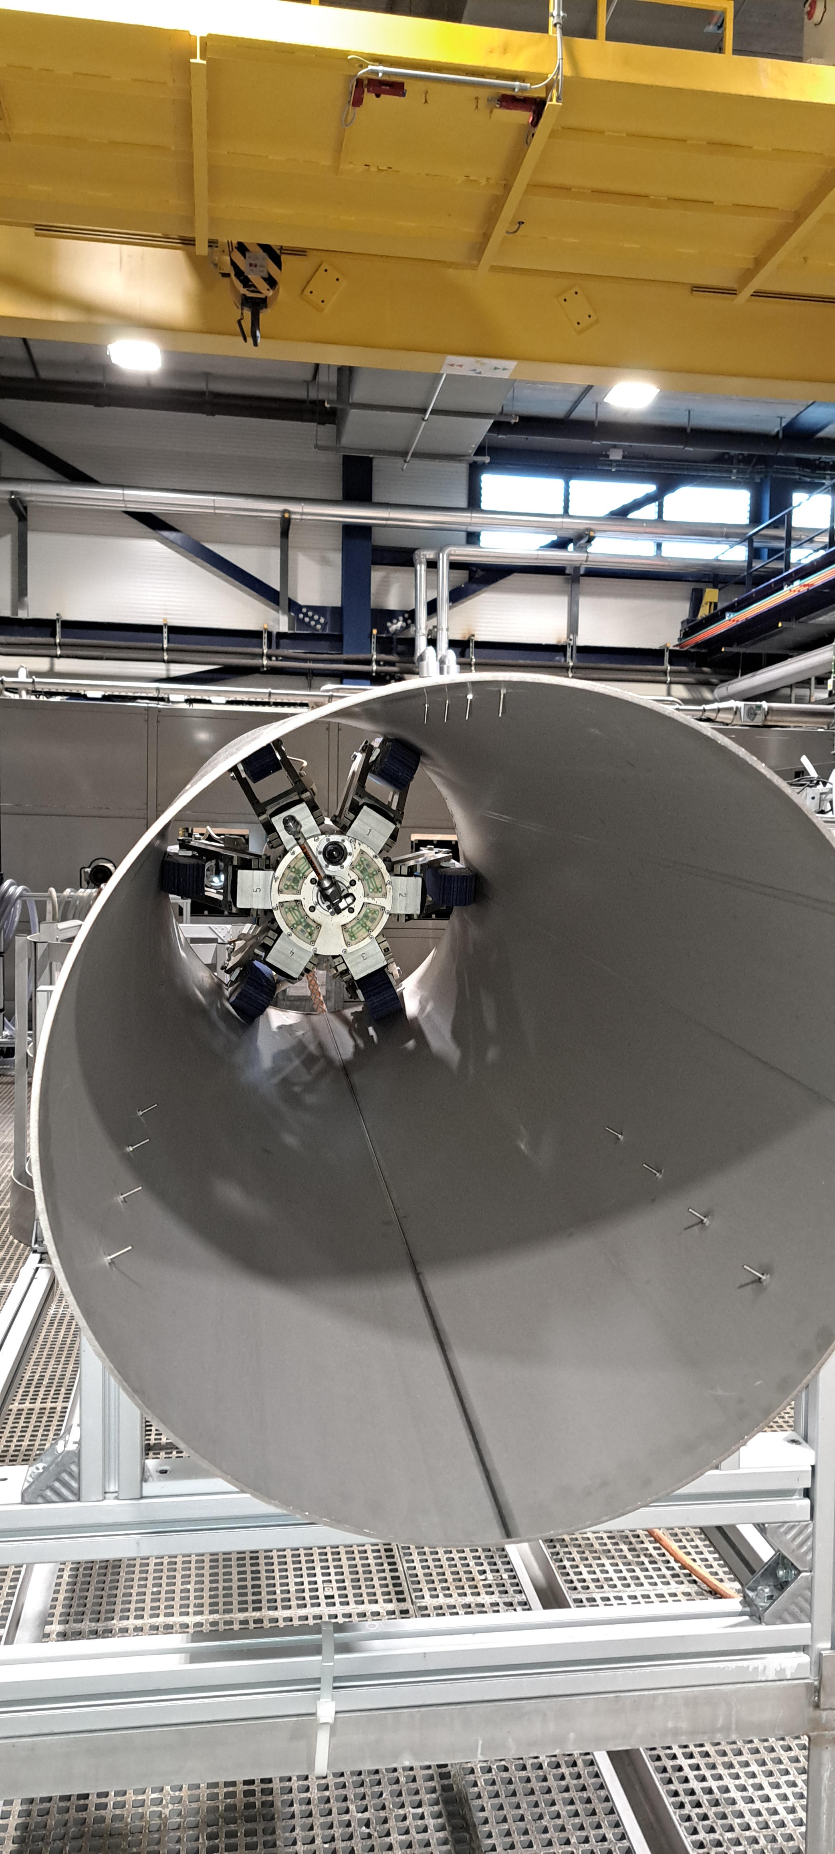
Start of the Contract
End date of the Contract
2024 - Main
achievements
01-08-2022
65%
31-07-2025
Cleaning test with robots
Cleaning studies in dimensions out of CERN capabilities
Images courtesy of L. Ferreira

Slide 22
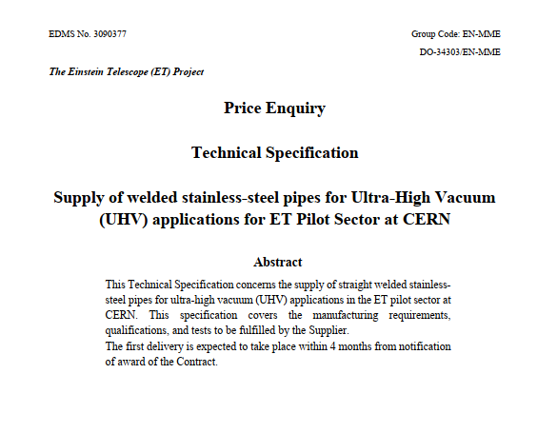
Start of the Contract
End date of the Contract
2024 - Main
achievements
01-08-2022
65%
31-07-2025
Pilot sector pipes
Technical Specification
Pilot sector pipes manufacturing price enquiry

Slide 23
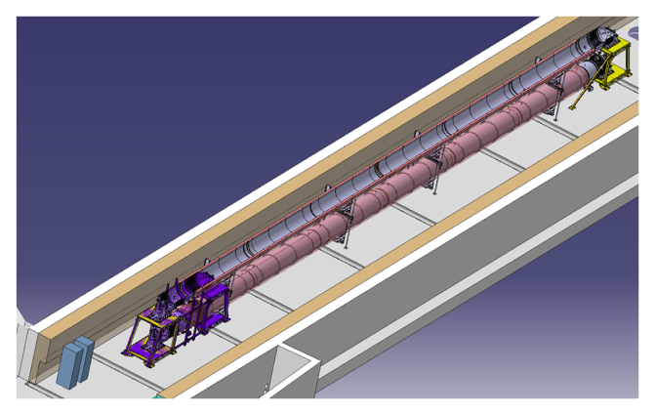
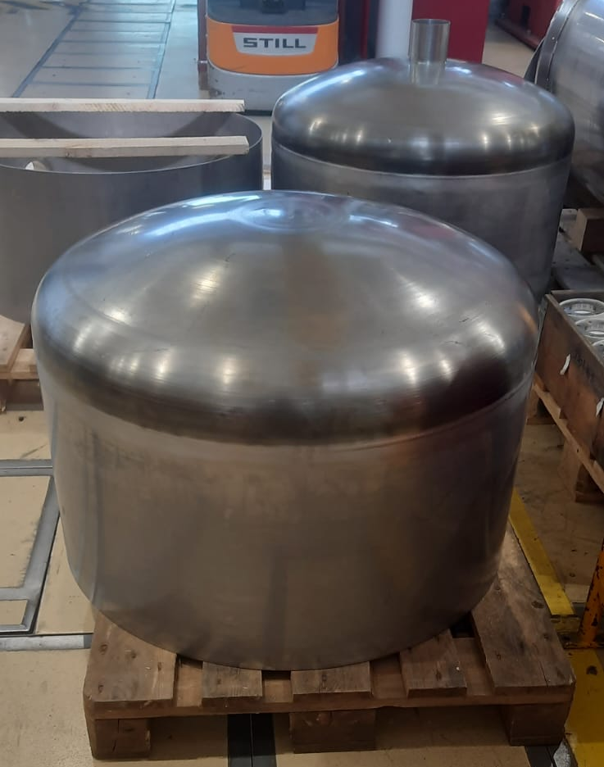
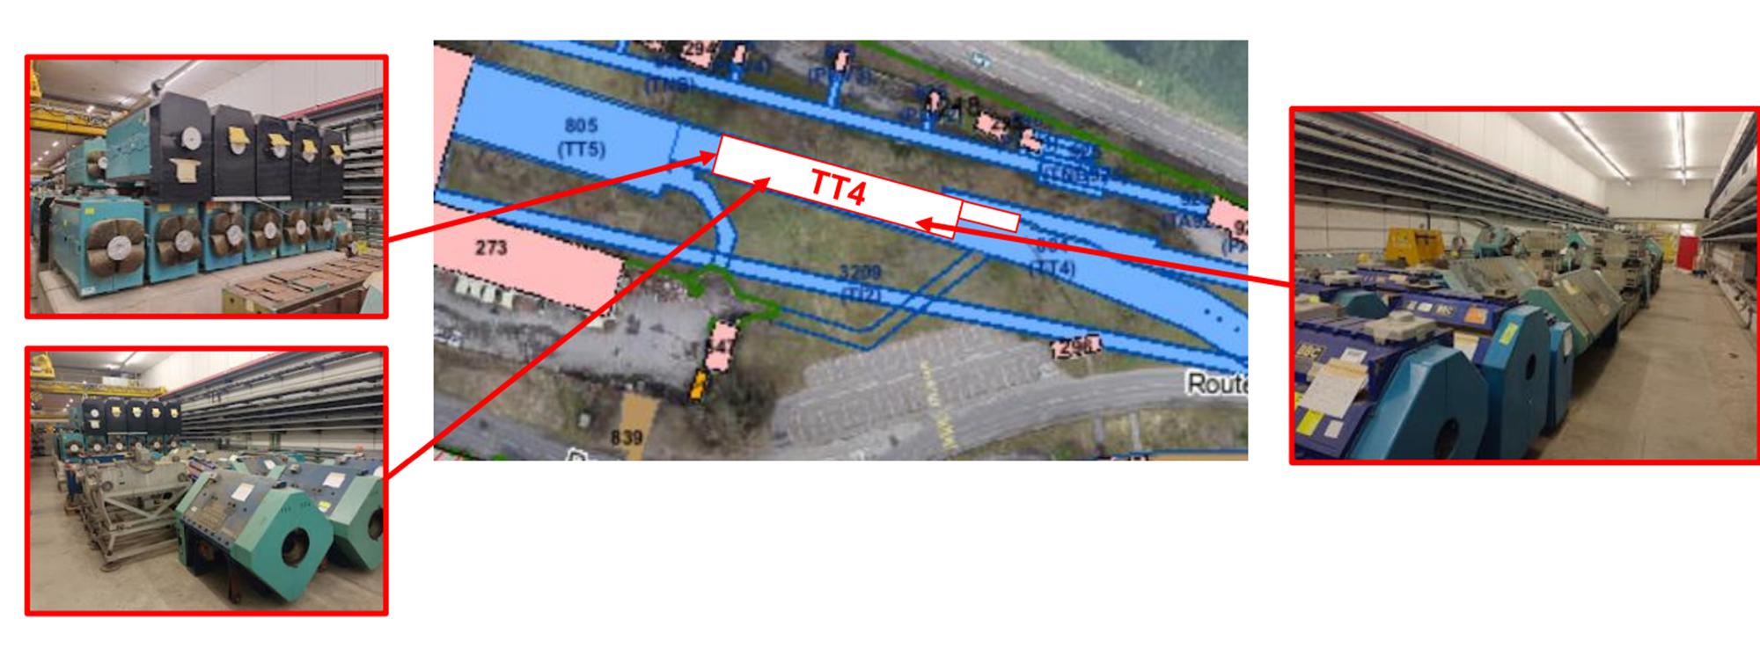
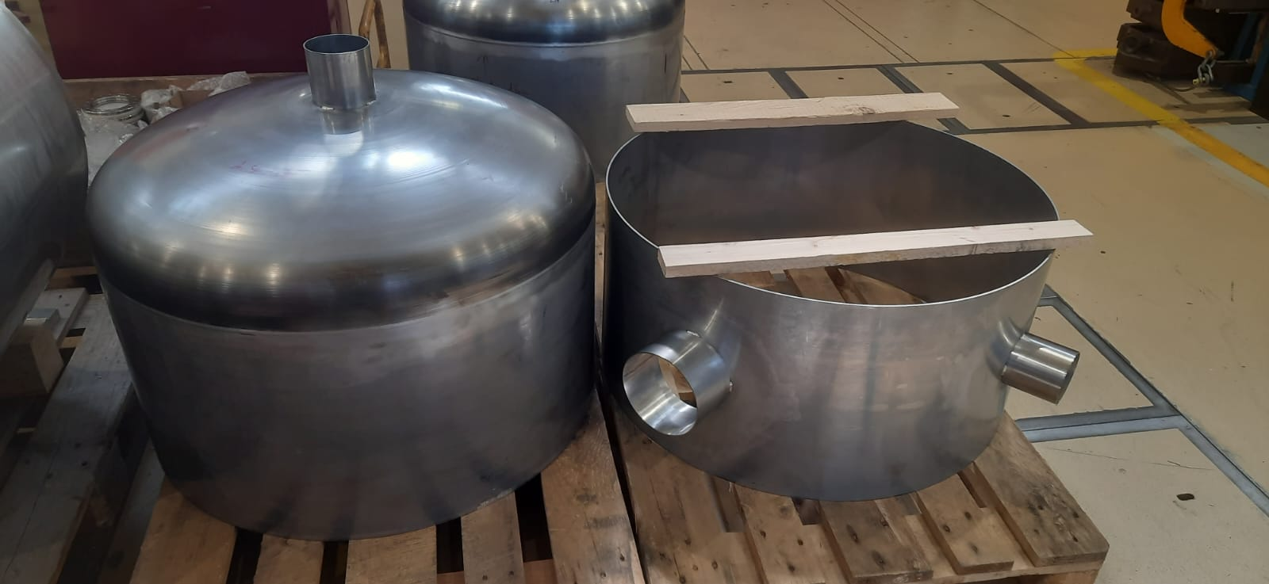
Start of the Contract
End date of the Contract
2024 - Main
achievements
01-08-2022
65%
31-07-2025
Fabrication of mock-up
Lay-out of the pilot sector in TT4 tunnel
Notes:
Peers review of the options proposed for the beampipe pilot sector
As it is not corrugated, TIG, plasma or laser are perfectly applicable for the ferritic grades

Slide 24
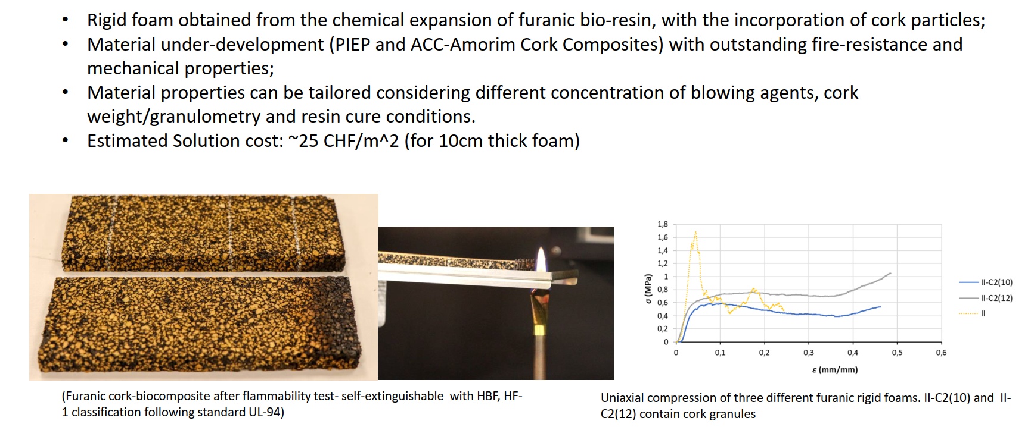
Start of the Contract
End date of the Contract
Currently
working on
01-08-2022
65%
31-07-2025
Thermal insulation studies
Corrosion test samples (welds)
Rigid foam (furanic-bio-resin with the incorporation of cork particles)
Notes:
Peers review of the options proposed for the beampipe pilot sector
As it is not corrugated, TIG, plasma or laser are perfectly applicable for the ferritic grades

Slide 25
Start of the Contract
End date of the Contract
Currently
working on
01-08-2022
65%
31-07-2025
Manufacturing of various components
Pilot sector pipes
installation procedure
for background test and transformation for final testing
Background vacuum measurements
Transformation for final testing
Notes:
Peers review of the options proposed for the beampipe pilot sector
As it is not corrugated, TIG, plasma or laser are perfectly applicable for the ferritic grades
Defining the measurement sequence

Slide 26
Start of the Contract
End date of the Contract
65%
01-08-2022
31-07-2025
Pilot sector installed and operational
Background vacuum characterisation concluded
At least one vacuum tube fully operational (4 mm)
2nd vacuum tube already manufactured or close to completion
Baffles installed and vacuum characterized
Pre-TDR written
Amendment of the present contract or new contract (wished start date 01/10/2024)

Slide 27
Start of the Contract
End date of the Contract
Proposed end date
65%
01-08-2022
31-07-2025
30-09-2027
Pilot sector installed and operational
Additional vacuum tube design (corrugated, spiral welded…)
Background vacuum characterisation concluded
Test degassing recipes to reduce Q of valves, flanges, gauges
At least one vacuum tube fully operational (4 mm)
ID1000 sector valves: test, integration, Q measurement
2nd vacuum tube already manufactured or close to completion
Dust control in the different phases of production and installation
Baffles installed and vacuum characterized
Alignment studies and optimisation of the supports
Pre-TDR written
Optimisation of leak detection procedure for pilot sector and ET
Optimisation of installation and commissioning procedure for ET
Optimisation of bakeout and thermal insulation
Amendment of the present contract or new contract (wished start date 01/10/2024)
Baffles: coating outgassing, integration and alignment
Update of TDR and cost assessment
Transfer of material and knowledge to the local team(s)

Slide 28
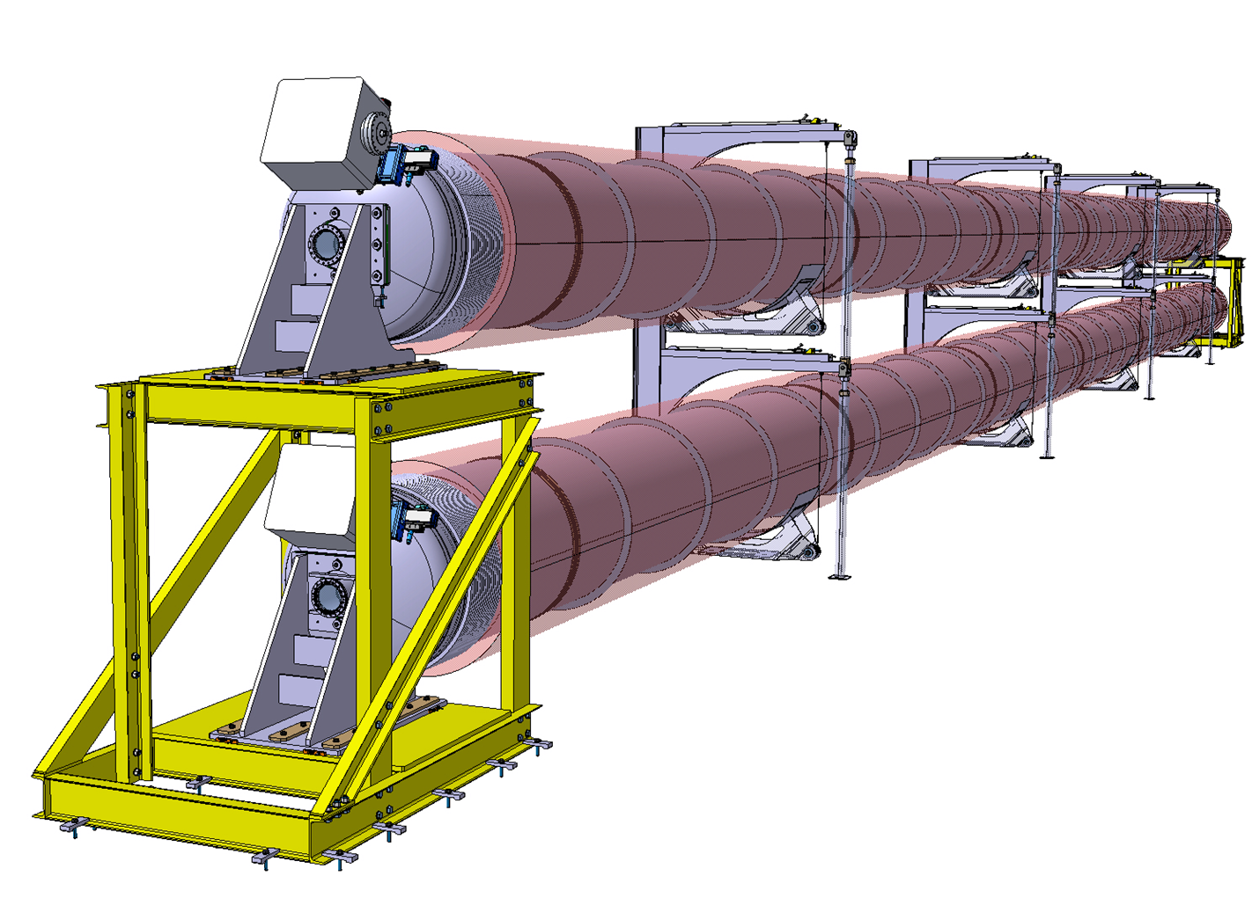
Conclusions
The ET beampipe activities at CERN have been summarized
Key technical decisions that will be implemented in the pilot sector have been discussed
We are progressing well towards our goal of making the pilot sector operational by 2025
An extension of the Contract is needed to accomplish additional tasks and optimizations that will be certainly useful for ET

Slide 29
Thanks!

Slide 30
ET beampipe pilot sector: purpose
  The pilot sector aims to test the design, fabrication, installation and commissioning of the proposed beampipes and support system. It also aims to compare the feasibility of a selected number of technical choices.
  Typical tests are:
  Installation and alignment of supports and beampipes.
  In-situ welding and assembly.
  Integration of thermal insulation, instrumentation and vacuum components.
  Leak detection procedure during fabrication and assembly.
  Pumpdown time.
  Bakeout: temperature distribution and efficiency.
  Ultimate partial pressures and outgassing rates.
  Validate the calculated vibration transmission matrix.
  Efficiency of the methods used to reduce the quantity of dust.
  Generate a platform that can be used for testing other solutions and provide a training set-up.

Slide 31
ET beampipe pilot sector: proposed material
Ø 400 mm x 2000 mm
Plate thickness < 1.5 mm
Corrugated pipe with thin wall
Standard (AISI 304L)/Alternate material
Accessories
Manufacturing
AISI 304L
Ferritic SS
S315MC
Manufacturing
WQ
Manufacturing
WQ
Manufacturing
WQ
Cu orifices
Supports
316LN flanges
316LN end covers
Cleaning
Small flanges machining
Welding flange-pipe-cover
Longitudinal welding
Forming/corrugation
Cleaning
Thermal treatment
Circular welding
Flanges welding
NDT
Metallurgy
Tensile testing
bending test
Longitudinal welding
Forming/corrugation
Cleaning
Circular welding
Flanges welding
Metallurgy
Tensile testing
Bending test
NDT
Longitudinal welding
Forming/corrugation
Cleaning
Circular welding
Flanges welding
Metallurgy
Tensile testing
NDT
Vacuum test

Slide 32
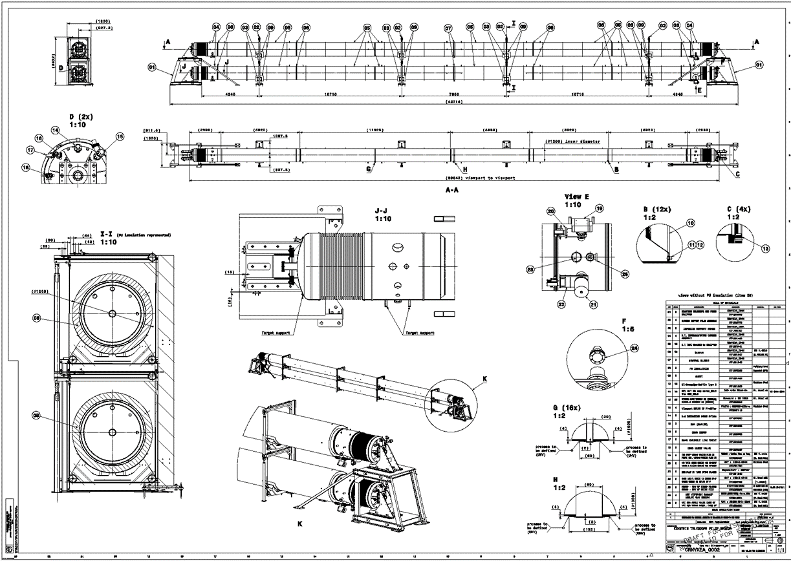

Slide 33
The main achievements
Q3-2022
Q4-2022
Q1-2023
Q4-2023
Q2-2023
Q3-2023
Q1-2024
Mild steel: firing not needed to attain requirements
Design of a corrugated beampipe
Strategy for surface
cleaning & metallurgical studies
Welding issues solved with AISI 441
Design of the pre-prototypes
AISI 304L pre-prototype
manufactured & installed
Mild-steel pre-prototype
manufactured & installed
Pumping modules
& integration
First cleaning test results
Ferritic StSt: firing not needed to attain requirements
Proposal for a vacuum layout & control system
Workshop
Choice of the space
for the pilot sector
Pilot sector: design, integration, bakeout
Support system &
vibration analysis
Design of baffles integration in pilot sector
Welding studies on ferritic StSt (corrugated)
Planning for pilot sector stablished

Slide 34
CERN participation: Main achievements
AISI 441 pre-prototype
manufactured & installed
Purchasing of AISI 441 coils for the pilot sector (12-week lead-time)
Peers review of the options proposed for the beampipe pilot sector
Technical specification for Virgo-like pipes for pilot sector
Pilot sector pipes manufacturing price enquiry
Lay-out of the pilot sector in TT4 tunnel
Q1-2024
Q2-2024
Proposal of a new welding procedure (4 mm thickness)
Cleaning tests with robot
Fabrication of mock-up for testing compatibility of new welding procedure and dust studies

Slide 35

ET beampipe pilot sector: detailed design

Slide 36
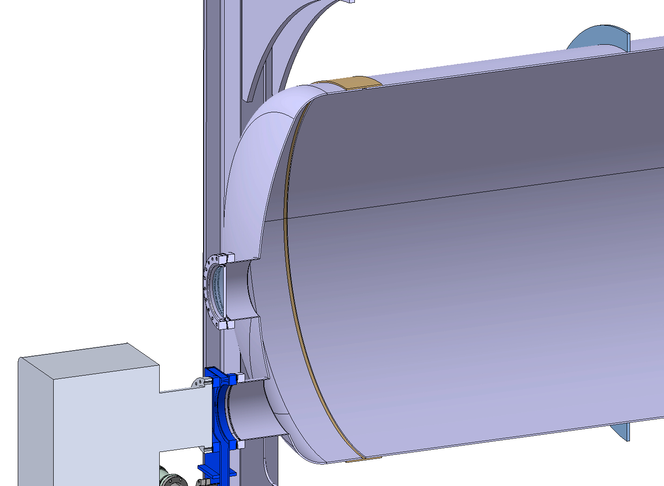
ET beampipe pilot sector: proposed material
Materials | ET Vacuum requirements | Manufacturability (Welding and forming) | Corrosion resistance | Air bakeout/ vacuum firing | Cost
AISI 304 L | Good | Good | High | Necessary | High
S 315 MC | Good | Good | Low | Not necessary | Low
AISI 441 | Good | Good | High | Not necessary | Low
Components | Material and dimensions (Procurement estimation)
Vacuum chamber and end caps | AISI 441, 2B surface,~ 4 mm thickness, width of coil ~1500 mm, quantity=12 tons**
Stiffeners | AISI 441 / 304L, 4-8 mm thickness, width 45-60 mm, length ~3.5m, 80-100 pieces
Sleeves | AISI 441, ~2mm thickness, standard width coil, 1 ton
S315 MC | AISI 441 | 304L
~1100 €/ton | ~2100 €/ton | ~4000 €/ton
** Quantity of material needed for two chambers

Slide 37
ET beampipe pilot sector: proposed connection welding
2 options:
Radial lip weld
External welded sleeve
Vacuum chamber wall
External sliding welding sleeve:
Same stainless steel grade
Fillet weld
Vacuum chamber wall
The second solution is considered for the pilot sector.

Slide 38
ET beampipe pilot sector: measurement sequence
Configuration 0
Configuration 1
Configuration A
Configuration B
Instruments
Valves
Only the mobile pumping group one
Pumps
Mobile pumping group only
Ultimate vacuum
Isosteres
Accumulations
Isosteres
Accumulations
Isosteres
Ultimate vacuum
Isosteres
Measurements
EC
+
bellow
PM
PM
EC
+
bellow
EC
+
bellow
PM
Chamber
PM
EC
+
bellow
Reduced system
Full system

Slide 39
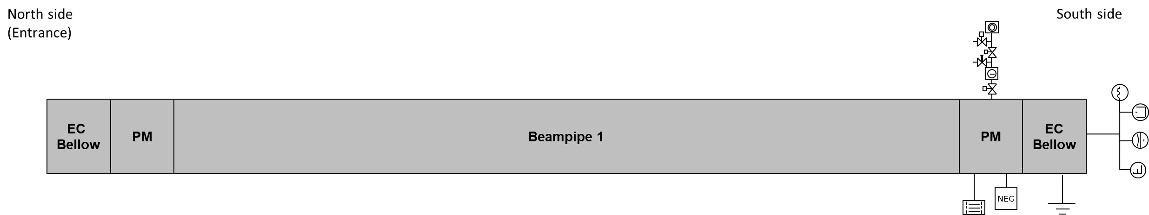
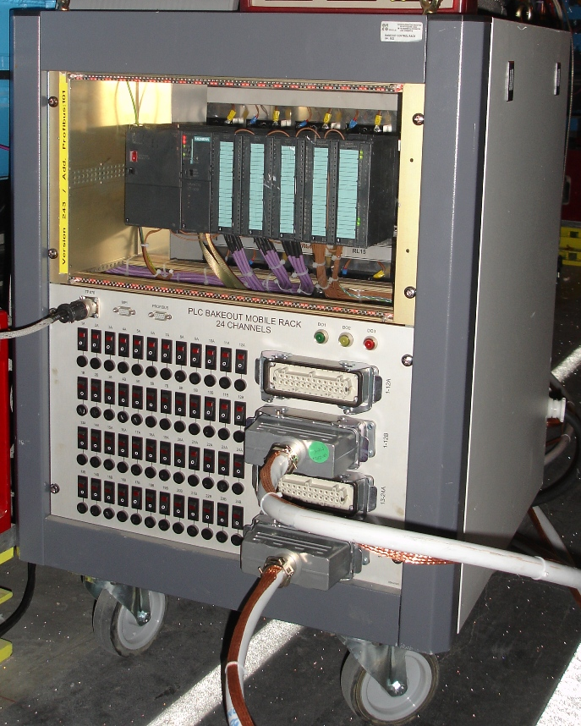
ET beampipe pilot sector: bakeout
Chamber:
I = 1855 A
R = 1.93 mΩ
V_{drop} = 2.7V
Connection to the pipe
I = 1855 A
4x250 mm², 5m, R = 0.08mΩ
V_{drop} = 0.15V
V_{drop tot} = 4 V
Return cable:
I = 1855 A
4x250 mm², 40m, R = 0.67 mΩ
Vdrop = 1.24V

Slide 40
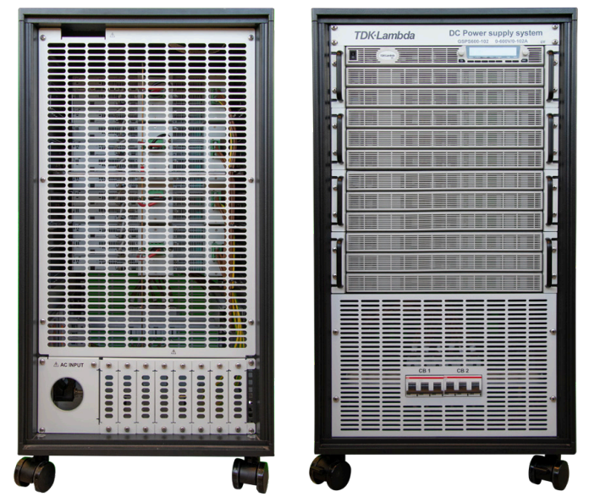
ET beampipe pilot sector: bakeout
TDK-Lambda (Origin: Israel IL)
  GSPS30-2040 (up to 2040 A / 30V unidirectional) with 20U mobile rack
  Price: 55 kCHF, including rack 19”, 20U
  Delivery time: approx. 14 weeks
  Quotation received in 09/2023

Slide 41
ET beampipe pilot sector: thermal insulation
Furanic-cork biocomposite rigid foam.

Slide 42
ET beampipe pilot sector: dust control
Reception 6m long units
Cleaning
Thermal insulation
Metrology
Baffle integration
Installation in place
Cleaning
Transport - storage
Welding
Leak detection
Welding of 18 m chambers
Global leak detection
Interface integration
Leak detection
Commissioning
Standard procedure
Specific procedure to maintain dust cleanliness (soft wall cleanroom)

Slide 43
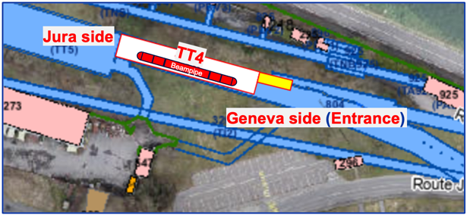
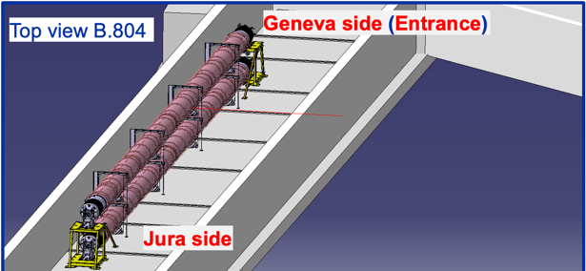
ET pilot sector – Alignment
Contact established with CERN alignment and survey services.
Request for support during the installation sequence in TT4 (see also next slide):
  Trace the floor plan before installation of the supports
  Help with the alignment of the vacuum supports during installation
  Help with the alignment of vacuum chambers with respect to the end supports before welding.
  Check the position of the chambers when the system is under vacuum.
Started discussions for the alignment techniques for the 10km installation.

Slide 44
ET – CERN to be proposed future scope extension
Test of beampipe other than AISI 441 4mm VIRGO-like.
Prepare the framework for other beampipe solutions to be tested in the same environment.
Purchase a gate valve and carry out the mechanical integration studies, the UHV caracterization inclusing the conditioning and outgassing rate measurements.
Workout the detailed integration with the civil engineering.
Study alignment techniques for the 10km assembly and installation and eventual optimisations of the support system.
Design of leak detection systems for the manufacturing, installation and final system.
Design the detailed procedures for the installation and commissioning in the final ET tunnel design.
Study for the control of dust during all assembly and installation processes.
Carry out the baffle material outgassing studies and its integration and alignment in the ET final tubes.
Open to discuss, via ETO, the possibility to carry out other type of tests.
Update the TDR and costing in line with general ET timeline.

Slide 45
ET pilot sector: peer review recommendations
Recommendation | Action
Investigation on corrosion resistance of ferritic stainless steels (tunnel environmental conditions) | Contract with UGhent to be launched for comparative corrosion studies
Use pilot sector as testbed for extrapolation of ET leak detection | Methodologies and tooling under investigation
ET pilot sector to be used to test different insulation materials and solutions (installation, removal) | Contact with companies started
Implementation of large gate valves (DN1000+) to test thermal cycling, stroke cycling, treatments etc. | Planned in the extension of ET-CERN scope
Implementation of temperature control systems in selected building | ET pilot sector moved to TT4 tunnel – stable temperature.
Consider launching a parallel test on a corrugated chamber (perhaps through external contribution) | Planned in the extension of ET-CERN scope
See Carlo’s Presentation

Slide 46
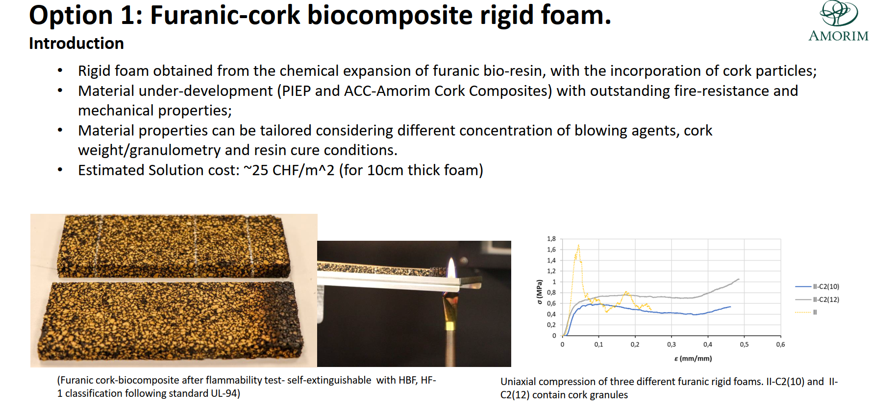

Slide 47
