Slide 1

Working Package 5
Project Office & Enginering Department
Alessandro Variola, INFN Roma1
Patrick Wernecke, NIEKHEF
Christian Olivetto, IJCLAB

Slide 2


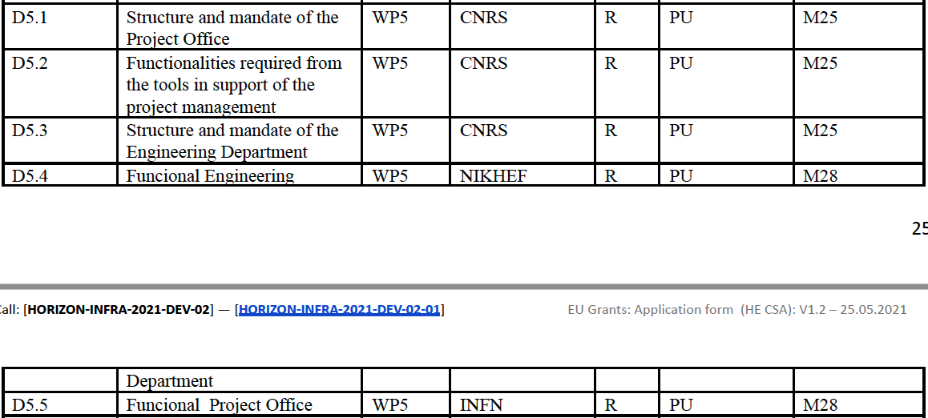
WP5: Deliverables (1)
03/05/2024
WP5 Meeting

Slide 3
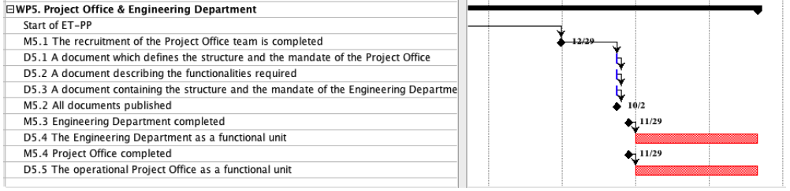
WP5: Deliverables (2)
03/05/2024
WP5 Meeting

Slide 4
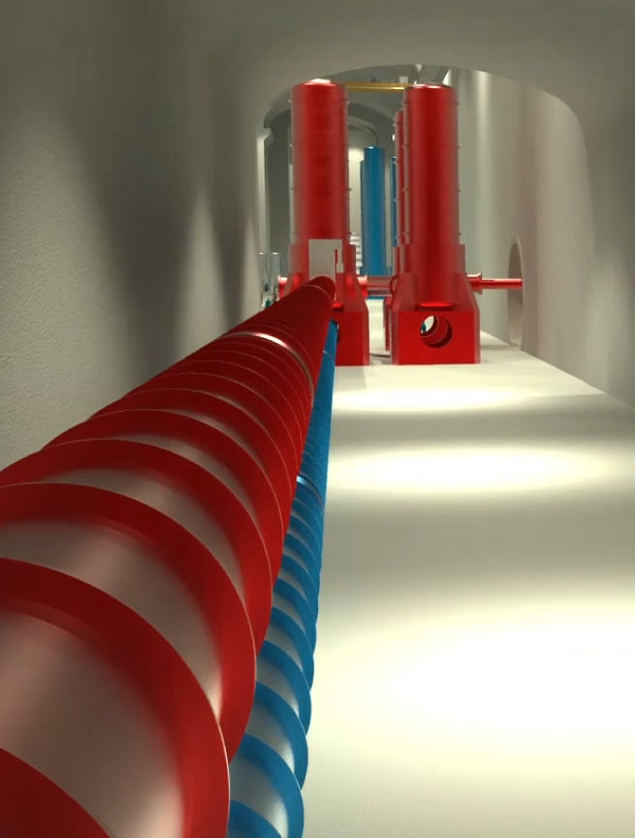
Engineering Department - Mandate
Mandate: design, procure, install, commission, operate, maintain and eventually, dismantle:
The technical infrastructure systems needed to operate the interferometer
  Civil Engineering: shafts, caverns and tunnels, surface buildings and landscaping, …..
  Technical Infrastructures: Cooling and Ventilation, Access and Alarms,
  Electricity Engineering, …..
The special systems associated with the gravitational wave detector
  Vacuum beampipe
  Cryogenics infrastructure
  Survey
Tasks associated with on-site responsibilities:
  Logistics and installation, engineering integration and safety in the field

Slide 5
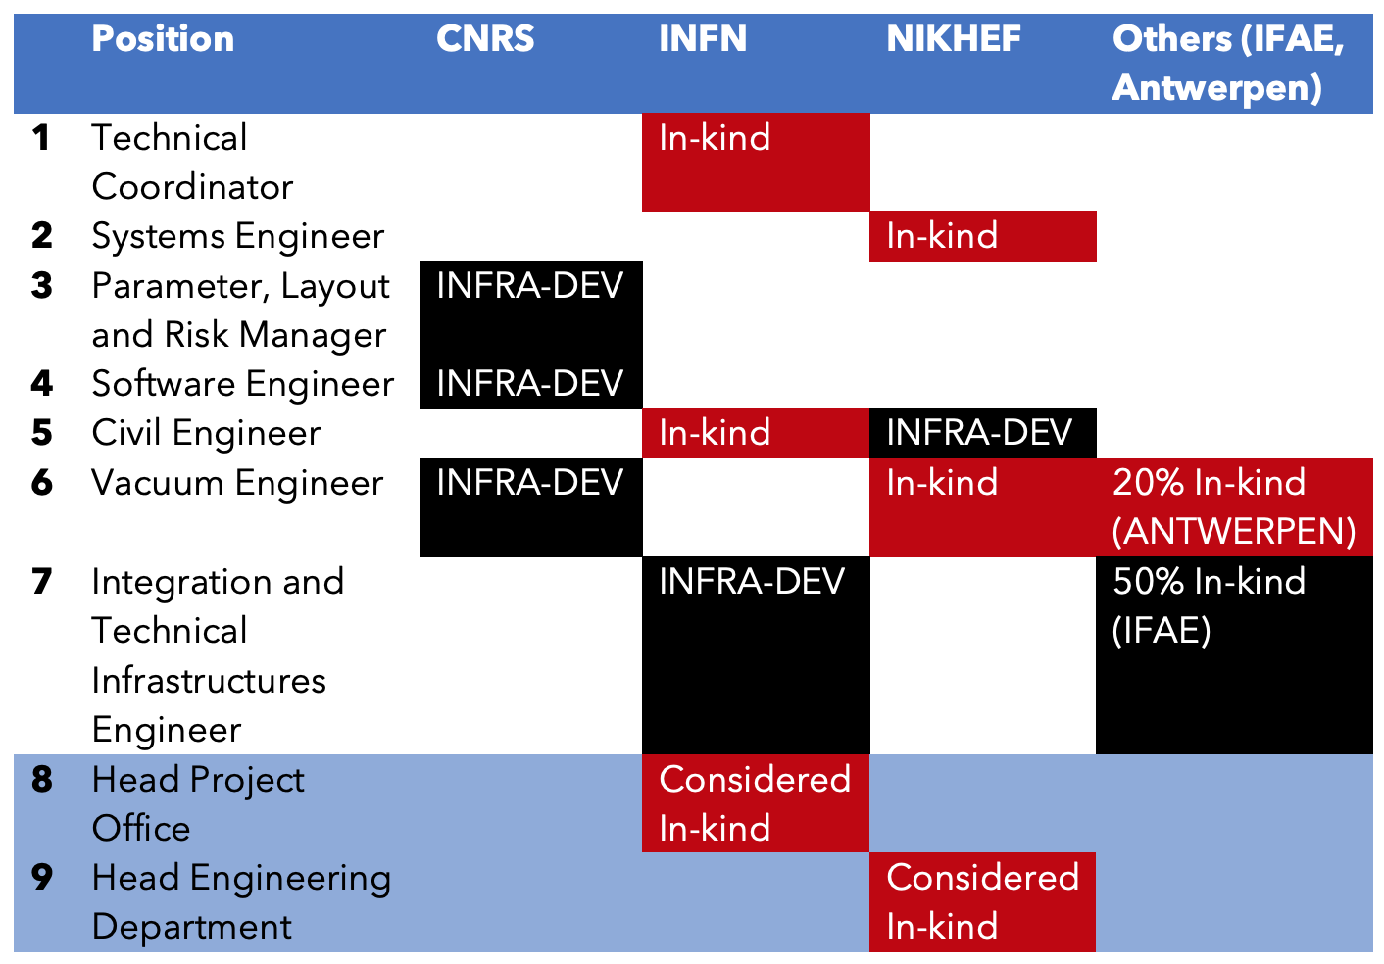
Engineering Department – Personnel
In Office
In office in Annecy
In Office
In Office
In Office
Still vacant
In office
One INFRA-DEV PP position remain vacant despite repeated recruitment attempts !

Slide 6
Engineering Department – Organisational Chart
Engineering Department
Patrick Werneke (Nikhef)
Civil Engineering
Maria Marsella (INFN)
Technical Infrastructure
……
Mechanical Engineering
……
Logistics and Installation
….
Coordination and Integration
…..
Civil Engineering:
Jonathan Bratanata (Nikhef)
Wissam Wahbeh (FHNW)
…..
Cooling and Ventilation
…..
Vacuum:
Marije Barel (Nikhef)
Alexandre Lacroix (CNRS)
Guillaume Deleglise (CNRS)
Romain Bonnand (CNRS)
Rafael Garcia (IFAE)
Logistics:
Max Majoor (Nikhef)
Integration:
…..
Access and Alarms
…..
Handling Engineering:
…..
Operational Safety:
Phase 2
Cryogenics:
…..
Electrical Engineering
…..
Survey:
…..

Slide 7
ETO Engineering Department – ET Phases
ET is currently in Phase I of a Design and Preparation Phase, which ends with the site decision and the principal approval for construction of ET.
Main ETO deliverables for Phase 1:
  Preliminary TDR
  Budget and risk report (Phase 2 + following phases)
  Planning report (Phase 2 + following phases )
  Organizational report (Phase 2 + following phases)
  Site evaluation report

Slide 8
ETO Engineering Department – ET Phases
Phase 2 + following Phases:
Phase 2 of the Design and Preparation: this phase will end with the final TDR, costing overview, risk assessment and schedule for the construction;
Implementation Phase: this phase will end with the Einstein Telescope commissioned;
Operation Phase;
Termination Phase.

Slide 9
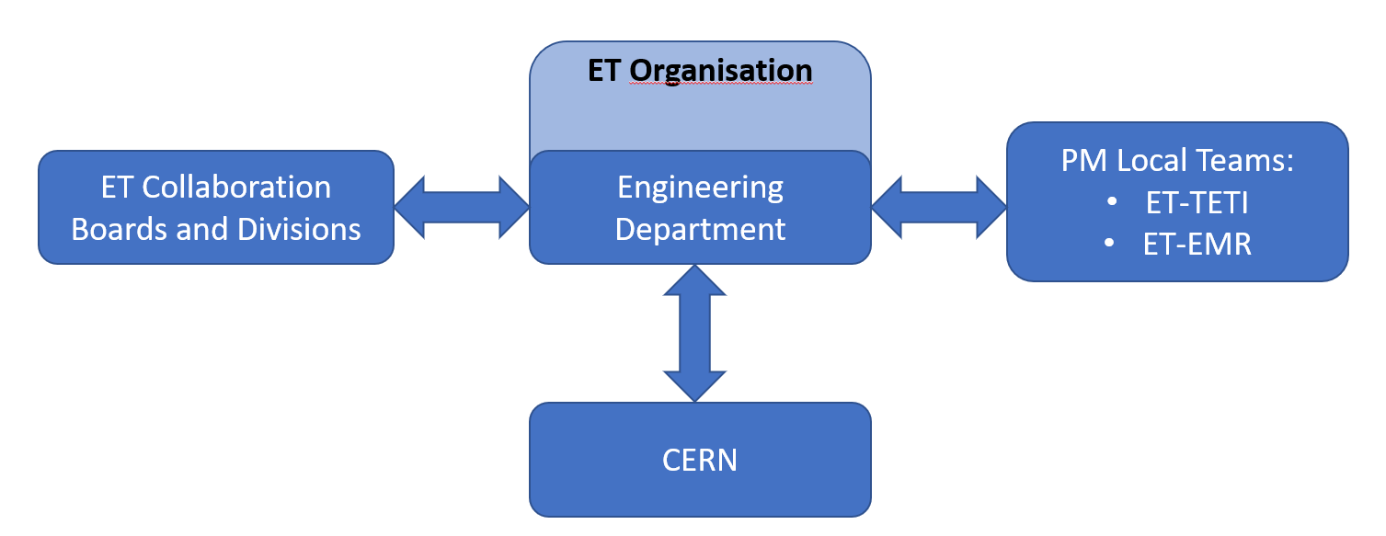
ETO Engineering Department – ET Phases
ET-PP: bi-weekly
ETO management: weekly and monthly f2f
Engineering Department: monthly
Civil Engineering: bi weekly
ETO – CERN vacuum: f2f /3 months
(monthly meeting @CERN)
ETO civil engineering – CERN civil engineering: monthly f2f
ETO civil engineering – Local teams (TETI & EMR) bi-weekly
Following the various technical ET Collaboration meetings

Slide 10
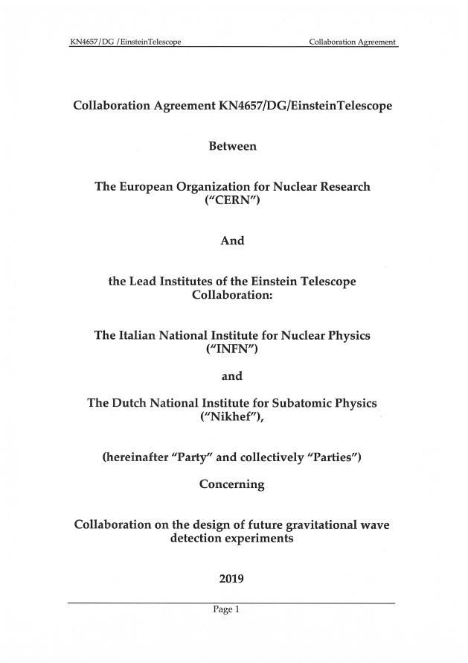
Collaboration Agreement with CERN
Vacuum beampipe: pilot sector and TDR (talk CERN)
Civil Engineering: technical support
Under discussion:
Technical Infrastructure
Occupational Health and Safety
Costing, planning, integration, information management
Cryogenics and Survey

Slide 11
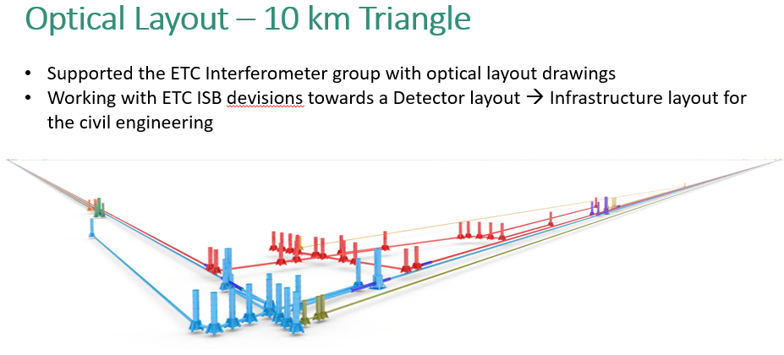
ED activities with ET Collaboration
11

Slide 12
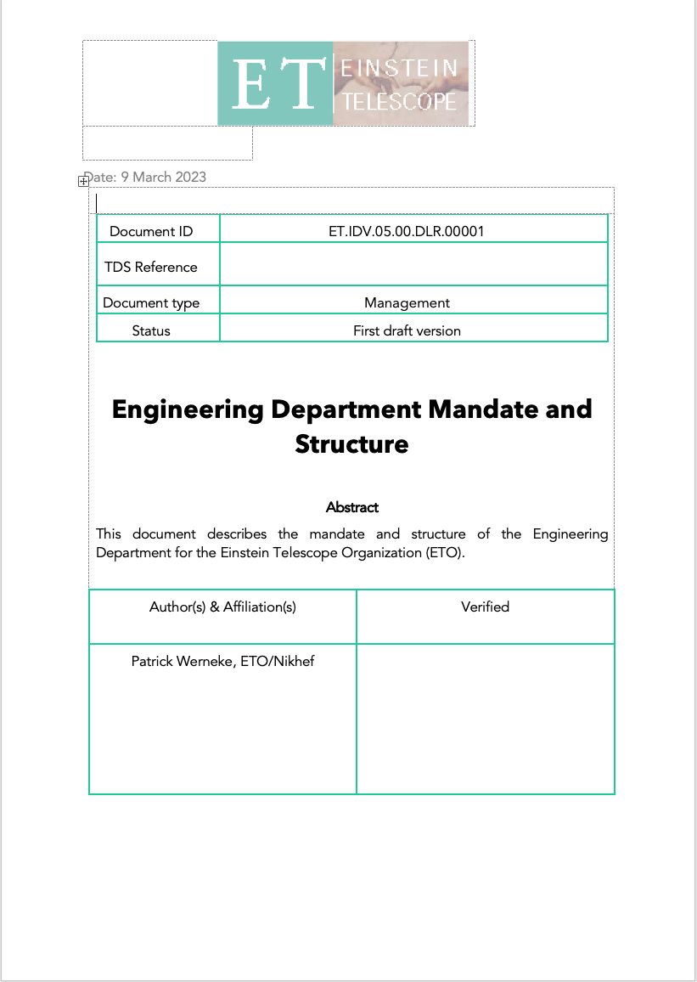
Next steps for the Engineering Department
ET-PP deliverables 2nd half 2024
Continue with recruitment of vacant position
Completing request of funds
Continue development of the Engineering Department
Working Closely with Collaboration and Local Teams.

Slide 13
The Project Office
Alessandro Variola, INFN Roma1

Slide 14
Mandate
PO main goal has been identified as :
guaranteeing that the as-built research infrastructure fully complies with ​the requirements, the parameters​ and the technical layouts detailed in the project baseline configuration included in the TDR.
This objective must be achieved without making changes that were not endorsed by the stakeholders​ and adhering to the final schedule and the estimated budget.
To accomplish this task we are working to set up:
A Schedule
A Budget (phase I – cost estimate)
The Configuration
These needs to be defined also by QA and risk analysis processes

Slide 15
Project Office Team & Expertise
 | Name | Institute | Role | e-mail
1 | Alessandro Variola | INFN | Project Office Head | alessandro.variola@roma1.infn.it
2 | Lucia Lilli | INFN | PO Assistant | lucia.lilli@infn.it
3 | Alessio Rocchi | INFN | Technical Coordinator | alessio.rocchi@roma2.infn.it
3 | Fiodor Sorrentino | INFN | Technical Coordinator | fiodor.sorrentino@ge.infn.it
4 | Luca Latronico | INFN | Quality Manager | luca.latronico@to.infn.it
5 | Leonardo Lucchesi | INFN | Quality Manager | leonardo.lucchesi@pi.infn.it
6 | Leonardo Orsini | INFN | Quality Manager | leonardo.orsini@pi.infn.it
7 | Sandro Vescovi | INFN | Safety Manager | sandro.vescovi@lnf.infn.it
8 | Patrice Verdier | CNRS IN2P3 | IT Manager | patrice.verdier@in2p3.fr
9 | Remi Barbier | CNRS IN2P3 | IT Manager | r.barbier@ip2i.in2p3.fr
 | Oussama El Mecherfi | CNRS IN2P3 | IT Manager | o.el-mecherfi@ip2i.in2p3.fr
 | Joseph Martino | CNRS IN2P3 | Risk Manager | joseph.martino@apc.in2p3.fr
10 | Ghada Mahmoud | CNRS IN2P3 | Risk Manager | mahmoud@apc.in2p3.fr
11 | Christian Olivetto | CNRS IN2P3 | Configuration Manager | Christian.olivetto@universite-paris-saclay.fr
12 | Romano Meijer | NIKHEF | Requirements Manager | rmeijer@nikhef.nl
13 | Ivan Maksimovic | CNRS IN2P3 | Schedule Manager | Ivan.Maksimovic@espci.fr
14 | X |  | Financial Manager
Working for a MoU with CERN for the cost estimate (financial management in phase 1)

Slide 16
Activities
PBS (Product Breakdown Structure) process reviews (see dedicated page on the ET wiki)
Project Office wiki pages (Introduction for each domain & sharing informations)
EDMS (Electronic Document Management System) test platform operative
Reference system (document on EDMS)
Work in progress:
Change request process
Nomenclature reference process
Roadmap definition for Project Office
Configuration, risk, requirements management plans and assessment
Schedule based on dedicated tool or gneral-purpose PLM Tool

Slide 17
Next
Project Office face-to-face day in Rome (July 1&2)
Elaborate a proposal for WBS (Working Breakdown Structure)
Elaborate a proposal for ‘preliminary’ cost and risk analysis
Provide the context for the configuration database
Provide inputs to the roadmap strategy

Slide 18
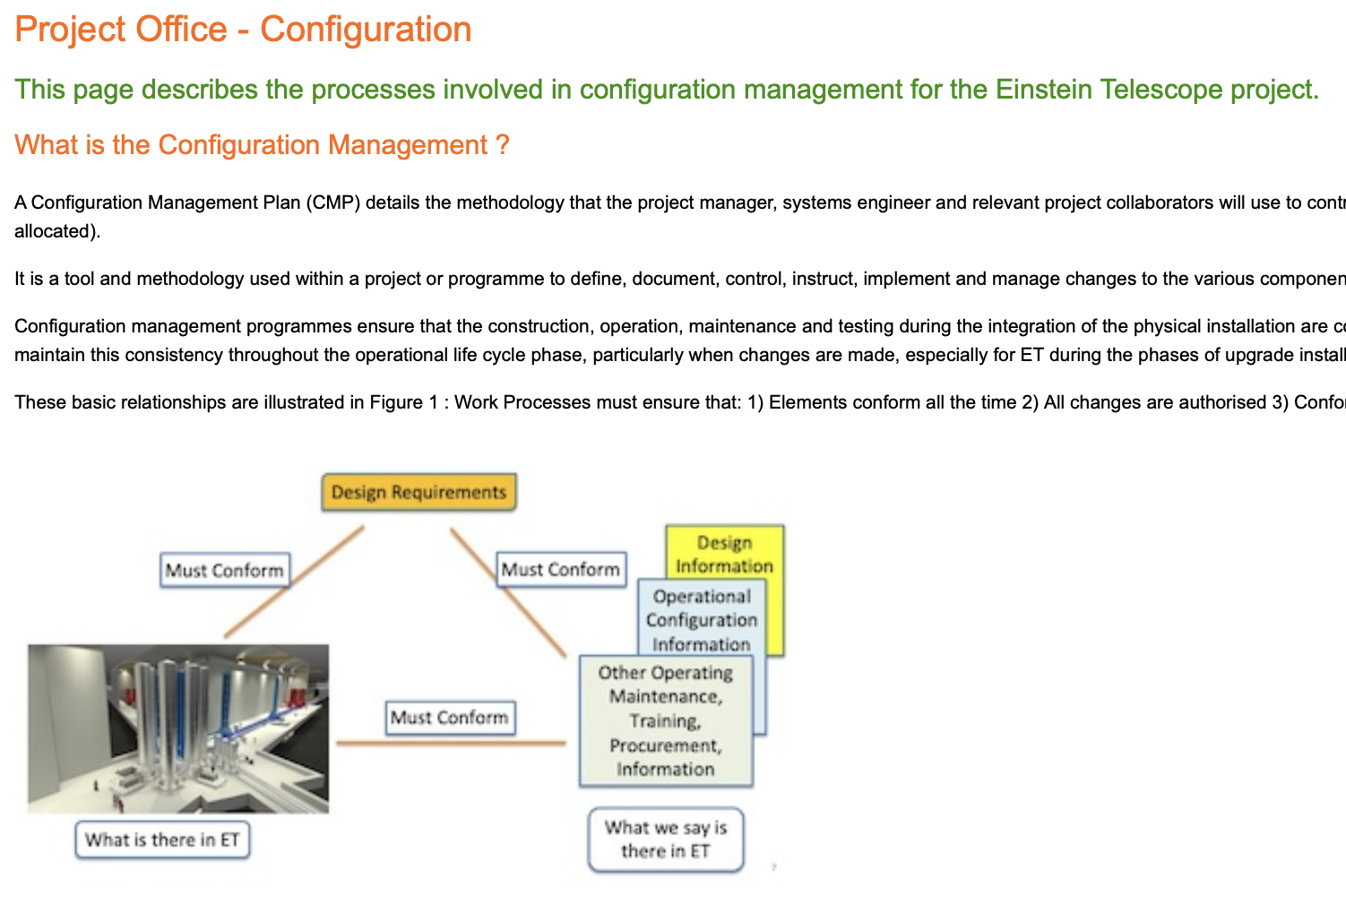
Extra Wiki Page

Slide 19
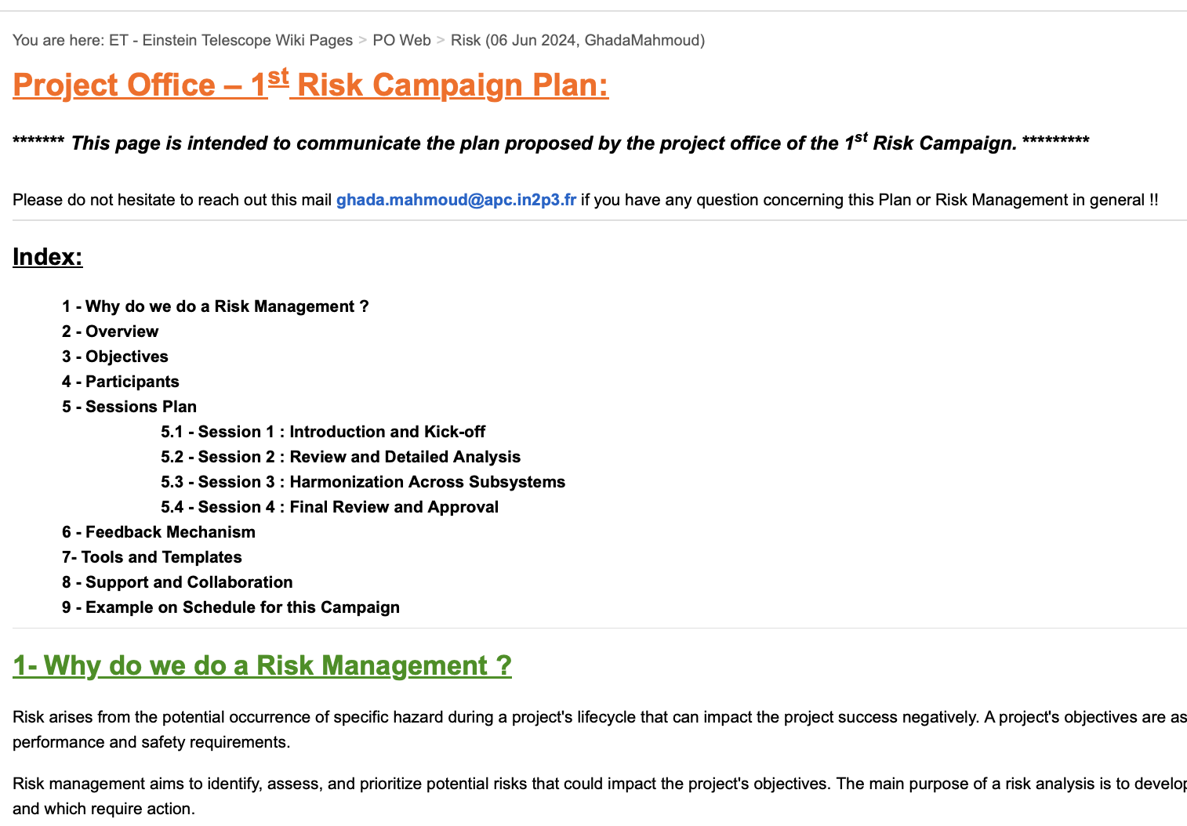
Extra Risks Interviews Campaign

Slide 20
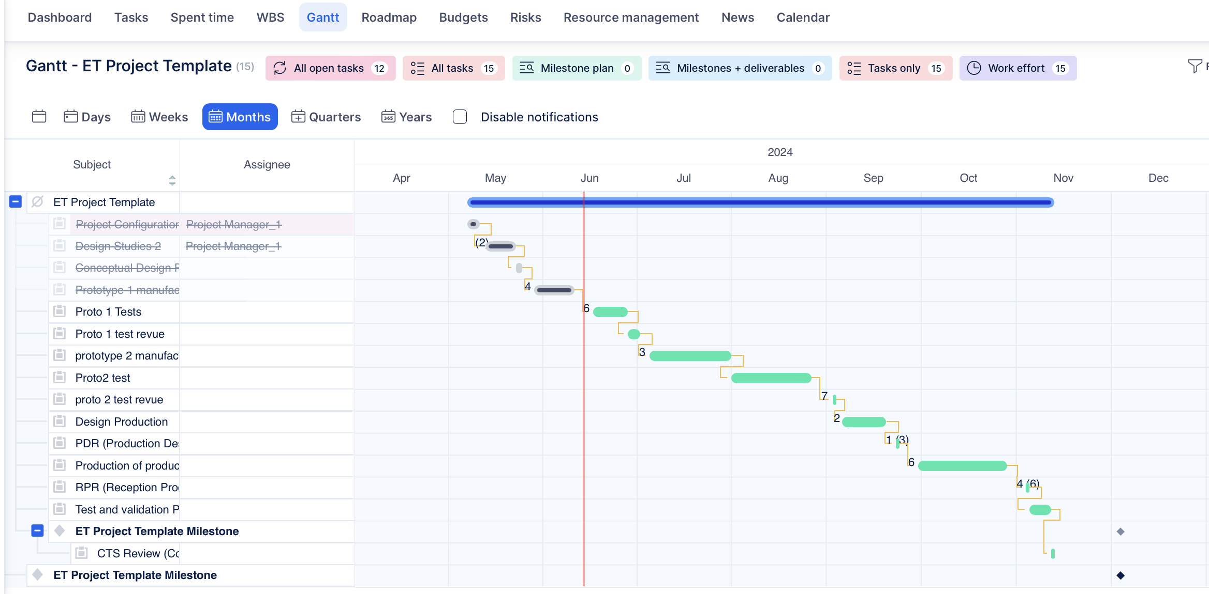
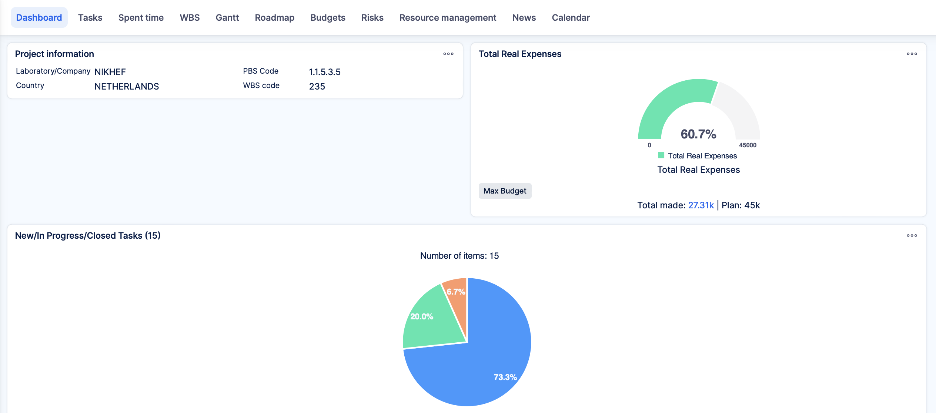
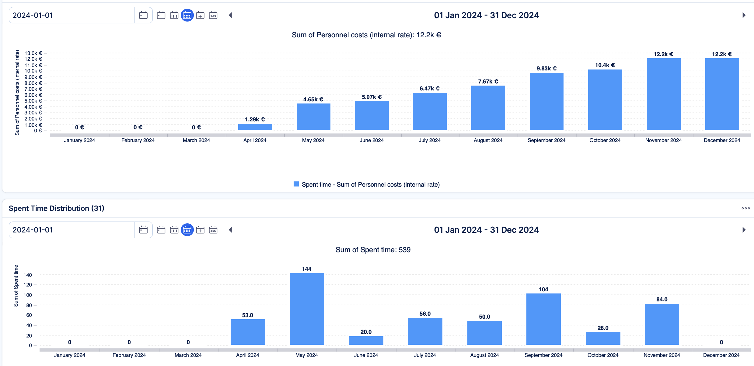
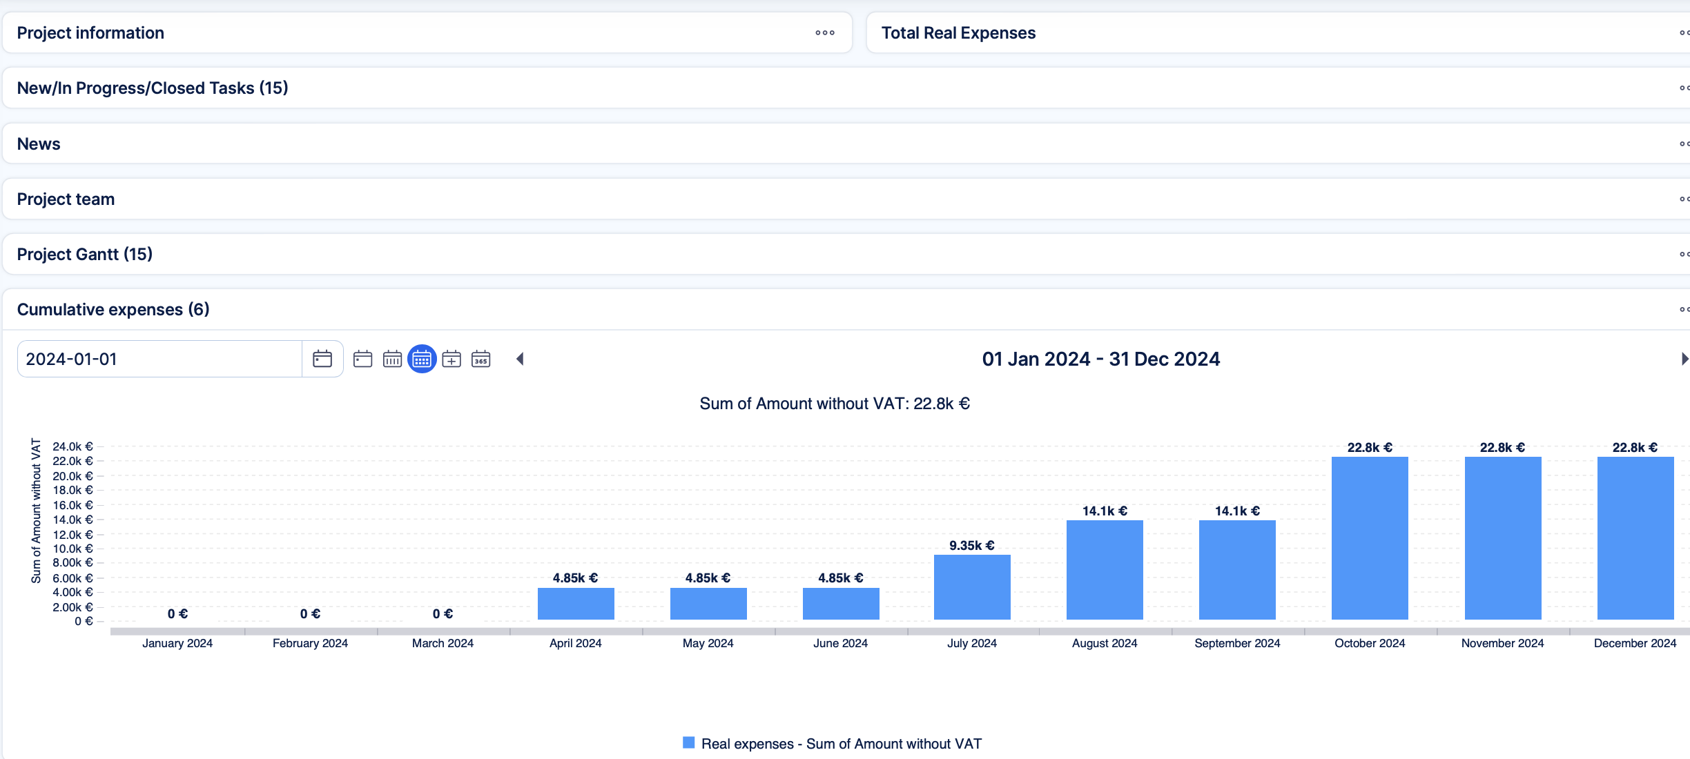
Extra Schedule Tool Evaluation

