Slide 1
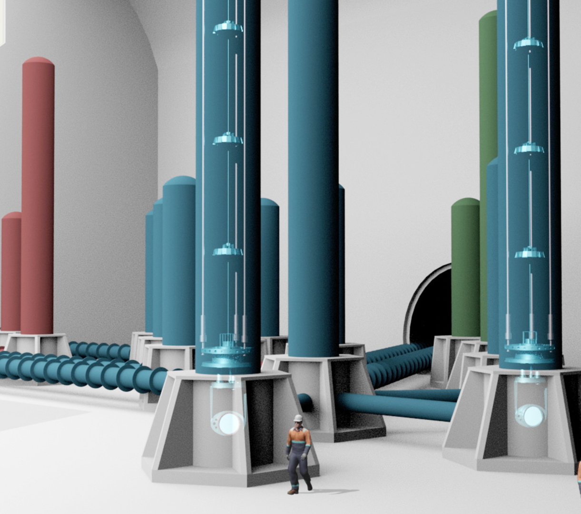
ET-PP June 2024
WP6 deliverables
Michele Punturo
Harald Lueck

Slide 2
WP6 - Deliverables
D6.1 Refined Science Case (M18) – Feb24
D6.2 Vacuum pipe Design (M24) – Sept 24;
D6.3 Preliminary RI TDR (M24) – Sept24;
D6.4 Preliminary DET TDR (M24) – Sept24;
D6.5 RI TDR (M40) – Feb26;
D6.6 DMP and Data Access Policy (M46) – Jul26.

Slide 3
WP6 - Deliverables
D6.1 Refined Science Case (M18) – Feb24
D6.2 Vacuum pipe Design (M24) – Sept 24;
D6.3 Preliminary RI TDR (M24) – Sept24;
D6.4 Preliminary DET TDR (M24) – Sept24;
D6.5 RI TDR (M40) – Feb26;
D6.6 DMP and Data Access Policy (M46) – Jul26.

Slide 4
D6.1 Refined Science Case
The status of this deliverable is summarised by the slides presented by the OSB chairs at the last ET Symposium
The first pillar of the deliverable is already available and published

Slide 5
D6.1 Refined Science Case
The status of this deliverable is summarized by the slides presented by the OSB chairs at the last ET Symposium
The first pillar of the deliverable is already available and published
The second pillar is the so-called Blue Book.

Slide 6
D6.1 Refined Science Case
The status of this deliverable is summarized by the slides presented by the OSB chairs at the last ET Symposium
The first pillar of the deliverable is already available and published
The second pillar is the so-called Blue Book.
It is supposed to be available in a complete but not polished version in Sept24

Slide 7
D6.1 Refined Science Case
Suggested strategy:
No need to push the Collaboration to obtain a polished version within Sept24
Proposal: Ensure delivery of the finalised version of the Blue Book by Feb25, but submit the CoBA paper and the complete draft version of the Blue Book to the EU officer as a preliminary «proof-of-state» in Sept24

Slide 8
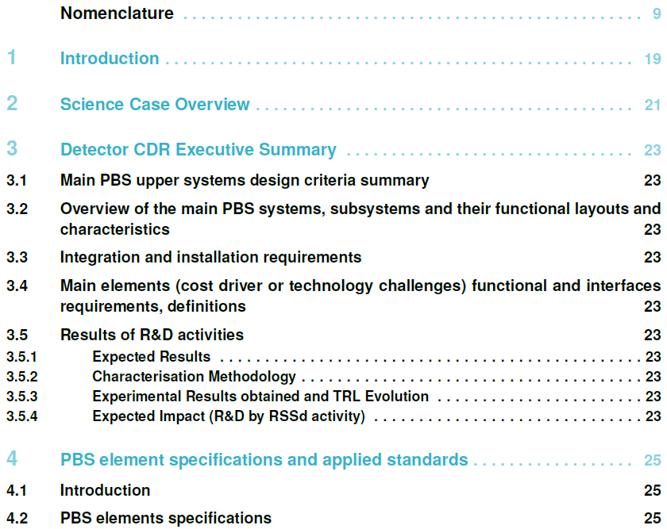
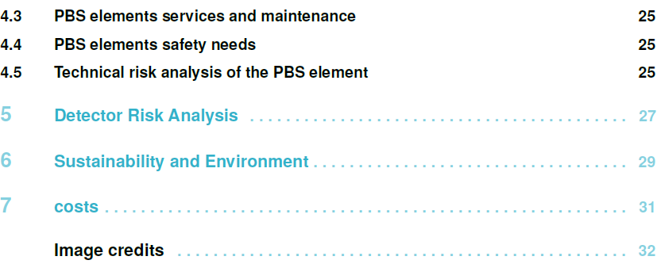
D6.4 Preliminary DET TDR (M24)
The activities and the path of the TDR have been described by the ETC management at the last ET symposium
The template of the TDR has been suggested by the ETO Project Office and the structure agreed in the regular bilateral meeting between EB/ED/PO chairs (Wednesday meetings)
The next slides have been extracted from that presentation

Slide 9
Contents
This can be extracted from the Blue Book prepared by the OSB
The timeline matches
We kindly ask the OSB to produce an executive summary of the Blue Book
ET-0307A-24

Slide 10
Contents
This block is composed of two main sub-blocks:
A revisited, summarized, updated version of the CDR (updated 2020 ET CDR, novel optical layout, …)
A new chapter on the ET R&D strategy
ET-0307A-24

Slide 11
Contents
This block is composed of two main sub-blocks:
A revisited, summarized, updated version of the CDR (updated 2020 ET CDR, novel optical layout, …)
For the preliminary TDR phase, we need to define a small team of writers that extracts and restructures as much as possible information from the CDR
EB → ISB
ET-0307A-24

Slide 12
Contents
This block is composed by two main sub-blocks:
A new chapter on the ET R&D strategy
For the preliminary TDR phase, it cannot be much more than a place-holder. R&D strategy, TRL status & evolution, impacts have still to be defined inside the ET collaboration
ET-0307A-24

Slide 13
Contents
ET-0307A-24
This block must be created automatically as far as possible based on the huge amount of work between ETC-ISB and the PO
In the preliminary-TDR phase the information will be quite incomplete and “poor”
It is due to the current maturity of the PBS and of the parameter tables

Slide 14
ET PBS elements and parameters DB
The ISB members of the collaboration, under the coordination of the PO, created a huge number of excel files containing the PBS structure and the PBS parameters
The PO (thanks to Oussama El-Mecherfi and P. Verdier) created a Database that read all these files
This DB is now capable to produce outputs in human-comuputer readable format (json)
[{"id":24430, "another_id":"1", "created_at":"2024-04-05T14:08:27.487Z", "updated_at":"2024-04-14T21:45:23.382Z", "pbs_element_id":105, "paramName":"Material ?", "paramValue":"Fused Silica", "paramUnit":"", "paramMargin":"", "paramType":"Constraint specific", "description":"", "ref":"ET-0007B-20 table 6.1 p95", "comment":"", "flag":"", "identity":"FUNCTIONAL", "impact_or_zaxis":"", "author":"Jessica Steinlechner", "verified_by":"", "custom_fields":null, "pbs_element_id__PBSCODE":"1.1.2.1.1.1"}
ET-0307A-24

Slide 15
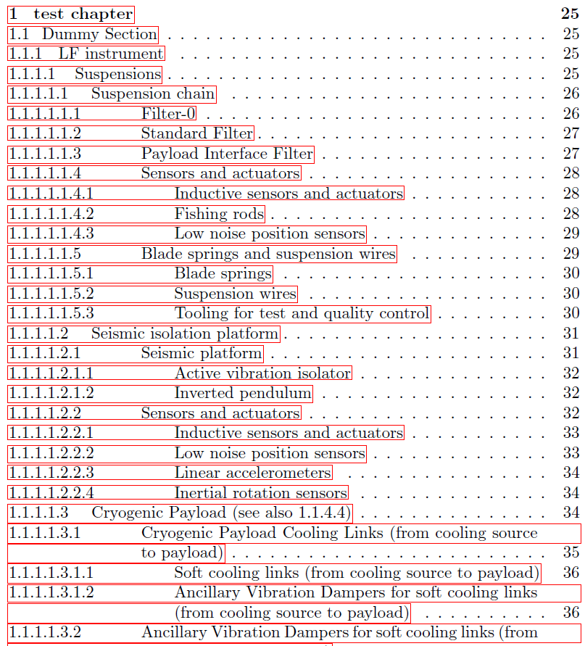
PBS2TDR
Harald Lueck realised a test Python script that transfers the PBS database into a latex document.
It works
A new stable version will be elaborated by Giuseppe Greco, reading the JSON output of the DB
We are able to transform the PBS hierarchy into LaTex sections, sub-sections, …
Severe Issue:
Quality of the PBS entries
PBS elements missing
Only 638 elements on 1824 have a parameter file attached
Descriptions are often missing or poor
ET-0307A-24

Slide 16
Contents
ET-0307A-24
Hard to have this chapter in the preliminary TDR
Few lines about the ETRAC/DREAMS studies?

Slide 17
Contents
ET-0307A-24
No hope to have this in the preliminary TDR
Should we have it in the final?

Slide 18
Contents
ET-0307A-24
No hope to have this in the preliminary TDR
We will need to extend the fields of the parameter files to obtain the cost list including error bars

Slide 19
Summary …. almost
The WP6 coordinators, namely M.Punturo and H.Lück, in their role of ETC Spokesperson and Deputy spokesperson, took on the task of delivering the TDR detector as part of the ET-PP
The style and the content has been agreed with the PO/ED
The difficulties and the status have been transparently described in a plenary session of the ET symposium
At the ET symposium, it was agreed to discuss the new timeline at this meeting

Slide 20
Questions
On 5 June, the PD convened a meeting with the ISB chairs (by accident, forgetting to inform the ETC management) and asked for a discussion (from the meeting notes) on:
Learn to speak the same language (what does “TDR” mean)
How to formalise interactions, written documents to answer questions
What responsibilities are needed (within the ISB)
Fast teams e.g US-style needed/wanted
Flow of deliverables, i.e. what parts of the detector design needs to be ready when (TDR, functional layout, TLR roadmap)
…
Next meeting scheduled for the 5th of July
What is the connection with the ET-PP TDR?
Is the ET-PP deliverable dummy?
Do we expect different TDRs for different recipients?
Do we cancel the WP6 TDR deliverable?
Is the scheme proposed by the PO/ED no more valid?
Can we be more efficient?

