Slide 1
Report from the collaboration
Michele Punturo
Harald Lueck

Slide 2
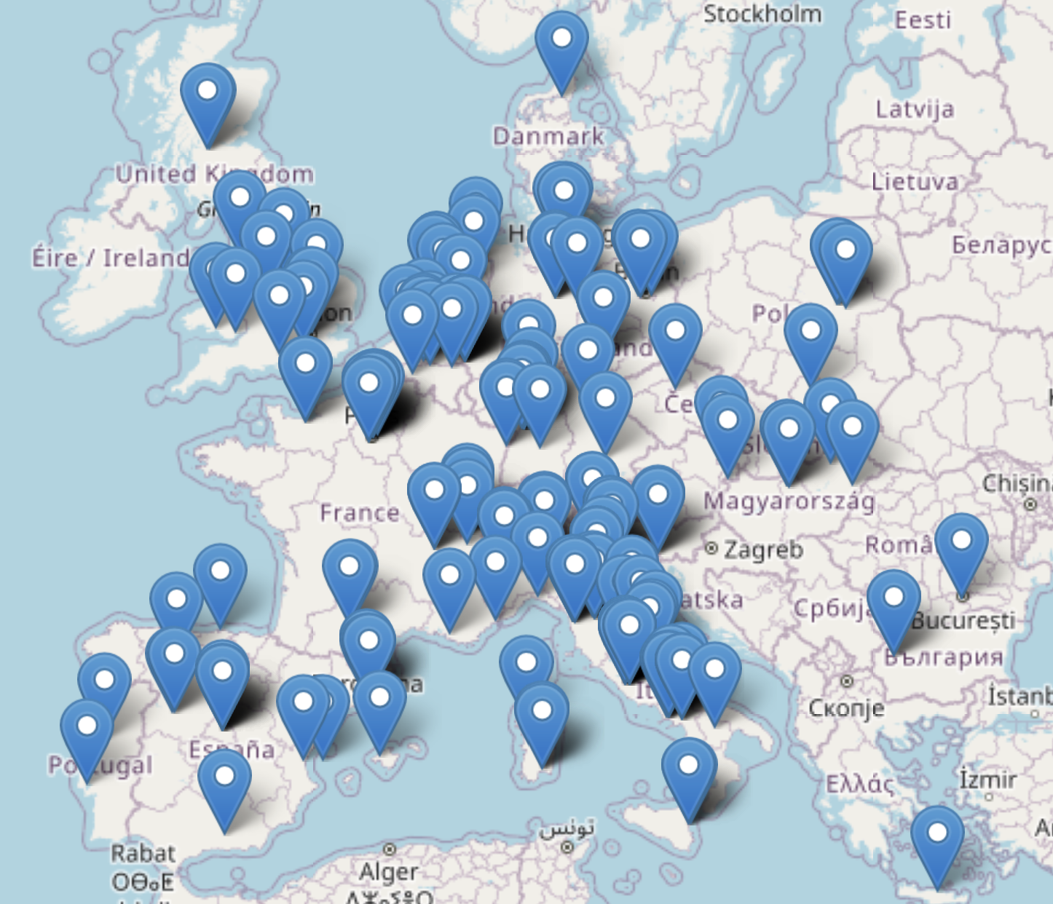
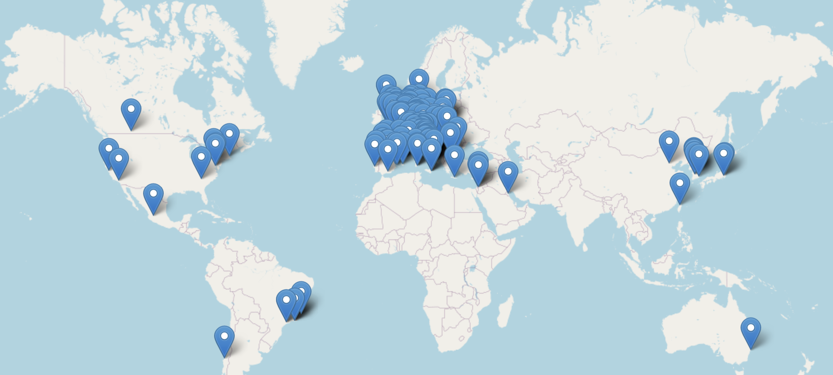
The Einstein Telescope Collaboration
90 Research Units (+1 request pending)
1689 members (24/11/2023 15:29)
Total: 243 Institutions
in 29 Countries
ET member database
ET Member‘s affiliation map
Notes:
Collaboration consists of 79 research Units with about 1300 members;
Concentrated in Europe

Slide 3
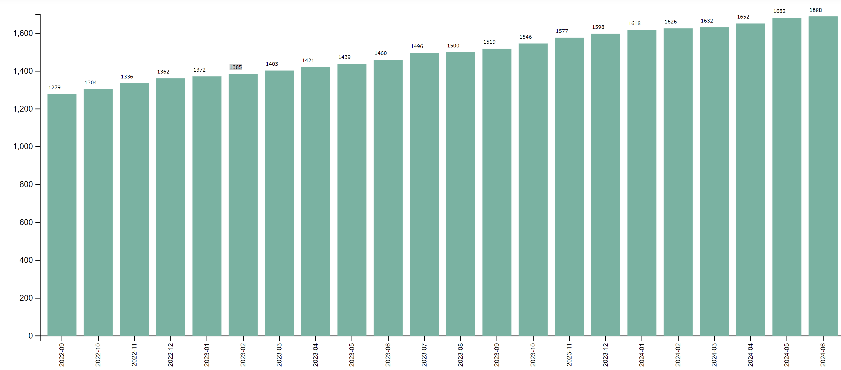
Evolution of the ET collaboration

Slide 4
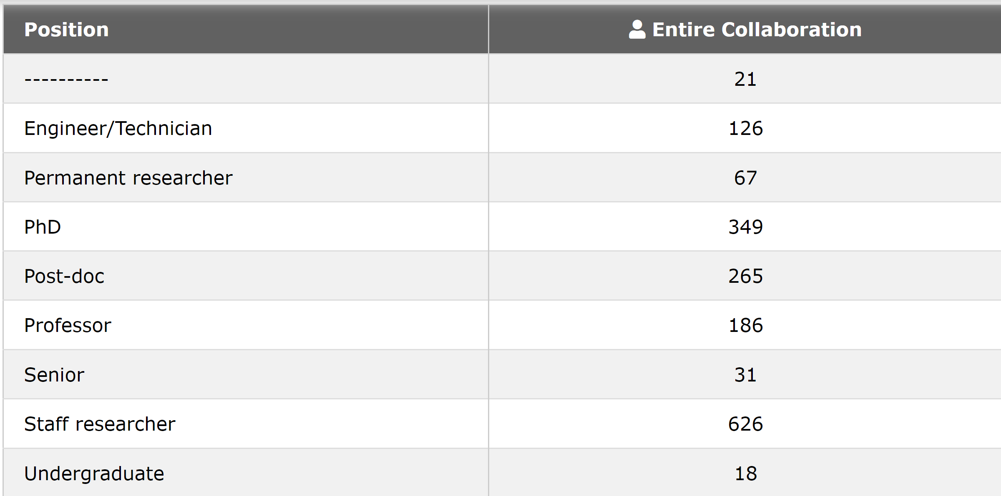
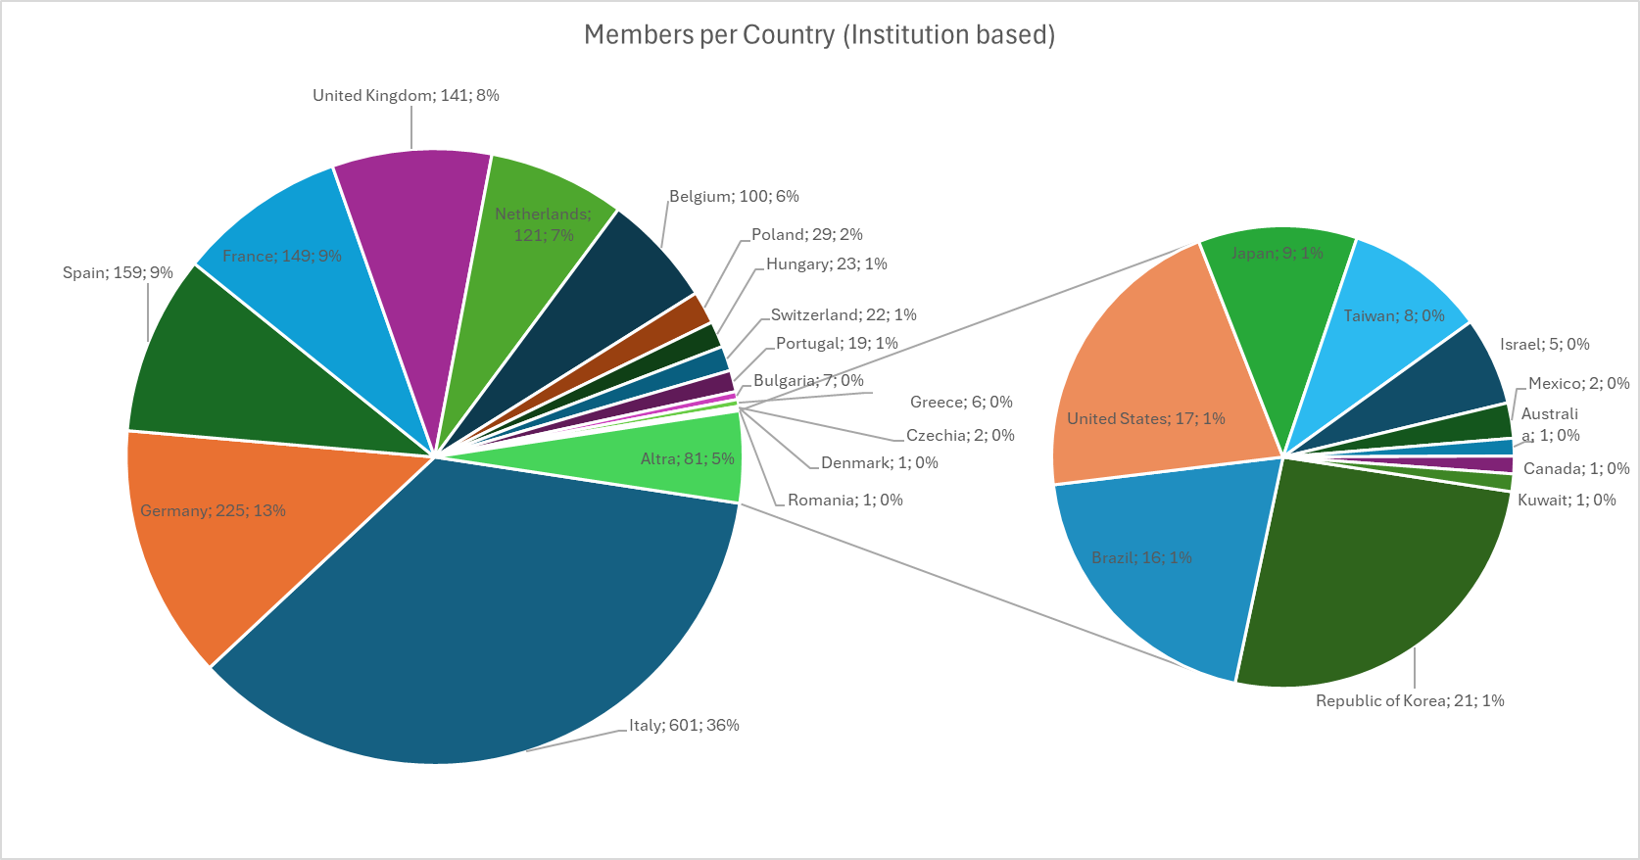
Composition of the ET collaboration

Slide 5
Workload apparent distribution

Slide 6
Phase 1 - Monitoring
The ET Executive Board just launched a monitoring action to prepare the future correction:
Associate to each activity the corresponding chairs (Board, division, WP) as “responsible”
This is a feature implemented in the Virgo member database that we need to clone
The FrTE of the responsibles are declared at the level of the chaired activity (hence, for example, OSB chairs declare their activity at the Board level, ISB division chairs at the level of the division)
Each ET member has to allocate his/her FrTE at the lowest level
This means WP level for ISB, Division for OSB,….
Point 3.b is a clear exception to this rule
Affiliation to an specific board activity is currently non-moderated, but communicated to the responsible(s).
Affiliation to a SSB committee is moderated by the committee chair
The corresponding mail list is automatically populated
We need to find a mechanism where also interested persons, not declaring FrTE in the WP can be inserted in the mail list. (for example I could be interested, as SP to follow the discussions in one WP or Division)

Slide 7
Phase 2: steering
In parallel to the monitoring phase, a new process will be started, thanks to the «Service and Standard Board (SSB)» support:
Definition of the ET collaboration (core) Programme
Set-up of a MOA mechanism between the Research Units (RU) and the collaboration (to be inserted in the byLaws)
Set-up of a activity monitoring (the most difficult part) where the contribution of each RU is monitored (either at level of RU or of the single member)

Slide 8
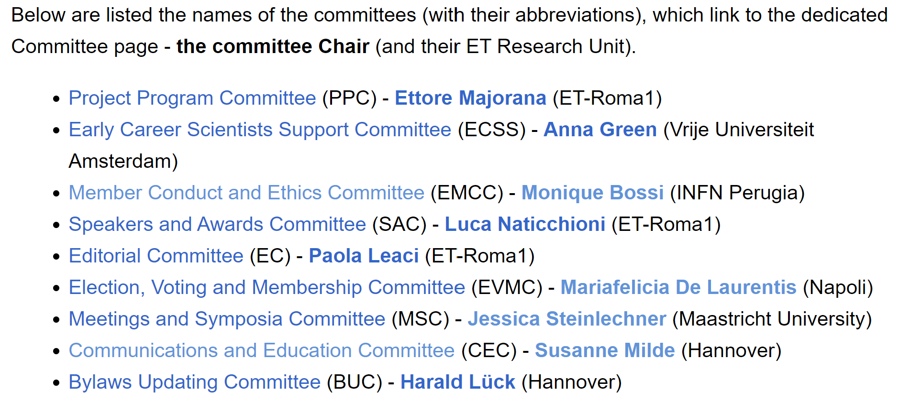
The SSB
The Services and Standards Board has been almost completed
At the last Collaboration Board (CB) the composition of 7 over 9 Committees has been endorsed

Slide 9
Current Pivotal activities
Updating the ET science case, considering the two possible configurations under evaluation: Δ or 2L
Blue Book expected within 2024
Realizing a European network of R&D infrastructures
Overall investment at the level of the RU (in some country) >60M€
Characterization of the sites
The definition of the standards to acquire characterization data and to analyze them
Active participation to the sites characterization in synergy with the National Host Teams
Defining the key elements of the ET detector design (TDR)
Currently defining the Product Breakdown Structure (PBS) by “attaching” parameter tables to each element
Activity steered by the Project Office
The WBS will be the next step
Providing the functional optical layout of the ET detector
Triangular shape delivered
L-geometry just started
Supporting the realization of the detector layout by the Engineering Department
Providing the requirements document for the vacuum pipe (ET-0385A-24)
Providing a differential risk evaluation triangle vs 2L

Slide 10
ET-DREAMS
ET-DREAMS: ET Differential Risk Evaluation And Mitigation Strategy
Antefact
The EB commissioned a study to a committee of experts (former Virgo/GEO/LIGO commissioning coordinators, detector coordinators, …) chaired by Lisa Barsotti (LIGO/CE) to compare the integration, commissioning, upgrade, operating risks in the triangle and in the 2L geometry
They delivered in May 2023 to the EB the ETRAC (ET Risk Analysis Committee) document
Available to the EB members in the TDS: ET-0132A-24
Considering the relevant conclusions they achieved, the EB decided to release this document “enveloped” in a risk mitigation strategy (ET-DREAMS)
This activity suffered of an excessive delay and recently we decided to restart
A committee composed by the EB, ISB and SPB chairs is now working to produce the “envelope” following a clearly defined path (ET-0246A-23)
The aim is to release it in few months

Slide 11
Conclusions
The collaboration is continuously growing
We need to pass from the inclusive phase to the delective phase
Duties and roles will be defined at the level of agreement between the Rus and the Collaboration
Pivotal activities are progressing often in collaboration with ETO and with the National Host Teams
The ET collaboration is a «collaborative» stakeholder, if respected as stakeholder!

